Slide 1

Paradigm Shift in the Management of Metastatic Castration-Sensitive Prostate Cancer (mCSPC)
Neal Shore, MD, FACS
Carolina Urologic Research Center
Myrtle Beach, SC
Alicia Morgans, MD, MPH
Northwestern University
Chicago, IL
Notes:
1

Slide 2
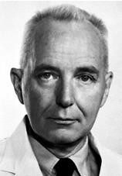
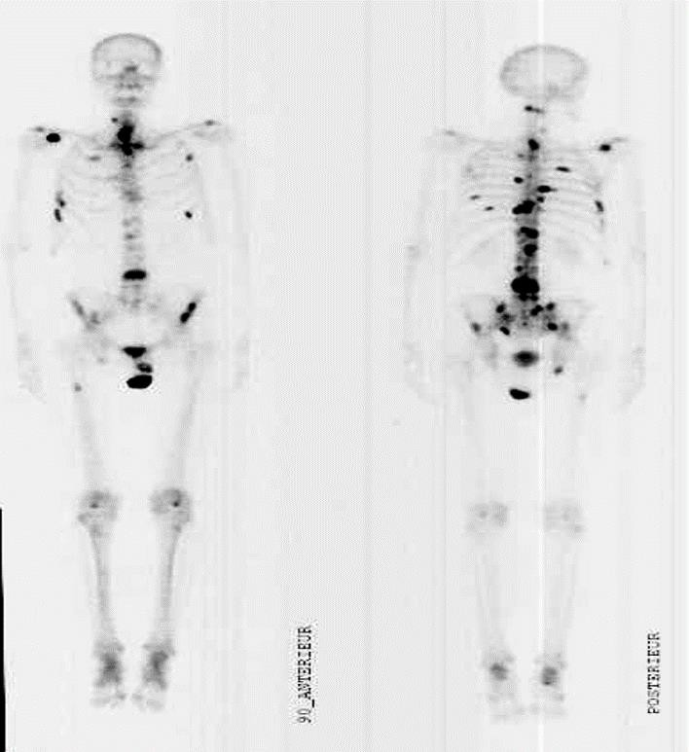
PROSTATE CANCER IS HORMONE DEPENDENT
“Despite regressions of great magnitude,
it is obvious that there were
many failures of endocrine therapy
to control the disease”
Charles B. Huggins
Nobel lecture, December 13, 1966
Huggins CB. Nobel lecture. Available from http://nobelprize.org/nobel_prizes/medicine/laureates/1966/huggins-lecture.html. Dec 13, 1966. Accessed August 2020.

Slide 3
Background
Androgen deprivation therapy (ADT) monotherapy for metastatic prostate cancer has been foundational yet has limited to poor clinical outcomes
Tumor burden, location, and biology affect overall survival
A new standard of care for metastatic castration-sensitive prostate cancer (mCSPC) is combined therapy
  ADT plus the early addition of either docetaxel or an androgen receptor pathway inhibitor (ARPI)
Lowrance W, et al. Advanced prostate cancer: AUA/ASTRO/SUO guideline. Available from https://www.auanet.org/guidelines/advanced-prostate-cancer. Accessed Jul 27, 2020;
Schaeffer E, et al. NCCN clinical practice guidelines in oncology. Prostate cancer, V2.2020. Available from www.nccn.org. May 21, 2020. Accessed Jul 27, 2020

Slide 4
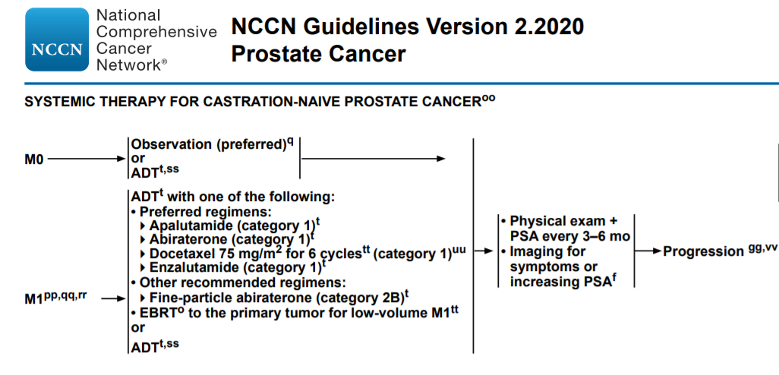
Treatment Options for mCSPC 2020
How to choose?
ADT, androgen deprivation therapy; EBRT, external beam radiation therapy; M0, nonmetastatic; M1, metastatic; mo, months; PSA, prostate specific antigen
Schaeffer E, et al. NCCN clinical practice guidelines in oncology. Prostate cancer, V2.2020. Available from www.nccn.org. May 21, 2020. Accessed Jul 27, 2020

Slide 5
Development of Novel Hormone Therapy and Chemotherapy

Slide 6
The Development of Novel Hormone Therapy and Chemotherapy in mCSPC
CHAARTED (docetaxel)
First patient in 2007
ASCO 2015¹
LATITUDE
(abiraterone)
First patient in 2013
ASCO 2017²
STAMPEDE
(abiraterone)
First patient in 2006
ESMO 2018 (arm G)³
TITAN
(apalutamide)
First patient in 2015
ASCO 2019⁴
ARCHES
(enzalutamide)
First patient in 2016
ASCO GU 2019⁵
ENZAMET
(enzalutamide)
First patient in 2014
ASCO 2019⁶
PEACE1⁷
(abiraterone + docetaxel + RT)
First patient in 2013,
last patient in 2020
ARASENS⁸
(darolutamide + docetaxel)
First patient in 2016;
primary completion: 2021
ASCO, American Society of Clinical Oncology; ESMO, European Society for Medical Oncology; GU, genitourinary; mCSPC, metastatic castration-sensitive prostate cancer; RT, radiation therapy
1. Maughan BL, et al. J Clin Oncol. 2015;33(suppl):e16079; 2. Fizazi K, et al. J Clin Oncol. 2017;35(suppl):LBA3. 3. Hoyle AP, et al. Ann Oncol. 2018;29(suppl 8):viii722 (abstract LBA4);
4. Chi KN, et al. J Clin Oncol. 2019;37(suppl):5006; 5. Armstrong AJ, et al. J Clin Oncol. 2019;37(suppl 7S):687; 6. Sweeney C, et al. J Clin Oncol. 2019;37(suppl):LBA2;
7. NCT01957436 at www.clinicaltrials.gov; 8. NCT02799602 at www.clinicaltrials.gov

Slide 7
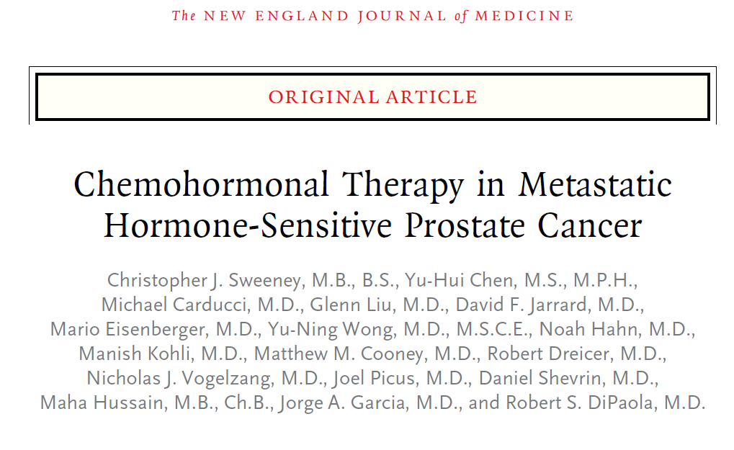
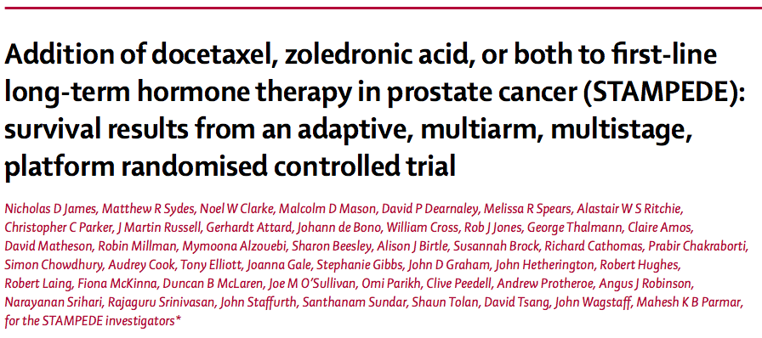
Chemohormonal Therapy
Sweeney CJ, et al. N Engl J Med. 2015;373:737-46; James ND, et al. Lancet. 2016;387:1163-77

Slide 8
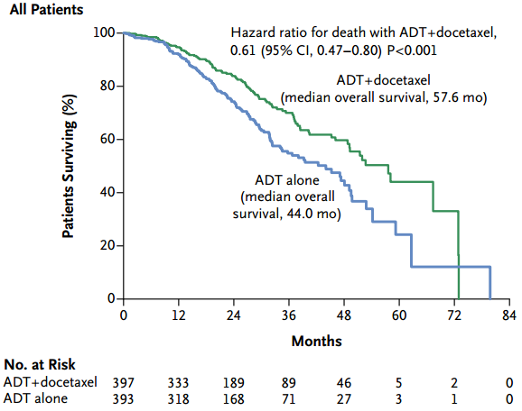
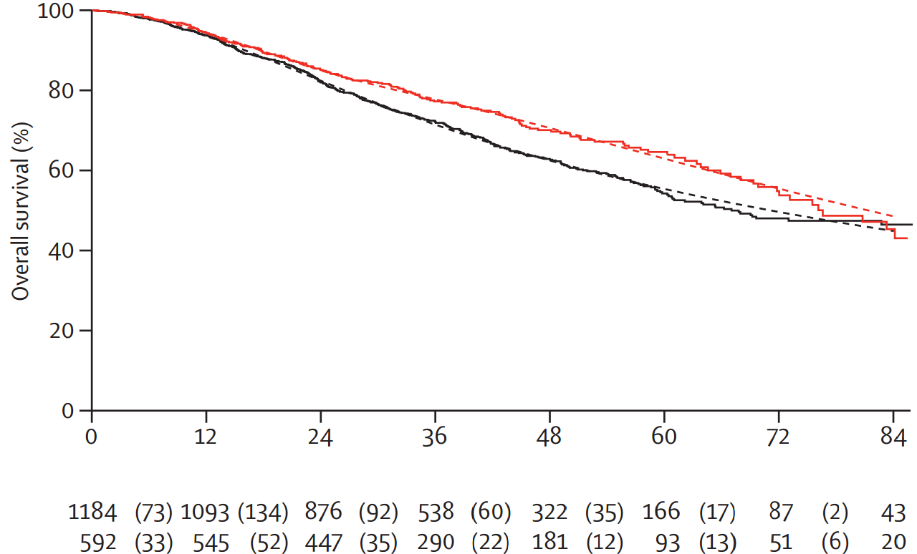
Chemohormonal Therapy: overall survival
CHAARTED¹
STAMPEDE²
Median OS docetaxel: 81 mo
Median OS SOC: 71 mo
HR 0.78, 95% CI 0.66–0.93; P = 0.006
Time from randomization (months)
No. at risk (events)
SOC
SOC +
docetaxel
ADT, androgen deprivation therapy; CI, confidence interval; HR, hazard ratio; mo, months; OS, overall survival; SOC, standard of care
1. Sweeney CJ, et al. N Engl J Med. 2015;373:737-46; 2. James ND, et al. Lancet. 2016;387:1163-77

Slide 9
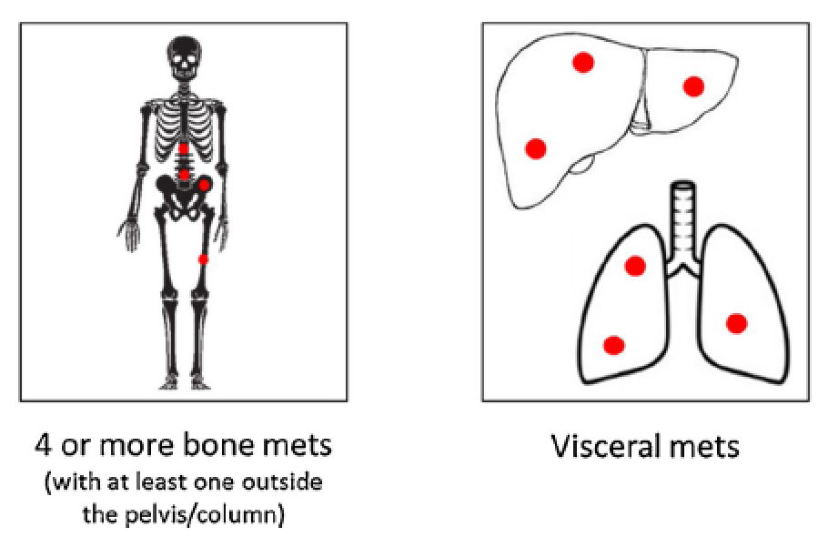
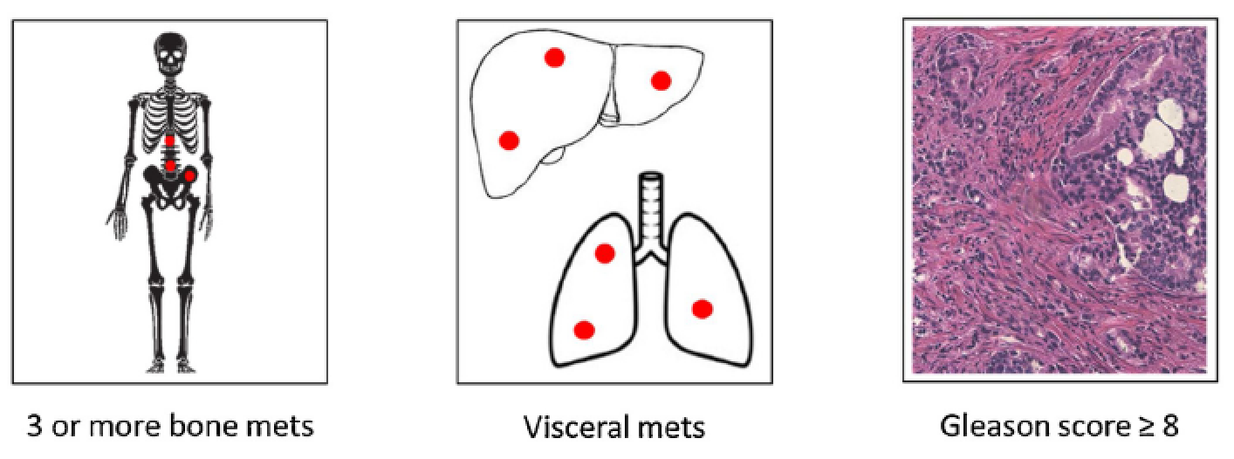
Definitions of “High Volume” and “high risk”
DEFINITION OF HIGH-VOLUME DISEASE (CHAARTED STUDY)¹
At least one of the following criteria:
DEFINITION OF HIGH-RISK DISEASE (LATITUDE STUDY)²
At least two of the following criteria:
“Low volume” is not high risk
mets, metastases
Iacovelli R, et al. Crit Rev Oncol Hematol. 2019;139:83-6
1. Sweeney CJ, et al. N Engl J Med. 2015;373:737-46; 2. Fizazi K, et al. N Engl J Med. 2017;377:352-60

Slide 10
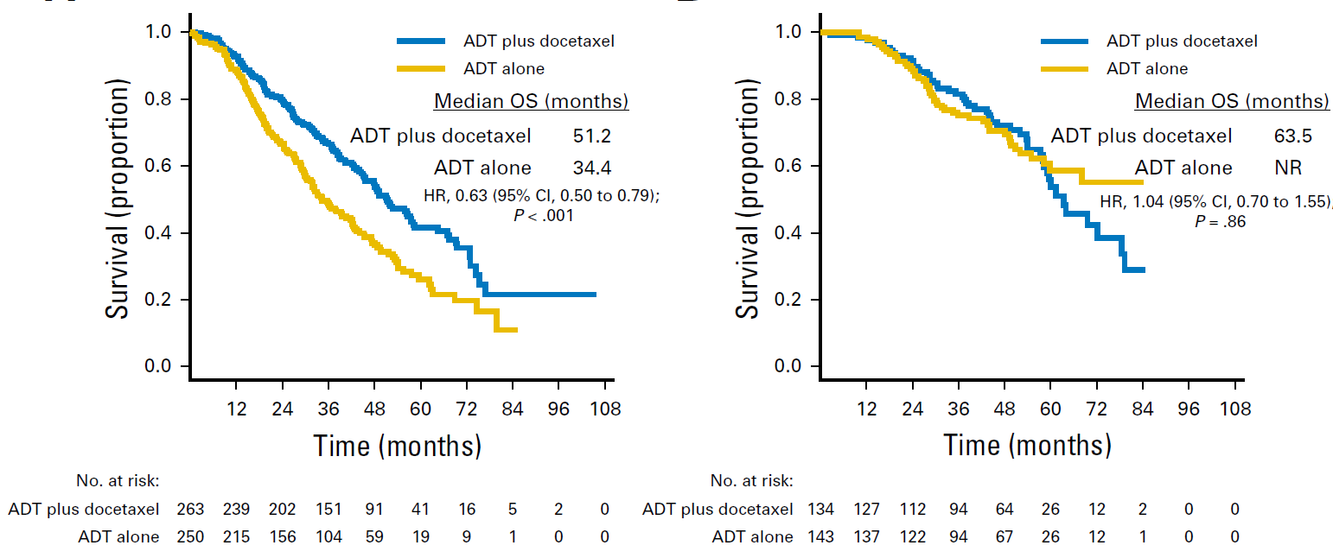
CHAARTED: High volume vs Low Volume
Median follow-up 53.7 months in patients with mCSPC randomly selected to receive ADT + docetaxel vs ADT alone (n = 790)
HIGH VOLUME
LOW VOLUME
ADT, androgen deprivation therapy; CI, confidence interval; HR, hazard ratio; NR, not reached; OS, overall survival
Kyriakopoulos CE, et al. J Clin Oncol. 2018;36:1080-7

Slide 11
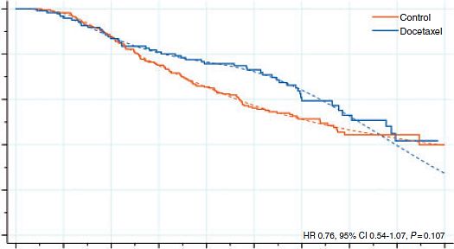
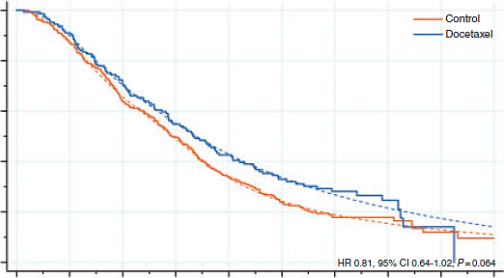
STAMPEDE: Survival Outcomes by Volume
OVERALL SURVIVAL: LOW-BURDEN M1
OVERALL SURVIVAL: HIGH-BURDEN M1
1.0
Control
docetaxel
1.0
Control
docetaxel
0.8
0.8
0.6
0.6
Survival
Survival
0.4
0.4
0.2
0.2
0
HR 0.76, 95% CI 0.54–1.07, P = 0.107
0
HR 0.81, 95% CI 0.64–1.02, P = 0.064
0
1
2
3
4
5
6
7
8
9
0
1
2
3
4
5
6
7
8
9
Number at risk
(events)
Time since randomization (years)
Number at risk
(events)
Time since randomization (years)
Control
docetaxel
238
124
(4)
(5)
227
117
(24)
(11)
201
105
(29)
(7)
172
96
(22)
(6)
149
86
(20)
(3)
104
70
(8)
(11)
69
38
(7)
(3)
33
24
(0)
(4)
16
10
(1)
(1)
1
1
Control
docetaxel
320
148
(40)
(13)
277
132
(75)
(29)
200
102
(43)
(23)
154
77
(49)
(17)
102
59
(29)
(13)
57
40
(13)
(5)
32
21
(0)
(2)
16
9
(4)
(3)
7
2
(1)
(1)
1
0
CI, confidence interval; HR, hazard ratio; M1, metastatic
Clarke NW, et al. Ann Oncol. 2019;30:1992-2003

Slide 12
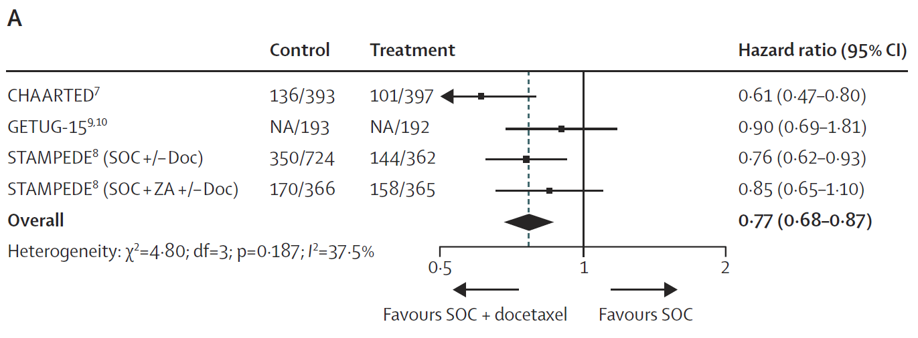
Meta-Analysis of RCTs of Docetaxel in mCSPC
OVERALL SURVIVAL
Absolute improvement in survival at 4 years: 9%
CI, confidence interval; Doc, docetaxel; mCSPC, metastatic castration-sensitive prostate cancer; NA, not available; RCT, randomized clinical trial; SOC, standard of care; ZA, zoledronic acid
Vale CL, et al. Lancet Oncol. 2016;17:243-56

Slide 13
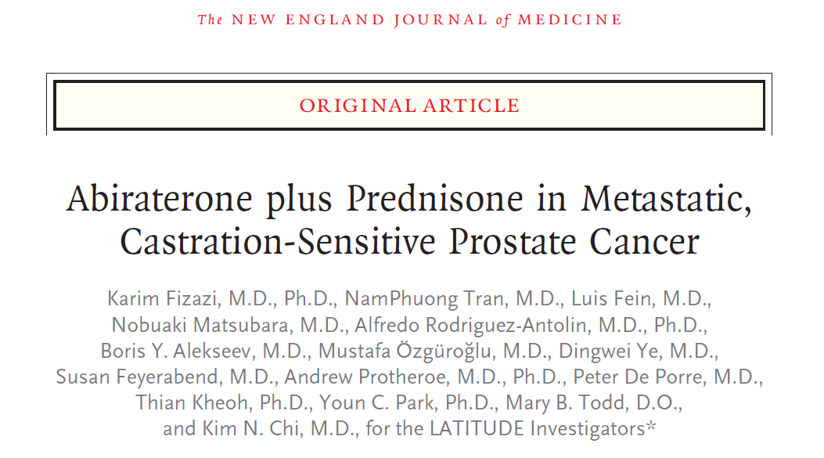
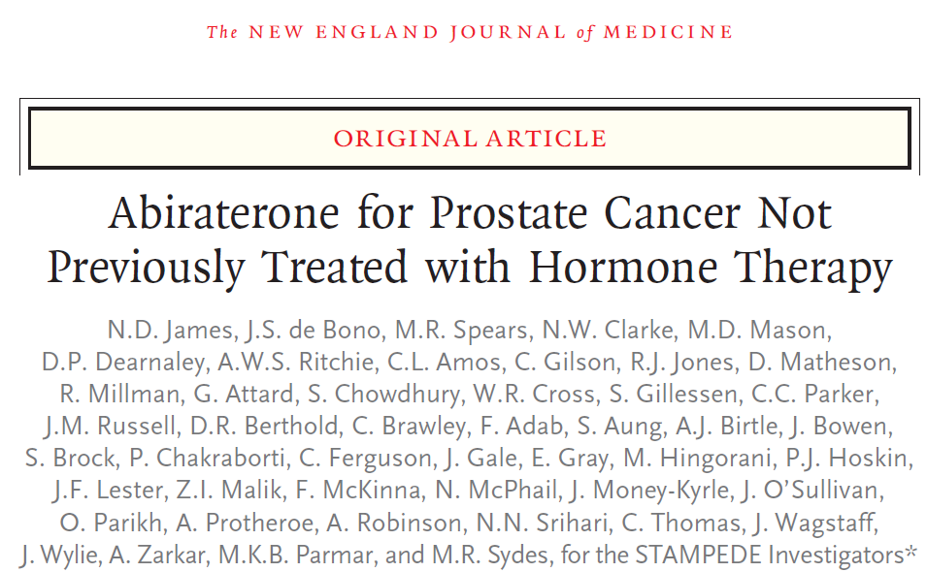
Abiraterone Acetate
LATITUDE
De novo metastatic disease and high risk = 2 of the following 3 factors:
Gleason score ≥ 8
Presence of ≥ 3 lesions on bone scan
Presence of a measurable visceral lesion
Fizazi K, et al. N Engl J Med. 2017;377:352-60; James ND, et al. N Engl J Med. 2017;377:338-51

Slide 14
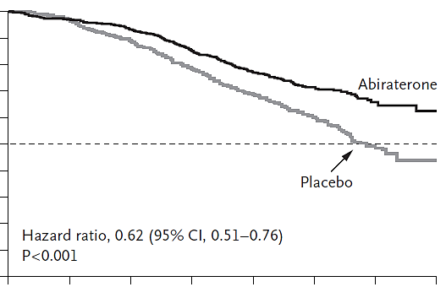
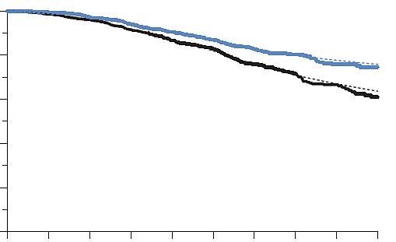
Abiraterone Acetate
LATITUDE: M1 HIGH-RISK mCSPC¹
STAMPEDE: M1 and M0 mCSPC²
100
1.0
90
Combination therapy
80
0.8
70
abiraterone
60
0.6
ADT alone
Overall survival (%)
Overall survival probability
50
40
Placebo
0.4
30
HR 0.63, 95% CI 0.52–0.76, P < 0.001
20
HR 0.62, 95% CI 0.51–0.76, P < 0.001
0.2
10
0
0
0
6
12
18
24
30
36
42
0
6
12
18
24
30
36
42
48
54
Months
Months since randomization
Combination therapy
ADT alone
abiraterone
Placebo
No. at risk
No. of patients (no. of deaths)
597
602
565
564
529
504
479
432
388
332
233
172
93
57
9
2
960
957
(26)
(37)
917
909
(63)
(88)
840
806
(67)
(92)
541
491
(25)
(36)
161
123
ADT, androgen deprivation therapy; CI, confidence interval; HR, hazard ratio; M0, nonmetastatic; M1, metastatic; mCSPC, metastatic castration-sensitive prostate cancer
1. Fizazi K, et al. N Engl J Med. 2017;377:352-60; 2. James ND, et al. N Engl J Med. 2017;377:338-51

Slide 15
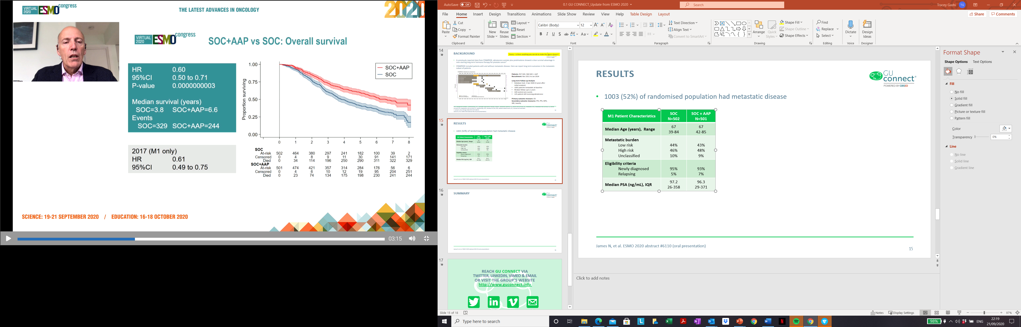
STAMPEDE: SOC + AAP VS SOC
1,003 (52%) of randomised population had metastatic disease
OS: SOC + AAP VS SOC
M1 patient characteristics | SOC (N=502) | SOC + AAP (N=501)
Median age (range), years | 67 (39-84) | 67 (42-85)
Metastatic burden,ª %
Low risk | 44 | 43
High risk | 46 | 48
Unclassified | 10 | 9
Eligibility criteria, %
Newly diagnosed | 95 | 93
Relapsing | 5 | 7
Median PSA (IQR), ng/mL | 97.2 (26-358) | 96.3 (29-371)
1.00
 | SOC (N=502) | ISOC + AAP (N=501)
Median survival, years | 3.8 | 6.6
Events, n | 329 | 244
0.75
Proportion surviving
0.50
HR 0.60, 95% CI 0.50-0.71;
p=0.0000000003
2017 (M1 only)
HR 0.61, 95% CI 0.49-0.75
0.25
0.00
0
1
2
3
4
5
6
7
8
SOC, n
At risk
Censored
Died
502
0
0
464
4
34
380
8
114
297
9
196
241
11
250
182
30
290
100
91
311
39
141
322
2
171
329
SOC + AAP, n
At risk
Censored
Died
501
0
0
474
4
23
421
6
74
357
10
134
314
12
175
284
19
198
176
95
230
56
204
241
6
251
244
ª Per LATITUDE risk criteria
AAP, abiraterone acetate + prednisolone; CI, confidence interval; HR, hazard ratio; IQR, interquartile range; M1, metastatic disease; OS, overall survival;
PSA, prostate specific antigen; SOC, standard of care
James ND, et al. N Engl J Med. 2017;377:338-51; James N, et al. ESMO 2020. Abstract #611O. Oral presentation

Slide 16
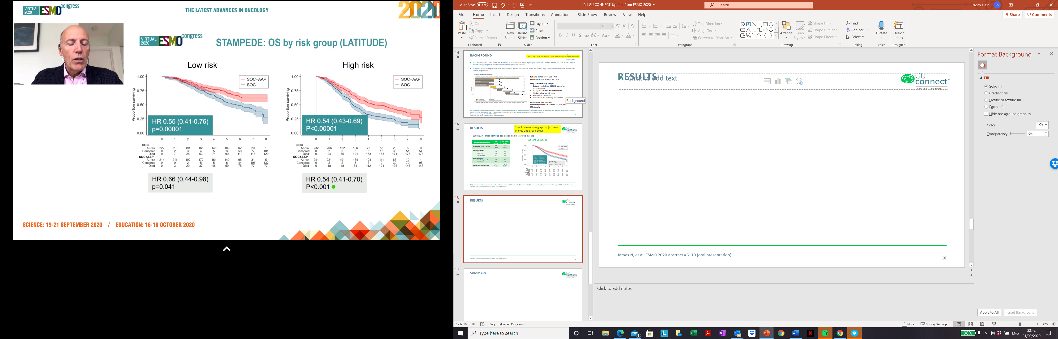
STAMPEDE: SOC + AAP VS SOC
OS BY RISK GROUP (LATITUDE)
Low Risk
High Risk
1.00
1.00
0.75
0.75
Proportion surviving
Proportion surviving
0.50
0.50
0.25
HR 0.55, 95% CI 0.41-0.76;
p=0.00001
0.25
HR 0.54, 95% CI 0.43-0.69;
p<0.00001
0.00
0.00
0
1
2
3
4
5
6
7
8
0
1
2
3
4
5
6
7
8
SOC, n
SOC, n
At risk
Censored
Died
222
0
0
213
2
7
191
3
28
165
4
53
146
5
71
109
14
99
62
50
110
29
77
116
1
101
120
At risk
Censored
Died
232
0
0
206
2
24
152
5
75
106
5
121
73
6
153
56
13
163
28
33
171
6
51
175
0
54
178
SOC + AAP, n
SOC + AAP, n
At risk
Censored
Died
214
0
0
211
0
3
192
2
20
172
5
37
161
5
48
149
6
59
95
44
75
31
106
77
5
132
77
At risk
Censored
Died
241
0
0
221
2
18
191
2
48
154
3
84
124
5
112
111
9
121
66
39
136
19
79
143
1
95
145
2018 analysis
HR 0.66 (0.44-0.98)
P=0.041
2018 analysis
HR 0.54 (0.41-0.70)
P<0.001
Toxicity at 4 years post-randomisation was similar between treatment arms, with 16% of patients in each group reporting grade ≥3 toxicity
AAP, abiraterone acetate + prednisolone; CI, confidence interval; HR, hazard ratio; SOC, standard of care
Hoyle AP, et al. Eur Urol 2019;76:719-728; James N, et al. ESMO 2020. Abstract #611O. Oral presentation

Slide 17
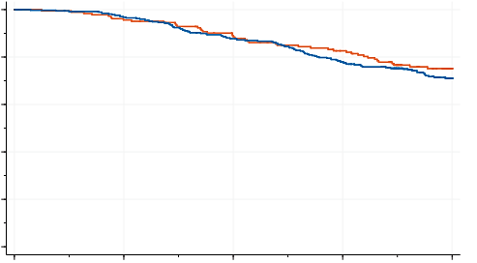
STAMPEDE Comparison: Overall Survival
KM OS: ABIRATERONE VS DOCETAXEL
1.0
SOC + DocP
0.8
SOC + AAP
0.6
Overall survival
0.4
0.2
Prostate cancer-specific
survival
HR 1.02 (0.70–1.49)
HR 1.16 (95% CI 0.82–1.65), P = 0.40
0
0
12
24
36
48
Number of patients (events)
Time from randomization (months)
SOC + DocP
SOC + AAP
189
377
(1)
(3)
183
371
(7)
(9)
175
358
(5)
(16)
168
339
(7)
(17)
158
320
(7)
(12)
146
307
(4)
(24)
139
278
(10)
(9)
112
240
(2)
(12)
74
161
AAP, abiraterone acetate + prednisone; CI, confidence interval; DocP, docetaxel + prednisone; HR, hazard ratio; KM, Kaplan-Meier; OS, overall survival; SOC, standard of care
Sydes MR, et al. Ann Oncol. 2018;29:1235-48
Notes:
No evidence of a difference in survival
Very few deaths in M0 pts

Slide 18
AR-Targeted Agent: Trial Design and
Patient Population Overview
 |  | ARCHES¹ (double blind) | ENZAMET^{2,a} (open label) | TITAN³ (double blind)
Treatment |  | enzalutamide + ADT (n = 574) vs placebo + ADT (n = 576) | enzalutamide + ADT (n = 563) vs NSAA + ADT (n = 562) | apalutamide + ADT (n = 525) vs placebo + ADT (n = 527)
Key inclusion criteria | Metastasis | Bone or soft tissue | Bone or soft tissue | ≥ 1 bone lesion, patients excluded if visceral metastasis only
 | Prior ADT | Allowed | Allowed | Allowed
 | Prior docetaxel | Allowed (18%) | Not allowed | Allowed (11%)
 | Early concomitant docetaxel | Not allowed | Allowed (45%) | Not allowed
Average duration of therapy |  | 14 months | 34 months | 23 months
ª The early administration of docetaxel with testosterone suppression was permitted in protocol version 2 as a stratification factor before randomization, according to evidence showing improved survival with this approach.
ADT, androgen deprivation therapy; AR, androgen receptor; NSAA, nonsteroidal antiandrogen
1. Armstrong AJ, et al. J Clin Oncol. 2019;37:2974-86; 2. Davis ID, et al. N Engl J Med. 2019;381:121-31; 3. Chi KN, et al. N Engl J Med. 2019;381:13-24

Slide 19
TITAN: Apalutamide for mCSPC
RADIOGRAPHIC PROGRESSION-FREE SURVIVAL
OVERALL SURVIVAL
100
100
apalutamide
75
75
apalutamide
Placebo
Placebo
Patients free of radiographic progression (%)
Patients surviving (%)
50
50
25
HR 0.48, P < 0.001
25
HR 0.67, P = 0.005
Placebo
0
0
0
6
12
18
24
30
36
0
6
12
18
24
30
36
Months
Months
HR, hazard ratio; mCSPC, metastatic castration-sensitive prostate cancer
Chi KN, et al. N Engl J Med. 2019;381:13-24

Slide 20
ARCHES: Enzalutamide for mCSPC
100
90
80
enzalutamide + ADT
70
60
Placebo + ADT
50
rPFS rate (%)
40
 | Median (95% CI), months
enzalutamide + ADT | NR (NR–NR)
Placebo + ADT | 19.0 (16.6–22.2)
HR | 0.39 (0.30–0.50)
P < 0.001
30
20
10
0
3
6
9
12
15
18
21
24
27
30
33
Months
Overall survival: HR 0.81 (95% CI 0.53–1.25), P = 0.3361, but survival data were immature,
with only 14.4 months median follow-up and 84 deaths
ADT, androgen deprivation therapy; CI, confidence interval; HR, hazard ratio; mCSPC, metastatic castration-sensitive prostate cancer; NR, not reached;
rPFS, radiographic progression-free survival
Armstrong AJ, et al. J Clin Oncol. 2019;37:2974-86

Slide 21
ENZAMET: Enzalutamide for mCSPC
Varied inclusion criteria: high and low volume, de novo vs metachronous metastasis, concurrent docetaxel, many permutations
CLINICAL PROGRESSION-FREE SURVIVAL
OVERALL SURVIVAL (Primary endpoint)
100
100
enzalutamide
75
enzalutamide
75
NSAA
Patients free of clinical progression (%)
Patients surviving (%)
50
50
Proportion alive at 36 months (95% CI)
NSAA
NSAA | enzalutamide
0.72 (0.68 to 0.76) | 0.80 (0.75 to 0.83)
25
25
Hazard ratio 0.40 (95% CI 0.33–0.49)
P < 0.001 by log-rank test
Hazard ratio 0.67 (95% CI 0.52–0.86)
P = 0.002 by log-rank test
0
0
0
6
12
18
24
30
36
42
48
0
6
12
18
24
30
36
42
48
Months
Months
CI, confidence interval; mCSPC, metastatic castration-sensitive prostate cancer; NSAA, nonsteroidal antiandrogen
Davis ID, et al. N Engl J Med. 2019;381:121-31; Sweeney C, et al. Journal of Clinical Oncology 2019; 37, no. 18_Suppl.LBA2 (Oral Presentation)

Slide 22
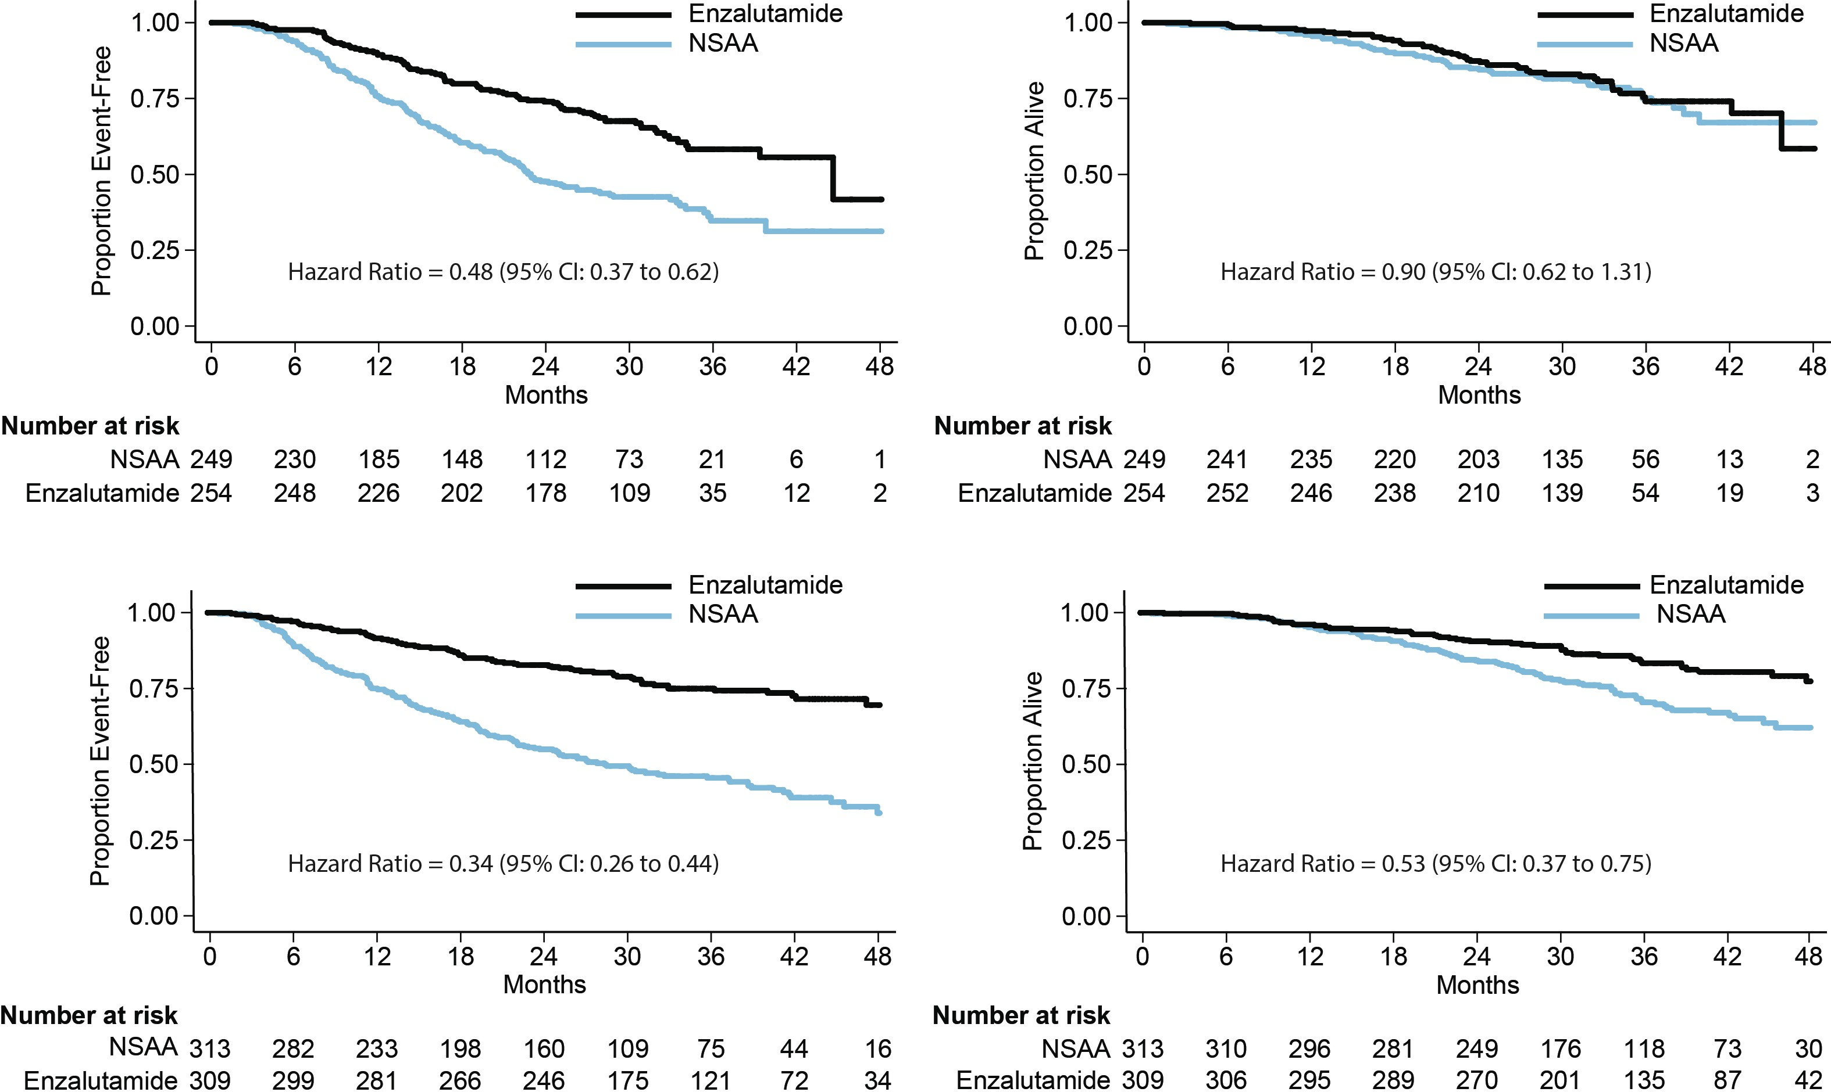
ENZAMET: Concurrent Docetaxel
CLINICAL PROGRESSION-FREE SURVIVAL
OVERALL SURVIVAL
Testosterone suppression
+
docetaxel
n = 503
(71% high volume)
Testosterone suppression
+
no docetaxel
n = 622
(37% high volume)
CI, confidence interval; NSAA, nonsteroidal antiandrogen
Davis ID, et al. N Engl J Med. 2019;381:121-31; Sweeney C, et al. Journal of Clinical Oncology 2019; 37, no. 18_Suppl.LBA2 (Oral Presentation)

Slide 23
ENZAMET: Selected docetaxel-relevant
Adverse Events
Adverse event during first 6 months | TS + NSAA, docetaxel n = 246 | TS + ENZA, docetaxel n = 254 | TS + NSAA, no docetaxel n = 312 | TS + ENZA, no docetaxel n = 309
Neutropenic fever | 32 (13%) | 35 (14%) | 0 | 1 (< 1%)
Sensory neuropathy, grade 2 | 7 (3%) | 24 (9%) | 2 (< 1%) | 0
Sensory neuropathy, grade 3 | 1 (< 1%) | 3 (1%) | 0 | 0
Motor neuropathy, grade 2 | 1 (< 1%) | 4 (2%) | 0 | 0
Motor neuropathy, grade 3 | 0 | 0 | 0 | 1 (< 1%)
Nail discoloration | 13 (5%) | 25 (10%) | 0 | 0
Watery eyes, grade 1 or 2 | 15 (6%) | 52 (20%) | 0 | 0
Fatigue, grade 2 | 35 (14%) | 52 (20%) | 9 (3%) | 32 (10%)
ENZA, enzalutamide; NSAA, nonsteroidal antiandrogen; TS, testosterone suppression
Sweeney C, et al. Journal of Clinical Oncology 2019; 37, no. 18_Suppl.LBA2 (Oral Presentation)

Slide 24
Should we treat the primary tumor?

Slide 25
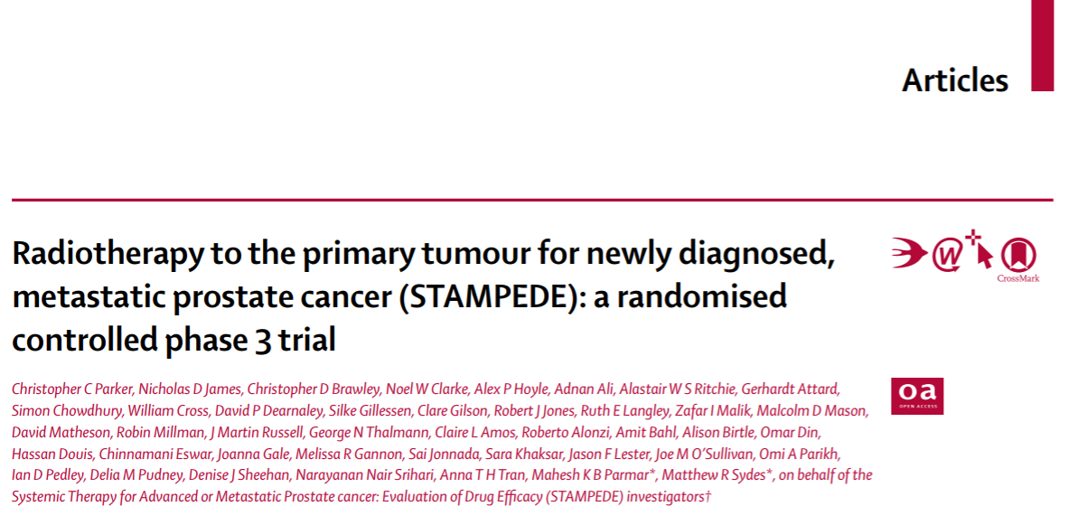
Radiation therapy to the Primary Tumor:
STAMPEDE (Arm H)
Parker CC, et al. Lancet. 2018;392:2353-66

Slide 26
STAMPEDE (Arm H) STUDY DESIGN
Men with newly diagnosed
metastatic prostate cancer
ADT ± docetaxel (SOC)
ADT ± docetaxel (SOC)
+ prostate irradiation
1:1
36 Gy (in 6 weekly fractions of 6 Gy) or
55 Gy (in 20 daily fractions of 2.75 Gy over 4 weeks)
Schedule nominated before randomization
Stratification variables
  Age (< 70 vs ≥ 70 years), nodal involvement (N0 vs N+ vs Nx), randomizing site
  WHO performance status (0 vs 1 or 2), type of ADT, aspirin or NSAID use, docetaxel use
ADT, androgen deprivation therapy; N0, no nodal involvement; N+, nodal involvement; NSAID, nonsteroidal anti-inflammatory drug; Nx, indeterminate nodal involvement; SOC, standard of care; WHO, World Health Organization
Parker CC, et al. Lancet. 2018;392:2353-66

Slide 27
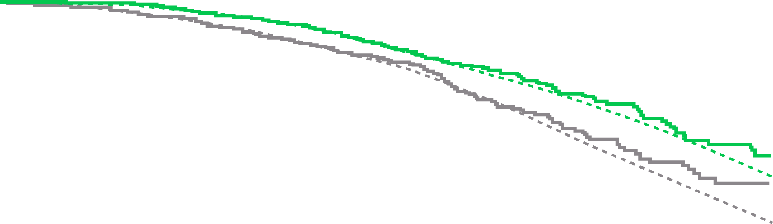

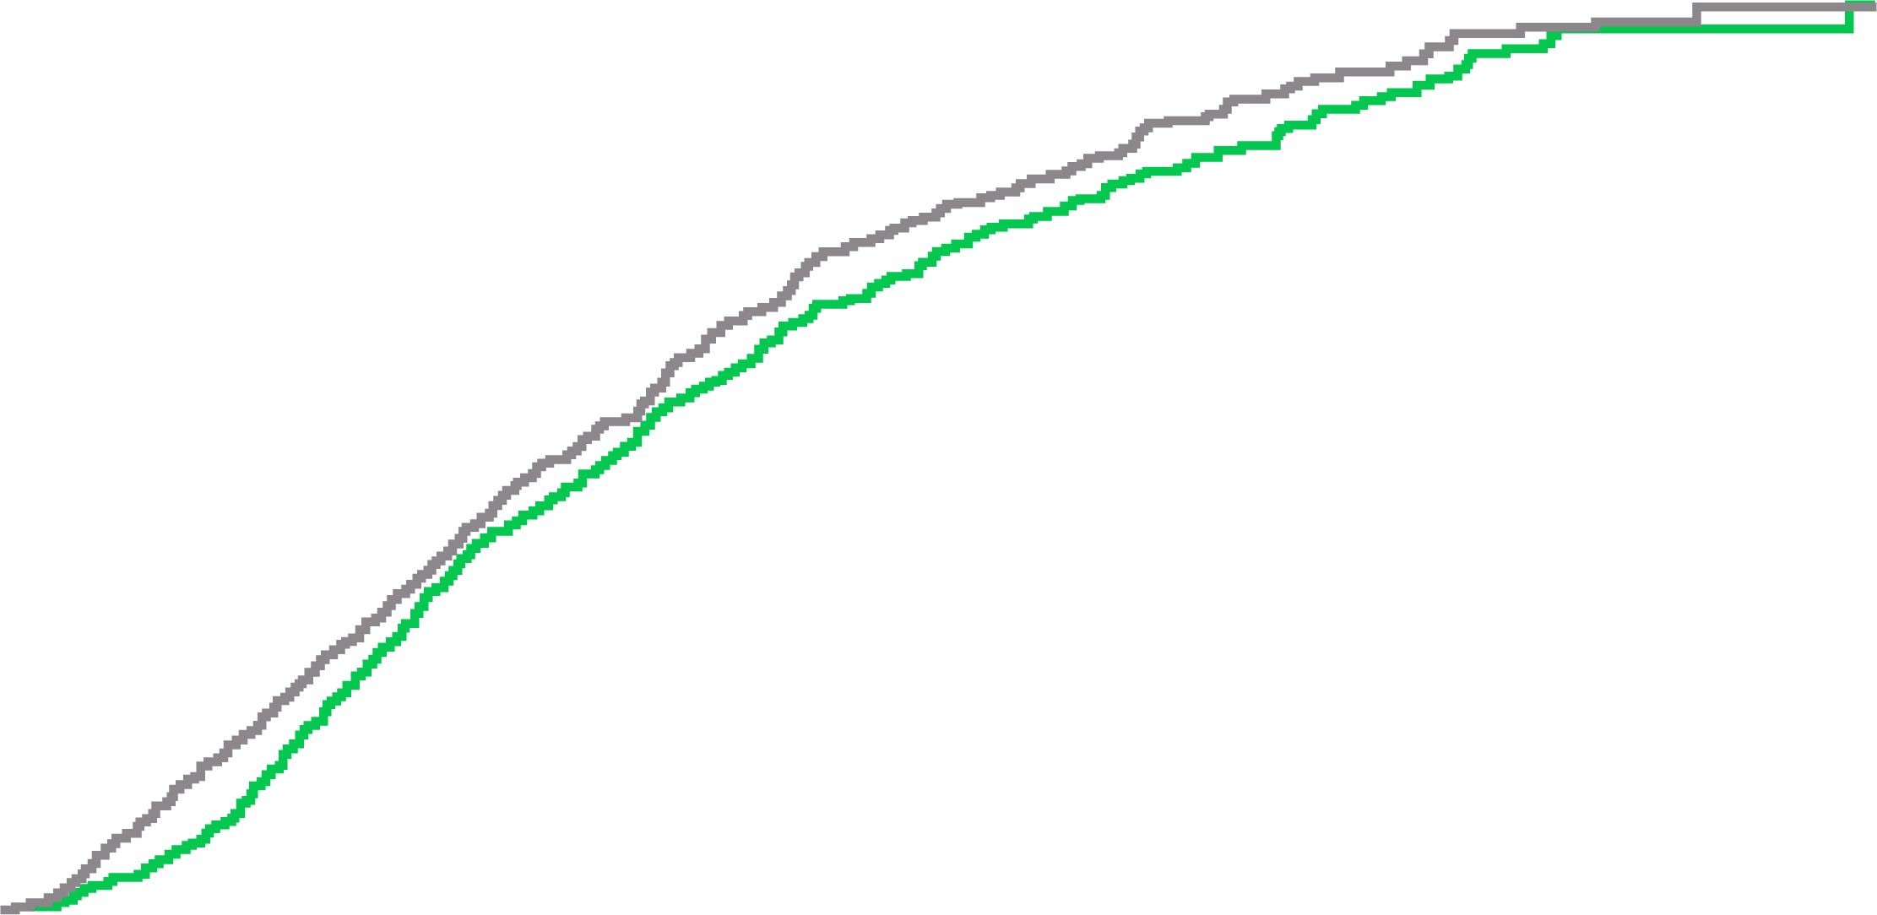
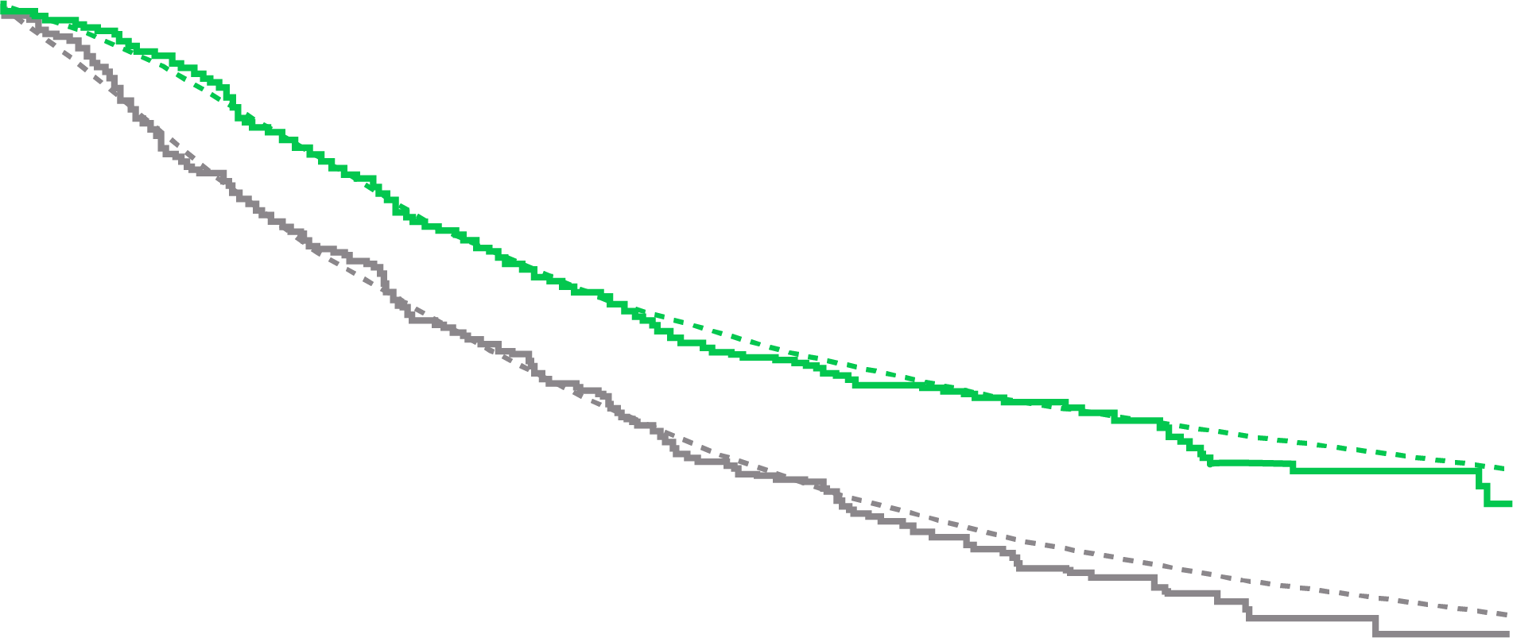
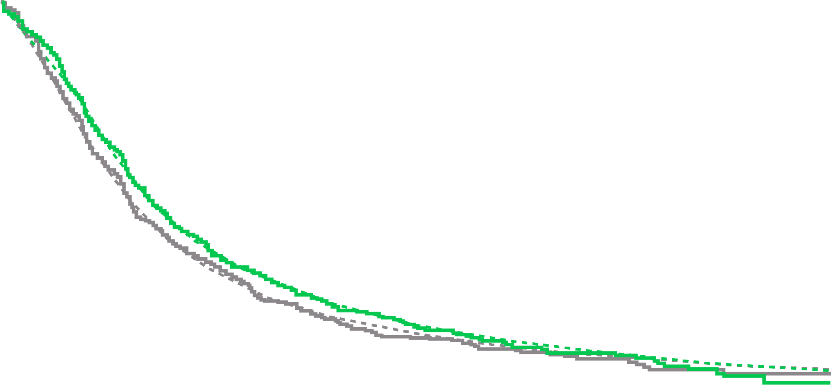
Potential Role of Primary Tumor Therapy in mCSPC: STAMPEDE (Arm H)
A) Overall survival in low metastatic burden
B) Overall survival in high metastatic burden
100
Control
Radiotherapy
Control
Radiotherapy
100
Control
Radiotherapy
80
60
80
Overall survival (%)
40
60
20
HR 0.68 (95% CI 0.52–0.90)
P = 0.007
HR 1.07 (95% CI 0.90–1.28)
P = 0.420
Proportion on life-prolonging treatment (%)
0
0
6
12
18
24
30
36
42
48
54
0
6
12
18
24
30
36
42
48
54
No. at risk (events)
Control
Radiotherapy
Time since randomization (months)
Time since randomization (months)
40
409
410
(5)
(1)
400
405
(9)
(4)
387
399
(17)
(12)
361
366
(17)
(12)
265
301
(12)
(19)
217
242
(22)
(10)
155
200
(16)
(15)
110
137
(8)
(11)
67
77
(5)
(5)
25
25
567
553
(11)
(10)
547
537
(42)
(38)
500
487
(58)
(48)
428
424
(41)
(59)
312
282
(27)
(30)
245
216
(43)
(31)
161
146
(20)
(19)
100
90
(7)
(14)
48
44
(3)
(5)
13
20
C) Failure-free survival in low metastatic burden
D) Failure-free survival in high metastatic burden
20
100
HR 0.59 (95% CI 0.49–0.72)
P < 0.0001
HR 0.88 (95% CI 0.71–1.01)
P = 0.059
80
0
60
0
6
12
18
24
30
36
42
48
54
Failure-free survival (%)
Time since randomization (months)
40
No. at risk
(events)
Control
Radiotherapy
20
1029
1032
(73)
(37)
930
963
(120)
(128)
772
792
(111)
(114)
607
620
(83)
(79)
388
411
(37)
(41)
280
306
(25)
(23)
193
228
(14)
(19)
125
148
(6)
(10)
72
75
(1)
(0)
24
29
0
0
6
12
18
24
30
36
42
48
54
0
6
12
18
24
30
36
42
48
54
No. at risk (events)
Control
Radiotherapy
Time since randomization (months)
Time since randomization (months)
409
410
(78)
(29)
324
377
(50)
(57)
269
318
(49)
(45)
211
255
(39)
(32)
121
178
(16)
(16)
83
142
(15)
(8)
53
113
(8)
(7)
32
75
(4)
(8)
16
35
(1)
(2)
6
12
567
553
(207)
(168)
350
279
(126)
(135)
223
237
(68)
(64)
147
166
(32)
(34)
83
96
(8)
(17)
59
60
(10)
(11)
41
35
(5)
(2)
21
22
(3)
(6)
11
10
(0)
(1)
3
5
CI, confidence interval; HR, hazard ratio; mCSPC, metastatic castration-sensitive prostate cancer
Parker CC, et al. Lancet. 2018;392:2353-66

Slide 28
Primary Directed Therapy in Low Volume mCSPC?
Trial | Intervention
STAMPEDE-H¹ | Radiation to primary, low volume
SWOG 1802² (results pending) | Radical prostatectomy or radiation
mCSPC, metastatic castration-sensitive prostate cancer; SWOG, Southwest Oncology Group
1. Parker CC, et al. Lancet. 2018;392:2353-66; 2. NCT03678025 at www.clinicaltrials.gov

Slide 29
Phase 3 Trials in mCSPC
Trial | Treatment arms
CHAARTED,¹ STAMPEDE-C² | ADT vs ADT + docetaxel
STAMPEDE-G,² LATITUDE³ | ADT vs ADT + abiraterone
ARCHES,⁴ ENZAMET⁵ | ADT + doc vs ADT + (doc 17.9%, 65%) + enzalutamide
TITAN⁶ | ADT (+ doc 11%) vs ADT (+ doc 11%) + apalutamide¹¹
ARASENS⁷ (results pending) | ADT + doc + pbo vs ADT + doc + darolutamide
PEACE1⁸ (results pending) | ADT + doc + pbo vs ADT + doc + abiraterone
KEYNOTE-991⁹ (results pending) | ADT + enza + pbo vs ADT + enza + pembrolizumab
CAPItello-281¹⁰ (results pending) | ADT + abi + pbo vs ADT + abi + capivasertib
abi, abiraterone; ADT, androgen deprivation therapy; doc, docetaxel; enza, enzalutamide; mCSPC, metastatic castration-sensitive prostate cancer; pbo, placebo
1. NCT00309985; 2. NCT00268476; 3. NCT01715285; 4. NCT02677896; 5. NCT02446405; 6. NCT02489318; 7. NCT02799602; 8. NCT01957436; 9. NCT04191096; 10. NCT04493853 at www.clinicaltrials.gov; 11. Chi KN, et al. N Engl J Med. 2019;381:13-24

Slide 30
Should we treat the metastases?
Metastasis-Directed Therapy

Slide 31
Ongoing Questions: Oligometastases
Oligometastases: either 1–3 or 1–5 metastases¹
Different presentations: de novo or synchronous vs oligorecurrent or metachronous vs oligoprogressive
Metastasis-directed therapy of regional and distant recurrences after curative treatment of prostate cancer: a systematic review of the literature²
  15 single-arm case series: a total of 450 patients
  Conclusion: Metastasis-directed therapy is a promising approach for oligometastatic prostate cancer recurrence,
  but the low level of evidence generated by a small case series does not allow extrapolation to a standard of care
Issues to consider
  How many lesions and where?
  Has the primary been treated?
  Sensitivity and accuracy of imaging?
  Therapeutic objectives: impact on overall survival vs delay of ADT (STOMP³, ORIOLE^{4,5})
  Prospective, randomized, phase 3 data still needed
ADT, androgen deprivation therapy
1. Reyes D, et al. Oncotarget 2015; 6: 8491-8524; 2. Ost P, et al. Eur Urol. 2015;67:852-63; 3. Ost P, et al. J Clin Oncol. 2018;36:446-53; 4. Radwan N, et al. BMC Cancer. 2017;17:453; 5. Phillips R, et al. JAMA Oncol. 2020;6:650-9

Slide 32
Other Considerations

Slide 33
Treatment Options for mCSPC 2020
Quality of life and patient preferences
must be considered!
How to choose?
ADT, androgen deprivation therapy; EBRT, external beam radiation therapy; M0, nonmetastatic; M1, metastatic; mo, months; mCSPC, metastatic castration-sensitive prostate cancer; PSA, prostate specific antigen
Schaeffer E, et al. NCCN clinical practice guidelines in oncology. Prostate cancer, V2.2020. Available from www.nccn.org. May 21, 2020. Accessed Jul 27, 2020

Slide 34
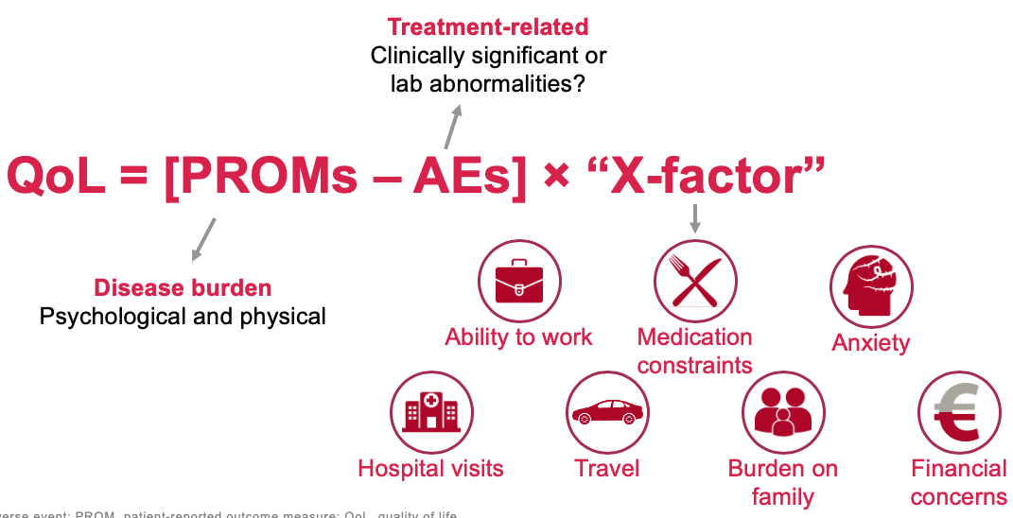
What contributes to QoL?
AE, adverse event; PROM, patient-reported outcome measure; QoL, quality of life

Slide 35
Considering All Factors in mCSPC
Treatment Decisions
Clinical benefit
OS and cancer-specific survival QoL
Disease specific
Disease characteristics such as volume and risk
Specific alterations such as genomic alterations
Patient specific
Patient characteristics such as age, comorbidities
Laboratory values such as ALP and LDH
Drug specific
AEs, drug-drug interactions, cost and accessibility,
route of administration, duration of treatment
AE, adverse event; ALP, alkaline phosphatase; LDH, lactate dehydrogenase; mCSPC, metastatic castration-sensitive prostate cancer; OS, overall survival; QoL, quality of Life
Based on personal experience, N. Shore
Cattrini C, et al. Cancers 2019; 11: 1355, doi:10.3390/cancers11091355
Notes:
https://www.mdpi.com/2072-6694/11/9/1355/htm
Cattrini C, Castro E, Lozano R, Zanardi E, Rubagotti A, Boccardo F, Olmos D.
Current Treatment Options for Metastatic Hormone-Sensitive Prostate Cancer.
Cancers (Basel). 2019 Sep 12;11(9).

Slide 36
Treatment Considerations in mCSPC
De novo versus recurrent disease at presentation
Volume of disease
Comorbidities
Adverse effect profiles
Patient preferences
Cost: direct and indirect costs
Convenience
COVID-19 concerns
Availability of drugs
Subsequent therapies
COVID-19, coronavirus disease 2019; mCSPC, metastatic castration-sensitive prostate cancer
Based on personal experience, N. Shore

Slide 37
Real-World Treatment Patterns in mCSPC
Most men with mCSPC are treated with
LHRH therapy alone
  A US physician-based syndicated patient-record tracking study captured use of anticancer
  and supportive care agents in prostate cancer
    Data collected online between June 2018 and
    June 2019
    156 physicians reported on 1,360 patients
  Patients with mCSPC were identified by using the
  following query
    Prostate, stage IV, not hormone refractory, metastatic line 1 by regimen
PATIENTS RECEIVING VARIOUS CATEGORIES
OF TREATMENT (%)
Patients (%)
LHRH therapy
alone
First-generation
antiandrogen
± LHRH therapy
Regimen
containing an
androgen
biosynthesis
inhibitor
Regimen
containing an
androgen
receptor
inhibitor
Regimen
containing
chemotherapyª
Other
ª Excluding regimens containing an androgen biosynthesis inhibitor or an androgen receptor inhibitor
LHRH, luteinizing hormone-releasing hormone; mCSPC, metastatic castration-sensitive prostate cancer
Ipsos. Healthcare US Oncology Monitor. Available from www.ipsos.com. Presented by Shore, N. ASCO 2020 Educational Session

Slide 38
New Molecular Taxonomy for Prostate Cancer
AR-variant (i.e. AR-V7) driven CRPC:
AR degraders, cofactor inhibitors, taxanes
Inhibition of enhanced androgen synthesis
AR N-terminal or DNA-BD inhibitors
GR or PR inhibition
AR-driven mCRPC
HRD⁺ CRPC (BRCA1/2,
ATM, PALB2, etc.)
PARPi based therapy,
immuno-oncologic combinations
Metastatic
prostate
cancer
MSI^{high} or MMRD mCRPC
PD-1 based immunotherapy
CDK12 biallelic loss
mCRPC
PD-1 based immunotherapy
AR-independent CRPC
(NEPC, “double negative”
mCRPC
DLL3 inhibition, combinations
Immunotherapy
Platinum-based chemotherapy
AR, androgen receptor; CRPC, castration-resistant prostate cancer; DLL3, delta-like ligand 3; DNA-BD, DNA binding domain; GR, glucocorticoid receptor; HRD, homologous recombination deficiency; mCRPC, metastatic castration-resistant prostate cancer; MMRD, DNA mismatch repair deficient; MSI, microsatellite instability; NEPC, neuroendocrine prostate cancer; PARPi, poly(ADP-ribose) polymerase inhibitor; PD-1, programmed cell death protein 1; PR, progesterone receptor
Courtesy of E. Antonarakis, MD, Johns Hopkins University
Notes:
38
38

Slide 39
Ongoing Trials:
Triple Therapy

Slide 40
PEACE1: European Phase 3 Trial in Newly Diagnosed M1 Prostate Cancer (Revised Design)ª
ADT + DOC
R
A
N
D
O
M
I
Z
E
D
Patients with newly diagnosed (castration-naïve) metastatic prostate cancer
1,173 patients enrolled
Primary completion date: Dec 2018
ADT + DOC + ABI/P
Coprimary endpoints:
OS and CRPC PFS
ADT + DOC + RT
ADT + DOC + ABI/P + RT
ª Protocol was amended, in November 2015 after the accrual of 276 patients, to include docetaxel with ADT
ABI/P, abiraterone + prednisone; ADT, androgen deprivation therapy; CRPC, castration-resistant prostate cancer; DOC, docetaxel; OS, overall survival;
PFS, progression-free survival; RT, radiation therapy
NCT01957436 at www.clinicaltrials.gov
Notes:
PEACE-1 is an academic phase 3 trial that is testing abiraterone and local treatment with radiotherapy using a 2x2 design in M1 patients, on top of SOC. Co-primaries are also OS and rPFS. SOC was originally ADT alone but the protocol was amended in Nov 2015 after the accrual of 276 pts to allow for docetaxel use on top of ADT.
Investigators can now decide on a one by one basis whether SOC is ADT alone or ADT + doce (and this is a stratification factor). Since the amendment, approximately 2/3 of pts receive ADT + doce as their SOC (1/3 ADT alone). In the abiraterone arms, abi is started right after randomization (ie it is used during the course of doce and then it is continued thereafter).
40

Slide 41
Arasens
Randomized, double-blind, phase 3 trial of darolutamide in
hormone-sensitive mPC
Study initiated: November 2016
Primary endpoint: overall survival
darolutamide 600 mg (2 × 300 mg) b.i.d. orally + standard ADT
+ docetaxel × 6 cycles
Men with newly
diagnosed, castration-
sensitive mPC
n = 1,303
R
Placebo b.i.d. orally
+ standard ADT
+ docetaxel × 6 cycles
ADT, androgen deprivation therapy; b.i.d., twice a day; mPC, metastatic prostate cancer; OS, overall survival; R, randomization
NCT02799602 at www.clinicaltrials.gov
Notes:
Triple therapy is being evaluated in multiple ongoing trials.

Slide 42
Conclusions
Standard of care for mCSPC requires consideration of early addition of either docetaxel or an AR-targeted agent (abiraterone acetate, apalutamide, enzalutamide) to ADT
Triple therapy adds toxicity but does not appear to add an early survival benefit (data continue
to mature)
ARPIs and docetaxel appear to have similar overall survival benefits in patients with high-risk or
high-volume disease
AR-targeted agents have similar relative benefits for patients with high-risk disease and patients with
low-risk or low-volume disease
Ongoing RCTs are evaluating the efficacy and safety of combination treatments for mCSPC
ADT, androgen deprivation therapy; AR, androgen receptor; ARPI, androgen receptor pathway inhibitor; mCSPC, metastatic castration-sensitive prostate cancer; RCT, randomized clinical trial

