Slide 2
Experts Knowledge Share:
Chemotherapy-free treatment approaches in lymphoma
Prof. Simon Rule, Dr. Loretta J. Nastoupil and Prof. Stefano Luminari
Sunday December 8th 2019, 20:30–22:30
Orlando, USA

Slide 3
disclosure
LYMPHOMA CONNECT
is supported by an Independent Educational Grant from Bayer
The views expressed within this presentation are the personal opinions of the authors. They do not necessarily represent the views of the authors’ academic institutions or the rest of the LYMPHOMA CONNECT group

Slide 4

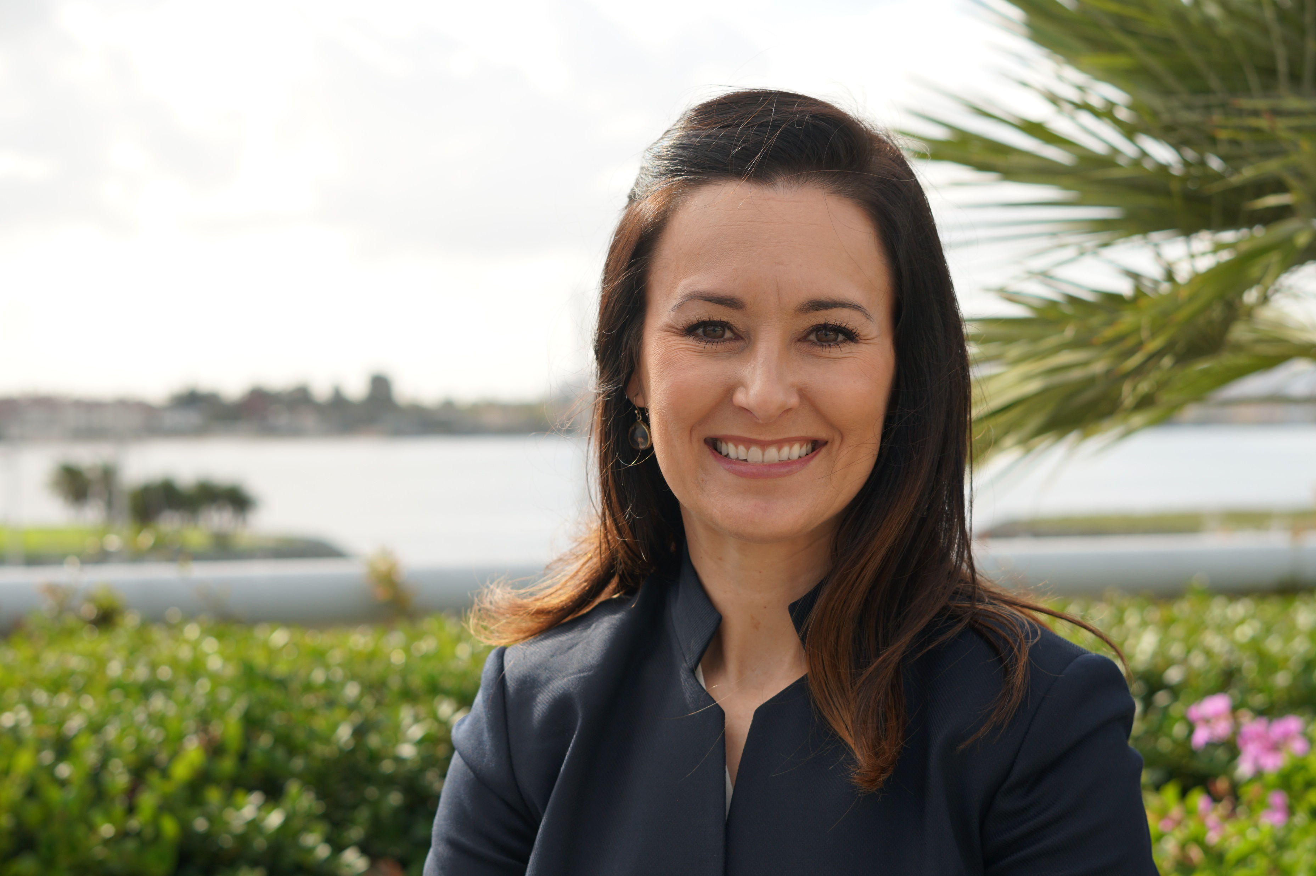
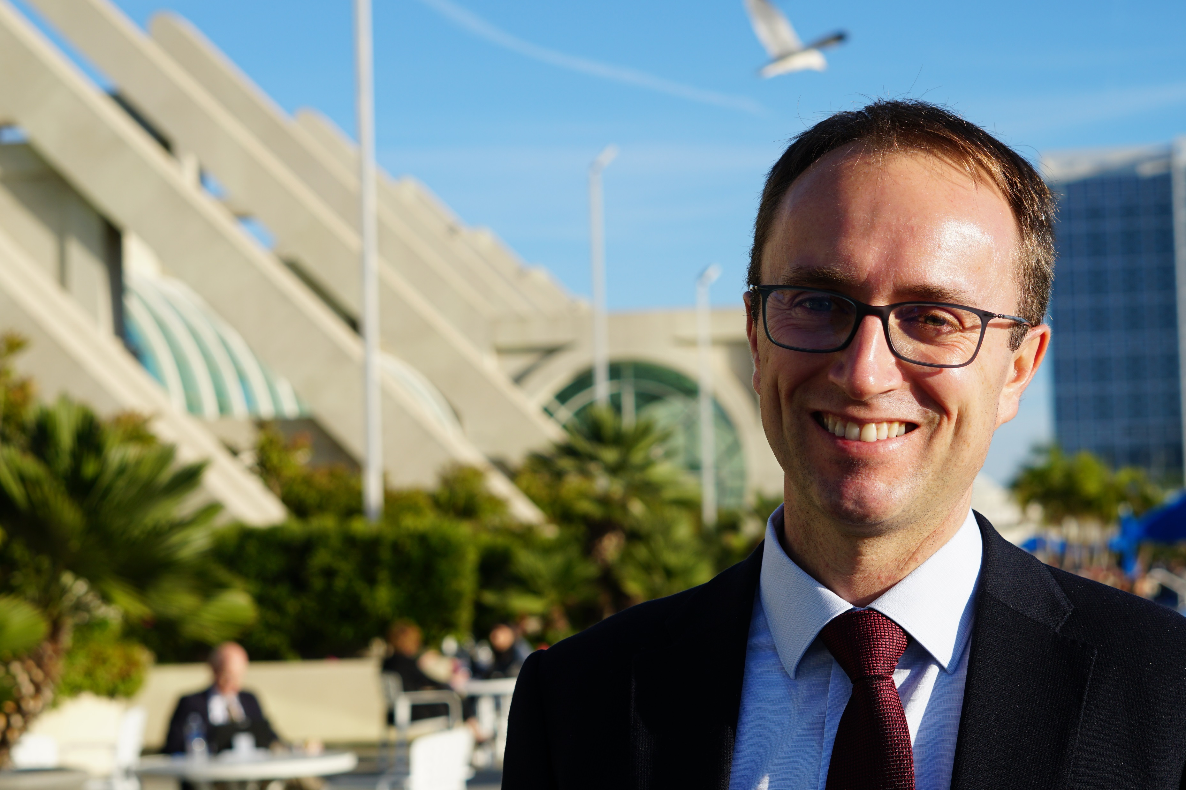
Lymphoma connect experts knowledge share 2019
THE SCIENTIFIC COMMITTEE
Prof. Simon Rule
Dr. Loretta J. Nastoupil
Prof. Stefano Luminari
THE DISCUSSION
Chemotherapy-free treatment approaches in lymphoma
BACKGROUND AND APPROACHES CONSIDERED
Background and scene setting – Prof. Simon Rule
Chemotherapy-free approaches in FL and MZL: An EU Perspective – Prof. Stefano Luminari
Chemotherapy-free approaches in FL and MZL: A US Perspective – Dr. Loretta J. Nastoupil
Summary of the discussion – Prof. Simon Rule

Slide 5
Scientific committee Disclosures
Prof. Simon Rule
Janssen, AstraZeneca, Pharmacyclics, Sunesis
Prof. Stefano Luminari
Advisory role: Roche, Celgene, Sandoz, Gilead
Travel grant: Celgene, Roche, Janssen
Dr. Loretta Nastoupil
Honorarium: Bayer, Celgene, Gamida, Genentech, Gilead/Kite, Janssen, Juno, Merck, Novartis, Spectrum, TG Therapeutics
Research support: Celgene, Genentech, Janssen, Juno, Karus, TG Therapeutics

Slide 6
Background and scene setting
Simon Rule
Plymouth Hospital NHS Trust, UK

Slide 7
chemotherapy

Slide 8
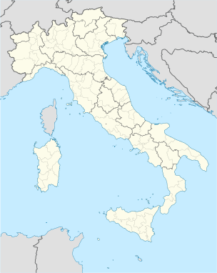
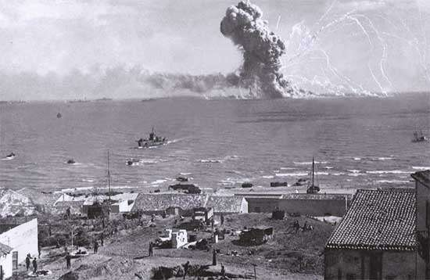
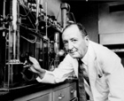
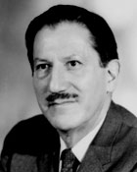
Chemotherapy – a history
1943 – Bari air raid
100s of sailors and civilians exposed to mustard gas
Big cover up by Allied command
Goodman and Gilman
Recruited by US dept of defense
Post-mortems showed lymphoid and myeloid suppression
Reasoned that might help lymphoma patients
Mustine administered to patients (with Gustav Linskog)
Saw dramatic reduction in NHL
Short lived but responded to further injections

Slide 9
Chemotherapy and cell cycle
G1 'gap 1'
cell prepares for DNA synthesis
M 'mitosis' division of the cell, giving rise to 2 daughter cells
Cell cycle
S 'synthesis' replication of DNA
G2 'gap 2' cell prepares for division
Non-specific | G1 | S | G2 | M
Cyclophosphamide | Steroids | Doxorubicin | Bleomycin | Vincristine
Melphalan |  | Cytarabine |  | Vinblastine
Cisplatin |  | Fludarabine |  | Vinorelbine
Dacarbazine |  | Methotrexate
 |  | 6-MP

Slide 10
Chemotherapy works!

Slide 11
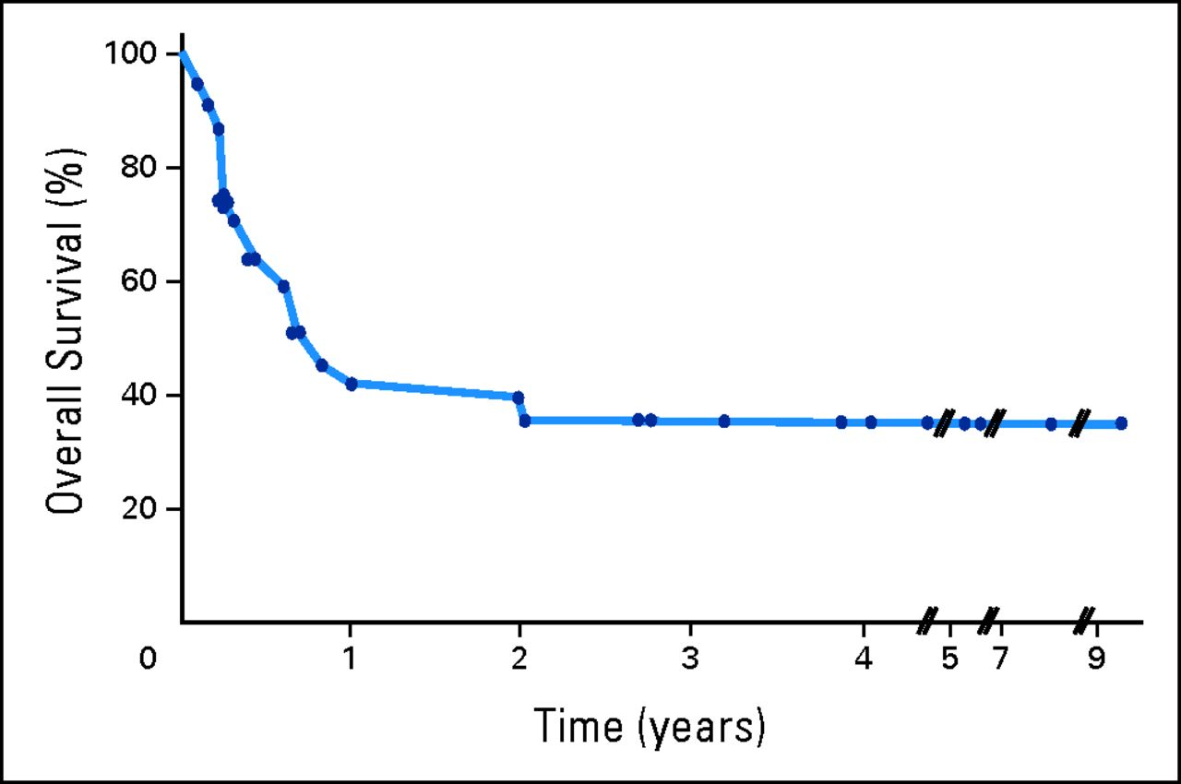
The first cure of patients with DLBCL (then called diffuse histolytic lymphomas)
using a modified mechlorethamine, vincristine, procarbazine, and prednisone programme substituting cyclophosphamide for mechlorethamine
DLBCL, diffuse large B-cell lymphoma

Slide 12
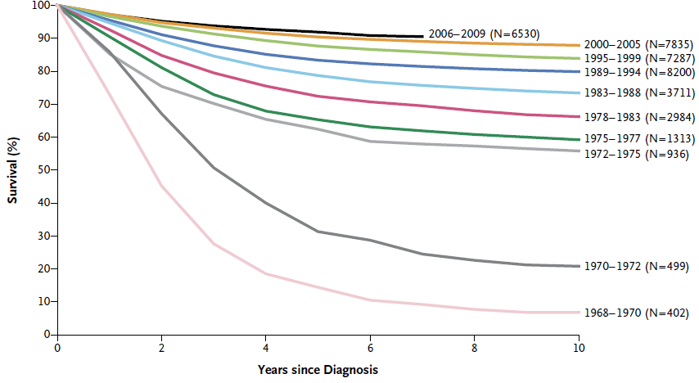
ALL in children
OS among children with ALL who were enrolled
in Children’s Cancer Group and
Children’s Oncology group Clinical Trials
1968-2009
ALL, acute lymphoblastic leukemia; OS, overvall survival
Hunger SP, et al. New Engl J Med 2015;373:1541-52

Slide 13
First example of effective targeted therapy

Slide 14
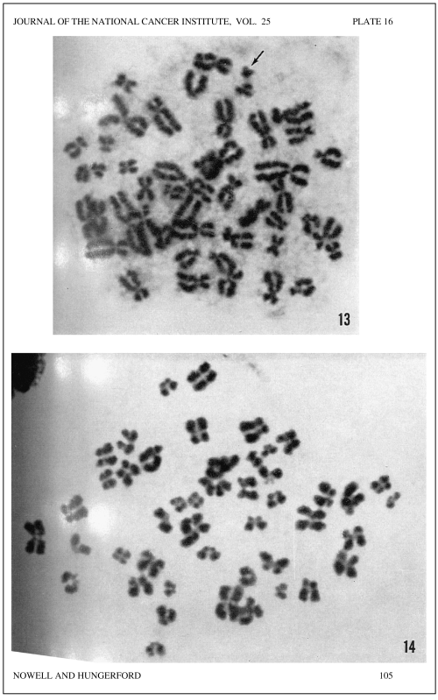
1960
Nowell PC, et al. J Natl Cancer Inst 1960;25:85-109

Slide 15
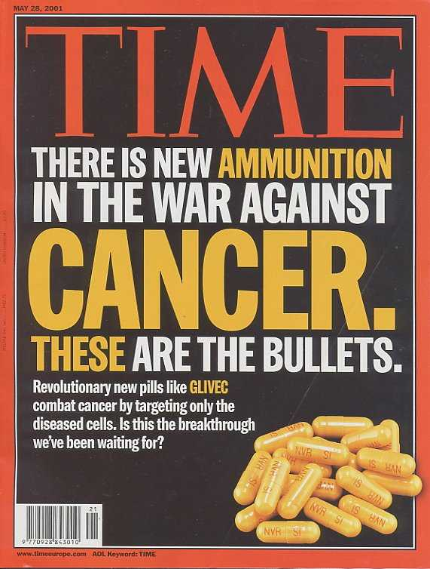

Slide 16
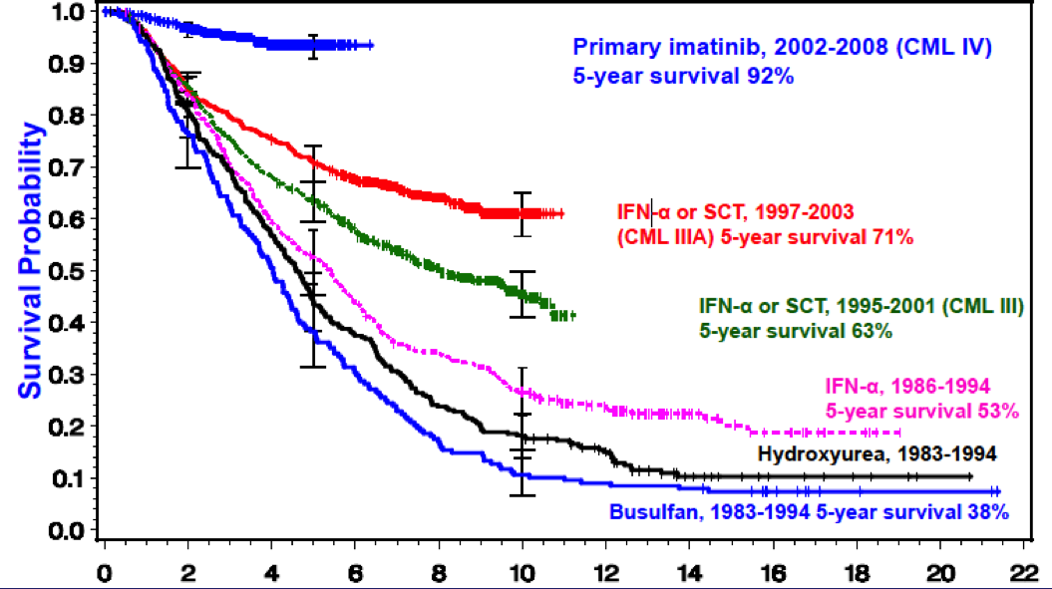
OS after introduction of TKIs:
German CML Study Group
Survival probability
CML, chronic myeloid leukemia; INF, interferon; OS, overall survival; SCT, stem-cell transplantation; TKI, tyrosine-kinase inhibitor
German CML Study Group, 2008

Slide 17
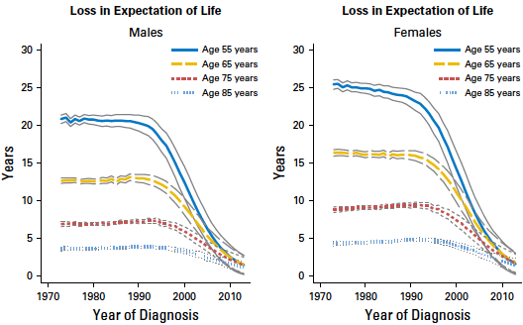
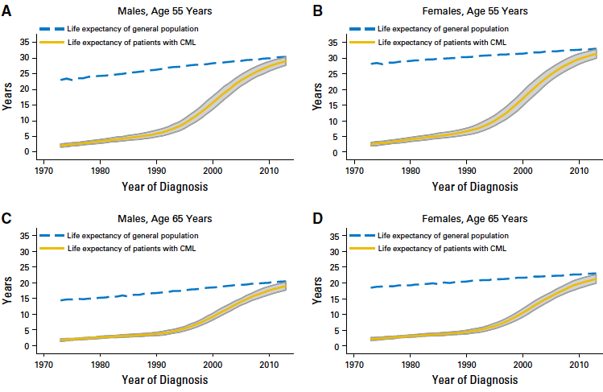
CML life expectancy approaches that of general population
4 subset of patients stratified for age: 55, 65, 75 and 85 years (2,262 patients)
Median life improvement reached a peak in 2013 and became similar to that of general population, regardless of sex
A 55-year old man diagnosed in 1980 had a median life expectancy of 3.5 years, while in 2010 there is a median life expectancy of 27.3 years
CML, chronic myeloid leukemia
Bower H et al. J Clin Oncol 2016;34:2851-7

Slide 19
chemotherapy-free approaches in FL and MZL
EU perspective
Stefano Luminari
University of Modena and Reggio Emilia,
Reggio Emilia, Italy

Slide 20
Chemo-free therapy in FL
EU perspective

Slide 21
Chemo-free is already an option for FL patients
Stage I/II | Stage III/IV | Stage III/IV (<65 years)ª | Stage III/IV (≥65 years)ª
Radiotherapy (involved field) 24-36 Gy In selected cases: watchful waiting | Watch and wait In symptomatic cases: consider rituximab monotherapy | Chemoimmunotherapy (e.g., R-CHOP, R-CVP, BR) In selected cases: rituximab monotherapy | Chemoimmunotherapy (e.g. R-CVP, BR, R-CHOP) or brief chemoimmunotherapy In selected cases, rituximab-chlorambucil rituximab monotherapy
ªAccording to biological age
BR, bendamustine and rituximab; FL, follicular lymphoma; R-CHOP, rituximab, cyclophosphamide, doxorubicin, vincristine, prednisolone; R-CVP, rituximab, cyclophosphamide, vincristine, prednisolone
Dreyling M, et al. Ann Oncol. 2014;25 Suppl 3:iii76-82.

Slide 22
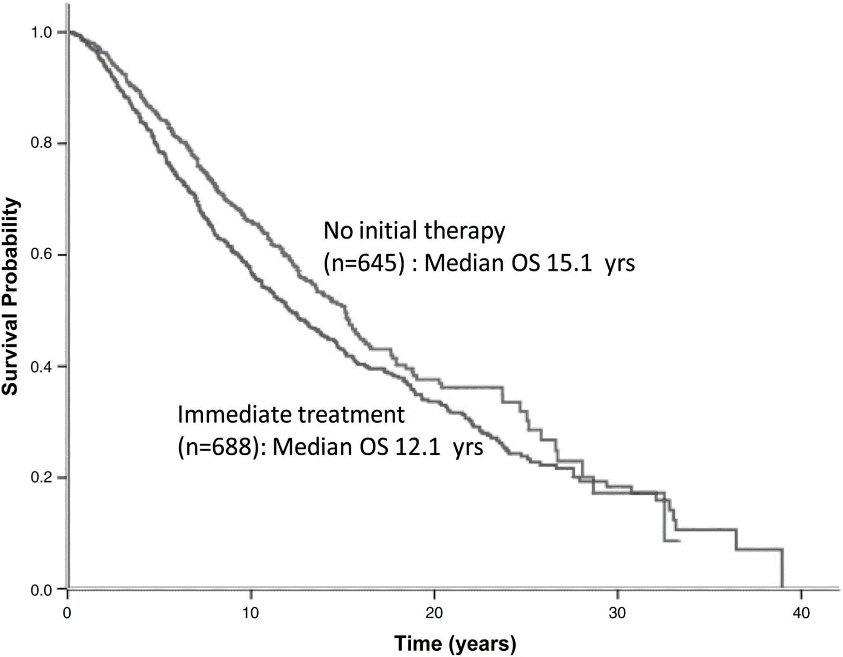
OS Stanford cohort:
Immediate vs delayed treatment
No evidence that timing of therapy initiation impacts OS of FL
FL, follicular lymphoma; OS, overall survival
Tan D, et al. Blood. 2013;122:981-7.

Slide 23
Rituximab vs WW in Advanced-Stage, Asymptomatic, Non-bulky FL
Open-label, Randomised, Phase 3 Trial
Time to start of new treatment
Progression-free survival
100
Watch and wait
100
Maintenance rituximab
75
75
50
50
No new treatment (%)
Progression-free survival (%)
25
HR 0.21 (95% CI 0.14-0.31)
Log-rank p<0.0001
25
HR 0.23 (95% CI 0.16-0.32)
Log-rank p<0.0001
Number at risk
Watch and wait
Maintenance rituximab
0
0
187
192
1
139
184
2
111
176
3
66
146
4
33
59
5
6
10
6
1
1
7
0
0
0
0
187
192
1
121
183
2
92
165
3
54
138
4
28
56
5
6
9
6
1
1
7
0
0
Years from randomisation
Years from randomisation
Overall survival
Time to histological transformation
100
100
75
75
50
50
Overall survival (%)
No histological transformation (%)
25
HR 0.73 (95% CI 0.34-1.54)
Log-rank p=0.40
25
HR 0.62 (95% CI 0.31-1.26)
Log-rank p=0.19
Number at risk
Watch and wait
Maintenance rituximab
0
0
187
192
1
181
189
2
175
186
3
130
163
4
68
72
5
18
16
6
4
3
7
0
0
0
0
187
192
1
177
187
2
168
182
3
121
158
4
64
69
5
15
15
6
4
3
7
0
0
Years from randomisation
Years from randomisation
CI, confidence interval; FL, follicular lymphoma; HR, hazard ratio; WW, watch and wait
Ardeshna KM, et al. Lancet Oncol. 2014;15:424-35.

Slide 24
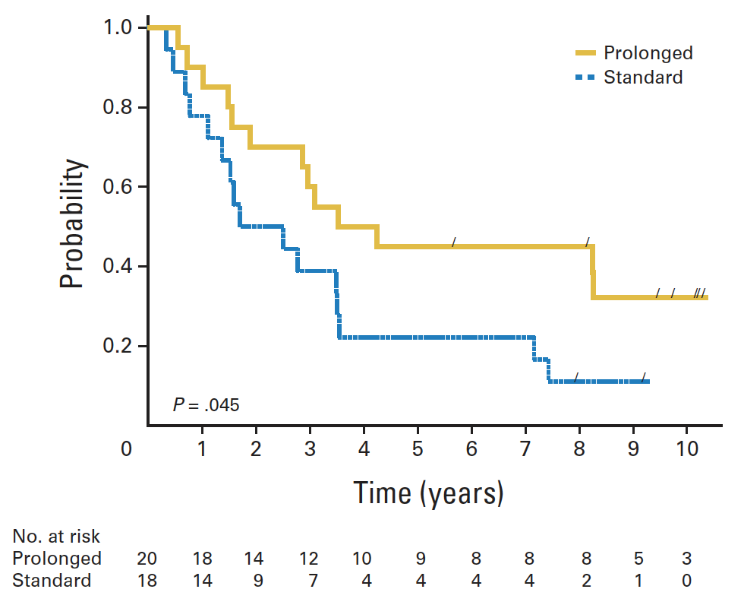
SAKK 35/98 trial
10-year follow-up
EFS of single-agent rituximab in newly diagnosed FL
After a 4-week induction phase (rituximab 375 mg/m²/week) patients with CR, PR or SD at week 12 were randomised to:
Standard: no further treatment
Prolonged: rituximab
375 mg/m² at week 12 and months 5, 7 and 9
P = 0.0007 Median FU: 9.4 years
45% of chemo-naive
responders in remission
at 8 years
CR, complete response; EFS, event-free survival; FL, follicular lymphoma; PR, partial response; SAKK, Swiss Group for Clinical Cancer Research; SD, stable disease
Martinelli G, et al. J Clin Oncol. 2010;28:4480-4.

Slide 25
Chemotherapy-Free Initial Treatment of Advanced Indolent Lymphoma Has Durable Effect With Low Toxicity
Results From Two Nordic Lymphoma Group Trials
With >10 Years of Follow-Up
OS, overall survival; R + IFN, rituximab plus interferon alfa-2a; R mono, single rituximab
Lockmer S, et al. J Clin Oncol. 2019;36:3315-25.

Slide 26
Single-Agent Activity in Relapsed FL
FL, follicular lymphoma
Younes A, et al. Nat Rev Clinc Oncol. 2017;14:335-46.

Slide 27
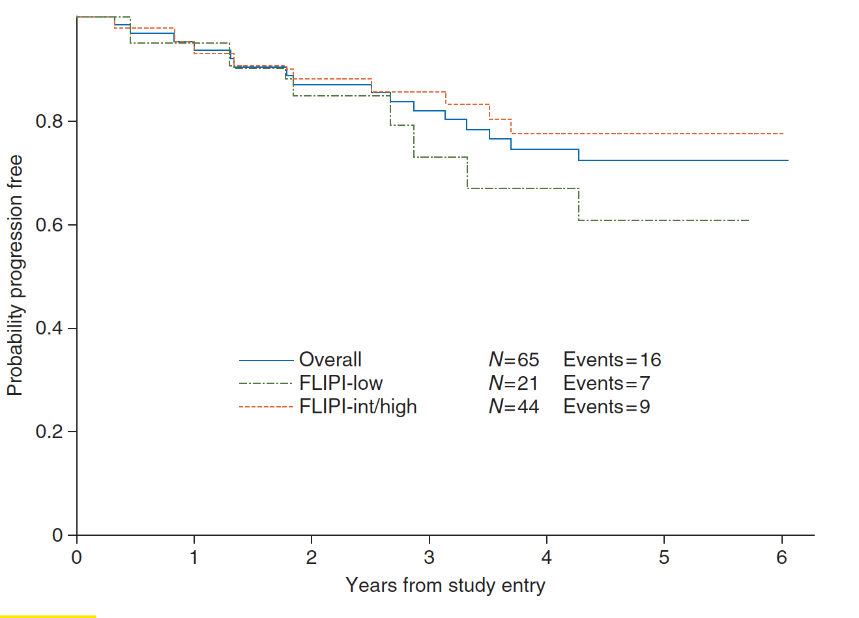
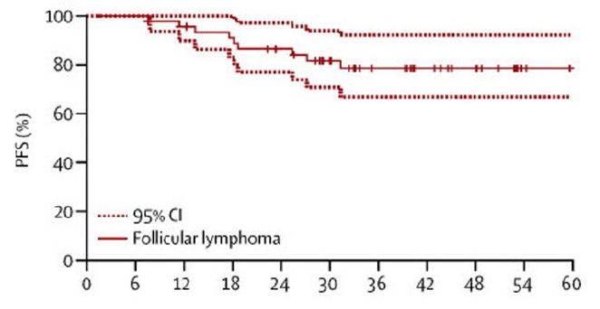
Alliance and CALGB phase 2 trials of R² for untreated FL
46 patients with FL¹
ORR 98% CR 87% PR 11%
3-year PFS 79%
3-year OS 94%
65 patients with FL (FLIPI 0-2)²
ORR 95% CR 72% PR 23%
5-year PFS 72%
5-year OS 100%
Rituximab 375 mg/m² d1/q28d for 6-12 cycles
Lenalidomide 20 mg/d d1–21/q28d for 6-12 cycles
Rituximab 375 mg/m² qw (c1) and q4w (c4, 6, 8, 10)
Lenalidomide 20–25 mg/d d1–21/q28d for 12 cycles
c, cycle; CALGB, Cancer and Leukemia Group B; CI, confidence interval; CR, complete response; FL, follicular lymphoma; FLIPI, FL international prognostic index; ORR, overall response rate; OS, overall survival; PFS, progression-free survival; PR, partial response; qw, every week; q4w, every 4 weeks; q28d, every 28 days; R², rituximab and lenalidomide
1. Fowler NH, et al. Lancet Oncol. 2014;15:1311-8; 2. Martin P, et al. Ann Oncol. 2017;28:2806-12.

Slide 28
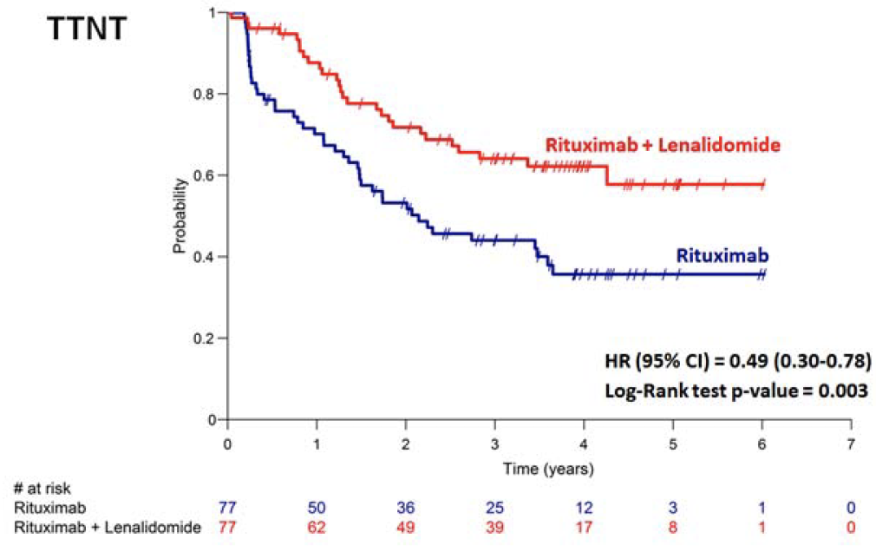
randomised phase 2 Trial
SAKK 35/10
Efficacy
Rituximab + lenalidomide (15 mg/d) was significantly more active than rituximab in
154 patients with untreated FL in need of therapy
Investigator-assessed response, ITT population, n (%) | R (n=77) | R + Len (n=77)
ORR | 47 (61) | 63 (82)
CR/CRuª | 19 (25) | 28 (36)
PR | 28 (36) | 35 (45)
SD | 6 (8) | 4 (5)
PD | 2 (3) | 3 (4)
Not evaluable | 22 (29) | 7 (9)
ª p=0.056
CR, complete response; FL, follicular lymphoma; ITT, intention to treat; len, lenalidomide; ORR, overall response rate; PD, progressive disease; PR, partial response; R, rituximab; SAKK, Swiss Group for Clinical Cancer Research; SD, stable disease; TTNT, time to next treatment
Zucca E, et al. Blood. 2019;134:353-362.

Slide 29
RELEVANCE Trial:
Efficacy
PFS by IRC
Co-primary endpoint:
Interim PFS (at approx. 50% events)
1.0
 | R² | R-CT
Patients, n | 513 | 517
Events, n (%) | 119 (23) | 115 (22)
3-year PFS, % (95% CI) | 77 (72-80) | 78 (74-82)
0.8
R-CT
0.6
PFS Probability (IRC)
0.4
R²
Interim PFS at median follow up of 37.9 months was similar in both arms
PFS benefit observed across pre-specified subgroups
0.2
HR: 1.1 (95% CI: 0.85-1.43; p=0.48)
0
0
6
12
18
24
30
36
42
48
54
60
66
Months from randomisation
Patients at risk, n
R²
R-CT
513
517
435
474
409
446
393
417
364
387
282
287
174
175
107
109
49
51
13
14
0
1
0
CI, confidence interval; CT, chemotherapy; HR, hazard ratio; IRC, independent review committee; PFS, progression-free survival; R, rituximab; R², rituximab and lenalidomide
Morschhauser F, et al. N Engl J Med 2018;379:934-47.

Slide 30
RELEVANCE Trial:
Safety
AEs for R² (n = 507), %
AEs for R-CT (n = 503), %
Grade 1/2
Grade 3/4
Grade 1/2
Grade 3/4
Secondary primary malignancies were similar between arms (7% vs 10% in the R² vs R-CT group)
1 patient per arm died due to study drug
AE, adverse event; CT, chemotherapy; R, rituximab; R², rituximab and lenalidomide
Morschhauser F, et al. N Engl J Med 2018;379:934-47.

Slide 31
AUGMENT: phase 3 trial of R² vs
R-placebo in rel/ref FL and MZL
Study design
Treatment: 1 year
Lenalidomide 20 mg/day,
day 1-21/28, for up to 12 cycles
+
Rituximab 375 mg/m²
weekly × 4, then monthly × 4
Relapse FL or MZL
(N=358)
R
Placebo
+
Rituximab 375 mg/m²
weekly × 4, then monthly × 4
Primary endpoint
Progression-free survival (PFS)
ITT population
Assessed by the independent review committee (IRC) per 2007 International Working Group criteria,
Secondary endpoints
Included ORR, CR, DoR, safety
Stratification Factors:
Previous R treatment (yes/no)
Time since last lymphoma therapy (≤2 years/>2 years)
Histology (FL/MZL)
CR, complete response; DoR, duration of response; FL, follicular lymphoma; HR, hazard ratio; IRC, Independent Review Committee; ITT, intention to treat; MZL, marginal zone lymphoma; ORR, overall response rate; PFS, progression-free survival; PO, per oral; qd, per day; R, rituximab; rel/ref, relapsed or refractory
Leonard JP, et al. J Clin Oncol. 2019;37:1188-99

Slide 32
AUGMENT: phase 3 trial of R² vs
R-placebo in rel/ref FL and MZL
IRC-Assessed PFS in ITT Population (Primary Endpoint)
Patients,
n
178
180
Median PFS,
months (95% CI)
39.4 (22.9-NR)
14.1 (11.4-16.7)
1.0
0.9
R²
R-Placebo
0.8
0.7
0.6
R²
0.5
PFS Probability
0.4
0.3
R-placebo
0.2
HR: 0.46 (95% CI: 0.34-0.62;
p<0.0001)
0.1
Median follow up: 28.3 months
0
0
6
12
18
24
30
36
42
48
Patients at Risk, n
R²
R-placebo
Months from randomisation
178
180
148
132
124
92
91
58
59
40
39
26
20
10
7
4
0
0
Comparable results obtained by investigator assessment (HR: 0.51; P<0.0001)
CI, confidence interval; HR, hazard ratio; FL, follicular lymphoma; IRC, independent review committee; ITT, intent-to-treat; MZL, marginal zone lymphoma; NR, not reached; PFS, progression-free survival; R, rituximab; R², rituximab and lenalidomide; rel/ref, relapsed/refractory
Leonard JP, et al. J Clin Oncol. 2019;37:1188-99

Slide 33
R² in the treatment of FL in Europe
In November 2019, the EMA’s CHMP adopted a
positive opinion
on R² in rel/ref FL
CHMP, Committee for Medicinal Products for Human Use; European Medicines Agency; FL, follicular lymphoma; R², rituximab + lenalidomide; rel/ref, relapsed/refractory

Slide 34
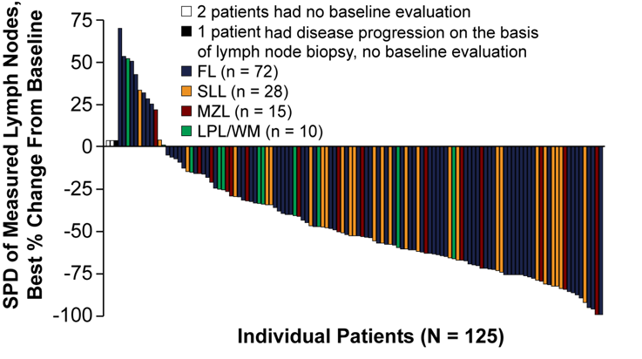
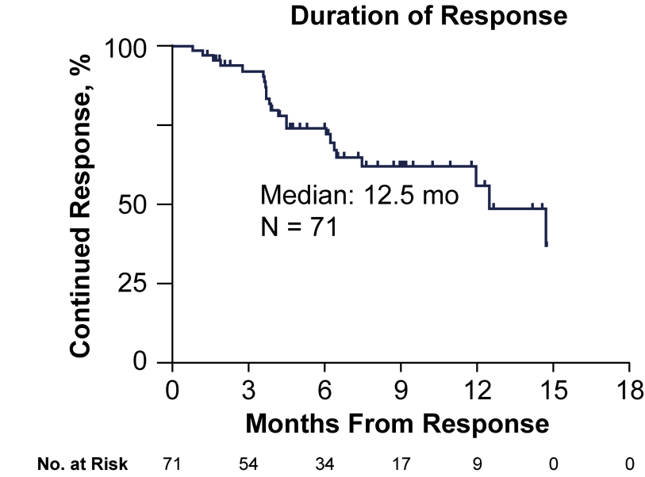
Efficacy of Idelalisib in Relapsed Indolent Lymphoma
IRC assessment:
ORR = 57% (71 responses in 125 pts)
FL, follicular lymphoma; IRC, Independent Review Committee; LPL/WM, lymphoplasmacytic lymphoma with or without Waldenström’s macroglobulinemia; mo, months; MZL, marginal zone lymphoma; ORR, overall response rate; SLL, small lymphocytic lymphoma; SPD, sums of the products of the perpendicular dimensions
1. Gopal AK, et al. N Engl J Med. 2014;370:1008-18; 2. Zydelig (idelalisib). Prescribing Information. https://www.gilead.com/~/media/Files/pdfs/medicines/oncology/zydelig/zydelig_pi.pdf. Accessed December 10, 2018.

Slide 35
Chemo-free therapy in MZL
EU perspective

Slide 36



Chemo-free treatment MZL european perspective
Rituximab is the only available chemo-free treatment option in MZL
  Mainly used as a single agent in splenic MZL
There is no innovative chemo-free treatment approach available in the EU
The decision on which patients should be treated and which one only observed is similar between MZL and FL

Slide 37
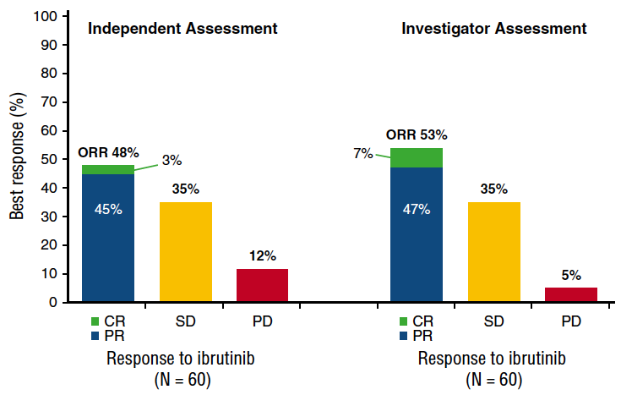
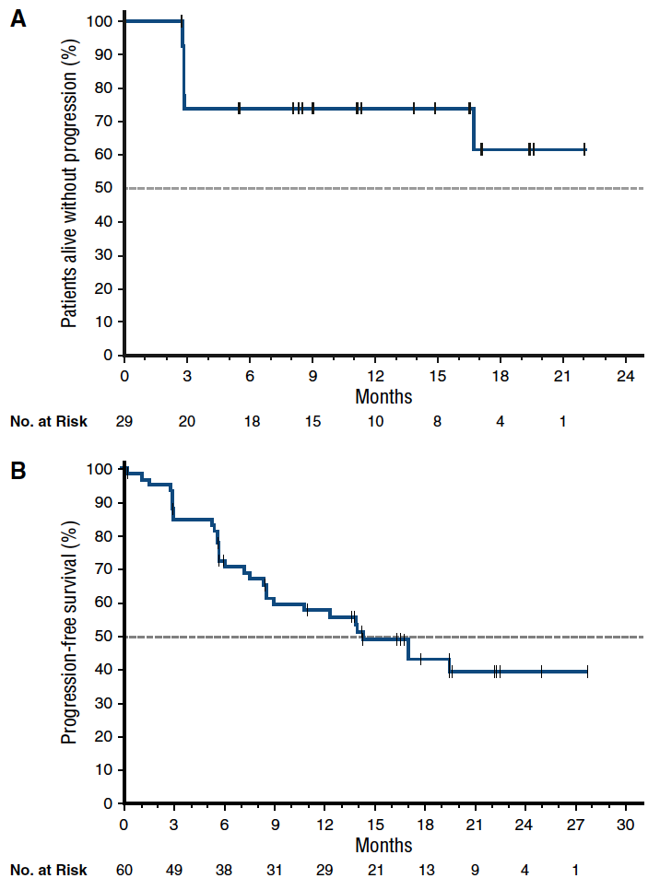
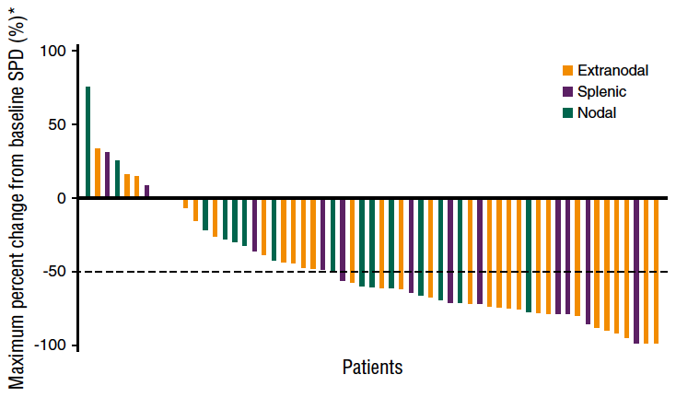
open-label phase 2 study of ibrutinib IN rel/ref MZL
Median DoR: NR (95% CI, 16.7-NE)
Median PFS: 14.2 (95% CI, 8.3 to NE)
DoR, duration of response; MZL, marginal-zone lymphoma; NE, not estimable; NR, not reached; PFS, progression-free survival; rel/ref, relapsed/refractory
Noy A, et al. Blood. 2017;129:2224–32.

Slide 38
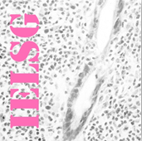
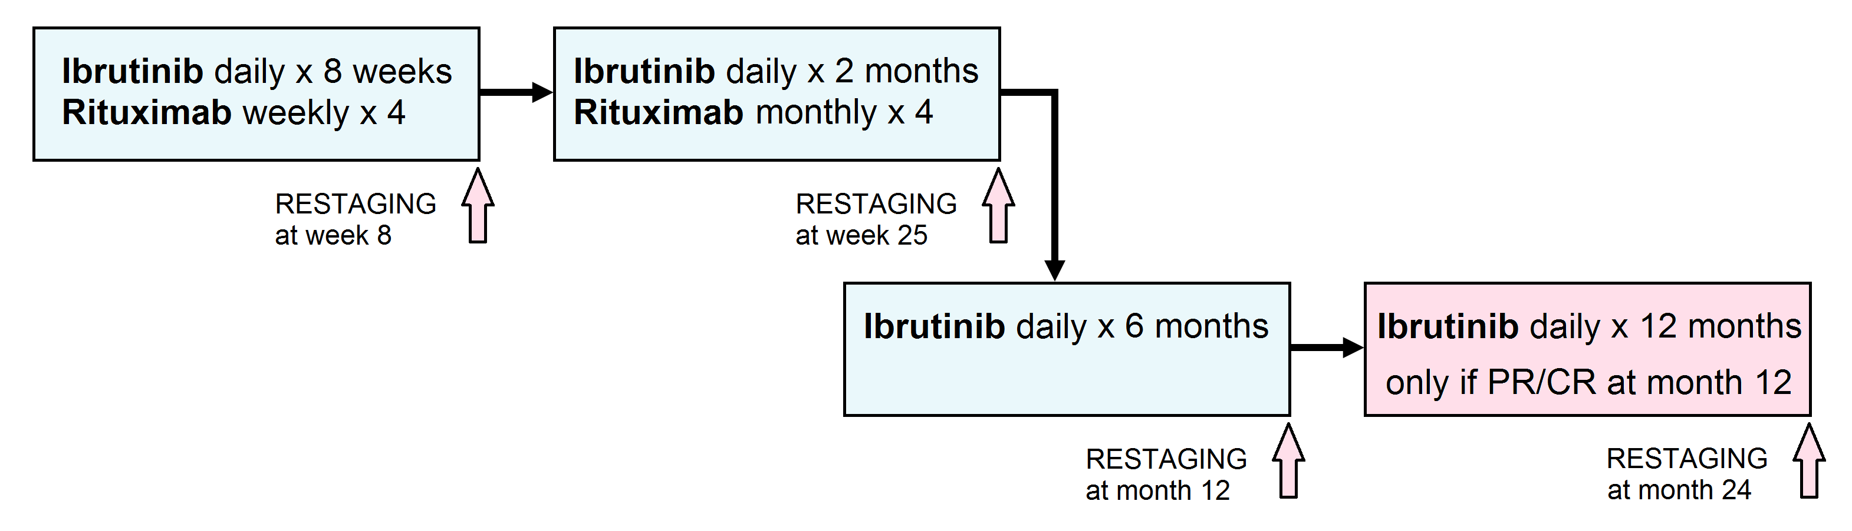



Phase 2 IELSG 47/MALIBU Study in untreated MZL is Ongoing
CR, complete response; MZL, marginal-zone lymphoma; PR, partial response
https://clinicaltrials.gov/ct2/show/NCT03697512

Slide 39
Chemo-free treatment FL and MZL european perspective
There is a natural place for
chemo-free therapies in FL and MZL
Available chemo-free options work, but
patient selection is the unmet need
Observation | Rituximab monotherapy | R² | New agents
Chemo-free = toxicity-free
always needs to be demonstrated
FL, follicular lymphoma; MZL, marginal-zone lymphoma; R², rituximab and lenalidomide

Slide 40
Chemotherapy Free Approaches in FL and MZL
US perspective
Loretta J. Nastoupil
University of Texas MD Anderson Cancer Center, Houston, TX

Slide 41
Chemo-free therapy in FL
US perspective

Slide 42
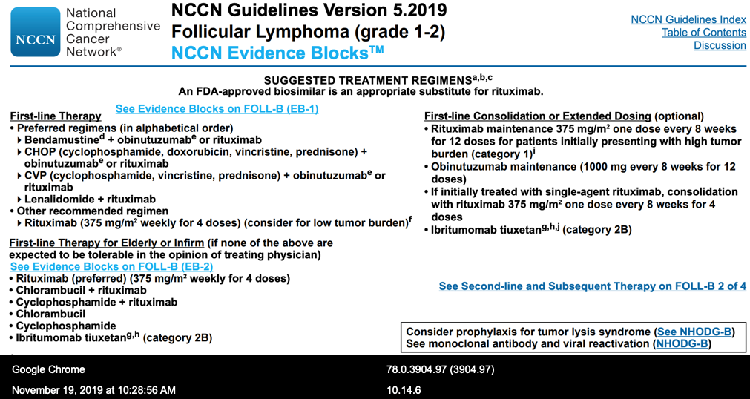
NCCN Guidelines
Frontline treatment of FL
FDA, Food and Drug Administration; FL, follicular lymphoma; NCCN, National Comprehensive Cancer Network
1. NCCN Clinical Practice Guidelines in Oncology B-Cell Lymphomas. Version 5. 2019.

Slide 43
RELEVANCE trial
Summary
R² is not superior to R-chemo (based on interim PFS and mature CR data at 120 weeks)
  Similar efficacy results between R² and R-chemo
Safety differences between treatment arms
  R-chemo: More frequent neutropenia, FN, growth factor usage, nausea, vomiting, peripheral neuropathy, and alopecia
  R²: More frequent cutaneous reactions, tumour flare and diarrhoea
R² is a potential first-line option in patients with FL who
require treatment
CR, complete response; FL, follicular lymphoma; FN, febrile neutropenia; G, grade; PFS, progression-free survival; R, rituximab; R², rituximab and lenalidomide
1. Fowler NH, et al. ASCO 2018. Abstract 7500; 2. Morschhauser F, et al. N Eng J Med. 2018;379:934-47.

Slide 44
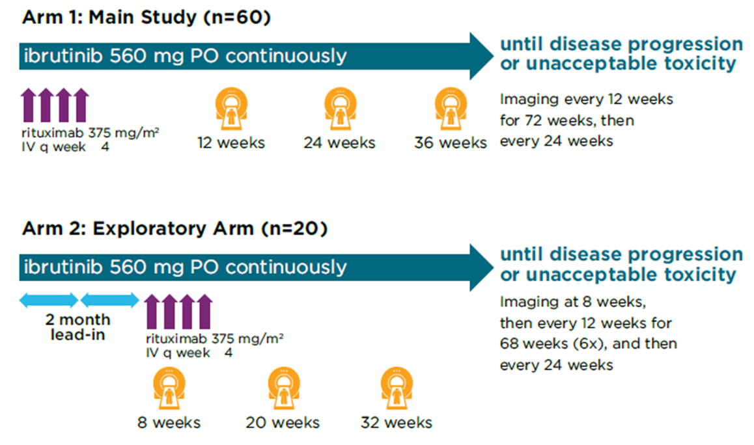
Rituximab and Ibrutinib in Untreated FL
Arm 1
Arm 2
ORR 85%
35%
(21/60)
ORR 75%
CR
PR
SD
Phase 2, Multicenter Study: Ibrutinib and rituximab
35%
(7/20)
Best response (%)
50%
(30/60)
40%
(8/20)
15%
15%
(9/60)
(3/20)
 | Arm 1 n=60 | Arm 2 n=20
Median time on study (range) | 22 months (5.8-27.6) | 15 months (4.4-20.8)
Median treatment duration (range) | 20 months (0.8-27.6) | 12 months (1.0-19.3)
Responders | n=51 | n=15
Median time to initial response (range) | 2.7 months (1.1-16.5) | 4.3 months (1.7-12.6)
Median time to best response (range) | 2.7 months (1.1-19.0) | 4.3 months (1.7-2.6)
CR, complete response; FL, follicular lymphoma; IV, intravenous; ORR, overall response rate; PO, per oral; PR, partial response; q week, once weekly; SD, stable disease
Fowler N, et al. ASH 2016. Abstract 1804.

Slide 45
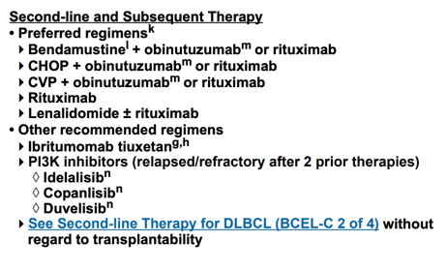
NCCN Guidelines:
Second- or later-line FL
CHOP, cyclophosphamide, doxorubicin, vincristine and prednisone; CVP, cyclophosphamide, vincristine and prednisone; DLBCL, diffuse large B-cell lymphoma; NCCN, National Comprehensive Cancer Network; PI3K, phosphoinositide 3-kinase
1. NCCN Clinical Practice Guidelines in Oncology B-Cell Lymphomas. Version 5. 2019.

Slide 46
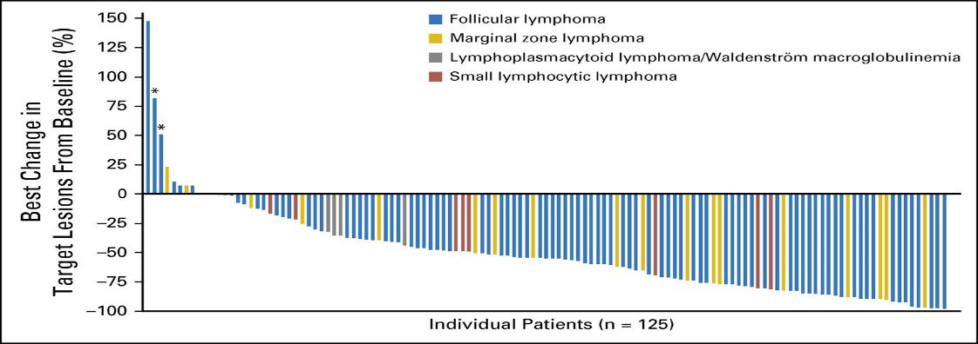
CHRONOS-1: Copanlisib in Patients With Rel/REF Indolent NHL
Phase 2 study^{2,3}
142 patients with rel/ref indolent lymphoma after ≥2 lines of therapy
Copanlisib¹ 60 mg intravenously on days 1, 8, and
15 of a 28-day cycle
Primary endpoint was ORR
Secondary endpoints included DOR, PFS, and OS
Best change in target lesion²
150
Copanlisib active in rel/ref indolent NHL²
ORR: 59% (84 of 142 patients)
CR: 12%
Activity confirmed in updated analysis³
ORR of 60.6%, with a 16.9% CR rate
Median DoR 14.1 months
Median PFS of 12.5 months
125
FL
MZL
LPL/WM
SLL
100
75
50
Best change in target lesion
from baseline (%)
25
0
–25
–50
–75
–100
Individual patients (n=125)
* Patient was assessed by independent review as having stable disease
CR, complete response; DoR, duration of response; FL, follicular lymphoma; LPL/WM, lymphoplasmacytoid lymphoma/Waldenstrӧm macroglobulinemia; MZL, marginal zone lymphoma; NHL, non-Hodgkin lymphoma; ORR, objective tumour response; OS, overall survival; PFS, progression-free survival; rel/ref, relapsed or refractory; SLL, small lymphocytic lymphoma
1. Aliqopa (copanlisib). Prescribing Information. http://labeling.bayerhealthcare.com/html/products/pi/Aliqopa_PI.pdf. Accessed December 10, 2018.
2. Dreyling M, et al. J Clin Oncol. 2017;35:3898-905; 3. Dreyling M, et al. Am J Hematol 2019 [Epub ahead of print].

Slide 47
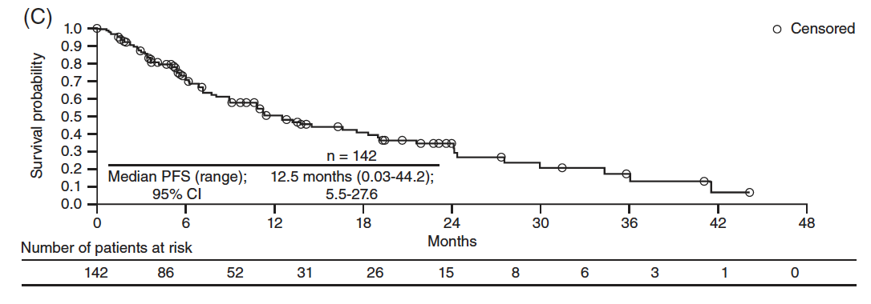
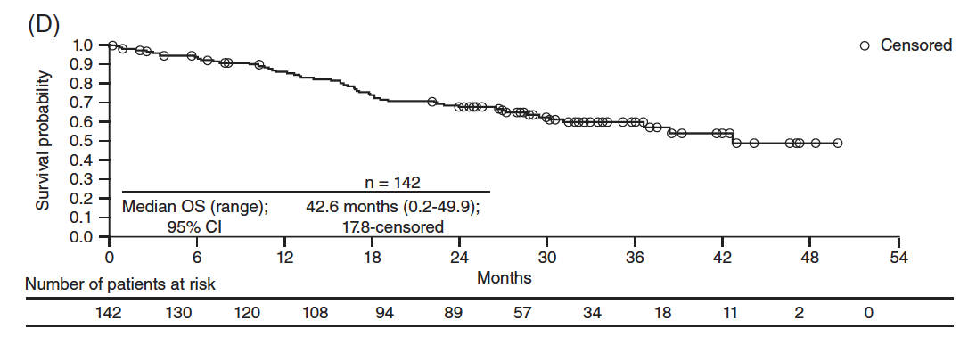
CHRONOS-1: PFS and OS With Copanlisib in rel/ref Indolent NHL
PFS
OS
Median, months¹ | 11.2 (95% CI 8.1-24.0)
Median, months¹ | NE (95% CI NE; range 0-30.3)
Updated data (Feb 2018 cut-off)²
Updated data (Feb 2018 cut-off)²
Median, months | 12.5 (95% CI 5.5-27.6)
Median, months | 42.6 (95% CI 17.8-censored)
CI, confidence interval; mo, months; NE, not evaluable; NHL, non-Hodgkin lymphoma; NR, not reached; OS, overall survival; PFS, progression-free survival; rel/ref, relapsed or refractory
1. Dreyling M, et al. J Clin Oncol. 2017;35:3898-905. 2. Dreyling M, et al. Am J Hematol 2019 [Epub ahead of print].

Slide 48

Special Considerations for Use of PI3K Inhibitors
Idelalisib^{1,2}
Oral administration, recommended starting dose 150 mg twice daily
Monitor for GI events, hepatotoxicity, pneumonitis, and intestinal perforation
  Interrupt, consider steroids, reduce or discontinue agent
Potential for infections, including opportunistic infections, such as CMV and PJP
Copanlisib^{1,3}
IV administration 60 mg 1-hour IV infusion on day 1, 8, and 15 of a 28-day treatment cycle on an intermittent schedule (3 weeks on, 1 weeks off); modify dosage in case of toxicity
Monitor patients for signs and symptoms of infection, withhold treatment for infections grade ≥3 until resolution
Monitor for hyperglycemia and hypertension (mostly self-limiting)
Duvelisib^{1,4}
Oral administration, 25 mg twice daily
Monitor hepatic function and blood counts; advise patients of potential risk to a fetus and to use effective contraception
Monitor for GI events, hepatotoxicity, pneumonitis, and intestinal perforation
  Interrupt, consider steroids, reduce or discontinue agent
CMV, cytomegalovirus; GI, gastrointestinal; IV, intravenous; PI3K, phosphoinositide 3-kinase; PJP, Pneumocystis jirovecii pneumonia
1. NCCN Clinical Practice Guidelines in Oncology B-Cell Lymphomas. Version 5. 2019; 2. Zydelig (idelalisib). Prescribing Information. https://www.gilead.com/~/media/Files/pdfs/medicines/oncology/zydelig/zydelig_pi.pdf. Accessed November 23, 2019; 3. Aliqopa (copanlisib). Prescribing Information. http://labeling.bayerhealthcare.com/html/products/pi/Aliqopa_PI.pdf. Accessed November 23, 2019; 4. Copiktra (duvelisib). Prescribing Information. https://www.verastem.com/wp-content/uploads/2018/08/prescribing-information.pdf. Accessed November 23, 2019.

Slide 49
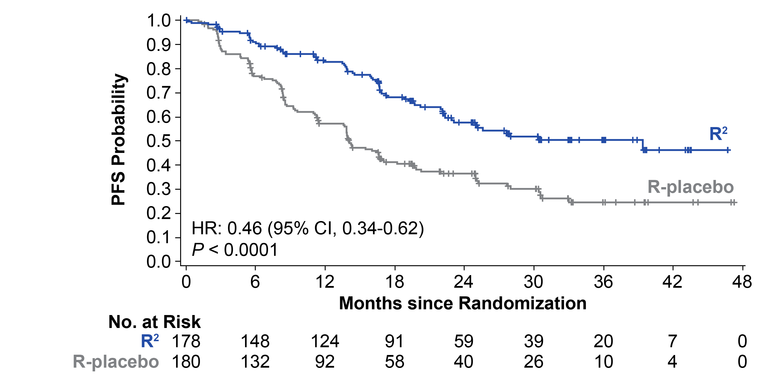
AUGMENT study: R² in rel/ref FL
Primary endpoint: PFS (ITT, IRC)
PFS by IRC*
Median follow up: 28.3 months
Median PFS | R² (n=178) | R-placebo (n=180) | HR (95% CI) | p value
By IRC, months (95% CI) | 39.4 (22.9-NR) | 14.1 (11.4-16.7) | 0.46 (0.34-0.62) | < 0.0001
By investigator, months (95% CI) | 25.3 (21.2-NR) | 14.3 (12.4-17.7) | 0.51 (0.38-0.69) | < 0.0001
CI, confidence interval; IRC, Independent Review Committee; HR, hazard ratio; ITT, intention-to-treat; NR, not reached; PFS, progression-free survival; R, rituximab; rel/ref, relapsed/refractory; R2, rituximab and lenalidomide
Leonard JP, et al. J Clin Oncol. 2019;37:1188-99

Slide 50
GALEN study: Obinutuzumab + Lenalidomide in rel/ref FL¹
Induction
6 x 28-day cycles
RE
Maintenance
Phase 1/2
1 year
2 years
Rel/ref NHL
FL grade 1-3a
ECOG PS≤2
≥1 prior rituximab-containing therapy
Lenalidomide
20 mg/day,
cycle 1 (Days 1-21/28
cycles 2-6 (Days 2-22/28)
+
Obinutuzumab
1,000 mg/day
c1 (Days 1, 8, 15, 22),
then Day 1 of cycles 2-6
Lenalidomide
10 mg/day,
cycles 7-18 (Days 2-22/28)
+
Obinutuzumab
1,000 mg/day
Day 1 every 2 cycles
Obinutuzumab
1,000 mg/day
Day 1 of each of six
56-day cycles
FU
Primary endpoint: ORR at end of induction by IWG criteria (Cheson 1999)²
Secondary endpoints included response rates (Cheson 2007)³, PFS, RD, OS, safety (AEs, SPMs)
Exploratory: response and outcome according to POD24 vs POD >24 months, refractory status (no response or PD within 6 months of last rituximab-containing regimen), number of prior regimens, tumour bulk
AE, adverse event; ECOG PS, Eastern Cooperative Oncology Group performance status; FL, follicular lymphoma; FU, follow up; IWG, International Working Group; NHL, non-Hodgkin lymphoma; ORR, overall response rate; OS, overall survival; PD, progressive disease; PFS, progression-free survival; POD, progression of disease; RD, response duration; RE, response evaluation; rel/ref, relapsed or refractory; SPM, second primary malignancy
1. Morschhauser F, et al. Lancet Haematol. 2019;6:e429-37. 2. Cheson BD, et al. J Clin Oncol;1999:17;1244. 3. Cheson BD, et al. J Clin Oncol. 2007;25:579-86.

Slide 51
GALEN study:
Response
Response rates at the end of induction
Response evaluation |  | All patients (N=86) | Early relapse patients (n=24) | Refractory patients (n=23)
IWG 1999 | ORR, % (95% CI) | 79 (69−87) | 70.8 (48.9-87.4) | 60.9 (38.5-80.3)
 | CR/CRu, % (95% CI) | 38 (28-50) | 33.3 (15.6-55.3) | 34.8 (16.4-57.3)
IWG 2007 | ORR, % (95% CI) | 76 (65-84) | 66.7 (44.7-84.4) | 56.5 (34.5-76.8)
 | CR, % (95% CI) | 47 (36-58) | 54.2 (32.8-74.4) | 30.4 (13.2-52.9)
CI, confidence interval; CR, complete response; CRu, unconfirmed CR; IWG, International Working Group; ORR, overall response rate
Morschhauser F, et al. Lancet Haematol. 2019;6:e429-37.

Slide 52
GALEN Study:
Progression-Free Survival
 | POD24 (n=24) | POD >24 months (n=62) | All patients (N=86)
1-year PFS, % (95% CI) | 74.8 (52.2-87.8) | 75.3 (60.9-85.0) | 75.5 (64.2-83.7)
Median follow-up: 18.1 month
CI, confidence interval; PFS, progression-free survival; POD, progression of disease
Morschhauser F, et al. Lancet Haematol. 2019;6:e429-37.

Slide 53
GALEN study:
Toxicity
Non-haematological AEs in ≥15% of patients, n (%) | Grade 1-2 | Grade ≥3
Asthenia | 52 (59) | 2 (2)
Bronchitis | 35 (40) | 1 (1)
Diarrhoea | 35 (40) | 0
Muscle spasms | 34 (39) | 0
Cough | 32 (36) | 0
Constipation | 30 (34) | 0
Peripheral neuropathy | 19 (22) | 1 (1)
Nausea | 19 (22) | 0
Weight loss | 19 (22) | 0
Nasopharyngitis | 17 (19) | 0
Rash | 17 (19) | 0
Pyrexia | 15 (17) | 0
Infusion-related reaction | 11 (13) | 3 (3)
Pruritus | 13 (15) | 0
Dyspnoea | 12 (14) | 1 (1)
Haematological AEs
  Neutropenia: 44.2%, all grade ≥3
  Thrombocytopenia: 14.0%,
  all grade ≥3
  Anaemia: 3.5%, all grade 3
  Lymphopenia: 3.5%, all grade ≥3
Febrile neutropenia
  5%, all grade ≥3
  1 grade 5 event
AE, adverse event.
Morschhauser F, et al. Lancet Haematol. 2019;6:e429-37.

Slide 54
Tazemetostat in rel/ref FL: ongoing study
Tazemetostat is a selective, oral EZH2 inhibitor
Open-label, multicentre, phase 2 study evaluating tazemetostat in patients with rel/ref grade 1-3b FL, with or without activating mutations in EZH2
POD24 subgroup: patients with PD or relapse <24 months of diagnosis or the start of frontline treatment with immunochemotherapy
Phase 1/2
Rel/ref FL
Grade 1-3a
ECOG PS ≤2
≥2 prior therapies
Measurable disease per 2007 IWG-NHL criteria
Tazemetostat
800 mg orally bid
Endpoints
Primary: ORR
Secondary: incl. PFS and safety
ECOG PS, Eastern Cooperative Oncology Group performance status; FL, follicular lymphoma; IWG, International Working Group; NHL, non-Hodgkin lymphoma; ORR, overall response; PD, progressive disease; PFS, progression-free survival; POD24, progressive disease within 24 months of diagnosis; rel/ref, relapsed/refractory
Morschhauser F, et al. ASH 2019. Abstract #123

Slide 55
Tazemetostat in rel/ref FL:
Efficacy
potent antitumour activity, regardless of prognostic category
Interim data | EZH2 mutated |  | EZH2 wildtype
 | Response evaluable (n=43) | POD24 subgroup (n=17) | Response evaluable (n=53) | POD24 subgroup (n=30)
ORR, n (%) | 33 (77) | 11 (65) | 18 (34) | 9 (30)
CR | 3 (7) | 1 (6) | 3 (6) | 0
PR | 30 (70) | 10 (59) | 15 (28) | 9 (30)
SD, n (%) | 10 (23) | 6 (35) | 16 (30) | 8 (27)
Treatment ongoing | 4 (9) | 4 (24) | 0 | 0
PD, n (%) | 0 | 0 | 19 (36) | 9 (30)
Median follow-up, months (range) | 15.9 (0.4-40.3) | 14.5 (1.6-26.8) | 24.9 (0.3-46.0) | 26.0 (1.2-42.3)
Median PFS, months (95% CI) | 11.1 (8.4-15.7)* | 13.8 (3.8-NE) | 5.7 (3.5-11.1) | 5.6 (1.9-11.1)
Median DoR, months (95% CI) | 8.3 (4.0-12.7)* | 8.2 (1.9-12.7) | 13.0 (7.3-NE) | 7.3 (1.7-NE)
* Data maturing
CI, confidence interval; DoR, duration of response; ITT, intent-to-treat; NE, not evaluable; PD, progressive disease; PFS, progression-free survival; POD24, progressive disease within 24 months of diagnosis; PR, partial response; SD, stable disease
Morschhauser F, et al. ASH 2019. Abstract #123

Slide 56
Tazemetostat in rel/ref FL:
Safety
Tazemetostat was generally well tolerated, with a low incidence of TRAEs
Grade ≥3 TRAEs
  17% of all patients
  15% of patients in the POD24 subgroup
The most common AEs included:
  Thrombocytopenia (3%)
  Anaemia (2%)
  Asthenia (2%)
  Vomiting (1%)
  Fatigue (1%)
5% of patients discontinued treatment
9% had dose reductions due to TRAEs
AE, adverse event; TRAE, treatment-related adverse event
Morschhauser F, et al. ASH 2019. Abstract #123

Slide 57
Chemo-free therapy in MZL
US perspective

Slide 58

Ibrutinib for rel/ref MZL
Phase 2, single-arm study
  560 mg ibrutinib daily until PD or unacceptable toxicity
  N=63 (extranodal, n=32;
  nodal, n=17; and splenic, n=14)
  35% patients had ≥3 prior therapies
Single-agent ibrutinib induced durable remissions (ORR 48%) with a favourable benefit–risk profile in patients with previously treated MZL
Median DoR not reached
(19-month follow-up)
Median PFS: 18 months
DoR, duration of response; MZL, marginal zone lymphoma; ORR, overall response rate; PD, progressive disease; PFS, progression-free survival; rel/ref, relapsed/refractory; SPD, sum of the products of longest diameters
Noy A, et al. Blood. 2017;129:2224-32.

Slide 59
Umbralisib, PI3K𝛅 inhibitor
UNITY-NHL Study Design
UNITY-NHL is an ongoing phase 2b, multicentre, multicohort trial evaluating umbralisib as monotherapy and in multiple combinations in previously treated patients with NHL
The MZL cohort receives single agent umbralisib 800 mg oral QD until disease progression or unacceptable toxicity
Key Inclusion Criteria:
MZL (splenic, nodal or extranodal) requiring treatment
Rel/ref following ≥1 lines of therapy, including ≥1 CD20-directed regimen (as monotherapy or chemoimmunotherapy)
ECOG PS ≤2
Primary Endpoint:
ORR by IRC by 2007 IWG criteria
Secondary Endpoints:
DoR
PFS
TTR
Safety
DoR, duration of response; ECOG PS, Eastern Cooperative Oncology Group performance status; IRC, Independent Review Committee; IWG, International Working Group; MZL, marginal zone lymphoma; NHL, non-Hodgkin lymphoma; ORR, overall response rate; PFS, progression-free survival; QD, once per day; rel/ref, relapsed or refractor; TTR, time to response
Fowler NH, et al. ASCO 2019. Abstract #7506.

Slide 60
Umbralisib:
AEs Regardless of Causality
AEs Regardless of Causality, All Treated Patients (N=69) | Grade 1 | Grade 2 | Grade 3 | Grade 4
Diarrhea | 33% | 19% | 10% | -
Nausea | 17% | 14% | - | -
Fatigue | 19% | 9% | 3% | -
AST increased | 17% | 3% | 9% | -
ALT increased | 6% | 9% | 9% | 1%
Headache | 16% | 6% | 3% | -
Cough | 17% | 4% | - | -
Decreased appetite | 14% | 7% | 1% | -
Vomiting | 12% | 9% | - | -
Rash | 12% | 3% | 3%
Dysgeusia | 14% | 3% | - | -
Edema peripheral | 12% | 4% | - | -
Dizziness | 7% | 7% | - | -
Neutropenia | 1% | - | 7% | 6%
Insomnia | 9% | 4% | - | -
Upper respiratory tract infection | 1% | 12% | - | -
Back pain | 6% | 3% | 3% | -
Hyperuricemia | 10% | - | - | -
Pyrexia | 6% | 4% | - | -
Umbralisib was well tolerated
No events of colitis
In 6 patients (9%) AEs lead to dose reduction
10 patients (14%) discontinued umbralisib due to an AE at least possibly related to treatment
The median duration of exposure was 6.9 months
No deaths occurred on study
Grade 3 infections were limited, occurring in 3 patients (bronchitis, pneumonia and influenza)
AE, adverse event; ALT, alanine transaminase; AST, aspartate transaminase
Fowler NH, et al. ASCO 2019. Abstract #7506.

Slide 61
Umbralisib:
Best Overall Response
Interim Efficacy Population (N=42)
IRC Assessment
(Primary Endpoint)
Investigator Assessment
ORR 52%
ORR 52%
CR 19%
CR 12%
PR 33%
SD 36%
PR 40%
SD 31%
PD 7%
PD 10%
Clinical benefit rate (PR+CR+SD) was 88% by IRC assessment
All patients in CR by IRC assessment remain in continued response on study
(range 10.1+ to 15.7+ months)
ORR by IRC
  57%, 42%, and 43% for the 3 MZL subtypes (extranodal, nodal, splenic, respectively)
  53% in patients with prior chemo-immunotherapy (n=32)
  44% in patients relapsed after ≥2 prior lines including an anti-CD20 and alkylating agent (n=18)
  38% in patients refractory to their last line of therapy (n=8)
2 patients by IRC, and 3 patients by investigator assessment were not evaluable, and are considered non-responders
CR, complete response; IRC, Independent Review Committee; MZL, marginal zone lymphoma; ORR, overall response rate; PD, progressive disease; PR, partial response; SD, stable disease
Fowler NH, et al. ASCO 2019. Abstract #7506.

Slide 62
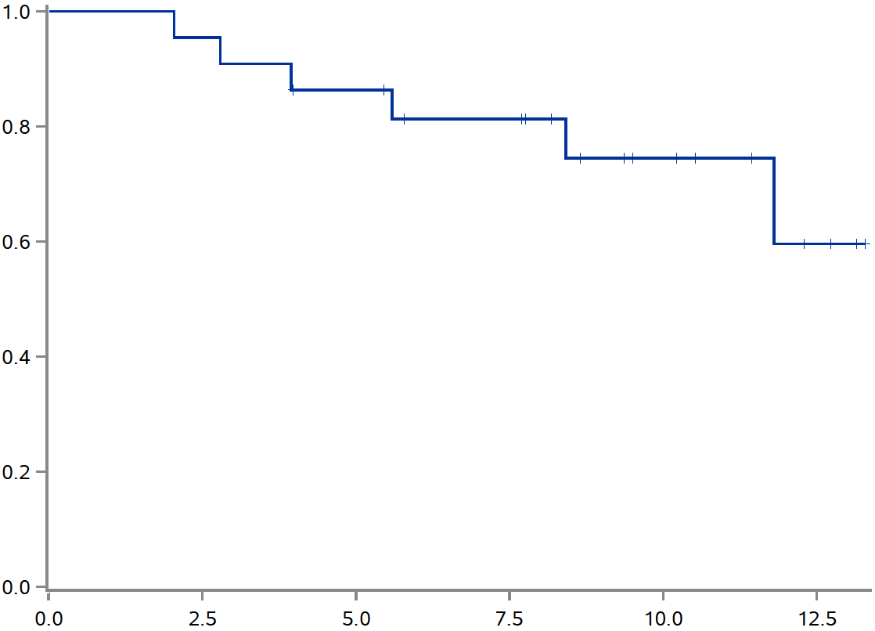
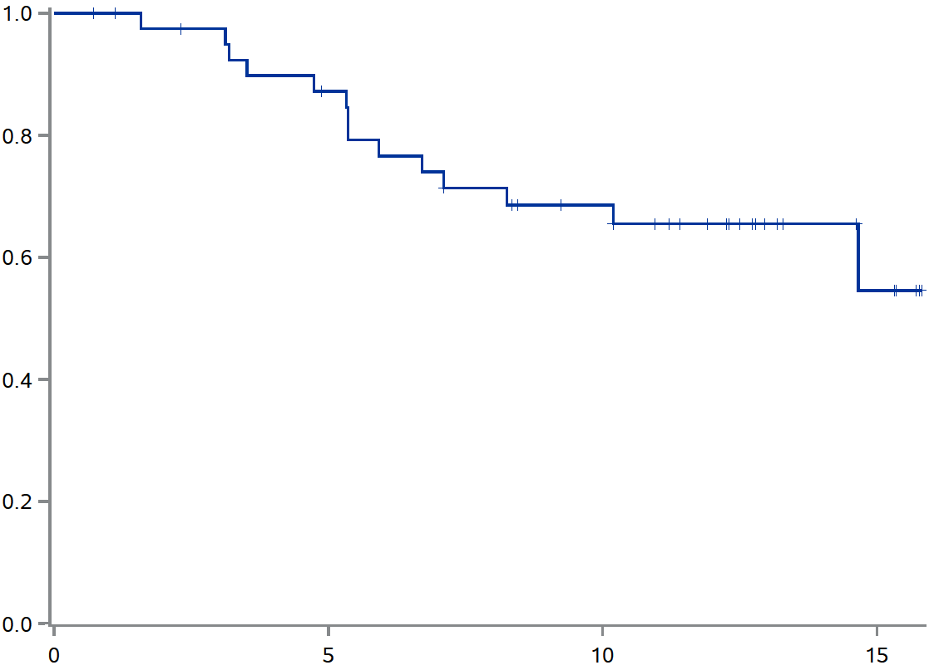
Umbralisib:
DoR and PFS
Interim Efficacy Population
Dor and PFS by Investigator Assessment
Duration of Response (N=22)
Progression-Free Survival (N=42)
Proportion in Response
Proportion Progression-Free
Median DoR not reached
(95% CI: 8.4 mos – NE)
Median PFS not reached
Estimated PFS at 12 months was 66%
Months
Months
CI, confidence interval; DoR, duration of response; NE, not evaluable; PFS, progression-free survival
Fowler NH, et al. Oral presentation at AACR 2019.

Slide 63



Conclusions
The prolonged natural history of iNHL highlights the attractiveness of effective yet well tolerated therapy
  Is chemotherapy-free truly an advantage or an attractive term?
In the US, patients play a role in treatment decisions for better or worse
  The oncologist’s role is to educate and inform that treatment decision
There is a critical need for observational studies to address the most effective sequencing of therapy, the impact on QoL, and the natural history of iNHL in the era of chemotherapy-free options
  Are we sacrificing efficacy for the sake of novelty?
iNHL, indolent NHL; QoL, quality of life

Slide 64
REACH LYMPHOMA CONNECT VIA
TWITTER, LINKEDIN, VIMEO & EMAIL
OR VISIT THE GROUP’S WEBSITE http://www.lymphomaconnect.info
Follow us on Twitter
@lymphoma_connec
Follow the
LYMPHOMA CONNECT
group on LinkedIn
Watch us on the
Vimeo Channel
LYMPHOMA CONNECT
Email
froukje.sosef
@cor2ed.com

Slide 65
Dr. Antoine Lacombe
Pharm D, MBA
Phone: +41 79 529 42 79
antoine.lacombe@cor2ed.com
Dr. Froukje Sosef
MD
Phone: +31 6 2324 3636
froukje.sosef@cor2ed.com

