Slide 2
Early-onset colorectal cancer
Prof. Hans Prenen
Medical Oncologist, University Hospital Antwerp, Antwerp, Belgium
Dr Renata D’Alpino Peixoto
Medical Oncologist, Centro Paulista de Oncologia, São Paulo, Brazil

Slide 3
Disclaimer and disclosures
Please note: The views expressed within this presentation are the personal opinions of the author. They do not necessarily represent the views of the author’s academic institution or the rest of the GI CONNECT group.
This content is supported by an Independent Educational Grant from Bayer.
Prof. Hans Prenen has no relevant financial relationships to disclose
Dr Renata D’Alpino Peixoto has no relevant financial relationships to disclose

Slide 4
EDUCATIONAL OBJECTIVE AND Clinical takeaway
Educational objective
Help healthcare professionals understand special considerations for the management of colorectal cancer (CRC) in younger patients
CLINICAL TAKEAWAY
The incidence of early-onset colorectal cancer (EOCRC) is rising globally for reasons including an increasingly westernised diet, obesity, and alterations in the gut microbiota
EOCRCs are more commonly left-sided and present with rectal bleeding and abdominal pain
Aggressive treatment regimens based solely on patient age at CRC diagnosis are not warranted

Slide 5
definition and epidemiology

Slide 6
Definition of eocrc and Epidemiology
EOCRC is generally accepted to be any CRC diagnosis at age <50 years, as this is the age at which most national screening programmes commence
The median age of CRC diagnosis dropped from 72 years in the early 2000s to 66 years today
Incidence of EOCRC has risen sharply since 1988 from 7.9 to 12.9 cases in 2015 per 100,000 people in the United States
In contrast to LOCRC (better screening?)
Approximately 12% of all new diagnoses will be in individuals age <50 years, the equivalent of 49 new cases per day
By 2030, 1 in 10 colon cancers and 1 in 4 rectal cancers will be diagnosed in individuals age <50 years
Key question is whether EOCRC and LOCRC are the same disease, and if EOCRC is caused by a unique underlying mechanism that is impacted by different risk factors
Most EOCRC studies are retrospective and include small number of patients
CRC, colorectal cancer; EOCRC, early- onset colorectal cancer; LOCRC, late-onset colorectal cancer
Akimoto N, et al. Nat Rev Clin Oncol. 2021;18:230-43; American Cancer Society. Colorectal Cancer Facts & Figures 2020-2022. Available from: www.cancer.org/content/dam/cancer-org/research/cancer-facts-and-statistics/colorectal-cancer-facts-and-figures/colorectal-cancer-facts-and-figures-2020-2022.pdf. Accessed November 2022; Bailey CE, et al. JAMA Surg. 2015;150:17-22; REACCT Collaborative. JAMA Surg. 2021;156:865-74; Siegel RL, et al. Gut 2019;68:2179-85; Siegel RL, et al. CA Cancer J Clin. 2020;70:145-64; Sinicope FA, et al. N Engl J Med. 2022;386:1547-58; Surveillance, Epidemiology, and End Results (SEER) Program. Available from: https://seer.cancer.gov/data/. Accessed November 2022; Vuik FE, et al. Gut. 2019;68:1820-6
6

Slide 7
Incidences of EOCRC are increasing worldwide
Age-standardised incidence rate during 2008-2012
for CRC among adults age 20-49 years²
Incidence rate ratio by birth cohort in the United States¹
Korea (5 registries)
Australia
USA, SEER (9 registries)
Slovakiaª
Japan (4 registries)
New Zealand
Netherlands
Canada^{b}
Norway
Croatia
Slovenia
Ireland
Brazil, Goiania
Italy (8 registries)
Israel
Cyprus
Spain (9 registries)
Germany (2 registries)
Kuwait: Kuwait^{c}
Sweden
Bulgaria
Denmark
United Kingdom
France (9 registries)
Switzerland (6 registries)
Iceland^{c}
Philippines, Manila
Colombia, Cali^{c}
China (5 registries)
Malta
Turkey (2 registries)
Poland, Kielce
Austria
Bahrain, Bahraini^{c}
Estonia
Lithuania
Thailand (4 registries)
Costa Rica^{d}
Ecuador, Quito^{c}
Chile, Valdivia^{c}
Uganda, Kampala^{c} India, Chennai
3.00
2.75
2.50
2.25
2.00
1.75
Incidence rate ratio
1.50
1.25
Shading indicates trend in incidence rates based on 10-year average annual per cent change
Statistically significant increase
1.00
Statistically significant decrease
Stable or insufficient number of cases for trend analysis (c)
1930
1940
1950
1960
1970
1980
1990
Birth cohort
Rate per 100,000 population
Rate for Finland unavailable.
ª Rate based on data during 2008-2010; ^{b} Excludes Nunavut, Quebec, and Yukon; ^{c} Excluded from trend analysis due to insufficient number of annual cases; ^{d} Rate based on data during 2008-2011.
CRC, colorectal cancer; EOCRC, early-onset colorectal cancer
Adapted from: 1. Stoffel EM, Murphy CC. Gastroenterology. 2020;158:341-53; 2. Siegel RL, et al. Gut. 2019;68:2179-85

Slide 8
EOCRC patients have a higher 5-year survival than patients with locrc for all stages of diagnosis…
CRC: 5-year survival by age and race/ethnicity, 2009-2015
… yet overall survival among patients age <50 years (68%) is similar to that in patients age 50-64 years (69%) because of a later stage at diagnosis
Survival (%)
Cause-specific survival rates are the probability of not dying from colorectal cancer within 5 years of diagnosis.
Rates are based on cases diagnosed from 2009 to 2017, all followed through 2016. Rates for American Indians/Alaska Natives are based on small case numbers, particularly for distant-stage disease.
CRC, colorectal cancer; EOCRC, early-onset colorectal cancer; LOCRC, late-onset colorectal cancer
American Cancer Society. Colorectal Cancer Facts & Figures 2020-2022. Available from: www.cancer.org/content/dam/cancer-org/research/cancer-facts-and-statistics/colorectal-cancer-facts-and-figures/colorectal-cancer-facts-and-figures-2020-2022.pdf. Accessed November 2022; Surveillance, Epidemiology, and End Results (SEER) Program. Available from: https://seer.cancer.gov/data/. Accessed November 2022
Adapted from: American Cancer Society. Colorectal Cancer Facts & Figures 2020-2022.

Slide 9
risk factors

Slide 10
Potential Causes/Risk Factors
Most cases are sporadic
Hereditary syndromes are more frequent in EOCRC vs LOCRC (16-25% vs 10-15%)
Lynch syndrome being the most frequent
Pathogenic germline variants are present in 1 in 6 patients with EOCRC
Incidences of familial syndromes are stable and are not likely contributing to the overall rise in EOCRC cases
Factors affecting the gut microbiome:
Changing dietary habits/westernised diet
More red and processed meat
More refined grains
More processed sugar
Obesity (especially abdominal fat)
Smoking
Sedentary behaviour
Prolonged use of antibiotics
CRC, colorectal cancer; EOCRC, early-onset colorectal cancer; LOCRC, late-onset colorectal cancer
Hur J, et al. Gut. 2021;70:2330-6; Møller P, et al. Gut. 2018;67:1306-316; Nguyen LH, et al. JNCI Cancer Spectr. 2018;2:pky073; REACCT Collaborative. JAMA Surg. 2021;156:865-74; Schumacher AJ, et al. Cancer Epidemiol Biomarkers Prev. 2021;30:1792-8; Sinicope FA, et al. N Engl J Med. 2022;386:1547-58; Tabung FK, et al. JAMA Oncol. 2018;4:366-73; Wan QY, et al. Gut. 2020;69:2059-2060; Yurgelun MB, et al. J Clin Oncol. 2017;35:1086-95; Zheng X, et al. J Natl Cancer Inst. 2021; 113:543-52

Slide 11
Most CRC cases (~80%) are sporadic, regardless of age
Prevalence of pathogenic variants by age at CRC diagnosis
Lynch syndrome | Polyposis syndromes | Other pathogenic variants
 |  | High penetrance | Moderate/low penetrance
MLH1 | APC | BRCA1 | CHEK2
MSH2 | MUTYH | BRCA2 | ATM
MSH6 | SMAD4 | TP53 | NBN
PMS2 | BMPR1A | PALB2 | BARD1
 | PTEN | CDKN2A | BRIP1
 | POLE
CRC, colorectal cancer
Adapted from: Stoffel EM, Murphy CC. Gastroenterology. 2020;158:341-53

Slide 12
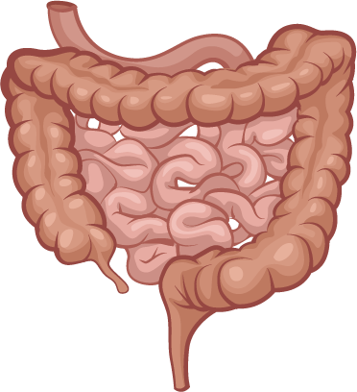
Factors impacting the gut microbiota and the development of EOCRC?
Early-life exposures
Mode of nutritional provision
Breastfeeding
Diet formula
Pre-probiotic supplement
Mode of delivery
Caesarean
Vaginal
Environment
Psychological and/or physical stress
Family environment and pets
Genetics
Antibiotics
2.7 courses by age 2 years
10.9 courses by age 10 years
Maternal infection, disease and/or medication
Maternal nutrition
Maternal stress
Exposomal elements
Global westernisation of diet
Unhealthy cooking practices
Red and processed meats
Synthetic dyes
Monosodium glutamate (MSG)
Titanium dioxide
High-fructose corn syrup
Microbiome development
EOCRC
Immunity and/or inflammation
Obesity
Diabetes
Infancy
Childhood
Adulthood
EOCRC, early-onset colorectal cancer
Adapted from: Hofseth LJ, et al. Nat Rev Gastroenterol Hepatol. 2020;17:352-64

Slide 13
Gut Microbiome
Gut microbes interact with the host immune system and influence the antitumour immune response
Patients with CRC have reduced bacterial diversity compared to healthy persons
Firmicutes, Bacteroidetes, enterotoxigenic Bacteroides fragilis, oral anaerobe Fusobacterium nucleatum are enriched in CRC
There are age-related differences in gut microbial composition
Flavonifractor plautii is an important bacterial species in EOCRC
Genus Streptococcus contains the key phylotype in the LOCRC
CRC, colorectal cancer; EOCRC, early-onset colorectal cancer; LOCRC, late-onset colorectal cancer
Flemer B, et al. Gut. 2017;66:633-43; Garrett WS. Science. 2019;364:1133-5; Ghosh TS, et al. ELife. 2020;9:e50240; Yang Y, et al. Nat Commun. 2021;12:6757

Slide 14
Risk estimates for eocrc vs locrc
Risk Factor |  |  | ORR (95% CI)
BMI | Early-onset CRC Late-onset CRC |  | 1.00 (0.95, 1.05) 1.12 (1.09, 1.14)
Height | Early-onset CRC Late-onset CRC |  | 1.06 (0.98, 1.14) 1.04 (1.01, 1.07)
Pack-years of smoking | Early-onset CRC Late-onset CRC |  | 0.96 (0.92, 1.01) 1.05 (1.03, 1.07)
Sedentary lifestyle | Early-onset CRC Late-onset CRC |  | 1.13 (0.88, 1.44) 1.11 (1.02, 1.22)
Alcohol use (0 g/day) | Early-onset CRC Late-onset CRC |  | 1.23 (1.08, 1.39) 1.20 (1.14, 1.26)
Alcohol use (>28 g/day) | Early-onset CRC Late-onset CRC |  | 1.25 (1.04, 1.50) 1.23 (1.15, 1.32)
Lower educational attainment | Early-onset CRC Late-onset CRC |  | 1.10 (1.04, 1.16) 1.06 (1.04, 1.08)
Diabetes diagnosis | Early-onset CRC Late-onset CRC |  | 1.25 (0.93, 1.68) 1.20 (1.12, 1.28)
Lower total folate intake | Early-onset CRC Late-onset CRC |  | 1.08 (0.98, 1.18) 1.04 (1.01, 1.07)
Lower fruit intake | Early-onset CRC Late-onset CRC |  | 1.01 (0.96, 1.07) 1.06 (1.04, 1.08)
Lower vegetable intake | Early-onset CRC Late-onset CRC |  | 1.00 (0.94, 1.06) 1.01 (0.99, 1.04)
Greater red meat intake | Early-onset CRC Late-onset CRC |  | 1.10 (1.04, 1.16) 1.07 (1.05, 1.10)
Greater processed meat intake | Early-onset CRC Late-onset CRC |  | 1.03 (0.95, 1.12) 1.06 (1.03, 1.09)
Lower total fiber intake | Early-onset CRC Late-onset CRC |  | 1.11 (1.00, 1.23) 1.10 (1.06, 1.14)
Lower total calcium intake | Early-onset CRC Late-onset CRC |  | 1.09 (0.99, 1.19) 1.13 (1.10, 1.16)
No aspirin use | Early-onset CRC Late-onset CRC |  | 1.10 (0.90, 1.34) 1.41 (1.34, 1.48)
No NSAID use | Early-onset CRC Late-onset CRC |  | 1.43 (1.21, 1.68) 1.40 (1.30, 1.51)
0.8
1
1.2
1.4
1.6
1.8
BMI, body mass index; CI, confidence interval; CRC, colorectal cancer; EOCRC, early-onset colorectal cancer; LOCRC, late-onset colorectal cancer; NSAID, nonsteroidal anti-inflammatory drug; OR, odds ratio
Adapted from: Archambault AN, et al. JNCI Cancer Spectr. 2021;5:pkab029

Slide 15
Disease characteristics and diagnosis

Slide 16
Eocrc: Disease Characteristics
More than 70% of EOCRCs are in the left colon at presentation
Higher rates of poorly differentiated tumours and more frequent signet ring cells
Approximately 1 in 5 individuals diagnosed with CRC at age <50 years carries a germline mutation associated with cancer
Higher frequencies of microsatellite instability high (MSI-H; Lynch syndrome)
Higher risk of metachronous disease
EOCRC more likely to be diagnosed at advanced stages (stage III-IV) compared to LOCRC
Significantly longer time to diagnosis and longer duration of symptoms compared to older patients
CRC, colorectal cancer; EOCRC, early-onset colorectal cancer; LOCRC, late-onset colorectal cancer
Akimoto N, et al. Nat Rev Clin Oncol. 2021;18:230-43; Cercek A, et al. J Natl Cancer Inst. 2021;113:1683-92; Chang DT, et al. Mod Pathol. 2012;25:1128-39; Dozois EJ, et al. Medicine (Baltimore). 2008;87:259-63; Meyer JE, et al. Cancer. 2010;116:4354-9; Mork ME, et al. J Clin Oncol. 2015; 33:3544-9; Pearlman R, et al. JAMA Oncol. 2017;3:464-71; Saraste D, et al. Br J Surg. 2020;107:301-9; Stoffel EM, et al. Gastroenterology. 2018;154:897-905.e1

Slide 17
Clinical presentation of eocrc vs LOcrc
Most common symptoms at presentation for EOCRC
Symptoms are frequently attributed to common, benign conditions
Less awareness of CRC:
Young patients
Healthcare providers
Frequency of symptoms (%)
CRC, colorectal cancer; EO, early onset; EOCRC, early-onset colorectal cancer; GI, gastrointestinal; LO, late onset
Adapted from: Cercek A, et al. J Natl Cancer Inst. 2021;113:1683-92

Slide 18
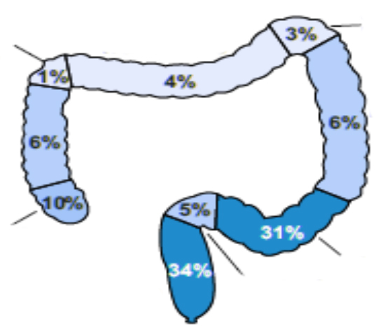
Clinical characteristics are similar regardless of age at onset
Patients (%)
Splenic flexure
0
25
50
75
100
Hepatic flexure
Transverse
EO 14-35
EO 36-49
LO ≥50
Gender
Female
Male
79%
Ascending colon
EO Age 14-35 years
Descending colon
EO 14-35
EO 36-49
LO ≥50
Race
White
Black or African American
Asian or Indian subcontinent
Other Not available
Cecum
Sigmoid
Rectum
Rectosigmoid
BMI
Underweight
Normal
Overweight
Obese Not available
Hepatic flexure
Transverse
Splenic flexure
EO 14-35
EO 36-49
LO ≥50
82%
Ascending colon
EO Age 36-49 years
Descending colon
Age at onset (years)
EO 14-35
EO 36-49
LO ≥50
Smoking status
Never
Ever Not available
Cecum
Sigmoid
Rectum
Rectosigmoid
EO 14-35
EO 36-49
LO ≥50
Stage at diagnosis
Stage I
Stage II
Stage III
Stage IV
Hepatic flexure
Transverse
Splenic flexure
Ascending colon
Descending colon
62%
LO
Average onset
EO 14-35
EO 36-49
LO ≥50
Tumour grade
Well differentiated
Well differentiated to moderately differentiated
Moderately differentiated
Moderately differentiated to poorly differentiated
Poorly differentiated Not available
Cecum
Sigmoid
Rectum
Rectosigmoid
No significant clinical or histological differences EO less likely to be diagnosed early
Higher incidence of left-sided tumours in EOCRC
CRC, colorectal cancer; EO, early onset; EOCRC, early-onset colorectal cancer; LO, late onset
Adapted from: Cercek A, et al. J Natl Cancer Inst. 2021;113:1683-92

Slide 19
Pathological and Molecular Features of EOCRC
Pathological features and molecular profile of EOCRC
Pathological features | Molecular profile
Poor differentiation | Microsatellite stability
Mucinous tumours | More likely to exhibit LINE-1 hypomethylation and TP53 sequence variations
Signet-ring morphology | Less frequently harbour KRAS, BRAF V600E, and APC sequence variations
Perineural/venous invasion | Promoter methylation of CpG islands
EOCRC, early-onset colorectal cancer; LINE-1, long interspersed nuclear elements; TP53, tumour protein 53
Cercek A, et al. J Natl Cancer Inst. 2021;113:1683-92; Lieu CH, et al. Clin Cancer Res 2019;25:5852-8; REACCT Collaborative. JAMA Surg. 2021;156:865-74
Adapted from: REACCT Collaborative. JAMA Surg. 2021;156:865-74

Slide 20
Treatment and qol considerations
QOL, quality of life

Slide 21
Treatment Characteristics of EOCRC
Younger patients with EOCRC are:
More likely to receive more adjuvant treatments
More likely to receive more intense regimens
More likely to complete the planned treatment (and with a high dose intensity)
No apparent OS difference between EOCRC and LOCRC in either initial or advanced settings
After adjusting for staging differences
Attention should be given to long-term cancer survivorship in patients with EOCRC as they face distinct survivorship challenges from older CRC patients
CRC, colorectal cancer; EOCRC, early-onset colorectal cancer; LOCRC, late-onset colorectal cancer; OS, overall survival
Fontana E, et al. J Clin Oncol. 2021;39:4009-19; Jin Z, et al. J Natl Cancer Inst. 2021;113:1693-704; Knuertz PJ, et al. JAMA Surg. 2015; 150:402-9; Lipsyc-Sharf M, et al. J Natl Cancer Inst. 2022;114:427-35

Slide 22
IDEA Database Analyses EOCRC vs LOCRC: Cancer Specific Survival
 |  | EOCRC | LOCRC | Adjusted HR (95% CI) | p value
3-year RFS rate,% | High-risk stage II | 87.6 (84.1-91.3) | 88.0 (86.8-89.2) | 0.98 (0.72-1.34) | 0.91
 | Low-risk stage III (T1-3 N1) | 81.6 (78.0-85.3) | 84.0 (83.0-84.9) | 0.99 (0.80-1.22) | 0.90
 | High-risk stage III (T4 and/or N2) | 54.5 (49.7-59.9) | 64.5 (63.1-65.9) | 0.74 (0.64-0.87) | 0.0003
5-year CSM rate, % | High-risk stage II | 4.8 (2.9-7.8) | 7.6 (6.6-8.7) | 1.38 (0.84-2.27) | 0.21
 | Low-risk stage III (T1-3 N1) | 7.1 (5.1-9.8) | 6.9 (6.3-7.5) | 0.96 (0.70-1.30) | 0.78
 | High-risk stage III (T4 and/or N2) | 23.9 (20.0-28.6) | 20.7 (19.5-21.9) | 0.81 (0.67-0.99) | 0.040
Cancer-specific survival: stage III patients
25
Age, years | Events, n/N | HR (95% CI) | 5-year CSM, % (95% CI)
<50 | 155/958 | Ref. | 21.3 (18.0-25.2)
≥50 | 1,451/10,418 | 0.83 (0.71-0.98) | 17.1 (16.3-18.1)
Stratified Gray K-sample test p value: 0.0317
20
15
10% difference in RFS
Death from colon cancer (%)
10
Higher mortality from CRC in younger patients
5
0
0
1
2
3
4
5
6
7
8
3% difference in CSM
Years from randomisation
No. at risk
958
10,418
919
1,0016
867
9,513
788
8,730
715
7,834
589
6,220
391
4,492
213
2,541
107
1,325
CI, confidence interval; CRC, colorectal cancer; CSM, cancer-specific mortality; EOCRC, early-onset colorectal cancer; HR, hazard ratio; LOCRC, late-onset colorectal cancer; RFS, recurrence-free survival
Adapted from: Fontana E, et al. J Clin Oncol. 2021;39:4009-19 (ASCO 2021, oral presentation)

Slide 23
Treat by stage not by age
Relative survival by age at diagnosis¹
5-year relative survival (%)
Aggressive treatment regimens based solely on the age at diagnosis are not warranted²
1. Siegel RL, et al. CA Cancer J Clin. 2020;70:145-64; 2. Cercek A, et al. J Natl Cancer Inst. 2021;113:1683-92
Adapted from: Siegel RL, et al. CA Cancer J Clin. 2020;70:145-64

Slide 24
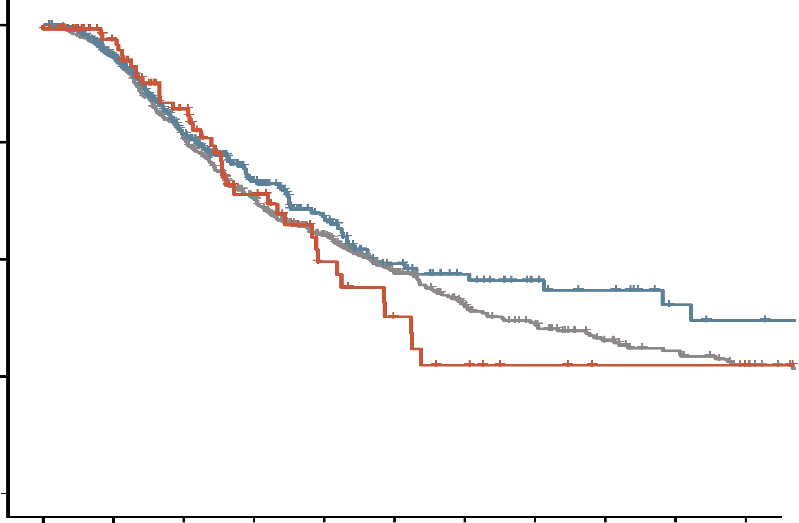
outcomes are similar REGARDLESS OF AGE OF ONSET
Best response to first-line chemotherapy at time of metastasis
100
100
75
75
Survival (%)
50
First-line response (% )
LO age > 50 years
EO age 36-49 years
EO age 14-35 years
50
25
25
Log-rank test p value = 0.18
0
0
12
24
36
48
60
72
84
96
108
120
0
Months from metastasis
EO age 14-35 years
LO age >50 years
No. of cases at risk
574 | 529 | 417 | 320 | 230 | 149 | 103 | 85 | 63 | 53 | 42
455 | 349 | 210 | 120 | 73 | 46 | 34 | 24 | 19 | 12 | 10
110 | 85 | 56 | 33 | 18 | 11 | 7 | 4 | 2 | 2 | 1
EO age 36-49 years
Not available
No response
Any response
EO, early onset; LO, late onset
Adapted from: Cercek A, et al. J Natl Cancer Inst. 2021;113:1683-92

Slide 25
EOCRC vs LOCRC: No difference in survival despite favourable baseline characteristics and higher treatment intensity
HRs for OS and PFS by age (N=2,326)
Outcome and analysis | Age <50 years | Age ≥50 years | p value
OS Events/patients, n/n Median OS, months (95% CI) Unadjusted HR (95% CI) Multivariable adjusted HR (95% CI)^{c} | 416/514 27.07 (25.04-30.06) 0.92 (0.82-1.02) 0.98 (0.88-1.10) | 1,557/1,812 26.12 (24.94-27.30) Ref. Ref. | – 0.12ª 0.12^{b} 0.78^{b}
PFS Events/patients, n/n Median PFS, months (95% CI) Unadjusted HR (95% CI) Multivariable adjusted HR (95% CI)^{c} | 473/514 10.87 (9.99-11.50) 0.98 (0.88-1.08) 1.02 (0.92-1.13) | 1,700/1,812 10.55 (10.12 to 10.94) Ref. Ref. | – 0.67ª 0.67^{b} 0.67^{b}
ORR, n (%) | 297 (57.8) | 1,009 (55.7) | 0.40^{d}
ª p values and associated median OS and PFS were calculated using the Kaplan-Meier method. All tests were 2-sided ^{b} p values for hazard ratios were calculated in corresponding Cox model. All tests were 2-sided ^{c} Adjusted with Cox proportional hazards analysis for patient sex (male vs female), race (white vs black vs other), Easter Cooperative Oncology Group performance status (0 vs 1 to 2), primary tumour location (right and transverse colon vs left colon vs unknown), primary tumour unresected (no vs yes), prior radiation (no vs yes), prior adjuvant chemotherapy (no vs yes), KRAS mutation status (wild-type vs mutant vs unknown), diabetes (no vs yes, as reported in a diet and lifestyle questionnaire), BMI at study entry (<21 vs 21 to <25 vs 25 to <30 vs 30 to <35 vs ≥35 kg/m², 3 patients with missing BMI were recoded into the majority category in 25 to <30 kg/m², protocol chemotherapy received (FOLFIRI vs mFOLFOX6), and arm of trial (bevacizumab vs cetuximab vs dual-antibody therapy) ^{d} p value for the ORR is based on 2-sided 𝜒² test
BMI, body mass index; CI, confidence interval; EOCRC, early-onset colorectal cancer; FOLFIRI, leucovorin, fluorouracil, and irinotecan; HR, hazard ratio; LOCRC, late-onset colorectal cancer; mFOLFOX6, leucovorin, fluorouracil and oxaliplatin; ORR, objective response rate; OS, overall survival; PFS, progression-free survival; Ref., referent
Adapted from: Lipsyc-Sharf M, et al. J Natl Cancer Inst. 2022;114:427-35

Slide 26
Screening and prevention
Implications and benefits of prevention efforts for early-onset cancers
CRC screening
The increasing incidence of CRC in younger populations recently led to the United States lowering the age of CRC screening from age 50 years to age 45 years
It was projected that this could prevent 29,400 CRC cases and 11,100 deaths over the next five years but at a cost of $10.4 billion
Cost-effective screening solutions are required
Promote healthy lifestyles from childhood
Implement healthy school meal programmes
Promote sustainable healthy food production and distribution systems
Public health authorities and policy makers
General communities
Increase awareness of early-onset cancers and promote hospital visits and referrals
Educate parents and school teachers to promote healthy lifestyles
Healthcare professionals
Prevention of other diabetes including later-onset cancers, cardiovascular disease and diabetes
New screening strategies
Identify novel risk factors
Primary prevention and early detection of early-onset cancers
Identify hereditary cancer syndromes by genetic testing and perform appropriate screening
CRC, colorectal cancer
Ugai T, et al. Nat Rev Clin Oncol. 2022;19:656-73; Ladabaum U, et al. Gastroenterology 2019; 157: 137-148
Adapted from: Ugai T, et al. Nat Rev Clin Oncol. 2022;19:656-73

Slide 27
The psychosocial impact of eocrc
Challenges for people with EOCRC
Emotional Distress
Worsening anxiety
Embarrassment with bowel movements
Low mood
Financial burden
Premature confrontation with mortality
Physical Burden
CRC has a unique and damaging stigma
Bowel movements
Digestive/GI symptoms
Ostomy bags
Sleeping disorders
Impact on body image and intimacy
Reproductive health and family planning
Social impact
Time away from family due to treatment
Physical symptoms affect interpersonal relationships
Difficulties coping with children
The need for family members to provide care to patient
Inability to perform social roles
Work impact
Impact on ability to perform role
Most are juggling various roles
Marriage/partnerships
Caring responsibilities
Career
Education
CRC, colorectal cancer; EOCRC, early-onset colorectal cancer; GI, gastrointestinal
Khoo A, et al. Cancer Medicine 2022; 11: 1688-1700; Eng C, et al. Lancet Oncol 2022; 23: e116–28

Slide 28
summary

Slide 29
summary
The incidence of EOCRC is rising globally, but the reason for this is unclear
Potential risk factors include a westernised diet, obesity, antibiotics and alterations in the gut microbiome
Patient with EOCRC tend to present with advanced disease stage and unfavourable histopathological features
Lower awareness of CRC, lack of screening, an underappreciation of symptoms, and reluctance to seek medical care may contribute to delayed diagnosis and advanced stage at diagnosis
EOCRCs are more commonly left-sided and present with rectal bleeding and abdominal pain, but are otherwise clinically and genomically indistinguishable from LOCRCs
Although genetic predisposition plays a role in EOCRC, most cases are sporadic
Survival data are limited and conflicting; despite accessing more neoadjuvant and adjuvant therapy, patients with EOCRC appear to have oncological outcomes equivalent to those of older counterparts
Aggressive treatment regimens based solely on the age at CRC diagnosis are not warranted
More clinical trials in this population are required
CRC, colorectal cancer; EOCRC, early-onset colorectal cancer; LOCRC, late-onset colorectal cancer
Akimoto N, et al. Nat Rev Clin Oncol. 2021;18:230-43; Cercek A, et al. J Natl Cancer Inst. 2021;113:1683-92; REACCT Collaborative. JAMA Surg. 2021;156:865-74

Slide 30
REACH GI CONNECT VIA TWITTER, LINKEDIN, VIMEO & EMAIL OR VISIT THE GROUP’S WEBSITE https://giconnect.cor2ed.com/
Follow us on Twitter @giconnectinfo
Follow the GI CONNECT group on LinkedIn
Watch us on the Vimeo Channel GI CONNECT
Email louise.handbury @cor2ed.com

