Slide 1

WELCOME TO EXPERTS
KNOWLEDGE SHARE
DIALOGUE BETWEEN THE HEART AND THE BRAIN

Slide 2


DISCLAIMER AND DISCLOSURES
Please note: The views expressed within this presentation are the personal opinions of the authors. They do not necessarily represent the views of the authors academic institutions, or COR2ED.
This programme is supported by an Independent Educational Grant from Amgen.
The experts have received financial support/sponsorship for research support, consultation, or speaker fees from the following companies:
Prof. Gilles Montalescot: Abbott, Amgen, AstraZeneca, Ascendia, Bayer, BMS, Boehringer-Ingelheim, Boston-Scientific, Celecor, CSLBehring, Idorsia, Lilly, Novartis, Novo, Opalia, Pfizer, Quantum Genomics, Sanofi, Terumo.
Prof. Charlotte Cordonnier: Research fundings for the institution or honoraria's:, Biogen, Amgen, BMS-Pfizer, Bayer
Prof. Roberto Ferrari: Speaker’s Bureau: Merck Serono, Novartis, Servier, International, Lupin, SunPharma. Advisory Board: Merck Serono, Amgen, Abbott, Servier International

Slide 3
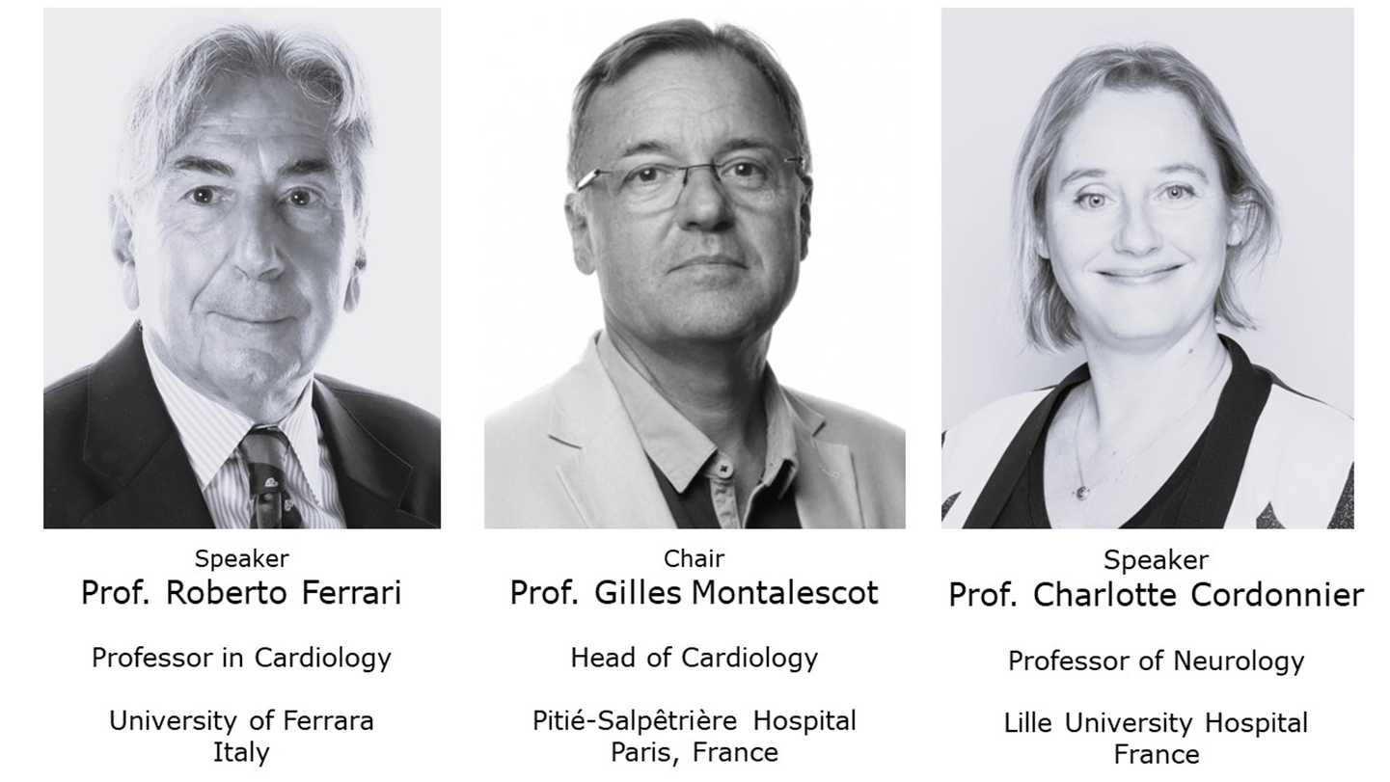
Expert panel

Slide 4
Cardiology: a story of success!
Life expectancy has increased by 10 years overall
Developments in cardiology have contributed 7 of those 10 years!
Oncology has contributed only a couple of months
  3.1 months at best
Ferrari R, et al. Eur Heart J. 2009; 30: 2415-2426

Slide 5
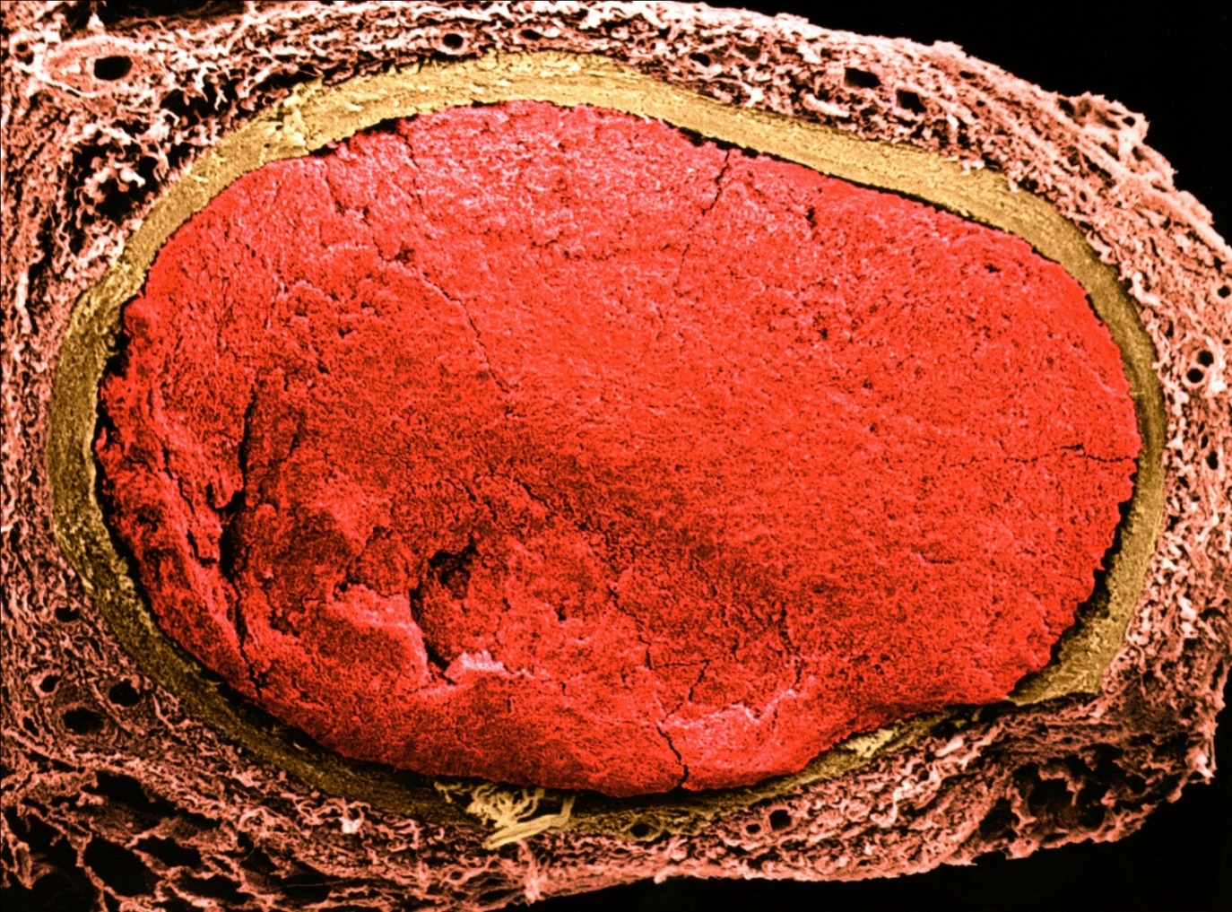
Few developments in the field of cardiology
where we have won!
The thrombus is the cause,
not the consequence, of infarction thrombolytics and mechanical reperfusion of AMI
AMI, acute myocardial infarction
Guardigli, et al. Eur J Prev Cardiol. 2022. DOI: 10.1093/eurjpc/zwab218; Ferrari R, et al. Nat Rev Cardiol. 2016;13(8):493-501

Slide 6
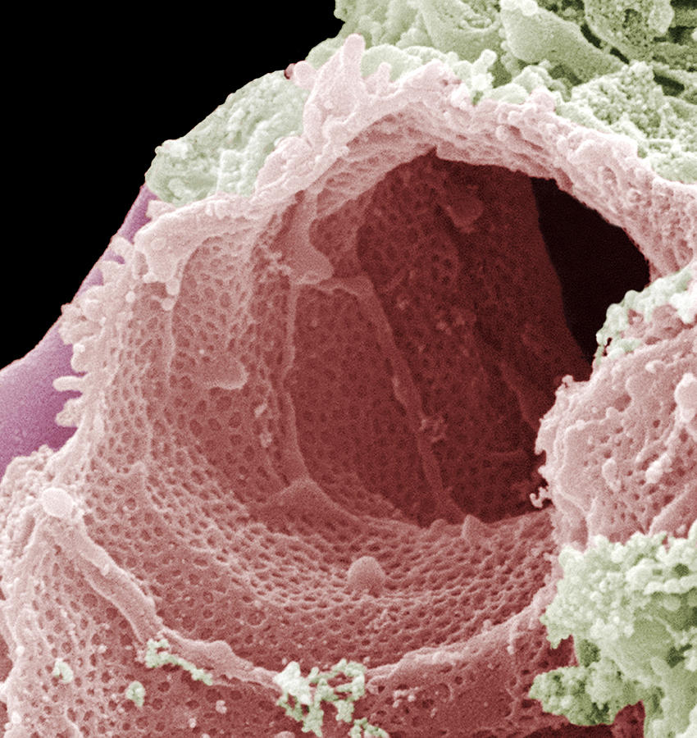
Other Developments in the field of cardiology
where we have won!
The deleterious role of cholesterol, LDL-C, hypertension, diabetes,
and inflammation in the CV continuum
Statins, ACE inhibitors, SGLT2 inhibitors, and antibody-based therapies, all acting on the endothelium
ACE, angiotensin converting enzyme; CV, cardiovascular; LDL-C, low-density lipoprotein cholesterol; SGLT2, sodium-glucose co-transporter 2
Guardigli, et al. Eur J Prev Cardiol. 2022. DOI: 10.1093/eurjpc/zwab218; Ferrari R, et al. Nat Rev Cardiol. 2016;13(8):493-501

Slide 7
Cardiology: A success...
Successes vs partial successes in cardiology
… BUT A partial success
In Europe, one heart attack every
26 seconds
One CV death per minute
1.9 million deaths per year
We have not reduced CV death, we have postponed it
We have transformed an “acute” pathology into a “chronic” pathology
CV, cardiovascular

Slide 8
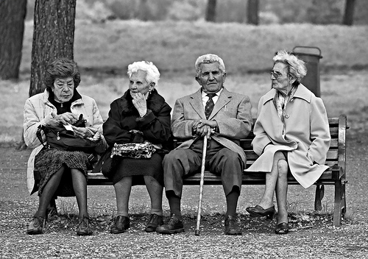
In practice
We have just contributed to population ageing…
… and to an increase in healthcare and research costs

Slide 9
Acute vs preventative care in cardiology
Cardiologists are excellent in treating acute ischaemia according to a “hub-and-spoke network” model with primary coronary angioplasty/percutaneous coronary intervention
However, cardiologist are less efficient in the proper management of cardiovascular prevention
This is bad, as Mendelian randomised clinical trials have shown the power of prevention

Slide 10
Combined Effect of LDL-c and SBP on MVE Events
N=14,368 MVEs
SBP genetic score | LDL-C effect size | SBP effect size |  | OR_{MVE} (95% CI)
Both LDL-C and SBP scores below median | −12.2 mg/dL | −3.1 mmHg |  | 0.542 (0.509-0.577) | p=9.6×10⁻⁸³
LDL-C score below median | −12.1 mg/dL | 0.2 mmHg |  | 0.758 (0.715-0.804) | p_{(diff)}=1.4×10⁻¹⁴
SBP score below median | 0.3 mg/dL | −3.0 mmHg |  | 0.821 (0.779-0.865) | p_{(diff)}=1.8×10⁻²³
OR
0.40
0.50
0.60
0.70
0.80
0.90
1.0
1.10
CI, confidence interval; LDL-C, low-density lipoprotein cholesterol; MVE, major vascular event; OR, odds ratio; OR_{MVE}, odds ratio major vascular event;
SBP, systolic blood pressure
Ference B, et al. ESC 2016. Abstract #3163. Oral presentation

Slide 11
Effect of 1 mmol/L lower LDL-C and 10 mmHg lower SBP on Major Cardiovascular Events: We could prevent 85% of CVD
OR_{MVE}: 0.139 (0.114-0.170)
per 1.0 mmol/l lower LDL-C
and 10 mmHg lower SBP
90%
SBP and LDL-C have independent, multiplicative and cumulative effects on CV risk
Proportional risk reduction (SE)
60%
30%
OR_{MVE}: 0.542 (0.509-0.577)
per 0.31 mmol/l lower LDL-C
and 3.1 mmHg lower SBP
Lower LDL-C (mmol/L)
Lower SBP (mmHg)
0
0
0.25
2.5
0. 5
5
0.75
7.5
1.0
10
CV, cardiovascular; CV, cardiovascular disease; LDL-C, low-density lipoprotein cholesterol; OR_{MVE}, odds ratio major vascular event; SBP, systolic blood pressure;
SE, standard error
Ference B, et al. ESC 2016. Abstract #3163. Oral presentation

Slide 12
Cardiology Clinical Case

Slide 13
clinical case
A case in which we, the cardiologists, did well in acute coronary syndromes but badly in CVD prevention
“The brain” contributed to worsen the situation…
…but stimulated an interaction with the neurologist
CVD, cardiovascular disease

Slide 14
Patient profile and case history
A 68-year-old man with previous appendectomy
Family history:
  Father with hypertension, diabetes mellitus, ischaemic stroke
  Brother with an inherited cardiac condition
Prostatic hypertrophy for 10 years treated with tamsulosin
Former smoker (15 cigarettes a day)

Slide 15
At the clinic
High blood pressure despite several treatments
SBP: 140-170 mmHg
DBP: 90-95 mmHg
Beta-blockers and diuretics
Stopped due to bradycardia
Dihydropyridines and diuretics
Stopped due to peripheral oedema
At the time of the visit, treated with ACE inhibitors
Sporadic cough at full dose
Patient is also taking aspirin (self-medication)
ACE, angiotensin converting enzyme; DBP, diastolic blood pressure; SBP, systolic blood pressure

Slide 16
Examination
Weight: 96 kg
Height: 185 cm
BMI: 26.9
Abdominal circumference: 106 cm
Normal heart sound
No peripheral oedema
Normal peripheral pulses
BMI, body mass index

Slide 17
Instrumental examination
Ocular fundus
Stage 2 hypertensive retinopathy
ECG
Sinus rhythm 80 bpm, ST alteration
Echocardiography
LV hypertrophy, small enlargement of left atrium
Normal ventricular function
ECG, electrocardiogram; LV, left ventricular

Slide 18
Blood test
Erythrocytes: 4.2 million/mm³
Haematocrit: 44.0%
Haemoglobin: 12.6%
Leukocytes: 5.1%
Sodium: 140 mmol/L
Potassium: 4.3 mmol/L
Serum creatinine: 1.0 mg/dL
Total cholesterol: 284 mg/dL
HDL-C: 48 mg/dL
LDL-C: 210 mg/dL
Triglycerides: 130 mg/dL
AST: 15 U/L
ALT: 16 U/L
Microalbuminuria
Urine examination negative
Clearance creatinine: 83 mg/dL
ALT, alanine aminotransferase; AST, aspartate aminotransferase; HDL-C, high-density lipoprotein cholesterol; LDL-C, low-density lipoprotein cholesterol
Notes:
Il problema della scarsa aderenza del paziente al trattamento, rilevante soprattutto nel caso della patologie croniche, è noto sin dagli albori della medicina

Slide 19

Poll question 1:
WHAT IS THE CV RISK ON THE BASIS OF THE SCORE2 PROJECT?
Low
Moderate
High ✅
Very high
CV, cardiovascular; ESC, European Society of Cardiology
SCORE2 working group and ESC Cardiovascular risk collaboration. Eur Heart J. 2021;42:2439-54

Slide 20
What did we do?
Suggested accurate BP control and monitoring, together with repetition of the lipid profile and microalbuminuria
Drug-therapy modification:
  Combination of candesartan/hydrochlorothiazide (16 mg/12.5 mg)
BP, blood pressure

Slide 21
neurology Clinical Case

Slide 22
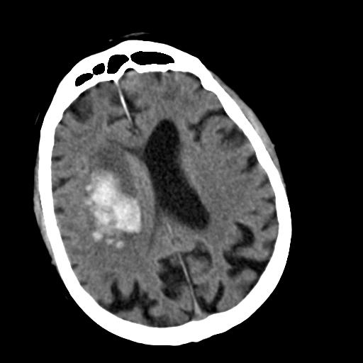
Neurology case: Suddenly…
Suddenly, he presents with left hemiplegia and a slight phasic disorder on the tennis court
His friend immediately calls emergency services. Upon arrival at the emergency department, the clinical examination reveals moderate left hemiplegia at all three levels (arm, face and leg)
His blood pressure is measured at 165/95 mmHg
Provided by: Prof. Charlotte Cordonnier

Slide 23
Poll question 2:
What immediate actions should be taken?
Lower the blood pressure as quickly as possible ✅
Platelet transfusion
Administer intravenous tranexamic acid
Surgically evacuate the intracerebral haemorrhage

Slide 24
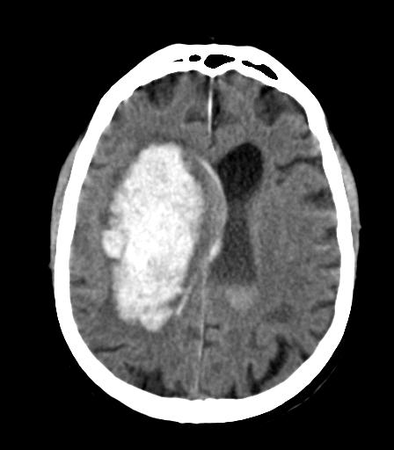
5 hours later
Time is brain

Slide 25
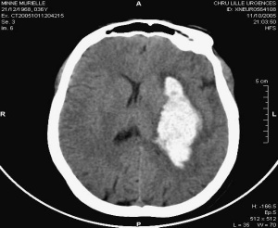
A frequent problem- ICH associated with antithrombotics
Registre PITCH
15% of non-traumatic ICH occur in patients taking oral anticoagulants¹
26% of non-traumatic ICH occur in patients taking antiplatelet agents²
ICH associated with antithrombotic use have a worse prognosis³
CC
2019
CC
2021
ICH, intracerebral haemorrhage
1. Dequatre-Ponchelle N, et al. Stroke. 2013;44:350–5; 2. Pasquini M, et al. Stroke. 2014;45:2643–8; Baharoglu MI, et al. Front Neurol. 2021; 12: 684476

Slide 26
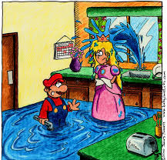
How can we fight against haematoma expansion?
Act on haemostasis
  Yes – if confirmed haemostatic disorders (anticoagulation)
  No – if ICH under antiplatelet therapy
  (Lancet 2016) → No platelet transfusions
Maybe Haemostatic agents? (tranexamic acid, desmopressin)
ICH, intracerebral haemorrhage
Baharoglu MI, et al. Lancet. 2016; 387:857–64

Slide 27
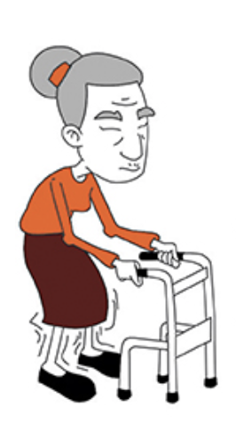
Blood pressure management: After Ich
Control blood pressure
A 10 mmHg decrease in systolic blood pressure
A 10% increase in the probability of a better functional prognosis
Target systolic blood pressure: 130 mmHg
As soon as possible
Demonstration of a concept – No specific agent
Monitor « Door to Needle » & « Door to Target »
Moullaali TJ, et al. Lancet Neurol. 2019; 18:2605–13

Slide 28
Poll question 3:
The patient has improved clinically. What is your prescription at discharge?
Suspend antiplatelet agents for 6 months
Avoid Statins
Administer blood pressure-lowering treatment ✅

Slide 29




Proportions re-starting anti-thrombotic drugs after ICH varies among countries
Re-initiation of anti-thrombotic drugs among ICH survivors
Proportions re-starting anti-thrombotic drugs
469 survivors at discharge had taken antithrombotic drugs
236 with
previous APD
206 with
previous VKA
27 with
previous APD and VKA
11%
15%
18%
204 (86%)
stopped APD
153 (75%)
stopped VKA
16 (59%)
stopped VKA
and APD
Amsterdam
Utrecht
Overall proportion of restarting: 20%
32 (14%) restarted APD
29 (14%) restarted VKA
23 (11%) were switched to APD
1 (0.5%) restarted VKA and APD
8 (30%) restarted APD only
2 (7%) restarted VKA only
1 (4%) restarted VKA and APD
Proportions in whom anti-thrombotic drugs were restarted differed according to cohort of origin
p<0.001
20%
45%
APD, antiplatelet drug; VKA, vitamin K antagonist
Pasquini M, et al. Stroke. 2014;45:2643–8

Slide 30

Provided by: Prof. Al-Shahi Salman

Slide 31
Incidence of major ischemic and haemorrhagic events after intracerebral haemorrhage
MAJOR ISCHAEMIC EVENTS
MAJOR HAEMORRHAGIC EVENTS
0.30
0.30
0.25
0.25
Deep
0.20
0.20
Cumulative incidence
Cumulative incidence
Lobar
0.15
0.15
0.10
Lobar
0.10
0.05
0.05
Deep
0.00
0.00
0
1
2
3
4
5
6
7
8
0
1
2
3
4
5
6
7
8
Follow-up (years)
Follow-up (years)
Patients at risk for
major ischaemic events
Patients at risk for
major haemorrhagic events
Lobar
Deep
115
195
92
142
84
127
78
114
73
103
61
88
50
80
35
68
24
51
Lobar
Deep
115
195
88
150
82
136
78
127
75
118
63
108
51
99
37
84
27
61
Death
0
56
75
84
96
117
132
149
162
Death
0
56
75
84
96
117
132
149
162
CC
2021
Deep and lobar refer to the location of the ICH
Casolla B, et al. Stroke. 2019; 50:1100-7

Slide 32
There is no such thing as a primary ICH
Deep perforating vasculopathy Haematoma located in the basal ganglia or brainstem; microbleeds or old intracerebral haemorrhage in the basal ganglia or brainstem; white matter lesions; lacunes
Cerebral amyloid angiopathy Lobar intracerebral haemorrhage; cortico-subcortical microbleeds; cortical superficial siderosis; apolipoprotein E 𝛆4; cognitive decline; transient focal neurological episodes
Brain arteriovenous malformation Extension to other brain compartments; flow voids; calcification
intracerebral arterial aneurysm Disproportionate subarachnoid extension
Cavernous malformation Small, homogeneous intracerebral haemorrhage with no extension to other brain compartments
intracerebral venous thrombosis Headaches preceding intracerebral haemorrhage onset; intracerebral haemorrhage close to sinuses or veins; high relative oedema volume; onset in pregnancy or postpartum
Dual arteriovenous fistula Subarachnoid or subdural extension; abnormal dilated cortical vessels
Haemorrhagic transformation of cerebral infarction Substantial areas of acute ischaemic lesions adjacent to the intracerebral haemorrhage or diffuse acute ischaemic lesions in other arterial territories
Severe clotting factor deficiency such as haemophilia Abnormal coagulation tests
Tumour (primary/metastasis) Large perihaematomal oedema
Vasculitis Headaches; small acute ischemic lesions in different arterial territories; focal diffuse arterial stenosis
Infective endocarditis Acute ischaemic lesions in different arterial territories; small irregular arterial aneurysms; diffuse brain microbleeds
Posterior reversible encephalopathy syndrome Thunderclap headaches; parietal and occipital asymmetrical oedematous lesions
ICH, intracerebral haemorrhage
Cordonnier C, et al. Lancet. 2018; 392:1257–68

Slide 33
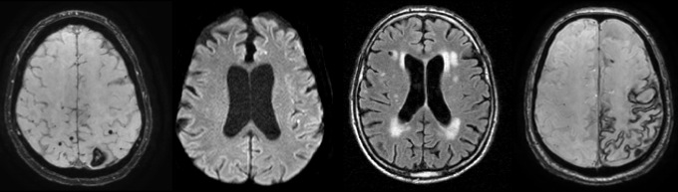
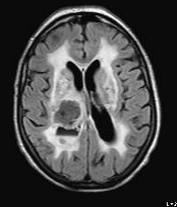
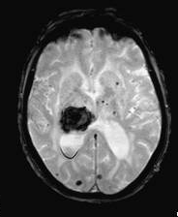
The 2 most frequent causes of ICH
CEREBRAL AMYLOID ANGIOPATHY
SMALL-VESSEL DISEASE
ICH, intracerebral haemorrhage
Provided by: Prof. Charlotte Cordonnier

Slide 34
EFFECTS OF ANTIPLATELET THErAPY AFTER STROKE DUE TO INTRACEREBRAL HAEMORRHAGE (RESTART): a randomised, open-label trial
RESTART Collaboration
Kaplan-Meier plot of the first occurrence of recurrent symptomatic intracerebral haemorrhage
100
Avoid
Start
90
80
Start vs avoid antiplatelet therapy:
adjusted HR 0.51 (95% CI 0.25-1.03);
p=0.060
70
60
Participants with recurrent
symptomatic intracerebral
haemorrhage (%)
50
40
30
20
10
0
0
1
2
3
4
Number at risk (number cumulative events)
Avoid
Start
Follow-up time (years)
268 (0)
268 (0)
184 (18)
190 (8)
121 (23)
122 (12)
73 (23)
72 (12)
22 (23)
25 (12)
Numbers at risk refer to survivors under follow-up at the start of each year according to treatment allocation. Cumulative events indicate the participants in follow-up with a first event
CI, confidence interval; HR, hazard ratio
RESTART Collaboration. Lancet. 2019;393:2613-23

Slide 35
TAKE HOME MESSAGE
Investigate the cause of the ICH to assess the haemorrhagic risk versus ischaemic risk
Strict control of blood pressure +++++ as quickly as possible
Resumption of aspirin allowed – when?
Lipid-lowering treatments: statins and PCSK9 inhibitors
Neurological follow-up as patients are at high risk of cerebrovascular recurrence, functional decline, and cognitive decline
ICH, intracerebral haemorrhage; PCSK9, proprotein convertase subtilisin/kexin type 9

Slide 36
Six months later…a cardiology case

Slide 37
Six months later…
Improvement from the previous stroke
All other parameters are unchanged
ECG and echocardiogram are unchanged
BP under control (135/80 mmHg)
BP, blood pressure; ECG, electrocardiogram
Notes:
Il problema della scarsa aderenza del paziente al trattamento, rilevante soprattutto nel caso della patologie croniche, è noto sin dagli albori della medicina

Slide 38
Exams
Eco doppler of the supra-aortic trunks:
  Diffuse thickening of the intima, no stenosis
Lab tests:
  Albumin: creatinine ratio of 34 mg/g (urine microalbuminuria)
  All other parameters unchanged:
    Total cholesterol: 276 mg/dL
    LDL-C: 203 mg/dL
    HDL-C: 48 mg/dL
    Triglycerides: 124 mg/dL
HDL-C, high-density lipoprotein cholesterol; LDL-C, low-density lipoprotein cholesterol
Notes:
Il problema della scarsa aderenza del paziente al trattamento, rilevante soprattutto nel caso della patologie croniche, è noto sin dagli albori della medicina

Slide 39
Poll question 4:
WHAT IS THE TARGET FOR LDL-C?
<75 mg/dL
<65 mg/dL
<55 mg/dL ✅
<50 mg/dL
LDL-C, low-density lipoprotein cholesterol

Slide 40
Drugs for secondary prevention: reduction of atherosclerosis progression
“Good”
New target for LDL-C reduction:
  ≤55 mg/dL even with ezetimibe on top of statins when necessary
PCSK9 inhibitors in high-risk patients
ACE inhibitors in high-risk patients
ARBs in case of ACE inhibitor intolerance (without definition)
“Good”
“Good”
“Bad”
ACE, angiotensin-converting-enzyme; ARB, angiotensin-II receptor blocker; LDL-C, low-density lipoprotein cholesterol; PCSK9, proprotein convertase subtilisin/kexin type 9

Slide 41
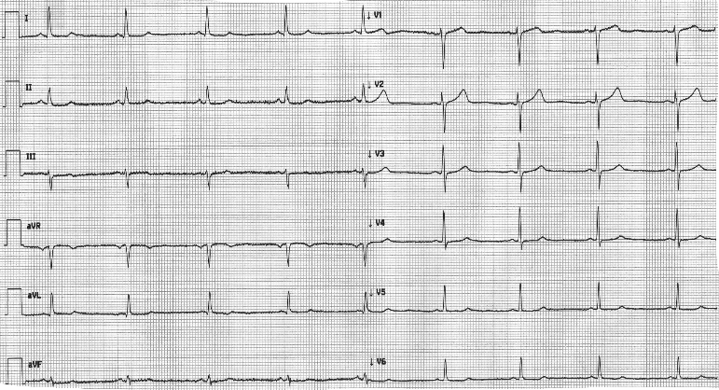
ECG
Sinus rhythm, cardiac frequency: 62 bpm
ECG, electrocardiogram
Notes:
Il problema della scarsa aderenza del paziente al trattamento, rilevante soprattutto nel caso della patologie croniche, è noto sin dagli albori della medicina

Slide 42
In January of 2022
Severe prolonged chest pain at home
Admission to the cath-lab with a diagnosis of anterior myocardial infarction
  Diagnosis was made in the ambulance and remotely confirmed
Time from pain to cath-lab: 1 hour 20 minutes
Treated with primary angioplasty

Slide 43
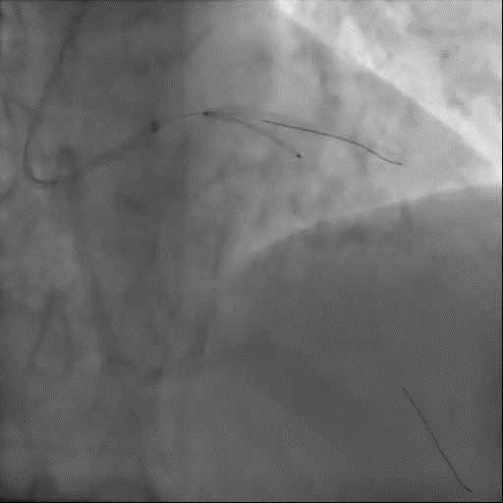
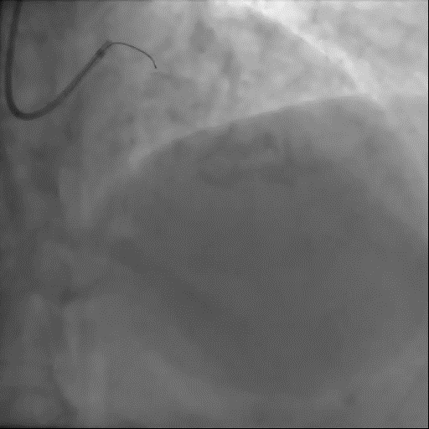
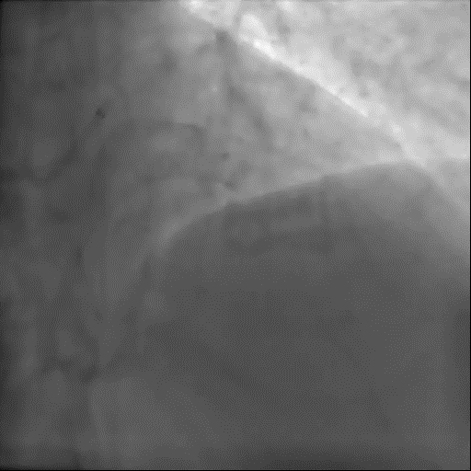
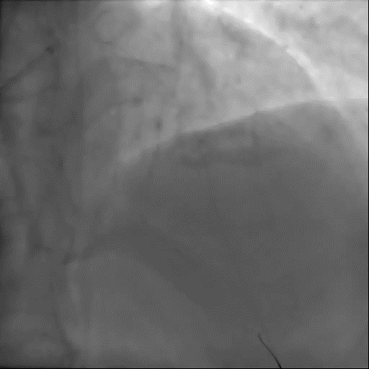

Slide 44
Discharge
Uncomplicated course, discharged with:
  Candesartan/hydrochlorothiazide: 16 mg/12.5 mg 1 capsule at 08:00
  Bisoprolol: 5 mg 1 capsule at 08:00
  Lercanidipine: 10 mg ½ capsule at 22:00
  Atorvastatin: 40 mg 1 capsule in the evening
  Tamsulosin: 0.4 mg at 20:00
  Aspirin: 100 mg after lunch
  Clopidogrel: 75 mg 1 capsule at 12:00
Request to continuously control BP
Lipid assessment after three months
BP, blood pressure
Notes:
Il problema della scarsa aderenza del paziente al trattamento, rilevante soprattutto nel caso della patologie croniche, è noto sin dagli albori della medicina

Slide 45
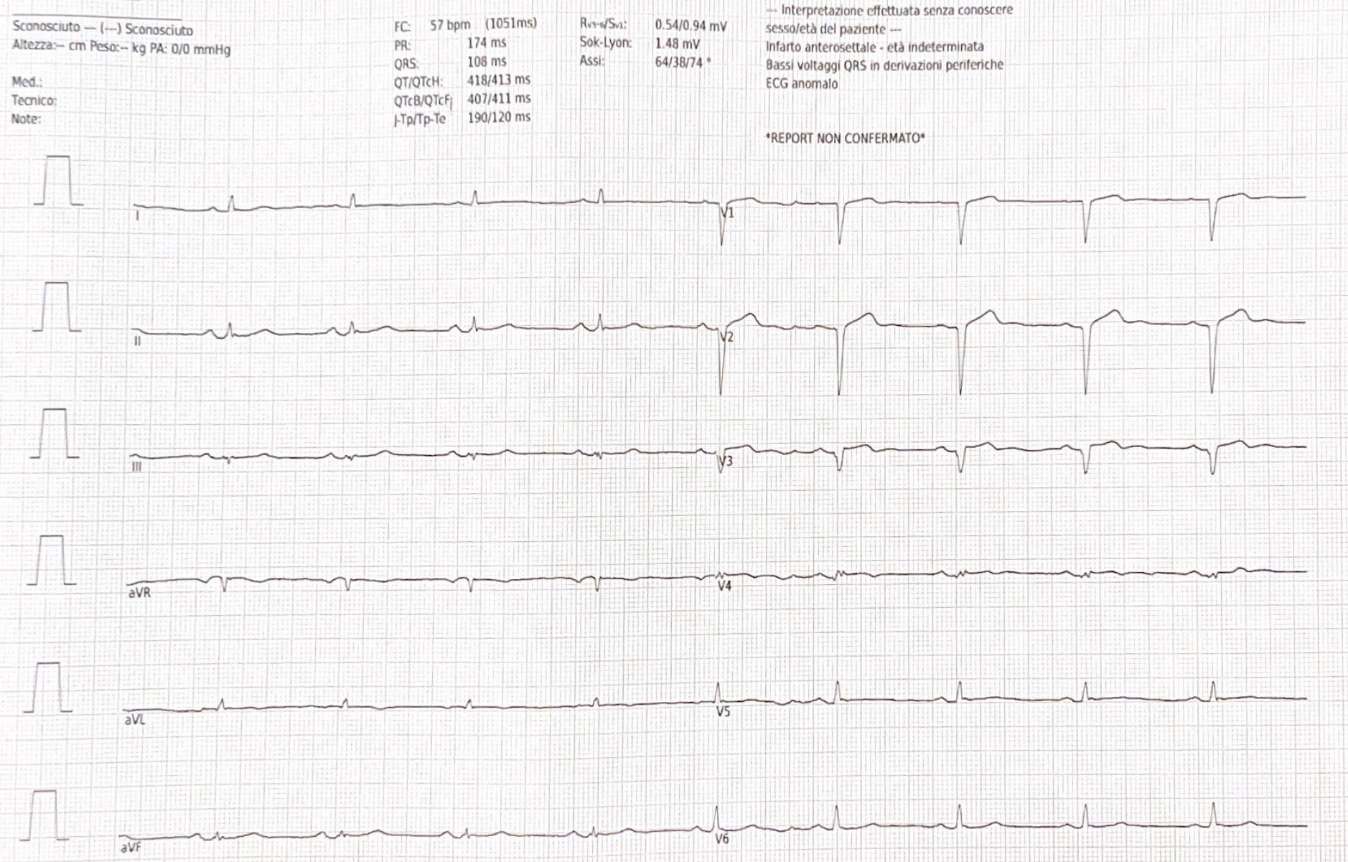
ECG
ECG, electrocardiogram

Slide 46
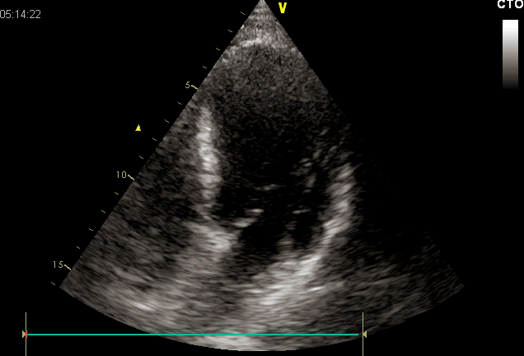
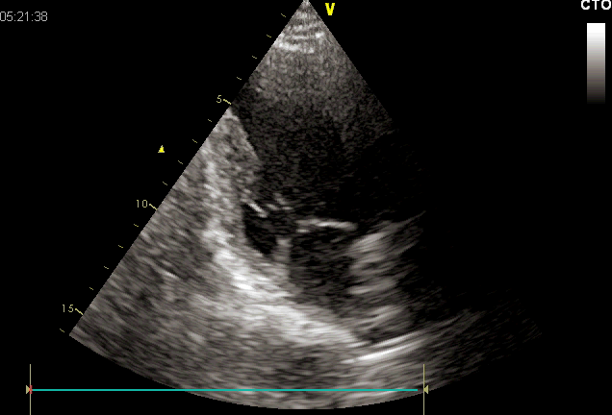
Ejection fraction: 40-45% left-ventricular hypertrophy (mild)

Slide 47
ESC 2019 guidelines for Chronic Coronary Syndromes: what’s new for treatment?
Lifestyle improvement is recommended in addition to drug treatment
Drug treatment for both event prevention and control of symptoms is recommended
Detailed recommendations for antiplatelet and anticoagulant therapy are available
ESC, European Society of Cardiology
Knuuti J, et al. Eur Heart J. 2020;41:407-77

Slide 48
Drugs for prevention: thrombus formation
“Good”
“Good”
“Good”
“Good”
Aspirin for all
Addition of a second anti-thrombotic in high-risk patients in sinus rhythm
NOAC preferred to VKA in AF and post-IMA
Dual therapy with prasugrel or ticagrelor over clopidogrel
AF, atrial fibrillation; IMA, acute myocardial infarction; NOAC, non-VK antagonist oral anticoagulants; VKA, vitamin K antagonists

Slide 49
6 months later
Reasonable wellbeing:
  No chest pain
  No dyspnoea
BP under control
Blood tests within normal parameters
  Exceptions:
    Total cholesterol: 144 mg/dL
    LDL-C: 85 mg/dL
    HDL-C: 37 mg/dL
    Triglycerides: 112 mg/dL
BP, blood pressure; HDL-C, high-density lipoprotein cholesterol; LDL-C, low-density lipoprotein cholesterol
Notes:
Il problema della scarsa aderenza del paziente al trattamento, rilevante soprattutto nel caso della patologie croniche, è noto sin dagli albori della medicina

Slide 50
Suggestions
Substitute atorvastatin 40 mg with a fixed combination of rosuvastatin/ezetimibe
(20 mg/10 mg)
All the other medications should be maintained
Notes:
Il problema della scarsa aderenza del paziente al trattamento, rilevante soprattutto nel caso della patologie croniche, è noto sin dagli albori della medicina

Slide 51
A few weeks later…a neurology case

Slide 52
A Few weeks later…
Admission to the emergency department for aphasia and transient motor deficit
Diagnosis: TIA
A telephone call was initiated with the neurologist
TIA, transient ischaemic attack
Notes:
Il problema della scarsa aderenza del paziente al trattamento, rilevante soprattutto nel caso della patologie croniche, è noto sin dagli albori della medicina

Slide 53
Suddenly…
The patient suddenly presents with right hemiparesis (face, arm and leg) associated with paraesthesia for 5 minutes
After that, he felt perfectly normal and continued to walk the dog
He mentions this incident at your outpatient clinic the day after. He had an appointment to check on his blood pressure

Slide 54
Poll Question 5:
What would you do?
Prescribe clopidogrel on top of aspirin while waiting for a neurology consult
Request a CT scan as soon as possible
Refer the patient to the emergency department ✅
CT, computed tomography

Slide 55

Transient ischaemic attack (TIA) presentation
Assume stroke in any patient with sudden, focal neurological deficit, until proven otherwise
TIA is an emergency
Duration: usually less than 1 hour…often less than 5 minutes
hr, hour; min, minute; TIA, transient ischaemic attack

Slide 56
What is not a TIA?
Non-focal signs are NOT compatible with a stroke
Isolated alteration of consciousness/decreased vigilance
Isolated dizziness
Isolated confusion
Generalized weakness
Lipothymia (near-fainting)
Isolated amnesia
Non-focal
signs/symptoms

Slide 57
Sudden, focal, neurological deficit is an emergency
Could it be a transient ischaemic attack?
Importance of education:
Healthcare providers effective at identifying at-risk individuals
Patient/public awareness - can recognise and identify of main symptoms
Often neglected due to:
  absence of pain
  transient symptoms
  lack of awareness of risks

Slide 58
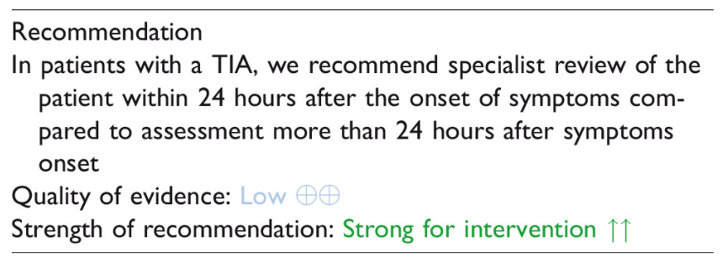
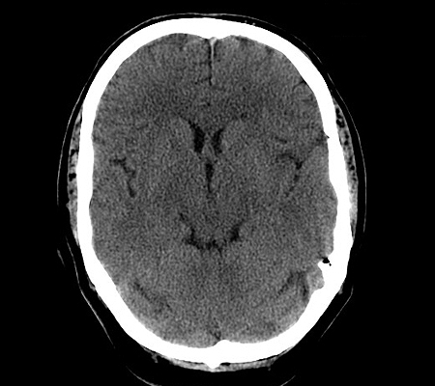
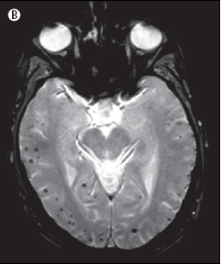
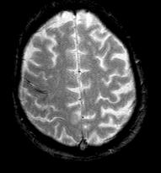
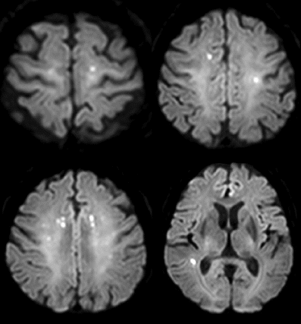
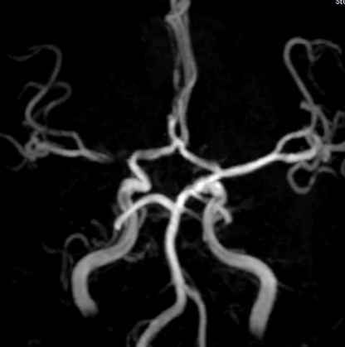
MANAGEMENT
European Stroke Organisation guidelines
Management within 24 hours
Imaging
  To confirm the diagnosis and initiate aetiological
  assessment
  CT scan→ INSUFFICIENT
Expert consensus statement In suspected TIA patients, to confirm ischaemic pathophysiology of transient neurological symptoms, where it will influence treatment and/or there is a diagnostic uncertainty, 8/9 experts suggest to use MR (multimodal) or CT perfusion, if feasible, instead of non-contrast CT.
CT, computed tomography; MR, magnetic resonance; TIA, transient ischaemic attack
Fonseca AC, et al. Eur Stroke J. 2021; 6:CLXIII-CLXXXVI

Slide 59
Poll question 6:
WHICH IS THE POSSIBLE CAUSE OF THE TIA?
Cardiac embolism → mitral regurgitation visible on echocardiography
Ischaemia → visible on exploration of the carotid artery
Atrial fibrillation → according to Holter monitor assessment, event-loop monitoring
All of the above ✅
TIA, transient ischaemic attack

Slide 60
TIA can be prevented by…?
Poll question 7:
Better BP control
Better lipid control
More communication with the patient
All of them ✅

Slide 61
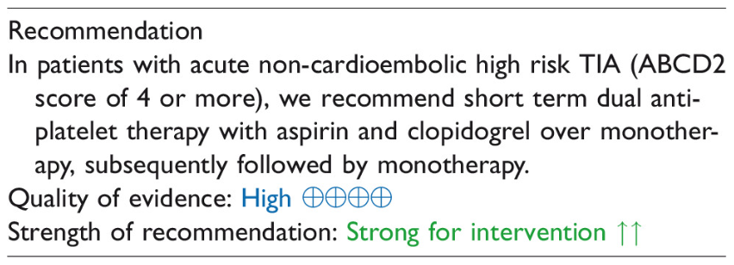
Management
European Stroke Organisation guideline
If high-risk TIA confirmed:
Initiate aspirin-clopidogrel combination (21 days)
Atheromatous cause
  On the same side as the carotid lesion
    Echo + MRA or angiogram
    Discussion of endarterectomy
    Yes, if within 15 days of the deficit
    Beyond that – if 50% stenosis, debatable...
  Intensification of lipid-lowering treatment
  Screening and control of other risk factors
MRA, magnetic resonance angiogram; TIA, transient ischaemic attack
Fonseca AC, et al. Eur Stroke J. 2021; 6:CLXIII-CLXXXVI

Slide 62




PANEL DISCUSSION
AND QUESTIONS?

