Slide 2
GU CONNECT animated video
Clinical implementation of testing and PARPi monotherapy, and the patient journey for prostate cancer patients
Dr Neal Shore, MD, FACS
Carolina Urologic Research Center and Chief Medical Officer for Genesis Care, USA
JULY 2023
PARPi, poly-ADP ribose polymerase inhibitors

Slide 3
Educational objectives
Recognise the efficacy and safety profiles of PARP inhibitors, know their differences and understand the place of PARP inhibitor monotherapy in the treatment landscape for patients with mCRPC
Understand the role of testing for assessment of HRRm status and subsequent decision making for treatment with PARP inhibitors as monotherapy
HRRm, homologous recombinant repair gene mutations; mCRPC, metastatic castration-resistant prostate cancer; PARP, poly-ADP ribose polymerase

Slide 4
Clinical takeaways
PARP inhibitors are effective drugs as monotherapy in mCRPC patients with HRR alterations
Genetic testing is important to inform on prognosis, help with treatment decision making and for understanding inherited risk
BRCA mutations are associated with poor outcomes in mCRPC patients
Patients with tumours harbouring BRCA1/BRCA2 alteration appear to derive the greatest clinical benefit from PARP inhibitor monotherapy, but patients with other HRR alterations might also derive benefit
BRCA1/2, breast cancer gene 1/2; HRR, homologous recombinant repair gene; mCRPC, metastatic castration-resistant prostate cancer; PARP, poly-ADP ribose polymerase

Slide 5

Developed by GU COnnect
This programme is developed by GU CONNECT,
an international group of experts in the field of
genitourinary oncology.
Acknowledgement and disclosures:
This GU CONNECT programme is supported through an independent Educational Grant from AstraZeneca.
The programme is therefore independent, the content is not influenced by the supporter and is under the sole responsibility of the experts.
Please note: The views expressed within this presentation are the personal opinions of the authors. They do not necessarily represent the views of the authors academic institutions, or the rest of the GU CONNECT group. The patient case used in this resource is based on constructed cases with representative data for learning purposes.
Expert Disclaimers:
Dr Neal Shore has received financial support/sponsorship for research support, consultation, or speaker fees from the following companies:
Abbvie, Astellas, Amgen, AstraZeneca, Bayer, BMS, Boston Scientific, Clarity, Clovis Oncology, Cold Genesys, Dendreon, Exact Imaging, Exact Sciences, FerGene, Foundation Medicine, Genesis Care, Invitae, Janssen, Lantheus, Lilly, MDxhealth, Merck, Myovant, Myriad, Nymox, Pacific Edge, Pfizer, Phosphorous, Photocure, Propella, PreView, Sanofi Genzyme, Sema4, Speciality Networks, Sesen Bio, Telix, Tempus, Tolmar and Urogen, Vaxiion.

Slide 6
Prostate cancer landscape: Treatment options

Slide 7
THE PROSTATE CANCER LANDSCAPE is complicated!
Docetaxel
Treatment sequencing decisions are complex
Patients with mCRPC should receive as many life-prolonging therapies as possible
Abiraterone
Enzalutamide
Apalutamide
Darolutamide + docetaxel
NEWLY
DIAGNOSED
mHSPC
PRIMARY
PROGRESSIVE
mHSPC
LOCALISED OR LOCALLY
ADVANCED
PROSTATE CANCER
BIOCHEMICAL
RECURRENCE
mCRPC
TERMINAL DISEASE
(DEATH)
nmCRPC
Docetaxel
All options added to ADT
Cabazitaxel
Enzalutamide
Abiraterone
Apalutamide
Enzalutamide
Darolutamide
Radium-223
ªFixed dose combination of the two treatments
ADT, androgen deprivation therapy; mHSPC, metastatic hormone sensitive prostate cancer; (n)mCRPC, (non-)metastatic castration resistant prostate cancer
Sipuleucel-T
Pembrolizumab
Olaparib ± abiraterone
Niraparib + abirateroneª
1. Abiraterone acetate PI; 2. Abiraterone acetate SmPC; 3. Enzalutamide PI; 4. Enzalutamide SmPC; 5. Apalutamide PI; 6. Apalutamide SmPC; 7. Docetaxel PI; 8. Docetaxel SmPC; 9. Darolutamide PI; 10. Darolutamide SmPC; 11. Cabazitaxel PI; 12. Cabazitaxel SmPC; 13. Radium Ra 223 dichloride PI; 14. Radium Ra 223 dichloride SmPC; 15. Olaparib PI; 16. Olaparib SmPC; 17. Sipuleucel-T PI; 18. Pembrolizumab PI; 19. Rucaparib PI; 20. Rucaparib SmPC; 21. Lutetium Lu 177 vipivotide tetraxetan PI. All accessed April 2023; 22. https://www.esmo.org/oncology-news/ema-recommends-granting-a-marketing-authorisation-for-akeega-fixed-dose-combinations-of-niraparib-abiraterone-acetate
Rucaparib
Lutetium-617

Slide 8





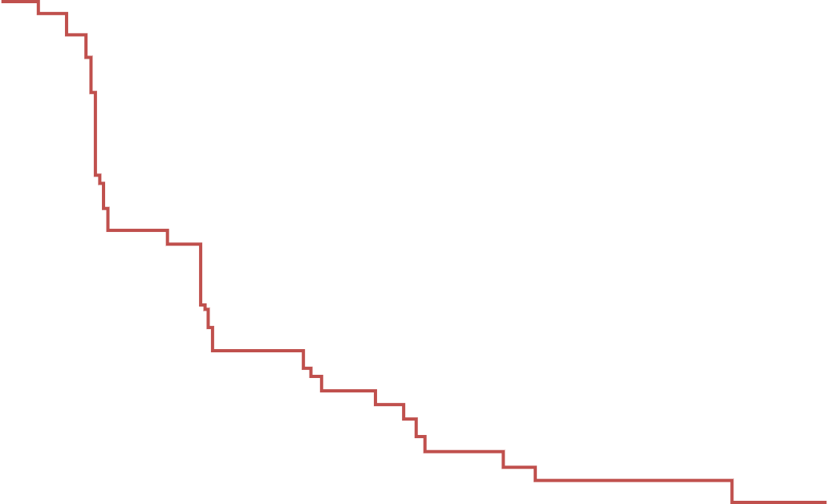
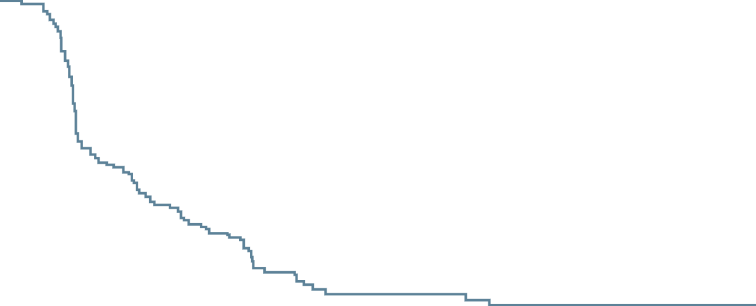
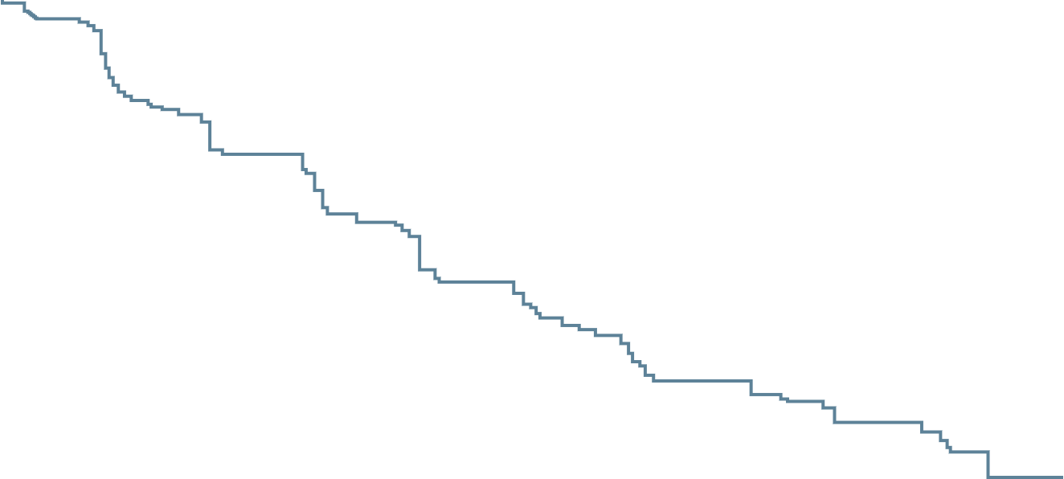
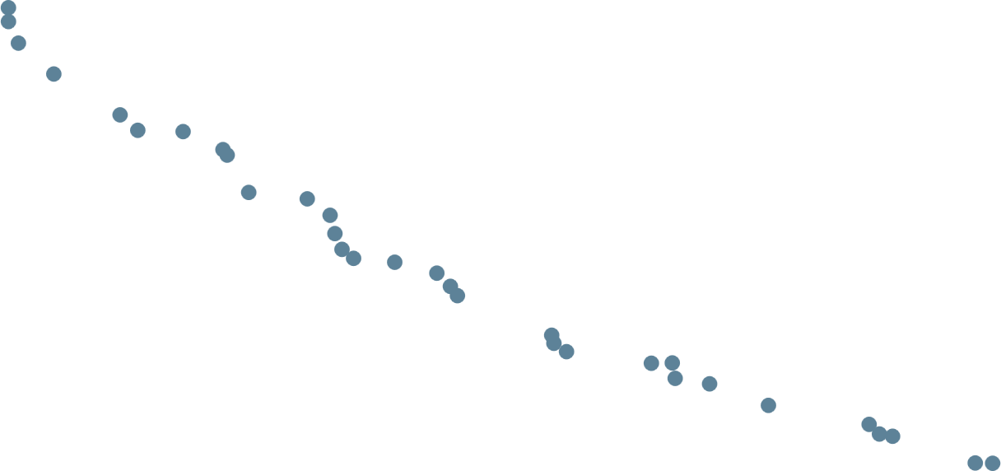

Treatments with different moas offer greater benefit than Sequential use of NHAs^{1,2}
PROfound: rPFS in Cohort A¹
CARD: imaging-based PFS²
1.0
100
 | Cabazitaxel | Androgen-signalling-targeted inhibitor
Median imaging‑based PFS | 8.0 (5.7–9.2) | 3.7 (2.8–5.1)
HR (95% CI) | 0.54 (0.40–0.73) P<0.001
 | Olaparib | Abiraterone | Enzalutamide
Median rPFS (months) | 7.4 | 3.5 | 3.6
HR (95% CI) |  | 0.35 (0.24-0.51) | 0.33 (0.21-0.52)
0.8
80
0.6
60
Probability of rPFS
Percentage of patients with PFS
0.4
40
0.2
20
0
0
0
3
6
9
12
18
24
30
0
1
2
3
4
5
6
7
8
9
10
11
12
13
14
15
16
17
18
19
20
Months
Time from randomisation (months)
PROfound compared olaparib with either abiraterone or enzalutamide in patients previously treated with NHA¹
Olaparib was more beneficial in improving rPFS and OS irrespective of the choice of NHA¹
CARD compared cabazitaxel with abiraterone or enzalutamide in patients with mCRPC previously treated with DOC and the alternative NHA²
In the control arm, the response rate and the duration of response to a second NHA were poor²
CI, confidence interval; DOC, docetaxel; HR, hazard ratio; mCRPC, metastatic castration resistance prostate cancer; NHA, new hormonal agent; OS, overall survival; PFS, progression-free survival; rPFS, radiographic PFS
1. Saad F, et al. Presented at AUA 2021. 10–13 September. Abstract 21-5996. 2. De Wit R, et al. N Engl J Med. 2019;26:381:2506-18.

Slide 9
DNA Damage repair mutations and genetic testing

Slide 10
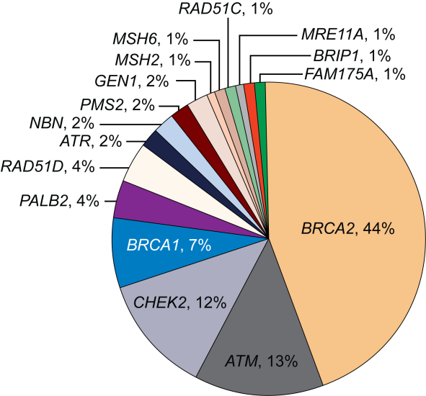
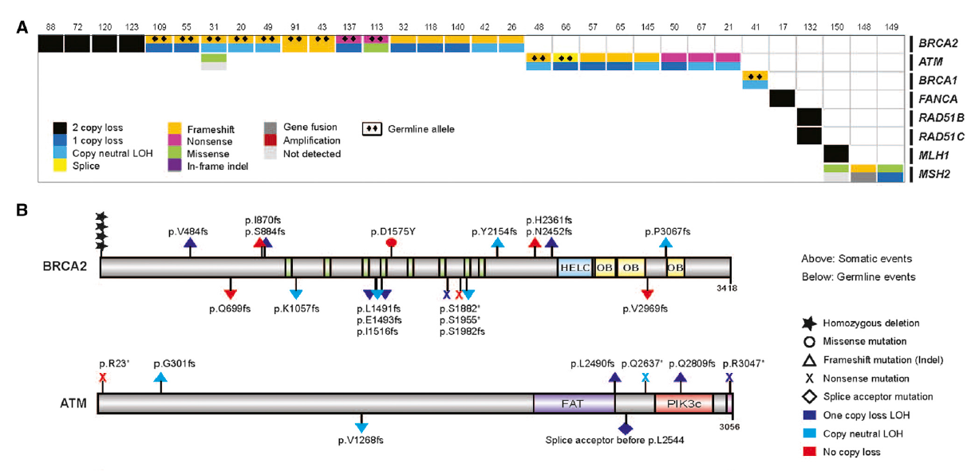
DNA damage-repair mutations occur in approximately a quarter of mCRPC patients
Somatic
Germline
~23% of men with mCRPC have DNA repair pathway aberrations
The incidence of DNA repair alterations is higher in men with metastatic prostate cancer than those with localised disease
~12% of men with metastatic prostate
cancer have germline mutations in one or more of the 16 DNA repair genes
LOH, loss of heterozygosity; mCRPC, metastatic castration resistant prostate cancer; PC, prostate cancer
1. Robinson D, et al. Cell. 2015;161:1215-28; 2. Pritchard CC, et al. N Engl J Med. 2016;375:443-53; 3. Antonarakis ES, et al. Eur Urol. 2018;74:218-25

Slide 11
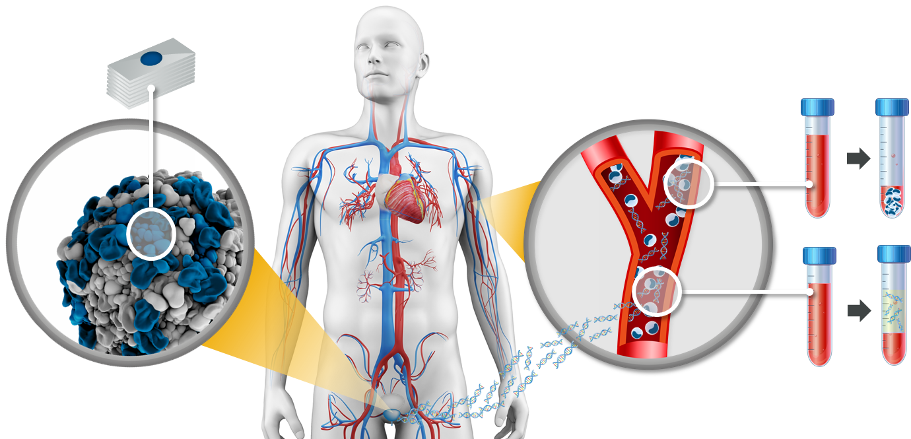
There are several ways to identify BRCA / HRR mutations in prostate cancer
Tissue testing
(Whole) blood testing
Somatic + germline
Germline
Somatic + germline
Plasma (ctDNA) testingª
ªTumour cells shed DNA into the circulation through necrosis or apoptosis. ctDNA can be isolated from a plasma sample
BRCA, breast cancer gene; ctDNA, circulating tumour DNA; HRR, homologous recombination repair
1. Cheng HH, et al. J Natl Compr Canc Netw. 2019;17:515-21; 2. Haber DA, Velculescu VE. Cancer Discov. 2014;4:650-61

Slide 12
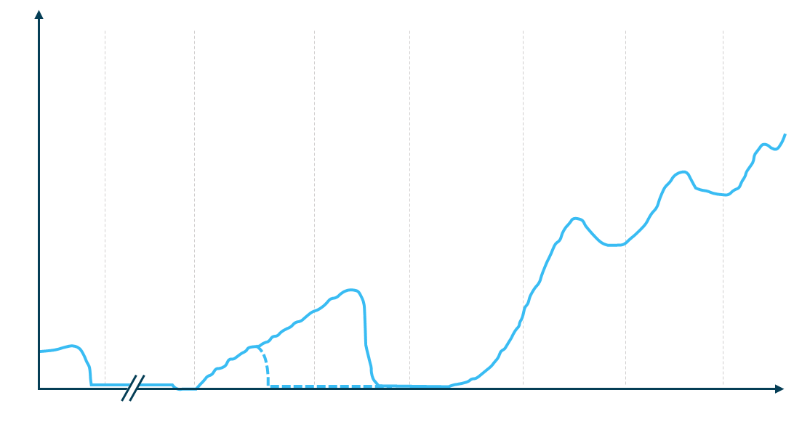
Considerations for when to test for HRRm are included in international guidelines
ESMO^{1,2}
Recommended for BRCA2 and other DDR genes associated with cancer predisposition in patients with family history of cancer
Should be considered in all patients with metastatic prostate cancer
Primary
Adjuvant
Biochemical recurrence
mHSPC
(inc. de novo)
1L
mCRPC
2L
mCRPC
3L
mCRPC
Consider HRRm and MSI dMRR testing in patients with mCRPC
EAU/EANM/ESTRO/ESUR/ISUP/SIOG³
Non-metastatic CRPC
Men with metastatic PCa;
Men with high-risk PCa and a family member diagnosed with PCa at age <60 years;
Men with multiple family members diagnosed with csPCa at age <60 years or a family member who died from PCa cancer;
Men with a family history of high-risk germline mutations or a family history of multiple cancers on the same side of the family.
Tumour testing
PSA
Consider HRRm and dMRR testing in all patients with mPC
Germline testing
NCCN⁴
Metastatic, regional (node positive), very-high-risk localised, or high-risk localised PCa
Family history of certain cancers
Known family history of familial cancer risk mutation
Personal history of breast cancer
Consider HRRm testing in patients with mPC
AUA/SUO⁵
Time
Testing for DDR, MSI dMMR, TMB and other potential mutations in mCRPC patients
Consider for mHSPC patients
Based on Scher et al, 2016
Testing for DDR, MSI dMMR, TMB and other potential mutations in mCRPC patients
Consider for mHSPC patients
1L/2L/3L, first/second/third line; BRCA2, breast cancer gene 2; CRPC, castration-resistant prostate cancer; csPCa, clinically significant PCa; DDR, DNA damage repair; dMMR, mismatch repair damage; HRRm, homologous recombination repair mutation; mCRPC, metastatic CRPC; mHSPC, metastatic hormone-sensitive prostate cancer; mPC, metastatic prostate cancer; MSI, microsatellite; PCa, prostate cancer; PSA, prostate-specific antigen; TMB, tumour mutational burden
1. Parker C, et al. Annals of Oncology 2020; 31(9): 1119-34; 2. Fizazi K, et al. Annals of Oncology 2023 https://doi.org/10.1016/j.annonc.2023.02.015 ; 3. Mottet N, et al. EAU - EANM - ESTRO - ESUR - ISUP - SIOG Guidelines on Prostate Cancer. EAU-EANM-ESTRO-ESUR-ISUP-SIOG-Guidelines-on-Prostate-Cancer-2023_2023-03-27-131655_pdvy.pdf (d56bochluxqnz.cloudfront.net) Accessed May 2023); 4. National Comprehensive Cancer Network. Prostate Cancer (Version 1.2023). https://www.nccn.org/professionals/physician_gls/pdf/prostate.pdf. Accessed May 2023; 5. Lowrance W, et al. J Urol. 2023; 209(6):10.1097/JU.0000000000003452; 6. Scher HI, et al. J Clin Oncol 2016; 34 (12): 1402-1418

Slide 13
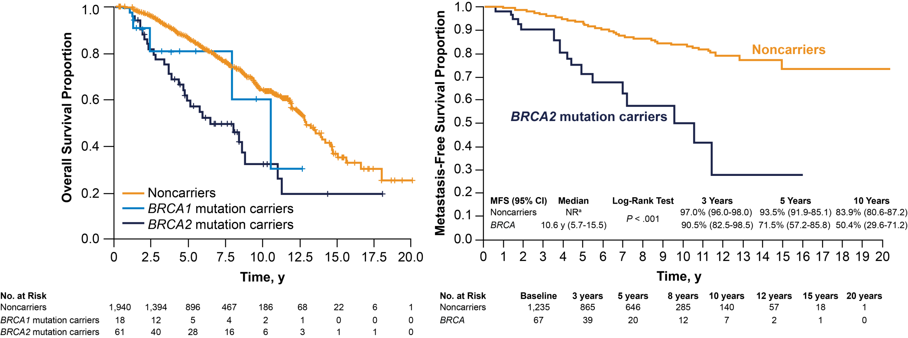
BRCA2 Carriers With Prostate Cancer Have Worse Prognosis^{1,2}
Noncarriers
BRCA1/2 mutation carriers
ª Median survival not reached after a median of 64 months of follow-up
BRCA1/2, breast cancer type 1/2 susceptibility protein; CI, confidence interval; MFS, metastasis-free survival; NR, not reached; y, years
1. Castro E, et al. J Clin Oncol. 2013;31:1748-57; 2. Castro E, et al. Eur Urol. 2015;68:186-93

Slide 14
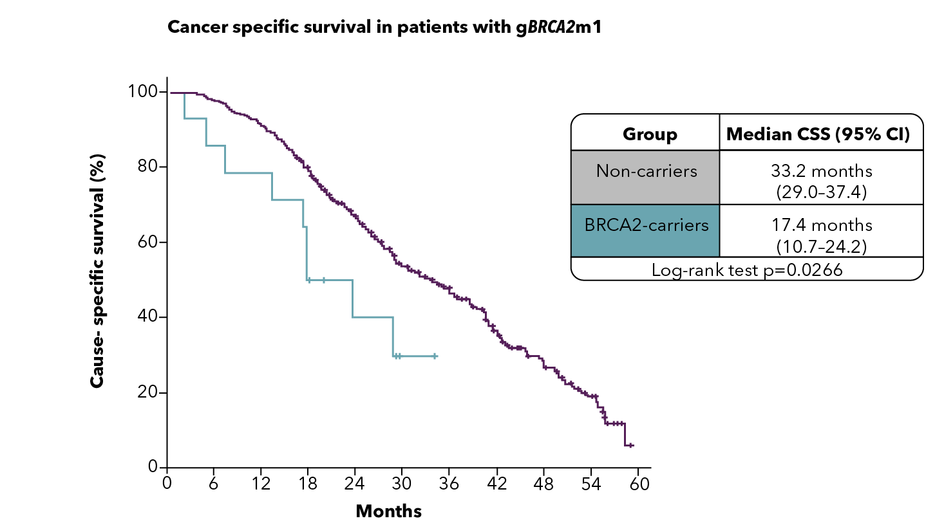
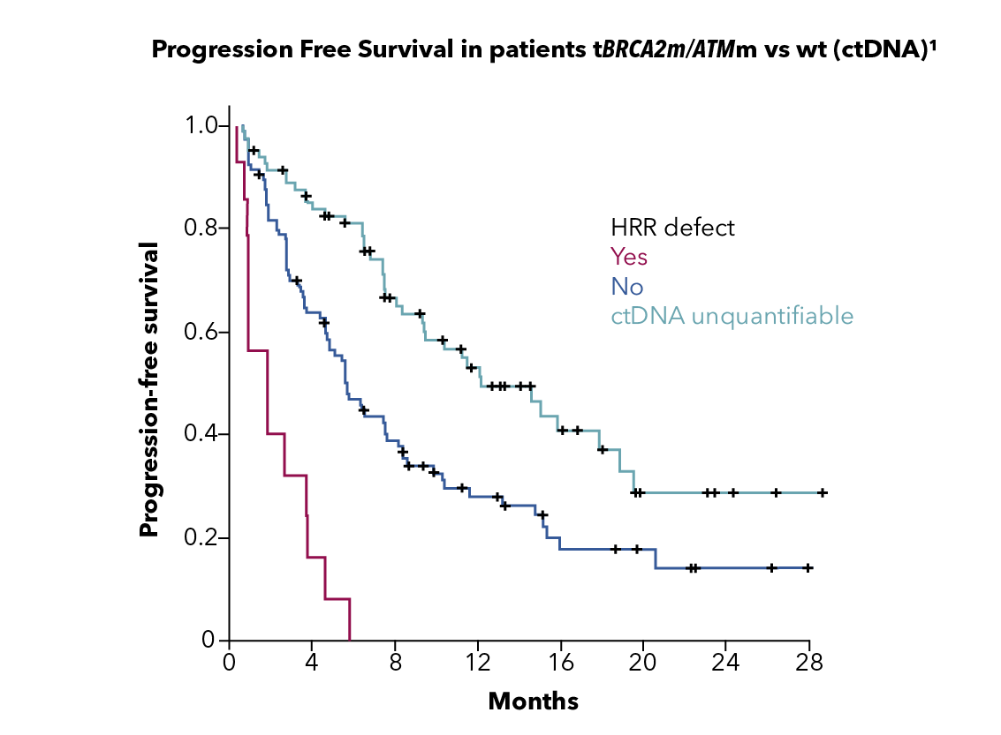
Patients WITH HRR MUTATIONS (INCLUDING BRCA2 MUTATIONS) ARE MORE LIKELY TO HAVE POOR OUTCOMES ON STANDARD-OF-CARE therapies¹⁻³
Patients with germline HRR mutations including BRCA2 mutations are more likely to have poor outcomes on standard-of care-therapies^{1,2}
Poor responses to standard therapy
also seen for tumour HRR mutations²
Cancer-specific survival in patients with
mCRPC with BRCA2 mutation¹
Time to progression in patients with
mCRPC with HRR mutations³
Group | Median CSS (months) (95% CI)
Non-carriers | 33.2 (29.0-37.4)
BRCA2 mutation carriers | 17.4 (10.7-24.2)
Log-rank test p=0.0266
HRR defect
Yes
No
ctDNA unquantifiable
CSS (%)
PFS (%)
Months
We clearly need to do better
Months
BRCA2, breast cancer gene 2; CI, confidence interval; CSS, cause-specific survival; ctDNA, circulating tumour DNA; HRR, homologous recombination repair; mCRPC, metastatic castration-resistant prostate cancer; PFS, progression-free survival
1. Adapted from: Castro E, et al. J Clin Oncol. 2019;6:490-503; 2. Annala M, et al. Eur Urol. 2017;72:34-42; 3. Annala M, et al. Cancer Discov. 2018;8:444-57

Slide 15





For patients with HRRm, PARPis are a treatment option as they trigger cell death in cancer cells with an HRR deficiency¹
PARPi mechanism of action
PARPi
PARP
Increase in double-strand breaks in replicating cells
Trapped PARP on single‑strand breaks
PARP
PARPi
Double-strand break
HRR-deficient cancer cell
Normal cell

Repair of double-strand breaks via the HRR pathway and cell survival
Reliance on error-prone pathways leads to accumulation of genomic instability and cell death
✓
HRR(m), homologous recombination repair (mutation); PARP(i), poly-ADP ribose polymerase (inhibitor)
Adapted from: 1. O’Connor MJ. Mol Cell. 2015;60:547-60

Slide 16
Introducing the Patient case

Slide 17

Case discussion
17
Germline BRCA2 mutation detection which is pathogenic.
Consider patient for treatment with a PARPi
Patient: Age 68 years
Presents with: Moderate LUTS
Medical history:
Well-controlled hypertension and angina; relieved by stent 4 years prior
No known family history of cancer
PSA 132
PSA nadir 0.9
PSA 1.6
PSA 3.4
ADT +
abiraterone/prednisone
12 months
18 months
24 months
Biopsy: 9/12 cores; adenocarcinoma Gleason 4+4
Staging: T2b/T3 by DRE
Imaging:
Metastases in hip, lumbar spine and ribs
Multiple retroperitoneal lymph nodes between 1 and 3 cm and two pulmonary nodules suspicious of metastases
Slight discomfort in lumbar spine
Imaging:
Progression of bone and soft‑tissue metastases
Haemoglobin: 10 g/dL
ADT, androgen-deprivation therapy; BRCA2, breast cancer gene 2; DRE, digital rectal exam; LUTS, lower urinary-tract symptoms; PSA, prostate-specific antigen; T, tumour stage

Slide 18
Parpi Key trial data

Slide 19
Phase 2/3 PARP inhibitor monotherapy trials in mCRPC
Q1 2017¹
PROfound
study initiated
Q2 2020²
PROfound
study published
Q2 2020³
FDA approval
of olaparib
Q3 2020⁴
EMA approval of olaparib
2015 | 2016 | 2017 | 2018 | 2019 | 2020 | 2021 | 2022 | 2023
Q4 2015⁵
TOPARP-A
data published
Q4 2019⁶
TOPARP-B
data published
Q1 2023¹⁴
P3 rucaparib study published (TRITON3)
Q1 2017⁸
P2 rucaparib study initiated (TRITON2)
Q2 2017⁷
P3 rucaparib study initiated (TRITON3)
Q2 2020⁹
FDA accelerated approval of rucaparib
Q3 2020¹⁰
P2 rucaparib study
published (TRITON2)
Q3 2016¹¹
P2 niraparib study initiated (GALAHAD)
Q3 2017¹²
P2 talazoparib study initiated (TALAPRO-1)
Q3 2021¹³
P2 talazoparib study published
(TALAPRO-1)
Q1 2022¹⁵
P2 niraparib study
published (GALAHAD)
EMA, European Medicines Agency; FDA, United States Food and Drug Administration; mCRPC, metastatic castration-resistant prostate cancer;
P, phase; PARP, poly-ADP ribose polymerase; Q, quarter
1. NCT02987543; 2. de Bono J, et al. N Engl J Med. 2020;382:2091-102; 3. www.fda.gov/drugs/drug-approvals-and-databases/fda-approves-olaparib-hrr-gene-mutated-metastatic-castration-resistant-prostate-cancer; 4. https://www.esmo.org/oncology-news/ema-recommends-extension-of-indications-for-olaparib2; 5. Mateo J, et al. N Engl J Med. 2015;373:1697-708; 6. Mateo J, et al. Lancet Oncol. 2020;21:162-74; 7.https://clinicaltrials.gov/ct2/show/NCT02975934; 8. https://clinicaltrials.gov/ct2/show/NCT02952534; 9. FDA grants accelerated approval to rucaparib for BRCA-mutated metastatic castration-resistant prostate cancer. www.fda.gov/drugs/fda-grants-accelerated-approval-rucaparib-brca-mutated-metastatic-castration-resistant-prostate; 10. Abida W, et al. J Clin Oncol. 2020;38:3763-72; 11. https://clinicaltrials.gov/ct2/show/NCT02854436; 12.https://clinicaltrials.gov/ct2/show/NCT03148795; 13. de Bono JS, et al. Lancet Oncol. 2022;9:1250-64. All accessed April 2023; 14. Fizazi K, et al. N Engl J Med 2023; 388: 719-32; 15. Smith MR, et al. Lancet Oncol. 2022;23: 362-73

Slide 20
Phase 2 and 3 clinical trials in mCRPC using PARPis as monotherapy
 | Olaparib |  | Niraparib | Talazoparib | Rucaparib
Trial name | TOPARP-B^{1-2a} | PROfound³⁻⁵ | GALAHAD⁶ | TALAPRO-1⁷ | TRITON2⁸⁻⁹ | TRITON3¹⁰⁻¹¹
Phase | 2 | 3 | 2 | 2 | 2 | 3
Required prior therapy | 1–2 taxane-based regimens, but ~90% were post‑abiraterone / enzalutamide | Progression on NHA for mPC and/or CRPC | ≥1 taxane-based regimen for mPC AND ≥1 NHA for mCRPC or nmCRPC and subsequent mets | ≥1 taxane-based regimen AND ≥1 NHA for mCRPC | 1 taxane-based regimen AND ≥1 NHA for CRPC | Evidence of disease progression after treatment with 1 prior NHA; no prior chemotherapy for mCRPC
Primary endpoint | Composite response^{b} | rPFS by BICR in Cohort A (BRCA1, BRCA2, or ATM mutations) | ORR (germline BRCA or biallelic BRCA) | ORR | ORR | rPFS
HRRm panel | Any HRR gene (GeneRead DNAseq Mix‑n-Match Panel V2 from Qiagen covering 113 genes) | 15 genes (BRCA1, BRCA2, ATM, BRIP1, BARD1, CDK12, CHEK1, CHEK2, FANCL, PALB2, PPP2R2A, RAD51B, RAD51C, RAD51D, RAD54L) | 8 genes (biallelic BRCA1, BRCA2, ATM, FANCA, PALB2, CHEK2, BRIP1, HDAC2 OR germline BRCA alteration) | 11 genes (monoallelic or biallelic BRCA1, BRCA2, CHEK2, ATM, ATR, FANCA, MLH1, MRE11A, NBN, PALB2, RAD51C) | 15 genes (germline or somatic) (monoallelic or biallelic BRCA1, BRCA2, ATM, BARD1, BRIP1, CDK12, CHEK2, FANCA, NBN, PALB2, RAD51, RAD51B, RAD51C, RAD51D, RAD54L) | 3 genes (somatic or germline mutation in BRCA1, BRCA2, or ATM)
ªNOTE: TOPARP-B included 300 mg BID and 400 mg BID treatment arms for olaparib. 400 mg BID is not the recommended tablet dose for olaparib.
^{b}Defined as a composite of any of the following outcomes: radiological objective response (RECIST v1.1), a decrease in PSA of 50% or more from baseline, or conversion of circulating tumour cell count (from ≥5 cells per 7.5 mL of blood at baseline to <5 cells per 7.5 mL of blood).
ATM, ataxia telangiectasia mutated; BICR, Blinded Independent Central Review; BID, twice a day; BRCA1/2, breast cancer gene 1/2; CDK12, cyclin-dependent kinase 12; CHEK1/2, checkpoint kinase 1/2; CRPC, castration-resistant prostate cancer; HDAC2, histone deacetylase 2; HRR, homologous recombination repair; HRRm, HRR mutation; mets, metastases; mPC, metastatic prostate cancer; NBN, nibrin; NHA, novel hormonal agent; (n)mCRPC, (non)-metastatic castration-resistant prostate cancer; ORR, objective response rate; PALB2, partner and localiser of BRCA2; PARP, poly (ADP-ribose) polymerase; PARPi, PARP inhibitor; PPP2R2A, protein phosphatase 2 regulatory subunit B alpha; PSA, prostate-specific antigen; RECIST, Response Evaluation Criteria in Solid Tumours; rPFS, radiographic progression-free survival
1. Mateo J, et al. N Engl J Med. 2015;373:1697-708; 2. Mateo J, et al. Lancet Oncol. 2020;21:162–74; 3. de Bono J, et al. N Engl J Med. 2020;382:2091-102; 4. Hussain M, et al. N Engl J Med. 2020;383:2345-57; 5. https://www.clinicaltrials.gov/ct2/show/NCT02987543; 6. Smith MR, et al. Lancet Oncol. 2022;23: 362-73; 7. de Bono JS, et al. Lancet Oncol. 2021;22(9):1250-64; 8. Abida W, et al. J Clin Oncol. 2020;32:3763-72; 9. Abida W, et al. Clin Cancer Res. 2020;26:2487-96; 10. https://clinicaltrials.gov/ct2/show/NCT02975934; 11. Bryce AL, et al. Prostate Cancer Foundation Retreat 2022 (oral presentation: https://clovisoncology.com/files/PCF2022_Bryce_Oral.pdf)

Slide 21
Outcomes from Phase 2 non-registrational studies
 | Olaparib | Niraparib | Talazoparib
Trial name | TOPARP-B^{1–2} | GALAHAD³ | TALAPRO-1⁴
Phase | 2 | 2 | 2
Dose | 300/400mg bidª | 300mg QD | 1mg QD^{c}
Required prior therapy | 1–2 taxane-based regimens, but >90% were post-abiraterone / enzalutamide | ≥1 taxane-based regimen for mPC AND ≥1 NHA for mCRPC or nmCRPC and subsequent mets | 1-2 taxane-based regimen for mPC AND ≥1 NHA for mCRPC
Primary endpoint | Composite response^{b} | ORR (germline BRCA or biallelic BRCA) | ORR
ORR in BRCAm population | TOPARP-B: 52.4% | 34.2% | 46% BRCA2 50% BRCA1
These are not head-to-head trial comparisons. Because clinical trials are conducted under widely varying conditions, endpoints observed in the clinical trials of one drug cannot be directly compared with those in clinical trials of another drug.
ªNote: TOPARP-B included 300 mg BID and 400 mg BID treatment arms for olaparib. 400 mg BID is not the recommended tablet dose for olaparib.
^{b} Defined as a composite of any of the following outcomes: radiological objective response (RECIST v1.1), a decrease in PSA of 50% or more from baseline, or conversion of circulating tumour cell count (from ≥5 cells per 7.5 mL of blood at baseline to <5 cells per 7.5 mL of blood).
^{c}0·75 mg per day for patients with moderate renal impairment, defined as an estimated glomerular filtration rate of 30–59 mL/min per 1·73 m²
BID, twice a day; BRCA, breast cancer gene; BRCAm, BRCA mutation; CRPC, castration-resistant prostate cancer; HRR, homologous recombination repair; mets, metastases; mPC, metastatic prostate cancer; NHA, novel hormonal agent; (n)mCRPC, (non)-metastatic castration-resistant prostate cancer; ORR, objective response rate; PSA, prostate specific antigen; QD, once daily; RECIST, Response Evaluation Criteria in Solid Tumours
1. Mateo J, et al. N Engl J Med. 2015;373:1697-708; 2. Mateo J, et al. Lancet Oncol. 2020;21:162-74; 3. Smith MR, et al. Lancet Oncol. 2022;23: 362-73;
4. de Bono JS, et al. Lancet Oncol. 2021;22(9):1250-64

Slide 22
AE profiles of PARPi from monotherapy trials
Frequency of AEs in prostate cancer trials – All Grade (Grade ≥3) | Olaparib (PROfound)¹ | Rucaparib (TRITON2)² | Niraparib (GALAHAD)³ | Talazoparib (TALAPRO-1)⁴
Hypertension % | NR | NR | 11.8 (4.2) | 5.5 (3.1)
Increased ALT/AST % | NR | 33.0 (5.2) | 12.8 (2.8) | 11.8 (2.4)
Insomnia % | NR | NR | 8.3 (0.3) | NR
Alopecia % | NR | NR | NR | NR
Frequency and grade of cytopenias in prostate cancer trials | Olaparib (PROfound)¹ | Rucaparib (TRITON2)² | Niraparib (GALAHAD)³ | Talazoparib (TALAPRO-1)⁴
Anaemia Grade ≥3 (%) | 23 | 25 | 33 | 31
Neutropenia Grade ≥3 (%) | NRª | 7 | 10 | 8
Thrombocytopenia Grade ≥3 (%) | NRª | 10 | 16 | 9
Please note that head-to-head studies were not conducted between these products. This data is for information purposes only, and no comparative claims of non-inferiority or superiority in terms of efficacy or safety are implied or intended. AEs highlighted in blue if value ≥10%
AE, adverse event; ALT, alanine aminotransferase; AST, aspartate aminotransferase; NR, not reported; PARPi, poly-ADP ribose polymerase inhibitor
1. Hussain M, et al. New Engl J Med. 2020;383:2345-57; 2. Abida W, et al. J Clin Oncol. 2020;38(32):3763-72 (supplementary appendix);
3. Smith MR, et al. Lancet Oncol. 2022;23(3):362-73; 4. de Bono JS, et al. Lancet Oncol. 2021;22(9):1250-64

Slide 23
PROfound: phase 3 data with
Olaparib in mCRPC (registrational study)
Olaparib 300 mg BID
(n=162)
Primary endpoint
rPFS in cohort A (RECIST 1.1 and PCWG3 by BICR)
Key eligibility criteria
mCRPC with disease progression on prior NHA (abiraterone acetate or enzalutamide)
Alterations in ≥1 of any qualifying gene with a direct or indirect role in HRR ª
Cohort A
BRCA1, BRCA2, or ATM alteration
(N=245)
Physician’s choice ^{b}
(n=83)
2:1 randomisation
(Open label)
Upon progression by BICR,
physician’s choice patients were
allowed to cross over to olaparib
Key secondary endpoints
rPFS in cohorts A and B (by BICR) Confirmed radiographic objective response rate in cohort A (by BICR) Time to pain progression in cohort A OS in cohort A
Cohort B
Other alterations
(N=142)
Olaparib 300 mg BID
(n=94)
Physician’s choice ^{b}
(n=48)
Stratification factors
Previous taxane
Measurable disease
ª An investigational clinical trial assay, based on the FoundationOne® CDx next-generation sequencing test, used to prospectively select patients with alteration of BRCA1, BRCA2, ATM, BARD1, BRIP1, CDK12, CHEK1, CHEK2, FANCL, PALB2, PPP2R2A, RAD51B, RAD51C, RAD51D, or RAD54L in their tumour tissue
^{b} Physician’s choice: enzalutamide 160 mg/day, or abiraterone 1,000 mg/day + prednisone 5 mg BID
ATM, ataxia telangiectasia mutated; BICR, blinded independent central review; BID, twice daily; BRCA1/2, breast cancer gene 1/2; CDK12, cyclin-dependent kinase 12; CHEK1/2, checkpoint kinase 1/2; HRR, homologous recombination repair; mCRPC, metastatic castration resistant prostate cancer; NHA, new hormonal agent; OS, overall survival; PALB2, partner and localiser of BRCA2; PCWG3, Prostate Cancer Working Group 3; PPP2R2A, protein phosphatase 2 regulatory subunit B alpha; QD, once daily; RECIST, Response Evaluation Criteria In Solid Tumours; rPFS, radiographic progression-free survival
de Bono J, et al. N Engl J Med. 2020;382:2091-102; Hussain M, et al. N Engl J Med. 2020;383(24):2345-57

Slide 24
PROfound: OLAPARIB MONOTHERAPY IMPROVES rPFS COMPARED TO NHA RECHALLENGE
COHORT A: BRCA1/2 or ATM
BRCA1 and/or BRCA2
HR (95% CI) 0.34 (0.25-0.47)
Median PFS: 7.4 vs 3.6 months; p<0.001
rPFSª
HR, 0.22 (95% CI, 0.15-0.32)
Median rPFS, 9.8 vs 3.0 months
1.0
100
0.9
6-month rate
60%
23%
0.8
80
0.7
12-month rate
28%
9%
0.6
60
Probability of rPFS
Probability of rPFS (%)
0.5
0.4
40
0.3
0.2
20
0.1
0.0
0
0
1
2
3
4
5
6
7
8
9
10
11
12
13
14
15
16
17
18
19
20
21
0
1
2
3
4
5
6
7
8
9
10
11
12
13
14
15
16
17
18
19
20
21
Time from randomisation (months)
No. at risk
Time from randomisation (months)
No. at risk
Olaparib
Physician’s
choice
102
58
93
56
87
30
83
27
78
10
77
10
67
6
66
5
48
4
45
3
36
1
33
1
23
1
22
0
16
0
8
0
8
0
2
0
2
0
0
0
0
0
0
0
Olaparib
162
149
126
116
102
101
82
77
56
53
42
37
26
24
18
11
11
3
2
0
0
0
Physician’s
choice
83
79
47
44
22
20
13
12
7
6
3
3
3
2
2
1
1
1
1
0
0
0
COHORT A. PFS by BICR assessment, data maturity=71%. Data cut-off date: 4 June 2019
ª The study was not powered for gene-by-gene analysis.
ATM, ataxia telangiectasia mutated; BRCA1/2, breast cancer gene 1/2; BICR, blinded independent central review; CI, confidence interval; HR, hazard ratio; NHA, new hormonal agent; (r)PFS, (radiographic) progression-free survival
de Bono J, et al. N Engl J Med. 2020;382:2091-102 (Supplementary appendix)

Slide 25
PROfound: 31% REDUCTION IN DEATH WITH OLAPARIB MONOTHERAPY COMPARED TO NHA RECHALLENGE
Cohort A: BRCA1/2 or ATM mutations
Cohort A with adjustment for crossoverª
100
100
HR (95% CI) 0.69 (0.50-0.97)
Median OS: 19.1 vs 14.7 months; p=0.02
HR (95% CI): 0.42 (0.19-0.91)
Crossover rate: 67% (56/83)
80
80
60
60
OS (%)
OS (%)
40
40
20
20
0
0
0
2
4
6
8
10
12
14
16
18
20
22
24
26
28
30
32
34
0
2
4
6
8
10
12
14
16
18
20
22
24
26
28
30
32
34
No. at risk
Time from randomisation (months)
No. at risk
Time from randomisation (months)
Olaparib
Physician’s
choice
155
79
44
15
Olaparib
Physician’s
choice
155
79
44
0
162
83
150
74
142
69
136
64
124
58
107
50
101
43
91
37
71
27
56
18
30
11
18
9
6
6
2
3
1
1
0
0
162
83
150
73
142
67
136
56
124
47
107
29
101
15
91
9
71
3
56
0
30
0
18
0
6
0
2
0
1
0
0
0
Median follow-up duration for censored patients: olaparib, 21.9 months; control, 21.0 months
ª Re-censored; conducted using rank-preserving structural failure time model to demonstrate the impact on OS of crossover of patients from the control arm to receive olaparib as a first subsequent anticancer therapy
BRCA1/2, breast cancer gene 1/2; CI, confidence interval; HR, hazard ratio; NHA, new hormonal agents; OS, overall survival
Adapted from: Hussain M, et al. N Engl J Med. 2020;383:2345-57

Slide 26
For final OS, an improved treatment effect was seen with olaparib IN PATIENTS WITH BRCA MUTATION-POSITIVE mCRPC AND who had not received a taxaneª
No prior taxane
Prior taxane
100
100
HR (95% CI): 0.64 (0.39-1.08)
Median OS: 17.4 vs 12.6 months
80
80
OS (%)
OS (%)
60
60
40
40
20
HR (95% CI): 0.30 (0.10-0.78)
Median OS: NR vs 18.8 months
20
0
0
0
2
4
6
8
10
12
14
16
18
20
22
24
26
28
30
32
34
0
2
4
6
8
10
12
14
16
18
20
22
24
26
28
30
32
34
Time from randomisation (months)
Time from randomisation (months)
No. at risk
Olaparib | 23 | 23 | 23 | 23 | 23 | 23 | 21 | 21 | 20 | 18 | 16 | 10 | 10 | 5 | 2 | 0 | 0 | 0
Physician’s choice | 20 | 20 | 19 | 19 | 18 | 15 | 14 | 13 | 12 | 7 | 5 | 4 | 3 | 3 | 1 | 0 | 0 | 0
No. at risk
Olaparib | 66 | 60 | 57 | 55 | 53 | 46 | 38 | 36 | 32 | 23 | 16 | 15 | 11 | 6 | 2 | 2 | 1 | 0
Physician’s choice | 32 | 29 | 25 | 23 | 21 | 19 | 16 | 14 | 11 | 10 | 5 | 5 | 4 | 3 | 3 | 2 | 0 | 0
ª Data are reported only for patients with alteration in a single gene
BRCA, breast cancer gene; CI, confidence interval; HR, hazard ratio; mCRPC, metastatic castration-resistant prostate cancer; NR, not reached; OS, overall survival
1. Hussain M, et al. N Engl J Med. 2020;383:2345-57 (Supplementary Appendix)

Slide 27
PROfound: most common AEs (≥20% any gradeª) in the overall population^{b}
Olaparib (N=256)
Physician’s choice (N=130)^{c}
Any
Anaemia
Nausea
Fatigue or asthenia^{d}
Decreased appetite
Diarrhoea
Vomiting
96
52
40
40
88
50
23
5
15
5
43
2
21
2
Grade ≥3
42
3
5
33
Any grade
3
5
Grade ≥3
31
2
<1
18
Any grade
2
21
<1
7
<1
20
2
<1
13
2
<1
100
80
60
40
20
0
0
20
40
60
80
100
Proportion of patients (%)
^{b} ≥20% any grade AEs in either treatment arm; ^{b} Patients had alterations in BRCA1, BRCA2, ATM, BARD1, BRIP1, CDK12, CHEK1, CHEK2, FANCL, PALB2, PPP2R2A, RAD51B, RAD51C, RAD51D, and / or RAD54L. Note, there were no cases of myelodysplastic syndromes or AML during the 30-day safety follow-up. There has since been one fatal case of AML 54 days after discontinuation of olaparib. ^{c} One patient in the control group did not receive treatment. ^{d} Grouped term.
AE, adverse event; AML, acute myeloid leukaemia; ATM, ataxia telangiectasia mutated; BRCA, breast cancer gene 1/2; CDK12, cyclin-dependent kinase 12; CHEK2, checkpoint kinase 2; DCO, data cut-off; OS, overall survival; PALB2, partner and localiser of BRCA2; PARP, poly-ADP ribose polymerase; PPP2R2A, protein phosphatase 2 regulatory subunit B alpha
1. Hussain M, et al. N Engl J Med. 2020;383(24):2345-57

Slide 28
TRITON2: open label, single-arm, phase 2 study of rucaparib in mCRPC patients (registrational study)
Screening
Key eligibility criteria
Treatment
28-day cycles
Identification of a deleterious somatic or germline alteration in HRR geneª
mCRPC
Deleterious somatic or germline alteration in HRR gene
Disease progression on AR-directed therapy (e.g. abiraterone, enzalutamide, or apalutamide) for PC and 1 prior taxane-based chemotherapy for CRPC
ECOG PS 0 or 1
No prior PARP inhibitor, mitoxantrone, cyclophosphamide, or platinum-based chemotherapy
Rucaparib 600 mg BID
HRR genes
BRCA1 BRCA2 ATM | BARD1 BRIP1 CDK12 CHEK2 | FANCA NBN PALB2 RAD51 | RAD51B RAD51C RAD51D RAD54L
Tumour assessments every 8 weeks for 24 weeks, then every 12 weeks
PSA assessments every 4 weeks
Treatment until radiographic progression or discontinuation for other reason
Primary endpoints^{b}
Patients with measurable disease at baseline: confirmed ORR per modified RECIST^{c}/PCWG3 by central assessment
Patients with non-measurable disease at baseline: confirmed PSA response (≥50% decrease) rate^{d}
ª Alterations detected by local testing or central testing of blood or tumour samples. ^{b}Efficacy analyses in TRITON2 will be conducted separately based on HRR gene with alteration and presence/absence of measurable disease. ^{c} RECIST modified to include up to 10 target lesions, maximum five per site, not including prostatic bed or bone lesions; MRI allowed. ^{d} The proportion of patients with a ≥50% decrease from baseline confirmed by a second consecutive measurement; PSA measurements performed by local laboratory.
AR, androgen receptor; ATM, ataxia telangiectasia mutated; BID, twice daily; BID, twice a day; BRCA, breast cancer gene 1/2; CDK12, cyclin-dependent kinase 12; CHEK2, checkpoint kinase 2; CRPC, castration-resistant prostate cancer; ECOG PS, Eastern Cooperative Oncology Group performance status; HRR, homologous recombination repair; mCRPC, metastatic CRPC; MRI, magnetic resonance imaging; ORR, objective response rate; PARP, poly (ADP-ribose) polymerase; PALB2, partner and localiser of BRCA2; PC, prostate cancer; PCWG3, prostate cancer working group 3; PSA, prostate specific antigen; RECIST, Response Evaluation Criteria in Solid Tumours version 1.1
Abida W, et al. ESMO 2019, abstract 2754 (poster discussion); Abida W, et al. J Clin Oncol. 2020;38:3763-72 (Supplementary appendix)

Slide 29
TRITON2: Rucaparib has anti-tumour activity in mCRPC patients with BRCA1/2 alterations¹
Response | Investigator-evaluable population (N=65) | IRR-evaluable population (N=62)
Confirmed ORR, n (% [95% CI])ª | 33 (50.8 [38.1-63.4]) | 27 (43.5 [31.0-56.7])
Complete response, n (%) | 4 (6.2) | 7 (11.3)
Partial response, n (%) | 29 (44.6) | 20 (32.3)
Stable disease, n (%) | 25 (38.5) | 28 (45.2)
Progressive disease, n (%) | 6 (9.2) | 6 (9.7)
Not evaluable, n (%) | 1 (1.5) | 1 (1.6)
 | Overall efficacy population (N=115)
Confirmed PSA, n (% [95% CI]) | 63 (54.8 [45.2-64.1])
Visit cut-off date: December 23, 2019
ª Per modified RECIST/Prostate Cancer Clinical Trials Working Group 3 criteria
Patients harbouring an ATM or CDK12 alteration did not receive significant benefit²
ATM, ataxia telangiectasia mutated; BRCA1/2, breast cancer gene 1/2; CDK12, cyclin-dependent kinase 12; CI, confidence interval; IRR, independent radiology review; mCRPC, metastatic castration-resistant prostate cancer; ORR, objective response rate; PSA, prostate-specific antigen; RECIST, Response Evaluation Criteria in Solid Tumours version 1.1
1. Abida W, et al. J Clin Oncol 2020;38:3763-72; 2. Abida W, et al. Clin Cancer Res. 2020;26:2487-96

Slide 30
TRITON2: Rucaparib achieved a median rpfs of 9 months in mCRPC patients with BRCA alterations
FDA granted accelerated approval based on data from TRITON2
100
90
Median, months | 95% CI | Range
9.0 | 8.3 to 13.5 | 0.0-27.6+
80
70
60
Radiographic progression-free survival (%)
50
40
30
20
10
0
0
4
8
12
16
20
24
28
Time (months)
No. at risk:
(events)
115 (0)
80
(21)
53
(34)
17
(50)
9
(53)
4
(53)
3
(53)
0
(53)
rPFS by blinded independent radiology review assessment. Visit cut-off date: December 23, 2019.
Progression was assessed per modified RECIST/PWCG3 criteria.
BRCA, breast cancer gene; CI, confidence interval; FDA, Food and Drug Administration; mCRPC, metastatic castration‑resistant prostate cancer; PCWG3, Prostate Cancer Clinical Trials Working Group 3; RECIST, Response Evaluation Criteria In Solid Tumours version 1.1; rPFS, radiographic progression-free survival
Abida W, et al. J Clin Oncol. 2020;38:3763-72; FDA grants accelerated approval to rucaparib for BRCA-mutated metastatic castration-resistant prostate cancer | FDA

Slide 31
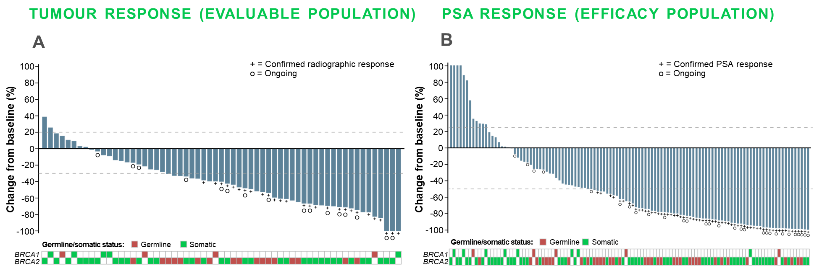
TRITON2: Post NHA and Chemo Rucaparib Monotherapy in mCRPC with brca1 or brca2 alterations
Best change from baseline in sum of target lesion(s) in the IRR-evaluable population
Best change from baseline in PSA in the overall efficacy population
A
B
BRCA1/2, breast cancer gene 1/2; chemo, chemotherapy; CI, confidence interval; IRR, independent radiology review; mCRPC, metastatic castration resistant prostate cancer; NHA, new hormonal agent; PSA, prostate-specific antigen, rPFS, radiographic progression-free survival
Adapted from: Abida W, et al. J Clin Oncol. 2020;38:3763-72

Slide 32
TRITON2: Rucaparib side effects
Individual TEAE (preferred terms) occurring in ≥15% of patients N=115; n (%) | Any grade | Grade ≥3
Asthenia/fatigue | 71 (61.7) | 10 (8.7)
Nausea | 60 (52.2) | 3 (2.6)
Anaemia/decreased hemoglobin | 50 (43.5) | 29 (25.2)
ALT/AST increased | 38 (33.0) | 6 (5.2)
Decreased appetite | 32 (27.8) | 2 (1.7)
Constipation | 31 (27.0) | 1 (0.9)
Thrombocytopenia/decreased platelets | 29 (25.2) | 11 (9.6)
Vomiting | 25 (21.7) | 1 (0.9)
Diarrhoea | 23 (20.0) | 0
Dizziness | 21 (18.3) | 0
Blood creatinine increased | 18 (15.7) | 1 (0.9)
ALT, alanine aminotransferase; AST, aspartate aminotransferase; TEAE, treatment-emergent adverse event
Abida W, et al. J Clin Oncol. 2020;38:3763-72

Slide 33
TRITON3 study design
Confirmatory study for accelerated approval of rucaparib
Rucaparib 600 mg BID
Key eligibility criteria
Randomisation 2:1
Endpoints^{d}
Chemotherapy-naïve mCRPC
BRCA or ATM alterationª
1 prior second-generation API in any setting^{b}
Stratification:
ECOG PS 0 vs 1
Hepatic metastases
yes vs no
BRCA1 vs BRCA2
vs ATM
Physician’s choice of^{c}:
Docetaxel
75 mg/m² Q21D; 10 cycles max
or
Abiraterone acetate
1000 mg QD
or
Enzalutamide
160 mg QD
Primary:
rPFS by IRR
Key secondary:
OS
ORR by IRR
Prior docetaxel or other
taxane chemotherapy for
castration-sensitive disease
was permitted
Patients who progress on physician’s choice of
treatment may be considered for crossover to rucaparib
Visit cut-off date: 25 August 2022. ª Determined by Foundation Medicine testing of tissue or plasma. ^{b} Protocol amendment June 19, 2018: patients’ qualifying second-generation API could be in any setting. ^{c} If chosen, patients received whichever second-generation API had not yet been received. ^{d} Tumour assessments were conducted at baseline and every 8 weeks for 24 weeks, then every 12 weeks, via CT/MRI and technetium-bone scans.
API, androgen pathway inhibitor; ATM, ataxia telangiectasia mutated; BID, twice daily; BRCA1/2, breast cancer gene 1/2; CT, computed tomography;
ECOG PS, Eastern Cooperative Oncology Group performance status; IRR, independent radiology review; mCRPC, metastatic castration-resistant prostate cancer; MRI, magnetic resonance imaging; ORR, objective response rate; OS, overall survival; Q21D, every 21 days; QD, once daily; rPFS, radiographic progression-free survival
Bryce AL, et al. Prostate Cancer Foundation Retreat 2022; Fizazi K, et al. N Engl J Med 2023; 388: 719-32

Slide 34

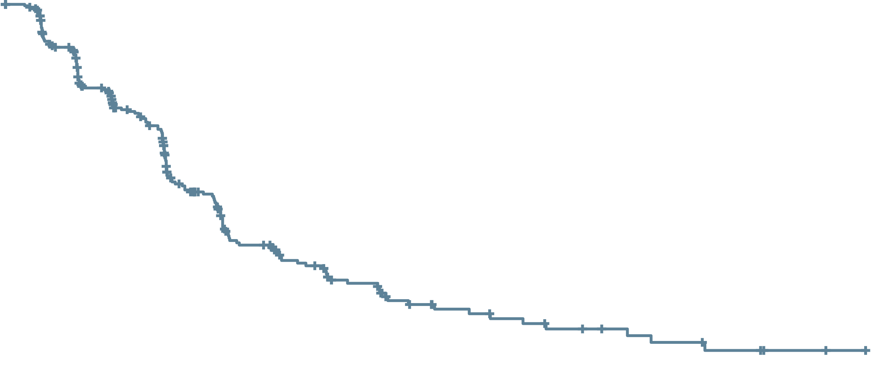
Triton3: rucaparib improves rPFS vs physician’s choice in itt population
100
90
80
70
60
50
40
30
20
10
0
 | Median, mo. | 95% CI
Rucaparib | 10.2 | 8.3-11.2
Physician’s choice | 6.4 | 5.6-8.2
Log-rank p=0.0003 HR (95% CI): 0.61 (0.47-0.80)
rPFS by IRR (%)
Rucaparib
Physician’s choice
0
3
6
9
12
15
18
21
24
27
30
33
36
39
42
45
Months
Patients at risk (events)
Rucaparib | 270 (0) | 220 (29) | 155 (68) | 99 (108) | 61 (135) | 46 (142) | 31 (150) | 19 (156) | 15 (158) | 12 (160) | 9 (161) | 7 (162) | 4 (164) | 2 (164) | 2 (164) | 0 (164)
Physician’s choice | 135 (0) | 97 (25) | 58 (56) | 28 (74) | 13 (88) | 6 (91) | 4 (92) | 1 (93) | 1 (93) | 0 (94)
Data maturity: 64% (258/405). The ATM subgroup completed enrolment in December 2019
ATM, ataxia telangiectasia mutated; CI, confidence interval; HR, hazard ratio; IRR, independent radiology review; ITT, intention-to-treat; mo., months; rPFS, radiographic progression-free survival
Bryce AL, et al. Prostate Cancer Foundation Retreat 2022; Fizazi K, et al. N Engl J Med 2023; 388: 719-32

Slide 35

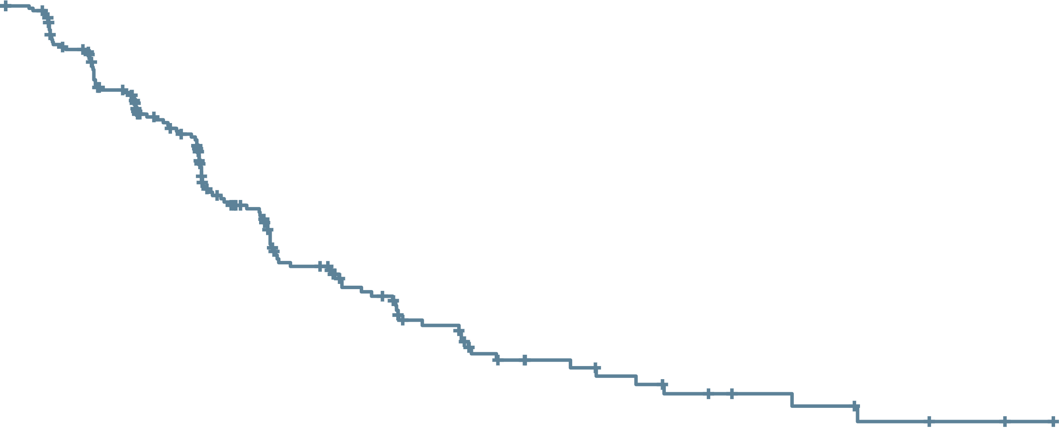

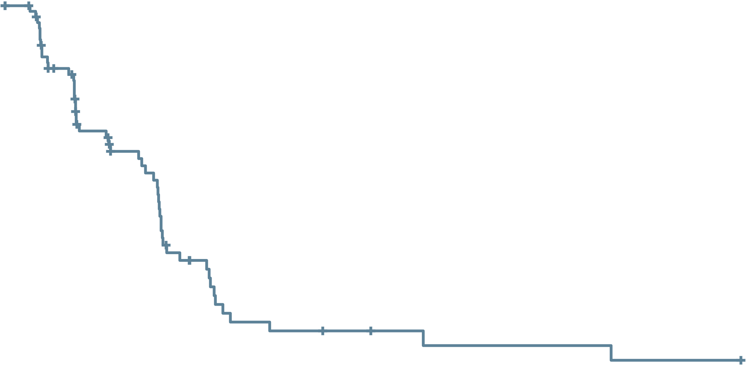
Triton3: rucaparib improves rPFS vs physician’s choice in BRCA subgroup
rPFS by IRR in the BRCA subgroup
rPFS by IRR in the ATM subgroup
100
90
80
70
60
50
40
30
20
10
0
 | Median, mo. | 95% CI
Rucaparib | 11.2 | 9.2-13.8
Physician’s choice | 6.4 | 5.4-8.3
Log-rank p<0.0001 HR (95% CI): 0.50 (0.36-0.69)
100
90
80
70
60
50
40
30
20
10
0
 | Median, mo. | 95% CI
Rucaparib | 8.1 | 5.5-8.3
Physician’s choice | 6.8 | 4.0-10.4
Log-rank p=0.84 HR (95% CI): 0.95 (0.59-1.52)
rPFS by IRR (%)
rPFS by IRR (%)
Rucaparib
Physician’s choice
Rucaparib
Physician’s choice
0
3
6
9
12
15
18
21
24
27
30
33
36
39
42
45
0
3
6
9
12
15
18
21
24
27
30
33
36
39
42
45
Months
Months
Patients at risk (events)
Rucaparib | 201 (0) | 169 (18) | 124 (44) | 83 (70) | 55 (89) | 41 (95) | 27 (103) | 16 (109) | 13 (110) | 10 (112) | 7 (113) | 6 (113) | 3 (115) | 2 (115) | 2 (115) | 0 (115)
Physician’s choice | 101 (0) | 69 (21) | 42 (42) | 19 (55) | 9 (64) | 4 (66) | 3 (66) | 0 (67)
Patients at risk (events)
Rucaparib | 69 (0) | 51 (11) | 31 (24) | 16 (38) | 6 (46) | 5 (47) | 4 (47) | 3 (47) | 2 (48) | 2 (48) | 2 (48) | 1 (49) | 1 (49) | 0 (49)
Physician’s choice | 34 (0) | 28 (4) | 16 (14) | 9 (19) | 4 (24) | 2 (25) | 1 (26) | 1 (26) | 1 (26) | 0 (27)
Data maturity: 60% (182/302).
Data maturity: 74% (76/103). The ATM subgroup completed enrolment in December 2019
ATM, ataxia telangiectasia mutated; BRCA1/2, breast cancer gene 1/2; CI, confidence interval; HR, hazard ratio; IRR, independent radiology review; mo., months; rPFS, radiographic progression-free survival
Bryce AL, et al. Prostate Cancer Foundation Retreat 2022; Fizazi K, et al. N Engl J Med 2023; 388: 719-32

Slide 36
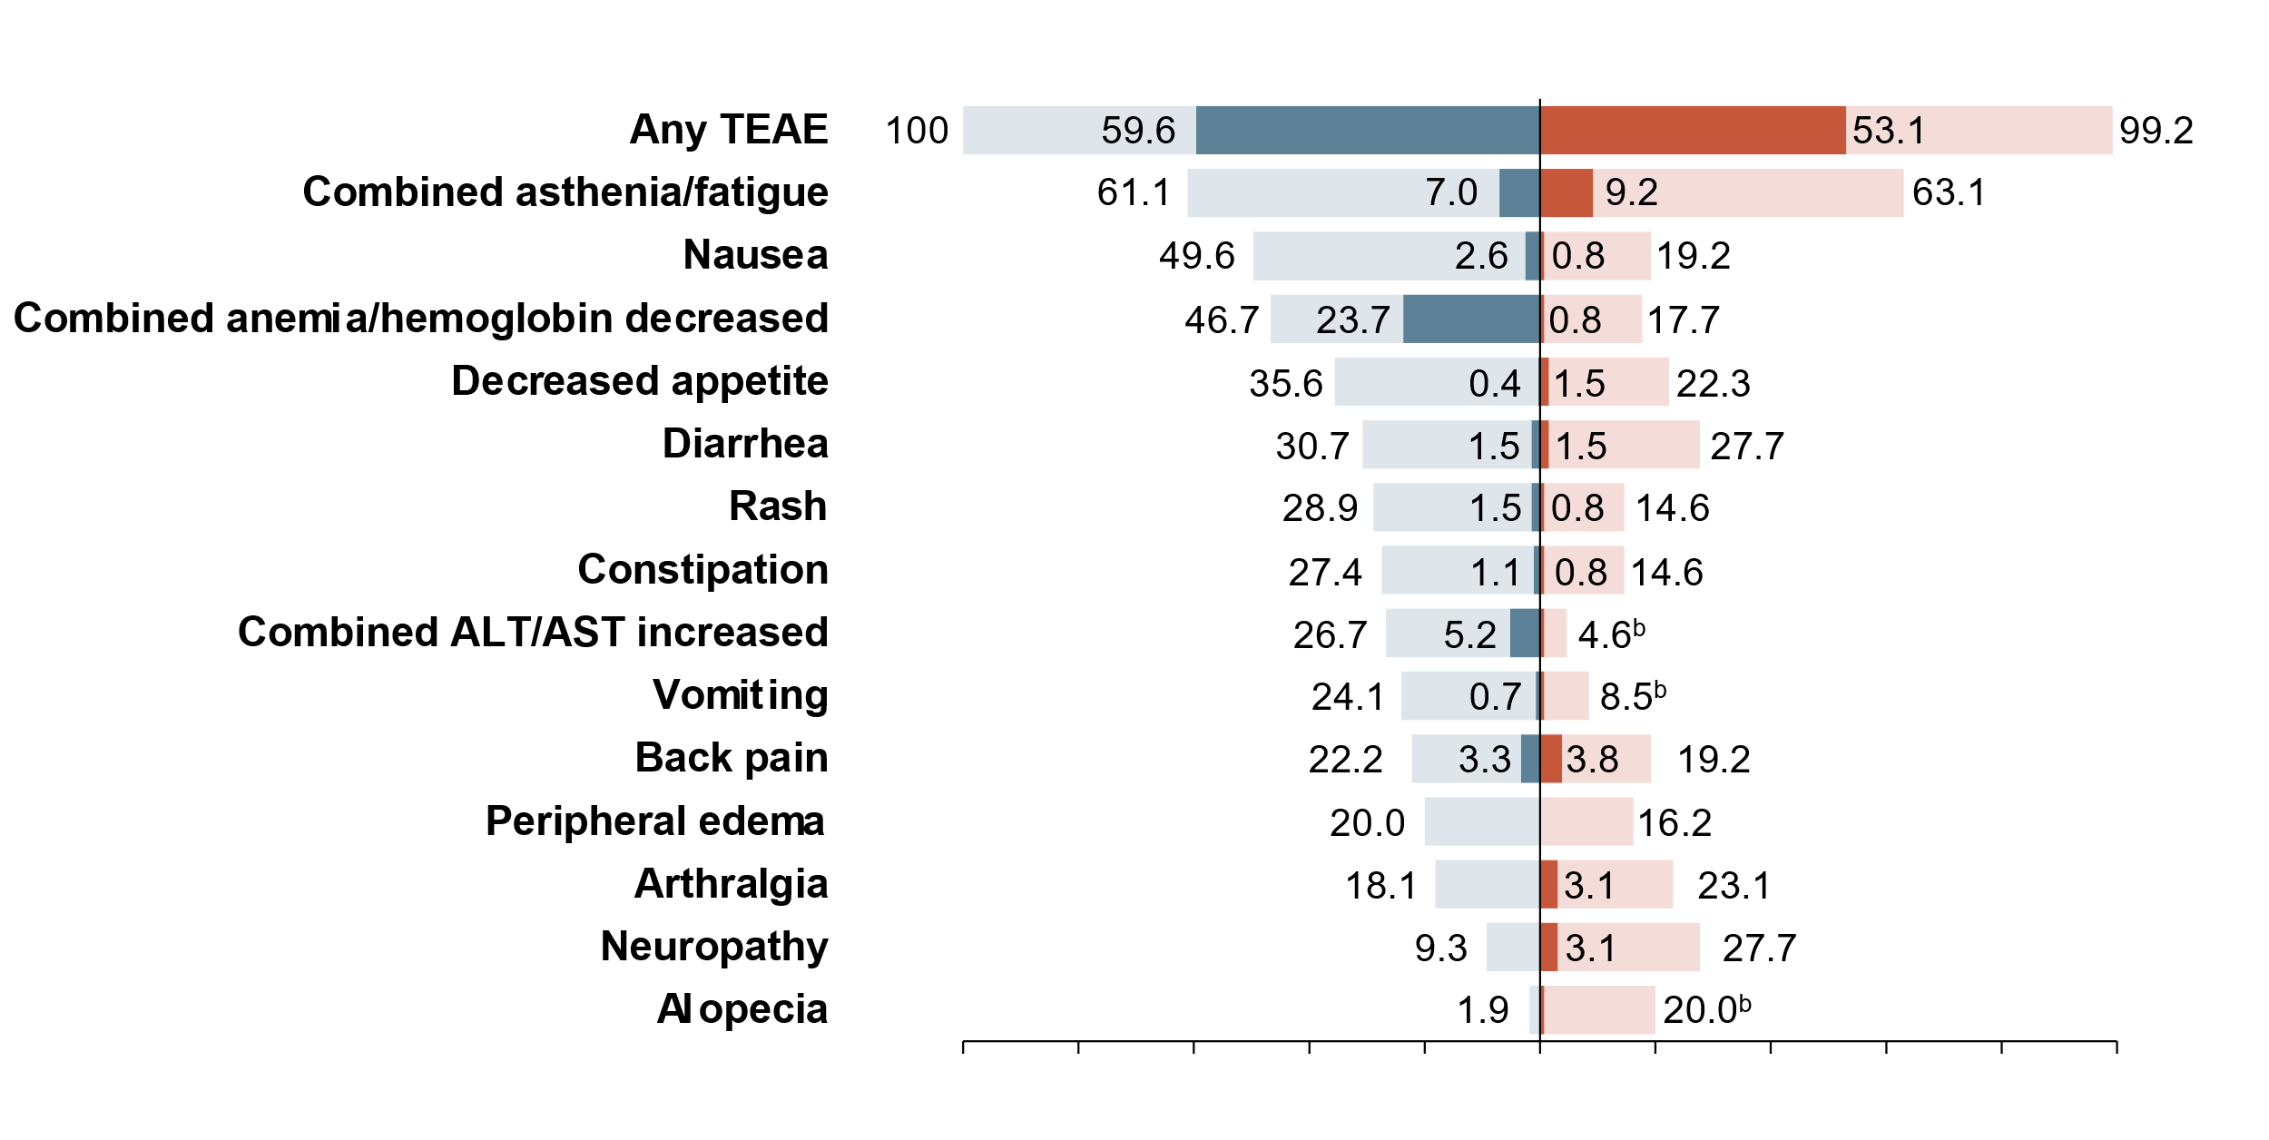
Triton3: MOST COMMON TEAEs (≥20% ANY GRADE)
Rucaparib (n=270ª)
Physician’s choice (n=130ª)
Grade ≥3
Any grade
Grade ≥3
Any grade
100
80
60
40
20
0
20
40
60
80
100
Proportion of patients (%)
ª Safety population (all patients who received ≥1 dose of protocol-specified treatment). ^{b} Grade ≥3, 0.8%
Neuropathy includes neurotoxicity, paraesthesia, peripheral motor neuropathy, peripheral neuropathy, peripheral sensory neuropathy, and polyneuropathy.
ALT, alanine aminotransferase; AST, aspartate aminotransferase; TEAE, treatment-emergent adverse event
Bryce AL, et al. Prostate Cancer Foundation Retreat 2022; Fizazi K, et al. N Engl J Med 2023; 388: 719-32

Slide 37
Treatment options for patient case

Slide 38
Case discussion
38
Patient: Age 68 years
Presents with: Moderate LUTS
Medical history:
Well-controlled hypertension and angina; relieved by stent 4 years prior
No known family history of cancer
PSA 132
PSA nadir 0.9
PSA 1.6
PSA 3.4
ADT +
abiraterone/prednisone
12 months
18 months
24 months
Biopsy: 9/12 cores; adenocarcinoma Gleason 4+4
Staging: T2b/T3 by DRE
Imaging:
Metastases in hip, lumbar spine and ribs
Multiple retroperitoneal lymph nodes between 1 and 3 cm and two pulmonary nodules suspicious of metastases
Slight discomfort in lumbar spine
Imaging:
Progression of bone and soft‑tissue metastases
Haemoglobin: 10 g/dL
ADT, androgen-deprivation therapy; BRCA2, breast cancer gene 2; DRE, digital rectal exam; LUTS, lower urinary-tract symptoms; PSA, prostate-specific antigen; T, tumour stage

Slide 39


PARP inhibitors are approved in prostate cancer
Olaparib FDA-approved indication¹
Olaparib EMA-approved indication²
Indicated as monotherapy for the treatment of adult patients with mCRPC and HRRm, who have progressed on enzalutamide or abiraterone acetate, selected using an FDA-approved Lynparza companion diagnostic
Indicated as monotherapy for the treatment of adult patients with mCRPC and a BRCAm, who have progressed on prior therapy, including an NHA. Determine BRCAm status with a validated test method
In combination with abiraterone and prednisone or prednisolone for the treatment of adult patients with mCRPC in whom chemotherapy is not clinically indicated
Rucaparib FDA-approved indication³
Indicated as monotherapy for the treatment of adult patients with BRCAm mCRPC who have progressed on AR-directed therapy and a taxaneª
ªRucaparib has no current approval in prostate cancer in Europe⁴
Niraparib EMA-approved indication⁵
Treatment should continue until progression or unacceptable toxicity. An LHRH analogue should be continued in patients who are not surgically castrated^{1,2}
Talazoparib is not currently approved in prostate cancer
Indicated as a fixed-dose combination of niraparib/abiraterone acetate with prednisone or prednisolone for the treatment of adult patients with mCRPC and BRCA1/2 gene mutations (germline and/or somatic) in whom chemotherapy is not clinically indicated
AR, androgen receptor; BRCAm, breast cancer gene mutation; EMA, European Medicines Agency; FDA, US Food and Drug Administration; HRRm, homologous recombination repair mutation; LHRH, luteinising hormone-releasing hormone; mCRPC, metastatic castration-resistant prostate cancer; NHA, new hormonal agent; PARP, poly-ADP ribose polymerase
1. Lynparza (olaparib) US prescribing information (Aug-2022); 2. Lynparza (olaparib) summary of product characteristics (Mar 2023); 3. Rubraca (rucaparib) US prescribing information (Jun 2022); 4. Rubraca (rucaparib) summary of product characteristics (Dec 2022); 5. https://www.esmo.org/oncology-news/ema-recommends-granting-a-marketing-authorisation-for-akeega-fixed-dose-combinations-of-niraparib-abiraterone-acetate

Slide 40
Treatment choice
PARP inhibitors are effective drugs as monotherapy in mCRPC patients with
HRR alterations
Genetic testing is important to inform on prognosis, help with treatment decision making and for understanding inherited risk
BRCA mutations are associated with poor outcomes in mCRPC patients
Patients with tumours harbouring BRCA1/BRCA2 alterations appear to derive the greatest clinical benefit from PARP inhibitors, but patients with other HRR alterations might also derive benefit
BRCA1/2, breast cancer gene 1/2; HRR, homologous recombination repair; mCRPC, metastatic castration-resistant prostate cancer; PARP, poly (ADP-ribose) polymerase

