Slide 2
Precision oncology connect Actionable fusions in solid tumours
Dr Fernando Lopez-Rios, MD, PhD
Department of Pathology, Hospital Universitario 12 de Octubre, Madrid, Spain
DECEMBER 2023

Slide 3
Developed by PRECISION ONCOLOGY COnnect
This programme is developed by PRECISION ONCOLOGY CONNECT, an international group of experts in the field of oncology.
Acknowledgement and disclosures
This PRECISION ONCOLOGY CONNECT programme is supported through an independent educational grant from Bayer. The programme is therefore independent, the content is not influenced by the supporter and is under the sole responsibility of the experts.
Please note: The views expressed within this programme are the personal opinions of the experts. They do not necessarily represent the views of the experts’ institutions, or the rest of the PRECISION ONCOLOGY CONNECT group.
Expert disclaimers:
Dr Fernando Lopez-Rios, MD, PhD has received financial support/sponsorship for research support, consultation, or speaker fees from the following companies: AbbVie, Astellas, AstraZeneca, Bayer. BMS, Daiichi Sankyo, Janssen, Lilly, MSD, Merck, Pfizer, Roche, Sanofi, Takeda and Thermo Fisher.

Slide 4
Clinical takeaways
Several fusions are now actionable in solid tumours
Most of them were initially studied in NSCLC (ALK, ROS1 and RET), but many are now being developed in a tumour-agnostic manner (NTRK, RET, FGFR)
The gold standard for detecting them is RNA-based NGS, but IHC, FISH and real-time PCR can also be used
ALK, anaplastic lymphoma kinase; FGFR, fibroblast growth factor receptor; FISH, fluorescence in situ hybridisation; IHC, immunohistochemistry; NGS, next‑generation sequencing; NSCLC, non-small cell lung cancer; NTRK, neurotrophic tropomyosin-receptor kinase; PCR, polymerase chain reaction; RNA, ribonucleic acid; RET, RET proto-oncogene; ROS1, ROS proto-oncogene 1 receptor tyrosine kinase

Slide 5
Educational objectives
Understand what a gene fusion is and the different types of genetic variations used in precision oncology
Know why gene fusions are oncogenic and how they can be identified
Have an awareness of the different types of gene fusions, their distribution across tumour types and key data related to associated treatments

Slide 6
content
What is a fusion?
Why are fusions oncogenic?
How can we identify fusions?
When should we search for fusions?
The lung carcinoma paradigm
The tumour agnostic (r)evolution

Slide 7
What is a fusion?
Types of genetic variation
Single nucleotide variants (SNV)
Short insertions or deletions (Indel)
Large structural variants (SV)
Deletion
Duplication
G
T
A
C
T
A
G
G
T
G
T
A
C
T
A
C
T
A
C
C
A
T
G
A
T
C
C
A
C
A
T
G
A
T
G
A
T
G
Inversion
Insertion
G
T
A
T
T
A
G
G
T
G
T
T
A
C
T
A
C
T
A
Translocation
C
A
T
A
A
T
C
C
A
C
A
A
T
G
A
T
G
A
T
Nesta AV, et al. Trends Genet. 2021;37:717-729

Slide 8
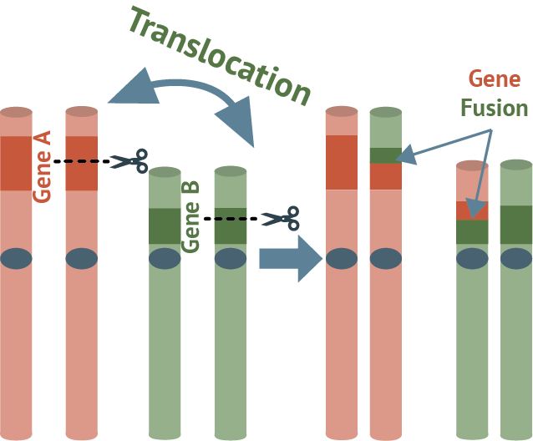
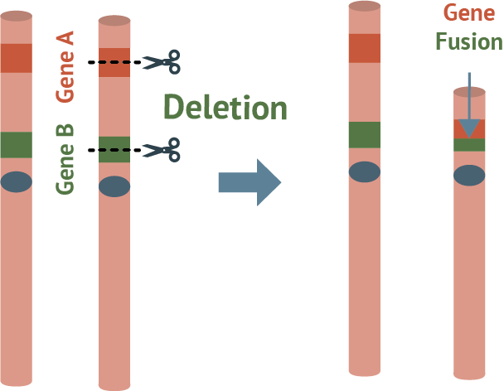
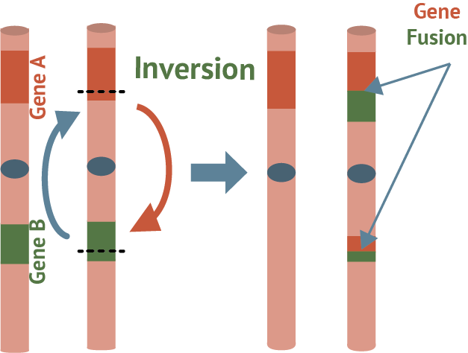
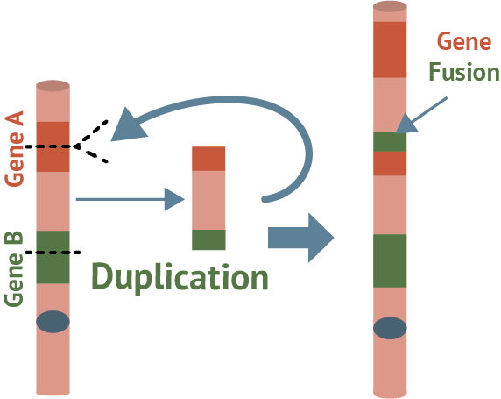
What is a fusion?
Definition
Translocation
Deletion
A novel gene product that is created from two previously separate and independent genes. Gene fusions may arise from genomic rearrangements such as:
Chromosomal translocations: the joining of DNA that previously resided within different chromosomal locations
Interstitial deletions: deletions that occur because of two breakpoints and the rejoining of the terminal end to the main chromosome
Inversions: a region of chromosomal DNA that is reversed
Tandem duplications: replication of the portion of the genomic sequence immediately adjacent to the duplication
Inversion
Duplication
DNA, deoxyribonucleic acid
Chakravarty D, et al. J Clin Oncol. 2022;40:1231-1258

Slide 9
Why are fusions oncogenic?
The instructions for how to make TRK proteins are stored in the double-stranded DNA
DNA is converted to single-stranded RNA for the instructions to be read
TRK proteins are assembled using the genetic information stored in NTRK genes
No cancer (normal cell growth)
Grow!
Normal
NTRK gene
TRK protein
Binds with activator molecules that help control cell growth
Molecules naturally separate after activation
Partner gene
Grow!
Grow!
Grow!
Grow!
Grow!
Grow!
TRK fusion cancer
NTRK gene fusion formed by joining with unrelated partner gene
TRK fusion protein
No activator molecule required to turn on cell growth
Signal for cells to divide remains ‛on’
TRK fusion cancer (uncontrolled cell growth)
DNA, deoxyribonucleic acid; NTRK, neurotrophic tyrosine receptor kinase; RNA, ribonucleic acid; TRK, tropomyosin receptor kinase
Rudzinski ER, et al. Future Oncol. 2022;18:4141-4151

Slide 10
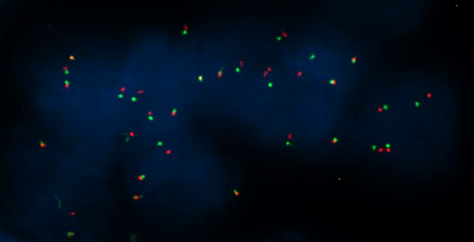
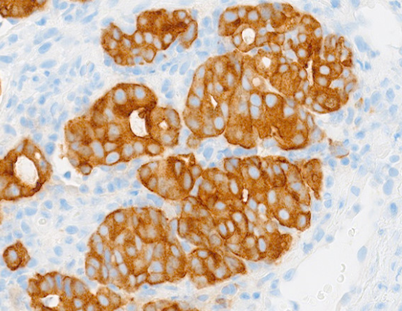
How can we identify fusions?
Fluorescence in situ hybridisation
Break-apart pattern
Immunohistochemistry
Cytoplasmic/membranous
Next generation sequencing
TPM3
NTRK1
NTRK1, neurotrophic tyrosine receptor kinase 1; TPM3, tropomyosin 3
Images provided by Dr Fernando Lopez-Rios

Slide 11
Immunohistochemistry (IHC)
Immunohistochemistry
Gene fusions detected | ALK, ROS1, NTRK
Advantages | Low input material Short turnaround time Usually, high sensitivity Low cost
Challenges | Specificity (ROS1 and NTRK positivity need to be confirmed by a genomic method)
ALK, anaplastic lymphoma kinase; NTRK, neurotrophic tyrosine receptor kinase; ROS1, ROS proto-oncogene 1 receptor tyrosine kinase

Slide 12
Fluorescence in situ hybridiSation (FISH)
Flourescence in-situ hybridisation
Methods | Break-apart probes
Advantages | Low input material Short turnaround time Usually, high specificity & sensitivity Low cost
Challenges | Interpretation

Slide 13
Real-time PCR
Real-time PCR
Methods | RNA real-time PCR
Advantages | Low input material Short turnaround time Usually, high specificity & sensitivity Low cost
Challenges | RNA failure rate Design of the assay Risk of false negatives Width – could miss certain alterations depending on selected design
Persevere if RNA fails
Re-test (different block/specimen)
Re-biopsy
Use another assay
Low width:
High width:
RNA, ribonucleic acid; PCR, polymerase chain reaction

Slide 14
Next-generation sequencing (NGS)
Next-generation sequencing
Methods | The study of thousands of genomic alterations
Advantages | Comprehensive Usually high specificity & sensitivity
Challenges | Longer turnaround time High cost Reduced sensitivity of DNA-only NGS for fusion testing RNA failure rate of RNA-only NGS
C
Chip-use optimisation
Persevere if RNA fails
Re-test (different block/specimen)
Re-biopsy
Use single analyte assays
Persevere if DNA-only NGS is negative
Use an RNA-based method
DNA, deoxyribonucleic acid; NGS, next-generation sequencing; RNA, ribonucleic acid

Slide 15
When should we search for fusions?
Gene fusions have a pivotal role in lung carcinoma
NTRK rearrangement (0.23%)
RET rearrangement (1.7%)
BRAF V600E mutation (2.1%)
HER2 exon 20 insertion mutation (2.3%)
ROS1 rearrangement (2.6%)
◼︎ No actionable alteration
MET exon 14 mutation (3.0%)
ALK rearrangement (3.8%)
◼︎ Other KRAS mutation
◼︎ KRAS G12C mutation
◼︎ Other EGFR mutation
◼︎ EGFR exon 20 insertion mutation
Outer circle: Asian populations
Inner circle: Western populations
◼︎ EGFR exon 19 deletion and L858R mutation
BRAF, B-Raf proto-oncogene; EGFR, epidermal growth factor receptor; HER2, human epidermal growth factor receptor 2; KRAS, Kirsten ras oncogene; MET, MET proto-oncogene; NTRK, neurotrophic tyrosine receptor kinase; RET, RET proto-oncogene; ROS1, ROS proto-oncogene 1 receptor tyrosine kinase
Tan AC and Tan DSW. J Clin Oncol. 2022;40:611-625

Slide 16
Distribution of kinase fusions across primary sites
The tumour agnostic (r)evolution
 | ALK | ROS1 | RET | NTRK1/2/3 | FGFR1/2/3 | BRAF/CRAF
Brain |  | X |  | X | X | X
Parotid gland |  |  |  | X
Oesophagus | X
Head and neck |  |  |  | X | X
Thyroid | X |  | X | X | X | X
Lung | X | X | X | X | X | X
Breast | X | X | X | X | X
Bones/soft tissue | X | X |  | X
Skin | X | X | X | X |  | X
Stomach |  | X |  |  | X | X
Liver/gall bladder | X | X |  | X | X
Pancreas |  |  |  |  |  | X
Kidney | X |  |  | X | X
Colon/rectum | X | X | X | X |  | X
Ovary |  | X
Bladder | X |  |  |  | X
Prostate |  |  |  |  | X | X
ALK, anaplastic lymphoma kinase; BRAF, B-Raf proto-oncogene; CRAF, c-RAF proto-oncogene; FGFR1/2/3, fibroblast growth factor receptor 1/2/3; NTRK1/2/3, neurotrophic tyrosine receptor kinase 1/2/3; RET, RET proto-oncogene; ROS1, ROS proto-oncogene 1 receptor tyrosine kinase
Schram AM, et al. Nat Rev Clin Oncol. 2017;14:735-748

Slide 17
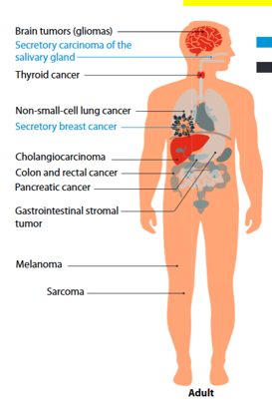
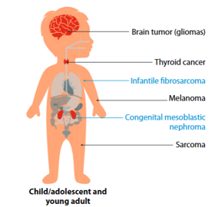
Types of NTRK fusion-positive cancers in children and adults
Brain tumours (gliomas)
Secretory carcinoma of the salivary gland
Thyroid cancer
Brain tumour (gliomas)
Non-small-cell lung cancer
Thyroid cancer
Secretory breast cancer
Infantile fibrosarcoma
Melanoma
Cholangiocarcinoma
Colon and rectal cancer
Congenital mesoblastic nephroma
Pancreatic cancer
Sarcoma
Gastrointestinal stromal tumour
Child/adolescent and young adult
Melanoma
Sarcoma
Rare tumours with high TRK fusion protein frequency
More common tumours with low TRK fusion protein frequency
Adult
NTRK, neurotrophic tyrosine receptor kinase; TRK, tropomyosin receptor kinase
Rudzinski ER, et al. Future Oncol. 2022;18:4141-4151

Slide 18
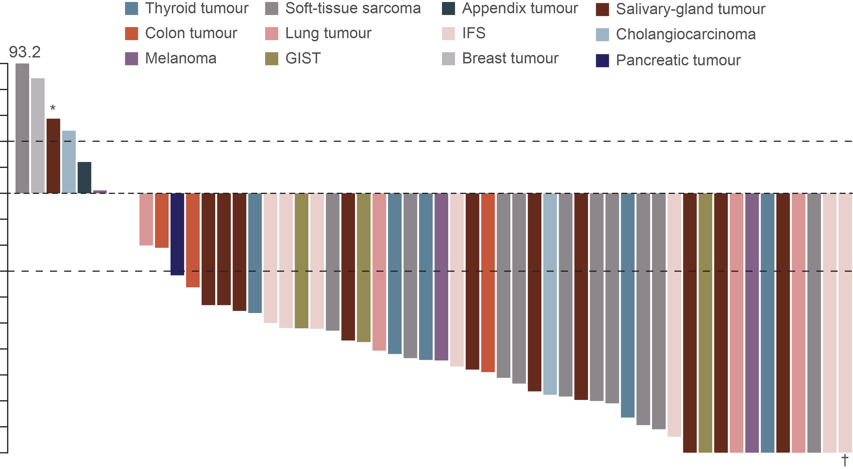
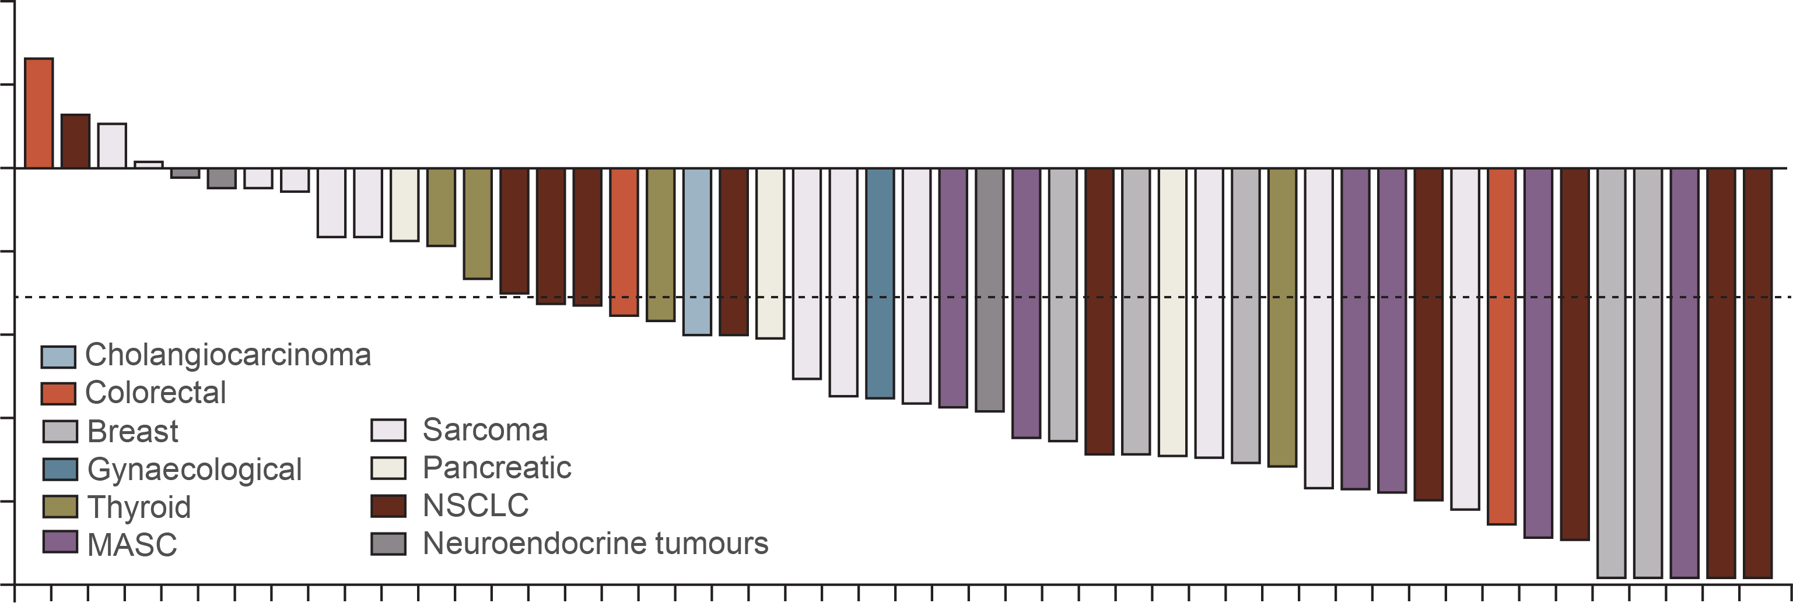
Initial Efficacy results of APPROVED trk inhibitors: Responses by tumour type
Larotrectinib¹
Entrectinib²
Data cut-off: 17 July 2017
Data cut-off: 31 May 2018
50
40
30
20
10
0
–10
–20
–30
–40
–50
–60
–70
–80
–90
–100
40
20
0
–20
Greatest change from baseline in sum of largest diameter in target lesions (%)
Maximum change tumour size (%)
–40
–60
–80
–100
Objective responses with larotrectinib are seen in multiple tumour types and in most of the patients:
Objective responses with entrectinib are seen in multiple tumour types and in most of the patients:
80%, 95% CI: 67-90
57%, 95% CI: 43.2-70.8
One patient (dagger) had a pathological complete response
CI, confidence interval; GIST, gastrointestinal stromal tumour; IFS, infantile fibrosarcoma; MASC, mammary analogue secretory carcinoma; NSCLC, non-small-cell lung cancer; TRK, tropomyosin receptor kinase
1. Drilon A, et al. N Engl J Med. 2018;378:731-739; 2. Doebele RC, et al. Lancet Oncol. 2020;21:271-282

Slide 19
types of RET-rearranged tumours
Focus on gastro-intestinal and neuroendocrine?
ARROW: pralsetinib in patients with RET‑fusion positive tumours¹
LIBRETTO-001: selpercatinib in patients with RET-fusion positive tumours^{a2}
Tumour type, n (%) | RET fusion-positive solid tumours
 | Efficacy-evaluable population (n=23) | Safety population (n=29)
Pancreatic | 4 (17) | 5 (17)
Cholangiocarcinoma | 3 (13) | 4 (14)
Neuroendocrine | 3 (13) | 3 (10)
Sarcoma | 3 (13) | 3 (10)
Head and neck | 2 (9) | 2 (7)
Colorectal | 2 (9) | 5 (17)
SCLC | 2 (9) | 2 (7)
Unknown primary | 1 (4) | 1 (3)
Gastric | 1 (4) | 1 (3)
Ovarian | 1 (4) | 1 (3)
Thymic | 1 (4) | 1 (3)
CNS | 0 | 1 (3)
Primary tumour diagnosis, n (%) | RET fusion tumour-agnostic population (n=45)
Pancreatic | 12 (27)
Colon | 10 (22)
Salivary | 4 (9)
Sarcoma | 3 (7)
Unknown primary | 3 (7)
Breast | 2 (4)
Carcinoma of the skin | 2 (4)
Cholangiocarcinoma | 2 (4)
Xanthogranuloma | 2 (4)
Carcinoid | 1 (2)
Ovarian | 1 (2)
Pulmonary carcinosarcoma | 1 (2)
Rectal neuroendocrine | 1 (2)
Small intestine | 1 (2)
ª excluding lung and thyroid
CNS, central nervous system; RET, RET proto-oncogene; SCLC, small-cell lung cancer
1. Subbiah V, et al. Nat Med. 2022;28:1640-1645; Subbiah V, et al. Lancet Oncol. 2022;23:1261-1273

Slide 20
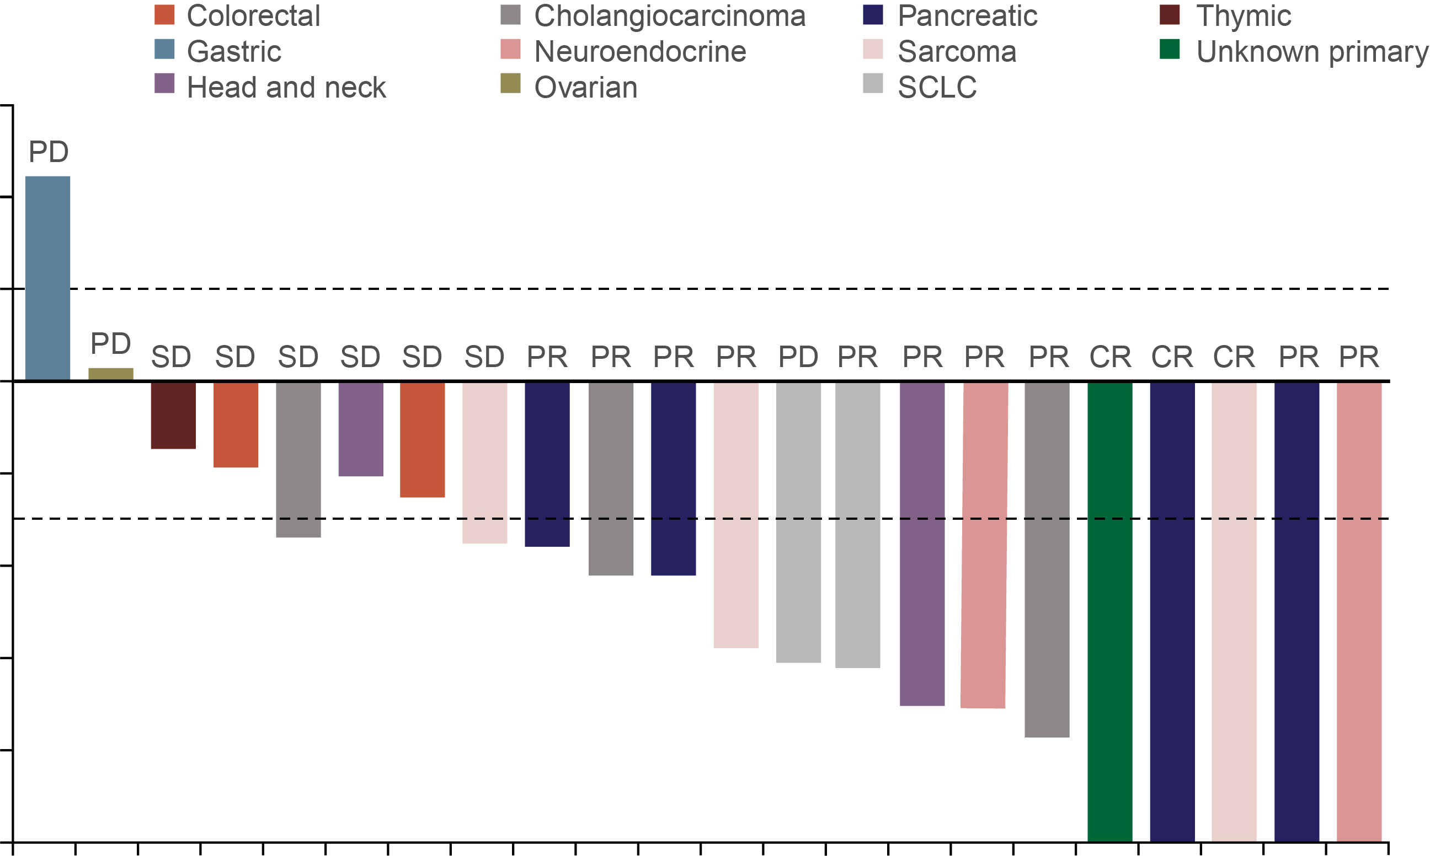
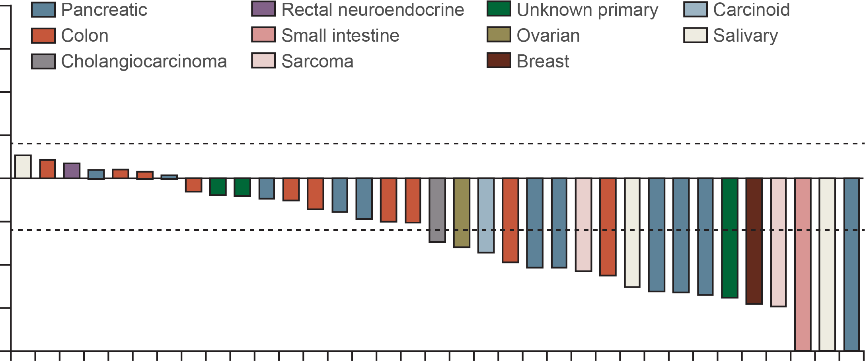
Initial Efficacy results of RET inhibitors: Responses by tumour type
ARROW: pralsetinib¹
LIBRETTO-001: selpercatinib²
Data cut-off: 18 Oct 2021
Data cut-off: 24 Sep 2021
60
100
40
75
20
+20%
50
0
25
Maximum change from baseline in target lesion size (%)
0
–20
Percentage change from baseline in sum of diameters (%)
–30%
–25
–40
–50
–60
–75
–80
–100
–100
Objective responses with pralsetinib are seen in multiple tumour types and in most of the patients:
Objective responses with selpercatinib are seen in multiple tumour types and in most of the patients:
57%, 95% CI: 35-77
43.9%, 95% CI: 28.5-60.3
CI, confidence interval; CR, complete response; PD, progressive disease; PR, partial response; RET, RET proto-oncogene; SCLC, small-cell lung cancer; SD, stable disease
1. Subbiah V, et al. Nat Med. 2022;28:1640-1645; 2. Subbiah V, et al. Lancet Oncol. 2022;23:1261-1273

Slide 21
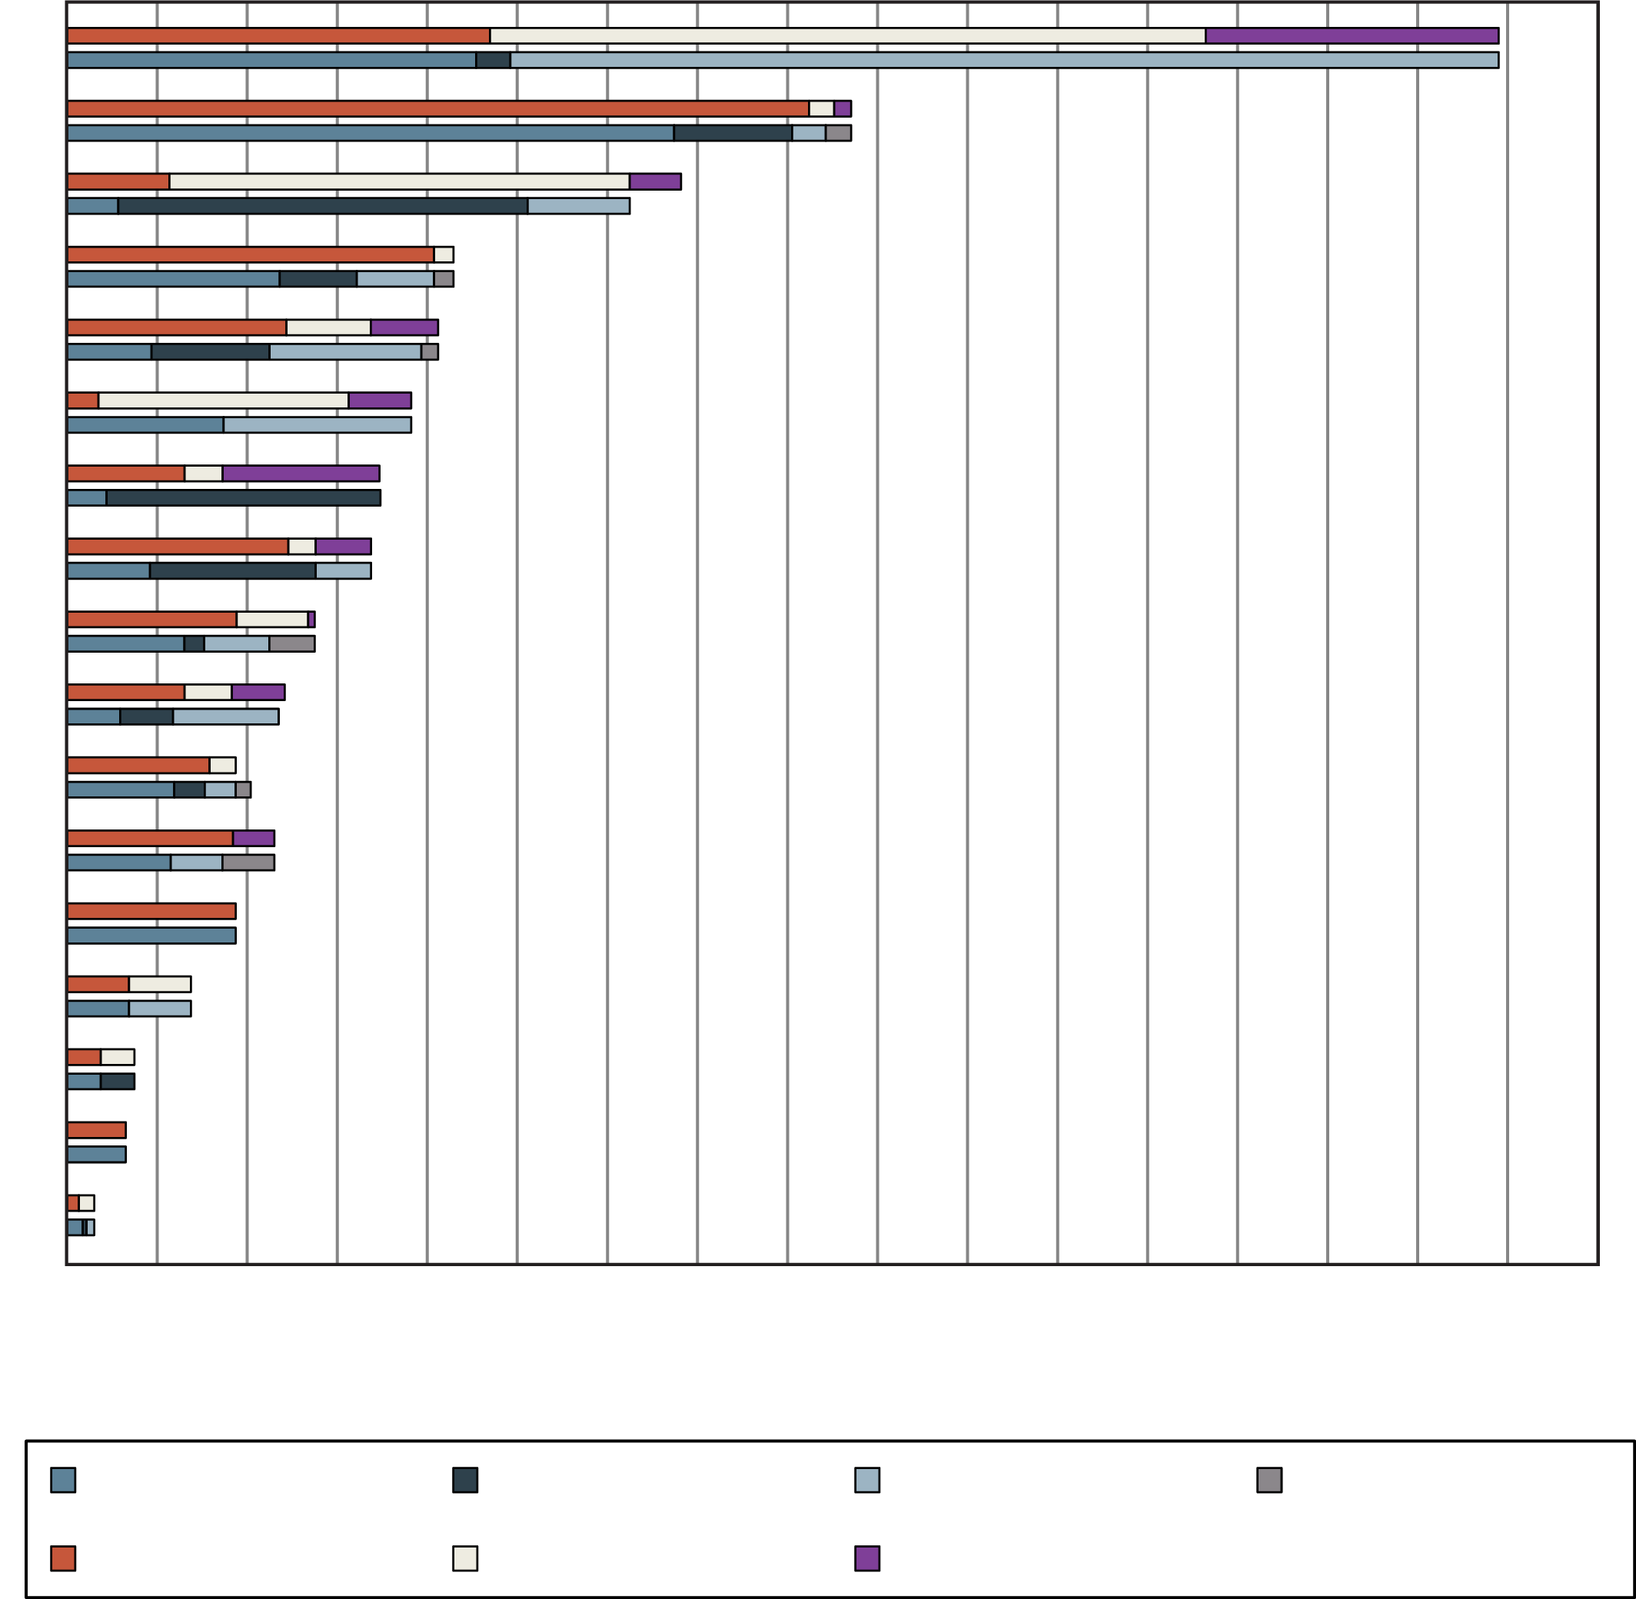
FGFR fusions are common in a wide variety of cancers
Urothelial carcinoma
Breast carcinoma
Endometrial adenocarcinoma
Ovarian carcinoma
Carcinoma unknown primary
Glioma
Cholangiocarcinoma
Gastric adenocarcinoma
Non-small cell lung carcinoma
Pancreatic exocrine carcinoma
Colorectal carcinoma
Renal cell carcinoma
Neuroendocrine carcinoma
Head and neck (squamous)
Melanoma
Leiomyosarcoma
Sarcoma (all)
4,853 solid tumours analysed on physician request by NGS
FGFR aberrations were found in 7.1% of cancers [66% gene amplifications, 26% mutations, 8% rearrangements]
FGFR1 was affected in 3.5% of 4,853 patients; FGFR2 in 1.5%; FGFR3 in 2.0%; and FGFR4 in 0.5%
0
2
4
6
8
10
12
14
16
18
20
22
24
26
28
30
32
34
Percentage of tumours with aberration
FGFR1
FGFR2
FGFR3
FGFR4
Amplification
Mutation
Rearrangement
FGFR(1/2/3/4), fibroblast growth factor receptor (1/2/3/4); NGS, next-generation sequencing
Helsten T, et al. Clin Cancer Res. 2016;22:259-267

Slide 22
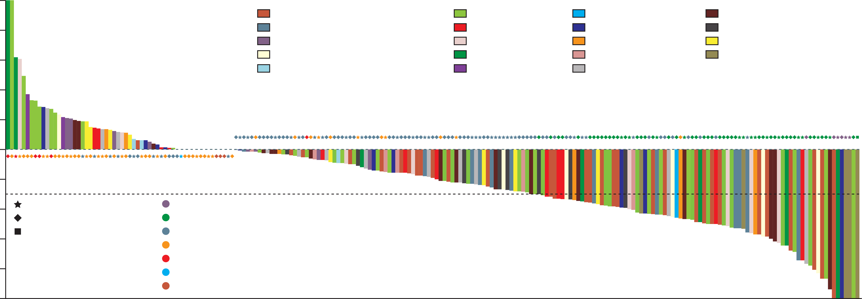
RAGNAR trial – Erdafitinib in FGFR-altered advanced solid tumours
100
Tumour histology
Cholangiocarcinoma
Squamous-cell head and neck cancers
Colorectal cancer
Ovarian cancer
Soft-tissue sarcoma
High-grade glioma
Squamous NSCLC
Endometrial cancer
Low-grade glioma
Prostate cancer
Pancreatic cancer
Non-squamous NSCLC
Oesophageal cancer
Cervical cancer
Others
Breast cancer
Carcinoma of unknown primary
Gastric cancer
Salivary gland cancer
80
60
40
20
Maximal reduction from baseline (%)
0
−20
−40
FGFR mutation
FGFR fusion
FGFR mutation and fusion
Complete response
Partial response
Stable disease
Progressive disease
Non-progressive disease
Non-complete response–non-progressive disease
Not evaluable
−60
−80
−100
Patients
FGFR, fibroblast growth factor receptor; NSCLC, non-small cell lung cancer
Pant S, et al. Lancet Oncol. 2023;24:925-935

Slide 23
The Tipping Point for NGS
The need to search for actionable fusions
NTRK
the tipping point
‟It looked smaller from the bottom!! Just gotta keep pushing”
‟whoo hoo!”
ALK, ROS1
RET, FGFR, etc…
It gets easier from here, and if you hit another hill you’ve got some momentum behind you
A lot of hard work & slow momentum
ALK, anaplastic lymphoma kinase; FGFR, fibroblast growth factor receptor; NGS, next-generation sequencing; NTRK, neurotrophic tyrosine receptor kinase; RET, RET proto-oncogene; ROS1, ROS proto-oncogene 1 receptor tyrosine kinase

