Slide 1
metastatic pancreatic ductal adenocarcinoma (mPDAC): from diagnosis to treatment micro learning module one diagnosis and management of mpdac
Prof. Efrat Dotan
Penn Medicine, Ann B. Barshinger Cancer Institute, PA, USA
Prof. Shubham Pant
MD Anderson Cancer Center, TX, USA
DECEMBER 2024

Slide 2

Developed by GI COnnect
This programme is developed by GI CONNECT,
an international group of experts in the field
of gastrointestinal oncology.
Acknowledgement and disclosures
This GI CONNECT programme is supported through an independent educational grant from Ipsen USA. The programme is therefore independent, the content is not influenced by the supporter and is under the sole responsibility of the experts.
Please note: The views expressed within this programme are the personal opinions of the experts. They do not necessarily represent the views of the experts’ institutions, or the rest of the GI CONNECT group.
Expert disclosures:
Prof. Efrat Dotan has received financial support/sponsorship for research support, consultation, or speaker fees from the following companies: Amgen, Dragonfly, Gilead, Incyte, Ipsen, Kinnate, Leap therapeutics, Lutris, MedImmune, Merck, MERUS, Olympus, Pfizer, Relay, TME biopharmaceuticals, Zymeworks
Prof. Shubham Pant has received financial support/sponsorship for research support, consultation, or speaker fees from the following companies: Alligator Bioscience, Amal Therapeutics, Arcus, AskGene Pharma, Astellas, AstraZeneca, BioNTech, Boehringer Ingelheim, BPGBio, Bristol-Myers Squibb, Elicio, Framewave, Immuneering, ImmunoMET, Ipsen, Janssen, Jazz, Lilly, Mirati Therapeutics, NGM Pharmaceuticals, Nihon Medi-Physics Co, Ltd, Novartis, Pfizer, Revolution Medicine, Theriva Biosciences, USWorldmeds, Zymeworks

Slide 3


This programme has been developed by experts
Prof. Efrat Dotan
Penn Medicine, Ann B. Barshinger Institute, USA
Prof. Shubham Pant
MD Anderson Cancer Center, USA

Slide 4
Educational objectives
Educational objectives
Be able to identify mPDAC early signs and symptoms to engage in the appropriate testing strategy for an early diagnosis
Be able to differentiate the efficacy and safety profiles of chemotherapies for mPDAC
Recognise how to optimise chemotherapies for patients with mPDAC, and understand the optimal combination of treatments

Slide 5
Clinical takeaways
Pancreatic ductal adenocarcinoma (PDAC) is usually diagnosed at an advanced, incurable stage due to non-specific symptoms and has an extremely poor prognosis
Recognition of symptoms and known risk factors is important for an early diagnosis
Systemic chemotherapy is the standard treatment for mPDAC but molecularly targeted treatments and immunotherapies may have a role for specific patients
Choice of treatment depends on several factors, including patients' performance status and co-morbidities

Slide 6
What is the issue?

Slide 7
Pancreatic ductal adenocarcinoma
Pancreatic ductal adenocarcinoma (PDAC) is a highly devastating disease with poor prognosis and rising incidence and accounts for the majority (90%) of pancreatic neoplasms.¹ Typically after
diagnosis, only 13% live for 5 years²
PDAC is the third-leading cause of cancer mortality in the US and the seventh-leading cause
worldwide.^{2,3} It is projected to become the second-leading cause of cancer-related mortality by 2030³
  Approximately 1.7% of men and women will be diagnosed with pancreatic cancer at some point during
  their lifetime²
In 2024, estimated numbers in the US are:
  66,440 new cases (3.3% of all new cancer cases)²
  51,750 deaths (8.5% of all cancer deaths)²
Pancreatic cancer is difficult to diagnose due to the lack of early symptoms and 80-90% of
patients have unresectable tumours due to the advanced stage at diagnosis⁴
Surgery, chemotherapy and radiation are the primary treatment options for pancreatic cancer¹
US, United States
1. Orth M, et al. Radiat Oncol. 2019;14:141; 2. Cancer Stat Facts: Pancreatic Cancer. Available from: https://seer.cancer.gov/statfacts/html/pancreas.html. Accessed October 2024; 3. Park W, et al. JAMA. 2021; 326:851-862; 4. Rawla P, et al. World J Oncol. 2019;10:10-27

Slide 8
pancreatic cancer has a low 5-year survival rate
Estimated new cases in 2024 | 66,440
% of all new cancer cases | 3.3%
5-year relative survival
12.8%
2014-2020
Estimated deaths in 2024 | 51,750
% of all cancer deaths | 8.5%
14
12
10
8
Rate per 100,000 persons
Rate of new cases
Death rate
6
4
2
0
1992
1996
2000
2004
2008
2012
2016
2022
Year
New cases come from SEER 12. Deaths come from U.S. Mortality.
All Races, Both Sexes. Rates are Age-Adjusted
SEER, Surveillance, Epidemiology, and End Results program
Cancer Stat Facts: Pancreatic Cancer. Available from: https://seer.cancer.gov/statfacts/html/pancreas.html. Accessed October 2024

Slide 9
Pancreatic cancer is most frequently diagnosed in people aged 65-74
Pancreatic cancer is most frequently diagnosed among people aged 65-74 years
Median age at diagnosis
70 years old
Percent of new cases
Age (years)
SEER, Surveillance, Epidemiology, and End Results program
Cancer Stat Facts: Pancreatic Cancer. Available from: https://seer.cancer.gov/statfacts/html/pancreas.html. Accessed October 2024

Slide 10
Majority of patients have advanced disease at diagnosis and a poor prognosis
Percent of cases by stage at diagnosis
5-year relative survival
Localised (14%)
Confined to primary site
Regional (29%)
Spread to regional lymph nodes
Distant (51%)
Cancer has metastasized
Unknown (6%)
Unstaged
Percent
Stage
SEER, Surveillance, Epidemiology, and End Results program
Cancer Stat Facts: Pancreatic Cancer. Available from: https://seer.cancer.gov/statfacts/html/pancreas.html. Accessed October 2024

Slide 11
Risk factors and clinical presentation

Slide 12
Risk factors
Modifiable/clinical¹⁻⁴
Non-modifiable^{1-3,5,6}
Smoking
Alcohol consumption
Being overweight
Dietary factors
Personal history of chronic pancreatitis
Personal history of diabetes
Age
  most frequently diagnosed:
  65-74 years of age
  median age at diagnosis of 70 years
Family history of pancreatic cancer
Hereditary conditions (~10-15%
of PDAC cases):
  hereditary pancreatitis
  Lynch syndrome
  mutations in the genes such as BRCA2, PALB2, ATM
ATM, ataxia-telangiectasia mutated; BRCA2, BReast CAncer 2 gene; PALB2, partner and localiser of BRCA2, PDAC, pancreatic ductal adenocarcinoma; SEER, Surveillance, Epidemiology, and End Results program
1. Ushio J, et al. Diagnostics (Basel) 2021;11(3): 562. doi: 10.3390/diagnostics11030562; 2. Gupta N, et al. World J Gastroenterol. 2021;27:3158-81; 3. Wood L, et al. Gastroenterology 2022;163:386-402; 4. Dong-Mei M, et al. Technol Cancer Res Treat. 2023; 22: doi: 10.1177/15330338231164875; 5. Cancer Stat Facts: Pancreatic Cancer. Available from: https://seer.cancer.gov/statfacts/html/pancreas.html. Accessed October 2024; 6. Copur MS, et al. Oncology (Williston Park). 2020;34:196-201.

Slide 13
Pdac symptoms and clinical presentation
Early-stage disease is usually clinically silent and can present as an incidental finding or symptoms related to local tumour effect (ie. painless jaundice)¹
Symptoms are generally non-specific
  Abdominal pain is the most frequently reported clinical symptom
  Other symptoms typically present when the tumour has grown and metastasised. These include:
    Weight loss^{1,2}
    Fatigue³
    Floating stools²
    Pain¹
    Pruritus¹
    Jaundice^{1,2}
    Nausea and vomiting²
NCCN, National Comprehensive Cancer Network; PDAC, pancreatic ductal adenocarcinoma
1. Schawkat K, et al. Radiographics 2020; 40:1219-1239; 2. NCCN Guidelines Version 3.2024. Available at: https://www.nccn.org/guidelines/guidelines-detail?category=1&id=1455. Accessed October 2024. 3. Rawla P, et al. World J Oncol. 2019;10:10-27

Slide 14
Diagnosis and evaluation

Slide 15
Diagnostic modalities
Imaging is the main tool for diagnosis^{1,2}
Computed tomography (CT) and Magnetic Resonance Imaging (MRI) – gold standard
Endoscopic ultrasound – obtain tissue for cytological diagnosis
Endoscopic retrograde cholangiopancreatography (ERCP)
Positron emission tomography–computed tomography (PET/CT)
Magnetic resonance cholangiopancreatography (MRCP)
Tumour markers
CA19-9: biomarker tool for monitoring and diagnosis of PDAC, however:
  up to 10% of the PDAC population is a CA19-9 non-secretor¹
  sensitivity of biomarker test approx. 80%¹
  useful in symptomatic patients but not in asymptomatic patients as not tumour specific²
CEA: can be useful in the diagnosis of pancreatic cancer when paired with CA19-9³
CA19-9, carbohydrate antigen 19-9; CEA, carcinoembryonic antigen; PDAC, pancreatic ductal adenocarcinoma
1. Bugazia D, et al. Front Oncol. 2024;14:1386699; 2. Rawla P, et al. World J Oncol. 2019;10:10-27;
3. Meng Q, et al. Onco Targets Ther. 2017;10:4591-4598

Slide 16
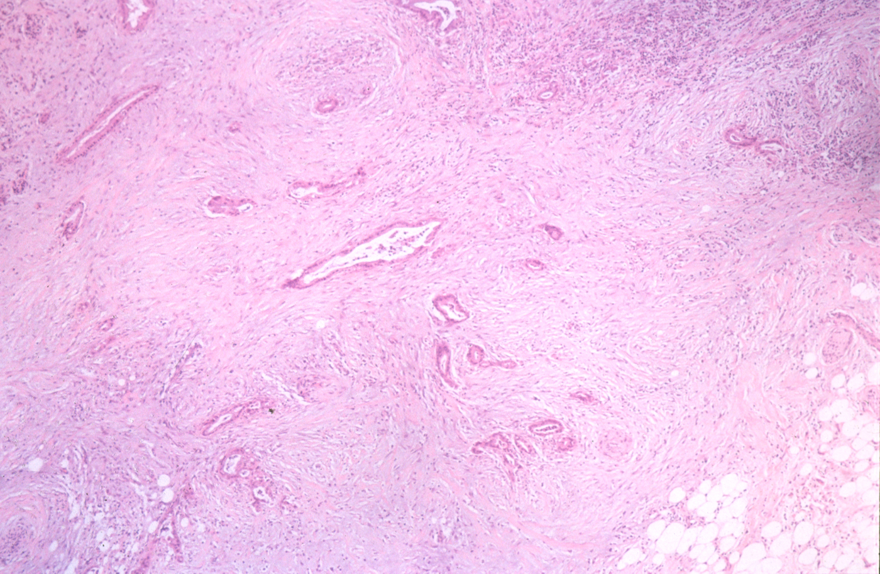
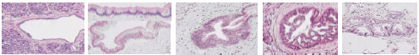
Microenvironment of pdac
PATHOLOGY AND MOLECULAR ALTERATIONS OF PANCREATIC DUCT LESIONS
Normal duct
Low cuboidal cells
Single cell layer
PanIN-1A
Elongated cells
Mucin production
PanIN-1B
Papillary
architecture
PanIN-2
Nuclear abnormalities:
e.g. enlargement,
some loss of polarity,
crowding
PanIN-3
Budding into lumen
Severe nuclear
atypia
Mitosis, some
abnormal
AdenoCA
Invasive growth
Marked stromal
reaction
(desmoplasia)
tumour
fibrosis
ERBB2,
EGFR
KRAS
INK4A
Type of lesion
Activation
Loss of function
TP53
SMAD4/DPC4
BRCA2*
Telomerase
Image provided by Dr Efrat Dotan
Telomere length
Solid lines correspond to alterations that are detected at significant levels at the indicated stages. Broken lines correspond to alterations that may occur at the indicated stages but require further validation.
AdenoCA, adenocarcinoma; BRCA2, BReast CAncer 2 gene; EGFR, epidermal growth factor receptor; ERBB2, erb-b2 receptor tyrosine kinase 2; INK4A, inhibitor of CDK4 (cyclin-dependent kinase 4); KRAS, Kirsten rat sarcoma viral oncogene homolog; PanIN-1A/1B/2/3, pancreatic intraepithelial neoplasia 1A/1B/2/3; PDAC, pancreatic ductal adenocarcinoma; TP53, tumour protein p53 gene
Hruban R, et al. Am J Surg Pathology. 2001;25:579-586; Chiao P and Ling J. Cancer Discovery 2011; 1: 103-5

Slide 17
Genomic testing
Germline Genetic Testing^{1,2}
Recommended to test for inherited mutations for any patients with confirmed pancreatic cancer diagnosis
Comprehensive gene panels for hereditary cancer syndromes
Genetic counseling is recommended for patients who test positive for a pathogenic mutation (ATM, BRCA1, BRCA2, CDKN2A, MLH1, MSH2, MSH6, PALB2, PMS2, STK11, and TP53) or for patients with a positive family history of cancer, especially pancreatic cancer, regardless of mutation status.
Tumour/Somatic Molecular Profiling^{1,2}
Recommended for locally advanced/metastatic disease who are suitable for anti-cancer therapy
Panels should include but not be limited to: fusions (ALK, NRG1, NTRK, ROS1, FGFR2, and RET), mutations (BRAF, BRCA1/2, HER2, KRAS, and PALB2), amplifications (HER2), microsatellite instability (MSI), mismatch repair deficiency (dMMR), or tumour mutational burden (TMB)
Next generation sequencing is the gold standard method of detection. RNA sequencing assays are preferred for detecting RNA fusions and immunohistochemistry to detect HER2 overexpression
ATM, ataxia-telangiectasia mutated; BRAF, B-Raf proto-oncogene serine/threonine kinase; BRCA1/2, BReast CAncer 1/2 gene; DNA, deoxyribonucleic acid; FGFR2, fibroblast growth factor receptor 2; HER2, human epidermal growth factor receptor 2; KRAS, Kirsten rat sarcoma viral oncogene homolog; NCCN, National Comprehensive Cancer Network; NRG1, neuregulin-1; PALB2, partner and localiser of BRCA2; PDAC, pancreatic ductal adenocarcinoma; RET, rearranged during transfection; RNA, ribonucleic acid; ROS1, ROS proto-oncogene 1 receptor tyrosine kinase
1. NCCN Guidelines Version 3.2024. Available at: https://www.nccn.org/guidelines/guidelines-detail?category=1&id=1455. Accessed October 2024; 2. Zhen DB, et al. Therap Adv Gastroenterol 2023;16:17562848231171456

Slide 18
Overview of systemic Treatments for mpdac
mPDAC, metastatic pancreatic ductal adenocarcinoma

Slide 19
Overview of treatment for mpdac
Chemotherapy is the mainstay of treatment for mPDAC patients
Enrolment on clinical trials should always be encouraged
<50% eligible
First-line treatment
Olaparib Maintenance (only for gBRCAm pts)
Progression
Second-line treatment
Progression
Third line treatment
mPFS: 7.4
months
mPFS:
6 months
NALIRIFOX
FOLFIRINOX
Gem + Nab-paclitaxel
NalIRI
FOLFOX
FOLFIRINOX
Gem + Nab-paclitaxel
Targeted therapies if
molecular alteration identified
Progression
mPFS = 5.5-6.4 months
Figure adapted from Casolino 2022
FOLFIRINOX, folinic acid (leucovorin calcium), fluorouracil, irinotecan, and oxaliplatin; FOLFOX, folinic acid (leucovorin calcium), fluorouracil, and oxaliplatin; gBRCAm, germline BReast CAncer (BRCA) gene mutation; gem, gemcitabine; mPDAC, metastatic pancreatic ductal adenocarcinoma; mPFS, median progression-free survival; Nab, nanoparticle albumin-bound; Nal-IRI, nanoliposomal irinotecan; NALIRIFOX; Nal-IRI, fluorouracil/folinic acid (leucovorin calcium), and oxaliplatin; mPDAC, metastatic pancreatic adenocarcinoma; mPFS, median progression-free survival
Casolino R, Biankin AV. Camb Prism Precis Med. 2023;1:e14

Slide 20
Key studies of 1L systemic therapy for mpdac
Study setting | Study | Study type | Arm (N) | Primary endpoint | Primary endpoint |  | Secondary endpoint | Secondary endpoint |  | ORR (%) | Notable adverse events (Grade ≥3)
 |  |  |  |  | Months | HR (95% CI) |  | Months | HR (95% CI)
First-line | PRODIGE¹ (2011) | RCT, phase 2/3 | FOLFIRINOX (171) | OS | 11.1 | 0.57 (0.45 to 0.73) | PFS | 6.4 | 0.47 (0.37 to 0.59) | 31.6 | FOLFIRINOX vs Gem: neutropenia 47.5 vs 21.0%, febrile neutropenia 5.4 vs 1.2%, thrombocytopenia 9.1 vs 3.6%, diarrhoea 12.7 vs 1.8%
 |  |  | Gemcitabine (171) |  | 6.8 |  |  | 3.3 |  | 9.4
First-line | MPACT² (2013) | RCT, phase 3 | Gem + NabP (431) | OS | 8.5 | 0.72 (0.62 to 0.83) | PFS | 5.5 | 0.69 (0.58 to 0.82) | 23.0 | Gem + NabP vs Gem: Neutropenia 38.0 vs. 27.0%, leukopenia 31.0 vs 16.0%, thrombocytopenia 13.0 vs 9.0%, fatigue 17.0 vs. 7.0%, and neuropathy 17.0 vs. 1.0%
 |  |  | Gemcitabine (430) |  | 6.7 |  |  | 3.7 |  | 7.0
First-line | NAPOLI-3³ (2023) | RCT, phase 3 | NALIRIFOX (383) | OS | 11.1 | 0.83 (0.70-0.99) | PFS | 7.4 | 0.69 (0.58-0.83) | 41.8 | NALIRIFOX vs Gem + NabP: hypokalaemia 15.0 vs 4.0%, diarrhoea 20.0 vs 5.0%, nausea 12.0 vs 3.0%. Lower rates of hematological AE’s with NALIRIFOX: neutropenia 14.0 vs 25.0%, anaemia 11.0 vs 17.0%
 |  |  | Gem + NabP (387) |  | 9.2 |  |  | 5.6 |  | 36.2
Metastatic maintenanceª | POLO^{4,5} (2019, 2022) | RCT, phase 3 | Olaparib (92) | PFS | 7.4 | 0.53 (0.35 to 0.82) | OS | 19.0 | 0.83 (0.56 to 1.22) | 23.1^{b} | Olaparib vs placebo: Fatigue 5.6 vs 0%, anaemia 12.2 vs 3.3%, decreased appetite 3.3 vs 0%
 |  |  | Placebo (62) |  | 3.8 |  |  | 19.2 |  | 11.5^{b}
ª Patients with germline mutations in BRCA1 or BRCA2, who had received at least 16 weeks of continuous platinum-based chemotherapy as the first line treatment for metastatic pancreatic cancer, were enrolled; ^{b}At data cut-off 1
AE, adverse event; BRCA1/2, BReast CAncer 1/2 gene; CI, confidence interval; FOLFIRINOX, folinic acid (leucovorin calcium), fluorouracil, irinotecan, and oxaliplatin; Gem+ Nab-P, gemcitabine and nab (nanoparticle albumin-bound)-paclitaxel; HR, hazard ratio; mPDAC, metastatic pancreatic ductal adenocarcinoma; Nal‑IRI, nanoliposomal irinotecan; NALIRIFOX; Nal-IRI, fluorouracil/folinic acid (leucovorin calcium), and oxaliplatin; ORR, objective response rate; OS, overall survival; PFS, progression-free survival; RCT, randomised controlled trial
1. Conroy T et al, N Engl J Med. 2011;364:1817-25; 2. Von Hoff D, et al. N Engl J Med. 2013;369:1691-703; 3. Wainberg Z, et al. Lancet 2023;402:1272-81;
4. Golan T, et al. N Engl J Med. 2019;381:317-27; 5. Kindler H, et al. J Clin Oncol. 2022;40:3929-39

Slide 21
Key studies of 2L systemic therapy for mpdac
Study setting | Study | Study type | Arm (N) | Primary endpoint | Primary endpoint |  | Secondary endpoint | Secondary endpoint |  | ORR (%) | Notable adverse events
 |  |  |  |  | Months | HR (95% CI) |  | Months | HR (95% CI)
Second- line | CONKO-003¹ (2014) | RCT, phase 3 | OFF (77) | OS | 5.9 | 0.66 (0.48-0.91) | PFS | 2.9 | 0.68 (0.50-0.94) | – | Rates of adverse events were similar between treatment arms, with the exception of grades 1 to 2 neurotoxicity 38.2% and 7.1% in the OFF and FF groups
 |  |  | FF (91) |  | 3.3 |  |  | 2.0 |  | –
Second- line | PANCREOX² (2016) | RCT, phase 3 | mFOLFOX (54) | PFS | 3.0 | 1.00 (0.66-1.53) | OS | 6.1 | 1.78 (1.08-2.93) | 13.2 | Increased toxicity was observed with the addition of oxaliplatin, with grade 3/4 adverse events occurring in 63.0% of patients who received mFOLFOX6 and 11.0% of those who received FU/LV.
 |  |  | 5FU/LV (54) |  | 2.8 |  |  | 9.9 |  | 8.5
Second- line | NAPOLI-1³ (2016) | RCT, phase 3 | Nal-IRI + 5-FU/LV (117) | OS | 6.1 | 0.67 (0.49 to 0.92) | PFS | 3.1 | 0.56 (0.41 to 0.75) | 16.2 | Most frequent grade 3 or 4 AEs for Nal-IRI + 5-FU/LV vs 5-FU/LV: neutropenia 27.0 vs 1.0%, diarrhoea 13.0 vs 4.0%, vomiting 11.0 vs 3.0%, and fatigue 14.0 vs 4.0%
 |  |  | 5-FU/LV (119) |  | 4.2 |  |  | 1.5 |  | 0.8
5-FU, fluorouracil; AE, adverse event; CI, confidence interval; FF, folinic acid (leucovorin calcium) and fluorouracil; HR, hazard ratio; LV, leucovorin calcium (folinic acid); mFOLFOX, modified FOLFOX: folinic acid (leucovorin calcium), fluorouracil, and oxaliplatin; mPDAC, metastatic pancreatic ductal adenocarcinoma; Nal‑IRI, nanoliposomal irinotecan; OFF, oxaliplatin and FF; ORR, objective response rate; OS, overall survival; PFS, progression-free survival; RCT, randomised controlled trial
1. Oettle H, et al. J Clin Oncol. 2014; 32: 2423-9; 2. Gill S, et al. J Clin Oncol. 2016;10;3914-20; 3. Wang-Gillam A, et al. Lancet 2016;387:545-57

Slide 22
Considerations for treatment selection
Patient performance status is key factor for treatment selection
Age and frailty
Co-morbidities
Molecular profile
Patient preference
Supportive system
Jiang Y, et al. JCO Oncol Pract. 2023;19(1):19-32

Slide 23
Systemic therapies for good PS 0-1
BASED ON NCCN GUIDELINES
Targeted therapies
Useful in certain circumstances
FOLFIRINOX / mFOLFIRINOX
NALIRIFOX
Gemcitabine-based therapy:
Gemcitabine + Nab-paclitaxel
Gemcitabine + cisplatin for known BRCA1/2 or PALB2 mutations)
Entrectinib, Larotrectinib, Repotrectinib (NTRK fusion)
Dabrafenib + trametinib (BRAF V600E mutation)
Selpercatinib (RET fusion)
Pembrolizumab (MSI-H, dMMR, or TMB-H)
First-line
Maintenance
Olaparib maintenance, only for patients with germline BRCA1/2 mutations
Chemotherapy is recommended as front-line therapy for mPDAC patients, but targeted therapies may be useful in certain circumstances (e.g. if a patient can no longer tolerate chemotherapy)
Liposomal irinotecan (Nal-IRI) +FU/LV
Fluoropyrimidine-based therapy
Entrectinib, Larotrectinib, Repotrectinib (NTRK fusion)
Dabrafenib + trametinib (BRAF V600E mutation)
Selpercatinib (RET fusion)
Adagrasib, sotorasib (KRAS G12C)
Trastuzumab deruxtecan (HER2)
If no prior immunotherapy:
Pembrolizumab (MSI-H, dMMR, or TMB-H)
Dostarlimab (MSI-H or dMMR)
Nivolumab + ipilimumab (TMB-H)
Liposomal irinotecan (Nal-IRI) +FU/LV (if no prior irinotecan)
Gemcitabine
Gemcitabine-based therapy
Subsequent therapy
5-FU, fluorouracil; BRAF, B-Raf proto-oncogene serine/threonine kinase; BRCA1/2, BReast CAncer 1/2 gene; dMMR, deficient DNA mismatch repair; HER2, human epidermal growth factor receptor 2; KRAS, Kirsten rat sarcoma viral oncogene homolog; LV, leucovorin calcium (folinic acid); (m)FOLFIRINOX, (modified) FOLFIRINOX, folinic acid (leucovorin calcium), fluorouracil, irinotecan, and oxaliplatin; MSI-H, microsatellite instability-high; Nab, nanoparticle albumin-bound; Nal-IRI, nanoliposomal irinotecan; NALIRIFOX; Nal-IRI, fluorouracil/folinic acid (leucovorin calcium), and oxaliplatin; NCCN, National Comprehensive Cancer Network; NRG1, neuregulin-1; NTRK, neurotrophic tyrosine receptor kinase; PALB2, partner and localiser of BRCA2; PS, performance status; RET, rearranged during transfection; TMB-H, tumour mutational burden-high
NCCN Guidelines Version 3.2024. Available at: https://www.nccn.org/guidelines/guidelines-detail?category=1&id=1455. Accessed October 2024 NCCN guidelines for pancreatic adenocarcinoma, Version 3.2024: pancreatic.pdf (nccn.org)

Slide 24
Systemic therapies for intermediate PS 2 or higher
BASED ON NCCN GUIDELINES
Targeted therapies
Useful in certain circumstances
Capecitabine
FOLFOX, FOLFIRI, CapeOx
5-FU
Gemcitabine + Nab-paclitaxel
Gemcitabine
Entrectinib, Larotrectinib, Repotrectinib (NTRK fusion)
Dabrafenib + trametinib (BRAF V600E mutation)
Selpercatinib (RET fusion) [ECOG PS 2 only for first-line]
Pembrolizumab (MSI-H, dMMR, or TMB-H)
First-line
Chemotherapy is recommended as front-line therapy for mPDAC patients, but targeted therapies may be useful in certain circumstances (e.g. if a patient can no longer tolerate chemotherapy)
Maintenance
Olaparib maintenance, only for patients with germline BRCA1/2 mutations
Entrectinib, Larotrectinib, Repotrectinib (NTRK fusion)
Dabrafenib + trametinib (BRAF V600E mutation)
Selpercatinib (RET fusion) [ECOG PS 2 only for first-line]
Adagrasib, sotorasib (KRAS G12C)
If no prior immunotherapy:
Pembrolizumab (MSI-H, dMMR, or TMB-H)
Dostarlimab (MSI-H or dMMR)
Nivolumab + ipilimumab (TMB-H)
Liposomal irinotecan (Nal-IRI) +FU/LV (if no prior irinotecan)
Gemcitabine + Nab-paclitaxel
Gemcitabine
Liposomal irinotecan +FU/LV
Capecitabine
5-FU/LV
Subsequent therapy
5-FU, fluorouracil; BRAF, B-Raf proto-oncogene serine/threonine kinase; BRCA1/2, BReast CAncer 1/2 gene; CapeOX, capecitabine and oxaliplatin; dMMR, deficient DNA mismatch repair; FOLFOX, folinic acid (leucovorin calcium), fluorouracil, and oxaliplatin; FOLFIRI, folinic acid (leucovorin calcium), fluorouracil and irinotecan; KRAS, Kirsten rat sarcoma viral oncogene homolog; LV, leucovorin calcium (folinic acid); MSI-H, microsatellite instability-high; Nab, nanoparticle albumin-bound; NCCN, National Comprehensive Cancer Network; NRG1, neuregulin-1; NTRK, neurotrophic tyrosine receptor kinase; PALB2, partner and localiser of BRCA2; PS, performance status; RET, rearranged during transfection; TMB-H, tumour mutational burden-high
NCCN Guidelines Version 3.2024. Available at: https://www.nccn.org/guidelines/guidelines-detail?category=1&id=1455. Accessed October 2024;

Slide 25
Patients with Poor performance status and progressive disease
PALLIATIVE CARE
Single agent chemotherapy (gemcitabine)
Targeted therapy (based on molecular profiling and as clinically indicated)
Palliative radiotherapy
  To relieve pain, bleeding and/or local obstructive symptoms
NCCN, National Comprehensive Cancer Network
NCCN Guidelines Version 3.2024. Available at: https://www.nccn.org/guidelines/guidelines-detail?category=1&id=1455. Accessed October 2024

Slide 26
Best supportive care

Slide 27
mpdac Patients may require best supportive care alongside systemic treatment
Biliary stent
  To treat biliary obstruction
Pain management
Pancreatic enzyme replacement
  In patients with symptoms of exocrine enzyme deficiency
Physical therapy
  To improve QoL by controlling symptoms of pain, reducing fatigue, and strengthening weak muscles
mPDAC, metastatic pancreatic ductal adenocarcinoma; NCCN, National Comprehensive Cancer Network; QoL, quality of life
NCCN Guidelines Version 3.2024. Available at: https://www.nccn.org/guidelines/guidelines-detail?category=1&id=1455. Accessed October 2024; van Weert E, et al. Physical Therapy 2010; 90: 1413-1425

Slide 28
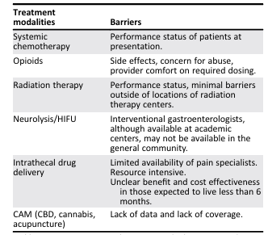
Pain management
Many patients continue to have cancer-related pain despite responding to chemotherapy
Pain management modalities can be used throughout the patient’s clinical course and to achieve optimal relief, can be switched or added to
CURRENT PAIN TREATMENTS
CURRENT PAIN TREATMENTS
Treatment modalities | Barriers
Systemic chemotherapy | Performance status of patients at presentation
Opioids | Side effects, concern for abuse, provider comfort on required dosing
Radiation therapy | Performance status, minimal barriers outside of locations of radiation therapy centers
Neurolysis/HIFU | Interventional gastroenterologists, although available at academic centers, may not be available in the general community
Intrathecal drug delivery | Limited availability of pain specialists Resource intensive Unclear benefit and cost effectiveness in those expected to live less than 6 months
CAM (CBD, cannabis, acupuncture) | Lack of data and lack of coverage
Radiation therapy | Neurolysis
HIFU
APAP | COX2i
Opioids immediate & extended release
IT drug
delivery
Pancreatic enzymes | Stents
Acupuncture | TENS
Increasing pain intensity
Dark coloured boxes, current standard of care; light coloured boxes, experimental modalities
APAP, acetaminophen; CAM, complementary and alternative medicine; CBD, cannabidiol; COX-2i, cyclooxygenase-2 inhibitor;
HIFU, high-intensity focused ultrasound; IT, intrathecal; TENS, transcutaneous electrical nerve stimulation.
Coveler AL, et al. Oncologist. 2021;26:e971-e982

Slide 29
Managing maldigestion and malabsorption
Pain
Anxiety
Depression
Loss of appetite
Pancreatic tumours often result in occlusion of the main pancreatic duct, impeding production of pancreatic enzymes or the transportation into the duodenum and resulting in pancreatic exocrine enzyme deficiency leading to malabsorption and postprandial pain^{1,2}
Pancreatic enzyme replacement therapy (PERT) may enhance nutritional status, helping the patient to undergo chemotherapy, increase quality of life
and overall survival¹
Psychological
factors
Malnutrition¹
Metabolic
factors
Gastrointestinal
factors
Diabetes mellitus,
due to cancer
or resection
Warburg effect
Pro-inflammatory
cytokine release by
tumour cells (IL-1,
IL-6, TNF-ɑ)
PEI due to tumour
growth or surgical
resection
Denervation
Anatomic diversion
Small intestinal
bacterial overgrowth
IL-1/6, interleukin 1/6; PEI, pancreatic exocrine insufficiency; TNF- α, tumour necrosis factor alpha
1. Pezzilli R, et al. Cancers (Basel). 2020;12:275; 2. Coveler AL, et al. Oncologist 2021;26:e971-e982

Slide 30
Targeted therapy in pancreatic cancer

Slide 31
Potential molecular targets in pdac
FAK TKI
CTGF Ab
Vitamin D Ag
FAP PRRT
DDR damaging therapy
PARP inh
ATR inh
Anti-PD1/anti-CTLA4
Anti-MSLN Ab
Anti-MSLN ADC
TCR-T, CAR-T cells
Anti-PD1/anti-CTLA4
20–25% of PDAC patients harbour targetable molecular alterations
Claudin 18.2 Ab, biAb
Claudin 18.2 ADC
CAR-T cells
Stroma
DDR
MSI
Anti-PD1
MSLN
Claudin 18.2
TMB
Anti-EGFR (TKI, Ab)
FGFR TKI
FGFR
KRAS^{WT}
KRAS G12C TKI
KRAS G12C + EGFR inh (Ab, TKI)
KRAS G12C + SOS1/SHP2 inh
p53 reactivator
TP53 Y220C
KRAS^{G12C}
MDM2
KRAS^{G12D,G12V,G12R}
KRAS G12D inh
Pan-RAS inh
siG12D LODER
KRAS vaccines
KRAS TCR T cells
MDM2/TP53 inh
ARID1A
HER2
EZH2 inh
HDAC6 inh
ATR inh
NTRK
NRG1
HER2 Ab, ADC, TKI
ALK
ROS1
BRAF
RET
HER2/HER3 biAb, TKI
Pan-EGFR inh
NTRK TKI
ALK/ROS TKI
RET TKI
BRAF/MEK TKI
ADC, antibody-drug conjugate; ALK, anaplastic lymphoma kinase; ARID1A, AT-rich interaction domain 1A; ATR, ataxia telangiectasia and Rad3-related protein; (bi)Ab, (bi-specific) antibody; BRAF, B-Raf proto-oncogene serine/threonine kinase; CAR-T, chimeric antigen receptor T-cell therapy; CTLA-4; cytotoxic T-lymphocyte-associated protein 4; DDR, DNA damage repair; EGFR, epidermal growth factor receptor; FAK, focal adhesion kinase; FAP, fibroblast activation protein; FGFR, fibroblast growth factor receptor; HDAC, histone deacetylase 6; inh, inhibitor; HER2/3, human epidermal growth factor receptor 2/3; KRAS, Kirsten rat sarcoma viral oncogene homolog; MEK, mitogen-activated protein kinase kinase; MSI, microsatellite instability; MSLN, mesothelin; NRG1, neuregulin-1; NTRK, neurotrophic tyrosine receptor kinase; PARP, poly(ADP-ribose) polymerase; PD-1, programmed cell death protein 1; PDAC, pancreatic ductal adenocarcinoma; PRRT, peptide receptor radionuclide therapy; RAS, rat sarcoma; RET, rearranged during transfection; ROS, ROS proto-oncogene receptor tyrosine kinase; siG12D LODER, small interfering RNA G12D Local Drug EluteR; TCR, T-cell receptor; TKI, tyrosine kinase inhibitor; TMB, tumour mutational burden; TP53, tumour protein p53 gene; WT, wild-type
Zhen DB, et al. Therap Adv Gastroenterol 2023;16:17562848231171456

Slide 32
Targeted therapy for pancreatic adenocarcinoma
Molecular Target | Targeted Therapy | NCCN panel recommendations
NTRK gene fusions | Larotrectinib | 1st line and subsequent treatment options for pts with NTRK gene fusion-positive locally advanced or metastatic pancreatic adenocarcinoma and for recurrent disease
 | Entrectinib
 | Repotrectinib | Category 2B recommendation as 1st line for patients with metastatic disease (PS 3) and subsequent therapy or therapy for recurrent disease for patients with intermediate/poor PS (PS 2-3)
RET gene fusions | Selpercatinib | 1st line: pts with locally advanced/metastatic disease (PS 0–2) and as subsequent therapy for pts with good PS (0–1)
NRG1 gene fusions | Zenocutuzumab-zbco | FDA approved for advanced, unresectable, or metastatic pancreatic adenocarcinoma harboring a NRG1 gene fusion with disease progression on or after prior systemic therapy. Awaiting incorporation into the NCCN guidelines
KRAS G12C mutations | Adagrasib | Subsequent therapy options for patients with any PS (category 2B for poor PS)
 | Sotorasib
BRAF V600E mutations | Dabrefenib/trametinib | 1st line: metastatic disease (category 2B) and as subsequent line options (category 2A) for pts with good/poor PS and BRAF V600E mutations
HER2-positive | Fam-trastuzumab-deruxtecan-nxki | As a subsequent therapy option only for patients with good PS and HER2 IHC 3+ expression
 | Pembrolizumab | In the advanced disease setting for first-line and subsequent treatment (if no prior immunotherapy)
 | Dostarlimab-gxly | As a subsequent treatment option (if no prior immunotherapy) for patients with MSI-H or dMMR locally advanced, metastatic, or recurrent pancreatic adenocarcinoma and any PS
 | Nivolumab/Ipilimumab | Category 2B, subsequent therapy option for patients with good or intermediate PS and those who did not receive prior immunotherapy
BRAF, B-Raf proto-oncogene serine/threonine kinase; dMMR, deficient DNA mismatch repair; HER2, human epidermal growth factor receptor 2; KRAS, Kirsten rat sarcoma viral oncogene homolog; MSI-H, microsatellite instability-high; NTRK, neurotrophic tyrosine receptor kinase; PDAC, pancreatic ductal adenocarcinoma; PS, performance status; RAS, rat sarcoma; RET, rearranged during transfection; TMB-H, tumour mutational burden-high
NCCN Guidelines Version 3.2024. Available at: https://www.nccn.org/guidelines/guidelines-detail?category=1&id=1455. Accessed October 2024 NCCN guidelines for pancreatic adenocarcinoma, Version 3.2024: pancreatic.pdf (nccn.org)

Slide 33
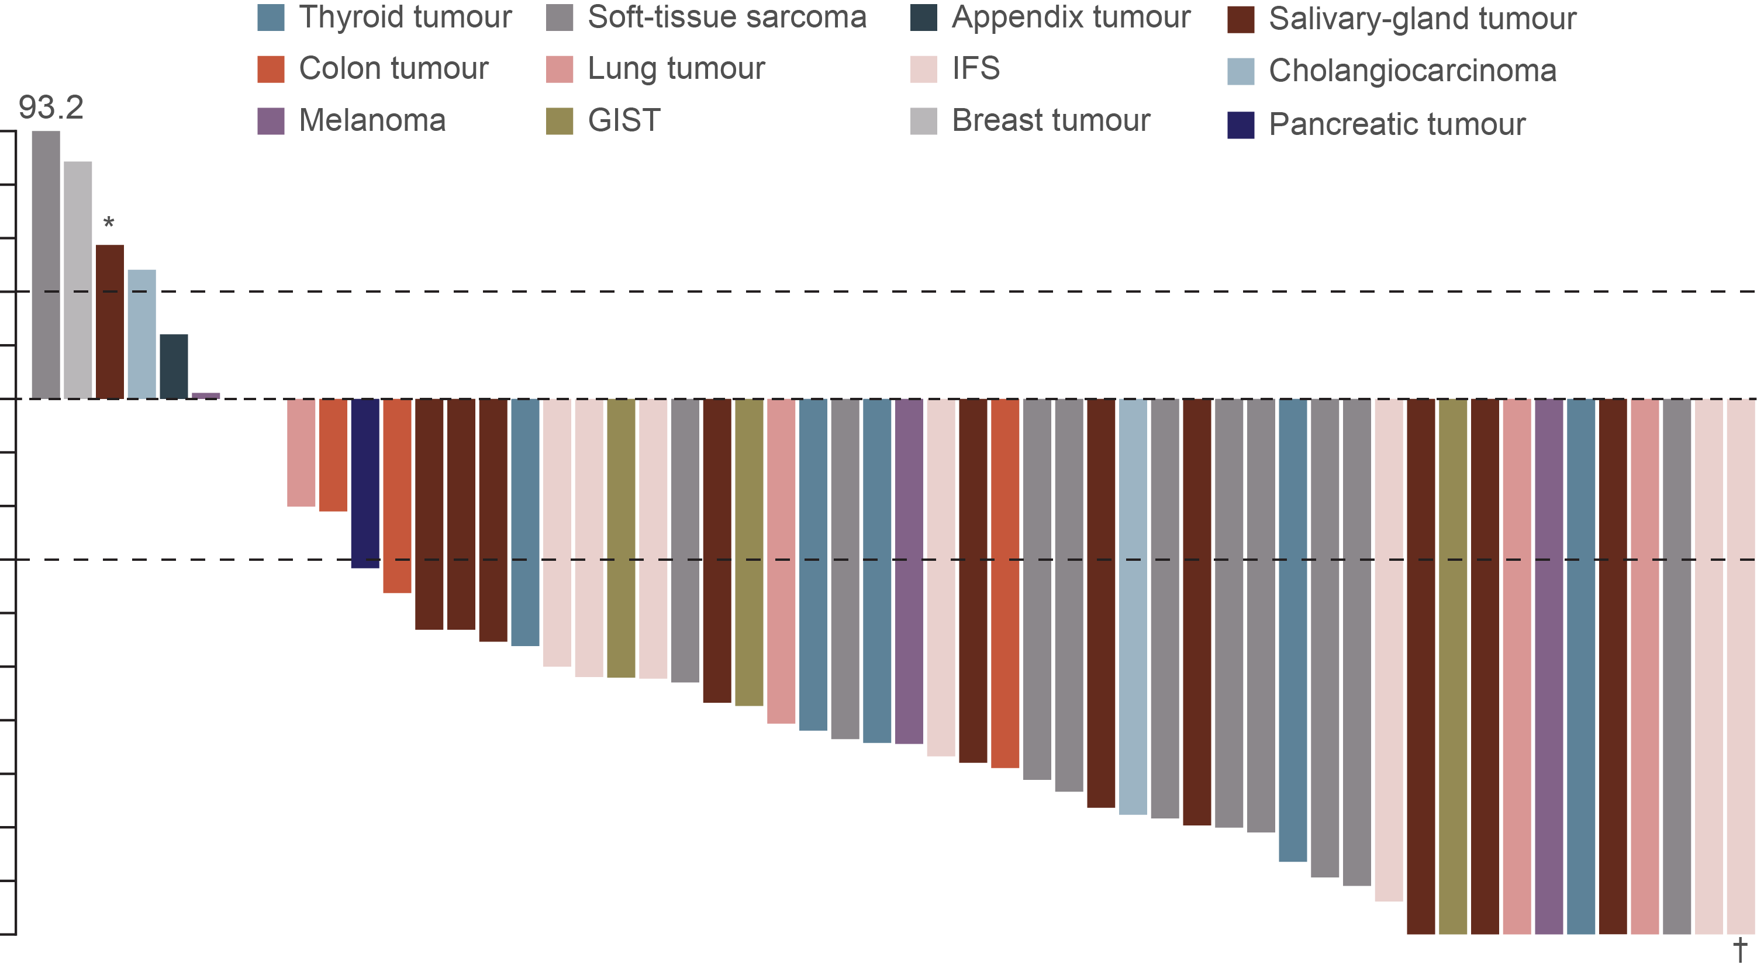
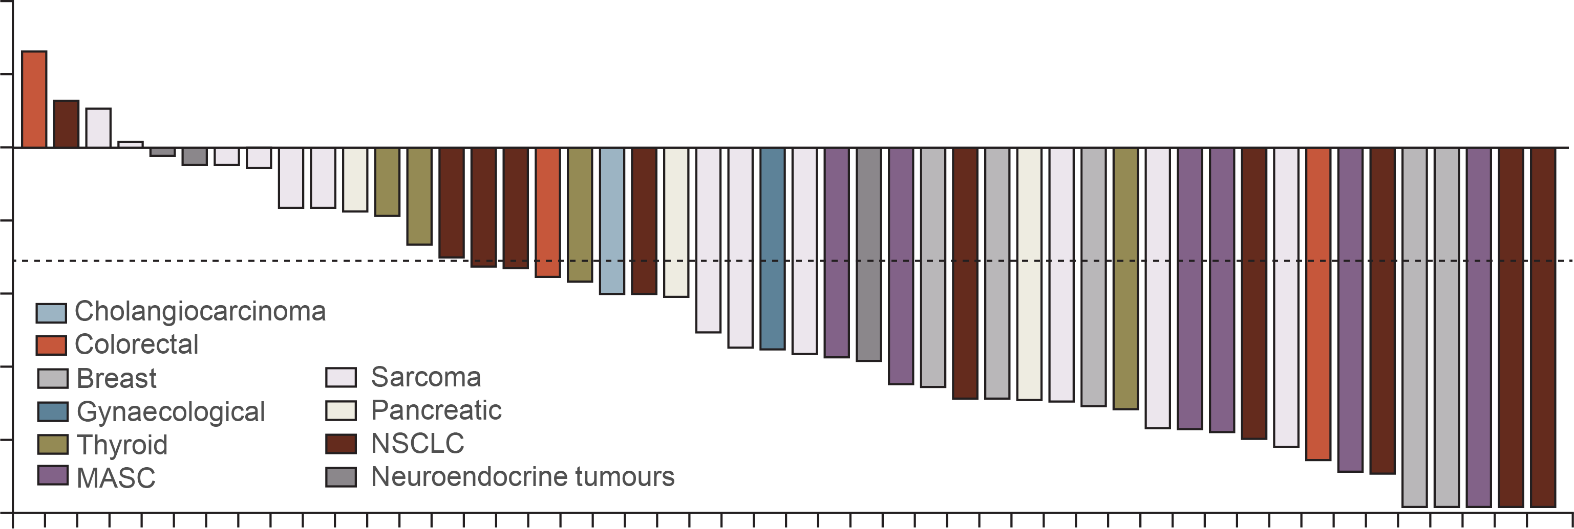
Initial Efficacy results of APPROVED trk inhibitors: Responses by tumour type
Larotrectinib¹
Entrectinib²
Data cut-off: 17 July 2017
Data cut-off: 31 May 2018
50
40
30
20
10
0
–10
–20
–30
–40
–50
–60
–70
–80
–90
–100
40
20
0
–20
Greatest change from baseline in sum of largest diameter in target lesions (%)
Maximum change tumour size (%)
–40
–60
–80
–100
Objective responses with larotrectinib are seen in
multiple tumour types and in most of the patients:
Objective responses with entrectinib are seen in
multiple tumour types and in most of the patients:
80%, 95% CI: 67-90
57%, 95% CI: 43.2-70.8
* Patient had TRK solvent front resistance mutation (NTRK3 G623R) at baseline owing to previous therapy
† Patient had a pathological complete response
CI, confidence interval; GIST, gastrointestinal stromal tumour; IFS, infantile fibrosarcoma; MASC, mammary analogue secretory carcinoma;
NSCLC, non-small-cell lung cancer; TRK, tropomyosin receptor kinase
1. Drilon A, et al. N Engl J Med. 2018;378:731-739; 2. Doebele RC, et al. Lancet Oncol. 2020;21:271-282

Slide 34
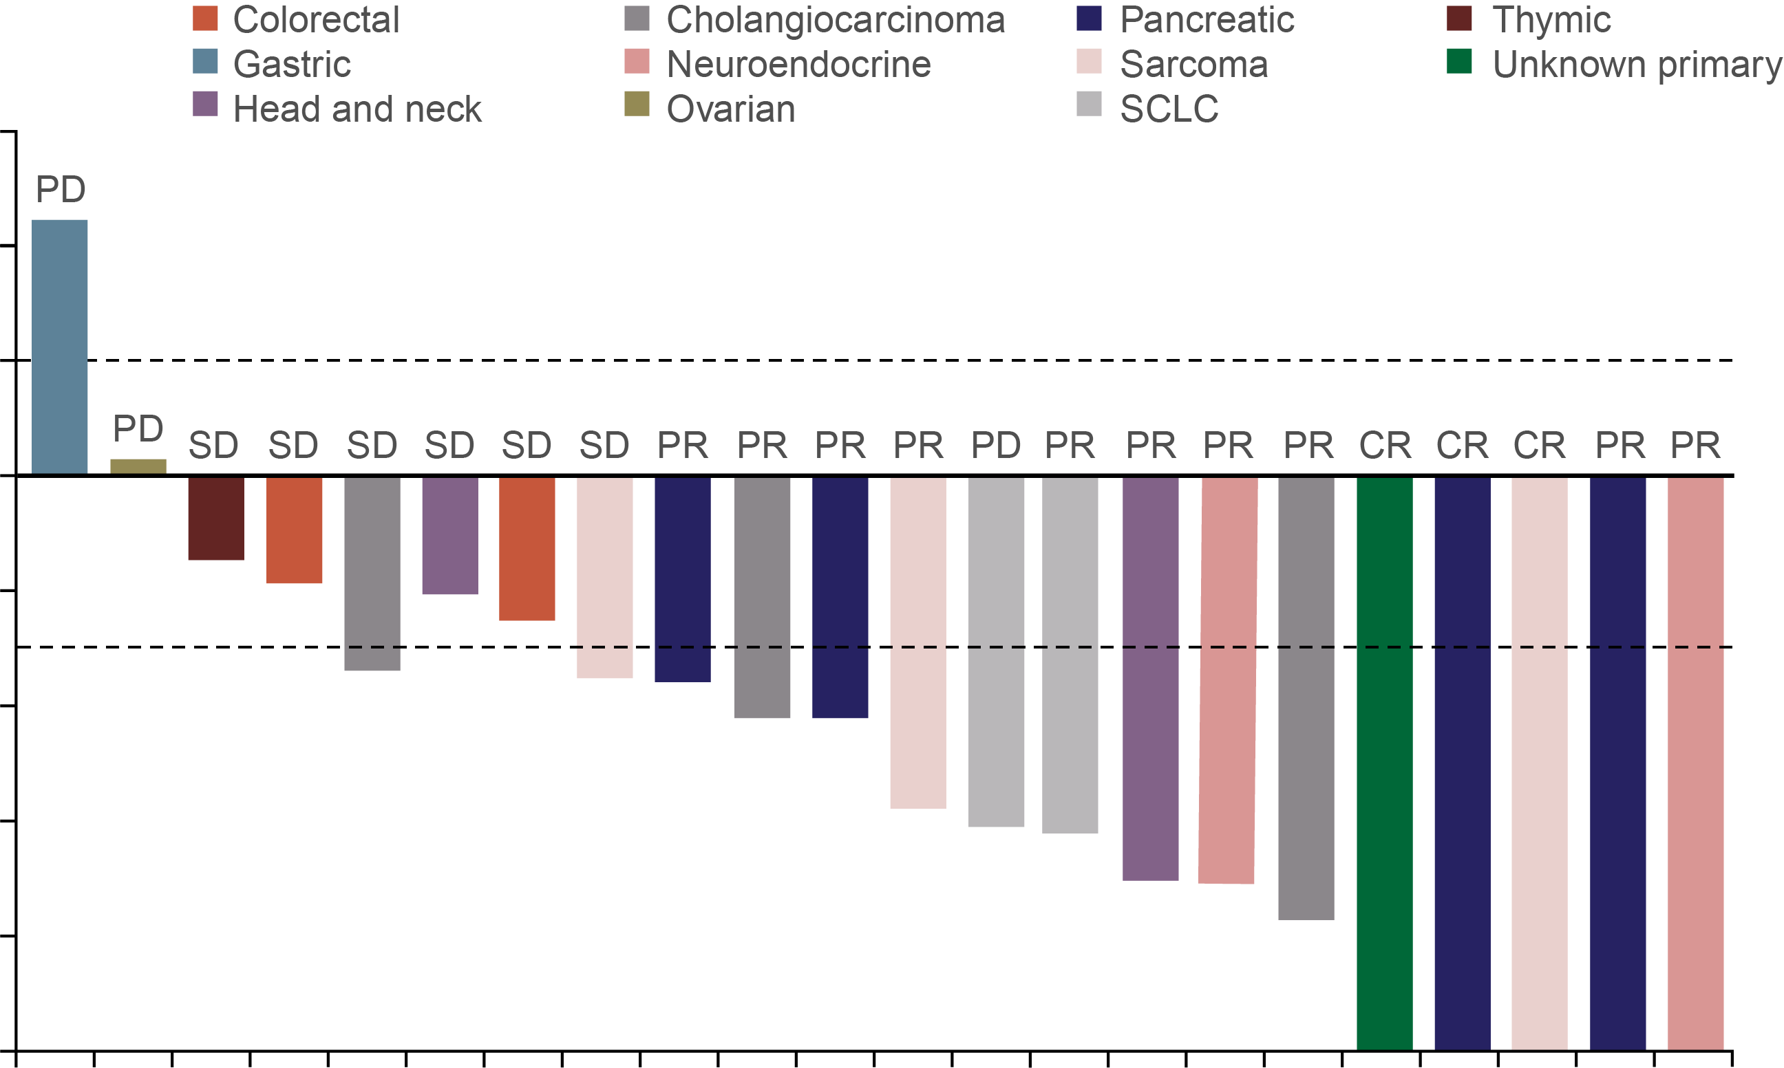
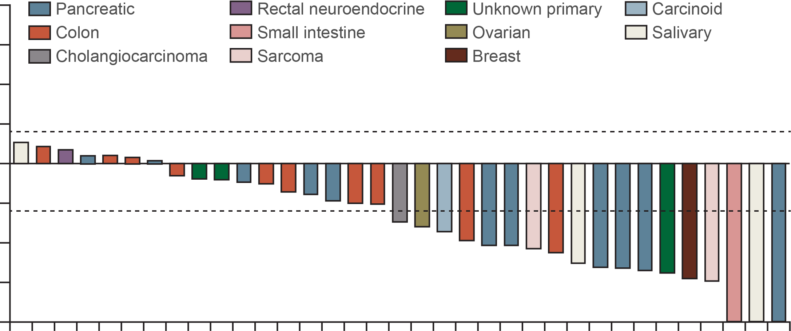
Initial Efficacy results of RET inhibitors:
Responses by tumour type
ARROW: pralsetinib¹
LIBRETTO-001: selpercatinib²
Data cut-off: 18 Oct 2021
Data cut-off: 24 Sep 2021
60
100
40
75
20
+20%
50
0
25
Maximum change from baseline in
target lesion size (%)
0
–20
Percentage change from baseline
in sum of diameters (%)
–30%
–25
–40
–50
–60
–75
–80
–100
–100
Objective responses with pralsetinib are seen in multiple tumour types
Objective responses with selpercatinib are seen in multiple
tumour types
ORR: 57%, 95% CI: 35-77
ORR: 43.9%, 95% CI: 28.5-60.3
CI, confidence interval; CR, complete response; ORR, objective response rate; PD, progressive disease; PR, partial response; RET, rearranged during transfection; SCLC, small-cell lung cancer; SD, stable disease
1. Subbiah V, et al. Nat Med. 2022;28:1640-1645; 2. Subbiah V, et al. Lancet Oncol. 2022;23:1261-1273

Slide 35
Initial Efficacy results of NRG1 inhibitor zenocutuzumab: Responses by tumour type
ORR (95% CI) RECIST 1.1, per investigator
All tumour types | 34% (24-46%; 27/79)
PDAC | 42% (20-67%; 8/19)
NSCLC | 35% (21-50%; 16/46)
80
PD
60
PD
PD
PD
40
PD
PD
PD
PD
SD
20
PD
PD
PD
PD
SD
SD
UNK
SD
PD
SD
0
SD
UNK
PD
Best percentage change
SD
SD
SD
SD
SD
-20
SD
SD
SD
SD
SD
PD
SD
SD
SD
SD
SD
SD
SD
SD
SD
SD
SD
-40
SD
Indication
PDAC
NSCLC
Breast
CRC
CUP
Cholangiocarcinoma
Pancreatic neuroendocrine carcinoma
RCC
Endometrial soft tissue sarcoma
PR
PR
PD
PR
PR
PR
PD
PR
PR
PR
PR
PR
PD
PR
PR
PR
PR
-60
PR
PR
PR
PR
PR
PR
Tumour reduction in
55/79 (70%) patients
PR
PR
PR
-80
PR
PR
-100
PR
PR
CI, confidence interval; CRC, colorectal cancer; CUP, cancer of unknown primary; PD, progressive disease; NRG1, Neuregulin 1; NSCLC, non-small-cell lung cancer; ORR, objective response rate; PDAC, pancreatic ductal adenocarcinoma; PR, partial response; RCC, renal cell carcinoma; RECIST, Response Evaluation Criteria in Solid Tumours; SD, stable disease; UNK, unknown
Schram A, et al. J. Clin Oncol 2022; 40 (16_suppl): 105 (oral presentation ASCO 2022)

Slide 36
Initial Efficacy results of kras g12c inhibitor ADAGRASIB
MAXIMUM PERCENTAGE TUMOUR CHANGE FROM BASELINE IN PATIENTS WITH PDAC
40
20
0
-20
Maximum change
from baseline (%)
-40
-60
Partial response
Stable disease
Progressive disease
-80
-100
Evaluable patients
PDAC, pancreatic ductal adenocarcinoma
Bekaii-Saab T, et al. J Clin Oncol 2023; 41: 4097-4106

Slide 37
summary
Pancreatic ductal adenocarcinoma (PDAC) is a devastating disease with poor prognosis and rising incidence and accounts for the majority of pancreatic neoplasms
Pancreatic cancer is difficult to diagnose early due to the lack of early symptoms and 80-90% of patients are diagnosed at late stages with unresectable tumours
Symptoms are generally non-specific with abdominal pain being the most frequently reported clinical symptom
All patients with metastatic pancreatic cancer should undergo germline and somatic next-generation sequencing to identify possible actionable variants
Cytotoxic chemotherapy is the cornerstone of systemic therapy for advanced or metastatic
pancreatic cancer
Maintenance therapy after a period of chemotherapy is an option for patients with BRCA alterations
Choice of treatment depends on several factors, including patients' performance status, co-morbidities and molecular targets
BRCA, BReast CAncer gene; PALB2, partner and localiser of BRCA2

