Slide 2
Clinical Topic
The evolving role of liquid biopsy in HR+/HER2- metastatic breast cancer
Prof. Frédérique Penault-Llorca
Molecular Pathologist, University of Clermont-Ferrand, France
Dr Aditya Bardia
Medical Oncologist, David Geffen School of Medicine at UCLA, United States
January 2025
HR, hormone receptor

Slide 3

Developed by PRECISION ONCOLOGY COnnect
This programme is developed by PRECISION ONCOLOGY CONNECT,
an international group of experts in the field of oncology.
Acknowledgement and disclosures
This PRECISION ONCOLOGY CONNECT programme is supported through an independent educational grant from Thermo Fisher Scientific. The programme is therefore independent, the content is not influenced by the supporter and is under the sole responsibility of the experts.
Please note:
This educational programme is intended for healthcare professionals only.
The views expressed within this programme are the personal opinions of the experts. They do not necessarily represent the views of the experts’ academic institutions, organisations, or other group or individual
Expert disclosures – the experts have received financial support/sponsorship for research support, consultation, travel or speaker fees from the following companies:
Dr Aditya Bardia: Consultant: Pfizer, Novartis, Genentech, Merck, Menarini, Gilead, Sanofi, AstraZeneca/Daiichi Sankyo, Alyssum, Eli Lilly
Prof. Frédérique Penault-Llorca: Personal honoraria: AbbVie, Amgen, Astellas, AstraZeneca, Bayer, BMS, Clovis, Daiichi-Sankyo, EISAI, Exact Science, GSK, Illumina, Invitae, Lilly, MSD, Myriad, Novartis, Pfizer, Pierre Fabre, Roche, Sanofi, Veracyte. Funding to institution for translational research: AbbVie, Astellas, AstraZeneca, Bayer, BMS, Genomic Health, Illumina, Lilly, MSD, Myriad, NanoString, Novartis, Pfizer, Pierre Fabre, Roche. Travel grants: AbbVie, AstraZeneca, Bayer, BMS, Daiichi Sankyo, Gilead, MSD, Novartis, Pfizer, Roche

Slide 4


This programme has been developed by a Group of experts
Prof. Frédérique Penault-Llorca
University of Clermont-Ferrand, France
Dr Aditya Bardia
David Geffen School of Medicine at UCLA, United States

Slide 5
Clinical takeaways
Liquid biopsies offer a less invasive alternative to traditional tissue biopsies in patients with advanced breast cancer, to examine molecular features
The role of liquid biopsy should be seen as a complementary testing method to tissue-based assays and the information derived should be reviewed in combination with tissue results
Liquid biopsy can detect mutations such as ESR1 and PIK3CA that are often associated with resistance to endocrine therapies and may be therapeutic targets
Multigene NGS testing is recommended by the ESMO and NCCN guidelines to ensure a broad spectrum of genetic alterations can be detected
NGS, next-generation sequencing

Slide 6
Educational objectives
Know the testing landscape in HR+/HER2- metastatic breast cancer, when and how to test using liquid and tumour biopsies
Be able to include all relevant biomarkers in test requests across the breast cancer
patient journey
Understand the implications of biomarker testing results on the management of HR+/HER2- metastatic breast cancer patients
HR, hormone receptor

Slide 7










What is a liquid biopsy?
A liquid biopsy can be derived from the blood and other body fluids, e.g., saliva,
ascites fluid, urine, cerebrospinal and pleural fluid
LIQUID BIOPSY
PERSONALISED MEDICINE
Enrichment and detection from plasma/serum of:
Circulating tumour cells
Circulating tumour nucleic acids
(cell-free DNA, microRNA, mRNA, IncRNA)
Circulating tumour microvesicles/exosomes
lncRNA, long non-coding RNA; mRNA, messenger RNA
Raimondi L, et al. Oncotarget. 2017;8:100831-51; Nikanjam M, et al. J Hematol Oncol. 2022;15:131

Slide 8
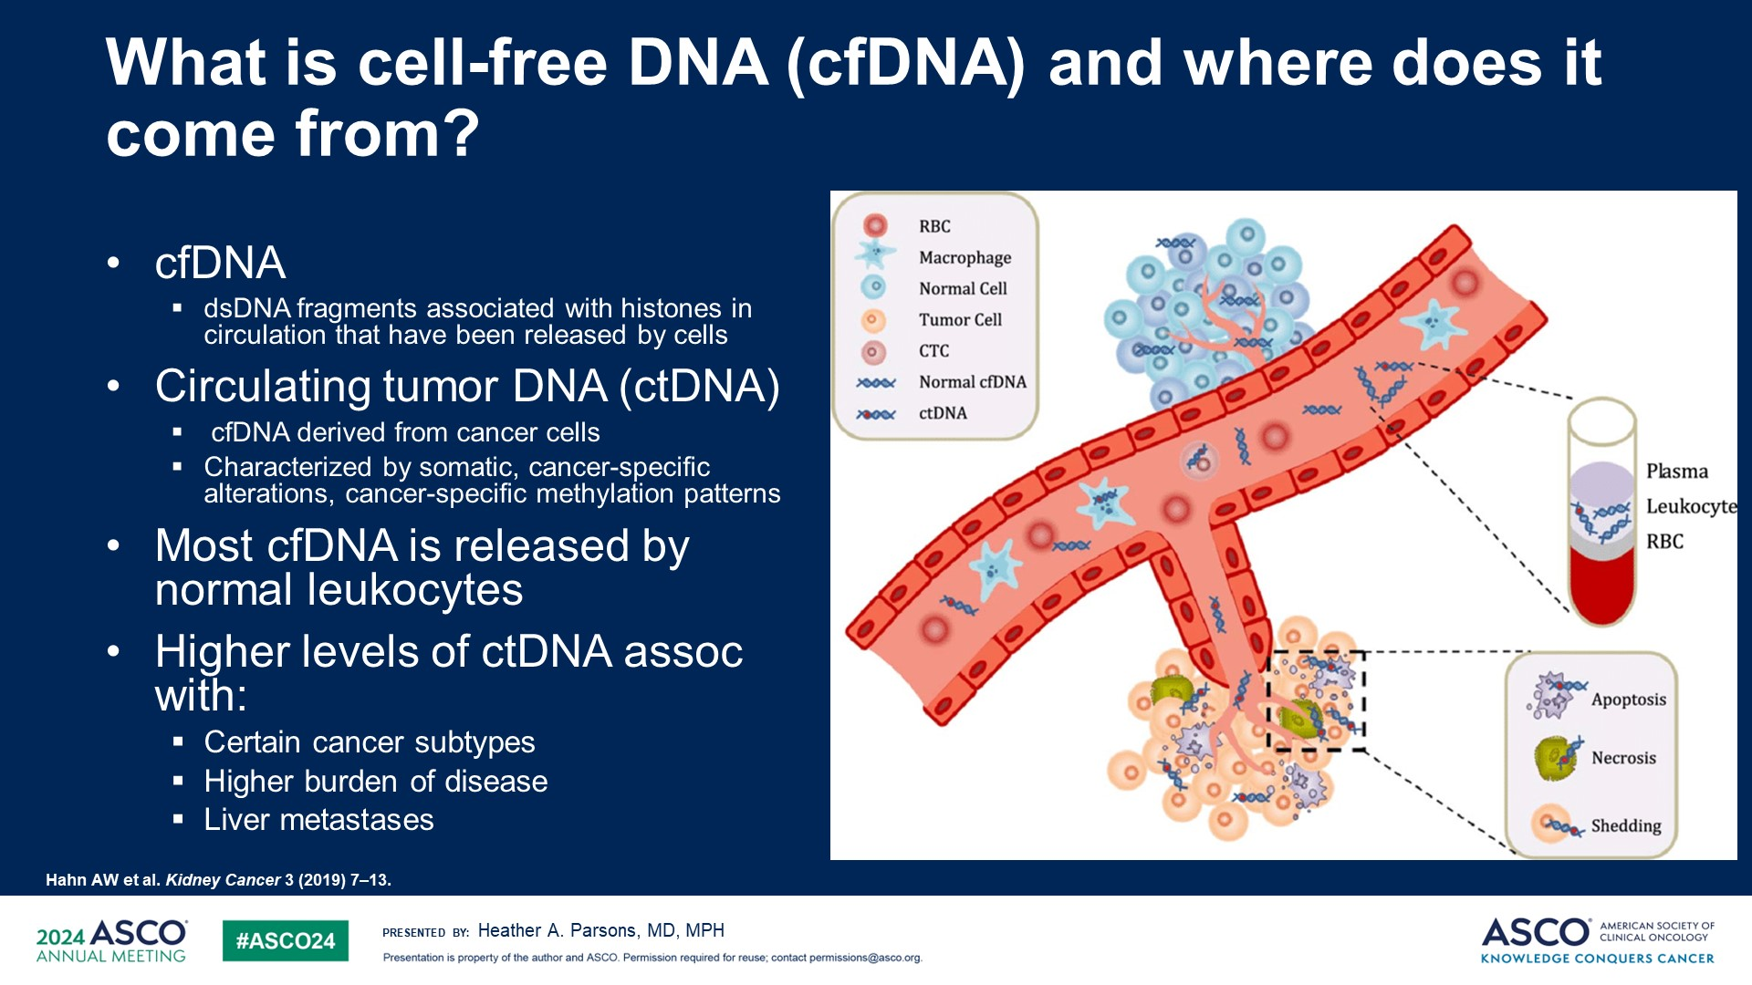
What is cell-free DNA (cfDNA) and circulating tumour dna (ctDNA)
cfDNA
  dsDNA fragments associated with
  histones in circulation that have
  been released by cells
Circulating tumour DNA (ctDNA)
  cfDNA derived from cancer cells
  Characterised by somatic, cancer-specific
  alterations, cancer-specific methylation patterns
Most cfDNA is released by normal leukocytes
Higher levels of ctDNA associated with:
  Certain cancer subtypes
  Higher burden of disease
  Liver metastases
RBC
Macrophage
Normal cell
Tumour cell
CTC
Normal cfDNA
ctDNA
Plasma
Leucocyte
RBC
Apoptosis
Necrosis
Shedding
cfDNA, cell-free DNA, CTC, circulating tumour cell; ctDNA, circulating tumour DNA, dsDNA, double-stranded DNA; RBC, red blood cell
Hahn AW, et al. Kidney Cancer 3, 2019;7-13; Qi T, et al. Int J. Mol Sci. 2023;24:1503; Sanchez-Herrero E, et al. Front. Oncol. 2022;12:943253;
Parsons HA. ASCO 2024

Slide 9

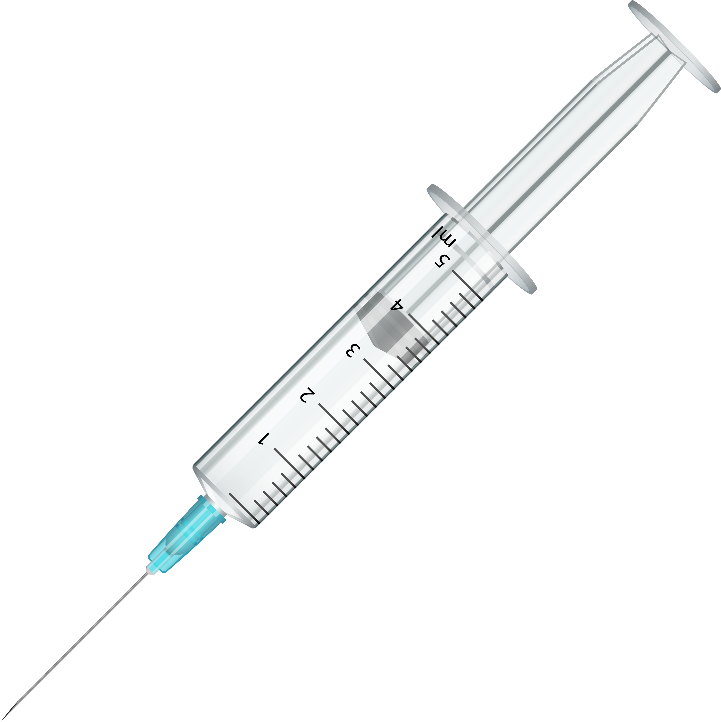


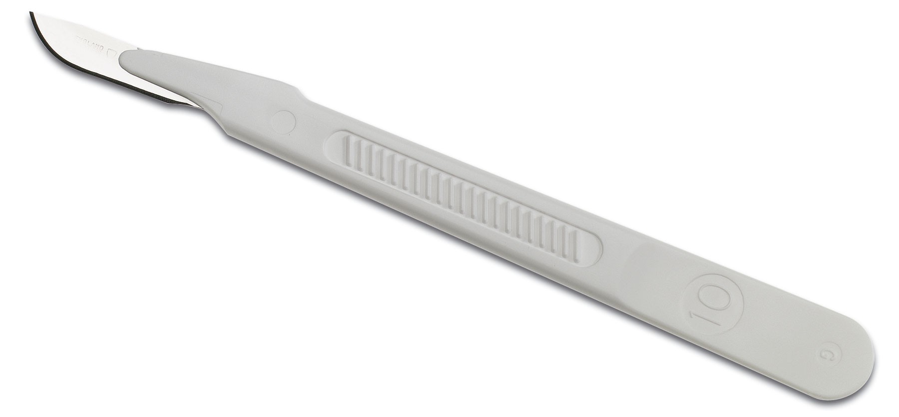
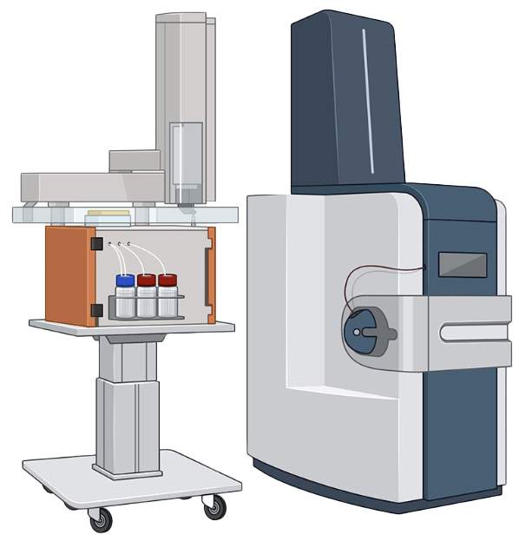
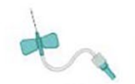


Tissue biopsy
Versus
Liquid biopsy
A
T
G
C
G
A
C
T
A
T
G
C
G
A
C
C
T
GOLD STANDARD
Rapid and minimally invasive
Provides important histopathological information
Captures tumour heterogeneity
Allows serial, dynamic testing
Captures neither tumour heterogeneity nor dynamic changes
Requires sensitive assays, and high ctDNA shedding
Patient with metastatic
breast cancer
Cannot replace histopathological assessment
Invasive procedure
Advantages
Limitations
Allows IHC, ISH, CGP, targeted molecular testing
Allows targeted molecular testing, CGP (with some limitations)
Adapted from Kavan S, et al. 2022
CGP, comprehensive genomic profiling; ctDNA, circulating tumour DNA; IHC, immunohistochemistry; ISH, in-situ hybridisation
Kavan S, et al. Cancer and Metastasis Rev. 2022;41:433-446; Penault-Llorca F. ESMO Advanced Course on Breast Cancer: Filling the Gaps Following Progression on CDK4/6 in Hormone Receptor Positive HER2 Negative Advanced Breast Cancer 2024: Doha. Session 3 – What to do after CDK4/6 inhibition in advanced breast cancer

Slide 10



Technologies for cfDNA have to be sensitive
ctDNA fraction and
technical limits of detection
Digital PCR-based ctDNA detection
Droplet-digital PCR
BEAMing
ctDNA fraction
in cfcDNA
Technical limits
of detection
100%
Advantages: sensitive, low cost
and quick; allows real-time serial
monitoring in large cohorts
Limitations: only one or a few
mutations detected and no TMB or
neoepitope prediction
10%
Sanger
cfcDNA
Blood
sample
Real-time PCR
and standard
NGS
DNA
extraction
1%
ctDNA
quantification
Plasma
Buffy coat
0.1%
Digital PCR
Red blood
cells
NGS-based ctDNA detection
Standard NGS
Optimised NGS
  Reduced base-position error rate
  Unique molecular identifiers
Optimised
NGS
0.01%
ctDNA
cfcDNA from normal cells
cfcDNA from clonal
Haematopoietic cells
Single
ctDNA
molecule
Advantages: enables the analysis of several
genes, TMB, neoepitope discovery, and dMMR
status assessment
Limitations: high cost, limited sensitivity (for
standard NGS), bioinformatic turnaround time
Background mutational
noise from clonal
haematopoiesis
FMI tests, Guardant, MSKCC liquid LdT
BEAMing, beads, emulsion, amplification, magnetics; cf(c)DNA, cell-free (circulating) DNA; ctDNA, circulating tumour DNA; dMMR, deficient DNA mismatch repair; FMI, Foundation Medicine; LdT, laboratory developed test; MSKCC, Memorial Sloane Kettering Cancer Center; NGS, next-generation sequencing; PCR, polymerase chain reaction; TMB, tumour mutational burden
Cabel L, et al. Nat Rev Clin Oncol. 2018;15:639-650; Penault-Llorca F. ESMO Advanced Course on Breast Cancer: Filling the Gaps Following Progression on CDK4/6 in Hormone Receptor Positive HER2 Negative Advanced Breast Cancer 2024: Doha. Session 3 – What to do after CDK4/6 inhibition in advanced breast cancer

Slide 11




How to test – Which technique?
PCR and dd-PCR
NGS
Detects a predefined set of specific genetic alterations (mutations-deletions>fusions>CNV)
Can only detect predefined mutations (hot spot mutations)
In general, rare mutations are not investigated
Allows the detection of alterations in several genes in a single test, without preconceived ideas
Able to detect the four main classes of genetic alterations
It can also be used to characterise new alterations
GENOMIC ALTERATIONS
GENOMIC SIGNATURES
GENOMIC ALTERATIONS
GENOMIC SIGNATURES
+ –
TMB
MSI
+ –
TMB
MSI
Detects
Detects
Detects
Detects
Measures
Measures
Base
substitutions
Insertions
and deletions
Copy number
alterations
Gene
rearrangements
Tumour
mutational
burden
Microsatellite
instability
CNV, copy number variation; dd-PCR, digital droplet PCR; MSI-H, microsatellite instability-high; NGS, next-generation sequencing; PCR, polymerase chain reaction; TMB, tumour mutational burden
Penault-Llorca F. ESMO Advanced Course on Breast Cancer: Filling the Gaps Following Progression on CDK4/6 in Hormone Receptor Positive HER2 Negative Advanced Breast Cancer 2024: Doha. Session 3 – What to do after CDK4/6 inhibition in advanced breast cancer

Slide 12
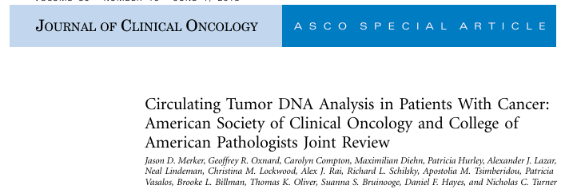
Mutation Testing in HR+/HER2− mBC:
Liquid Biopsy^{1,2}
Samples should be taken at disease progression for tumour genotyping¹
Consider tumour biopsy testing to confirm negative results¹
Liquid biopsy
Consider treatment with targeted therapy^{1,2}
Variant not detected
Variant detected
Tumour biopsy
Variant not detected
Consider alternative therapy
HR, hormone receptor; mBC, metastatic breast cancer
1. Merker JD, et al. J Clin Oncol. 2018;36:1631-41; 2. NCCN Guidelines Version 6.2024 for Invasive Breast Cancer. Available at: https://www.nccn.org/professionals/physician_gls/pdf/breast.pdf (accessed January 2025); Penault-Llorca F. ESMO Advanced Course on Breast Cancer: Filling the Gaps Following Progression on CDK4/6 in Hormone Receptor Positive HER2 Negative Advanced Breast Cancer 2024: Doha. Session 3 – What to do after CDK4/6 inhibition in advanced breast cancer

Slide 13
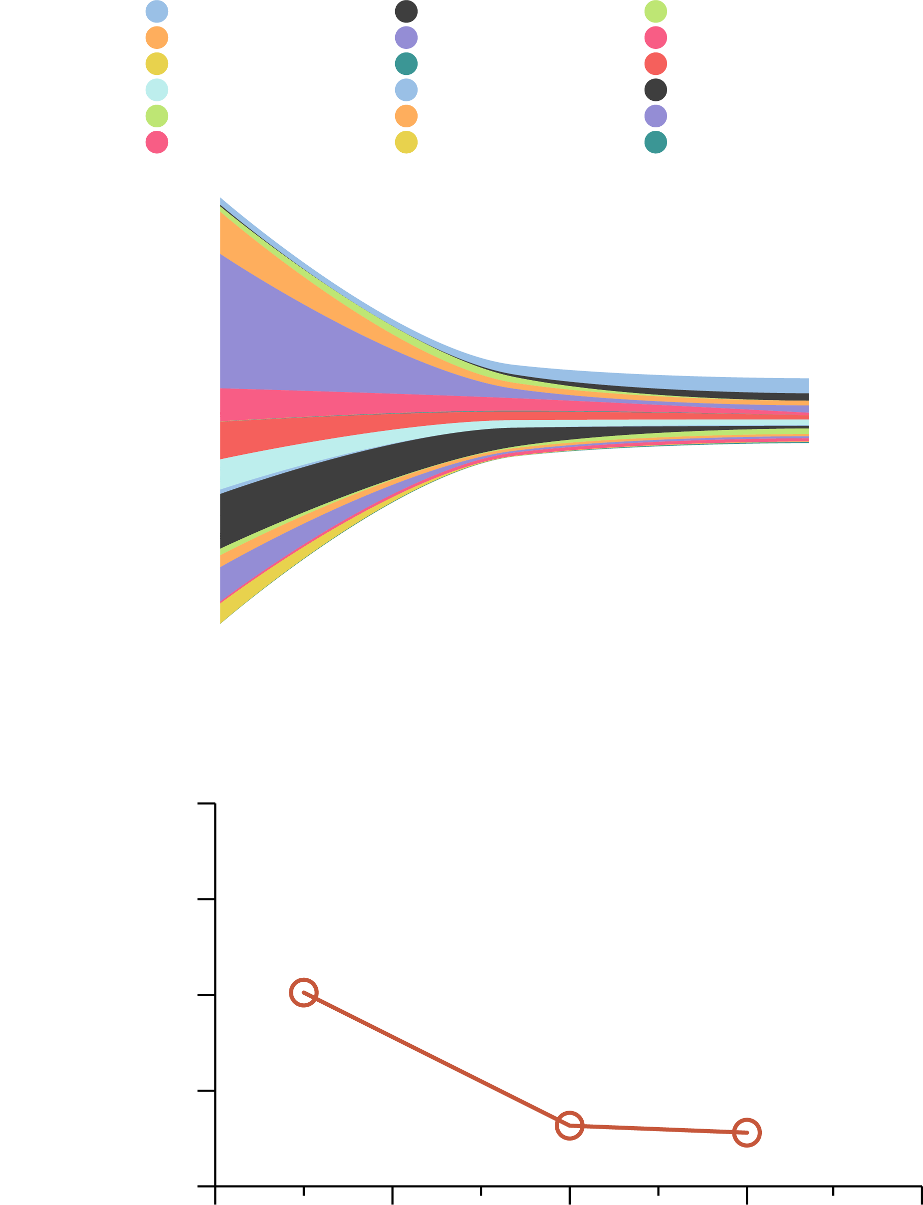
liquid biopsy: when to use it?
A. Change of individual mutations in a patient with BC^{1, a}
AP1M2-p.R245W
C2orf40-p.S9C
GNB2L1-p.S297I
MROH2A-p.E619K
PDSS2-p.Q83*
USP28-p.G939E
C1orf51-p.N25Y
ERBB2-p.V777L
KCNH2-p.M801L
NRXN3-p.G81V
STAT5A-p.D605N
XKR3-p.I149L
C1orf51-p.K95*
ERBB3-p.T355I
MLLT4-p.Q445*
OR7C1-p.S148A
THBS3-p.S923T
ZFP2-p.Q233E
Risk of false negative in ctDNA if disease is responding to therapy (no shedding)^{2,4}
Better to test with liquid biopsy when the tumour is progressing (higher probability of shedding, higher tumour burden) ➔ either before 1L, or at progression before 2L)^{2,3,4}
OR
SD
2017/12/22
2018/03/09
2018/05/07
B. Overall change (sum) of all mutations on the panels¹
2.0
1.5
CCF (%)
2017/12/22
Don’t anticipate testing when the patient is stable under therapy as the risk of false negative is very high^{2,4}
1.0
0.5
2018/05/07
0.0
0
2
4
6
8
Time (months)
ª Stream plot representing the change of individual mutations (colours indicate different genes and specific mutations on the panels)
1L, first-line; 2L, second-line; BC, breast cancer; CCF, ctDNA content fraction; ctDNA, circulating tumour DNA; OR, objective response; SD, stable disease
1. Li J, et al. J Transl Med. 2020;18:293; 2. Kuligina ES, et al. Cancer Genet. 2021;256-257:165-178; 3. Pascual J, et al. Annals of Oncology 2022; 33: 750-768; 4. Penault-Llorca F. ESMO Advanced Course on Breast Cancer: Filling the Gaps Following Progression on CDK4/6 in Hormone Receptor Positive HER2 Negative Advanced Breast Cancer 2024: Doha. Session 3 – What to do after CDK4/6 inhibition in advanced breast cancer

Slide 14
Biomarkers For targeted therapy
Frequency of Level IA Biomarkers in HR+ breast cancer¹
PIK3CAm
30-40%
AKT1m
5%
PTEN
7%
gBRCAm
5%
ESR1m
~30-40%
g, germline; HR+, hormone receptor positive; m, mutated
1. Mosele M, et al. Annals of Oncology 2024; 35: 588-606; 2. Penault-Llorca F. ESMO Advanced Course on Breast Cancer: Filling the Gaps Following Progression on CDK4/6 in Hormone Receptor Positive HER2 Negative Advanced Breast Cancer 2024: Doha. Session 3 – What to do after CDK4/6 inhibition in advanced breast cancer

Slide 15
Importance of using ‘broad’ NGS-type tests instead of PCR
Proportion of the 18 most-frequent PIK3CA mutations in PIK3CAmut BC from a combined dataset
Present in therascreen
Not present in therascreen
The currently validated therascreen
companion diagnostic PCR test, which covers 11 hotspot mutations,
might not capture up to 20% of patients with
PIK3CA mutations
Proportion of PIK3CA mutations (%)
H1047R
E545K
E542K
N345K
H1047L
E726K
C420R
Q546R
G118D
E453K
Q546K
G1049R
M1043I
K111E
E81K
E545A
E545G
N1044K
BC, breast cancer; NGS, next-generation sequencing; PCR, polymerase chain reaction
Martínez-Sáez O, et al. Breast Cancer Res. 2020;22:45; Penault-Llorca F. ESMO Advanced Course on Breast Cancer: Filling the Gaps Following Progression on CDK4/6 in Hormone Receptor Positive HER2 Negative Advanced Breast Cancer 2024: Doha. Session 3 – What to do after CDK4/6 inhibition in advanced breast cancer

Slide 16
Longer exposure to ET in 1L increases the chance of developing ESR1 mutation during treatment
1%
Early breast cancer
Metastatic breast cancer
Adjuvant ET
1st line ET
2nd line ET
3rd line ET
RECURRENCE
PROGRESSION
PROGRESSION
1%
5%
Up to 40%
Prevalence of ESR1-mut
33%
ESR1-mut occur almost exclusively after aromatase inhibitors in the metastatic setting⁵
Testing for ESR1-mut should occur at each progression on ET if not detected¹¹⁻¹³
1L, first line; ET, endocrine therapy; ESR1, estrogen receptor 1
Modified from: 1. Jeselsohn R, et al. Clin. Cancer Res. 2014;20:1757-67; 2. Jeselsohn R, et al. Cancer Cell. 2018;33:173-86;
3. Allouchery V, et al. Breast Cancer Res. 2018;20:40; 4. Schiavon G, et al. Sci Transl Med. 2015;7(313);313ra182;
5. Brett JO, et al. Breast Cancer Res. 2021;23(1):85; 6. Toy W, et al. Nat Genet. 2013;45(12):1439-45; 7. Bidard FC et al. J Clin Oncol 2022;40:3246-56;
8. Jhaveri et al, Annals of Oncology. 2023;34 (suppl_2): S334-90; 10.1016/annonc/annonc1299; 9. Lin et al, Annals of Oncology. 2023;34 (suppl_2): S334-90; 10.1016/annonc/annonc1299; 10. Bhave et al, SABCS 2023_PO2-1605; 11. Lee N, et al Int J Mol Sci. 2020;21(22):8807;
12. Gennari A, et al. Ann Oncol. 2021;32(12):1475-95; 13. Burstein HJ, et al J Clin Oncol. 2023;41(18):3423-5

Slide 17
ESR1: TESTING RECOMMENDATIONS
Test at progression of first-line therapy¹
Breast cancer^{1,2} | PIK3CA mutations ERBB2 amplification BRCA1/2 mutations ESR1 mutations MSI-H NTRK 1/2/3 fusions | IA IA IA IB IC IC | ESR1 mutations should preferentially be tested in ctDNA²
IA³
REFERENCE METHOD in PADA-1 trial:
droplet digital PCR⁴
REFERENCE METHOD in EMERALD trial:
Guardant360® CDx (Guardant Health)⁵
CDx, companion diagnostic; ctDNA, circulating tumour DNA; MSI-H, microsatellite instability-high; NGS, next-generation sequencing; PCR, polymerase chain reaction
1. Burstein H, et al. J Clin Oncol 2024; 42: 1450-1453; 2. Pascual J, et al. Ann Oncol. 2022;33:750-768; 3. Mosele MF, et al. Ann Oncol. 2024;35:588-606; 4. Callens C, et al. Anal Chem. 2022;94:6297-6303; 5. Bidard F-C, et al. J Clin Oncol. 2022:3246-3256
Penault-Llorca F. ESMO Advanced Course on Breast Cancer: Filling the Gaps Following Progression on CDK4/6 in Hormone Receptor Positive HER2 Negative Advanced Breast Cancer 2024: Doha. Session 3 – What to do after CDK4/6 inhibition in advanced breast cancer

Slide 18
Important message: Tumour NGS does not replace germline testing
Tumour-only sequencing:
germline variants detected/not detected
Tumour-only sequencing:
germline variants missed
A)
300
B)
HRD
DDR
MMR
Other
20
HRD
200
Not detected
Detected
Alu insertion
Intronic SNV
Del/dup
P/LP germline variants (#)
Missed P/LP germline
variants (#)
10
100
0
0
NF1 (n=48)
BRIP (n=2)
RB1 (n=47)
BAP1 (n=3)
BAP1 (n=17)
ATM (n=222)
MLH1 (n=56)
TP53 (n=44)
PMS2 (n=57)
BRIP1 (n=51)
MSH2 (n=80)
MSH6 (n=52)
BRCA2 (n=6)
PALB2 (n=78)
CHEK2 (n=67)
PALB2 (n=13)
BRCA2 (n=281)
BRCA1 (n=10)
RAD51C (n=3)
BRCA1 (n=161)
RAD51D (n=25)
RAD51C (n=20)
Breast cancer variants not detected affecting HRD or DDR genes: 13.2% (95% CI: 8.9-19.1)
More frequently missed: BRCA 1/2, PALB2 intronic variants, insertions, large rearrangements ➔ false negative
CI, confidence interval; DDR, DNA damage response; del, deletion; dup, duplication; HRD, homologous recombination deficiency; MMR, mismatch repair; NGS, next-generation sequencing; P/LP, pathogenic/likely pathogenic; SNV, single-nucleotide variant
Terraf P, et al. Ann Oncol. 2022;33:426-433; Penault-Llorca F. ESMO Advanced Course on Breast Cancer: Filling the Gaps Following Progression on CDK4/6 in Hormone Receptor Positive HER2 Negative Advanced Breast Cancer 2024: Doha. Session 3 – What to do after CDK4/6 inhibition in advanced breast cancer

Slide 19
NCCN targeted therapy recommendations
Targeted therapies and associated biomarker testing for recurrent unresectable (local or regional) or stage Iv (m1) disease
Biomarkers associated with FDA-approved therapies
Breast cancer subtype | Biomarker | Detection | FDA-approved agents | NCCN category of evidence | NCCN category of preference
HR-positive, HER2-negative | PIK3CA activating mutation | NGS, PCR (tumour tissue or blood) | Inavolisib + palbociclib + fulvestrant | Category 1 | Useful in certain circumstances first-line therapy
HR-positive/ HER2-negative | PIK3CA activating mutation | NGS, PCR (tumour tissue or blood) | Alpelisib + fulvestrant | Category 1 | Preferred second- or subsequent-line therapy
HR-positive/ HER2-negative | PIK3CA or AKT1 activating mutations or PTEN alterations | NGS, PCR (tumour tissue or blood) | Capivasertib + fulvestrant | Category 1 | Preferred second- or subsequent-line therapy in select patients
HR-positive/ HER2-negative | ESR1 mutation | NGS, PCR (blood preferred) | Elacestrant | Category 2A | Other recommended regimen
If liquid biopsy is negative, tumour tissue testing is recommended
FDA, Food and Drug Administration; HR, hormone receptor; M, metastatic stage; NCCN, National Comprehensive Cancer Network; NGS, next-generation sequencing; PCR, polymerase chain reaction
NCCN Guidelines Version 6.2024 for Invasive Breast Cancer. Available at: https://www.nccn.org/professionals/physician_gls/pdf/breast.pdf (accessed January 2025)

Slide 20
ESMO targeted therapy recommendations
Patients with ER+/HER2– MBC
If imminent organ failure
ET–CDK4/6 inhibitor
PD or intolerable toxicities
ChT
Somatic mutation testing
(tissue or liquid)
Germline BRCA1/2 testing
+ PALB2
If HER2-low:
Trastuzumab deruxtecan
PD
No imminent organ failure and
long PFS on prior endocrine therapy
Imminent organ failure or short
PFS on endocrine-based therapy
Everolimus–exemestane
or
Everolimus–fulvestrant
or
Switch endocrine therapy ± CDK4/6 inhibitor
or
Fulvestrant monotherapy
If PIK3CAm+:
Fulvestrant–alpelisib
If ESR1m+:
Elacestrant
If germline BRCA/PALB2m+:
PARP inhibitor
PD
If HER2-0
If HER2-low
Sacituzumab govitecan
Trastuzumab deruxtecan
ChT
or
Sacituzumab govitecan
if not used before
ChT, chemotherapy; ER, estrogen receptor; ESMO, European Society for Medical Oncology; ET, endocrine therapy; m, mutation; MBC, metastatic breast cancer; PARP, poly (ADP-ribose) polymerase; PD, progressive disease; PFS, progression-free survival
Gennari A, et al. Ann Oncol. 2021;32:1475-1495; ESMO Metastatic Breast Cancer Living Guideline > ER-positive HER2-negative Breast Cancer. Available at: https://www.esmo.org/living-guidelines/esmo-metastatic-breast-cancer-living-guideline/er-positive-her2-negative-breast-cancer (accessed January 2025)

Slide 21
targeted therapy for less frequent alterations
If drugs are available
HER2m^{1,2}
^{If lobular carcinoma}
^{(up to 25%)}
MSI-H³
~1%
TMB-H⁴
~10%
NTRK fusions⁵
<1%
HR, hormone receptor; MSI-H, microsatellite instability-high; TMB-H, tumour mutational burden-high
1. Ma J, et al. Transl Oncol. 2022;21:101444; 2. Kennedy LC, et al. J Clin Oncol. 2024;42(16 suppl):TPS630 (presented at 2024 ASCO Annual Meeting I); 3. Vidula N, et al. NPJ Breast Cancer. 2022;8:117; 4. Barroso-Sousa R, et al. Cancers (Basel). 2023;15:3997; 5. Theik NWY, et al. Int J Mol Sci. 2024;25:2366
Mosele M, et al. Annals of Oncology 2024; 35: 588-606; Penault-Llorca F. ESMO Advanced Course on Breast Cancer: Filling the Gaps Following Progression on CDK4/6 in Hormone Receptor Positive HER2 Negative Advanced Breast Cancer 2024: Doha. Session 3 – What to do after CDK4/6 inhibition in advanced breast cancer; NCCN Guidelines Version 6.2024 for Invasive Breast Cancer. Available at: https://www.nccn.org/professionals/physician_gls/pdf/breast.pdf (accessed January 2025)
HER2m
NTRK
MSI
TMB

Slide 22
NCCN targeted therapy recommendations
Biomarkers associated with FDA-approved therapies
Breast cancer subtype | Biomarker | Detection | FDA-approved agents | NCCN category of evidence | NCCN category of preference
Any | Germline BRCA1 or BRCA2 mutation | Germline sequencing | Olaparib Talazoparib | Category 1 | Preferred
Any | NTRK fusion | FISH, NGS, PCR (tumour tissue or blood) | Larotrectinib Entrectinib Repotrectinib | Category 2A | Useful in certain circumstances
Any | MSI-H/dMMR | IHC, NGS, PCR, (tumour tissue or blood) | Pembrolizumab | Category 2A
 |  |  | Dostarlimab-gxly
Any | TMB-H (≥10 mut/Mb) | NGS (tumour tissue) | Pembrolizumab | Category 2A
Any | RET-fusion | NGS (tumour tissue or blood | Selpercatinib | Category 2A
FDA, Food and Drug Administration; FISH, fluorescence in-situ hybridisation; IHC, immunohistochemistry; Mb, megabase; MSI-H, microsatellite instability-high; mut, mutation; NCCN, National Comprehensive Cancer Network; NGS, next-generation sequencing; PCR, polymerase chain reaction; TMB-H, tumour mutational burden-high
NCCN Guidelines Version 6.2024 for Invasive Breast Cancer. Available at: https://www.nccn.org/professionals/physician_gls/pdf/breast.pdf (accessed January 2025)

Slide 23
summary
Liquid biopsy has completely changed the diagnostic pathway of our patients
  It provides quick results and is useful for serial testing of alterations and the dynamic evaluation of the appearance or disappearance of some alterations
Tissue biopsy remains important - plasma and tissue generally provide complementary information
Biomarkers with clinical utility in HR+ HER2- metastatic breast cancer are somatic PIK3CA/AKT1/PTEN, ESR1, BRCA alterations and germline BRCA/PALB2
Multigene NGS testing is recommended by the ESMO and NCCN guidelines. Tumour NGS does not replace germline testing
Timing of testing depends on the alteration
Use of plasma to detect resistance mechanisms to prior therapy should occur when the disease is progressing (e.g. ESR1m)
A negative liquid biopsy does not mean there are no relevant alterations – confirm with tissue testing
ESMO, European Society for Medical Oncology; HR, hormone receptor; NGS, next-generation sequencing; NCCN, National Comprehensive Cancer Network
NCCN Guidelines Version 6.2024 for Invasive Breast Cancer. Available at: https://www.nccn.org/professionals/physician_gls/pdf/breast.pdf (accessed January 2025); Turner B, et al. Human Pathology Reports 2021: doi.org/10.1016/j.hpr.2021.300574; Mosele M, et al. Annals of Oncology 2024; 35: 588-606;
Penault-Llorca F. ESMO Advanced Course on Breast Cancer: Filling the Gaps Following Progression on CDK4/6 in Hormone Receptor Positive HER2 Negative Advanced Breast Cancer 2024: Doha. Session 3 – What to do after CDK4/6 inhibition in advanced breast cancer

