Slide 2
gi connect highlights from asco gi 2025 BRAF-mutated CRC
Dr Elena Élez, MD, PhD Vall d’Hebron University Hospital, Barcelona, Spain
JANUARY 2025
CRC, colorectal cancer

Slide 3
Developed by GI COnnect
This programme is developed by GI CONNECT, an international group of experts in the field of gastrointestinal oncology.
Acknowledgement and disclosures
This GI CONNECT programme is supported through an independent educational grant from Pierre Fabre Laboratories. The programme is therefore independent, the content is not influenced by the supporter and is under the sole responsibility of the experts.
Please note:
This educational programme is intended for healthcare professionals outside the UK and ROI only
The views expressed within this programme are the personal opinions of the experts. They do not necessarily represent the views of the experts’ academic institutions, organisations, Pierre Fabre Laboratories, or other group or individual
Expert disclosures:
Dr Elena Élez has received financial support/sponsorship for research support, consultation, or speaker fees from the following companies:
Agenus, Amgen, Bayer, BMS, Boehringer Ingelheim, Cure Teq AG, GlaxoSmithKline, Hoffman La Roche, Janssen, Johnson & Johnson, Lilly, Medscape, Merck Serono, MSD, Novartis, Organon, Pfizer, Pierre Fabre, Repare Therapeutics Inc., RIN Institute Inc., Rottapharm Biotech, Sanofi, Seagen International GmbH, Servier, and Takeda

Slide 4
Clinical takeaways
BREAKWATER: demonstrated a statistically significant and clinically meaningful benefit in ORR with EC + mFOLFOX6 that was rapid and durable in BRAF V600E-mutant mCRC. The results support EC + mFOLFOX6 as a new first-line SOC for patients with BRAF V600E-mutant CRC
CHECKMATE 8HW: NIVO + IPI demonstrated statistically significant and clinically meaningful improvement in PFS vs NIVO in patients with MSI-H/dMMR mCRC across all lines of therapy and across prespecified subgroups, including patients who also harboured a BRAF mutation
dMMR, deficient mismatch repair; EC, encorafenib plus cetuximab; IPI, ipilimumab; mCRC, metastatic colorectal cancer; mFOLFOX6, modified fluouracil/leucovorin/oxaliplatin; MSI-H, microsatellite instability-high; NIVO, nivolumab; ORR, overall response rate; PFS, progression-free survival; SOC, standard of care

Slide 5
Educational objectives
Understand the latest highlights on practice changing BRAF-mutated colorectal cancer data from the ASCO GI 2025 conference, accentuating the implementation of the latest data into clinical practice

Slide 6
BREAKWATER: Analysis of first-line encorafenib + cetuximab + chemotherapy in BRAF V600E-mutant mCRC
Kopetz S, et al. Abstract 16, ASCO GI 2025
mCRC, metastatic colorectal cancer

Slide 7
Breakwater: background and study design
8%-12% of patients with mCRC have BRAF V600E mutations, which confer poor prognosis¹
Encorafenib plus cetuximab was approved for the treatment of previously treated patients with BRAF V600E-mutant mCRC based on the phase 3 BEACON trial^{2,3}
First-line treatment options remain an unmet need for patients with BRAF V600E-mutant mCRC^{4,5}
BREAKWATER is an open-label phase 3 trial in first-line BRAF V600E-mutant mCRC⁶
Inclusion criteria
Age ≥16 years (or ≥18 based on country)
No prior systemic treatment for metastatic disease
Measurable disease (RECIST 1.1)
BRAF V600E-mutant mCRC by local or central laboratory testing
ECOG PS 0 or 1
Adequate bone marrow, hepatic, and renal function
Exclusion criteria
Prior BRAF or EGFR inhibitors
Symptomatic brain metastases
MSI-H/dMMR tumours (unless patients were ineligible to receive immune checkpoint inhibitors due to a pre-existing medical condition)
Presence of a RAS mutation
EC (n=158)
Dual primary endpoints:
PFS and ORR by BICR (EC + mFOLFOX6 vs SOC)
Key secondary endpoint:
OS (EC + mFOLFOX6 vs SOC)
N=637
R 1:1:1
EC + mFOLFOX6 (n=236)
SOC (n=243)
Stratified by regions (US/Canada vs Europe vs Rest of World) and ECOG PS (0 vs 1)
The EC arm was dropped following a protocol amendment
BICR, blinded independent central review; dMMR, deficient mismatch repair; EC, encorafenib plus cetuximab; ECOG PS, Eastern Cooperative Oncology Group performance status; EGFR, epidermal growth factor receptor; mCRC, metastatic colorectal cancer; mFOLFOX6, modified fluorouracil / leucovorin / oxaliplatin; MSI-H, microsatellite instability-high; ORR, objective response rate; OS, overall survival; PFS, progression-free survival; R, randomisation; RECIST, Response Evaluation Criteria in Solid Tumours; SOC, standard of care
1. Tabernero J, et al. ASCO Educ Book. 2022;42:254-263; 2. Tabernero J, et al. J Clin Oncol. 2021;39:273-284; 3. FDA Approves Cetuximab Plus Encorafenib for BRAF V600E-Mutant Metastatic CRC After Prior Therapy. Available here (accessed January 2025); 4. Van Cutsem E, et al. J Clin Oncol. 2023;412628-2637; 5. Cohen R, et al. J Natl Cancer Inst. 2021;113:1386-1395; 6. Kopetz S, et al. Abstract 16, ASCO GI 2025

Slide 8
Breakwater: RESPONSE results (co-primary)
Four-hundred-and-seventy-nine pts were randomised to the EC + mFOLFOX6 and SOC arms (EC + mFOLFOX6: n=236; SOC: n=243)
Baseline demographics and disease characteristics were similar across arms (median age: 61.0 years; male: 50.5%; ECOG PS 0: 54.3%)
CONFIRMED ORR BY BICR
CONFIRMED BOR, TTR, AND DoR BY BICR
100%
Odds ratio (95% CI): 2.443 (1.403-4.253) One-sided p value=0.0008
 | EC + mFOLFOX6 N=110 | SOC N=110
Confirmed best overall response, n (%) CR PR SD Non-CR/non-PD PD NE | 3 (2.7) 64 (58.2) 31 (28.2) 3 (2.7) 3 (2.7) 6 (5.5) | 2 (1.8) 42 (38.2) 34 (30.9) 4 (3.6) 9 (8.2) 19 (17.3)
 | N=67 | N=44
TTR, median (range), weeks | 7.1 (5.7-53.7) | 7.3 (5.4-48.0)
Estimated DoR, median (range), months | 13.9 (8.5-NE) | 11.1 (6.7-12.7)
Patients with a DoR of ≥6 months, n (%) | 46 (68.7) | 15 (34.1)
Patients with a DoR of ≥12 months, n (%) | 15 (22.4) | 5 (11.4)
80%
60.9% (51.6%-69.5%)
CR
PR
60%
40.0% (31.3%-49.3%)
Percentage of patients
40%
20%
0%
EC + mFOLFOX6
N=110
SOC
N=110
BICR, blinded independent central review; BOR, best overall response; CI, confidence interval; CR, complete response; DoR, duration of response; EC, encorafenib plus cetuximab; ECOG PS, Eastern Cooperative Oncology Group performance status; mFOLFOX6, modified fluouracil / leucovorin / oxaliplatin; NE, not estimable; ORR, objective response rate; PD, progressive disease; PR, partial response; SD, stable disease; SOC, standard of care; TTR, time to response
Kopetz S, et al. Abstract 16, ASCO GI 2025; Kopetz S, et al. Nat Med. 2025. doi: 10.1038/s41591-024-03443-3. Online ahead of print.

Slide 9
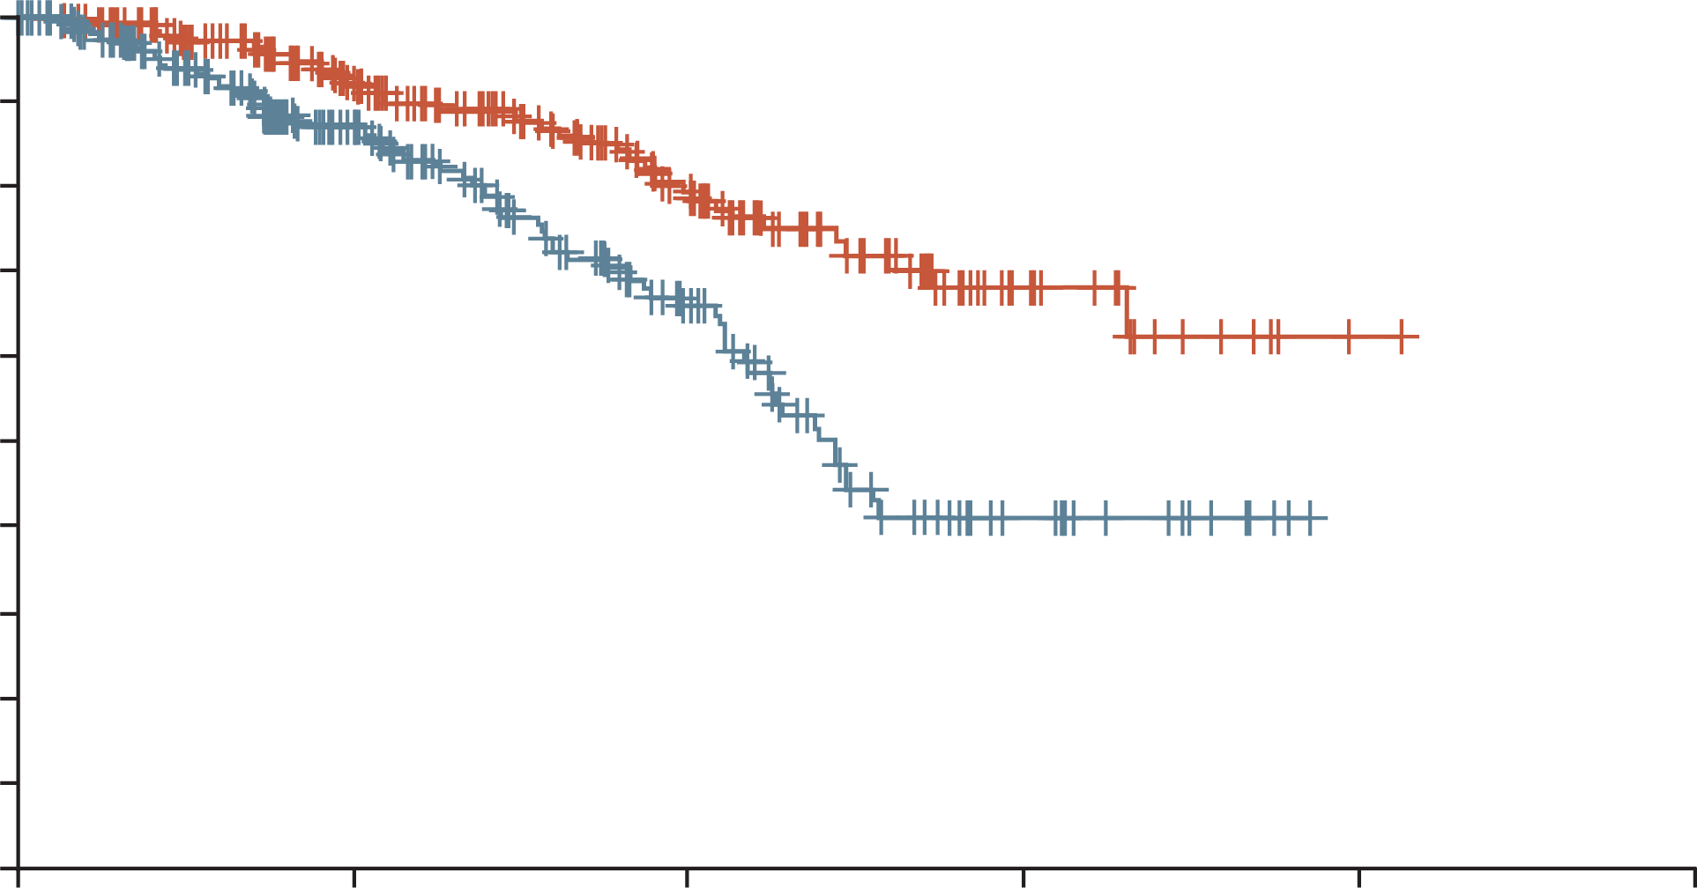
Breakwater: OVERALL SURVIVAL (interim) results
There was a trend towards an improvement in overall survival but data are immature at this point
1.0
0.9
0.8
0.7
0.6
EC + mFOLFOX6
Probability of survival
0.5
0.4
SOC
0.3
 | Number of events, n (%) | Median overall survival, months (95% CI)
EC + mFOLFOX6 | 40 (16.9) | NE (19.8-NE)
SOC | 72 (29.6) | 14.6 (13.4-NE)
Hazard ratio, 0.47 (95% CI, 0.318-0.691)
0.2
0.1
0
0
6
12
18
24
30
No. of patients at risk
EC + mFOLFOX6
SOC
Time (months)
236
243
156
138
81
64
20
14
1
0
0
0
CI, confidence interval; EC, encorafenib plus cetuximab; mFOLFOX6, modified fluouracil / leucovorin / oxaliplatin; NE, not estimable; SOC, standard of care
Kopetz S, et al. Abstract 16, ASCO GI 2025; Kopetz S, et al. Nat Med. 2025. doi: 10.1038/s41591-024-03443-3. Online ahead of print.

Slide 10
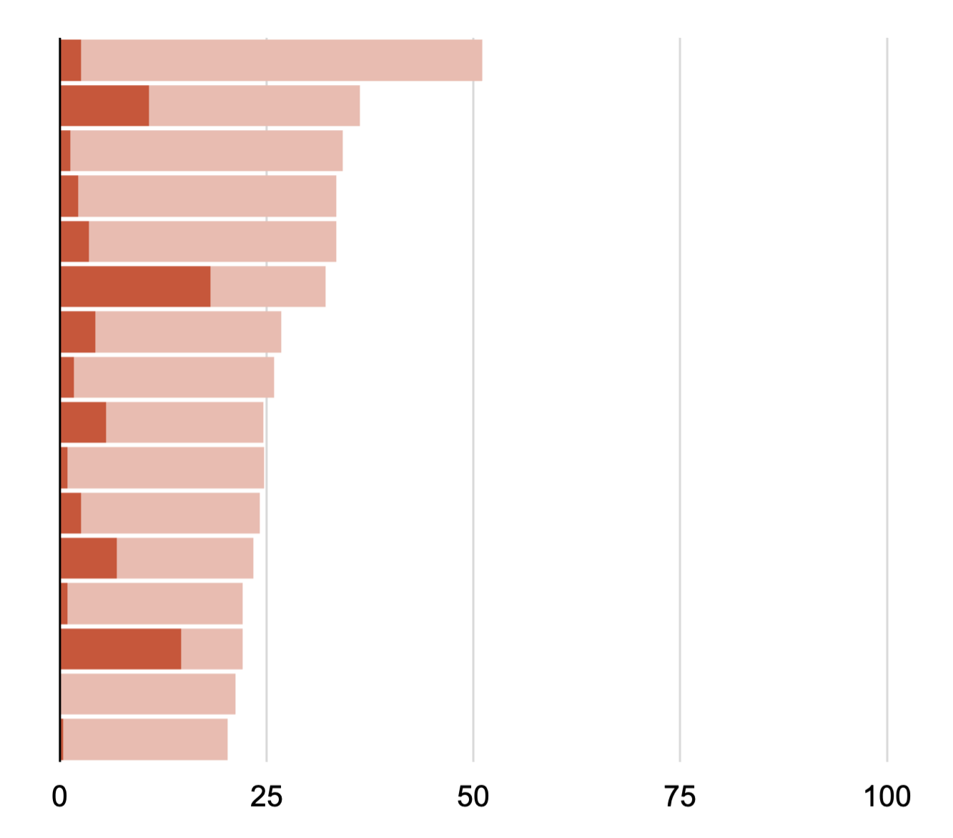
Breakwater: safety results
Most frequent (≥20%)ª all–causality teaes
EC + mFOLFOX6
SOC
Grade 1/2
Grade ≥3
Grade 1/2
Grade ≥3
Nausea
Anaemia
Diarrhoea
Decreased appetite
Vomiting
Neutrophil count decrease
Asthenia
Pyrexia
Peripheral sensory neuropathy
Rash
Fatigue
Neuropathy peripheral
Arthralgia
Neutropenia
Alopecia
Constipation
48.5
2.6
25.5
10.8
32.9
1.3
31.2
2.2
29.9
3.5
13.9
18.2
22.5
4.3
24.2
1.7
19.0
5.6
23.8
0.9
21.6
2.6
16.5
6.9
21.2
0.9
7.4
14.7
21.2
19.9
0.4
100
75
50
25
Percentage of patients
Serious treatment-emergent adverse events (EC+mFOLFOX6: n=231; SOC: n=228) occurred in 37.7% vs 34.6% of pts in the respective arms
The safety profile was consistent with that known for each agent
ª Frequency based on the EC + mFOLFOX6 arm
EC, encorafenib plus cetuximab; mFOLFOX6, modified fluouracil / leucovorin / oxaliplatin; SOC, standard of care; TEAE, treatment-emergent adverse event
Kopetz S, et al. Abstract 16, ASCO GI 2025

Slide 11
Breakwater: summary
BREAKWATER demonstrated a statistically significant and clinically meaningful benefit in ORR with EC + mFOLFOX6 that was rapid and durable in BRAF V600E-mutant mCRC
A trend towards an OS improvement was observed with EC + mFOLFOX6 vs SOC; data are immature at this point
EC + mFOLFOX6 was generally well-tolerated, with the most frequently reported TEAEs being consistent with those expected for each of the study treatments
Clinical Perspective
BREAKWATER supports EC + mFOLFOX6 as a new first-line SOC for patients with BRAF V600E-mutant CRC
EC, encorafenib plus cetuximab; (m)CRC, (metastatic) colorectal cancer; mFOLFOX6, modified fluouracil / leucovorin / oxaliplatin; ORR, objective response rate; OS, overall survival; SOC, standard of care; TEAE, treatment emergent adverse event
Kopetz S, et al. Abstract 16, ASCO GI 2025; Kopetz S, et al. Nat Med. 2025. doi: 10.1038/s41591-024-03443-3. Online ahead of print.

Slide 12
First results of NIVOlumab plus IPIlimumab vs NIVOlumab monotherapy for MSI-H/dMMR mCRC from CheckMate 8HW
André T, et al. Abstract LBA143, ASCO GI 2025
dMMR, deficient mismatch repair; mCRC, metastatic colorectal cancer; MSI-H, microsatellite instability-high

Slide 13
Checkmate 8hw: background and study design
Tumours with MSI-H/dMMR status are found in 5-7% of mCRC patients¹⁻³ and are associated with poor outcomes with chemotherapy ± targeted therapies⁴
Concurrent BRAFm and dMMR/MSI-H status is a rare (≈2 %) subtype of mCRC with a poor prognosis^{1,5}
CheckMate 8HW is a randomised, phase 3 trial comparing NIVO + IPI with NIVO or chemotherapy in patients with MSI-H/dMMR mCRC across different lines of therapy^{6,7}
Key eligibility criteria:
Histologically confirmed unresectable or metastatic CRC
MSI-H/dMMR status by local testing
Immunotherapy-naïve
ECOG PS 0 or 1
N=353
NIVO 240 mg Q2W for 6 doses, followed by NIVO 480 mg Q4W
Dual primary endpoints in patients with centrally confirmed MSI-H/dMMR status:
PFS by BICR (NIVO + IPI vs chemo in the 1L setting)
PFS by BICR (NIVO + IPI vs NIVO across all lines)
Other select endpoints:
Safety
ORR by BICR (NIVO + IPI vs NIVO across all lines)
HRQoL
OS
R 2:2:1
N=354
NIVO 240 mg + IPI 1 mg/kg Q3W for 4 doses, followed by NIVO 480 mg Q4W
N=132
Investigator’s choice chemo (mFOLFOX6 or FOLFIRI ± bevacizumab or cetuximab)
Stratification factors:
Prior lines of treatment (0 vs 1 vs ≥2)
Primary tumour location (right vs left)
Treatment until disease progression, unacceptable toxicity, withdrawal of consent (all arms), or a maximum treatment duration of 2 years (NIVO and NIVO + IPI arms only)
1L, first-line; BICR, blinded independent central review; BRAFm, BRAF mutated; dMMR, deficient mismatch repair; ECOG PS, Eastern Cooperative Oncology Group performance status; FOLFIRI, fluorouracil / leucovorin / irinotecan; HRQoL, health related quality of life; IPI, ipilimumab; (m)CRC, (metastatic) colorectal cancer; mFOLFOX6, modified fluorouracil / leucovorin / oxaliplatin; MSI‑H, microsatellite instability-high; NIVO, nivolumab; ORR, objective response rate; OS, overall survival; PFS, progression-free survival; Q2/3/4W, every 2/3/4 weeks; R, randomisation
1. Venderbosch S, et al. Clin Cancer Res. 2014;20:5322-5330; 2. Gutierrez C, et al. JCO Precis Oncol. 2023;7:e2200179; 3. Innocenti F, et al. J Clin Oncol. 2019;37:1217-1227; 4. André T, et al. Abstract LBA768, ASCO GI 2024; 5. Ambrosini M, et al. Eur J Cancer. 2024;210:114290; 6; André T, et al. Abstract LBA143, ASCO GI 2025; 7. André T, et al. Lancet. 2025. doi: 10.1016/S0140-6736(24)02848-4. Online ahead of print

Slide 14
Checkmate 8hw: results
BASELINE CHARACTERISTICS
30% of the patients in the NIVO + IPI arm and 24% in the NIVO arm had BRAF mutations
Characteristic (all randomised patients) | Category | NIVO + IPI (n=354) | NIVO (n=353)
BRAF, KRAS, NRAS mutation status, n (%)ª | BRAF/KRAS/NRAS all wild type BRAF mutant KRAS or NRAS mutant Unknown | 83 (23) 106 (30) 83 (23) 73 (21) | 103 (29) 85 (24) 89 (25) 74 (21)
ª Percentages may not add up to 100% due to rounding
RESULTS: PROGRESSION-FREE SURVIVAL
NIVO + IPI demonstrated significant and clinically meaningful PFS benefit vs NIVO in patients with MSI-H/dMMR mCRC across all lines of therapy
This benefit was consistently seen in prespecified subgroups across all lines of therapy, including patients who also harboured a BRAF mutation
Category (centrally confirmed MSI-H/dMMR) | Subgroup | Median PFS,ª mo |  | Unstratified HR | Unstratified HR (95% CI)
 |  | NIVO + IPI | NIVO
Overall (N=582) |  | NR | 39.3 | 0.63
BRAF, KRAS, NRAS mutation status | BRAF/KRAS/NRAS all wild type (n=156) BRAF mutant (n=179) KRAS or NRAS mutant (n=125) Unknown (n=114) | NR NR NR 54.1 | 44.3 25.9 NR 38.1 | 0.64 0.62 0.76 0.48
ª Per BICR
0.125
0.25
0.5
1
2
NIVO + IPI
NIVO
BICR, blinded independent central review; CI, confidence interval; dMMR, deficient mismatch repair; HR, hazard ratio; IPI, ipilimumab; mCRC, metastatic colorectal cancer; mo, months; MSI-H, microsatellite instability-high; NIVO, nivolumab; PFS, progression-free survival
André T, et al. Abstract LBA143, ASCO GI 2025; André T, et al. Lancet. 2025. doi: 10.1016/S0140-6736(24)02848-4. Online ahead of print

Slide 15
Checkmate 8hw: safety
A higher incidence of TRAEs was observed with NIVO + IPI versus nivolumab
The safety profile of NIVO + IPI was manageable and no new safety signals were reported
 | NIVO + IPI (N=352) |  | NIVO (N=351)
 | Any grade | Grade 3/4 | Any grade | Grade 3/4
TRAEs, n (%)ª Any TRAEs Serious TRAEs TRAEs leading to discontinuation | 285 (81) 65 (18) 48 (14) | 78 (22) 55 (16) 33 (9) | 249 (71) 29 (8) 21 (6) | 50 (14) 24 (7) 14 (4)
Treatment-related deaths, n (%)^{c} | 2 (<1)^{d} |  | 1 (<1)^{e}
TRAEsª reported in ≥10% of patients, n (%) Pruritus Diarrhoea Hypothyroidism Asthenia Fatigue Hyperthyroidism Arthralgia Rash Adrenal insufficiency | 91 (26) 71 (20) 61 (17) 58 (16) 42 (12) 40 (11) 38 (11) 34 (10) 34 (10) | 0 3 (<1) 2 (<1) 2 (<1) 1 (<1) 0 1 (<1) 3 (<1) 8 (2) | 63 (18) 59 (17) 31 (9) 44 (13) 35 (10) 16 (5) 23 (7) 29 (8) 12 (3) | 0 2 (<1) 0 2 (<1) 1 (<1) 0 0 1 (<1) 3 (<1)
ª Includes events reported between first dose and 30 days after last dose of study therapy. ^{b} Discontinuation of any component of the combination regimen was counted as a drug discontinuation event. ^{c} Treatment-related deaths were reported regardless of timeframe. ^{d} Includes 1 event each of myocarditis and pneumonitis. No new treatment-related deaths were reported since the previous interim analysis. ^{e} One event of pneumonitis
IPI, ipilimumab; NIVO, nivolumab; TRAE, treatment related adverse event
André T, et al. Abstract LBA143, ASCO GI 2025; André T, et al. Lancet. 2025. doi: 10.1016/S0140-6736(24)02848-4. Online ahead of print

Slide 16
Checkmate 8hw: summary
NIVO + IPI demonstrated statistically significant and clinically meaningful improvement in PFS vs NIVO in patients with MSI-H/dMMR mCRC across all lines of therapy
The PFS benefit was consistent across prespecified subgroups and all lines of therapy, including patients who also harboured a BRAF mutation
No new safety signals were identified; grade 3/4 TRAEs were reported in 22% of patients of NIVO + IPI and 14% with NIVO
Clinical Perspective
Nivolumab + ipilimumab may be a treatment option in the future for dMMR/MSI-H mCRC patients, including BRAF-mutant mCRC patients
There will need to be consideration about the optimal treatment sequence for this patient subgroup
BRAF-mutated; dMMR, deficient mismatch repair; IPI, ipilimumab; mCRC, metastatic colorectal cancer; MSI-H, microsatellite instability-high; NIVO, nivolumab; PFS, progression-free survival; TRAE, treatment related adverse event
André T, et al. Abstract LBA143, ASCO GI 2025; André T, et al. Lancet. 2025. doi: 10.1016/S0140-6736(24)02848-4. Online ahead of print

