Slide 1
CHEMOTHERAPY strategies IN metastatic Pancreatic Ductal AdenoCarcinoma (mPDAC): first-line chemotherapy options
Dr Eileen O’Reilly, MD
Memorial Sloan Kettering Cancer Center, USA
April 2025
mPDAC, metastatic pancreatic ductal adenocarcinoma

Slide 2
Developed by GI COnnect
This programme is developed by GI CONNECT, an international group of experts in the field of gastrointestinal oncology.
Acknowledgement and disclosures
This GI CONNECT programme is supported through an independent educational grant from Ipsen USA. The programme is therefore independent, the content is not influenced by the supporter and is under the sole responsibility of the experts.
Please note: The views expressed within this programme are the personal opinions of the experts. They do not necessarily represent the views of the experts’ institutions, or the rest of the GI CONNECT group.
Expert disclosures:
Dr Eileen O’Reilly, MD:
Research Funding to institution: Genentech/Roche, BioNTech, AstraZeneca, Arcus, Elicio, Parker Institute, NIH/NCI, Digestive Care, Break Through Cancer, Agenus, Amgen, Revolution Medicines
Consulting/DSMB (mostly uncompensated): Arcus, AstraZeneca, Ability Pharma, Alligator BioSciences, Agenus, BioNTech, Ipsen, Ikena, Merck, Moma Therapeutics, Novartis, Leap Therapeutics, Astellas, BMS, Revolution Medicines, Regeneron, Tango.
Travel: BioNTech
Abbvie (spouse)

Slide 3
Educational objectives
Be able to differentiate the efficacy and safety profiles of chemotherapies for mPDAC and understand how mode of delivery plays a role in this
Be able to recognise the cause of toxicities and have an awareness of strategies that can be used to improve tolerability and manage side effects whilst maintaining optimal efficacy
mPDAC, metastatic pancreatic ductal adenocarcinoma

Slide 4
Clinical takeaways
Pancreatic ductal adenocarcinoma (PDAC) is usually diagnosed at an advanced, incurable stage due to non-specific symptoms and has an extremely poor prognosis
Systemic chemotherapy is the standard treatment for metastatic PDAC but molecularly targeted treatments and immunotherapies may have a role for specific patients
Treatment selection depends on several factors, including patients' performance status and co-morbidities. These should be considered alongside the efficacy and safety profiles of the different chemotherapy regimens
Treatment strategies can be implemented to manage toxicities associated with the different chemotherapy regimens to enable a patient to stay on treatment for optimal efficacy

Slide 5
Pancreatic ductal adenocarcinoma
introduction
Pancreatic ductal adenocarcinoma (PDAC) is a highly devastating disease with poor prognosis and rising incidence and accounts for the majority (90%) of pancreatic neoplasms.¹ Typically after diagnosis, only 13% live for 5 years²
PDAC is the third-leading cause of cancer mortality in the US and the seventh-leading cause worldwide.^{2,3} It is projected to become the second-leading cause of cancer-related mortality by 2030³
Approximately 1.7% of men and women will be diagnosed with pancreatic cancer at some point during their lifetime²
In 2024, estimated numbers in the US are:
66,440 new cases (3.3% of all new cancer cases)²
51,750 deaths (8.5% of all cancer deaths)²
Pancreatic cancer is difficult to diagnose due to the lack of early symptoms and 80-90% of patients have unresectable tumours due to the advanced stage at diagnosis⁴
Surgery, chemotherapy and radiation are the primary treatment options for pancreatic cancer¹
US, United States
1. Orth M, et al. Radiat Oncol. 2019;14:141; 2. Cancer Stat Facts: Pancreatic Cancer. Available from: https://seer.cancer.gov/statfacts/html/pancreas.html. Accessed October 2024; 3. Park W, et al. JAMA. 2021; 326:851-862; 4. Rawla P, et al. World J Oncol. 2019;10:10-27

Slide 6
Overview of treatment for mpdac
Chemotherapy is the mainstay of treatment for mPDAC patients
Enrolment in clinical trials should always be encouraged
<50% eligible
First-line treatment
Olaparib Maintenance (only for gBRCAm pts)
Progression
Second-line treatment
Progression
Third-line treatment
mPFS:
7.4 months
mPFS: 6 months
NALIRIFOX
FOLFIRINOX
Gem + Nab-paclitaxel
Nal-IRI
FOLFOX
FOLFIRINOX
Gem + Nab-paclitaxel
Targeted therapies if molecular alteration identified
Progression mPFS = 5.5-6.4 months
Figure adapted from Casolino 2022
gBRCAm, germline BRCA mutation; FOLFIRINOX, folinic acid (leucovorin calcium), fluorouracil, irinotecan, and oxaliplatin; FOLFOX, folinic acid (leucovorin calcium), fluorouracil, and oxaliplatin; gem, gemcitabine; mPDAC, metastatic pancreatic adenocarcinoma; mPFS, median progression-free survival; Nab, nanoparticle albumin-bound; Nal-IRI, nanoliposomal irinotecan; NALIRIFOX; Nal-IRI, fluorouracil/folinic acid (leucovorin calcium), and oxaliplatin
Casolino R, Biankin AV. Camb Prism Precis Med. 2023;1:e14

Slide 7
Key studies of 1L systemic therapy for mpdac
Study setting | Study | Study type | Arm (N) | Primary endpoint | Primary endpoint |  | Secondary endpoint | Secondary endpoint |  | ORR (%) | Notable adverse events (Grade ≥3)
 |  |  |  |  | Months | HR (95% CI) |  | Months | HR (95% CI)
First-line | PRODIGE¹ (2011) | RCT, phase 2/3 | FOLFIRINOX (171) | OS | 11.1 | 0.57 (0.45 to 0.73) | PFS | 6.4 | 0.47 (0.37 to 0.59) | 31.6 | FOLFIRINOX vs Gem: neutropenia 47.5 vs 21.0%, febrile neutropenia 5.4 vs 1.2%, thrombocytopenia 9.1 vs 3.6%, diarrhoea 12.7 vs 1.8%
 |  |  | Gemcitabine (171) |  | 6.8 |  |  | 3.3 |  | 9.4
First-line | MPACT² (2013) | RCT, phase 3 | Gem + NabP (431) | OS | 8.5 | 0.72 (0.62 to 0.83) | PFS | 5.5 | 0.69 (0.58 to 0.82) | 23.0 | Gem + NabP vs Gem: Neutropenia 38.0 vs. 27.0%, leukopenia 31.0 vs 16.0%, thrombocytopenia 13.0 vs 9.0%, fatigue 17.0 vs. 7.0%, and neuropathy 17.0 vs. 1.0%
 |  |  | Gemcitabine (430) |  | 6.7 |  |  | 3.7 |  | 7.0
First-line | NAPOLI-3³ (2023) | RCT, phase 3 | NALIRIFOX (383) | OS | 11.1 | 0.83 (0.70-0.99) | PFS | 7.4 | 0.69 (0.58-0.83) | 41.8 | NALIRIFOX vs Gem + NabP: hypokalaemia 15.0 vs 4.0%, diarrhoea 20.0 vs 5.0%, nausea 12.0 vs 3.0%. Lower rates of hematological AE’s with NALIRIFOX: neutropenia 14.0 vs 25.0%, anaemia 11.0 vs 17.0%
 |  |  | Gem + NabP (387) |  | 9.2 |  |  | 5.6 |  | 36.2
Metastatic maintenanceª | POLO^{4,5} (2019, 2022) | RCT, phase 3 | Olaparib (92) | PFS | 7.4 | 0.53 (0.35 to 0.82) | OS | 19.0 | 0.83 (0.56 to 1.22) | 23.1^{b} | Olaparib vs placebo: Fatigue 5.6 vs 0%, anaemia 12.2 vs 3.3%, decreased appetite 3.3 vs 0%
 |  |  | Placebo (62) |  | 3.8 |  |  | 19.2 |  | 11.5^{b}
ª Patients with germline mutations in BRCA1 or BRCA2, who had received at least 16 weeks of continuous platinum-based chemotherapy as the first line treatment for metastatic pancreatic cancer, were enrolled; ^{b}At data cut-off 1
AE, adverse event; BRCA1/2, BReast CAncer 1/2 gene; CI, confidence interval; FOLFIRINOX, folinic acid (leucovorin calcium), fluorouracil, irinotecan, and oxaliplatin; Gem+ Nab-P, gemcitabine and nab (nanoparticle albumin-bound)-paclitaxel; HR, hazard ratio; mPDAC, metastatic pancreatic ductal adenocarcinoma; Nal‑IRI, nanoliposomal irinotecan; NALIRIFOX; Nal-IRI, fluorouracil/folinic acid (leucovorin calcium), and oxaliplatin; ORR, objective response rate; OS, overall survival; PFS, progression-free survival; RCT, randomised controlled trial
1. Conroy T et al, N Engl J Med. 2011;364:1817-25; 2. Von Hoff D, et al. N Engl J Med. 2013;369:1691-703; 3. Wainberg Z, et al. Lancet 2023;402:1272-81; 4. Golan T, et al. N Engl J Med. 2019;381:317-27; 5. Kindler H, et al. J Clin Oncol. 2022;40:3929-39

Slide 8
PRODIGE4/ACCORD11: STUDY DESIGN
Folfirinox vs gemcitabine as 1l therapy
FOLFIRINOX (n=171)
Oxaliplatin 85 mg/m²
Irinotecan 180 mg/m²
Leucovorin 400 mg/m²
5-FU bolus 400 mg/m², then 2,400 mg/m² infusional over 46 hours, every 2 weeks
Metastatic Pancreatic Cancer
Gemcitabine (n=171)
1,000 mg/m² weekly × 7 of 8 (cycle 1), then weekly × 3 of 4 (cycle 2 and subsequent cycles)
1L, first-line; 5-FU, fluorouracil; FOLFIRINOX, folinic acid (leucovorin calcium), fluorouracil, irinotecan, and oxaliplatin
Conroy T, et al. N Engl J Med. 2011;364:1817-25

Slide 9
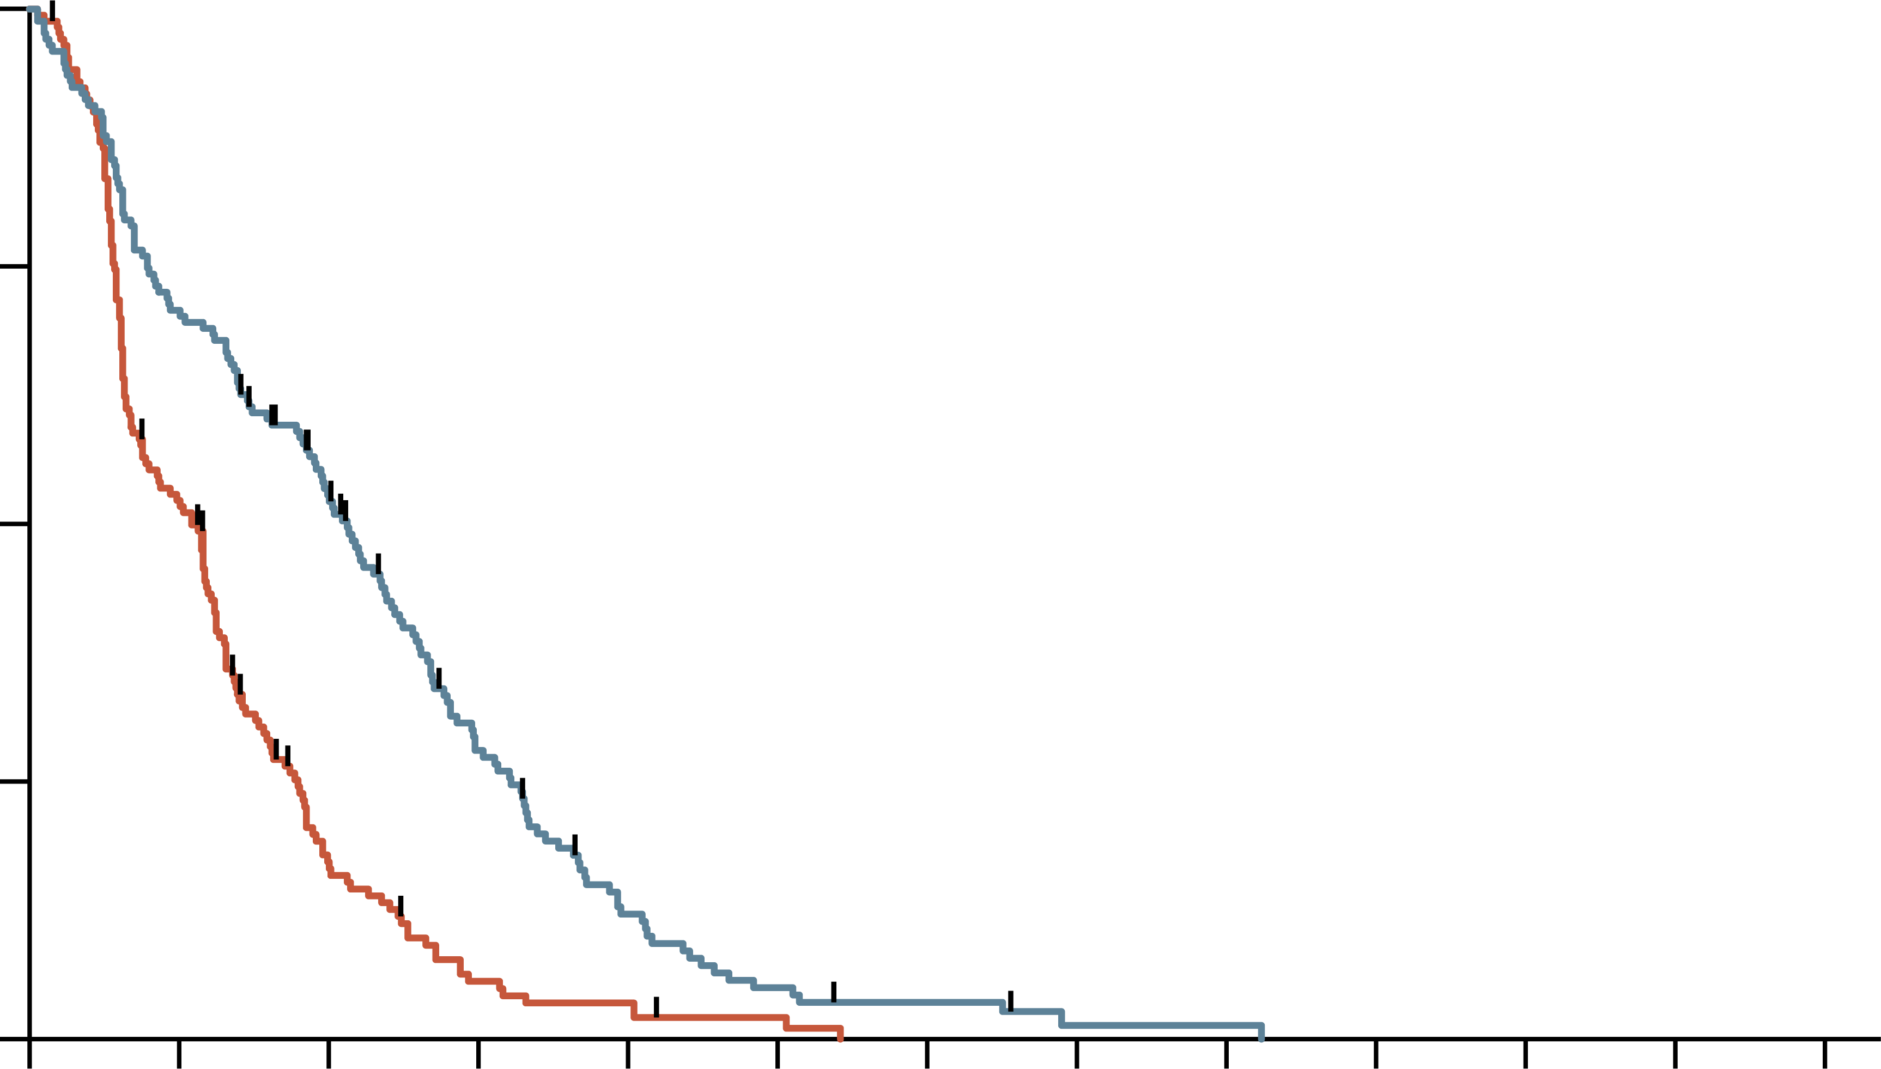
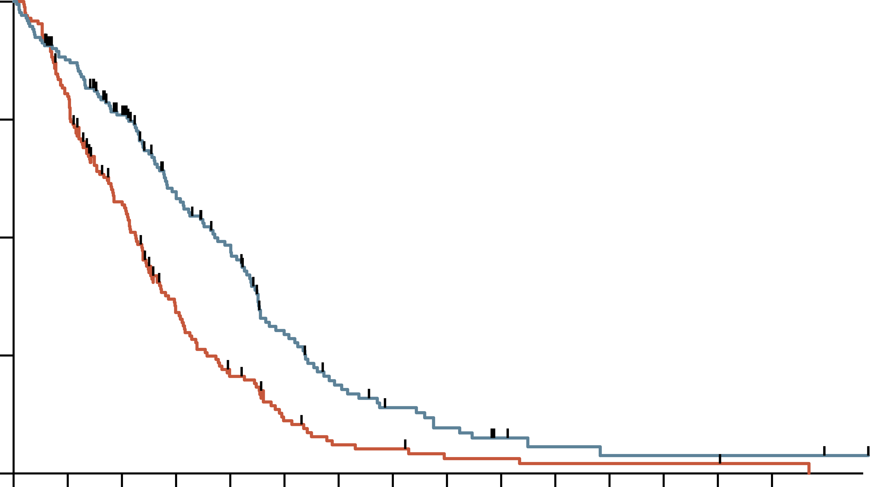
PRODIGE4/ACCORD11: FOLFIRINOX emerged as a 1l option
Progression-free survival
overall survival
100
100
Hazard ratio, 0.47 (95% CI, 0.37-0.59) P<0.001
Hazard ratio, 0.57 (95% CI, 0.45-0.73) P<0.001 by stratified log-rank test
75
75
Probability (%)
Probability (%)
50
FOLFIRINOX
50
FOLFIRINOX
25
25
0
Gemcitabine
0
Gemcitabine
0
3
6
9
12
15
18
21
24
27
30
33
36
0
3
6
9
12
15
18
21
24
27
30
33
36
39
42
Time (months)
Time (months)
No. at risk
Gemcitabine
FOLFIRINOX
No. at risk
Gemcitabine
FOLFIRINOX
171
171
88
121
26
85
8
42
5
17
2
7
0
4
0
1
0
1
0
0
0
0
0
0
0
0
171
171
134
146
89
116
48
81
28
62
14
34
7
20
6
13
3
9
3
5
2
3
2
2
2
2
2
2
1
2
Median PFS: 6.4 mo FOLFIRINOX vs 3.3 mo gemcitabine
Median OS: 11.1 mo FOLFIRINOX vs 6.8 mo gemcitabine
1L, first-line; CI, confidence interval; FOLFIRINOX, folinic acid (leucovorin calcium), fluorouracil, irinotecan, and oxaliplatin; mo, months; OS, overall survival; PFS, progression-free survival
Conroy T, et al. N Engl J Med. 2011;364:1817-25

Slide 10
PRODIGE4/ACCORD11: SAFETY
MOST COMMON GRADE 3 OR 4 ADVERSE EVENTS OCCURRING IN MORE THAN 5% OF PATIENTS IN THE SAFETY POPULATIONª
Event | FOLFIRINOX (N=171) | Gemcitabine (N=171) | P value
Hematologic, n/N (%)
Neutropenia | 75/164 (47.5) | 35/167 (21.0) | <0.001
Febrile neutropenia | 9/166 (5.4) | 2/169 (1.2) | 0.03
Thrombocytopenia | 15/165 (9.1) | 6/168 (3.6) | 0.04
Anaemia | 13/166 (7.8) | 10/168 (6.0) | NS
Non-hematologic, n/N (%)
Fatigue | 39/165 (23.6) | 30/169 (17.8) | NS
Vomiting | 24/166 (14.5) | 14/169 (8.3) | NS
Diarrhoea | 21/165 (12.7) | 3/169 (1.8) | <0.001
Sensory neuropathy | 15/166 (9.0) | 0/169 | <0.001
Elevated level of alanine aminotransferase | 12/165 (7.3) | 35/168 (20.8) | <0.001
Thromboembolism | 11/166 (6.6) | 7/169 (4.1) | NS
ªEvents listed are those that occurred in more than 5% of patients in either group. NS denotes not significant
FOLFIRINOX, folinic acid (leucovorin calcium), fluorouracil, irinotecan, and oxaliplatin
Conroy T, et al. N Engl J Med. 2011;364:1817-25

Slide 11
MPACT: study design
nab-paclitaxel plus gemcitabine as 1l therapy
Pancreatic cancer
(metastatic adenocarcinoma)
N=861
Gemcitabine
1,000 mg/m²
weekly × 7 of 8 (cycle 1), then weekly × 3 of 4 (cycle 2 and subsequent cycles)
Gemcitabine
1,000 mg/m²
plus
Nab-paclitaxel 125 mg/m²
weekly × 3 of 4
1L, first-line; Nab, nanoparticle albumin-bound
Von Hoff D, et al. N Engl J Med. 2013;369:1691-703

Slide 12
MPACT: Efficacy
 | GEM + NabP (n=431) | GEM (n=430) | Hazard ratio
Overall survival, months | 8.5 | 6.7 | 0.72 (p<0.001)
One-year survival, % | 35 | 22
Progression-free survival, months | 5.5 | 3.7 | 0.69 (p<0.001)
6-month PFS, % | 44 | 25
Response rate, % | 23 | 7 | p<0.001
Median treatment duration (range), months | 3.9 (0.1-21.9) | 2.8 (0.1-21.5)
% protocol doseª Nab-paclitaxel Gemcitabine | 80.6 75.2 | – 84.6%
ªProportion of administered cumulative dose relative to the planned cumulative dose
GEM, gemcitabine; HR, hazard ratio; NabP, nanoparticle albumin-bound paclitaxel; PFS, progression-free survival
Von Hoff D, et al. N Engl J Med. 2013;369:1691-703

Slide 13
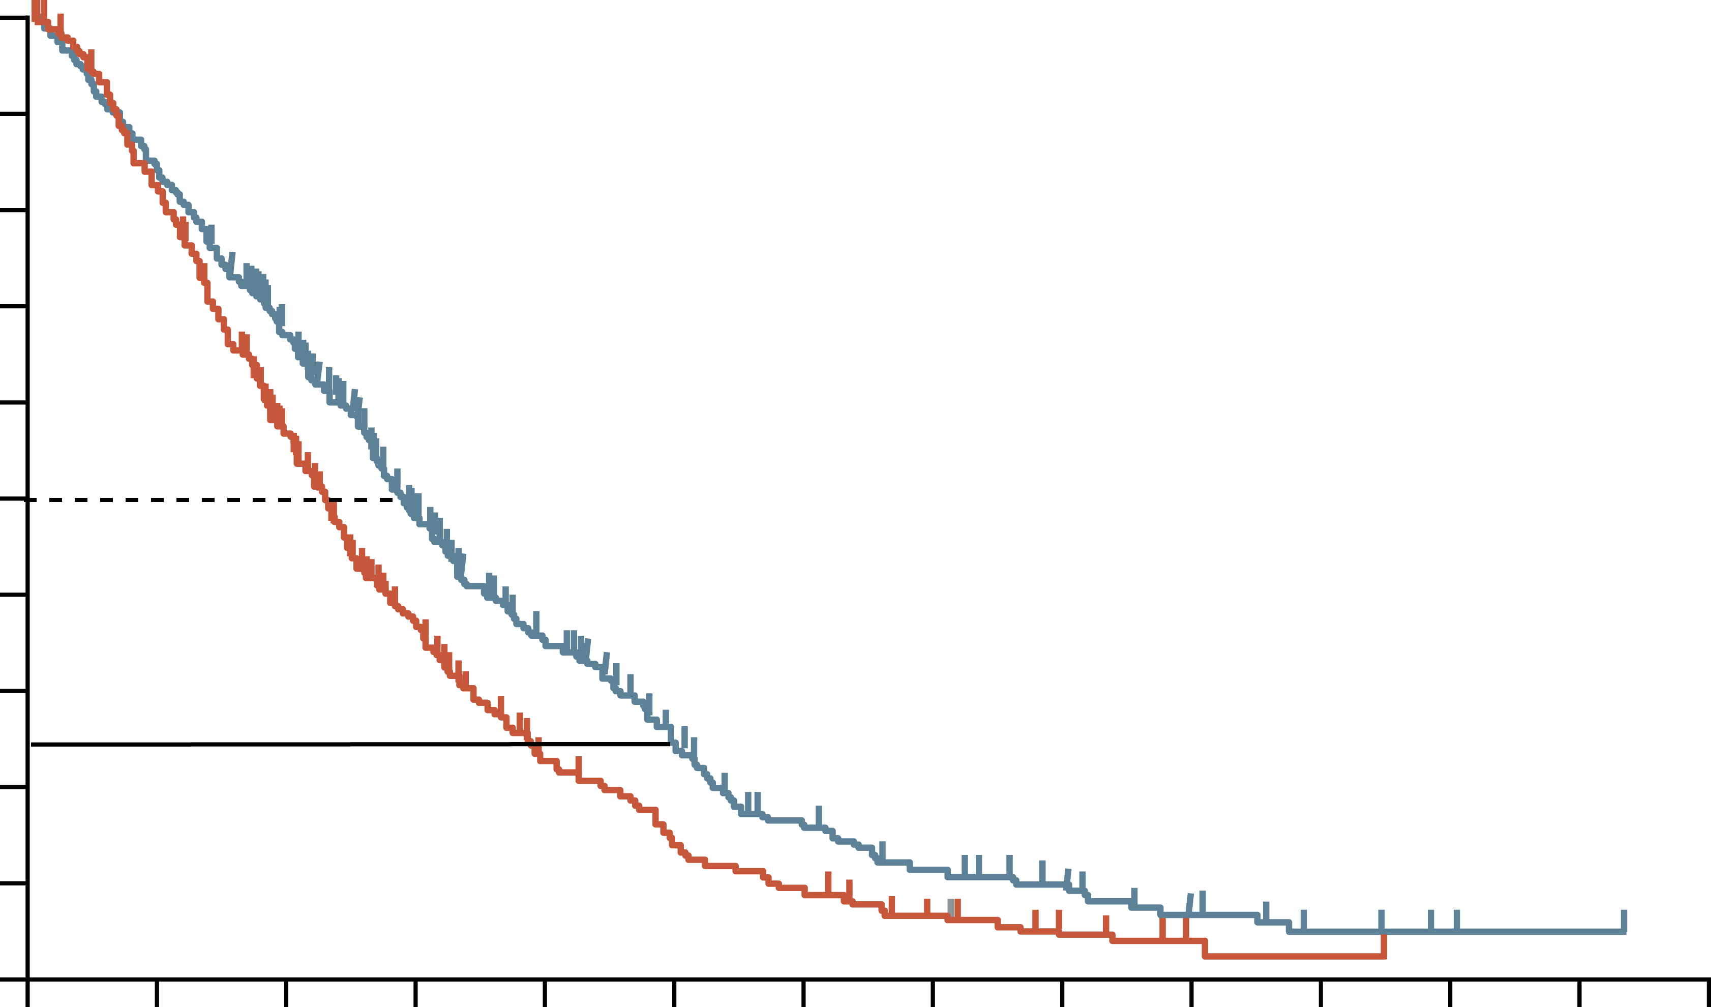
MPACT: the addition of Nabp to gem improves Overall Survival
100
90
Hazard ratio for death, 0.72 (95% CI, 0.62-0.83) P<0.001 by stratified log-rank test
80
70
60
Patients who were alive (%)
50
40
GEM + NabP
30
20
10
GEM
0
0
3
6
9
12
15
18
21
24
27
30
33
36
39
Time (months)
No. at risk
GEM + NabP
GEM
431
430
357
340
269
220
169
124
108
69
67
40
40
26
27
15
16
7
9
3
4
1
1
0
1
0
0
0
CI, confidence interval; GEM, gemcitabine; HR, hazard ratio; NabP, nanoparticle albumin-bound paclitaxel
Von Hoff D, et al. N Engl J Med. 2013;369:1691-703

Slide 14
MPACT: Pre-specified subgroup analysis
Overall Survival
Subgroup | GEM + NabP | GEM | Hazard Ratio for death (95% CI)
 | No. of events/no. of patients
All patients | 333/431 | 359/430 |  | 0.72 (0.62-0.83)
Age
<65 yr | 188/254 | 209/242 |  | 0.65 (0.53-0.79)
≥65 yr | 145/177 | 150/188 |  | 0.81 (0.63-1.03)
Sex
Female | 138/186 | 141/173 |  | 0.72 (0.57-0.93)
Male | 195/245 | 218/257 |  | 0.72 (0.59-0.88)
Karnofsky performance-status score
70-80 | 142/179 | 146/161 |  | 0.61 (0.48-0.78)
90-100 | 187/248 | 212/268 |  | 0.75 (0.62-0.92)
Primary tumour location
Head | 142/191 | 155/180 |  | 0.59 (0.46-0.75)
Other | 188/237 | 201/246 |  | 0.80 (0.65-0.98)
Liver metastases
Yes | 290/365 | 309/360 |  | 0.69 (0.59-0.81)
No | 43/66 | 50/70 |  | 0.86 (0.56-1.33)
No. of metastatic sites
1 | 21/33 | 16/21 |  | 0.41 (0.19-0.88)
2 | 159/202 | 163/206 |  | 0.75 (0.60-0.95)
3 | 104/136 | 121/140 |  | 0.79 (0.61-1.04)
>3 | 49/60 | 59/63 |  | 0.50 (0.33-0.76)
Level of CA19-9
Normal | 47/60 | 43/56 |  | 1.07 (0.69-1.66)
<59x ULN | 96/122 | 95/120 |  | 0.83 (0.61-1.12)
≥59x ULN | 151/197 | 171/195 |  | 0.61 (0.48-0.77)
Region
Australia | 50/61 | 53/59 |  | 0.67 (0.44-1.01)
Eastern Europe | 62/64 | 59/62 |  | 0.84 (0.58-1.23)
Western Europe | 14/38 | 17/38 |  | 0.72 (0.35-1.47)
North America | 207/268 | 230/271 |  | 0.68 (0.56-0.82)
0.125
0.25
0.50
1.00
2.00
GEM + NabP Better
GEM Better
CA19-9, carbohydrate antigen 19-9; CI, confidence interval; GEM, gemcitabine; NabP, nanoparticle albumin-bound paclitaxel; ULN, upper limit of normal; yr, year
Von Hoff D, et al. N Engl J Med. 2013;369:1691-703

Slide 15
MPACT: Safety
Preferred Term | GEM + NabP (n=421) | GEM (n=402)
Grade ≥3 Hematologic AEª, % Neutropenia Leukopenia Thrombocytopenia Anaemia | 38 31 13 13 | 27 16 9 12
Patients who received growth factors, % | 26 | 15
Febrile Neutropenia,^{b} % | 3 | 1
Grade ≥3 Non-hematologic AE^{b} in >5% patients, % Fatigue Peripheral Neuropathy^{c} Diarrhoea | 17 17 6 | 7 <1 <1
Grade ≥3 Neuropathy Median time to Onset, median days Median time to Improvement by 1 Grade, median days Median time to Improvement to Grade ≤1, median days Patients who resumed NabP, % | 140 21 29 44 | 113 29 NR NA
GEM + NabP group:
High levels of neutropenia, and thrombocytopenia
Significant percentage of patients with peripheral neuropathy
ª Based on lab values; ^{b} Based on investigator assessment of treatment-related events; ^{c} grouped term
AE, adverse event; GEM, gemcitabine; NabP, nanoparticle albumin-bound paclitaxel; NA, not applicable; NR, not reached
Von Hoff D, et al. N Engl J Med. 2013;369:1691-703
15
Notes:
15

Slide 16
Modified Gemcitabine plus Nab-paclitaxel
A modified regimen of biweekly mGEM + NabP in metastatic pancreatic cancer patients is tolerable and effective
Variable | mGEM + NabP | MPACT trial
Median PFS, months | 5.4, N=57 | 5.5, N=431
Median OS, months | 10, N=57 | 8.5, N=431
Grade 3 or 4 toxicity, hematological, n/N(%)
Anaemia | 8/57 (14%) | 53/405 (13%)
Neutropenia | 11/57 (19%) | 153/405 (38%)
Thrombocytopenia | 1/57 (2%) | 52/405 (13%)
Growth factor support | 7/57 (12%) | 110/431 (26%)
Grade 3 or 4 neurotoxicity | 1/57 (2%) | 70/421 (17%)
Dose reduction, (%): Nab-paclitaxel Gemcitabine | 20% 16% | 41% 47%
mGEM + NabP, modified regimen of gemcitabine and nanoparticle albumin-bound paclitaxel; OS, overall survival; PFS, progression-free survival
Ahn D, et al. Therapeutic Advances in Medical Oncology 2017; 9(2):75-8

Slide 17
two-week low dose GEM-NabP dosing manages toxicity and maintains efficacy
Outcome | First-line GEM + NabP efficacy
Median OS (95% CI), mo | 7.5 (6.51-10.33)
Median OS (95% CI) stratified by ECOG PS, mo
0 | 12.7 (8.49-18.49)
1 | 9.6 (6.48-12.04)
2 | 5.3 (4.41-10.2)
3 | 1.6 (NE)
 | P value <0.0001
Median PFS (95% CI), mo | 2.8 (2.3-3.68)
Median PFS (95% CI) stratified by ECOG PS, mo
0 | 5.3 (2.73-9.11)
1 | 2.8 (2.24-4.34)
2 | 1.8 (1.41-3.59)
3 | 1.4 (NE)
 | P value = 0.0072
Outcome | Second-line GEM + NabP efficacy
Median OS (95% CI), mo | 7.6 (6.12-8.26)
Median OS (95% CI) stratified by ECOG PS, mo
0 | 8 (6.22-12.99)
1 | 7.3 (5.33-9.14)
2 | 6.1 (4.61 - NE)
 | P value = 0.581
Median PFS (95% CI), mo | 2.5 (2.14-3.85)
Median PFS (95% CI) stratified by ECOG PS, mo
0 | 3.5 (2.07-7.24)
1 | 2.4 (2.07-2.99)
2 | 2.6 (1.74 - NE)
 | P value = 0.362
Median dosing was 600 mg/m² at fixed dose rate for GEM and 125 mg/m² for NabP given predominantly (~90%) every two weeks
CI, confidence interval; ECOG PS, Eastern Cooperative Oncology Group Performance Status; GEM-NabP, gemcitabine + nanoparticle albumin-bound paclitaxel; mo, months; NE, not estimable; OS, overall survival; PFS, progression-free survival
Rogers J, et al. Cancer Med. 2020;9:5406-15

Slide 18
NAPOLI-3: Study design
A randomised, open-label phase 3 study of liposomal irinotecan + 5-fluorouracil/leucovorin + oxaliplatin (NALIRIFOX) versus gemcitabine + Nab-paclitaxel in treatment-naïve patients with metastatic pancreatic ductal adenocarcinoma
Lower dose of oxaliplatin and liposomal irinotecan than FOLFIRINOX
Primary endpoint: OS
Secondary endpoints: PFS, ORR
Exploratory endpoints: QOL, biomarker analyses
Key inclusion criteria
Aged ≥18 years
Confirmed PDAC not previously treated in the metastatic setting
Metastatic disease diagnosed ≤6 weeks prior to screening
≥1 metastatic lesions measurable by CT/MRI according to RECIST v1.1
ECOG PS 0 or 1
NALIRIFOX
Liposomal irinotecan 50 mg/m^{2a} + 5-FU 2400 mg/m²
+ LV 400 mg/m²
+ oxaliplatin 60 mg/m²
Days 1 and 15 of a 28-day cycle^{b}
Tumour assessment every 8 weeks per RECIST v1.1^{c}
Treatment until disease progression, unacceptable toxicity or study withdrawal
AEs recorded and coded using MedDRA (v24.0); severity graded by NCI-CTCAE (v5.0)
Follow-up every 8 weeks until death or study end^{d}
R 1:1
GEM + NabP
GEM 1000 mg/m² + NabP 125 mg/m²
Days 1, 8 and 15 of a 28-day cycle
Stratification
ECOG PS 0/1
Region
Liver metastases
ª Dose expressed as irinotecan free base equivalent; ^{b} Administered sequentially as a continuous infusion over 46 hours beginning on days 1 and 15 of a 28-day cycle (dose delays and oxaliplatin discontinuation were permitted); ^{c} Until progressive disease; ^{d} The study was completed once all patients had discontinued the study treatment and at least 543 events had occurred in randomised patients
5-FU, fluorouracil; AE, adverse event; CT, computed tomography; ECOG PS, Eastern Cooperative Oncology Group performance status; FOLFIRINOX, folinic acid (leucovorin calcium), fluorouracil, irinotecan, and oxaliplatin; GEM, gemcitabine; LV, leucovorin calcium (folinic acid); MedDRA, Medical Dictionary for Regulatory Activities; MRI magnetic resonance imaging; NabP, nanoparticle albumin-bound paclitaxel; Nal-IRI, nanoliposomal irinotecan; NALIRIFOX; Nal-IRI, fluorouracil/folinic acid (leucovorin calcium), and oxaliplatin; NCI-CTCAE, National Cancer Institute Common Terminology Criteria for Adverse Events; ORR, objective response rate; OS, overall survival; PDAC, pancreatic ductal adenocarcinoma; PFS, progression-free survival; QoL, quality of life; R, randomisation; RECIST, Response Evaluation Criteria in Solid Tumours
O’Reilly E, et al. J. Clin Oncol. 2023;41;16_suppl:4006 (ASCO 2023 oral presentation); Jung K, et al. Ther Adv Med Oncol 2023; 15: 1-15

Slide 19
How is Nanoliposomal irinotecan (Nal-iri) different to irinotecan?
Liposomal irinotecan⁵
Nanoliposomal irinotecan: irinotecan encapsulated in liposome nanoparticles¹
Liposome shelters irinotecan from conversion to its active metabolite (SN-38) thereby remaining in the circulation for longer than free (unencapsulated) irinotecan¹⁻³
Leads to increases and prolonged intratumoural levels of both irinotecan and SN-38 compared with free irinotecan¹
Median OS of 5·2 months for Nal-IRI in a phase 2 study of gemcitabine-refractory metastatic pancreatic cancer^{1,4}
PEG-DSPE
~80,000 irinotecan salt molecules
Lipid membrane
~110nm
Internal aqueous space
Nal-IRI, nanoliposomal irinotecan; OS, overall survival; PEG-DSPE, polyethylene glycol-distearoylphosphatidylethanolamine
1. Wang-Gillam A, et al. Lancet 2016;387:545-57; 2. Kalra AV, et al. Cancer Res. 2014;74:7003-13; 3. Roy AC, et al. Ann Oncol. 2013;24: 1567-73; 4. Ko AH, et al. Br J Cancer. 2013;109:920-25; 5. Image: Camptothecin & Its Derivatives for Cancer Therapy | Biopharma PEG. Available at: https://www.biochempeg.com/article/310.html. Accessed July 2024

Slide 20
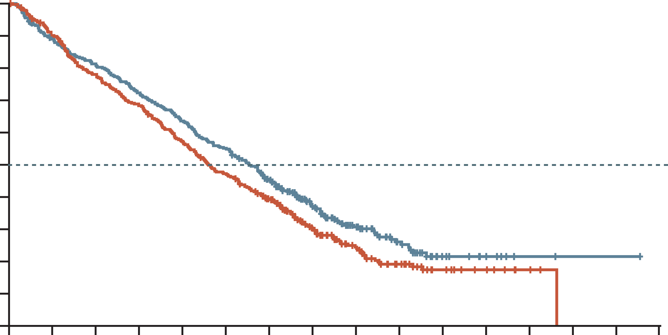
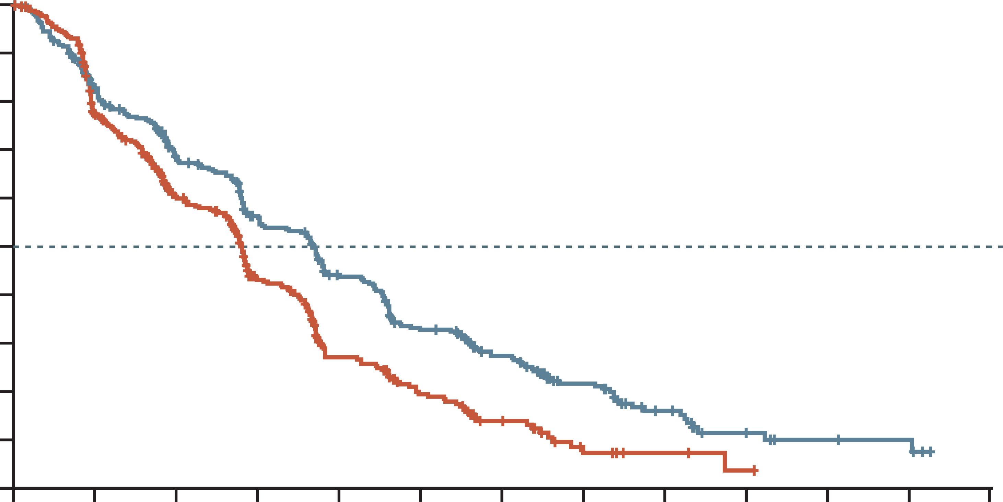
Napoli-3: nalirifox more effective than nabp/gem
OVERALL SURVIVAL
Progression-free SURVIVAL
 | NALIRIFOX | GEM + NabP
Median (95% CI), mo | 11.1 (10.0-12.1) | 9.2 (8.3-10.6)
Hazard ratio (95% CI) | 0.83 (0.70-0.99)
P value | 0.036
 | NALIRIFOX | GEM + NabP
Median (95% CI), mo | 7.4 (6.0-7.7) | 5.6 (5.3-5.8)
Hazard ratio (95% CI) | 0.69 (0.58-0.83)
P value | P<0.0001
100
100
90
90
80
80
70
70
60
60
Overall survival (%)
Progression-free survival (%)
50
50
40
40
30
30
20
20
10
10
0
0
2
4
6
8
10
12
14
16
18
20
22
24
26
28
30
0
0
2
4
6
8
10
12
14
16
18
20
22
24
Number at risk (number censored)
NALIRIFOX
GEM + NabP
Time (months)
Number at risk (number censored)
NALIRIFOX
GEM + NabP
Time (months)
383
(0)
387
(0)
337
(4)
345
(4)
308
(4)
298
(5)
274
(4)
261
(5)
241
(4)
218
(6)
209
(4)
179
(7)
162
(15)
140
(17)
98
(53)
80
(48)
59
(77)
50
(65)
32
(97)
28
(77)
13
(111)
15
(88)
7
(117)
10
(93)
2
(122)
3
(100)
1
(123)
0
(102)
1
(123)
0
(102)
0
(124)
0
(102)
383
(0)
387
(0)
271
(52)
267
(40)
210
(68)
182
(68)
164
(77)
112
(89)
122
(84)
60
(102)
87
(88)
38
(108)
61
(101)
19
(117)
39
(111)
6
(123)
20
(121)
3
(126)
9
(127)
1
(127)
5
(130)
0
(128)
4
(131)
0
(128)
0
(134)
0
(128)
CI, confidence interval; GEM, gemcitabine; mo, months; NabP, nanoparticle albumin-bound paclitaxel; Nal-IRI, nanoliposomal irinotecan; NALIRIFOX; Nal-IRI, fluorouracil/folinic acid (leucovorin calcium), and oxaliplatin
Wainberg Z, et al. Lancet 2023;402:1272-81

Slide 21
NAPOLI-3: OS subgroup analyses (ITT population)
 | Events/patients |  | NALIRIFOX, median (months) | GEM + NabP, median (months) |  | Hazard ratio (95% CI)
Age | NALIRIFOX | GEM + NabP
Presence of liver metastases at baseline
Yes | 220/309 | 242/309 | 10.3 | 8.6 |  | 0.82 (0.68-0.98)
No | 39/74 | 43/78 | 15.0 | 13.8 |  | 0.89 (0.57-1.37)
Number of metastatic sites
1 | 75/114 | 92/138 | 11.5 | 11.3 |  | 0.98 (0.72-1.32)
2 | 87/120 | 83/108 | 11.5 | 10.1 |  | 0.89 (0.65-1.20)
≥3 | 97/149 | 110/141 | 10.9 | 7.7 |  | 0.69 (0.52-0.90)
Baseline ECOG performance status
0 | 97/168 | 112/171 | 13.9 | 11.4 |  | 0.75 (0.57-0.98)
1 | 162/215 | 173/216 | 8.5 | 7.6 |  | 0.91 (0.73-1.13)
Region
North America | 85/120 | 94/122 | 11.2 | 9.1 |  | 0.79 (0.59-1.06)
Rest of the world | 174/263 | 191/265 | 11.1 | 9.3 |  | 0.86 (0.70-1.05)
Main pancreatic tumour location
Head | 97/147 | 116/156 | 10.2 | 9.1 |  | 0.86 (0.65-1.12)
Other | 162/236 | 169/231 | 11.7 | 9.2 |  | 0.83 (0.67-1.02)
Baseline CA 19-9
<37 U/mL | 34/60 | 45/71 | 13.2 | 10.9 |  | 0.75 (0.48-1.17)
≥37 U/mL | 223/321 | 240/316 | 11.1 | 9.1 |  | 0.84 (0.70-1.01)
Race
White | 218/315 | 240/324 | 10.7 | 9.0 |  | 0.84 (0.70-1.01)
Sex
Male | 139/204 | 175/230 | 10.9 | 9.0 |  | 0.82 (0.66-1.02)
Female | 120/179 | 110/157 | 11.6 | 9.5 |  | 0.88 (0.68-1.14)
Age, years
<65 | 127/193 | 130/191 | 11.5 | 9.9 |  | 0.92 (0.72-1.17)
≥65 | 132/190 | 155/196 | 11.0 | 9.0 |  | 0.77 (0.61-0.97)
Overall | 259/383 | 285/387 | 11.1 | 9.2 |  | 0.83 (0.70-0.99)
0
0.5
1.0
1.5
2.0
NALIRIFOX Better
GEM + NabP Better
CA19-9, carbohydrate antigen 19-9; CI, confidence interval; ECOG, Eastern Cooperative Oncology Group; GEM, gemcitabine; ITT, intention-to-treat; NabP, nanoparticle albumin-bound paclitaxel; Nal-IRI, nanoliposomal irinotecan; NALIRIFOX; Nal-IRI, fluorouracil/folinic acid (leucovorin calcium), and oxaliplatin; OS, overall survival
Wainberg Z, et al. Lancet 2023;402:1272-81

Slide 22
NAPOLI-3: overview of TEAEs in safety population
More hematologic toxicity observed with GEM + NabP
More diarrhoea, nausea, and vomiting observed with NALIRIFOX
TEAEs of grade 3-4 occurring in ≥5% of patients in either treatment arm | NALIRIFOX (N=370) | GEM + NabP (N=379)
Diarrhoea | 75 (20%) | 17 (5%)
Nausea | 44 (12%) | 10 (3%)
Vomiting | 26 (7%) | 8 (2%)
Decreased appetite | 32 (9%) | 10 (3%)
Hypokalaemia | 56 (15%) | 15 (4%)
Fatigue | 23 (6%) | 20 (5%)
Asthenia | 33 (9%) | 19 (5%)
Neutropenia | 52 (14%) | 93 (25%)
Neutrophil count decreased | 36 (10%) | 51 (14%)
Anaemia | 39 (11%) | 66 (17%)
Peripheral neuropathy | 12 (3%) | 22 (6%)
Increased 𝛾-glutamyltransferase | 23 (6%) | 21 (6%)
The most common AEs (any grade) leading to dose reduction of liposomal irinotecan and oxaliplatin was diarrhoea (40% and 36% of patients with dose reductions, respectively)
Data are median (range; IQR) or n (%)
AEs, adverse events; GEM, gemcitabine; NabP, nanoparticle albumin-bound paclitaxel; Nal-IRI, nanoliposomal irinotecan; NALIRIFOX; Nal-IRI, fluorouracil/folinic acid (leucovorin calcium), and oxaliplatin; TEAE, treatment-emergent adverse event
Wainberg Z, et al. Lancet. 2023;402:1272-81

Slide 23
Overall Survival in patients WITH AND WITHOUT DOSE REDuCTION OF LIPOSOMAL IRINOTECAN AND OXALIPLATIN
POST HOC ANALYSIS OF NAPOLI-3 STUDY
Liposomal irinotecan or oxaliplatin dose reductions do not adversely affect OS
Overall
North America
ROW
/
/
/
 | Dose reduced/dose not reduced
Liposomal irinotecan | N | Events | OS (95% CI) | Oxaliplatin | N | Events | OS (95% CI)
 | 194 | 118 | 12.6 (11.0-14.5) |  | 217 | 128 | 13.5-(11.7-15.2)
 | 176 | 129 | 9.4 (7.6-11.5) |  | 153 | 119 | 7.7 (6.2-10.2)
 | 63 | 43 | 13.0 (8.6-15.4) |  | 72 | 46 | 14.4 (11.5-15.9)
 | 49 | 35 | 10.9 (7.7-13.9) |  | 40 | 32 | 8.3 (5.9-11.2)
 | 131 | 75 | 12.1 (10.5-16.2) |  | 145 | 82 | 13.2 (11.1-16.2)
 | 127 | 94 | 8.6 (6.6-11.6) |  | 113 | 87 | 7.5 (5.7-10.3)
6
7
8
9
10
11
12
13
14
15
16
17
5
6
7
8
9
10
11
12
13
14
15
16
17
Median OS (95% CI), months
Median OS (95% CI), months
CI, confidence interval; OS, overall survival; RoW, rest of world
Patel A, et al. J Clin Oncol 2025; 43, 716-716: DOI:10.1200/JCO.2025.43.4_suppl.716 (ASCO GI 2025 poster presentation)

Slide 24
Summary of Efficacy and safety of NALIRIFOX and FOLFIRINOX
 | NALIRIFOX¹ N=370 | FOLFIRINOX² N=171
Efficacy Results
Median OS, months | 11.1 | 11.1
OS at 12 months, % | 45.6 | 48.4
OS at 18 months, % | 26.2 | 18.6
Median PFS, months | 7.4 | 6.4
ORR, % | 41.8 | 31.6
Safety Results
Grade 3-4 diarrhoea, % | 20.3 | 12.7
Grade 3-4 vomiting, % | 7.0 | 14.5
Grade 3-4 neuropathy, % | 3.2 | 9.0
Grade 3-4 neutropenia, % | 14.1 | 45.7
Data presented for information purposes. Cross-trial comparison is not intended
FOLFIRINOX, folinic acid (leucovorin calcium), fluorouracil, irinotecan, and oxaliplatin; Nal-IRI, nanoliposomal irinotecan; NALIRIFOX; Nal-IRI, fluorouracil/folinic acid (leucovorin calcium), and oxaliplatin; ORR, objective response rate; OS, overall survival; PFS, progression-free survival
1. Wainberg Z, et al. Lancet 2023; 402:1272-81; 2. Conroy T, et al. N Engl J Med. 2011;364:1817-25

Slide 25
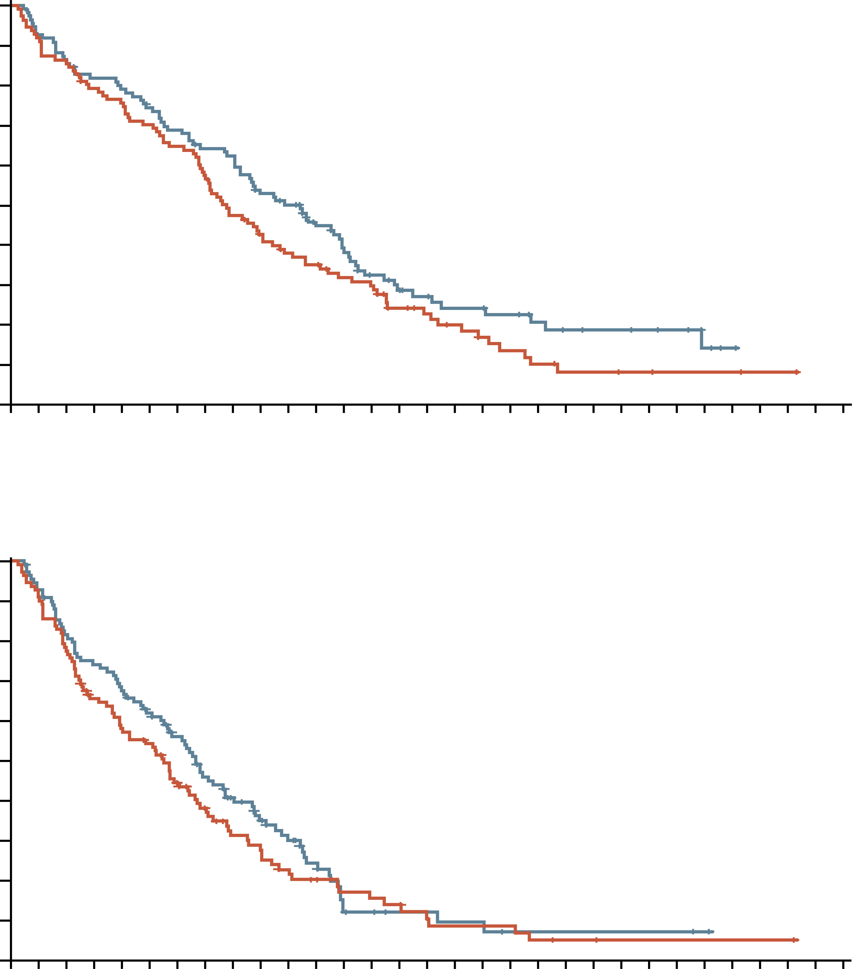
Gem + NabP is effective for patients with a Poor Performance Status
1.0
0.9
Arm
B
D
B, censored
D, censored
0.8
0.7
0.6
Cumulative OS (probability)
0.5
Patients enrolled and randomly assigned (n=221)
0.4
0.3
0.2
0.1
Assigned to arm B (NabP 100 mg/m² +
GEM 1000 mg/m²; n=111)
Assigned to arm D (NabP 125 mg/m² +
GEM 1000 mg/m²; n=110)
0
0
1
2
3
4
5
6
7
8
9
10
11
12
13
14
15
16
17
18
19
20
21
22
23
24
25
26
27
28
29
30
No. at risk
Arm B
Arm D
Follow-up time (months)
110
109
101
101
95
93
86
88
82
85
76
79
70
73
62
67
51
65
44
54
38
50
35
40
29
33
27
25
19
20
15
18
12
18
9
15
7
13
5
10
4
8
3
8
3
7
2
6
2
5
2
2
1
0
1
1
0
Schedule 3 weeks on 1 week off
Median age 71 and 68 (range 35-89)
mPFS 5.4 vs 6.6 months (P=0.28)
Free of disease progression at 6 months: 44% vs 58%
mOS 7.7m vs 9.8m (P=0.11)
No significant differences in AEs between the two dose regimens
1.0
0.9
Arm
B
D
B, censored
D, censored
0.8
0.7
0.6
Cumulative PFS (probability)
0.5
0.4
0.3
0.2
0.1
0
0
1
2
3
4
5
6
7
8
9
10
11
12
13
14
15
16
17
18
19
20
21
22
23
24
25
26
27
28
29
30
No. at risk
Arm B
Arm D
Follow-up time (months)
111
110
100
100
85
87
69
79
61
72
56
64
43
55
35
44
25
36
22
29
17
23
14
16
10
7
9
7
8
6
6
4
5
4
5
3
4
2
3
2
2
2
1
2
1
2
1
2
1
1
1
1
1
0
1
1
0
AEs, adverse events; GEM, gemcitabine; (m)OS, (median) overall survival; (m)PFS, (median) progression-free survival; NabP, nanoparticle albumin-bound paclitaxel
Maccarulla T, et al. J Clin Oncol. 2019;37:230-238

Slide 26
POLO: PARPi as Maintenance therapy for brcam mpdac patients post-platinum chemotherapy
Global, randomised, double-blind phase 3 trial
Patients with metastatic pancreatic cancer and deleterious/suspected deleterious germline BRCA1/2 mutation, ≥16 wks of first-line platinum-based therapy without progression (4-8 wks from last dose)
(N=154)
Olaparib 300 mg BID
(n=92)
Continue until PD or unacceptable toxicity
Placebo
(n=62)
Primary endpoint: PFS by blinded independent central review
Key secondary endpoints: safety/tolerability, PFS2, ORR, OS, HRQoL
1L, first-line; BID, twice daily; BRCA, BReast CAncer 1/2 gene; HRQoL, health-related quality of life; ORR, objective response rate; OS, overall survival; PD, progressive disease; PFS(2), (second) progression-free survival; wks, weeks
Golan T, et al. N Engl J Med. 2019;381:317-27; Kindler H, et al. J Clin Oncol. 2022;40:3929-39

Slide 27
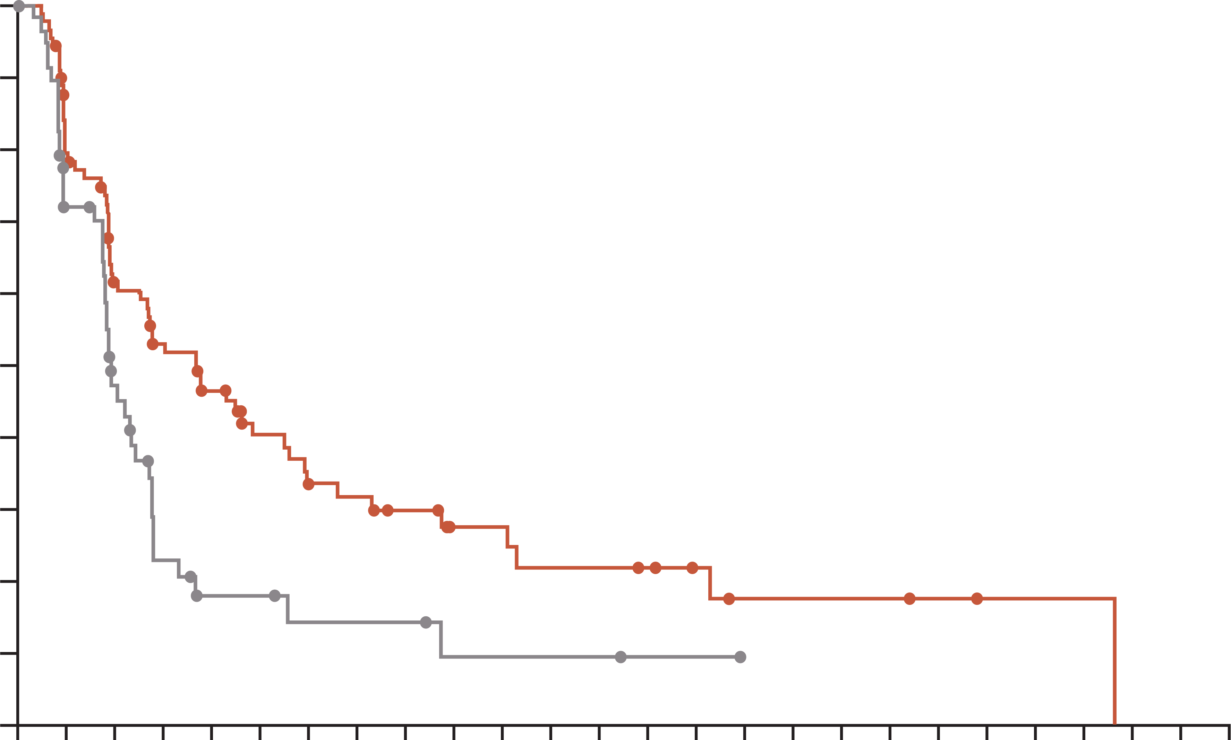
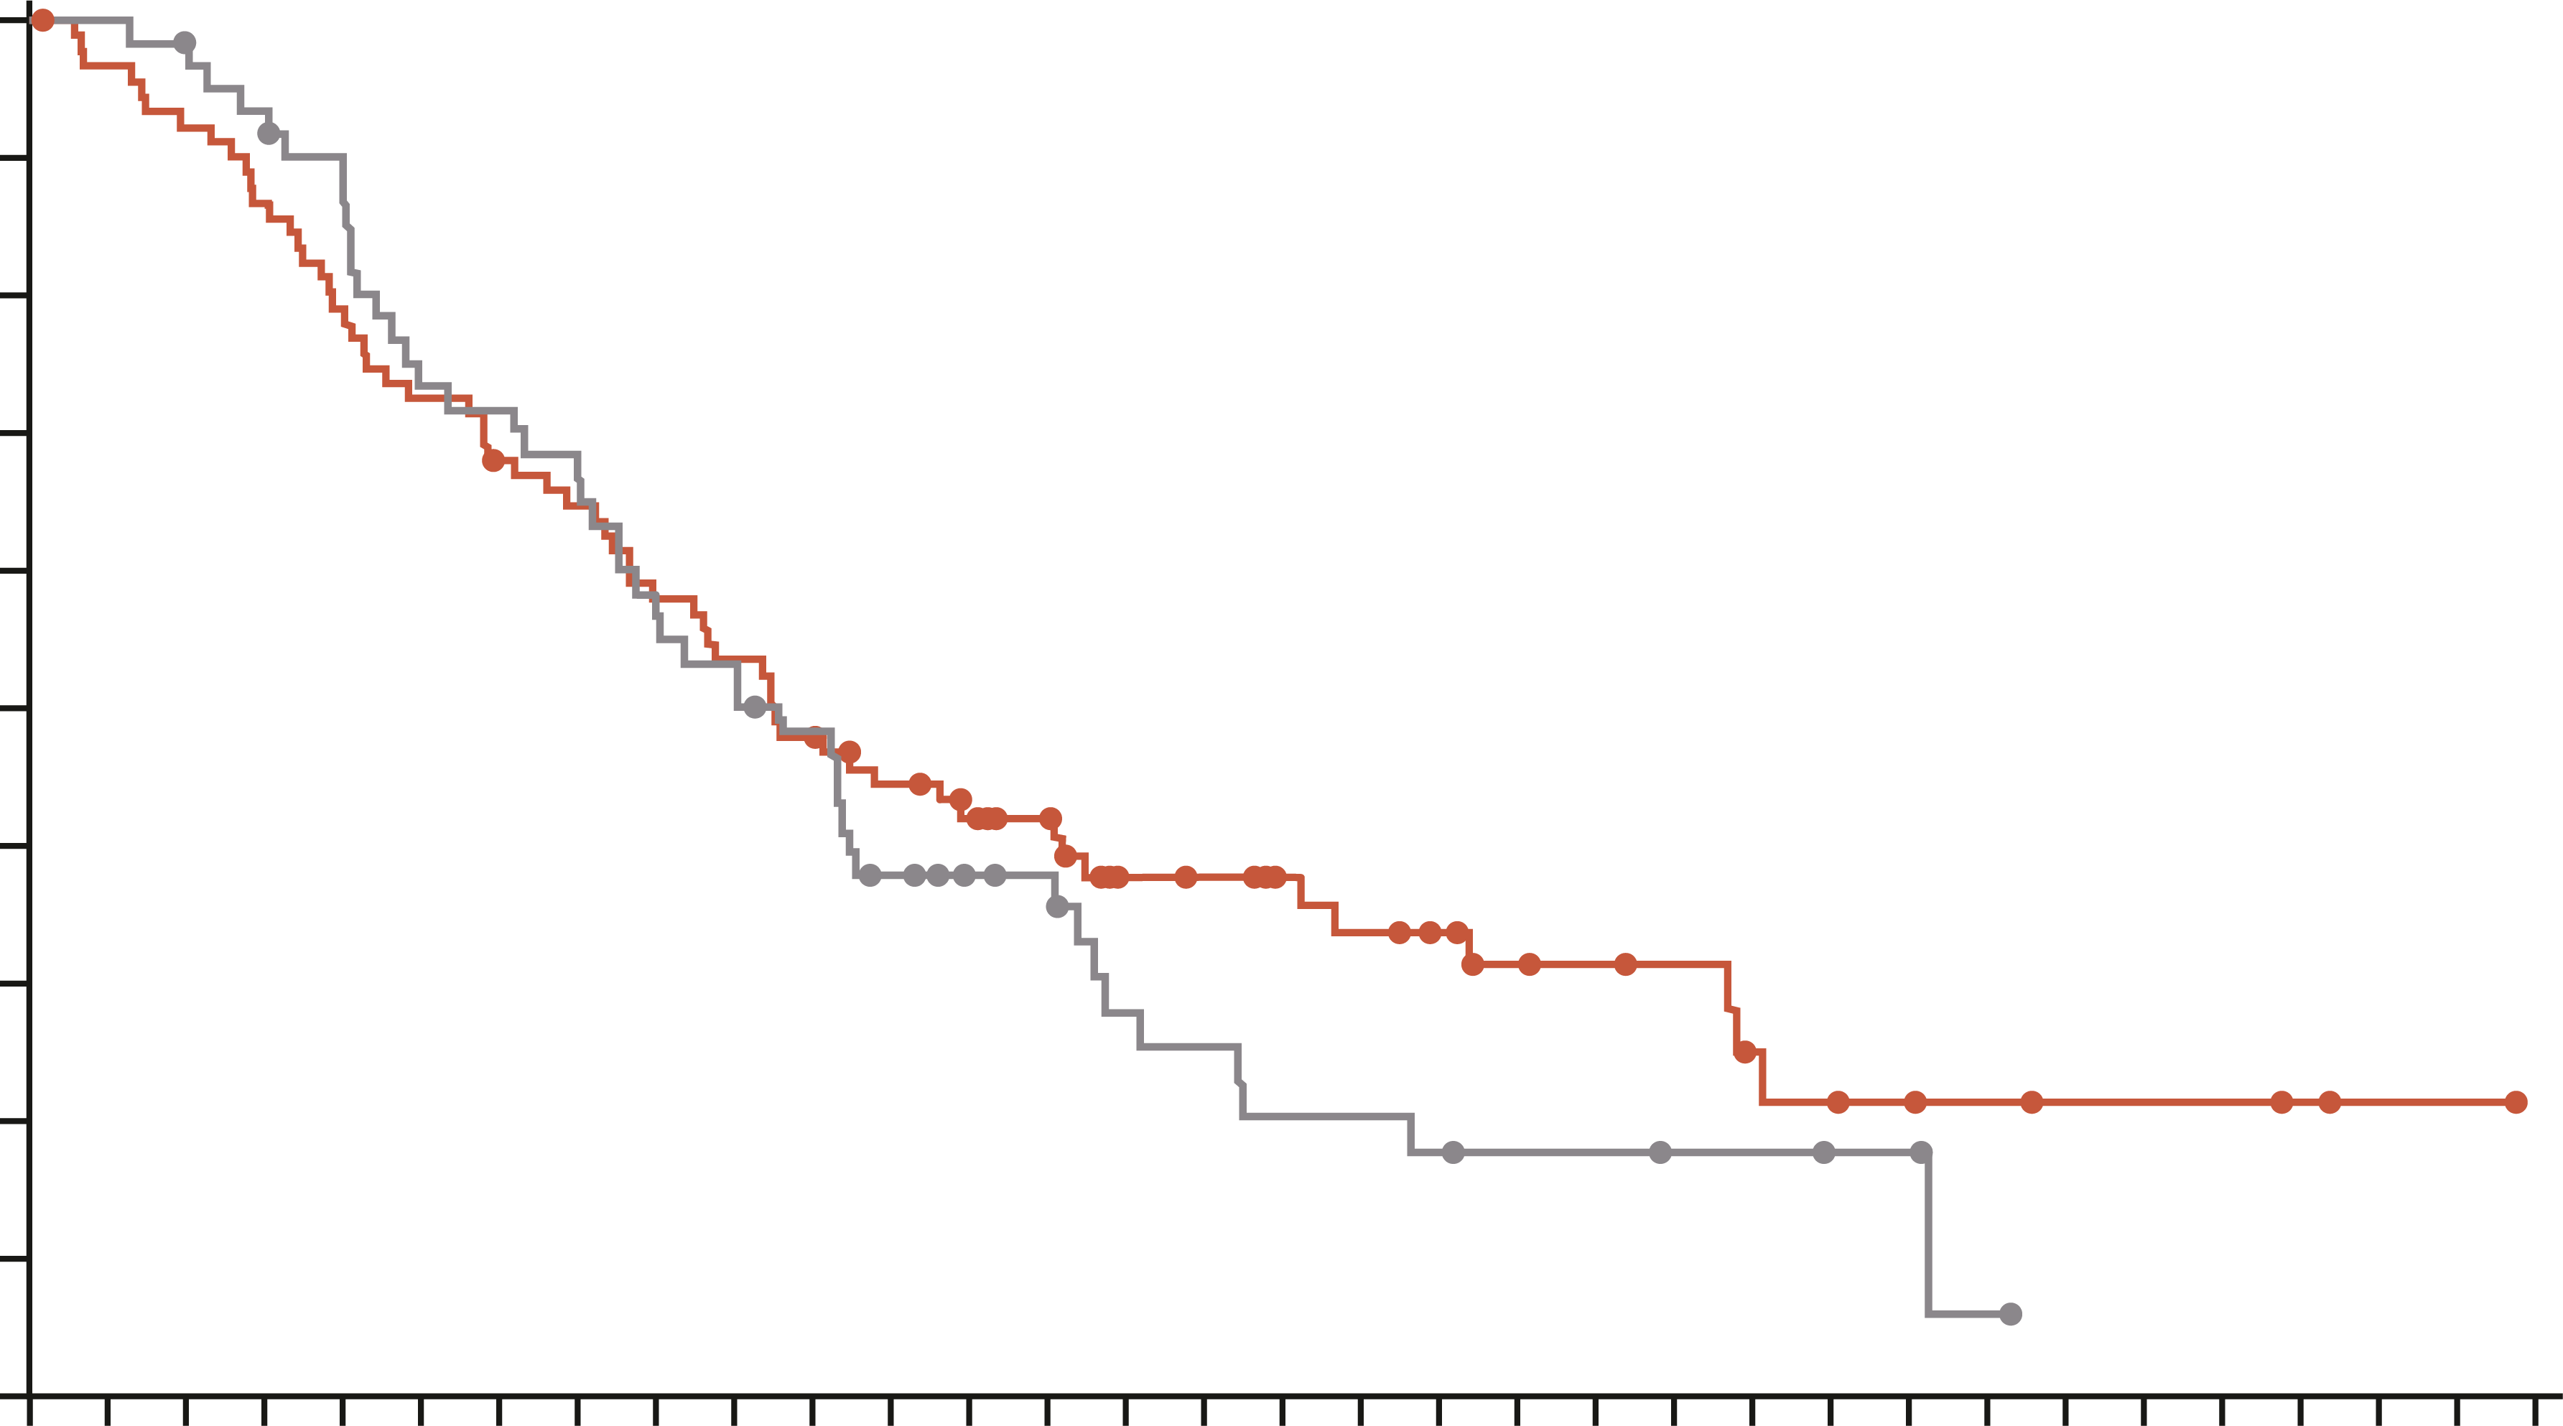
POLO: pfs LONGER WITH MAINTENANCE OLAPARIB THAN PLACEBO
Progression-free survival¹
overall survival²
1.0
Progression-free survival (%) | Olaparib (n=92) | Placebo (n=62)
Month 6 Month 12 Month 18 Month 24 | 53.0% 33.7% 27.6% 22.1% | 23.0% 14.5% 9.6% 9.6%
Median, 7.4 mo vs. 3.8 mo Hazard ratio, 0.53 (95% CI, 0.35-0.82 P=0.004
 | Olaparib (n=92) | Placebo (n=62)
Events, n (%) | 61 (66.3) | 47 (75.8)
Median OS, months | 19.0 | 19.2
HR (95% CI) P value | 0.83 (0.56-1.22) 0.3487
Ongoing investigational treatment at DCO, n (%) | 13 (14.1) | 2 (3.2)
1.0
0.9
0.9
0.8
0.8
0.7
0.7
0.6
0.6
PFS (probability)
OS (probability)
0.5
0.5
0.4
0.4
0.3
0.3
0.2
0.2
0.1
0.1
0.0
0.0
0
2
4
6
8
10
12
14
16
18
20
22
24
26
28
30
32
34
36
38
40
42
44
46
48
50
0
2
4
6
8
10
12
14
16
18
20
22
24
26
28
30
32
34
36
38
40
42
44
46
48
50
52
54
56
58
60
62
64
No. at risk
Olaparib
Placebo
Time since random assignment (months)
No. at risk
Olaparib
Placebo
Time since random assignment (months)
92
62
69
39
50
23
41
10
34
6
24
6
18
4
17
4
14
4
10
2
10
2
8
2
8
2
7
1
5
1
3
0
3
3
3
2
1
1
1
0
92
62
88
62
84
60
79
57
72
53
66
44
61
43
58
40
52
34
48
32
43
28
38
21
34
17
31
16
23
11
22
10
19
8
17
8
15
7
12
6
11
6
10
5
7
5
6
4
5
4
4
1
3
0
3
3
2
1
1
0
CI, confidence interval; BRCA, BReast CAncer gene mutation; DCO, data cut-off; HR, hazard ratio; mo, months; mPDAC, metastatic pancreatic ductal adenocarcinoma; OS, overall survival; PARPi, poly(ADP-ribose) polymerase inhibitor; PFS, progression-free survival
1. Golan T, et al. N Engl J Med. 2019;381:317-27; 2. Kindler H, et al. J Clin Oncol. 2022;40:3929-39

Slide 28
Targeted therapy for pancreatic adenocarcinoma
Molecular Target | Targeted Therapy | NCCN panel recommendations
NTRK gene fusions | Larotrectinib | 1st line and subsequent treatment options for pts with NTRK gene fusion-positive locally advanced or metastatic pancreatic adenocarcinoma and for recurrent disease
 | Entrectinib
 | Repotrectinib | Category 2B recommendation as 1st line for patients with metastatic disease (PS 3) and subsequent therapy or therapy for recurrent disease for patients with intermediate/poor PS (PS 2-3)
RET gene fusions | Selpercatinib | 1st line: pts with locally advanced/metastatic disease (PS 0–2) and as subsequent therapy for pts with good PS (0–1)
NRG1 gene fusions | Zenocutuzumab-zbco | FDA approved for advanced, unresectable, or metastatic pancreatic adenocarcinoma harboring a NRG1 gene fusion with disease progression on or after prior systemic therapy. Awaiting incorporation into the NCCN guidelines
KRAS G12C mutations | Adagrasib | Subsequent therapy options for patients with any PS (category 2B for poor PS)
 | Sotorasib
BRAF V600E mutations | Dabrefenib/trametinib | 1st line: metastatic disease (category 2B) and as subsequent line options (category 2A) for pts with good/poor PS and BRAF V600E mutations
HER2-positive | Fam-trastuzumab-deruxtecan-nxki | As a subsequent therapy option only for patients with good PS and HER2 IHC 3+ expression
MSI-H/TMB-H/dMMR | Pembrolizumab | In the advanced disease setting for first-line and subsequent treatment (if no prior immunotherapy)
 | Dostarlimab-gxly | As a subsequent treatment option (if no prior immunotherapy) for patients with MSI-H or dMMR locally advanced, metastatic, or recurrent pancreatic adenocarcinoma and any PS
 | Nivolumab/Ipilimumab | Category 2B, subsequent therapy option for patients with good or intermediate PS and those who did not receive prior immunotherapy
BRAF, B-Raf proto-oncogene serine/threonine kinase; dMMR, deficient DNA mismatch repair; HER2, human epidermal growth factor receptor 2; KRAS, Kirsten rat sarcoma viral oncogene homolog; MSI-H, microsatellite instability-high; NTRK, neurotrophic tyrosine receptor kinase; PDAC, pancreatic ductal adenocarcinoma; PS, performance status; RAS, rat sarcoma; RET, rearranged during transfection; TMB-H, tumour mutational burden-high
NCCN Guidelines Version 3.2024. Available at: https://www.nccn.org/guidelines/guidelines-detail?category=1&id=1455. Accessed October 2024 NCCN guidelines for pancreatic adenocarcinoma, Version 3.2024: pancreatic.pdf (nccn.org)

Slide 29
summary
Cytotoxic chemotherapy remains the cornerstone of systemic therapy for advanced or metastatic pancreatic cancer
NALIRIFOX is a possible new option for frontline therapy based on the NAPOLI-3 clinical trial
Maintenance therapy after a period of chemotherapy is an option for patients with BRCA or PALB2 alterations
Treatment selection depends on several factors, including patients' performance status and co-morbidities. These should be considered alongside the efficacy and safety profiles of the different chemotherapy regimens
Treatment strategies can be implemented to manage toxicities associated with the different chemotherapy regimens to enable a patient to stay on treatment for optimal efficacy
BRCA1/2, BReast CAncer 1/2 gene; Nal‑IRI, nanoliposomal irinotecan; NALIRIFOX; Nal-IRI, fluorouracil/folinic acid (leucovorin calcium), and oxaliplatin; PALB2, partner and localiser of BRCA2
NCCN Guidelines Version 3.2024. Available at: https://www.nccn.org/guidelines/guidelines-detail?category=1&id=1455. Accessed October 2024

