Slide 1
CHEMOTHERAPY strategies IN metastatic Pancreatic Ductal AdenoCarcinoma (mPDAC): second-line chemotherapy options
Prof. Efrat Dotan Penn Medicine, Ann B. Barshinger Cancer Institute, PA, USA
April 2025
mPDAC, metastatic pancreatic ductal adenocarcinoma

Slide 2
Developed by GI COnnect
This programme is developed by GI CONNECT, an international group of experts in the field of gastrointestinal oncology.
Acknowledgement and disclosures
This GI CONNECT programme is supported through an independent educational grant from Ipsen USA. The programme is therefore independent, the content is not influenced by the supporter and is under the sole responsibility of the experts.
Please note: The views expressed within this programme are the personal opinions of the experts. They do not necessarily represent the views of the experts’ institutions, or the rest of the GI CONNECT group.
Expert disclosures:
Prof. Efrat Dotan has received financial support/sponsorship for research support, consultation, or speaker fees from the following companies: Agenus, Amgen, Ipsen, Merck, MERUS, Olympus, Pfizer, TME Biopharmaceuticals

Slide 3
Educational objectives
Be able to differentiate the efficacy and safety profiles of chemotherapies for mPDAC and understand how mode of delivery plays a role in this
Be able to recognise the cause of toxicities and have an awareness of strategies that can be used to improve tolerability and manage side effects whilst maintaining optimal efficacy
mPDAC, metastatic pancreatic ductal adenocarcinoma

Slide 4
Clinical takeaways
Pancreatic ductal adenocarcinoma (PDAC) is usually diagnosed at an advanced, incurable stage due to non-specific symptoms and has an extremely poor prognosis
Systemic chemotherapy is the standard treatment for metastatic PDAC but molecularly targeted treatments and immunotherapies may have a role for specific patients
Treatment selection depends on several factors, including patients' performance status and co-morbidities. These should be considered alongside the efficacy and safety profiles of the different chemotherapy regimens
Treatment strategies can be implemented to manage toxicities associated with the different chemotherapy regimens to enable a patient to stay on treatment for optimal efficacy

Slide 5
Overview of treatment for mpdac
Chemotherapy is the mainstay of treatment for mPDAC patients
Enrolment on clinical trials should always be encouraged
<50% eligible
First-line treatment
Olaparib Maintenance (only for gBRCAm pts)
Progression
Second-line treatment
Progression
Third line treatment
mPFS: 7.4 months
mPFS: 6 months
NALIRIFOX
FOLFIRINOX
Gem + Nab-paclitaxel
NalIRI
FOLFOX
FOLFIRINOX
Gem + Nab-paclitaxel
Targeted therapies if molecular alteration identified
Progression mPFS = 5.5-6.4 months
Figure adapted from Casolino 2022
FOLFIRINOX, folinic acid (leucovorin calcium), fluorouracil, irinotecan, and oxaliplatin; FOLFOX, folinic acid (leucovorin calcium), fluorouracil, and oxaliplatin; gBRCAm, germline BReast CAncer (BRCA) gene mutation; gem, gemcitabine; mPDAC, metastatic pancreatic ductal adenocarcinoma; mPFS, median progression-free survival; Nab, nanoparticle albumin-bound; Nal-IRI, nanoliposomal irinotecan; NALIRIFOX; Nal-IRI, fluorouracil/folinic acid (leucovorin calcium), and oxaliplatin; mPDAC, metastatic pancreatic adenocarcinoma; mPFS, median progression-free survival
Casolino R, Biankin AV. Camb Prism Precis Med. 2023;1:e14

Slide 6
Key studies of 2L systemic therapy for mpdac
Study setting | Study | Study type | Arm (N) | Primary endpoint | Primary endpoint |  | Secondary endpoint | Secondary endpoint |  | ORR (%) | Notable adverse events
 |  |  |  |  | Months | HR (95% CI) |  | Months | HR (95% CI)
Second- line | CONKO-003¹ (2014) | RCT, phase 3 | OFF (77) | OS | 5.9 | 0.66 (0.48-0.91) | PFS | 2.9 | 0.68 (0.50-0.94) | – | Rates of adverse events were similar between treatment arms, with the exception of grades 1 to 2 neurotoxicity 38.2% and 7.1% in the OFF and FF groups
 |  |  | FF (91) |  | 3.3 |  |  | 2.0 |  | –
Second- line | PANCREOX² (2016) | RCT, phase 3 | mFOLFOX (54) | PFS | 3.0 | 1.00 (0.66-1.53) | OS | 6.1 | 1.78 (1.08-2.93) | 13.2 | Increased toxicity was observed with the addition of oxaliplatin, with grade 3/4 adverse events occurring in 63.0% of patients who received mFOLFOX6 and 11.0% of those who received FU/LV.
 |  |  | 5FU/LV (54) |  | 2.8 |  |  | 9.9 |  | 8.5
Second- line | NAPOLI-1³ (2016) | RCT, phase 3 | Nal-IRI + 5-FU/LV (117) | OS | 6.1 | 0.67 (0.49 to 0.92) | PFS | 3.1 | 0.56 (0.41 to 0.75) | 16.2 | Most frequent grade 3 or 4 AEs for Nal-IRI + 5-FU/LV vs 5-FU/LV: neutropenia 27.0 vs 1.0%, diarrhoea 13.0 vs 4.0%, vomiting 11.0 vs 3.0%, and fatigue 14.0 vs 4.0%
 |  |  | 5-FU/LV (119) |  | 4.2 |  |  | 1.5 |  | 0.8
5-FU, fluorouracil; AE, adverse event; CI, confidence interval; FF, folinic acid (leucovorin calcium) and fluorouracil; HR, hazard ratio; LV, leucovorin calcium (folinic acid); mFOLFOX, modified FOLFOX: folinic acid (leucovorin calcium), fluorouracil, and oxaliplatin; mPDAC, metastatic pancreatic ductal adenocarcinoma; Nal‑IRI, nanoliposomal irinotecan; OFF, oxaliplatin and FF; ORR, objective response rate; OS, overall survival; PFS, progression-free survival; RCT, randomised controlled trial
1. Oettle H, et al. J Clin Oncol. 2014; 32: 2423-9; 2. Gill S, et al. J Clin Oncol. 2016;10;3914-20; 3. Wang-Gillam A, et al. Lancet 2016;387:545-57

Slide 7
Considerations for treatment selection
Prior treatments
Patient performance status
Age and frailty
Co-morbidities
Residual side effects from prior treatments
Molecular profile
Patient preference
Supportive system
Jiang Y, et al. JCO Oncol Pract. 2023;19(1):19-32

Slide 8
Systemic therapies for good PS 0-1
BASED ON NCCN GUIDELINES
Targeted therapies
Useful in certain circumstances
FOLFIRINOX / mFOLFIRINOX
NALIRIFOX
Gemcitabine-based therapy:
Gemcitabine + Nab-paclitaxel
Gemcitabine + cisplatin for known BRCA1/2 or PALB2 mutations)
Entrectinib, Larotrectinib, Repotrectinib (NTRK fusion)
Dabrafenib + trametinib (BRAF V600E mutation)
Selpercatinib (RET fusion)
Pembrolizumab (MSI-H, dMMR, or TMB-H)
First-line
Maintenance
Olaparib maintenance, only for patients with germline BRCA1/2 mutations
Chemotherapy is recommended as front-line therapy for mPDAC patients, but targeted therapies may be useful in certain circumstances (e.g. if a patient can no longer tolerate chemotherapy)
Liposomal irinotecan (Nal-IRI) +FU/LV
Fluoropyrimidine-based therapy
Entrectinib, Larotrectinib, Repotrectinib (NTRK fusion)
Dabrafenib + trametinib (BRAF V600E mutation)
Selpercatinib (RET fusion)
Adagrasib, sotorasib (KRAS G12C)
Trastuzumab deruxtecan (HER2)
If no prior immunotherapy:
Pembrolizumab (MSI-H, dMMR, or TMB-H)
Dostarlimab (MSI-H or dMMR)
Nivolumab + ipilimumab (TMB-H)
Liposomal irinotecan (Nal-IRI) +FU/LV (if no prior irinotecan)
Gemcitabine
Gemcitabine-based therapy
Subsequent therapy
5-FU, fluorouracil; BRAF, B-Raf proto-oncogene serine/threonine kinase; BRCA1/2, BReast CAncer 1/2 gene; dMMR, deficient DNA mismatch repair; HER2, human epidermal growth factor receptor 2; KRAS, Kirsten rat sarcoma viral oncogene homolog; LV, leucovorin calcium (folinic acid); (m)FOLFIRINOX, (modified) FOLFIRINOX, folinic acid (leucovorin calcium), fluorouracil, irinotecan, and oxaliplatin; MSI-H, microsatellite instability-high; Nab, nanoparticle albumin-bound; Nal-IRI, nanoliposomal irinotecan; NALIRIFOX; Nal-IRI, fluorouracil/folinic acid (leucovorin calcium), and oxaliplatin; NCCN, National Comprehensive Cancer Network; NRG1, neuregulin-1; NTRK, neurotrophic tyrosine receptor kinase; PALB2, partner and localiser of BRCA2; PS, performance status; RET, rearranged during transfection; TMB-H, tumour mutational burden-high
NCCN Guidelines Version 3.2024. Available at: https://www.nccn.org/guidelines/guidelines-detail?category=1&id=1455. Accessed October 2024 NCCN guidelines for pancreatic adenocarcinoma, Version 3.2024: pancreatic.pdf (nccn.org)

Slide 9
Systemic therapies for intermediate PS 2 or higher
BASED ON NCCN GUIDELINES
Targeted therapies
Useful in certain circumstances
Capecitabine
FOLFOX, FOLFIRI, CapeOx
5-FU
Gemcitabine + Nab-paclitaxel
Gemcitabine
Entrectinib, Larotrectinib, Repotrectinib (NTRK fusion)
Dabrafenib + trametinib (BRAF V600E mutation)
Selpercatinib (RET fusion) [ECOG PS 2 only for first-line]
Pembrolizumab (MSI-H, dMMR, or TMB-H)
First-line
Chemotherapy is recommended as front-line therapy for mPDAC patients, but targeted therapies may be useful in certain circumstances (e.g. if a patient can no longer tolerate chemotherapy)
Maintenance
Olaparib maintenance, only for patients with germline BRCA1/2 mutations
Entrectinib, Larotrectinib, Repotrectinib (NTRK fusion)
Dabrafenib + trametinib (BRAF V600E mutation)
Selpercatinib (RET fusion) [ECOG PS 2 only for first-line]
Adagrasib, sotorasib (KRAS G12C)
If no prior immunotherapy:
Pembrolizumab (MSI-H, dMMR, or TMB-H)
Dostarlimab (MSI-H or dMMR)
Nivolumab + ipilimumab (TMB-H)
Liposomal irinotecan (Nal-IRI) +FU/LV (if no prior irinotecan)
Gemcitabine + Nab-paclitaxel
Gemcitabine
Liposomal irinotecan +FU/LV
Capecitabine
5-FU/LV
Subsequent therapy
5-FU, fluorouracil; BRAF, B-Raf proto-oncogene serine/threonine kinase; BRCA1/2, BReast CAncer 1/2 gene; CapeOX, capecitabine and oxaliplatin; dMMR, deficient DNA mismatch repair; FOLFOX, folinic acid (leucovorin calcium), fluorouracil, and oxaliplatin; FOLFIRI, folinic acid (leucovorin calcium), fluorouracil and irinotecan; KRAS, Kirsten rat sarcoma viral oncogene homolog; LV, leucovorin calcium (folinic acid); MSI-H, microsatellite instability-high; Nab, nanoparticle albumin-bound; NCCN, National Comprehensive Cancer Network; NRG1, neuregulin-1; NTRK, neurotrophic tyrosine receptor kinase; PALB2, partner and localiser of BRCA2; PS, performance status; RET, rearranged during transfection; TMB-H, tumour mutational burden-high
NCCN Guidelines Version 3.2024. Available at: https://www.nccn.org/guidelines/guidelines-detail?category=1&id=1455. Accessed October 2024;

Slide 10
Patients with Poor performance status and progressive disease
PALLIATIVE CARE
Single agent chemotherapy (gemcitabine)
Targeted therapy (based on molecular profiling and as clinically indicated)
Palliative radiotherapy
To relieve pain, bleeding and/or local obstructive symptoms
NCCN, National Comprehensive Cancer Network
NCCN Guidelines Version 3.2024. Available at: https://www.nccn.org/guidelines/guidelines-detail?category=1&id=1455. Accessed October 2024

Slide 11
How is Nanoliposomal irinotecan (Nal-iri) different to irinotecan?
Liposomal irinotecan⁵
Nanoliposomal irinotecan: irinotecan encapsulated in liposome nanoparticles¹
Liposome shelters irinotecan from conversion to its active metabolite (SN-38) thereby remaining in the circulation for longer than free (unencapsulated) irinotecan¹⁻³
Leads to increases and prolonged intratumoural levels of both irinotecan and SN-38 compared with free irinotecan¹
Median OS of 5·2 months for Nal-IRI in a phase 2 study of gemcitabine-refractory metastatic pancreatic cancer^{1,4}
PEG-DSPE
~80,000 irinotecan salt molecules
Lipid membrane
~110nm
Internal aqueous space
Nal-IRI, nanoliposomal irinotecan; OS, overall survival; PEG-DSPE, polyethylene glycol-distearoylphosphatidylethanolamine
1. Wang-Gillam A, et al. Lancet 2016;387:545-57; 2. Kalra AV, et al. Cancer Res. 2014;74:7003-13; 3. Roy AC, et al. Ann Oncol. 2013;24: 1567-73; 4. Ko AH, et al. Br J Cancer. 2013;109:920-25; 5. Image: Camptothecin & Its Derivatives for Cancer Therapy | Biopharma PEG. Available at: https://www.biochempeg.com/article/310.html. Accessed July 2024

Slide 12
Oxaliplatin phase 3 second-line studies
CONKO-003¹
FF (5-FU and Folinic acid)
(n=91)
Patients with advanced pancreatic cancer previously treated with gemcitabine, with a KPS ≥ 70%
N=168
Continue until progression or unacceptable toxicity
R
OFF (5-FU, Folinic acid + oxaliplatin)
(n=77)
Primary endpoint: OS
PANCREOX²
mFOLFOX6
(n=54)
Patients with advanced pancreatic cancer previously treated with gemcitabine, with an ECOG PS 0-2
N=108
Continue until progression or unacceptable toxicity
R
5-FU/LV
(n=54)
Primary endpoint: PFS
5-FU, fluorouracil; ECOG PS, Eastern Cooperative Oncology Group performance status; FF, folinic acid (leucovorin calcium) and fluorouracil; KPS, Karnofsky performance status; LV, leucovorin calcium (folinic acid); mFOLFOX6, modified FOLFOX6: folinic acid (leucovorin calcium), fluorouracil, and oxaliplatin; OFF, oxaliplatin and FF; OS, overall survival; PFS, progression-free survival
1. Oettle H, et al. J Clin Oncol. 2014 Aug 10;32:2423-9; 2. Gill S, et al. J Clin Oncol. 2016;10;3914-20

Slide 13
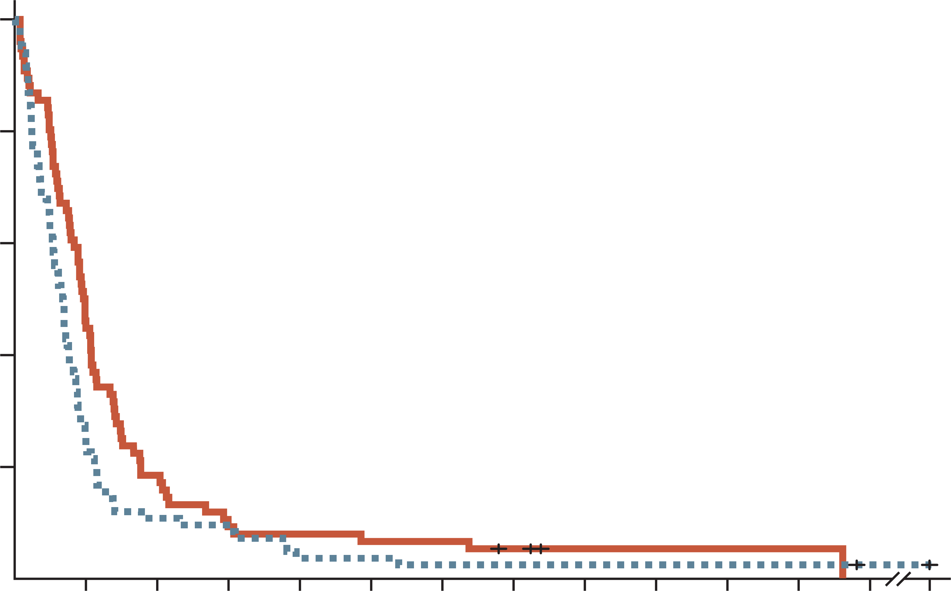
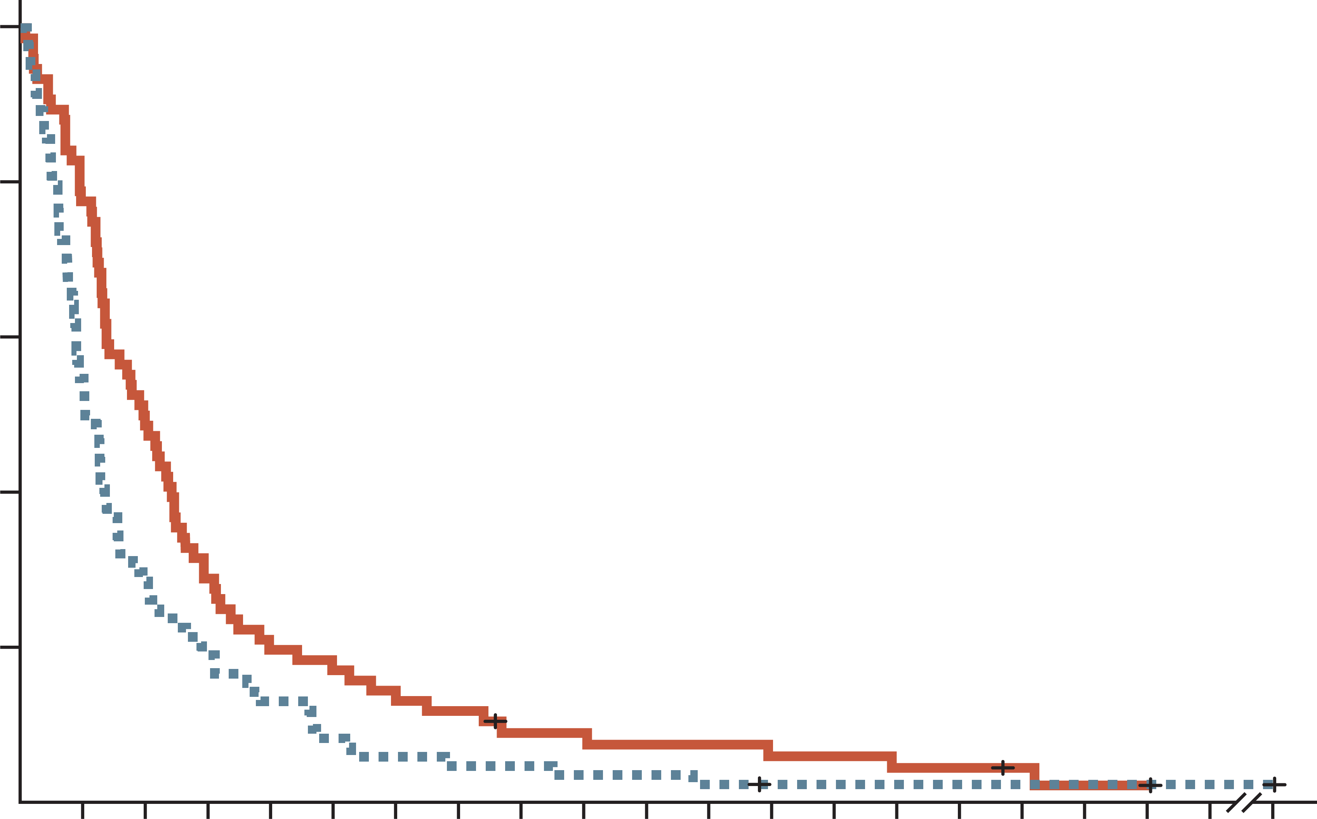
CONKO-003: 5FU+ Folinic Acid +/- Oxaliplatin (off) efficacy
progression-free survival
Overall survival
100
 | OFF | FF
Median (95% CI), months | 2.9 (2.4-3.2) | 2.0 (1.6-2.3)
Log-rank | P=0.019
HR (95% CI) | 0.68 (0.50-0.94)
100
 | OFF | FF
Median (95% CI), months | 5.9 (4.1-7.4) | 3.3 (2.7-4.0)
Log-rank | P=0.010
HR (95% CI) | 0.66 (0.48-0.91)
80
80
60
60
Progression-free survival (%)
Overall survival (%)
40
40
20
20
0
0
3
6
9
12
15
18
21
24
27
30
33
36
86
0
0
3
6
9
12
18
24
30
36
42
48
54
86
No. at risk
OFF
FF
Time (months)
No. at risk
OFF
FF
Time (months)
76
84
34
20
14
9
7
7
6
3
5
3
5
2
3
2
1
2
1
2
1
2
1
2
0
1
0
1
76
84
59
46
37
24
22
16
15
11
10
5
6
4
5
3
4
1
3
1
2
1
1
1
0
1
Rates of adverse events were similar between treatment arms, except for grades 1 to 2 neurotoxicity, which were reported in 29 patients (38.2%) and six patients (7.1%) in the OFF and FF groups, respectively (P<0.001)
1L, first-line; 5-FU, fluorouracil; CI, confidence interval; FF, folinic acid (leucovorin calcium) and fluorouracil; HR, hazard ratio; OFF oxaliplatin and FF
Oettle H, et al. J Clin Oncol. 2014 Aug 10;32:2423-9

Slide 14
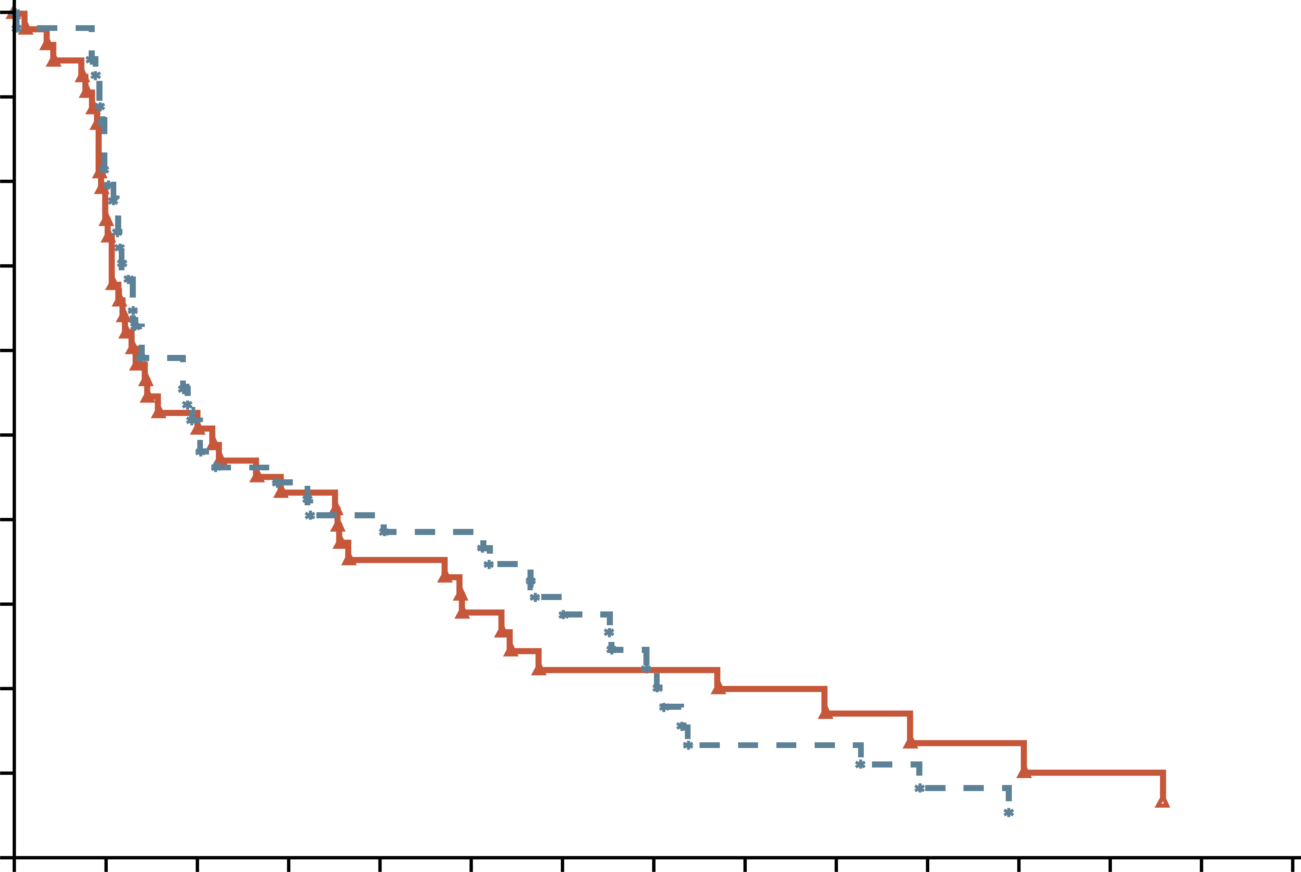
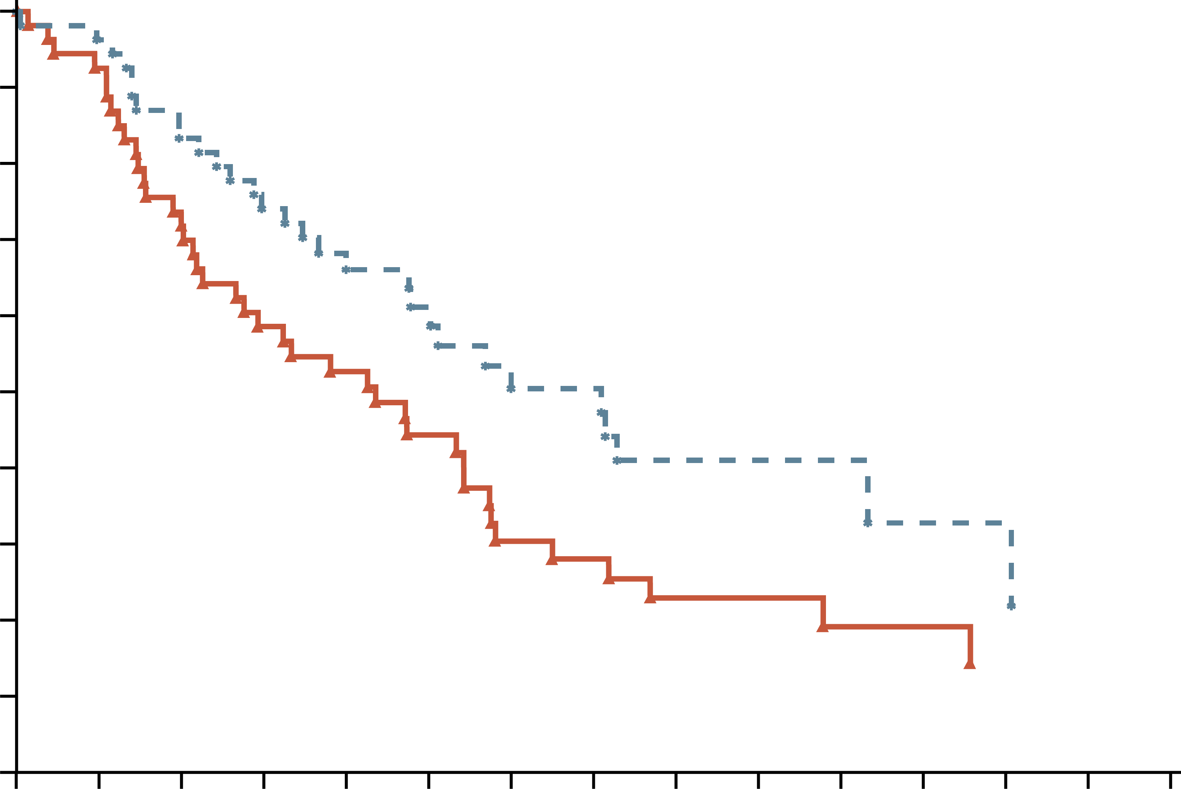
PANCREOX: addition of oxaliplatin to 5-Fu in 2L WAS detrimental
PROGRESSION-FREE SURVIVAL
Overall survival
 | mFOLFOX6 | 5-FU/LV
No. of patients | 54 | 54
Event, n (%) | 41 (75.9%) | 29 (53.7%)
Censored, n (%) | 13 (24.1%) | 25 (46.3%)
Median OS (95% CI), d | 183 days (95, 241) | 298 days (200, 507)
Log-rank | 0.0355
Hazard ratio | 1.6819
p-value (hazard ratio) | 0.0334
1.0
 | mFOLFOX6 | 5-FU/LV
No. of patients | 54 | 54
Event, n (%) | 47 (87.0%) | 49 (90.7%)
Censored, n (%) | 7 (13.0%) | 5 (9.3%)
Median PFS (95% CI), d | 92 days (51, 154) | 86 days (56, 215)
Log-rank | 0.8897
Hazard ratio | 0.9754
p-value (hazard ratio) | 0.9051
0.9
0.9
0.9
0.8
0.8
0.7
0.7
0.6
0.6
Progression-free survival (probability)
Overall survival (probability)
0.5
0.5
0.4
0.4
0.3
0.3
0.2
0.2
0.1
0.1
0.0
0.0
0
42
84
126
168
210
252
294
336
378
420
462
504
546
588
0
42
84
126
168
210
252
294
336
378
420
462
504
546
588
No. at risk
Oxaliplatin
No Oxaliplatin
Time (days)
No. at risk
Oxaliplatin
No Oxaliplatin
Time (days)
54
54
42
47
28
28
23
24
18
21
13
20
10
15
10
10
7
6
6
6
4
3
4
2
3
1
2
1
2
1
54
54
49
52
39
45
31
40
26
32
20
24
13
18
12
16
7
13
7
11
5
5
5
4
3
3
3
2
3
1
Grade 3 or 4 toxicity: 63% on mFOLFOX6; 11% on 5-FU/LV
2L, second-line; 5-FU, fluorouracil; CI, confidence interval; d, days; LV, leucovorin calcium (folinic acid); mFOLFOX6, modified infusional fluorouracil, leucovorin (folinic acid), and oxaliplatin; PFS, progression-free survival
Gill S, et al. J Clin Oncol. 2016;10;3914-20

Slide 15
Phase 3 experience in 2L with OXALIPLATIN
Contradicting results observed with second-line oxaliplatin regimens in the CONKO-003 and PANCREOX trials
 | CONKO-003¹ N=160ª |  | PANCREOX² N=108
Treatment | OFF | 5-FU/LV | mFOLFOX6 | 5-FU/LV
Median OS, mo | 5.9 | 3.3 | 6.1 | 9.9
HR | 0.66, P=0.01 |  | 1.78, P=0.02
Median PFS, mo | 2.9 | 2.0 | 3.0 | 2.8
HR | 0.68, P=0.02 |  | 0.98, P=0.91
Data presented for information purposes. Cross-trial comparison is not intended
ªPatients eligible for primary analysis
2L, second-line; 5-FU, fluorouracil; HR, hazard ratio; LV, leucovorin calcium (folinic acid); mFOLFOX6, modified infusional fluorouracil, leucovorin, and oxaliplatin; mo, months; OS, overall survival; PFS, progression-free survival; OFF, folinic acid (leucovorin calcium), fluorouracil and oxaliplatin
1. Oettle H, et al. J Clin Oncol. 2014;32: doi.org/10.1200/JCO.2013.53.6995; 2. Gill S, et al. J Clin Oncol. 2016;10; 3914-20

Slide 16
Napoli-1: study design
Nal-iri alone and in combination with 5-fu/lv as 2l therapy
Initial design
After amendmentª
Total
Nal-IRI 120 mg/m², q3w
N=33
N=118
N=151
Inclusion criteria
Metastatic pancreatic cancer
Received prior gemcitabine-based therapy
R
5-FU/LV 2000/200 mg/m² weekly × 4, q6w
N=30
N=119
N=149
Nal-IRI + 5-FU/LV 80 mg/m² + 2400/400 mg/m², q2w
N=117
N=117
Stratification factors: Albumin, KPS and ethnicity
Primary endpoint: Overall survival
Secondary endpoints: PFS, ORR, TTTF, CA19-9 response, safety
ª Study was amended to add the Nal-IRI + 5-FU/LV arm once safety data on the combination became available. Only those patients enrolled in the 5FU/LV arm after the amendment (N=119), were used as the control for the combination arm
2L, second-line; 5-FU, fluorouracil; CA19-9; carbohydrate antigen 19-9; KPS, Karnofsky performance status; LV, leucovorin calcium (folinic acid); Nal‑IRI, nanoliposomal irinotecan; ORR, overall response rate; PFS, progression-free survival; q2w/q3w/q6/w, every 2/3/6 weeks; R, randomised; TTTF, time to treatment failure
Wang-Gillam A, et al. Lancet. 2016;387:545-57

Slide 17
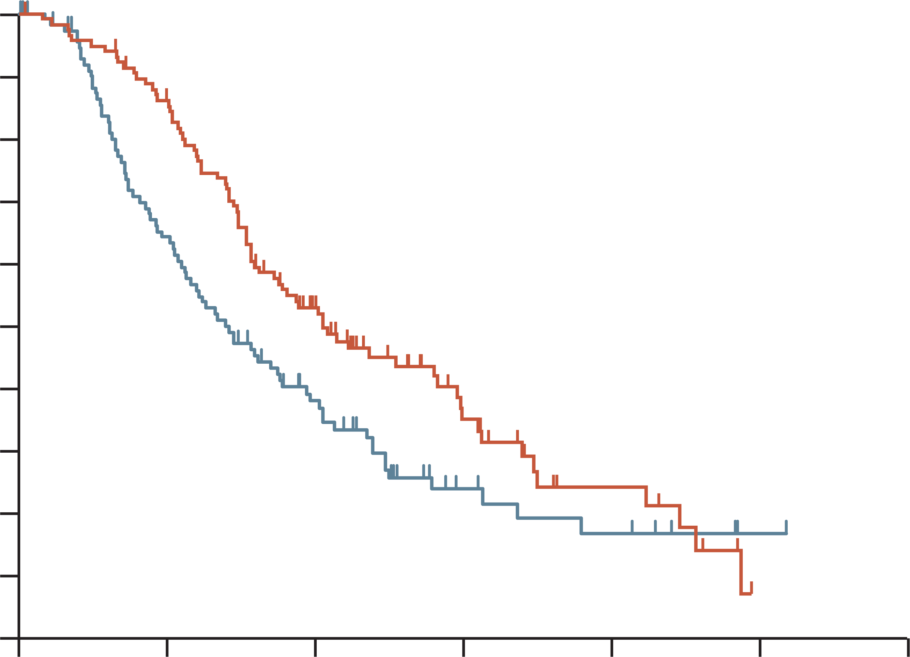
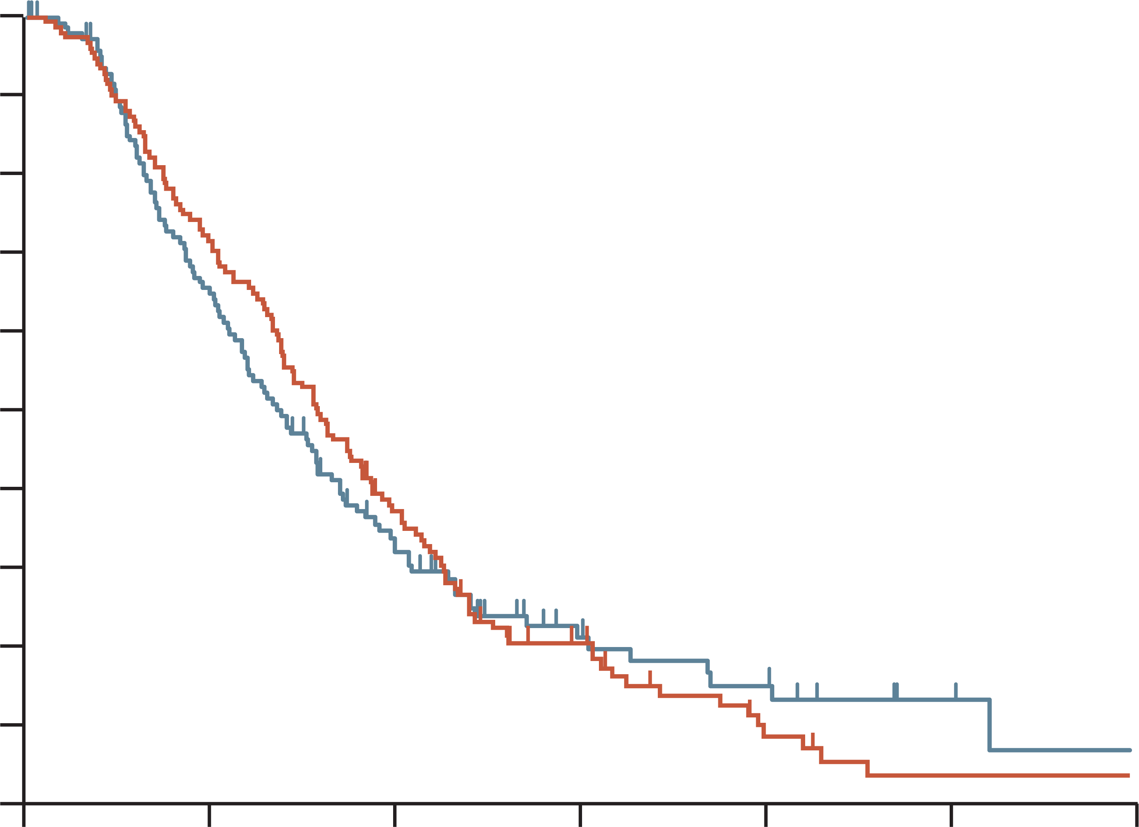
Napoli-1: overall survival (ITT)
 | Nal-IRI + 5-FU/LV | 5-FU/LV
Median OS (95% CI), months | 6.1 (4.8-8.9) | 4.2 (3.3-5.3)
Unstratified HR (95% CI): | 0.67 (0.49-0.92) P=0.012
 | Nal-IRI monotherapy | 5-FU/LV
Median OS (95% CI), months | 4.9 (4.2-5.6) | 4.2 (3.6-4.9)
Unstratified HR (95% CI): | 0.99 (0.77-1.28) P=0.94
1.0
1.0
0.9
0.9
0.8
0.8
0.7
0.7
0.6
0.6
Overall survival proportion
Overall survival proportion
0.5
0.5
0.4
0.4
0.3
0.3
0.2
0.2
0.1
0.1
0.0
0.0
0
3
6
9
12
15
18
0
3
6
9
12
15
18
Time from randomisation (months)
Time from randomisation (months)
No. at risk
117
119
97
68
51
34
20
11
8
6
0
1
0
1
No. at risk
151
149
109
89
23
41
21
16
10
9
2
3
2
1
Protocol-defined primary analysis data cut (14 February 2014, after 305 events)
5-FU, fluorouracil; CI, confidence interval; HR, hazard ratio; ITT, intention-to-treat; LV, leucovorin calcium (folinic acid); Nal-IRI, nanoliposomal irinotecan; OS, overall survival
Wang-Gillam A, et al. Lancet. 2016;387:545-57

Slide 18
Napoli-1: safety
Adverse event, n (%) | Nal-IRI + 5-FU/LV (N=117) |  | Nal-IRI monotherapy (N=147) |  | 5-FU/LV (N=134)
 | Any grade | Grades 3-4 | Any grade | Grades 3-4 | Any grade | Grades 3-4
Diarrhoea | 69 (59%) | 15 (13%) | 103 (70%) | 31 (21%) | 35 (26%) | 6 (4%)
Vomiting | 61 (52%) | 13 (11%) | 80 (54%) | 20 (14%) | 25 (26%) | 4 (3%)
Nausea | 60 (51%) | 9 (8%) | 89 (61%) | 8 (5%) | 46 (34%) | 4 (3%)
Decreased appetite | 52 (44%) | 5 (4%) | 72 (49%) | 13 (19%) | 43 (32%) | 3 (2%)
Fatigue | 47 (40%) | 16 (14%) | 54 (37%) | 9 (6%) | 37 (28%) | 5 (4%)
Neutropeniaª | 46 (39%) | 32 (27%) | 37 (25%) | 22 (15%) | 7 (5%) | 2 (1%)
Anaemia | 44 (38%) | 11 (9%) | 48 (33%) | 16 (11%) | 31 (23%) | 9 (7%)
Hypokalaemia | 14 (12%) | 4 (3%) | 32 (22%) | 17 (12%) | 12 (9%) | 3 (2%)
Data are number of patients (%). The table shows grade 3 and 4 adverse events reported in ≥5% of patients whose treatment included nanoliposomal irinotecan with ≥2% incidence versus fluorouracil and folinic acid. ª includes agranulocytosis, febrile neutropenia, granulocytopenia, neutropenia, neutropenic sepsis, decreased neutrophil count, and pancytopenia
5-FU, fluorouracil; LV, leucovorin calcium (folinic acid); Nal-IRI, nanoliposomal irinotecan
Wang-Gillam A, et al. Lancet 2016;387:545-57

Slide 19
Napoli-1: Dose modifications of nal-iri + 5-fu/lv
POST HOC ANALYSIS: IMPACT of dose modifications or delays ON EFFICACY
 | Nal-IRI + 5-FU/LV | 5-FU/LV
 | Nal-IRI dose delay
Median overall survival, mos | 8.4 (N=49) | 4.2 (N=105)
Hazard ratio (95% CI) | 0.66 (0.46, 0.94)
 | Nal-IRI dose reduction
Median overall survival, mos | 9.4 (N=34) | 4.2 (N=105)
Hazard ratio (95% CI) | 0.58 (0.38, 0.88)
5-FU, fluorouracil; CI, confidence interval; LV, leucovorin calcium (folinic acid); mos, months; Nal‑IRI, nanoliposomal irinotecan; OS, overall survival
Wang-Gillam A, et al. J. Clin. Oncol. 2018; 36(4_suppl):388

Slide 20
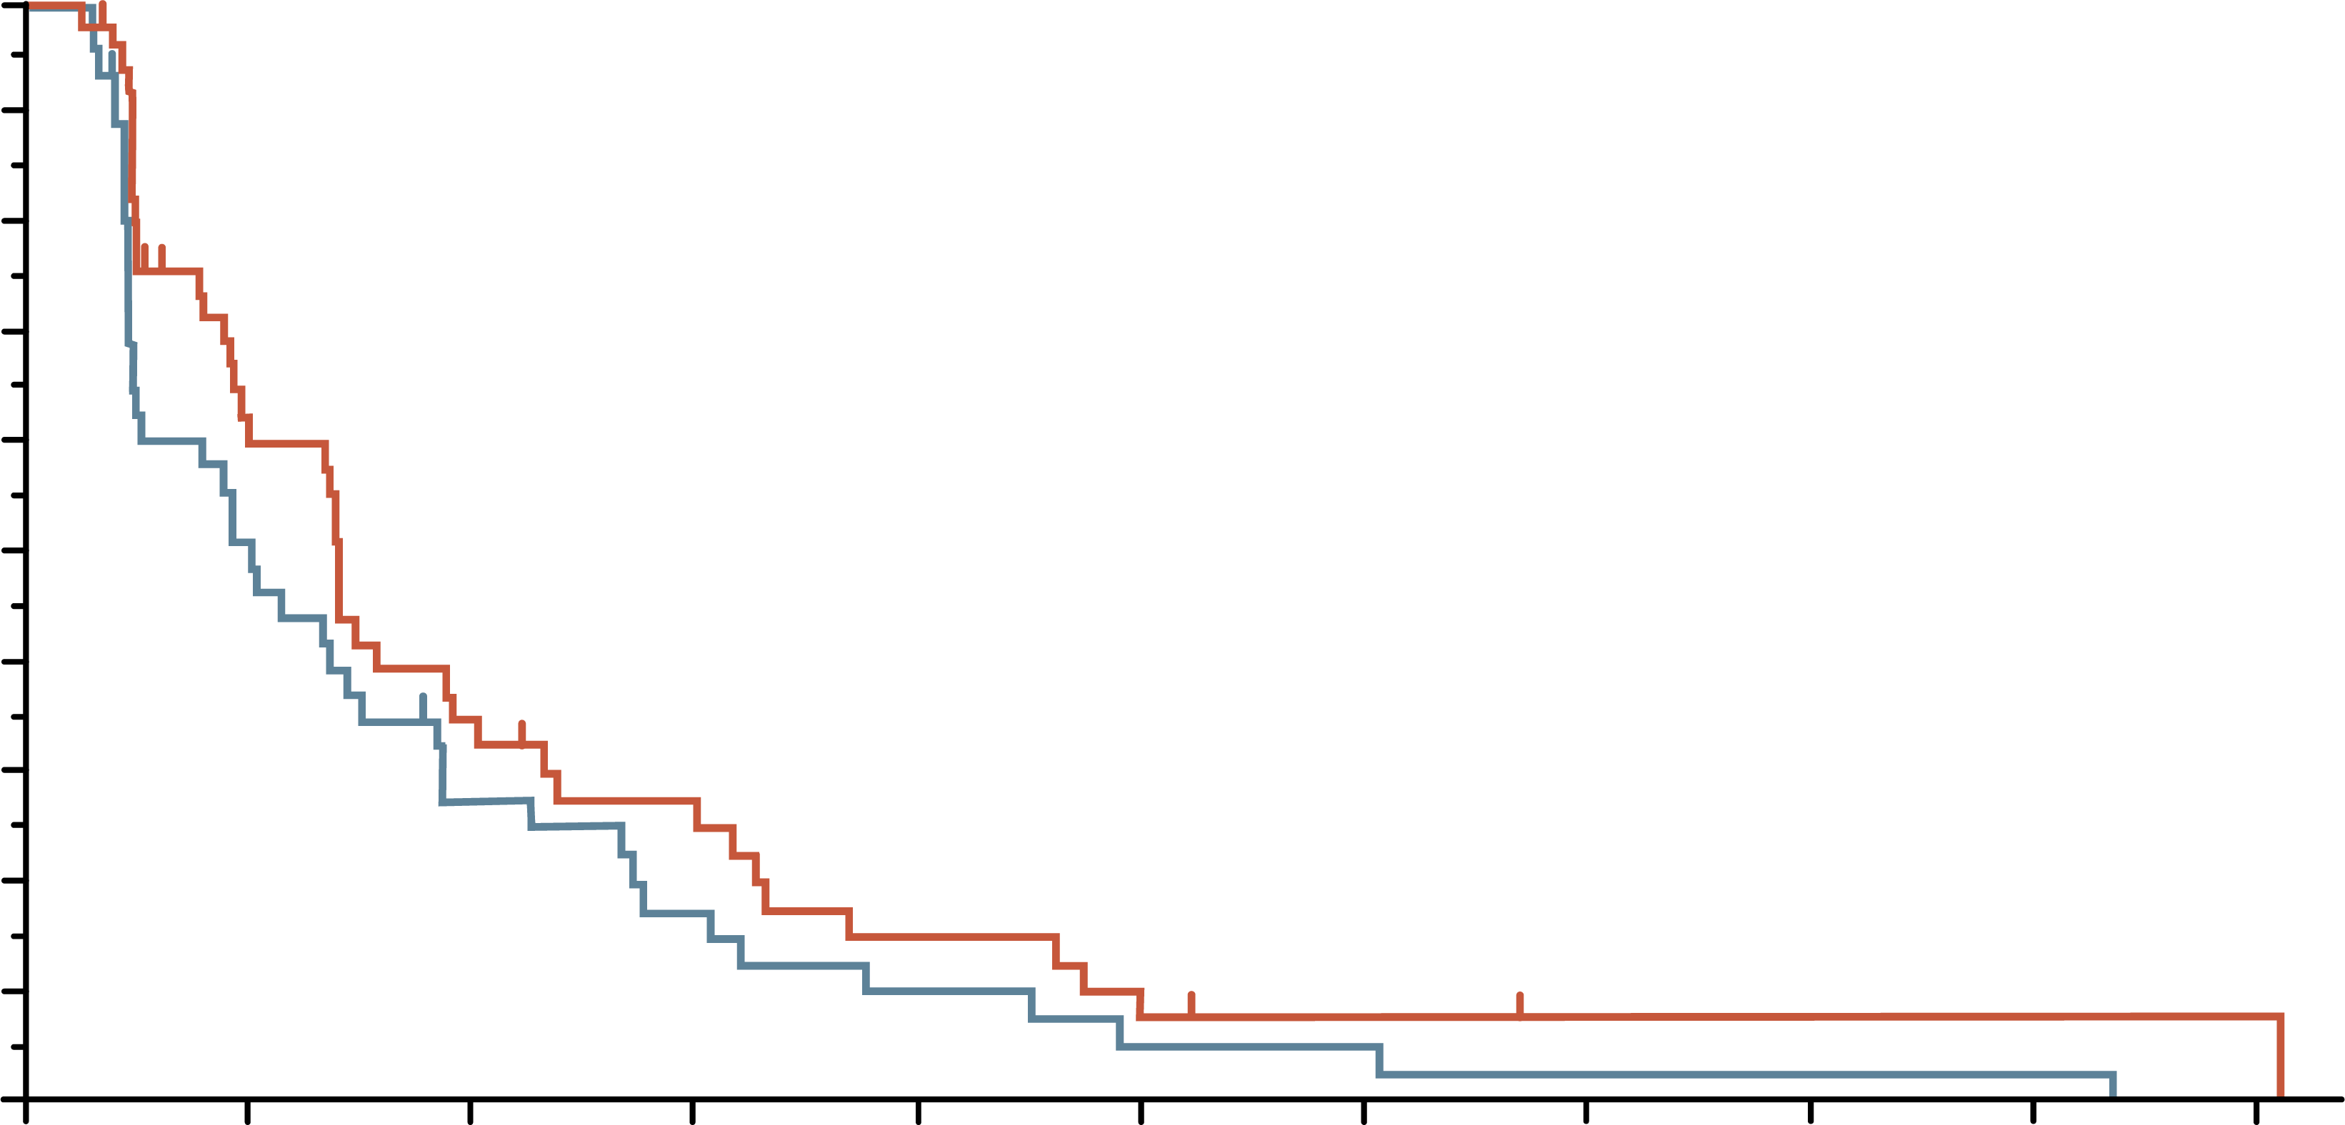
Napoli-1: Dose modifications of nal-iri + 5-fu/lv
POST HOC ANALYSIS: IMPACT ON EFFICACY
100
 | Nal-IRI + 5-FU/LV, early modification | Nal-IRI + 5-FU/LV, no modification
Median OS, months (95% CI) | 8.44 (5.26-11.04) | 6.67 (4.70-8.87)
HR | 0.89 (0.59-1.35)
100
 | Nal-IRI + 5-FU/LV, early modification | Nal-IRI + 5-FU/LV, no modification
Median PFS, months (95% CI) | 4.21 (2.79-5.72) | 3.06 (1.45-4.53)
HR | 0.74 (0.48-1.13)
90
90
80
80
70
70
60
60
Overall survival
Progression-free survival
50
50
40
40
30
30
20
20
10
10
0
0
0
3
6
9
12
15
18
21
24
27
30
0
3
6
9
12
15
18
21
24
27
30
Time from randomisation (months)
Time from randomisation (months)
No. at risk
53
49
48
41
31
27
25
14
19
10
13
8
7
7
4
5
4
3
1
3
1
1
No. at risk
53
49
26
22
15
11
11
7
6
4
3
2
2
2
1
1
1
1
1
1
1
0
Tolerability-guided dose modification of liposomal irinotecan does not adversely affect efficacy outcomes
5-FU, fluorouracil; CI, confidence interval; HR, hazard ratio; LV, leucovorin calcium (folinic acid); Nal‑IRI, nanoliposomal irinotecan; OS, overall survival; PFS, progression-free survival
Chen L-T, et al. Pancreatology. 2021;21:192-199

Slide 21
Potential molecular targets in pdac
FAK TKI
CTGF Ab
Vitamin D Ag
FAP PRRT
DDR damaging therapy
PARP inh
ATR inh
Anti-PD1/anti-CTLA4
Anti-MSLN Ab
Anti-MSLN ADC
TCR-T, CAR-T cells
Anti-PD1/anti-CTLA4
20–25% of PDAC patients harbour targetable molecular alterations
Claudin 18.2 Ab, biAb
Claudin 18.2 ADC
CAR-T cells
Stroma
DDR
MSI
Anti-PD1
MSLN
Claudin 18.2
TMB
Anti-EGFR (TKI, Ab)
FGFR TKI
FGFR
KRAS^{WT}
KRAS G12C TKI
KRAS G12C + EGFR inh (Ab, TKI)
KRAS G12C + SOS1/SHP2 inh
p53 reactivator
TP53 Y220C
KRAS^{G12C}
MDM2
KRAS^{G12D,G12V,G12R}
KRAS G12D inh
Pan-RAS inh
siG12D LODER
KRAS vaccines
KRAS TCR T cells
MDM2/TP53 inh
ARID1A
HER2
EZH2 inh
HDAC6 inh
ATR inh
NTRK
NRG1
HER2 Ab, ADC, TKI
ALK ROS1
BRAF
RET
HER2/HER3 biAb, TKI
Pan-EGFR inh
NTRK TKI
ALK/ROS TKI
RET TKI
BRAF/MEK TKI
ADC, antibody-drug conjugate; ALK, anaplastic lymphoma kinase; ARID1A, AT-rich interaction domain 1A; ATR, ataxia telangiectasia and Rad3-related protein; (bi)Ab, (bi-specific) antibody; BRAF, B-Raf proto-oncogene serine/threonine kinase; CAR-T, chimeric antigen receptor T-cell therapy; CTLA-4; cytotoxic T-lymphocyte-associated protein 4; DDR, DNA damage repair; EGFR, epidermal growth factor receptor; FAK, focal adhesion kinase; FAP, fibroblast activation protein; FGFR, fibroblast growth factor receptor; HDAC, histone deacetylase 6; inh, inhibitor; HER2/3, human epidermal growth factor receptor 2/3; KRAS, Kirsten rat sarcoma viral oncogene homolog; MEK, mitogen-activated protein kinase kinase; MSI, microsatellite instability; MSLN, mesothelin; NRG1, neuregulin-1; NTRK, neurotrophic tyrosine receptor kinase; PARP, poly(ADP-ribose) polymerase; PD-1, programmed cell death protein 1; PDAC, pancreatic ductal adenocarcinoma; PRRT, peptide receptor radionuclide therapy; RAS, rat sarcoma; RET, rearranged during transfection; ROS, ROS proto-oncogene receptor tyrosine kinase; siG12D LODER, small interfering RNA G12D Local Drug EluteR; TCR, T-cell receptor; TKI, tyrosine kinase inhibitor; TMB, tumour mutational burden; TP53, tumour protein p53 gene; WT, wild-type
Zhen DB, et al. Therap Adv Gastroenterol 2023;16:17562848231171456

Slide 22
Targeted therapy for pancreatic adenocarcinoma
Molecular Target | Targeted Therapy | NCCN panel recommendations
NTRK gene fusions | Larotrectinib | 1st line and subsequent treatment options for pts with NTRK gene fusion-positive locally advanced or metastatic pancreatic adenocarcinoma and for recurrent disease
 | Entrectinib
 | Repotrectinib | Category 2B recommendation as 1st line for patients with metastatic disease (PS 3) and subsequent therapy or therapy for recurrent disease for patients with intermediate/poor PS (PS 2-3)
RET gene fusions | Selpercatinib | 1st line: pts with locally advanced/metastatic disease (PS 0–2) and as subsequent therapy for pts with good PS (0–1)
NRG1 gene fusions | Zenocutuzumab-zbco | FDA approved for advanced, unresectable, or metastatic pancreatic adenocarcinoma harboring a NRG1 gene fusion with disease progression on or after prior systemic therapy. Awaiting incorporation into the NCCN guidelines
KRAS G12C mutations | Adagrasib | Subsequent therapy options for patients with any PS (category 2B for poor PS)
 | Sotorasib
BRAF V600E mutations | Dabrefenib/trametinib | 1st line: metastatic disease (category 2B) and as subsequent line options (category 2A) for pts with good/poor PS and BRAF V600E mutations
HER2-positive | Fam-trastuzumab-deruxtecan-nxki | As a subsequent therapy option only for patients with good PS and HER2 IHC 3+ expression
MSI-H/TMB-H/dMMR | Pembrolizumab | In the advanced disease setting for first-line and subsequent treatment (if no prior immunotherapy)
 | Dostarlimab-gxly | As a subsequent treatment option (if no prior immunotherapy) for patients with MSI-H or dMMR locally advanced, metastatic, or recurrent pancreatic adenocarcinoma and any PS
 | Nivolumab/Ipilimumab | Category 2B, subsequent therapy option for patients with good or intermediate PS and those who did not receive prior immunotherapy
BRAF, B-Raf proto-oncogene serine/threonine kinase; dMMR, deficient DNA mismatch repair; HER2, human epidermal growth factor receptor 2; KRAS, Kirsten rat sarcoma viral oncogene homolog; MSI-H, microsatellite instability-high; NTRK, neurotrophic tyrosine receptor kinase; PDAC, pancreatic ductal adenocarcinoma; PS, performance status; RAS, rat sarcoma; RET, rearranged during transfection; TMB-H, tumour mutational burden-high
NCCN Guidelines Version 3.2024. Available at: https://www.nccn.org/guidelines/guidelines-detail?category=1&id=1455. Accessed October 2024 NCCN guidelines for pancreatic adenocarcinoma, Version 3.2024: pancreatic.pdf (nccn.org)

Slide 23
summary
Cytotoxic chemotherapy remains the cornerstone of systemic therapy for advanced or metastatic pancreatic cancer
The choice of second-line therapy depends on which treatments the patient has received in the first-line setting and therefore which options are left available to them
Treatment selection depends on several other factors, including patients' performance status and co-morbidities. These should be considered alongside the efficacy and safety profiles of the different chemotherapy regimens
Treatment strategies can be implemented to manage toxicities associated with the different chemotherapy regimens to enable a patient to stay on treatment for optimal efficacy
BRCA1/2, BReast CAncer 1/2 gene; Nal‑IRI, nanoliposomal irinotecan; NALIRIFOX; Nal-IRI, fluorouracil/folinic acid (leucovorin calcium), and oxaliplatin; PALB2, partner and localiser of BRCA2
NCCN Guidelines Version 3.2024. Available at: https://www.nccn.org/guidelines/guidelines-detail?category=1&id=1455. Accessed October 2024

