Slide 2
Improving acne vulgaris with multimodal treatment strategies micro learning
Prof. Alison Layton, MD, ChB, FRCP
Skin Research Centre, Hull York Medical School, University of York, UK
Prof. Dr Falk Ochsendorf, MD, MME
Frankfurt University, University Hospital, Clinic for Dermatology, Venerology and Allergology, Germany
June 2025

Slide 3
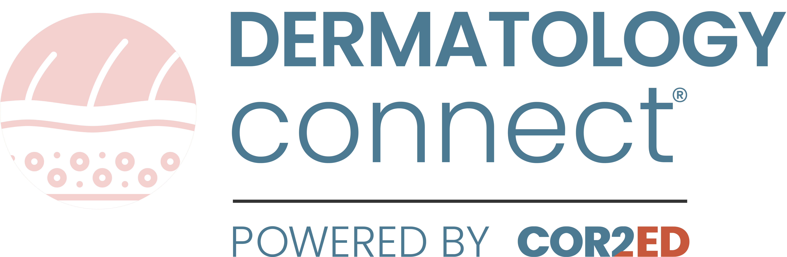
Developed by DERMATOLOGY COnnect
This programme is developed by DERMATOLOGY
CONNECT, an international group of experts in the field
of dermatology.
Acknowledgement and disclosures
This DERMATOLOGY CONNECT programme is supported through an independent educational grant from Glenmark Pharmaceuticals. The programme is therefore independent, the content is not influenced by the supporter and is under the sole responsibility of the experts.
Please note:
This educational programme is intended for healthcare professionals only
The views expressed within this programme are the personal opinions of the experts. They do not necessarily represent the views of the experts’ academic institutions, organisations, or other group or individual
Expert disclosures:
Prof. Alison Layton has received financial support/sponsorship for research support, consultation, or speaker fees from the following companies: Alliance, Almirall, Beiersdorf, Eligo, Galderma Pharma, Incyte, La Roche-Posay, Leo Pharma, L’Oreal, Novartis and Vakona
Prof. Dr Falk Ochsendorf has received financial support/sponsorship for research support, consultation, or speaker fees from the following companies: InfectoPharm, Mylan and Pierre Fabre Laboratories

Slide 4


This programme has been developed by a Group of experts
Prof. Alison Layton
Skin Research Centre, Hull York Medical School, University of York, UK
Prof. Falk Ochsendorf
Frankfurt University Hospital, Clinic for Dermatology, Venerology and Allergology, Germany

Slide 5
Educational outcomes
Describe the four primary pathogenic factors resulting in the development of
acne vulgaris
Name the treatment options for acne vulgaris and how each targets the associated pathogenic factors
Differentiate the appropriate placement of therapies in acne vulgaris in accordance
with the guidelines across the patient journey and disease severities
Explain the need to adopt a multimodal treatment approach for acne vulgaris

Slide 6
Key clinical takeaways and recommendations
Acne vulgaris is driven by four key pathogenic factors: Excess sebum production and constituents, inflammation, follicular hyperkeratinisation, and microbial changes
Treatment options and guidelines: Latest guidelines provide excellent evidence-based treatments
options available to optimise acne outcomes aligned to patient needs and expectations
Appropriate placement of therapies: Depends on disease severity, duration, disease burden,
history, prior therapies and response
Use multimodal treatment strategies: Combining treatments targeting different pathogenic factors is essential to achieve the best efficacy
Recommendations
Assess and tailor treatment – Carefully evaluate lesion type, site and extent and factors influencing severity, and personalise treatment based on history, clinical presentation, patient needs and expectations
Take acne vulgaris seriously – Acne is not a trivial disease. The burden is not always linked to objective
visual severity; individual patient experiences and psychosocial impact should also guide management

Slide 7
Introduction prevalence and pathophysiology of acne vulgaris

Slide 8
Before you proceed: reflect briefly is acne vulgaris one of the top 10 diseases?

Slide 9

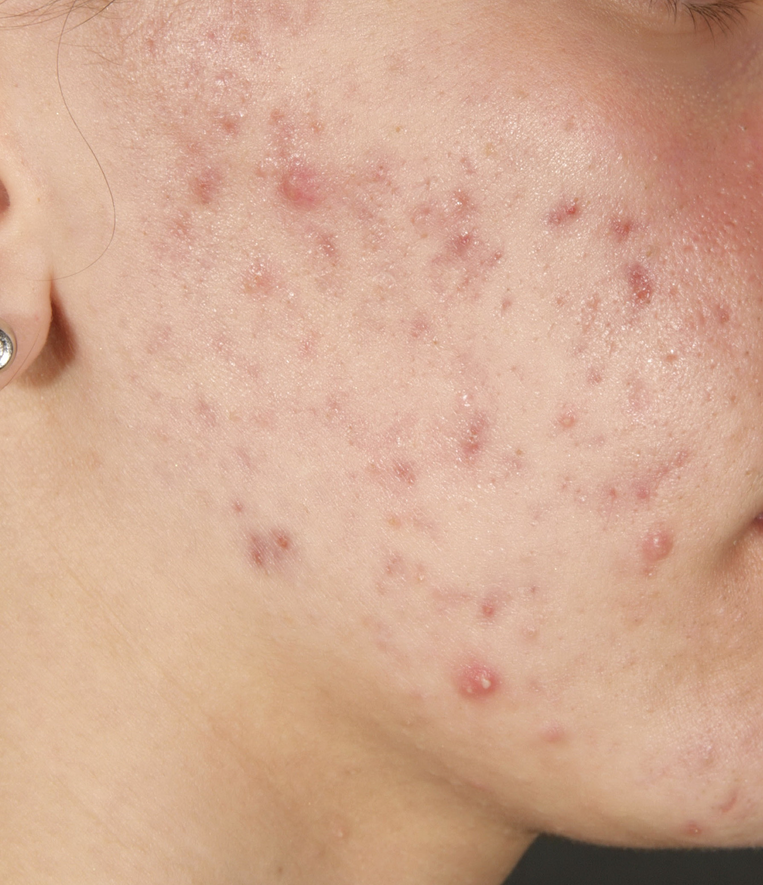


The relevance and prevalence of Acne vulgaris acne is in the top 10 of the most prevalent diseases worldwide^{1,2}
According to the
Global Burden of Skin Disease Study
Acne affects 85% of young adults aged 12-25 years³
Worldwide acne prevalence is 9%¹
650 million people around the world are affected¹
An example of acne vulgarisª
ª Image kindly provided by Prof. Ochsendorf
1. Dreno B, et al. J Cosmet Dermatol. 2020;19:2201-11; 2. Hay RJ, et al. J Invest Dermatol. 2014;134(6):1527-34; 3. Lynn D, et al. Adol Health Med Ther. 2016:713-25

Slide 10
Acne natural history a chronic disease, most common in adolescent age group
Acne can persist into, or develop
during, adulthood. It affects:^{1,a}
  64% of 20–29-year-olds
  43% of 30–39-year-olds
  3–5% of 40-49-year-olds have acne
Mild acne may persist for a couple of
years
Severe acne can last for many years
Burden of acne²
Acne vulgaris, 2010
300
Males
250
Females
200
Years lived with disability per 100.000 population
150
100
50
0
0
5
10
15
20
25
30
35
40
45
50
55
60
65
70
75
80
85
Once regarded as a transient disease
of teenagers, acne is now presenting earlier and lasting longer
Age (years)
ª According to a survey of the German population
1. Scott-Emuakpor R, et al. Cureus. 2023;15:e38019; 2. Lynn DD, et al. Adolesc Health Med Ther. 2016;7:13-25

Slide 11
Before you proceed: reflect briefly
How familiar are you with the key pathogenic factors in the development of acne vulgaris?

Slide 12
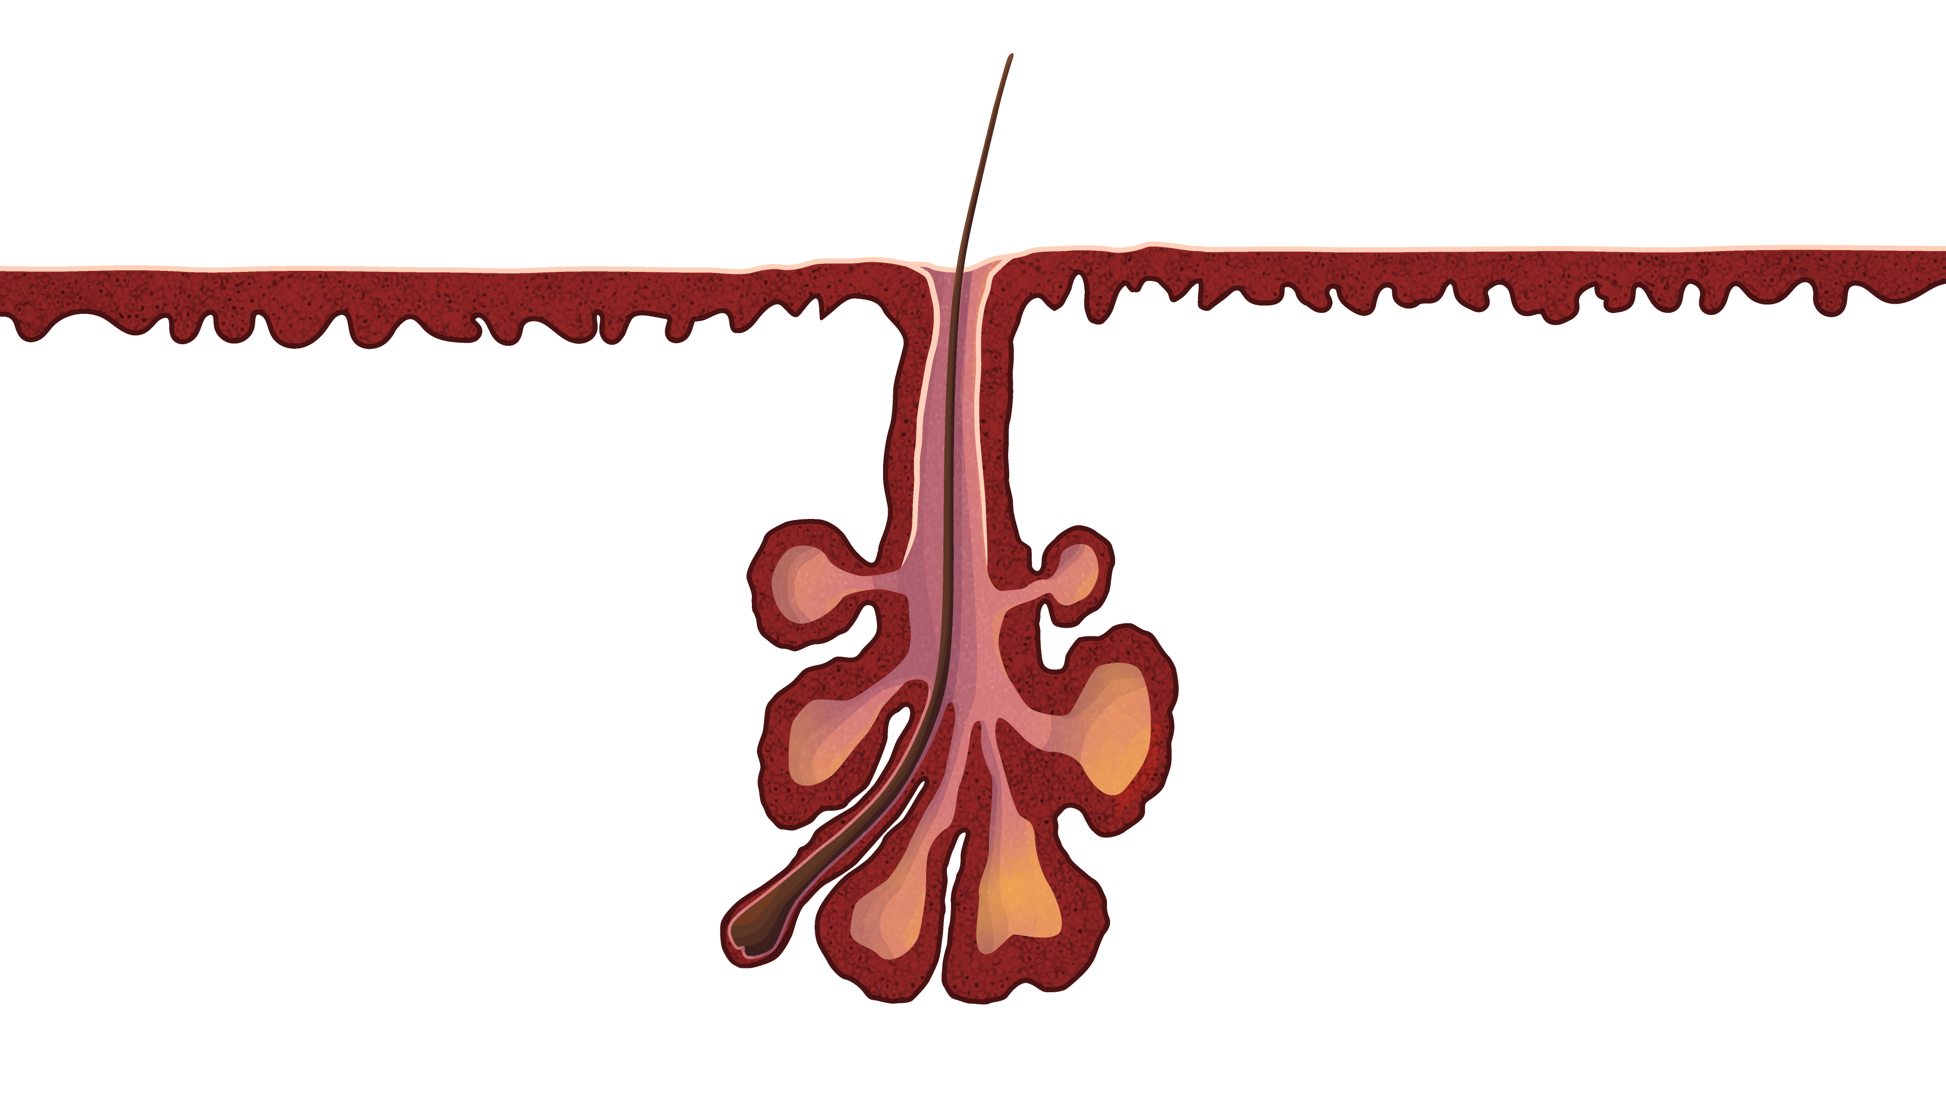
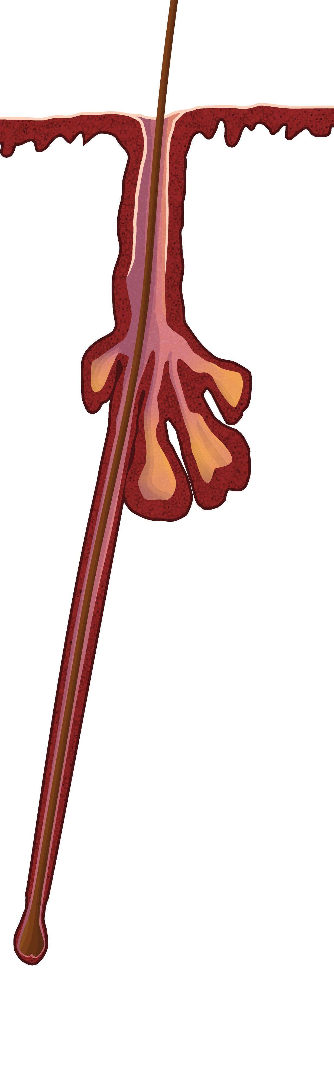
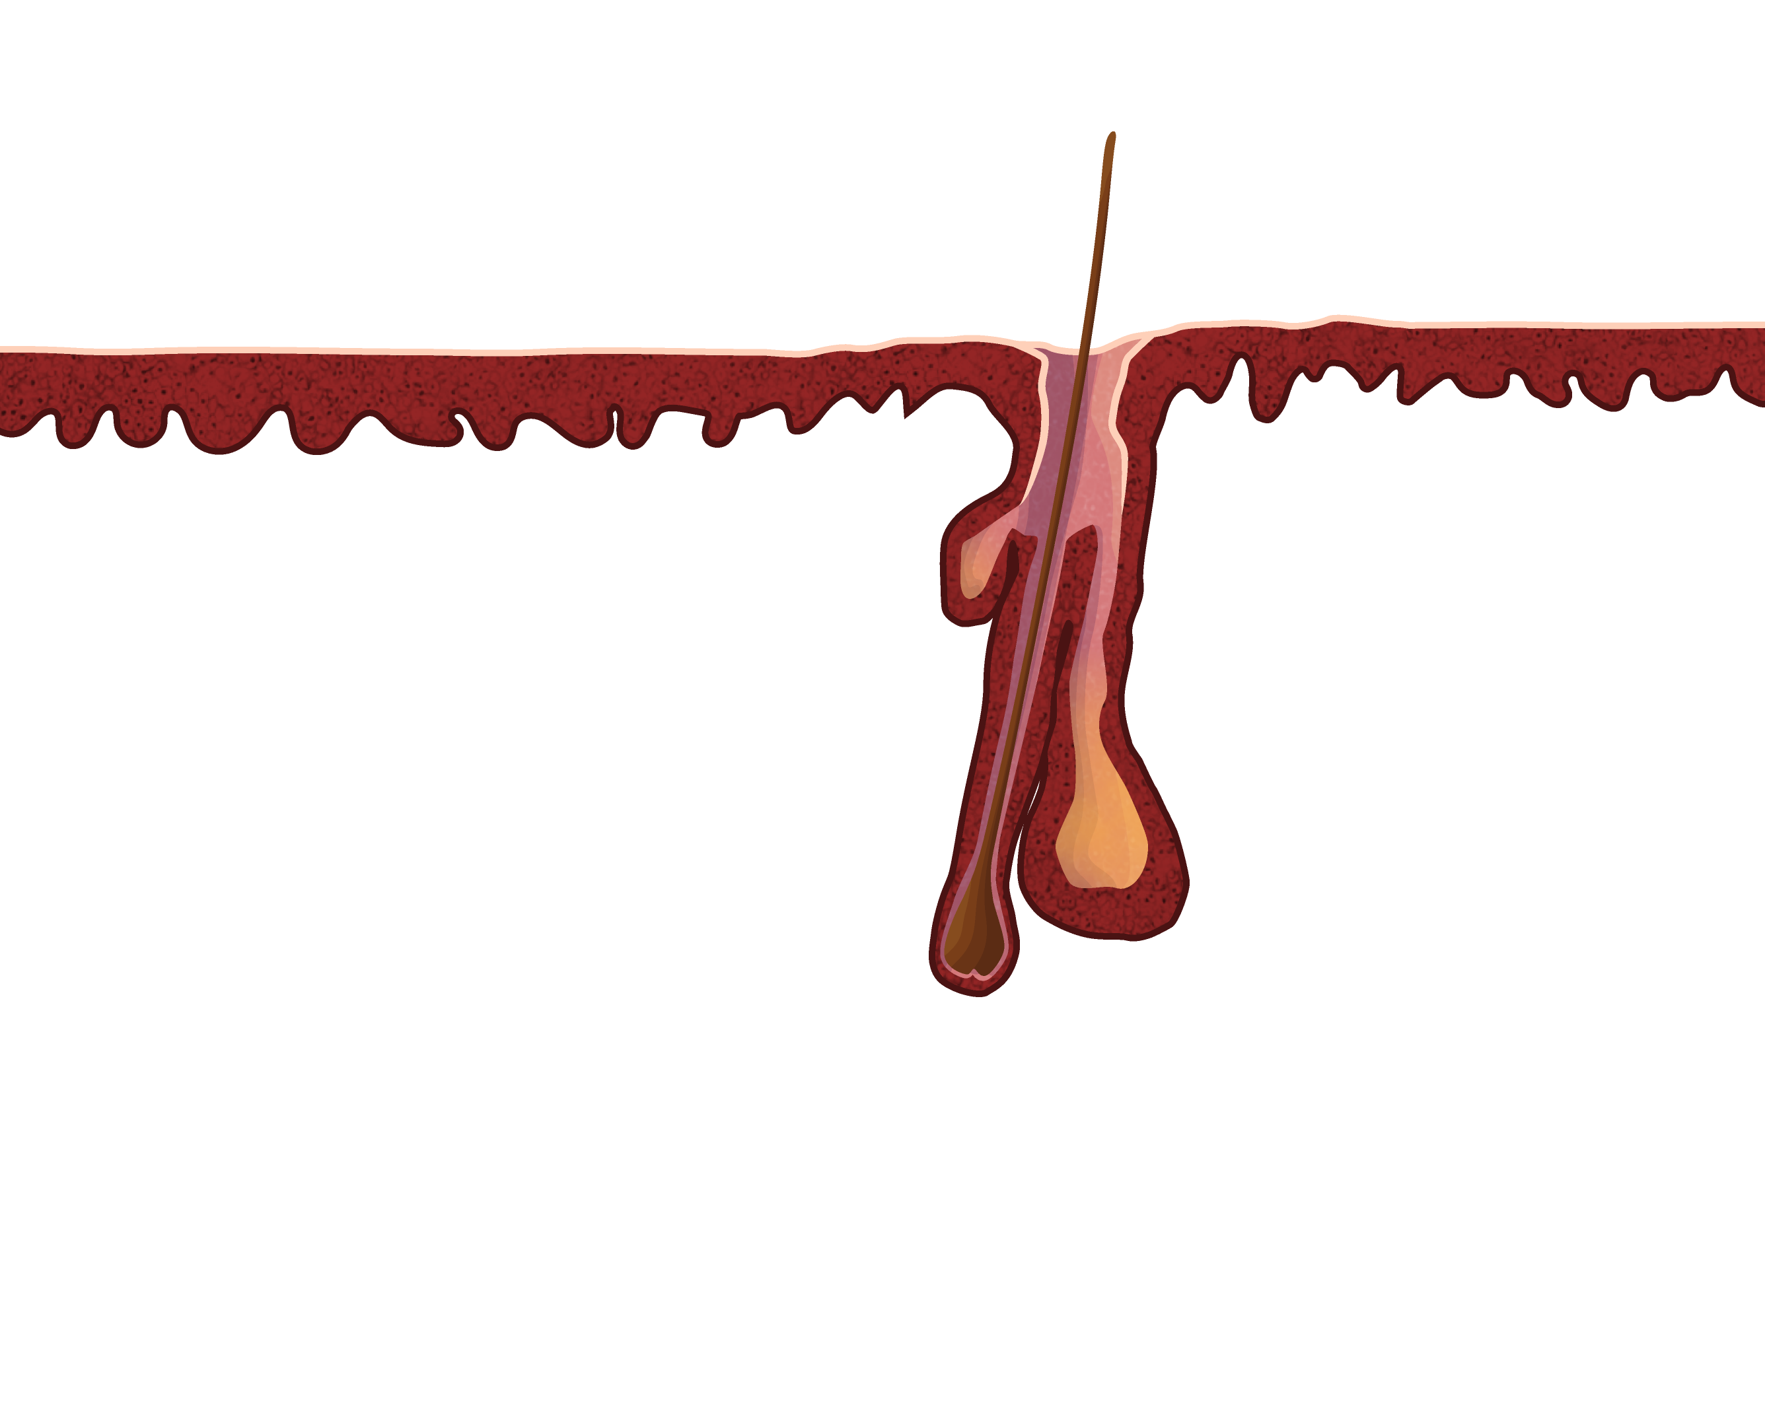
Acne is centred around the pilosebaceous unit acne Is primarily an inflammatory skin disease
Miniature hairs
Chronic inflammatory disease of sebaceous follicles affects:²
  the face (99% of cases; highest density of sebaceous follicles)
  back (60% of cases)
  chest (15% of cases)
Clinically very heterogeneous presentation²
  different lesions, frequent seborrhoea
Vellus follicle¹:
Small and numerous; contribute some surface lipids but play no major role in acne
Large sebaceous glands
Sebaceous follicle¹:
Key site of acne development; large, multilobular sebaceous glands with a narrow hair and a canal packed with keratinised cells
Terminal hair follicle¹:
Contains a thick hair that fills the canal; usually unaffected by acne, except in conditions like dissecting cellulitis (formerly acne inversa/hidradenitis suppurativa)
1. Plewig, G., Melnik, B. and Chen, W.C. (2019) Plewig and Kligman's Acne and Rosacea. 4th Edition, Springer, Berlin (chapter 1); 2. EDF. S3-Guideline for the Treatment of Acne (Update 2016). Available here (accessed May 2025)

Slide 13
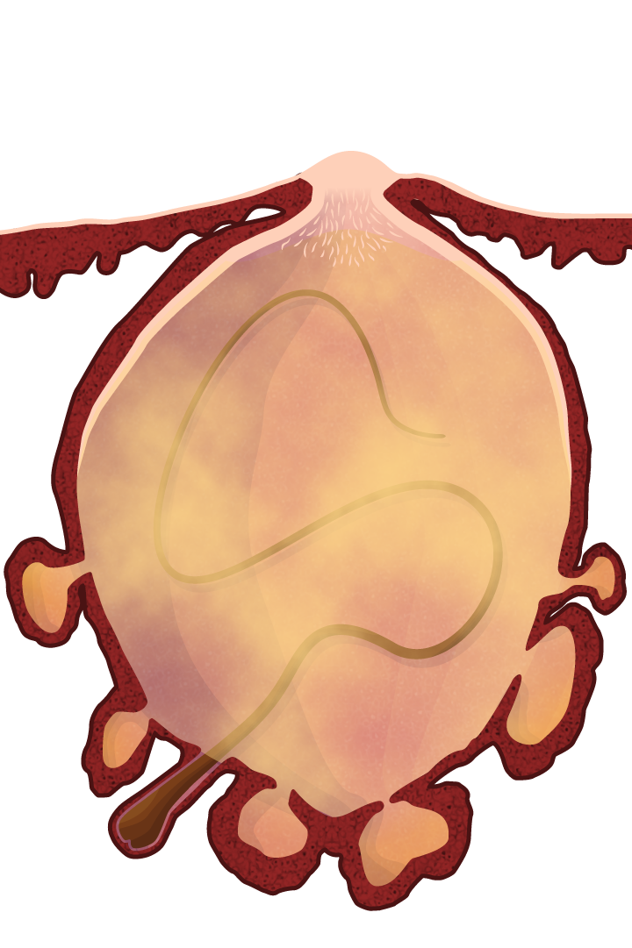
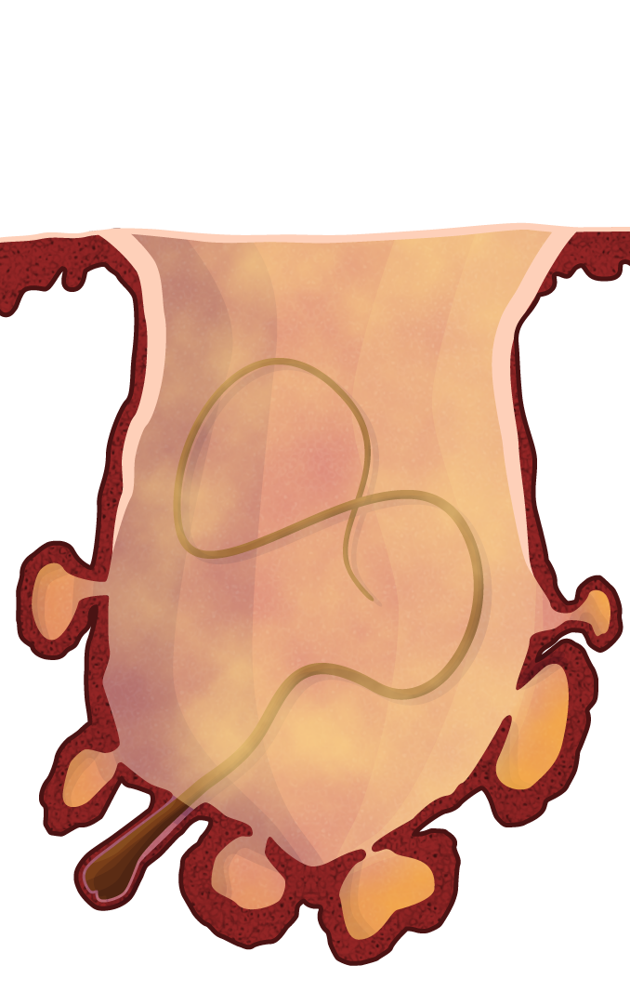
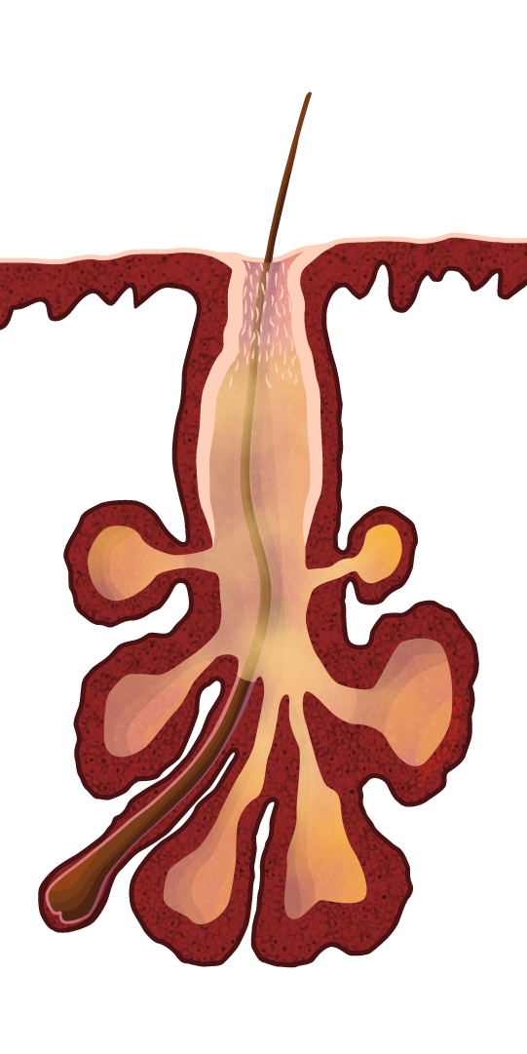
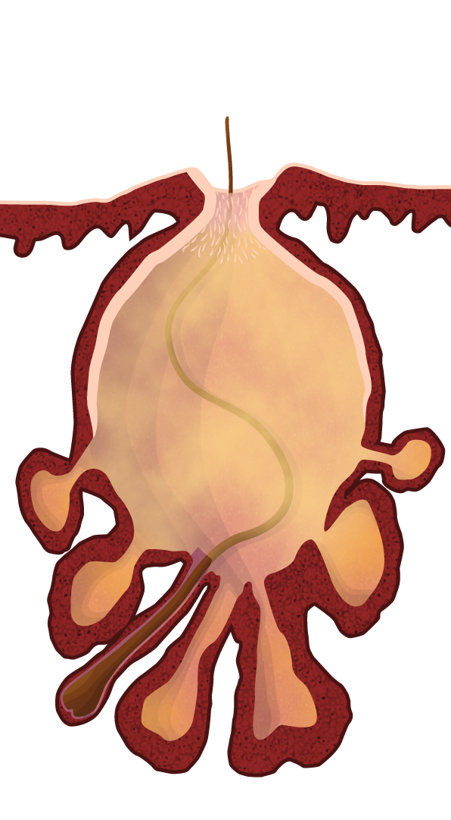
comedogenesis the life history of the comedo
Normal sebaceous follicle
Early microcomedo
Late microcomedo
Closed comedone
Open comedone
1. Plewig, G., Melnik, B. and Chen, W.C. (2019) Plewig and Kligman's Acne and Rosacea. 4th Edition, Springer, Berlin (chapter 3)

Slide 14
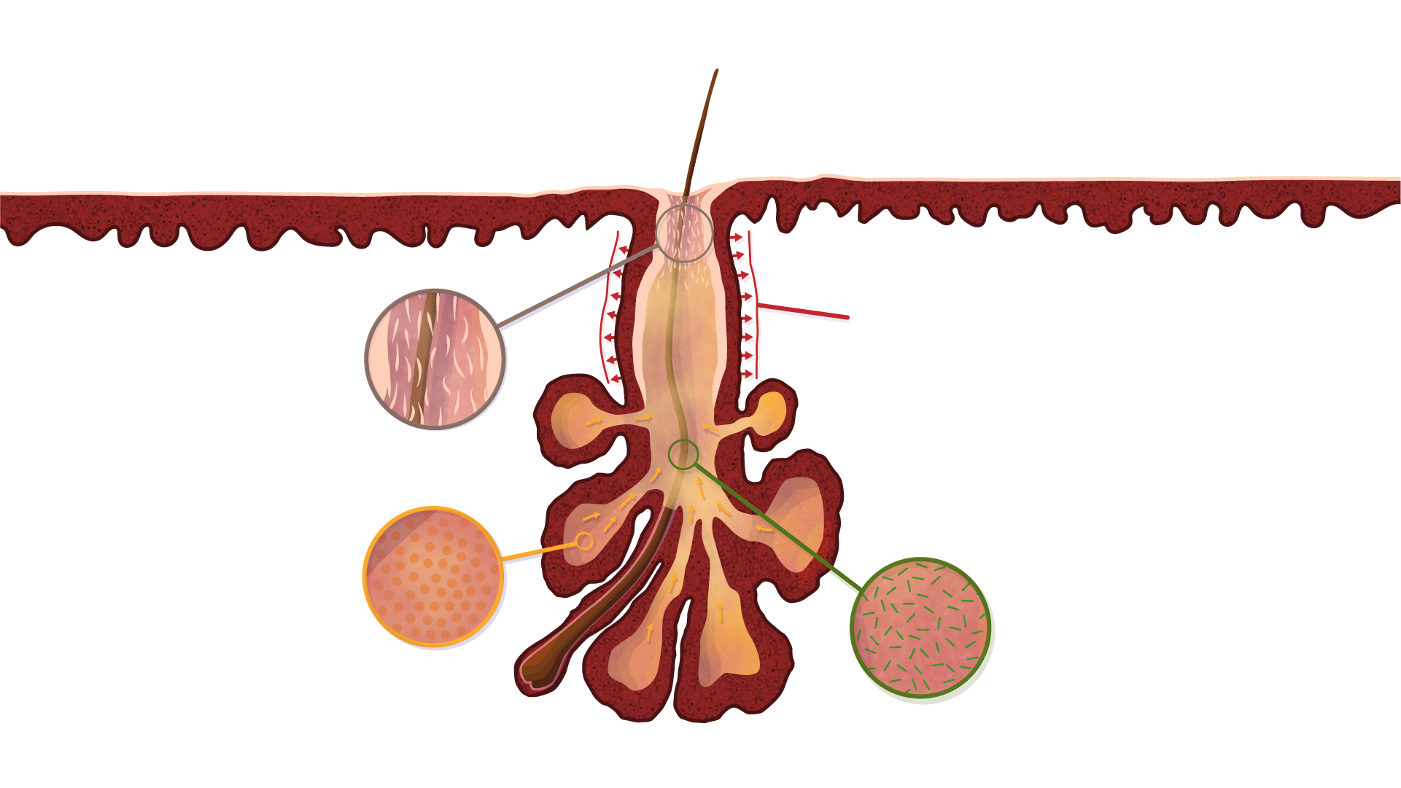
Pathophysiology of acne vulgaris
The four primary pathogenic factors resulting in the complex development of acne^{1,2}
Inflammation:^{2,4} Subclinical and clinical
Follicular
hyperkeratinisation^{2,3,a}
Sebum:^{2,3}
Excessive sebum productionª
Change in sebum constituents
Microbial colonisation with Cutibacterium acnes and shift in the microbiome^{5,6}
Number and size of the sebaceous follicles are genetically determined
ª Follicular hyperkeratinisation and excessive sebum production are mediated by hormonal regulation^{3,5,6}
1. Williams HC, et al. Lancet. 2012;379(9813):361-72; 2. Zaenglein AL. N Engl J Med. 2018;379(14):1343-52; 3. Gollnick H, et al. J Am Acad Dermatol. 2003;49(1 Suppl):S1-S37; 4. Zaenglein AL, et al. J Am Acad Derm. 2016;74:945-73.e33; 5. Del Rosso JQ, Kircik L. J Dermatolog Treat. 2024;35(1):2296855; 6. Kim HJ, Kim YH. Int J Mol Sci. 2024;25(10):5302

Slide 15
Development of acne vulgaris

Slide 16
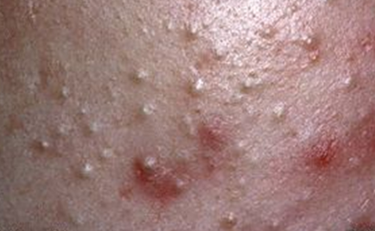
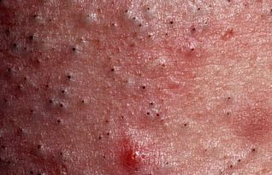
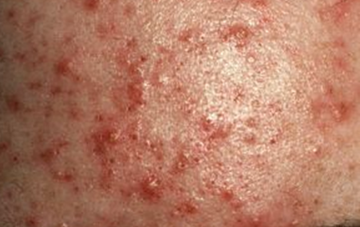
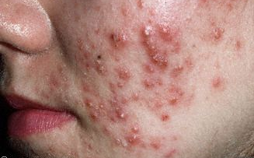
Lesion progression in acne vulgaris
Evolution of acne lesions^{1,2}
Comedonal acne
Inflammatory lesions
Scars
Microcomedo
Not clinically visible
Precursor to all clinical lesions
Images kindly provided by Prof. Layton
1. Thiboutot D, et al. J Am Acad Dermatol. 2009;60(5 Suppl):S1-S50. 2. Gollnick H, et al. J Am Acad Dermatol. 2003;49(1 Suppl):S1-S37

Slide 17



Acne severity is difficult to evaluate
There are over 20 grading systems^{1,2}
Assessment tools
Tool | Global acne severity grading | Acne lesion counting | Multimodal digital imaging
Advantages | Simple and quick to use over serial clinic visits Estimates the full extent of involvement Evaluates the range of aspects pertinent to severityª Allows the clinician to observe the dominant lesions | Precise, objective and highly discriminative Quantifies the types of lesion present Distinguishes small effects in therapeutic response Allows examination of morphogenesis and evolution of individual lesions Can provide continuous data for statistically analysis | Permanent record of acne severity Allows reliable recoding of change with time
Disadvantages | Subjective assessment Multiple variables (including variability between assessors) Less sensitive to change Too simplistic to provide useful insight | Time consuming – not practical in the clinic Intrusive for the patient Dependent on external variables such as assessor’s visual acuity, skin quality, and office lighting Counting requires specialist knowledge and training to administer Does not capture various clinical aspects of symptoms including concentration, distribution and size of lesions, or skin redness | Difficulty with standardisation Requires expensive equipment Does not adequately detect small, noninflamed lesions Two-dimensional images only – no account of palpation or lesion depth
ª i.e. number, type and size of lesions, and presence and coverage of inflammation, erythema and seborrhoea
1. Agnew T, et al. J Clin Aesthet Dermatol. 2016;9(7):40-52; 2. Bae IH, et al. Ann Dermatol. 2024;36(2):65-73

Slide 18
Acne severities
Acne severity defined by NICE guideline¹
For mild-to-moderate acne, this includes people who have 1 or more of:
  Any number of non-inflammatory lesions (comedones)
  Up to 34 inflammatory lesions with or without non-inflammatory lesions in the whole face
  Up to two nodules
Acne severity varies along a continuum
For moderate-to-severe acne, this include people who have either or both of:
  35 or more inflammatory lesions (with or without non-inflammatory lesions)
  Three or more nodules
20%
of young people suffer from moderate-to-severe acne² and need adequate treatment
1. National Institute for Health and Care Excellence. Acne vulgaris: management NICE guideline [NG198]. Available at: www.nice.org;
2. Bhate K, Williams HC. Br J Dermatol. 2013;168(3):474-85

Slide 19
Patient assessment
FACTORS POTENTIALLY INFLUENCING SEVERITY
Personal factors^{1,2}
History of infantile acne
Earlier age of onset
Menarche^{2,5}
Earlier onset
High DHEAS levels
Increasing
acne severity
Genetics^{3,4}
History in first-degree relative
Hormonal imbalance/ systemic disease
Seborrhoea^{6,7}
Earlier and higher levels of sebum production
High sebum levels (less responsive to antibiotics)
DHEAS, dehydroepiandrosterone sulfate
1. Chew EW, et al. Clin Exp Dermatol. 1990;15(5):376-7; 2. Lucky, AW, et al. J Pediatr. 1997;130:30-9; 3. Sutaria AH, et al. Acne Vulgaris. [Updated 2023 Aug 17]. In: StatPearls [Internet]. Treasure Island (FL): StatPearls Publishing; 2025 Jan-. Available here (accessed June 2025); 4. Lolis MS, et al. Med Clin North Am. 2009;93:1161-81; 5. Lucky AW. Dermatology. 1998;196:95-7; 6. Del Rosso JQ, Kircik L. J Dermatolog Treat. 2024;35(1):2296855; 7. Mourelatos K, et al. Br J Dermatol. 2007;156:22-31;

Slide 20
Disease burden impact on patients living with acne vulgaris

Slide 21
Before you proceed: reflect briefly
How do you think acne vulgaris impacts a patient’s daily life beyond physical symptoms?

Slide 22
Quality of Life deficit in Acne the impact on patients living with acne vulgaris
Quality of Life (SF-36ª)
 | Social functioning | Role fulfilment for emotional reasons | Mental health | Energy and vitality
Acne | 11.1 | 7.4 | 13.4 | 7.0
Asthma | 5.9 | 6.3 | 4.2 | 6.0
Diabetes | 8.7 | 9.5 | 5.9 | 9.1
Back pain | 8.9 | 6.9 | 4.1 | 8.5
Epilepsy | 7.4 | 5.3 | 3.4 | 5.9
Acne patients report levels of social, psychological and emotional problems
on a par with those reported by patients with what would normally be considered
much more ‘serious’ general chronic disabling medical conditions.
ª SF-36 scores range from 1–100
SF-36, Short Form-36 Health Survey
Mallon E, et al. Br J Dermatol. 1999;140(4):672-6

Slide 23
Disease burden identification of the impact – how acne makes you feel?
Negative self image
Negative self perception
(16/22 studies)
Negative self concept /
belief
Patient
Perspective from
Qualitative data
(22 of 408 studies)
Psychological consequences (15/22 studies)
Self consciousness / self-conscious emotions
Negative peer behaviour
(10/22 studies)
Negative self perception was the most commonly reported theme (n=16/22 studies)
Fear of negative evaluation (10/22 studies)
Negative effects on relationships (10/22 studies)
Smith H, et al. Am J Clin Dermatol. 2021;22(2):159-171

Slide 24

Psychological well-being in adolescents with acne increased suicidal ideation, mental health problems and social impairment
Cross-sectional, questionnaire-based study
  3775 adolescents
  18-19 years old
  14% having substantial acne (a lot and very much)
 | Suicidal thoughts
 | With “very much” acneª | No or “little” acneª
Women, % | 25.5 | 11.9
Men, % | 22.6 | 6.3
ª Possible responses to answer on occurrence of pimples the previous week were no, yes – a little, yes – a lot, and yes – very much
Halvorsen JA, et al. J Invest Dermatol. 2011;131(2):363-70

Slide 25
The burden of Acne scars
Highlighting the significant psychosocial impact of acne scars
Mean (SEM) DLQI score by acne scars severity
(Scored from 0 to 3)ª
High psychosocial impact of acne scars
Patients frequently feel uncomfortable
and embarrassed
Q10: Treatment difficulties
Q9: Sexual difficulty
Q8: Interpersonal problems
Q7: Work/Study
Q6: Sport
Q5: Social or leisure activities
Q4: Choice of clothes
Q3: Daily activities
Q2: Embarrassment
Q1: Physical symptoms
0
0.2
0.4
0.6
0.8
1
1.2
1.4
1.6
Severe/very severe
Moderate
Mild
ª Mean (SEM) DLQI scores for each questionnaire item (Q1–Q10) based on acne scarring severity grades. Each question was scored from a minimum of 0 (i.e. no impact on HRQoL) to a maximum of 3 (i.e. very strong impact on HRQOL)
DLQI, Dermatology life Quality Index; HRQoL, health-related quality of life; SEM, standard error of the mean
Tan J, et al. Am J Clin Dermatol. 2022;23(1):115-123; 2. Tan J, et al. JAAD Int. 2021;3:102-110

Slide 26
The burden of Acne scars is high
Early treatment may help prevent them
Establish how long the acne has
been present^{1,2}
More frequent in severe /
very severe acne³
  May arise from mild acne in
  susceptible individual
The degree and duration of clinical inflammation influences resultant scarring³
Select appropriate therapy to reduce inflammatory acne^{3,4}
Duration of time before adequate acne treatment³
12
Males
10
Females
8
Mean scarring score
6
4
2
0
<6
>6 to 12
>12 to 18
>18 to 24
>24 to 36
>36 to 48
>48
Time (months)
Increasing clinically relevant acne scarring
(overall SCAR-S scores ≥2) with duration of acne⁵
18
16
14
12
10
Percent of subjects
Early treatment targeting inflammation likely to reduce scarring⁴
8
6
4
2
0
<6 mths
6-11 mths
1-2 yrs
>2-3 yrs
>3-5 yrs
>5-10 yrs
>10 yrs
Acne duration
mths, months; yrs, years;
SCAR-S, Scar Cosmesis Assessment and Rating scale – Simplified
1. National Institute for Health and Care Excellence. Acne vulgaris: management NICE guideline [NG198]. Available at: www.nice.org; 2. DermNet. Acne vulgaris. Available here (accessed June 2025); 3. Layton AM, et al. Clin Exp Dermatol. 1994;19(4):303-8; 4. Kurokawa I, et al. Dermatol Ther (Heidelb). 2021;11(4):1129-1139; 5. Tan JK, et al. J Cutan Med Surg. 2010;14(4):156-60

Slide 27
The evolving treatment landscape in acne vulgaris treatments, mechanisms of action, Safety and efficacy and administration

Slide 28
Before you proceed: reflect briefly
Are you familiar with most relevant treatments for acne vulgaris and how they target the key pathogenic factors?

Slide 29
Treatments for acne vulgaris understanding treatment approvals and availability
This micro learning focuses on evidence-based treatments for acne vulgaris, as supported by the latest international guidelines (American,¹ UK,² and European³) and scientific data
While these treatments are widely recognised in clinical practice, regulatory approval and market availability vary across countries
The goal of this module is to offer a comprehensive overview of current evidence-based options, regardless of regional variation in approval or access
Please note that local prescribing practices, reimbursement, and product availability may differ depending on national regulatory frameworks
UK, United Kingdom
1. Reynolds RV, et al. J Am Acad Dermatol. 2024;90(5):1006.e1-1006.e30; 2. National Institute for Health and Care Excellence. Acne vulgaris: management NICE guideline [NG198]. Available at: www.nice.org; 2. EDF. S3-Guideline for the Treatment of Acne (Update 2016). Available here (accessed May 2025)

Slide 30
Overview of topical treatment options for acne vulgaris
How each therapy targets a key pathogenic factor
Normalise follicular
keratinisation¹
Anti-inflammatory^{3,4,6}
Benzoyl peroxide
Topical retinoids
Antibiotics
Azelaic acidª
Azelaic acidª
Topical anti-androgen (clascoterone)
Inhibit sebum
production²
Antibacterial^{3,4}
Topical anti-androgen (clascoterone)
Benzoyl peroxide
Antibiotics
Topical
Antibiotics
Azelaic acidª
ª Azelaic acid has diverse physiological activities, including antimelanogenic antioxidant effects⁵
1. Sutaria AH, et al. Acne Vulgaris. [Updated 2023 Aug 17]. In: StatPearls [Internet]. Treasure Island (FL): StatPearls Publishing; 2025 Jan-. Available here (accessed June 2025); 2. Hebert A, et al. JAMA Dermatol. 2020;156(6):621-630; 3. DermNet. Benzoyl peroxide. Available here (accessed June 2025); 4. Reynolds RV, et al. J Am Acad Dermatol. 2024;90(5):1006.e1-1006.e30; 5. Feng X, et al. Clin Cosmet Investig Dermatol. 2024;17:2359-2371; 6. Eichenfield LF, et al. J Drugs Dermatol. 2024 ;23(1):1278-1283.

Slide 31
Overview of systemic treatment options for acne vulgaris
How each therapy targets a key pathogenic factor
Normalise follicular
keratinisation¹
Anti-inflammatory^{3,4}
Antibiotics
Oral retinoid (isotretinoin)
Oral retinoid (isotretinoin)
Inhibit sebum
production²
Antibacterial^{3,4}
Oral retinoid (isotretinoin)
Oral anti-androgens (spironolactone)
Antibiotics
Oral retinoid (isotretinoin)
Combined hormonal contraceptives
Oral/systemic
1. Ganceviciene R, Zouboulis CC. J Dtsch Dermatol Ges. 2010;8 Suppl 1:S47-59; 2. Lam C, Zaenglein AL. Clin Dermatol. 2014;32(4):502-15; 3. Sutaria AH, et al. Acne Vulgaris. [Updated 2023 Aug 17]. In: StatPearls [Internet]. Treasure Island (FL): StatPearls Publishing; 2025 Jan-. Available here (accessed June 2025); 4. Pile HD, et al. Isotretinoin. [Updated 2025 Mar 4]. In: StatPearls [Internet]. Treasure Island (FL): StatPearls Publishing; 2025 Jan-. Available here (accessed June 2025); 5. Reynolds RV, et al. J Am Acad Dermatol. 2024;90(5):1006.e1-1006.e30

Slide 32
Topical retinoids (1/2)
Tretinoin, Adapalene, Tazarotene AND TRIFAROTENEª
1960s
1970s
1980s
1990s
2000s
2010s
Tretinoin (retinoic acid)¹
Strong comedolytic effect²
Adapalene (1996)¹
Same efficacy as tretinoin, less irritating. Commonly used for acne management³
Tazarotene (1997)¹
Only available in some countries⁴
Trifarotene (2019)¹
Selectively targets retinoic acne receptor (RAR) gamma licensed for both facial AND truncal acne⁵
Mode of action
Primary: Desquamation & normalise keratinization. Promote shedding of abnormal epithelium, altering microclimate in microcomedones^{1,2,6}
Resolves mature comedones and prevents the formation of new ones⁶
Enhances the penetration and effectiveness of other topical treatments like antibiotics⁷
Reduces inflammation by activating TLR-2 (Toll-like receptor 2), reducing acne-related redness and swelling⁸
No direct antibacterial effect: Makes follicles more accessible to antimicrobials, creating synergistic effects^{2,6,9}
ª May vary according to country
1. Baldwin H, et al. Am J Clin Dermatol. 2021;22(3):315-327; 2. Leyden J, et al. Dermatol Ther (Heidelb). 2017;7(3):293-304; 3. Tu P, et al. J Eur Acad Dermatol Venereol. 2001;15 Suppl 3:31-6; 4. Han G, et al. J Clin Aesthet Dermatol. 2020;13:E59-E65; 5. Annunziata MC, et al. Dermatol Ther (Heidelb). 2025;15(2):245-264; 6. Motamedi M, et al. J Cutan Med Surg. 2022;26(1):71-78; 7. Dreno B. Drugs. 2004;64:2389-97; 8. Zhang B, et al. Biomed Sermatol 3, 4 (2019); 9. Dessinioti C, Katsambas A. Dermatol Ther (Heidelb). 2024;14(1):31-44

Slide 33

Topical retinoids (2/2)
Tretinoin, Adapalene, Tazarotene AND TRIFAROTENE
Clinical effects
Possible acne flare in the first weeks due to increased epidermal proliferation^{1,2}
Stimulates blood flow and collagen production,^{3,4} speeding up healing
Pharmacokinetics
Minimal systemic absorption⁵
Side effects^{6,7}
Erythema, dryness, itching, stinging (varies by vehicle, skin type, frequency, and mode of application)
Trifarotene receptor specific aimed to enhance tolerability
Indications
Topical retinoids can be used by both males and females⁸
  should be avoided in pregnancy and in patients aiming to conceive⁷
For comedonal and mild inflammatory acne, and / or as part of maintenance therapy^{7,9}
Often used in combination with benzoyl peroxide or antibiotics and can be effective for mild,
moderate and severe acne⁷
1. Del Rosso JQ, editors. J Clin Aesthet Dermatol. 2008;1:41-3; 2. Dreno B, et al. J Drugs Dermatol. 2022;21:734-740; 3. Harvard Health Publishing. Do retinoids really reduce wrinkles? Available here (accessed June 2025); 4. Sitohang IBS, et al. Int J Womens Dermatol. 2022;8(1):e003; 5. Chien A, et al. J Drugs Dermatol. 2018;17(12):s51-55; 6. Motamedi M, et al. J Cutan Med Surg. 2022;26(1):71-78; 7. NICE. Acne vulgaris: Topical retinoids. Available here (accessed June 2025); 8. Dermatology Advisor. Racial and Sex Differences Observed in the Efficacy of Once-Daily Tretinoin for Acne. Available here (accessed June 2025); 9. DermNet. Topical retinoids. Available here (accessed June 2025)
Annunziata MC, et al. Dermatol Ther (Heidelb). 2025;15(2):245-264;

Slide 34
Benzoyl peroxide¹ a key topical treatment for acne
History
Leading over-the-counter topical treatment¹
Widely used since the late 1970s¹
Mode of action¹
Primary: Powerful antimicrobial: Rapidly reduces C. acnes by 90% and free fatty acids by 40% within days
Anti-inflammatory: Reduces oxygen free radicals, stimulates epidermal mitosis
Slightly comedolytic
Pharmacokinetics¹
Decomposes in light, rapidly metabolised to benzoic acid on skin, no systemic absorption
Side effects
Moderate irritation, dryness, scaling¹
Bleaches clothes, bed linen, hair¹
Rare contact allergy¹
Recent safety concerns²
  No issues when stored at correct temperature^{3,4}
  The American Academy of Dermatology recommends patients to store the product at room temperature or cooler⁴
Indication
Suitable for individuals aged 12 and above⁵
Mild inflammatory acne, part of combination therapies in moderate to severe acne^{6,7}
1. Plewig, G., Kligman, A.M. (1993). Benzoyl Peroxide. In: ACNE and ROSACEA. Springer, Berlin, Heidelberg. https://doi.org/10.1007/978-3-642-97234-8_75; 2. AAD statement of Benzoyl Peroxide in OTC Personal Care Products. Available here (accessed June 2025); 3. Garate D, et al. J Am Acad Dermatol. 2024;91(5):966-8; 4. Veenstra J, et al. J Am Acad Dermatol. 2024;91(3):533-4; 5. NHS. Who can and cannot use benzoyl peroxide. Available here (accessed June 2025); 6. National Institute for Health and Care Excellence. Acne vulgaris: management NICE guideline [NG198]. Available at: www.nice.org; 7. Nast A, et al. JEADV. 2016;30:1261-1268

Slide 35
Azelaic Acid^{1,2}
History¹
Approved by the FDA in 2002 for papulopustular rosacea; now commonly used as a second-line treatment
for acne vulgaris
Mode of action^{1,2}
Comedolytic, higher concentrations (e.g. ~20–30%) are anti-bacterial; anti-inflammatory effects, lightening effect on hyperpigmentation
Acts through multiple mechanisms
Pharmacokinetics¹
Poor percutaneous absorption (3-5% retained in the skin), enhanced with gel formulations (up to 8%)
Efficacy¹
Effective in treating both non-inflammatory and inflammatory acne, with significant improvement in post-inflammatory hyperpigmentation
Slow onset of actionª
Safety / side effects¹
Well tolerated; Mild irritation
Indication¹
Suitable for individuals aged 12 and above
Safe in pregnancy³
ª Personal note
FDA, Food and Drug Administration
1. Feng X, et al. Clin Cosmet Investig Dermatol. 2024;17:2359-2371; 2. Plewig, G., Melnik, B. and Chen, W.C. (2019) Plewig and Kligman's Acne and Rosacea. 4th Edition, Springer, Berlin (chapter 7); 3. Ly S, et al. Dermatol Ther (Heidelb). 2023;13(1):115-130

Slide 36
topical anti-androgen clascoterone is a topical treatment option for acne in maleS and femaleS
Efficacy – change in lesion reduction⁴
History
Clascoterone cream was approved by the FDA in 2020 and by
the UK MHRA in 2025 based on 2 Phase 3 studies^{1,2}
Mode of action
  First-in-class topical anti-androgen, reduces sebum production³
  Anti-inflammatory: Inhibits the transcription of androgen-responsive genes including inflammatory cytokines³
Pharmacokinetics
  Only local, not systemic, antiandrogenic activity⁴
Efficacy
Clascoterone is effective in the treatment of acne vulgaris, showing statistically significant improvements in all primary and secondary efficacy endpoints⁴
Safety / side effects
Adverse events rates are low and mostly mild⁴
  The predominant local skin reaction was trace or mild erythema
Indication
Suitable for individuals aged 12 and above³
Clascoterone can be used as part of a multimodal approach with other fixed combination products or oral therapies available for acne management, addressing more key pathophysiological factors
Study CB-03-01/25
Study CB-03-01/26
TLC
NILC
ILC
TLC
NILC
ILC
Estimated reduction from baseline, %
Improvement of acne⁴
Baseline
Week 12
FDA, Food and Drug Administration; MHRA, Medicines and Healthcare Products Regulatory Agency; UK, United Kingdom
1. Piszczatoski CR, Powell J. Clin Ther. 2021;43(10):1638-1644; 2. FirstWord PHARMA. Cosmo and Glenmark Announces UK MHRA Approval of Winlevi for Treatment of Acne. Available here (accessed June 205); 3. Eichenfield LF, et al. J Drugs Dermatol. 2024;23(1):1278-1283; 4. Hebert A, et al. JAMA Dermatol. 2020 ;156(6):621-630;

Slide 37

Antibiotics for the treatment of acne
Guideline driven antibiotic use
Oral antibiotics remain important but should be limited due to global AMR concerns¹⁻³
  Limit treatment to 3 months (up to 6 months in select cases)^{1,2}
  Combine with benzoyl peroxide to reduce resistance¹
Prefer doxycycline, lymecycline, or sarecycline (narrow spectrum) over minocycline^{1,2}
  Avoid minocycline due to the risk of severe eruptions and neurological side effects²
Limit trimethoprim-sulfamethoxazole due to risk of rare, but severe hypersensitivity reactions¹
  Stevens-Johnson syndrome/toxic epidermal necrolysis
  Acute respiratory failure
Reserve macrolides (e.g. erythromycin) for specific cases only²
  e.g. during pregnancy or in patients where tetracyclines are contraindicated
Stop antibiotics once control is achieved and start maintenance therapy^{1,3,4}
AMR, antimicrobial resistance
1. Reynolds RV, et al. J Am Acad Dermatol. 2024;90(5):1006.e1-1006.e30; 2. National Institute for Health and Care Excellence. Acne vulgaris: management NICE guideline [NG198]. Available at: www.nice.org; 3. Nast A, et al. JEADV. 2016;1261-1268; 4. Zaenglein AL, et al. J Am Acad Derm. 2016;74:945-73.e33

Slide 38
Oral retinoid isotretinoin
History¹
Discovered in 1971, registered for severe acne since 1982
Mode of action¹
Primary: Apoptosis-mediated sebum suppression in sebaceous glands
Changes gene-expression leading to altered terminal differentiation of keratinocytes and anti-inflammatory effects
Pharmacokinetics¹
Systemic absorption: rapidly absorbed, bioavailability 25%, significantly increased with intake of fatty food
Efficacy²
Most effective acne drug
Safety / side effects¹
Teratogenic
Strict contraception in all women in childbearing age
Side effects like vitamin-A hypervitaminosis (xeroderma, lipid/liver enzyme elevations [among others])
Conflicting data on depression/suicidal intents
Indication¹
Conglobate acne, severe acne, scarring acne, acne resistant to other therapies
1. Plewig, G., Melnik, B. and Chen, W.C. (2019) Plewig and Kligman's Acne and Rosacea. 4th Edition, Springer, Berlin (chapter 7); 2. Huang CY, et al. Ann Fam Med. 2023;21:358-369

Slide 39
Combined Hormonal contraceptives
History
Introduced in the 1960s as birth control¹
Mode of action
Reduce sebaceous gland activity, mediated by a reduced level of circulating androgens²
Pharmacokinetics
Orally absorbed, metabolised by the liver, and reduces free androgens³
Efficacy
Efficient in the treatment of acne and reduce inflammatory and comedonal lesions⁴
Full effect after 6–9 months of use⁵
No superiority of one combined hormonal contraceptive over the other for the treatment of acne⁶
Safety / side effects
Generally well-tolerated⁵
Systematic reviews exhibit an increased risk of breast cancer and cervical cancer⁵
Indication
Although not licensed for acne in all countries may help moderate to severe acne in females and may
be used when a female with acne requires contraception or requires them for hormonal reasons^{4,7}
Contraindicated in the case of genetic clotting disorders, positive history of venous thromboembolism,
heart disease, hypertension, obesity, smoking in women older than 35 years of age, diabetes mellitus, liver
disease, migraine and headache, prolonged immobilisation, history of breast, endometrial and liver
malignancy, pregnancy and breastfeeding, and hypersensitivity to any component of the product⁵
1. Christin-Maitre S. Best Pract Res Clin Endocrinol Metab. 2013;27(1):3-12; 2. Zaenglein AL, et al. J Am Acad Derm. 2016;74:945-73.e33; 3. Elliman A. BMJ Sex Reprod Health. 2000;26:109-111; 4. Arowojolu AO, et al. Cochrane Database Syst Rev. 2012;2012(7):CD004425; 5. Plewig, G., Melnik, B. and Chen, W.C. (2019) Plewig and Kligman's Acne and Rosacea. 4th Edition, Springer, Berlin (chapter 7); 6. Reynolds RV, et al. J Am Acad Dermatol. 2024;90(5):1006.e1-1006.e30; 7. National Institute for Health and Care Excellence. Acne vulgaris: management NICE guideline [NG198]. Available at: www.nice.org

Slide 40
Oral anti-androgen spironolactone
Mean Acne-QoL symptom subscale score by time point for each treatment group²
History
Spironolactone used off-label to treat acne vulgaris in women¹
  Based on the evidence for use in two independent large clinical studies^{1,2}
Mode of action
An oral anti-androgen to reduce sebum production^{1,2}
Efficacy
Improves acne compared to placebo¹ and doxycycline²
Greater improvements at 6 months than at 3 months¹
Safety / side effects
Well tolerated^{1,2}
  SAFA trial: more headaches (no SAEs)²
  Most spironolactone-related AEs in the FASCE study were mild to moderate events of irregular menstruation and did not lead to withdrawal of the patients from treatment¹
Indication
May be an effective alternative to oral antibiotics for women with persistent acne who have not responded to first-line topical treatments²
Primary
endpoint
End of
treatment
25
20
15
Mean acne-QoL symptom subscale score
10
5
Spironolactone
Placebo
0
Baseline
6
12
24
≤52
Timepoint (weeks)
Evolution of the global AFAST score¹
3.5
Spironolactone
3.0
Doxycycline
2.5
2.0
Mean AFAST score
1.5
1.0
0.5
0
Baseline
Month 2
Month 4
Month 6
Month 9
Month 12
AE, adverse event; Acne-QoL, Acne-Specific Quality of Life; AFAST, Adult Female Acne Scoring Tool; SAE, serious adverse events
1. Dréno B, et al. Acta Derm Venereol. 2024;104:adv26002; 2. Santer M, et al. Drug Ther Bull. 2023;62(1):6-10

Slide 41
Multimodal treatment strategies treatment approaches across the patient journey and disease severities

Slide 42
Before you proceed: reflect briefly
Is a multimodal approach more effective in managing acne vulgaris compared to monotherapy? If yes, why?

Slide 43
Combinations of the treatments for acne vulgaris
The importance of a multimodal approach
Addressing as many pathophysiological factors implicated in acne as possible leads to better outcomes^{1,2}
A multimodal approach works more rapidly for patients²
Adherence is improved with preferably fixed combination therapies which are more convenient for patients to use³
More rapid control of inflammatory processes translates to less distressing and disfiguring sequelae⁴
1. National Institute for Health and Care Excellence. Acne vulgaris: management NICE guideline [NG198]. Available at: www.nice.org; 2. Reynolds RV, et al. J Am Acad Dermatol. 2024;90(5):1006.e1-1006.e30; 3. Yentzer BA , et al. Cutis. 2010;86(2):103-8; 4. Dréno B, Gold LS. Dermatol Ther (Heidelb). 2021;11(4):1075-1078

Slide 44
Managing acne vulgaris: NICE guidelines (1/2) evidence-based recommendations for multimodal treatment
Offer a 12-week course of first-line treatment
Explain that positive effects may take 6-8 weeks to appear
Take into account patient preference and acne severity
Discuss the advantages and disadvantages of treatment
Therapy options (part 1)
Topical fixed combination – Single-application
First line treatment options
Severity
Advantages
Disadvantages
Colours correspond to medicines
Does not contain antibiotics
Does not contain antibiotics
Skin irritation
Topical fixed
combination
Benzoyl
peroxide
Moderate
Photosensitivity
Adapalene
Mild
Severe
Bleaching of hair and fabrics
Does not contain antibiotics
Does not bleach hair or fabrics
Skin irritation
Topical fixed
combination
Moderate
Photosensitivity
Tretinoin
Clindamycin
Mild
Severe
Does not contain antibiotics
Skin irritation
Topical fixed
combination
Benzoyl
peroxide
Moderate
Photosensitivity
Clindamycin
Mild
Bleaching of hair and fabrics
National Institute for Health and Care Excellence. Acne vulgaris: management NICE guideline [NG198]. Available at: www.nice.org
Infographic adapted from Xu et al. (2021)
Xu J, et al. BMJ. 2021;374:n1800

Slide 45
Managing acne vulgaris: NICE guidelines (2/2) evidence-based recommendations for multimodal treatment
Therapy options (part 2)
Combined use of separate topical and oral agents
Maintenance
Encourage continued appropriate skin care
Consider maintenance treatment in people with a history of frequent relapse after treatment
  A fixed combination of topical adapalene and topical benzoyl peroxide
  If not tolerated, or contraindicated: topical monotherapy with adapalene, benzoyl peroxide or azelaic acid
First line treatment options
Severity
Advantages
Disadvantages
Colours correspond to medicines
Does not contain antibiotics
Skin irritation
Topical fixed
combination
Adapalene
Benzoyl
peroxide
Oral component may be
effective in treating acne in
areas that are difficult to
reach with topical option
Photosensitivity
Moderate
Bleaching of hair and fabrics
Severe
+
Oral
lymecycline ª
Oral
doxycycline ª
Systemic side effects
or
Antimicrobial resistance
Treatment with adequate
courses of standard therapy with systemic antibiotics and topical therapy is a Medicines and Healthcare products Regulatory Agency (MHRA) requirement for subsequent oral isotretinoin
Topical
azelaic acid
Photosensitivity
Moderate
Severe
Systemic side effects
+
Oral
lymecycline ª
Oral
doxycycline ª
Antimicrobial resistance
or
Topical benzoyl peroxide
Does not contain antibiotics
Consider if above treatment
options are contraindicated
or the person wishes to avoid
antibiotic or topical retinoid
Does not contain topical
retinoid or antibiotics
Skin irritation
Topical
benzoyl
peroxide
Photosensitivity
Mild
Moderate
Severe
Bleaching of hair and fabrics
ª or consider trimethoprim or oral macrolide
National Institute for Health and Care Excellence. Acne vulgaris: management NICE guideline [NG198]. Available at: www.nice.org
Infographic adapted from Xu et al. (2021)
Xu J, et al. BMJ. 2021;374:n1800

Slide 46
Managing acne vulgaris: AAD guidelines (1/2) evidence-based recommendations for multimodal treatment
The AAD 2016 acne vulgaris guidelines¹ were updated in 2024 with 18 evidence-based recommendations and 5 good practice statements²
Strong recommendations for: topical benzoyl peroxide, retinoids, antibiotics, oral doxycycline; oral isotretinoin for severe or treatment-resistant acne²
Conditional recommendations for: topical clascoterone, salicylic acid, azelaic acid, oral minocycline, sarecycline, combined oral contraceptives, and spironolactone²
Good clinical practices: combining topical therapies with multiple mechanisms, limiting systemic antibiotics, and using intralesional corticosteroid injections²
Management of AV (part 1)²
Adults, adolescents, and preadolescents (≥9 years) with acne vulgaris
Severity Assessment:
Acne objective severity should be assessed consistently, using the Physician Global Assessment (PGA) or other scales
Assess satisfaction with appearance, extent of scar / dark marks, treatment satisfaction, long-term acne control, and impact on quality of life
Routine microbiological and endocrine testing are not indicated
Baseline Evaluation
Mild
Moderate
to severe
AAD, American Academy of Dermatology; AV, acne vulgaris; BPO, benzoyl peroxide; LFT, liver function test
1. Zaenglein AL, et al. J Am Acad Derm. 2016;74:945-73.e33; 2. Reynolds RV, et al. J Am Acad Dermatol. 2024;90(5):1006.e1-1006.e30

Slide 47
Managing acne vulgaris: AAD guidelines (2/2) evidence-based recommendations for multimodal treatment
Mild
Management of AV (part 2)
Moderate
to severe
TOPICAL TREATMENTS
SYSTEMIC ANTIBIOTICS
Multimodal therapy combining multiple mechanisms of action
is recommended
Limit systemic antibiotic use when possible to reduce the development
of antibiotic resistance and other antibiotic-associated complications
Topical retinoids
Use concomitant BP and other topical treatment
BP
Doxycycline
Topical antibiotics
Minocycline
Monotherapy is not recommended
Sarecycline
Doxycycline over azithromycin
Topical antibiotic & BP
HORMONAL AGENTS
Multimodal topical therapy
Topical retinoid & BP
Combined oral contraceptives
Fixed-dose combinations
Topical retinoid & antibiotic
Spironalactone
Concomitant use of BP can prevent the development of antibiotic resistance
Potassium monitoring is of low usefulness in patients without risk factors for hyperkalaemia (e.g. older age, medical comorbidities, medications)
Clascoterone
Intralesional corticosteroids
Salicylic acid
Adjuvant treatment for larger acne papules or nodules at risk of acne scarring or for rapid improvement in inflammation and pain
Azelaic acid
ISOTRETINOIN
PHYSICAL MODALITIES
Isotretinoin
Pneumatic broadband light added to adapalene
Patients with psychosocial burden or scarring should be considered candidates for isotretinoin
We recommend monitoring only LFT and lipids
Population-based studies have not identified increased risk of neuropsychiatric conditions or inflammatory bowel disease with isotretinoin
For persons of pregnancy potential, pregnancy prevention is mandatory
Key:
Strong recommendation in favour of the intervention
Conditional recommendation in favour of the intervention
Strong recommendation against the intervention
Conditional recommendation against the intervention
Daily dosing over intermittent dosing
Either lidose-isotretinoin or standard isotretinoin
AAD, American Academy of Dermatology; AV, acne vulgaris; BP, benzoyl peroxide; LFT, liver function test;
Reynolds RV, et al. J Am Acad Dermatol. 2024 May;90(5):1006.e1-1006.e30

Slide 48
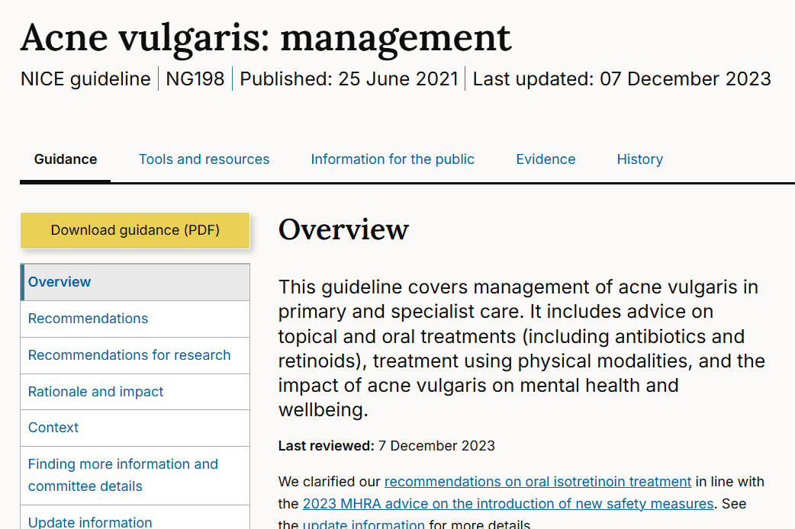
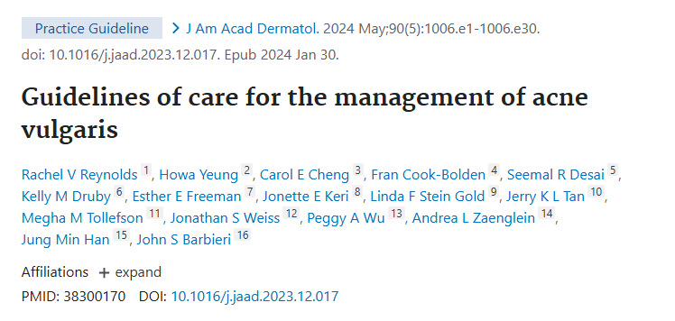
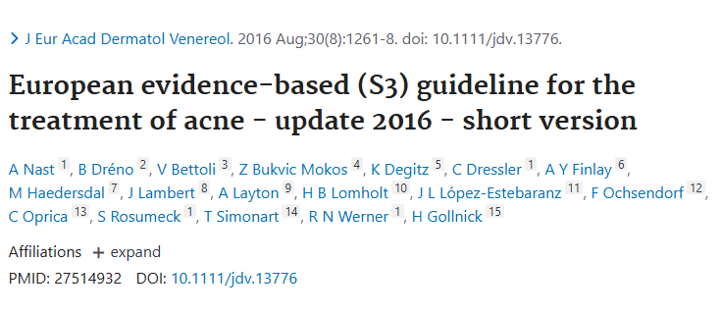
Managing acne vulgaris: guidelines further reading
NICE management guideline for acne vulgaris¹
  Click HERE
AAD guidelines of care for the management of acne vulgaris²
  Click HERE
European S3 guideline for the treatment of acne*³
  Click HERE
These guidelines may require updates as new insights and evolving treatment options continue to shape the acne vulgaris management landscape,
especially as part of combination therapies with longer-known treatments
AAD, American Academy of Dermatology; NICE, National Institute for Health and Care Excellence
*Currently being updated (June 2025)
1. National Institute for Health and Care Excellence. Acne vulgaris: management NICE guideline [NG198]. Available at: www.nice.org;
2. Reynolds RV, et al. J Am Acad Dermatol. 2024;90(5):1006.e1-1006.e30; 3. EDF. S3-Guideline for the Treatment of Acne (Update 2016). Available here (accessed May 2025)

Slide 49
conclusions

Slide 50
Conclusions
Improving acne vulgaris with multimodal treatment strategies
Acne vulgaris is a widespread and burdensome condition: Optimal patient care requires recognising physical and psychological impacts
Pathophysiology-driven treatment selection is key: Understanding the main pathogenic factors enables more effective and targeted management
Multimodal treatment approaches improve outcomes: Combining therapies to address different pathogenic factors is the best practice for more rapid and better long-term success
Guidelines continue to evolve: Stay updated on emerging therapies and changes in evidence-based recommendations
Future perspectives: Further optimising the use of current and novel treatment options through multimodal treatment strategies to improve patient outcomes

Slide 51
Before you proceed: reflect briefly
What is you number 1 take-home message?

