Slide 2
Clinical topic newsletter
The latest developments in
BRAF-mutated and MSI-H mCRC
Prof. Chiara Cremolini, MD, PhD
University of Pisa, Azienda Ospedaliero-Universitaria Pisana
July 2025
mCRC, metastatic colorectal cancer; MSI-H, microsatellite instability-high
Notes:
2

Slide 3

Developed by GI COnnect
This programme is developed by GI CONNECT,
an international group of experts in the field
of gastrointestinal oncology.
Acknowledgement and disclosures
This GI CONNECT programme is supported through an independent educational grant from Pierre Fabre Laboratories. The programme is therefore independent; the content is not influenced by the supporter and is under the sole responsibility of the experts.
Please note:
This educational programme is intended for healthcare professionals outside the United Kingdom and Republic of Ireland only
The views expressed within this programme are the personal opinions of the experts. They do not necessarily represent the views of the experts’ academic institutions, organisations, Pierre Fabre Laboratories, or other group or individual
Expert disclosures:
Dr Chiara Cremolini has received financial support/sponsorship for research support, consultation, or speaker fees from the following companies:
  Bayer, Merck, Nordic Pharma, Pierre Fabre, Roche, Servier, Takeda, Tempus

Slide 4
Clinical takeaways
Dual immunotherapy is now 1st line for dMMR mCRC patients: CheckMate 8HW demonstrated significant benefit from adding ipilimumab to nivolumab in dMMR patients regardless of BRAF status
FOLFOX + encorafenib/cetuximab is a new 1st line standard for BRAF-mutant/pMMR mCRC: BREAKWATER showed the combination of encorafenib/cetuximab with FOLFOX chemotherapy significantly improves outcomes, doubling survival in BRAFV600E-mutant patients
Encorafenib + cetuximab remains effective post-immunotherapy: for dMMR and BRAF-mutant patients progressing after immunotherapy, 2nd line treatment with encorafenib + cetuximab is effective, showing comparable benefit regardless of MMR status, supported by real-world evidence
Clear treatment sequencing is emerging:
  dMMR/BRAF-mutant mCRC: 1) immunotherapy (ipi-nivo), 2) targeted therapy (encorafenib + cetuximab), and 3) chemotherapy as a third-line option
  pMMR/BRAF-mutant mCRC: 1) FOLFOX +EC, 2) chemotherapy/anti-angiogenesis), and 3) FTD-TPI/bevacizumab as a third-line option
d/pMMR, deficient/proficient mismatch repair; ipi, ipilimumab; mCRC, metastatic colorectal cancer; FOLFOX, fluorouracil / leucovorin / oxaliplatin; FTD-TPI, trifluridine-tipiracil; nivo, nivolumab

Slide 5
Educational objectives
Understand clinical trial data and real-world evidence of therapies for the treatment of BRAFV600E-mutant and MSI-H mCRC and relevant patient subgroups
Recognise the appropriate sequencing of therapies for the treatment of
BRAFV600E-mutant and MSI-H mCRC across the patient journey to ensure optimal outcomes
mCRC, metastatic colorectal cancer; MSI-H, microsatellite instability-high

Slide 6
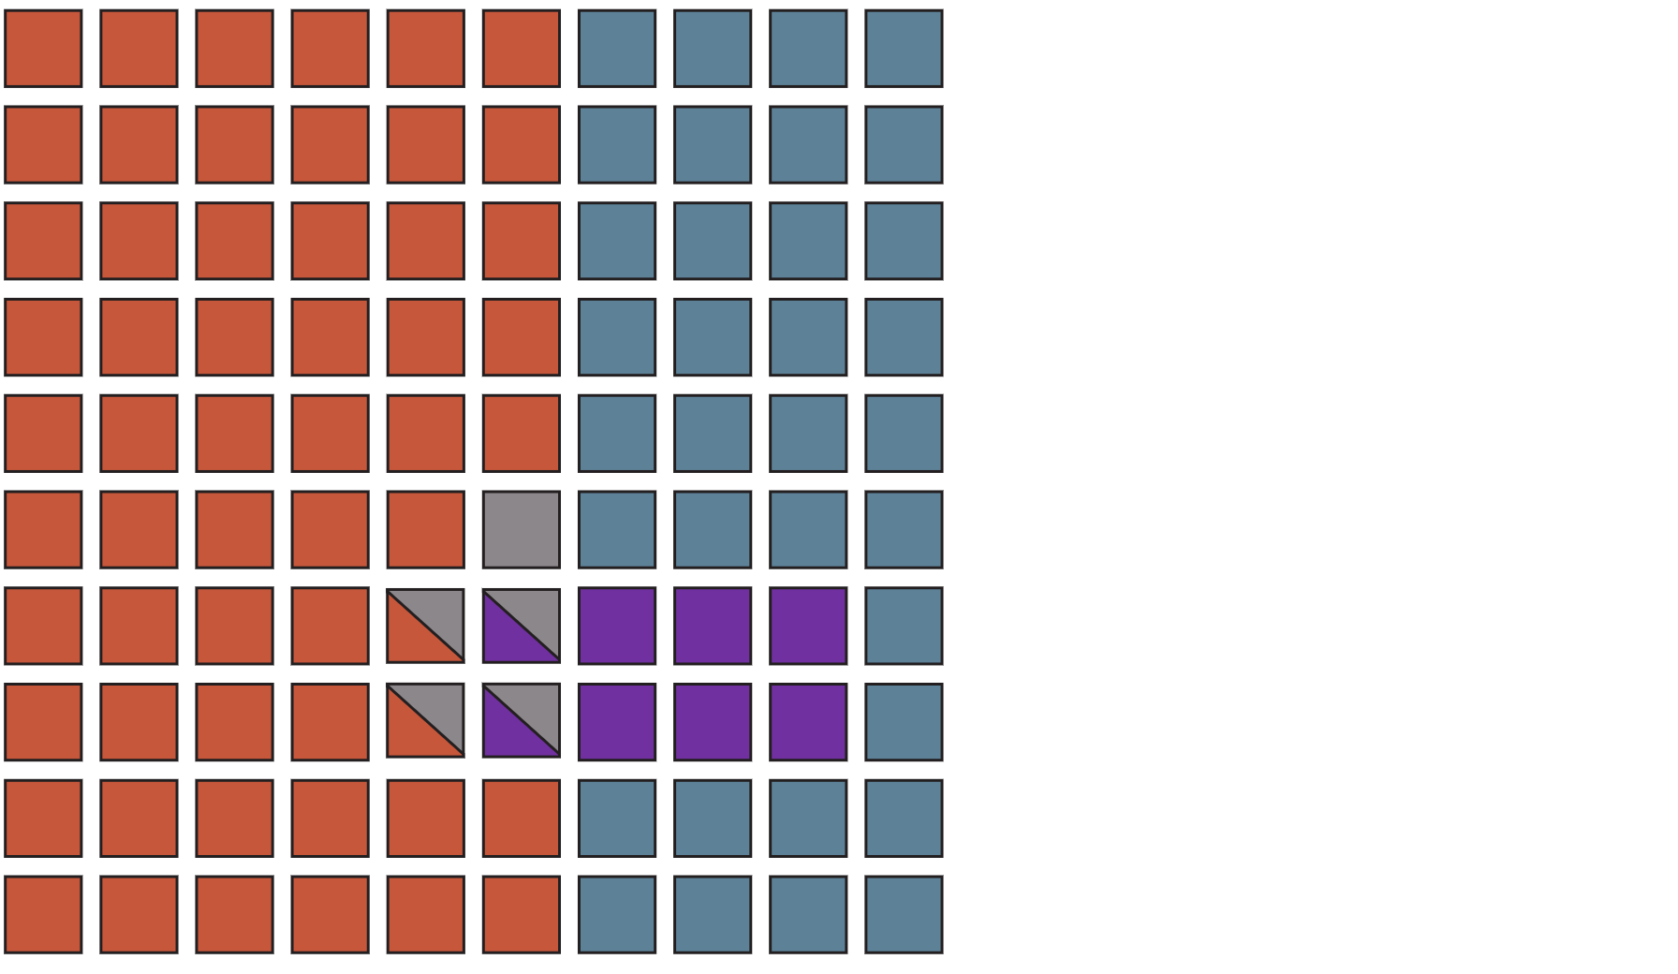
Molecular subgroups of mCRC
According to international guidelines
dMMR/MSI-high
RAS-mutant
BRAFV600E-mutant
No genomic alterations
dMMR, deficient mismatch repair; mCRC, metastatic colorectal cancer; MSI-H, microsatellite instability-high
Cervantes A, et al. Ann Oncol 2023;34(1):10-32; Cervantes A, et al. Ann Oncol. 2024;35(2):241-243

Slide 7
Choice of the first-line
Clearly resectable mets?
Resectability
Yes
No
Peri-operative
CTª
Mismatch repair (MMR)
or microsatellite status
MMR/MSI status
Surgical resection
+/- locoregional tx
Peri-operative
CTª
pMMR
or MSS
dMMR
or MSI-H
“Adjuvant”
CT
Patients’ conditions
Fit for
combo CT?
Ipilimumab + nivolumab
Primary tumour side and RAS/BRAF status
No
Yes
Left-sided &
RAS/BRAF wt
All the others
Left-sided &
RAS/BRAF wt
Right-sided and/or
RAS mut
BRAFV600E mut
5-FU/LV plus
anti-EGFR
5-FU/LV or cape
plus bevacizumab
5-FU/LV plus
anti-EGFR
FOLFOXIRI^{b} plus bev
Doublet plus bev
FOLFOX + EC
ª Not in dMMR/MSI-H?; ^{b} Only if <75 years old (71-75 years old with ECOG performance status 0)
bev, bevacizumab; cape, capecitabine; CT, chemotherapy; (d/p)MMR, (deficient/proficient) mismatch repair; EC, encorafenib-cetuximab; FOLFOX(IRI), fluorouracil / leucovorin / oxaliplatin (/ irinotecan); mets, metastases; MSI-H, microsatellite instability-high; MSS, microsatellite stable; mut, mutant; tx, treatment; wt, wild-type
Adapted from Cremolini C, ESMO 2022, Educational Session

Slide 8
CheckMate 8HW – Study Design
CheckMate 8HW is a randomised, multicentre, open-label phase 3 studyª
Key eligibility criteria:
Histologically confirmed unresectable or metastatic CRC
MSI-H/dMMR status by local testing
Immunotherapy-naïve
ECOG PS 0 or 1
N=353
NIVO 240 mg Q2W for 6 doses,
followed by NIVO 480 mg Q4W^{b}
Dual primary endpoints in patients with centrally confirmed MSI-H/dMMR status^{e}:
PFS by BICR^{f} (NIVO + IPI vs chemo in the 1L setting)
PFS by BICR^{f} (NIVO + IPI vs NIVO
across all lines)
Other select endpoints:
Safety
ORR by BICR^{f} (NIVO + IPI vs NIVO across all lines)
HRQoL
OS
R
2:2:1
N=354
NIVO 240 mg + IPI 1 mg/kg Q3W for 4 doses,^{c}
followed by NIVO 480 mg Q4W^{b}
N=132
Investigator’s choice chemo^{d} (mFOLFOX6 or FOLFIRI ± bevacizumab or cetuximab)
Stratification factors:
Prior lines of treatment (0 vs 1 vs ≥2)
Primary tumour location (right vs left)
Treatment until disease progression,
unacceptable toxicity, withdrawal of consent
(all arms), or a maximum treatment duration
of 2 years (NIVO and NIVO + IPI arms only)
At data cutoff (August 28, 2024), the median follow-up^{g} was 47.0 months (range, 16.7-60.5)
ª ClinicalTrials.gov. NCT04008030; ^{b} Patients with ≥2 prior lines are randomised only to the NIVO or NIVO + IPI arms; ^{c} Patients can continue NIVO treatment upon early IPI discontinuation; ^{d} Patients receiving investigator’s choice of chemo are eligible to receive NIVO + IPI upon progression (crossover treatment);
^{e} Confirmed using either IHC and/or polymerase chain reaction-based tests; ^{f} Evaluated using RECIST v1.1; ^{g} Time between randomisation and data cutoff among all randomised patients across all 3 treatment arms
1L, first-line; BICR, blinded independent central review; chemo, chemotherapy; CRC, colorectal cancer; dMMR, deficient mismatch repair; ECOG PS, Eastern Cooperative Oncology Group performance status; FOLFIRI, fluorouracil / leucovorin / irinotecan; HRQoL, health related quality of life; IPI, ipilimumab; IHC, immunohistochemistry; mFOLFOX6, modified fluorouracil / leucovorin / oxaliplatin; MSI‑H, microsatellite instability-high; NIVO, nivolumab; ORR, objective response rate; OS, overall survival; PFS, progression-free survival; Q2/3/4W, every 2/3/4 weeks; R, randomisation; RECIST, Response Evaluation Criteria in Solid Tumours
André T, et al. J Clin Oncol. 43(Number 4_suppl; abstract LBA143) [ASCO GI 2025; oral presentation]; André T, et al. Lancet. 2025;405:383-395

Slide 9
CheckMate 8HW: Nivo +/- Ipi across all lines of therapy in dMMR/MSI-h mCRC
Progression-free survival
Centrally confirmed MSI-H/dMMR | NIVO + IPI (N=296) | NIVO (N=286)
Median PFS, moª | NR | 39.3
95% CI | 53.8-NE | 22.1-NE
HR (95% CI) | 0.62 (0.48-0.81)
p value^{b} | 0.0003
100
90
12-mo rate
24-mo rate
36-mo rate
80
76%
71%
70
68%
60
63%
NIVO + IPI
Progression-free survival (%)
50
56%
51%
40
NIVO
30
20
10
0
0
3
6
9
12
15
18
21
24
27
30
33
36
39
42
45
48
51
54
57
60
Months
No. at risk
NIVO + IPI | 296 | 248 | 234 | 225 | 214 | 207 | 200 | 180 | 164 | 146 | 136 | 134 | 121 | 102 | 100 | 61 | 54 | 29 | 23 | 0 | 0
NIVO | 286 | 210 | 191 | 179 | 169 | 164 | 158 | 141 | 124 | 109 | 98 | 95 | 81 | 72 | 69 | 39 | 31 | 15 | 12 | 1 | 0
ª Per BICR; ^{b} Boundary for statistical significance: p<0.0095
BICR, blinded independent central review; CI, confidence interval; dMMR, deficient mismatch repair; HR, hazard ratio; IPI, ipilimumab; mCRC, metastatic colorectal cancer; mo, months; MSI-H, microsatellite instability-high; NE, not evaluable; NIVO, nivolumab; NR, not reached; PFS, progression-free survival
André T, et al. J Clin Oncol. 43(4_suppl; abstract LBA143) [ASCO GI 2025; oral presentation]; André T, et al. Lancet. 2025;405:383-395

Slide 10
CheckMate 8HW – Nivo +/- Ipi across all lines of therapy in dMMR/MSI-high mCRC
Progression-free survival subgroup analysis
Category (centrally confirmed MSI-H/dMMR) | Subgroup | Median PFS,ª mo |  | Unstratified HR | Unstratified HR (95% CI)
 |  | NIVO + IPI | NIVO
Overall (N=582) |  | NR | 39.3 | 0.63
Age, years | <65 (n=321) ≥65 (n=261) | NR NR | NR 29.4 | 0.60 0.66
Sex | Male (n=284) Female (n=298) | NR NR | 28.2 NR | 0.60 0.67
Region | US/Canada/Europe (n=415) Asia (n=52) Rest of world (n=115) | NR NR NR | 29.4 NR NR | 0.63 0.40 0.73
EGOG PS | 0 (n=313) 1 (n=269) | 54.1 NR | NR 18.2 | 0.69 0.60
Tumour sidedness | Left (n=152) Right (n=430) | NR NR | NR 33.2 | 0.62 0.64
Liver metastases^{a,b} | Yes (n=210) No (n=368) | NR NR | NR 33.2 | 0.68 0.60
Peritoneal metastases^{a,b} | Yes (n=226) No (n=352) | 54.1 NR | 24.8 NR | 0.55 0.67
Tumour cell PD-L1 expression | ≥1% (n=133) <1% (n=427) | NR NR | NR 24.8 | 0.77 0.57
BRAF/KRAS/NRAS mutation status | BRAF/KRAS/NRAS all wild type (n=156) BRAF mutant (n=179) KRAS or NRAS mutant (n=125) Unknown (n=114) | NR NR NR 54.1 | 44.3 25.9 NR 38.1 | 0.64 0.62 0.76 0.48
Clinical history of Lynch syndrome | Yes (n=83) No (n=334) Unknown (n=156) | 53.8 NR NR | 38.1 44.3 33.2 | 0.90 0.56 0.71
0.125
0.25
0.5
1
2
PFS consistently favoured NIVO + IPI vs NIVO in prespecified subgroups across all lines of therapy
NIVO + IPI
NIVO
ª Per BICR; ^{b} Patients may have had more than one site of metastasis
BICR, blinded independent centra review; CI, confidence interval; dMMR, deficient mismatch repair; ECOG PS, Eastern Cooperative Oncology Group performance status; HR, hazard ratio; IPI, ipilimumab; mCRC, metastatic colorectal cancer; MSI‑H, microsatellite instability-high; NIVO, nivolumab; NR, not reached; PFS, progression-free survival; US, United States
André T, et al. J Clin Oncol. 43(4_suppl; abstract LBA143) [ASCO GI 2025; oral presentation]; André T, et al. Lancet. 2025;405:383-395

Slide 11
BREAKWATER: FOLFOX/ENCO/CET vs SOC in first-line BRAF-MUTANT mCRC
Inclusion criteria
Age ≥16 years (or ≥18 years based on country)
No prior systemic treatment for metastatic disease
Measurable disease (RECIST 1.1)
BRAFV600E-mutant mCRC by local or central laboratory testing
ECOG PS 0 or 1
Adequate bone marrow, hepatic, and renal function
Exclusion criteria
Prior BRAF or EGFR inhibitors
Symptomatic brain metastases
MSI-H/dMMR tumours (unless patients were ineligible to receive immune checkpoint inhibitors due to a pre-existing medical condition)
Presence of a RAS mutation
The EC arm was dropped following interim analysis
EC (n=158)
Dual primary endpoints:
PFS and ORR by BICR
(EC + mFOLFOX6 vs SOC)
Key secondary endpoint:
OS (EC + mFOLFOX6 vs SOC)
N=637
R
1:1:1
EC + mFOLFOX6 (n=236)
SOC (n=243)
SOC = chemotherapy with or without bevacizumab
Stratified by regions (US/Canada vs Europe
vs Rest of World) and ECOG PS (0 vs 1)
BICR, blinded independent central review; CET, cetuximab; dMMR, deficient mismatch repair; EC, encorafenib plus cetuximab; ECOG PS, Eastern Cooperative Oncology Group performance status; ENCO, encorafenib; mCRC, metastatic colorectal cancer; (m)FOLFOX(6), (modified) fluorouracil / leucovorin / oxaliplatin; MSI-H, microsatellite instability-high; ORR, objective response rate; OS, overall survival; PFS, progression-free survival; R, randomisation; RECIST, Response Evaluation Criteria in Solid Tumours; SOC, standard of care
Elez E, et al. N Eng J Med. 2025; 392:2425-37; Kopetz S, et al. J Clin Oncol. 43(4_suppl; abstract 16) [ASCO GI 2025; oral presentation]

Slide 12
BREAKWATER: FOLFOX/Enco/Cet vs SOC in first-line BRAF-MUTANT mCRC
Progression-free survival
 | EC + mFOLFOX6 N=236 | SOC N=243
No. of events, n (%) | 122 (51.7) | 132 (54.3)
Median PFS, mo (95% CI) | 12.8 (11.2, 15.9) | 7.1 (6.8, 8.5)
HR (95% CI) | 0.53 (0.41, 0.68) p<0.001
Subgroup | No. of events/no. of patients |  |  | Hazard ratio (95% CI)
 | EC + mFOLFOX6 | SOC
All patients
Stratified Unstratified | 122/236 122/236 | 132/243 132/243 |  | 0.53 (0.41-0.68) 0.51 (0.40-0.65)
Age
<65 years ≥65 years | 78/150 44/86 | 71/139 61/104 |  | 0.51 (0.37-0.71) 0.51 (0.34-0.75)
Sex
Male Female | 59/123 63/113 | 63/119 69/124 |  | 0.50 (0.35-0.72) 0.53 (0.37-0.75)
ECOG performance-status score
0 1 | 60/131 62/105 | 74/136 58/107 |  | 0.43 (0.30-0.61) 0.63 (0.44-0.90)
No. of organs involved
≤2 ≥3 | 52/119 70/117 | 66/127 66/116 |  | 0.40 (0.28-0.58) 0.64 (0.45-0.90)
Location of tumour
Left side of colon Right side of colon | 51/90 71/146 | 53/98 79/145 |  | 0.49 (0.33-0.73) 0.52 (0.37-0.72)
Liver metastases
Yes No | 87/147 35/89 | 86/160 46/83 |  | 0.60 (0.44-0.81) 0.36 (0.23-0.57)
1.0
0.9
0.8
0.7
0.6
Probability of PFS
0.5
0.4
EC+FOLFOX6
0.3
0.2
0.1
SOC
0.0
0
6
12
18
24
30
36
42
No. at risk
EC+
FOLFOX6
SOC
Time (months)
236
243
156
100
96
34
39
11
16
3
4
1
1
0
0.2
1.0
2.0
Favours
EC+mFOLFOX6
Favours SOC
Data cutoff: January 6, 2025.
CET, cetuximab; CI, confidence interval; EC, encorafenib plus cetuximab; ECOG PS, Eastern Cooperative Oncology Group; ENCO, encorafenib; HR, hazard ratio; mCRC, metastatic colorectal cancer; (m)FOLFOX(6), (modified) fluorouracil / leucovorin / oxaliplatin; mo, months; PFS, progression-free survival; SOC, standard of care
Elez E, et al. N Eng J Med. 2025; 392: 2425-37

Slide 13
BREAKWATER: FOLFOX/Enco/Cet vs SOC in first-line BRAF-MUTANT mCRC
Overall survival
 | EC + mFOLFOX6 N=236 | SOC N=243
No. of events, n (%) | 94 (39.8) | 148 (60.9)
Median OS, mo (95% CI) | 30.3 (21.7, NE) | 15.1 (13.7, 17.7)
OS HR (95% CI) | 0.49 (0.37, 0.63) p<0.001
Subgroup | No. of events/no. of patients |  |  | Hazard ratio (95% CI)
 | EC + mFOLFOX6 | SOC
All patients
Stratified Unstratified | 94/236 94/236 | 148/243 148/243 |  | 0.49 (0.38-0.63) 0.48 (0.37-0.62)
Age
<65 years ≥65 years | 56/150 38/86 | 85/139 63/104 |  | 0.44 (0.31-0.62) 0.54 (0.36-0.82)
Sex
Male Female | 54/123 40/113 | 71/119 77/124 |  | 0.59 (0.42-0.85) 0.38 (0.26-0.56)
ECOG performance-status
0 1 | 42/131 52/105 | 76/136 72/107 |  | 0.42 (0.29-0.62) 0.54 (0.38-0.77)
No. of organs involved
≤2 ≥3 | 32/119 62/117 | 66/127 82/116 |  | 0.39 (0.25-0.59) 0.52 (0.38-0.73)
Side of tumour
Left Right | 38/90 56/146 | 62/98 86/145 |  | 0.48 (0.32-0.72) 0.49 (0.35-0.68)
Liver metastases
Yes No | 73/147 21/89 | 104/160 44/83 |  | 0.58 (0.43-0.78) 0.31 (0.18-0.52)
1.0
0.9
0.8
0.7
0.6
Probability of survival
0.5
0.4
EC+FOLFOX6
0.3
0.2
SOC
0.1
0.0
0
6
12
18
24
30
36
42
No. at risk
EC+
FOLFOX6
SOC
Time (months)
236
243
216
202
182
147
121
64
48
27
17
9
2
0
0
0
0.2
1.0
2.0
Favours
EC+mFOLFOX6
Favours SOC
Data cutoff: January 6, 2025.
CET, cetuximab; CI, confidence interval; EC, encorafenib plus cetuximab; ECOG PS, Eastern Cooperative Oncology Group; ENCO, encorafenib; HR, hazard ratio; mCRC, metastatic colorectal cancer; (m)FOLFOX(6), (modified) fluorouracil / leucovorin / oxaliplatin; mo, months; OS, overall survival; SOC, standard of care
Elez E, et al. N Eng J Med. 2025;392: 2425-37

Slide 14
Continuum of care for BRAFV600E-MUTANT mCRC patients
BRAF V600E mut mCRC
BRAFV600E mut mCRC
dMMR/MSI-H
(30%)
pMMR/MSS
(70%)
1st line
Ipilimumab/nivolumab
FOLFOX/encorafenib/cetuximab
Cremolini C. Personal communication
d/pMMR, deficient/proficient mismatch repair; FOLFOX, fluorouracil / leucovorin / oxaliplatin; mCRC, metastatic colorectal cancer; MSI-H, microsatellite instability-high; MSS, microsatellite stable; mut, mutant

Slide 15

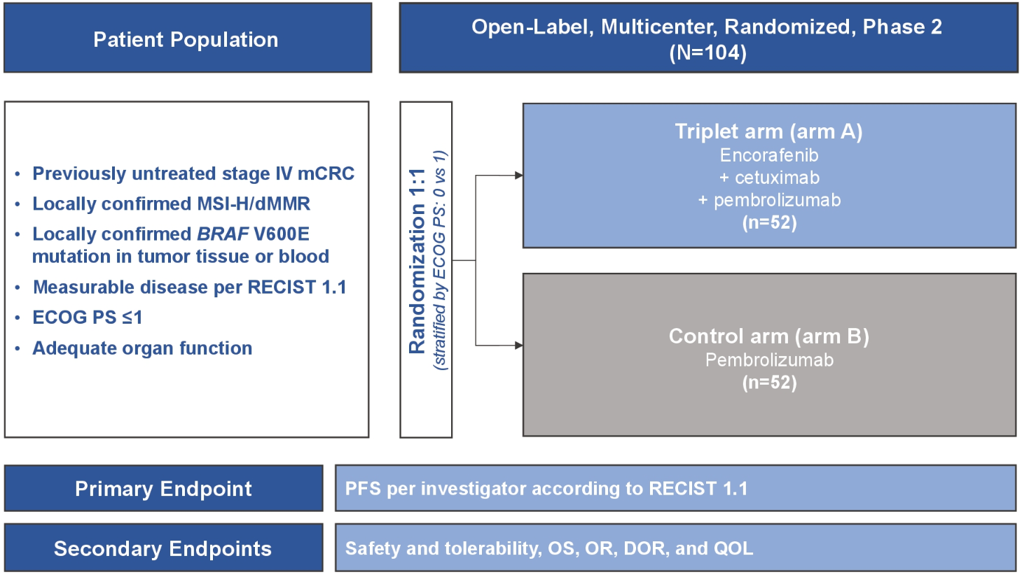
On the horizon for untreated dMMR/MSI-H and
BRAF-MUTANT mCRC
BRAFV600-mutant
MSI-H or dMMR
~30%
Accrual completed
NCT05217446
dMMR, deficient mismatch repair; DOR, duration of response; ECOG PS, Eastern Cooperative Oncology Group performance status; mCRC, metastatic colorectal cancer; MSI-H, microsatellite instability-high; OR, objective response; OS, overall survival; PFS, progression-free survival; QOL, quality of life; RECIST, Response Evaluation Criteria in Solid Tumours
Kopetz S, et al. J Clin Oncol. 2022;40(16_suppl; abstract TPS3634) [ASCO 2022; oral presentation]

Slide 16
BEACON: Enco/Cet vs SOC in pre-treated BRAF-MUTANT mCRC
OVERALL SURVIVAL RESULTSª
ENCO/BINI/CET vs control
ENCO/CET vs control
1.0
 | ENCO/BINI/ CET | Control
No. of events | 137 | 157
Median OS, mo (95% CI) | 9.3 (8.2-10.8) | 5.9 (5.1-7.1)
HR (95% CI) | 0.60 (0.47-0.75)
1.0
 | ENCO/CET | Control
No. of events | 128 | 157
Median OS, mo (95% CI) | 9.3 (8.0-11.3) | 5.9 (5.1-7.1)
HR (95% CI) | 0.61 (0.48-0.77)
0.9
0.9
0.8
0.8
0.7
0.7
0.6
0.6
Probability of survival
Probability of survival
0.5
0.5
0.4
0.4
0.3
0.3
0.2
0.2
0.1
0.1
0.0
0.0
0
3
6
9
12
15
18
21
24
27
0
3
6
9
12
15
18
21
24
27
Time (months)
Time (months)
No. at risk
ENCO/BINI/CET
Control
No. at risk
ENCO/CET
Control
224
221
198
166
157
98
89
54
56
33
33
15
15
6
9
2
4
0
0
0
220
221
197
166
143
98
83
54
47
33
28
15
13
6
7
2
2
0
0
0
Objective response rate
Confirmed response by blinded central review | ENCO/BINI/ CET (triplet) N=224 | ENCO/CET (doublet) N=220 | Control N=221
Objective response rate, % | 27% | 20% | 2%
95% CI | 21%, 33% | 15%, 25% | <1%, 5%
p value vs control | <0.0001 | <0.0001 | NA
ª Median follow-up: 12.8 months
BINI, binimetinib; CET, cetuximab; CI, confidence interval; ENCO, encorafenib; HR, hazard ratio; mCRC, metastatic colorectal cancer; mo, months; NA, not applicable; OS, overall survival; SOC, standard of care
Tabernero J, et al. J Clin Oncol. 2021;39:273-284

Slide 17








Confirmatory real-world evidence: findings consistent with the BEACON trial, for EC treatment in BRAF-mutated CRC
BEACON Efficacy Findings (doublet therapy)
Median PFS: 4.3 months; median OS: 9.3 months
BERING CRC (N=150)
(3 Sep 2020 to 26 Apr 2024; ongoing)¹
CONFIDENCE (N=81)
(Mar to Jul 2022)²
B-REAL, an AGEO study (N=201)
(Jan 2020 to Jun 2022)³
Encorafenib + cetuximab (n=141; FAS)
Encorafenib + cetuximab (N=81)
Encorafenib + cetuximab (n=176)
12.6
(8.0, 17.3)
9.5
(7.8, 10.6)
9.1
(7.6, 10.6)
5.2
(4.5, 5.5)
5.0
(3.8, 6.2)
4.5
(3.8, 5.4)
AGEO, Association des Gastro-Entérologues Oncologues; CI, confidence interval; FAS, full analysis set; (m)OS, (median) overall survival; (m)PFS, (median) progression-free survival
1. Stintzing S, et al. Annals of Oncology (2025) 36 (suppl_1): S1-S65. 10.1016/annonc/annonc1820 (ESMO GI 2025; poster presentation); 2; Fernandez Montes A, et al. ESMO Real World Data and Digital Oncology 2024; 5:100055; 3. Gallois C, et al. ESMO Open 2024; 9: doi.org/10.1016/j.esmoop.2024.103696

Slide 18
Confirmatory real-world evidence: findings consistent with the BEACON trial, for EC treatment in BRAF-mutated CRC
Retrospective, Longitudinal, Pooled Analysis
Results from pooled dataset (N=709)
(BERING CRC, B-REAL, CATAMARAN, CONFIDENCE, GONO Cohort)
Encorafenib + cetuximab (n=709)
9.0
(8.0, 9.9)
mOS (95% CI),
months
mPFS (95% CI),
months
5.0
(4.7, 5.3)
CI, confidence interval; EC, encorafenib +cetuximab; (m)OS, (median) overall survival; (m)PFS, (median) progression-free survival
Cremolini C, et al. Ann Oncol. 2025;36(supplement 1: S23-S24) [ESMO GI 2025; poster presentation]

Slide 19
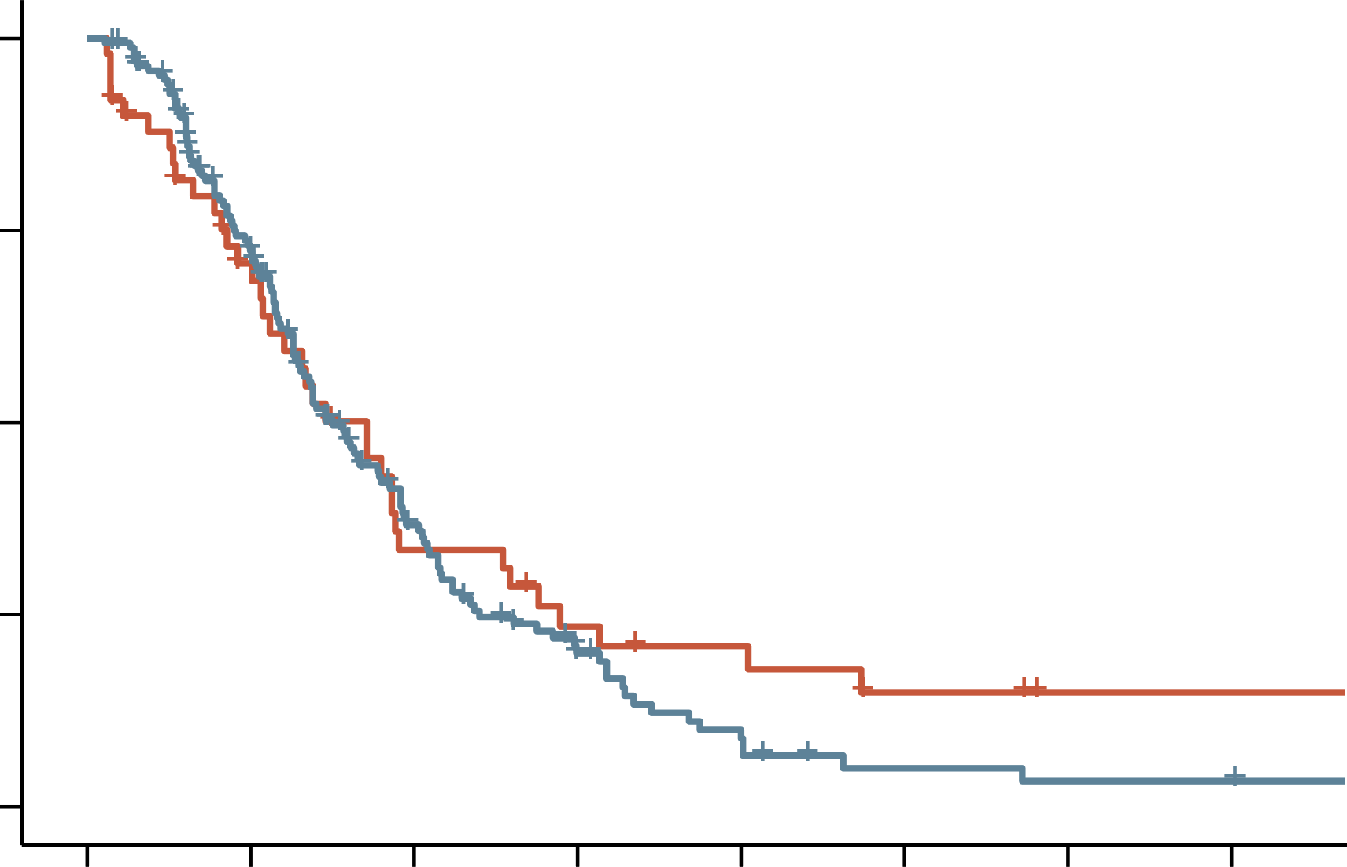
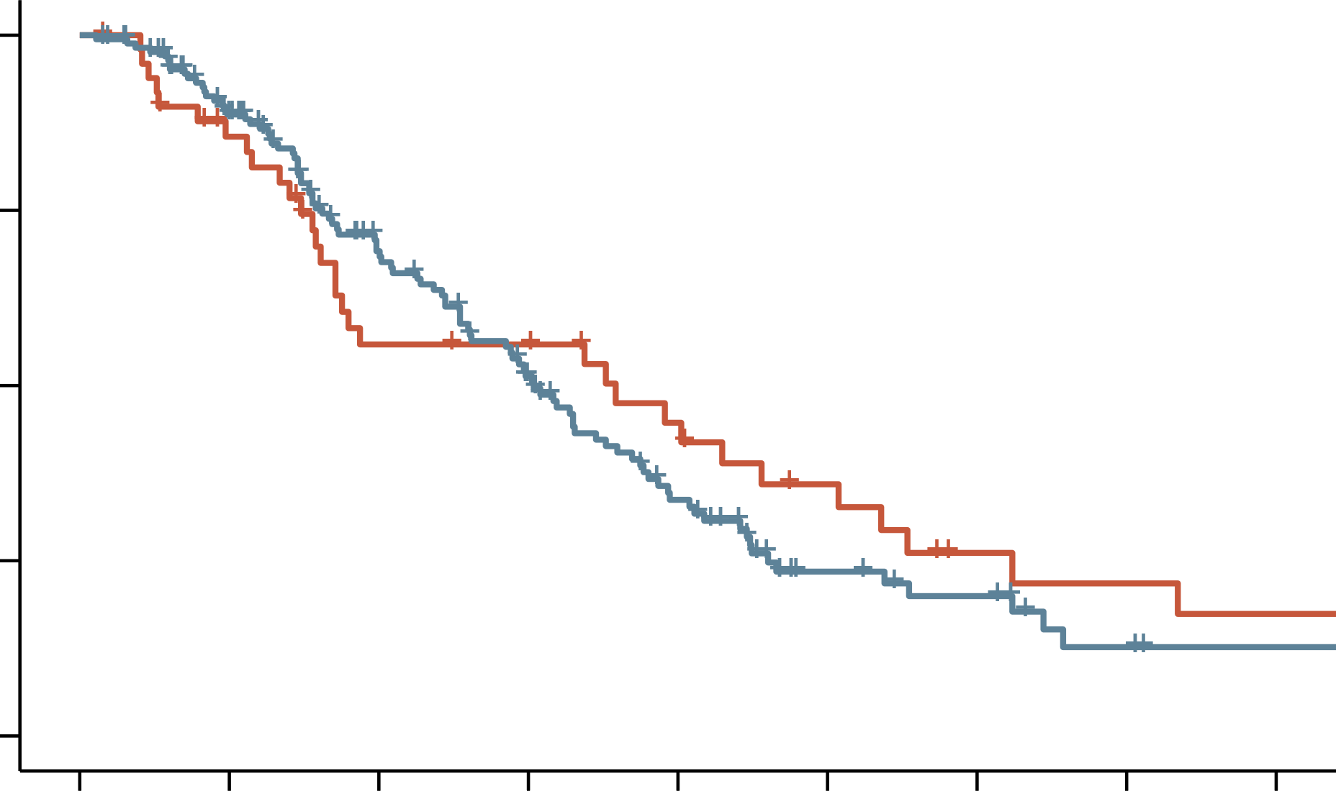
BRAFi + EGFRi ± MEKi following ICIs in BRAF-MUTANT and dMMR/MSI-H mCRC^{1,2}
1.00
 | pMMR/MSS | dMMR/MSI-H
Median PFS, mo (95% CI) | 4.50 (3.91-5.75) | 5.13 (3.35-7.63)
HR (95% CI) | 0.83 (0.57-1.20) P=0.31
B-REAL and AGEO-IMMUNODIG MSI, AGEO studies (N=220) (Jan 2017 to Jan 2024)
0.75
PFS (%)
0.50
 | BRAFV600E-mut pMMR/MSS (n=170) | BRAFV600E-mut dMMR/MSI-H (n=50) | HR (95% CI) | p value
ORR, % | 32 | 18 |  | 0.09
DCR, % | 73 | 60 |  | 0.11
mPFS, months | 4.50 | 5.13 | 0.83 | 0.31
mOS, months | 9.11 | 10.75 | 0.89 | 0.55
0.25
dMMR/MSI-H
pMMR/MSS
0.00
0
3
6
9
12
15
18
21
No. at risk
pMMR/MSS
dMMR/MSI-H
Time (months)
170
50
110
31
46
14
19
9
8
7
3
4
2
2
2
2
1.00
 | pMMR/MSS | dMMR/MSI-H
Median OS, mo (95% CI) | 9.11 (7.82-11.08) | 10.75 (5.26-16.08)
HR (95% CI) | 0.89 (0.59-1.32) P=0.55
0.75
OS (%)
0.50
0.25
dMMR/MSI-H
AGEO, Association des Gastro-Entérologues Oncologues; BRAFi, BRAF inhibitor; CI, confidence interval;
BRAFi, BRAF inhibitor; DCR, disease control rate; d/pMMR, deficient/proficient mismatch repair; EGFRi, EGFR inhibitor; HR, hazard ratio; ICI, immune checkpoint inhibitor; mCRC, metastatic colorectal cancer; MEKi, MEK inhibitor; MSI-H, microsatellite instability-high;
(m)OS, (median) overall survival; (m)PFS, (median) progression-free survival; MSS, microsatellite stability; mut, mutant; ORR, overall response rate
1. Ambrosini M, et al. Ann Oncol. 2024;35(Supplement 1; S32) [ESMO GI Congress 2024; poster presentation]; 2. Ambrosini M, et al. Eur J Cancer. 2024;210:114290
0.00
pMMR/MSS
0
3
6
9
12
15
18
21
24
No. at risk
pMMR/MSS
dMMR/MSI-H
Time (months)
170
50
135
39
88
24
59
23
34
16
15
11
11
6
5
5
3
4

Slide 20
Continuum of care for BRAFV600E-MUTANT mCRC patients
BRAFV600E-mutant mCRC
dMMR/MSI-H
(30%)
pMMR/MSS
(70%)
1st line
Ipilimumab/nivolumab
FOLFOX/encorafenib/cetuximab
2nd line
Encorafenib/cetuximab
FOLFIRI/anti-angiogenesis
3rd line
Chemotherapy/anti-angiogenesis
FTD-TPI/bevacizumab
d/pMMR, deficient/proficient mismatch repair; FOLFIRI, fluorouracil / leucovorin / irinotecan; FOLFOX, fluorouracil / leucovorin / oxaliplatin; FTD-TPI, trifluridine-tipiracil; mCRC, metastatic colorectal cancer; MSI-H, microsatellite instability-high; MSS, microsatellite stable
Cremolini C. Personal communication.

