Slide 2
advanced hcc: treatment strategies for patients ineligible for IO or those with progression on IO micro learning
Assoc. Prof. Lorenza Rimassa, MD
Humanitas University and IRCCS Humanitas Research Hospital, Italy
Dr Amit Singal, MD, MS
UT Southwestern Medical Center, USA
JUNE 2025

Slide 3


Developed by HCC COnnect
This programme is developed by HCC CONNECT,
an international group of experts in the field of
hepatocellular carcinoma and brought to you alongside
GI CONNECT, an international group of experts in the
field of gastrointestinal oncology.
Acknowledgement and disclosures
This educational programme is supported through an independent educational grant from Bayer. The programme is therefore independent, the content is not influenced by the supporter and is under the sole responsibility of the experts.
Please note:
This educational programme is intended for healthcare professionals only
The views expressed within this programme are the personal opinions of the experts. They do not necessarily represent
the views of the experts’ academic institutions, organisations, or the rest of the HCC CONNECT and GI CONNECT groups.
Expert disclosures:
Assoc. Prof. Lorenza Rimassa has received financial support/sponsorship for research support, consultation, or speaker
fees from the following companies: AbbVie, AstraZeneca, Basilea, Bayer, BeiGene, BMS, Eisai, Elevar Therapeutics, Exelixis, Fibrogen, Genenta, Guerbet, Hengrui, Incyte, Ipsen, Jazz Pharmaceuticals, MSD, Nerviano Medical Sciences, Roche, Servier, Taiho Oncology, TransThera Sciences, Zymeworks
Dr Amit Singal has received financial support/sponsorship for research support, consultation, or speaker fees from the
following companies: Abbott, AstraZeneca, Bayer, Boston Scientific, DELFI, Eisai, Elevar, Exact Sciences, Exelixis,
FujiFilm Medical Sciences, Genentech, Glycotest, HelioGenomics, HistoSonics, ImCare, Merck, Roche, Sirtex and Universal DX

Slide 4


This programme has been developed by a Group of experts
Assoc. Prof. Lorenza Rimassa
Humanitas University and IRCCS Humanitas Research Hospital, Italy
Dr Amit Singal
UT Southwestern Medical Center, USA

Slide 5
Key clinical takeaways
Advanced hcc: strategies for patients ineligible for IO or those with progression on IO
For patients with HCC who are ineligible for IO, the tyrosine kinase inhibitors (TKIs) sorafenib and lenvatinib remain the recommended 1st line treatment options
After progression on 1st line IO, multiple treatment strategies are available. If a clinical trial is not available, switching to a TKI, or considering alternative IO-based approaches may be viable options based on patient eligibility, disease factors, and local availability
Post-IO progression, two main approaches involving TKIs are available: focusing on 1st line TKIs (sorafenib or lenvatinib) or expanding to all available 2nd line options (sorafenib, lenvatinib, regorafenib, cabozantinib, and ramucirumabª)
There are limited prospective data available on treatment outcomes following progression
on 1st line IO therapies. To address this gap, patients should be referred to clinical trials whenever possible to help establish evidence-based sequencing strategies
Transition to 2nd line therapy should be considered after radiologic or clinical progression, with attention to the patient’s clinical condition and liver function
ª If serum α-fetoprotein (AFP) levels ≥400 ng/mL
HCC, hepatocellular carcinoma; IO, immuno-oncology (therapy); mRECIST, modified Response Evaluation Criteria in Solid Tumours

Slide 6
1st line systemic treatment options for patients with HCC
Ineligible for IO 1st line
HCC, hepatocellular carcinoma; IO, immuno-oncology (therapy)

Slide 7
systemic treatment options for patients with HCC
IMMUNOTHERAPY (IO)¹
TYROSINE KINASE INHIBITORS (TKIs)²
PD-L1 binds to PD-1 and inhibits
T cell killing of tumour cell
Blocking PD-L1 or PD-1 allows
T cell killing of tumour cell
GF
GF
EGFR, VEGFR, PDGFR, ABL, SCR…
GF
GF
Tyrosine kinase
receptor
Cell
membrane
Tumour cell
Tumour cell death
TKI
TKI
ATP
ATP
TKI
PD-L1
Antigen
PD-L1
PD-1
T cell
receptor
Anti-PD-L1
MAPK
JAK/STAT
PI3K/AKT
Signalling
pathways
Anti-
PD-1
PD-1
T cell
T cell
Metastasis, angiogenesis,
cell proliferation
Figure adapted from Terese Winslow LLC
Figure adapted from Gabora K, et al.
ABL, Abelson tyrosine kinase family; AKT, protein kinase B; ATP, adenosine triphosphate; EGFR, endothelial growth factor receptor; GF, growth factor;
JAK, Janus kinase protein; MAPK, mitogen-activated protein kinase; PD-1, programmed death 1; PDGFR, platelet-derived growth factor receptor;
PD-L1, programmed death ligand 1; PI3K, phosphoinositide-3-kinase; SCR, SCR tyrosine kinase family; STAT, signal transducer and activation of
transcription protein; VEGFR, vascular endothelial growth factor receptor
1. Terese Winslow LLC. 2015. Available from: https://www.teresewinslow.com/#/cellular-scientific/ (accessed Jan 2025); 2. Gabora K, et al. Drug Metab Rev. 2019;51:562-569

Slide 8
1st line systemic Treatment strategy for patients with hcc
For Patients ineligible for IO THERAPIES, TKIs (sorafenib, lenvatinib) recommended as 1st line treatment
DISEASE STAGE^{1,2}
Patients with advanced stage HCC (BCLC C, portal invasion and/or extrahepatic spread) or
intermediate state HCC (BCLC B, multinodular progressing upon loco-regional therapies or
not candidates for logo-regional therapies. Child-Pugh A and ECOG PS 0 or 1). Well-preserved liver function²
Suitable for ICI therapy?
Yes
No
Atezolizumab + bevacizumab [I, A]^{1,2,a}
1st line options
Tremelimumab + durvalumab [I, A]²
Sorafenib [I, A] or lenvatinib [I, A]²
Ipilimumab + nivolumab [I, B]^{2,3}
Durvalumab [I, A]^{2,b}
ª In patients with portal hypertension, screening for varices is strongly recommended before initiation of atezolizumab-bevacizumab²
^{b} Patients who have contraindications to ICI combination therapies (not FDA-approved)
BCLC, Barcelona Clinic Liver Cancer; ECOG PS, Eastern Cooperative Oncology Group performance status; FDA, Food and Drug Administration; HCC, hepatocellular carcinoma; ICI, immune checkpoint inhibitor; IO, immuno-oncology; TKI, tyrosine kinase inhibitor
1. Reig M, et al. J Hepatol. 2022;76:681-693; 2. Vogel A, et al. Ann Oncol. 2025 (article in press; https://doi.org/10.1016/j.annonc.2025.02.006); 3. Nivolumab Plus Ipilimumab Receives EC Approval for First-Line Unresectable HCC. Available here (accessed March 2025)

Slide 9
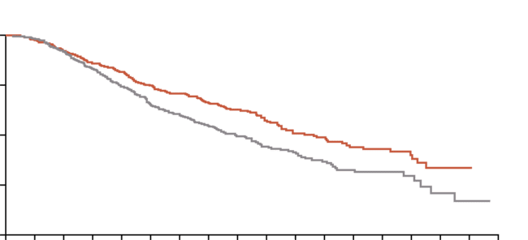
1st line TKI: sorafenib
Median overall survival and time to progression were nearly 3 months longer for patients treated with sorafenib than for those given placebo
Overall survival
Incidence of drug-related adverse events (safety population)ª
Adverse event, % | Sorafenib (N=297) |  |  | Placebo (N=302)
 | Any grade | Grade 3 | Grade 4 | Any grade | Grade 3 | Grade 4
Overall incidence | 80 |  |  | 52
Constitutional symptoms Fatigue Weight loss | 22 9 | 3 2 | 1 0 | 16 1 | 3 0 | <1 0
Dermatologic events Alopecia Dry skin Hand–foot skin reaction Pruritus Rash or desquamation Other | 14 8 21 8 16 5 | 0 0 8 0 1 1 | 0 0 0 0 0 0 | 2 4 3 7 11 1 | 0 0 <1 <1 0 0 | 0 0 0 0 0 0
Gastrointestinal events Anorexia Diarrhoea Nausea Vomiting | 14 39 11 5 | <1 8 <1 1 | 0 0 0 0 | 3 11 8 3 | 1 2 1 1 | 0 0 0 0
Voice changes | 6 | 0 | 0 | 1 | 0 | 0
Hypertension | 5 | 2 | 0 | 2 | 1 | 0
Liver dysfunction | <1 | <1 | 0 | 0 | 0 | 0
Abdominal pain not otherwise specified | 8 | 2 | 0 | 3 | 1 | 0
Bleeding | 7 | 1 | 0 | 4 | 1 | <1
ª Listed are adverse events, as defined by the National Cancer Institute Common Terminology Criteria (version 3.0), 5% of patients in either study group.
1.00
0.75
Probability of survival
0.50
Sorafenib
0.25
p<0.001
Placebo
0.00
0
1
2
3
4
5
6
7
8
9
10
11
12
13
14
15
16
17
No. at risk
Sorafenib
Placebo
Months since randomisation
299
303
290
295
270
272
249
243
234
217
213
189
200
174
172
143
140
108
111
83
89
69
68
47
48
31
37
23
24
14
7
6
1
3
0
0
Median OS was 10.7 months in the sorafenib group and 7.9 months in the placebo group (HR in the sorafenib group, 0.69; 95% CI, 0.55 to 0.87; p<0.001)
CI, confidence interval; HR, hazard ratio; OS, overall survival; TKI, tyrosine kinase inhibitor
Llovet JM, et al. N Engl J Med. 2008;359;378-390

Slide 10
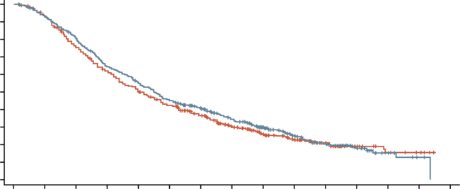
1st line TKI: lenvatinib
LENVATINIB was non-inferior to sorafenib in overall survival in patients with untreated advanced hcc
TEAEs occurring in ≥15% of patients in either arm
Overall survival
Adverse event, n (%) | Lenvatinib (N=476) |  | Sorafenib (N=475)
 | Any grade | Grade ≥3 | Any grade | Grade ≥3
Palmar-plantar erythrodysaesthesia | 128 (26.9) | 14 (2.9) | 249 (52.4) | 54 (11.4)
Diarrhoea | 184 (38.7) | 20 (4.2) | 220 (46.3) | 20 (4.2)
Hypertension | 201 (42.2) | 111 (23.3) | 144 (30.3) | 68 (14.3)
Decreased appetite | 162 (34.0) | 22 (4.6) | 127 (26.7) | 6 (1.3)
Decreased weight | 147 (30.9) | 36 (7.6) | 106 (22.3) | 14 (2.9)
Fatigue | 141 (29.6) | 18 (3.8) | 119 (25.1) | 17 (3.6)
Alopecia | 14 (2.9) | 0 (0) | 119 (25.1) | 0 (0)
Proteinuria | 117 (24.6) | 27 (5.7) | 54 (11.4) | 8 (1.7)
Dysphonia | 113 (23.7) | 1 (0.2) | 57 (12.0) | 0 (0)
Nausea | 93 (19.5) | 4 (0.8) | 68 (14.3) | 4 (0.8)
Abdominal pain | 81 (17.0) | 8 (1.7) | 87 (18.3) | 13 (2.7)
Decreased platelet count | 87 (18.3) | 26 (5.5) | 58 (12.2) | 16 (3.4)
Elevated aspartate aminotransferase | 65 (13.7) | 24 (5.0) | 80 (16.8) | 38 (8.0)
Hypothyroidism | 78 (16.4) | 0 (0) | 8 (1.7) | 0 (0)
Vomiting | 77 (16.2) | 6 (1.3) | 36 (7.6) | 5 (1.1)
Constipation | 76 (16.0) | 3 (0.6) | 52 (10.9) | 0 (0)
Rash | 46 (9.7) | 0 (0) | 76 (16.0) | 2 (0.4)
1.0
0.9
0.8
0.7
0.6
0.5
0.4
0.3
0.2
0.1
0.0
Median (month) (95% CI)
Lenvatinib: 13.6 (12.1-14.9)
Sorafenib: 12.3 (10.4-13.9)
HR (95% CI): 0.92 (0.79-1.06)
Probability
0
3
6
9
12
15
18
21
24
27
30
33
36
39
42
No. at risk
Lenvatinib
Sorafenib
Time (months)
478
476
436
440
374
348
297
282
253
230
207
192
178
156
140
116
102
83
67
57
40
33
21
16
8
8
2
4
0
0
Lenvatinib demonstrated a statistically significant improvement to sorafenib in all secondary efficacy endpoints (PFS, TTP, and ORR)
CI, confidence interval; HCC, hepatocellular carcinoma; HR, hazard ratio; ORR, objective response rate; PFS, progression-free survival; TEAE, treatment-emergent adverse event; TKI, tyrosine kinase inhibitor; TTP, time to progression
Kudo M, et al. Lancet. 2018;391:1163-1173

Slide 11
sequencing strategies, treatment options, and available data after progression on IO
IO, immuno-oncology (therapy)

Slide 12
SEQUENCING Strategies after progression on 1st line IO options, guidelines and approaches
IO, immuno-oncology (therapy)

Slide 13
options after progression on 1st line IO in HCC overview
Enrolment in a clinical trial
Switching to a TKI or anti-VEGFR-2
  T-1 approach
  Line-agnostic approach
Considering IO after IO approaches
Providing best supportive care for patients unsuitable for further systemic therapies
BCLC systemic treatment strategy¹
1st line
Atezolizumab-bevacizumab/durvalumab-tremelimumab
If not feasible sorafenib or lenvatinib or durvalumab²
2nd line
regorafenib
(sorafenib-tolerant)
cabozantinib
ramucirumab
(AFP ≥400 ng/mL)
Clinical
trials
Post sorafenib
Not
feasible
Post atezolizumab-bevacizumab
Post durvalumab-tremelimumab
Post lenvatinib or durvalumab²
Not feasible
3rd line
Not
feasible
Cabozantinib
AFP, α--fetoprotein; BCLC, Barcelona Clinic Liver Cancer; HCC, hepatocellular carcinoma; IO, immuno-oncology (therapy); TKI, tyrosine kinase inhibitor
1. Reig M, et al. J Hepatol. 2022;76:681-693; 2. Gordan JD, et al. J Clin Oncol. 2024;42:1830-1850

Slide 14
BCLC UpdATED treatment algorithm
HCC
Based on tumour burden,
liver function and
physical status
Refined by AFP, ALBI score,
Child-Pugh, MELD
Very early stage (0)
Single ≤2 cm
Preserved liver functionª, PS 0
Early stage (A)
Single, or ≤3 nodules each ≤3 cm
Preserved liver functionª, PS 0
Intermediate stage (B)
Multinodular
Preserved liver functionª, PS 0
Advanced stage (C)
Portal invasion and/or extrahepatic spread
Preserved liver function, PS 1-2
Terminal stage (D)
Any tumour burden
End stage liver function, PS 3-4
Prognosis
To decide individualised
treatment approach
Potential candidate
for liver
transplantation
Single
≤3 nodules,
each ≤3 cm
Extended
liver transplant
criteria
(size, AFP)
Well defined
nodules, preserved
portal flow,
selective access
Diffuse, infiltrative,
extensive
bilobar liver
involvement
Portal pressure, bilirubin
Patient characterisation
No
Yes
Normal
Increased^{b}
Contraindications
to LT
Yes^{b}
No
1st treatment option
Ablation
Resection
Ablation
Transplant
TACE
Systemic treatment
BSC
Expected survival
>5 years
>2.5 years
>2 years
3 months
Treatment stage migration
Primes lower priority
options due to non-liver
related clinical profile
(Age, comorbidities, patient
values and availability)
1st Line
Not feasible or failure
Successful
downstaging
Atezolizumab-bevacizumab/durvalumab-tremelimumab
If not feasible sorafenib or lenvatinib or durvalumab
2nd Line
regorafenib
(sorafenib-tolerant)
cabozantinib
ramucirumab
(AFP ≥400 ng/mL)
Clinical
trials
Not
feasible
or failure
Not
feasible
Clinical decision-making
TACE
Radioembolisation (only for single lesion ≤8 cm)
Post sorafenib
Post atezolizumab-bevacizumab
Post durvalumab-tremelimumab
Post lenvatinib or durvalumab
Not feasible
Alternative
sequences may
be considered
but they have not
been proved
3rd Line
Cabozantinib
Not
feasible
ª Except for those with tumour burden acceptable for transplant
^{b} Resection may be considered for single peripheral HCC with adequate remnant liver volume
AFP, α-fetoprotein; ALBI, albumin-bilirubin; BCLC, Barcelona Clinic Liver Cancer; BSC, best supportive care; HCC, hepatocellular carcinoma; LT, liver transplantation; MELD, model of end-stage liver disease; PS, performance status; TACE, transarterial chemoembolisation
Reig M, et al. J Hepatol. 2022;76:681-93

Slide 15
Hcc esmo guidelines management of advanced hcc¹
Systemic treatment for advanced HCCª
BCLC B-C^{b}
BCLC D
Suitable for
ICI therapy
Not suitable for
ICI therapy
BSC (including SBRT for pain management) III, A]
Atezolizumab–bevacizumab [I, A; MCBS 5]^{c}
Durvalumab–tremelimumab [I, A; MCBS 5]^{c}
Camrelizumab–rivoceranib^{d} [I, B]
Nivolumab–ipilimumab^{d} [I, B]
Durvalumab^{e, f} [I, A; MCBS 4]^{c}
Tislelizumab^{d,e} [I, A]
Lenvatinib [I, A]^{g}
Sorafenib [I, A; MCBS 3]^{c}
Following first-line
lenvatinib
Following first-line
sorafenib
Lenvatinib^{h} [IV, A]
Regorafenib^{i} [IV, A]
Cabozantinib^{j} [IV, A]
Sorafenib [IV, B; MCBS 3]^{c}
Ramucirumab (AFP ≥400 ng/ml)^{i} [IV, B]
Sorafenib [IV, A; MCBS 3]^{c}
Regorafenib^{i} [IV, A]
Cabozantinib^{j} [IV, A]
Ramucirumab
(AFP ≥400 ng/ml)^{i} [IV, B]
Regorafenib [I, A; MCBS 4]^{c}
Cabozantinib [I, A; MCBS 3]^{c}
Ramucirumab (AFP
≥400 ng/ml) [I, B; MCBS 1]^{c}
AFP, α-foetoprotein; BCLC, Barcelona Clinic Liver Cancer; BSC, best supportive care; ECOG PS, Eastern Cooperative Oncology Group performance status; EMA, European Medicines Agency; ESMO, European Society for Medical Oncology; FDA, Food and Drug Administration; HCC, hepatocellular carcinoma; ICI, immune checkpoint inhibitor; MCBS, Magnitude of Clinical Benefit Scale; SBRT, stereotactic body radiotherapy
ª Locoregional therapies may be appropriate for selected patients ^{b} Patients with well-preserved liver function and ECOG PS 0-1 ^{c} ESMO-MCBS v1.1 was used to calculate scores for therapies/indications approved by the EMA or FDA. The scores have been calculated and validated by the ESMO-MCBS Working Group and reviewed by the authors (https://www.esmo.org/guidelines/esmo-mcbs/esmo-mcbs-for-solid-tumours/esmo-mcbs-evaluation-forms [accessed March 2025]). ^{d} Recently approved in Europe for 1st line unresectable HCC². ^{e} In patients with contraindications to ICI combinations. ^{f} EMA approved, not FDA approved. ^{g} Non-inferiority established versus sorafenib via ESMO-MCBS v1.1. ^{h} Not EMA or FDA approved for second-line use
1. Vogel A, et al. Ann Oncol. 2025 (article in press; https://doi.org/10.1016/j.annonc.2025.02.006); 2. Nivolumab Plus Ipilimumab Receives EC Approval for First-Line Unresectable HCC. Available here (accessed March 2025)

Slide 16
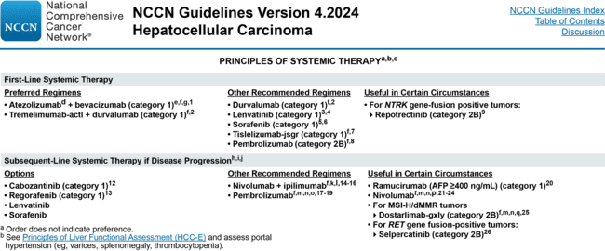
NCCN Guidelines
Principles of systemic therapy
NCCN Guidelines Version 4.2024, HCC. Available from: https://www.nccn.org/professionals/physician_gls/pdf/hcc.pdf (accessed February 2025)

Slide 17
t-1 approach: progression on 1st line io prior 1st line therapies (sorafenib and lenvatinib) are used as 2nd line therapies
Progression on 1st line IO
Durvalumab + tremelimumab
2nd line systemic therapy options
Or
Sorafenib
Or
Lenvatinib
Atezolizumab + bevacizumab
Prior 2nd line systemic therapies are reserved for 3rd line and beyond
Regorafenib
Cabozantinib
Ramucirumabª
Nivolumab
+ ipilimumab^{b}
Or
Or
Or
ª If AFP ≥400 ng/mL
^{b} Nivolumab + ipilimumab is approved for 2nd line after progression on sorafenib based on Phase 2 CheckMate 040 data in the US (Saung et al.¹)
AFP, α-fetoprotein; IO, immuno-oncology (therapy); US, United States
1. Saung MT, et al. Oncologist. 2021;26:797-806

Slide 18
Line-agnostic approach: progression on 1st line io
One is agnostic to prior lines of approval
Progression on 1st line IO
Durvalumab + tremelimumab
2nd line systemic therapy options
Or
Sorafenib
Or
Lenvatinib
Atezolizumab + bevacizumab
2nd line systemic therapy options as per off-label availability
Regorafenib
Cabozantinib
Ramucirumabª
Nivolumab
+ ipilimumab^{b}
Or
Or
Or
In this approach, one is agnostic to prior lines of approval and one can choose from any of the regimens for 2nd line based on multiple clinical factors including patient performance status, tumour burden, liver dysfunction, response to 1st line therapy, patient preference, and local availability
ª If AFP ≥400 ng/mL
^{b} nivolumab + ipilimumab is approved for 2nd line after progression on sorafenib based on Phase 2 CheckMate 040 data in the US (Saung et al.¹)
1L, first-line, 2L, second-line; AFP, α-fetoprotein; IO, immuno-oncology (therapy); US, United States
Saung MT, et al. Oncologist. 2021;26:797-806

Slide 19
2nd line treatment options regorafenib, cabozantinib and ramucirumab

Slide 20
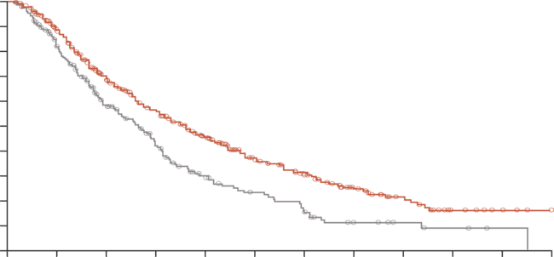
2nd line tkis: REGORAFENIB (RESORCE)
Regorafenib showed survival benefit in patients with hcc progressing on sorafenib¹
TEAEs occurring in ≥10% of patients in either arm
100
Overall survival
Adverse event, n (%) | Regorafenib (N=374) |  |  | Placebo (N=193)
 | Any grade | Grade 3 | Grade 4 | Any grade | Grade 3 | Grade 4
Any adverse event | 374 (100) | 208 (56) | 40 (11) | 179 (93) | 61 (32) | 14 (7)
Hand-foot skin reaction | 198 (53) | 47 (13) | NA | 15 (8) | 1 (1) | NA
Diarrhoea | 155 (41) | 12 (3) | 0 | 29 (15) | 0 | 0
Fatigue | 151 (40) | 34 (9) | NA | 61 (32) | 9 (5) | NA
Hypertension | 116 (31) | 56 (15) | 1 (<1) | 12 (6) | 9 (5) | 0
Anorexia | 116 (31) | 10 (3) | 0 | 28 (15) | 4 (2) | 0
Increased blood bilirubin | 108 (29) | 37 (10) | 2 (1) | 34 (18) | 15 (8) | 6 (3)
Abdominal pain | 105 (28) | 13 (3) | NA | 43 (22) | 8 (4) | NA
Increased AST | 92 (25) | 37 (10) | 4 (1) | 38 (20) | 19 (10) | 3 (2)
Fever | 72 (19) | 0 | 0 | 14 (7) | 0 | 0
Nausea | 64 (17) | 2 (1%) | NA | 26 (13) | 0 | NA
Constipation | 65 (17) | 1 (<1) | 0 | 22 (11) | 1 (1) | 0
Ascites | 58 (16) | 16 (4) | 0 | 31 (16) | 11 (6) | 0
Anaemia | 58 (16) | 16 (4) | 2 (1) | 22 (11) | 10 (5) | 1 (1)
Limb oedema | 60 (16) | 2 (1) | NA | 24 (12) | 0 | NA
Increased ALT | 55 (15) | 10 (3) | 2 (1) | 22 (11) | 5 (3) | 0
Hypoalbuminaemia | 57 (15) | 6 (2) | 0 | 16 (8) | 1 (1) | 0
General disorders and administration site conditions, other | 53 (14) | 16 (4) | 2 (1) | 29 (15) | 6 (3) | 3 (2)
Weight loss | 51 (14) | 7 (2) | NA | 9 (5) | 0 | NA
Oral mucositis | 47 (13) | 4 (1) | 0 | 6 (3) | 1 (1) | 0
Vomiting | 47 (13) | 3 (1) | 0 | 13 (7) | 1 (1) | 0
Investigations, other | 40 (11) | 4 (1) | 0 | 11 (6) | 1 (1) | 0
Back pain | 42 (11) | 6 (2) | 1 (<1) | 17 (9) | 2 (1) | 0
Thrombocytopenia | 39 (10) | 13 (3) | 1 (<1) | 5 (3) | 0 | 0
Cough | 40 (11) | 1 (<1) | NA | 14 (7) | 0 | NA
Hypophosphataemia | 37 (10) | 30 (8) | 2 (1) | 4 (2) | 3 (2) | 0
Hoarseness | 39 (10) | 0 | NA | 1 (1) | 0 | NA
Adverse events were graded using NCI-CTCAE version 4.03.
90
80
70
60
Probability of survival (%)
50
40
Placebo
30
Regorafenib
20
10
HR: 0.63 (95% CI 0.50-0.79);
one-sided p<0.0001
0
0
3
6
9
12
15
18
21
24
27
30
33
No. at risk
Regorafenib
Placebo
Months since randomisation
379
194
316
149
224
95
170
62
122
37
78
26
54
16
34
8
21
5
10
3
4
1
0
0
REFINE studied the real-world dosing of regorafenib in patients with unresectable hepatocellular carcinoma (uHCC). Safety was consistent with RESORCE²
The safety of regorafenib as second-line therapy for patients who were not included in the RESORCE trial was verified in the Phase 2 REGAIN trial, which included post lenvatinib and post atezolizumab + bevacizumab3
ALT, alanine transaminase; AST, aspartate transaminase; CI, confidence interval; HCC, hepatocellular carcinoma; HR, hazard ratio; NA, not applicable; NCI CTCAE, National Cancer Institute Common Terminology Criteria for Adverse Events; OS, overall survival; TEAE, treatment-emergent adverse event; TKI, tyrosine kinase inhibitor (u)HCC, (unresectable) hepatocellular carcinoma
1. Bruix J, et al. Lancet. 2017;389:56-66; 2. Finn RS, et al. J Clin Oncol. 2023;41 (no. 4 suppl):518 (presented at ASCO GI Cancer Symposium); 3. Koroki K, et al. Presented at ILCA 2023. Poster P-97

Slide 21
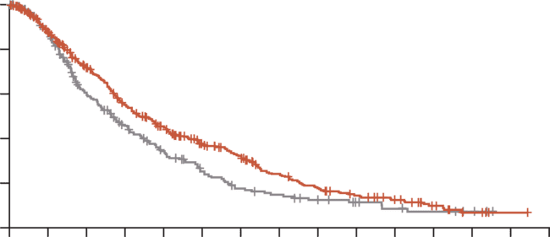
2nd line tkis: CABOZANTINIB (CELESTIAL)
Cabozantinib showed survival benefit in patients with hcc previously treated with sorafenib including those who had received up to two prior systemic therapies
Adverse events occurring in ≥10% of patients in either arm
Overall survival
Event, n (%) | Cabozantinib (N=467) |  |  | Placebo (N=237)
 | Any grade | Grade 3 | Grade 4 | Any grade | Grade 3 | Grade 4
Any adverse event | 460 (99) | 270 (58) | 46 (10) | 219 (92) | 80 (34) | 6 (3)
Diarrhoea | 251 (54) | 45 (10) | 1 (<1) | 44 (19) | 4 (2) | 0
Decreased appetite | 225 (48) | 27 (6) | 0 | 43 (18) | 1 (<1) | 0
Palmar-plantar erythrodysesthesia | 217 (46) | 79 (17) | 0 | 12 (5) | 0 | 0
Fatigue | 212 (45) | 49 (10) | 0 | 70 (30) | 10 (4) | 0
Nausea | 147 (31) | 10 (2) | 0 | 42 (18) | 4 (2) | 0
Hypertension | 137 (29) | 73 (16) | 1 (<1) | 14 (6) | 4 (2) | 0
Vomiting | 121 (26) | 2 (<1) | 0 | 28 (12) | 6 (3) | 0
Increased AST | 105 (22) | 51 (11) | 4 (1) | 27 (11) | 15 (6) | 1 (<1)
Asthenia | 102 (22) | 31 (7) | 1 (<1) | 18 (8) | 4 (2) | 0
Dysphonia | 90 (19) | 3 (1) | 0 | 5 (2) | 0 | 0
Constipation | 87 (19) | 2 (<1) | 0 | 45 (19) | 0 | 0
Abdominal pain | 83 (18) | 7 (1) | 1 (<1) | 60 (25) | 10 (4) | 0
Weight loss | 81 (17) | 5 (1) | 0 | 14 (6) | 0 | 0
Increased ALT | 80 (17) | 23 (5) | 0 | 13 (5) | 5 (2) | 0
Mucosal inflammation | 65 (14) | 8 (2) | 0 | 5 (2) | 1 (<1) | 0
Pyrexia | 64 (14) | 0 | 0 | 24 (10) | 1 (<1) | 0
Upper abdominal pain | 63 (13) | 3 (1) | 0 | 31 (13) | 0 | 0
Cough | 63 (13) | 1 (<1) | 0 | 26 (11) | 0 | 0
Peripheral edema | 63 (13) | 4 (1) | 0 | 32 (14) | 2 (1) | 0
Stomatitis | 63 (13) | 8 (2) | 0 | 5 (2) | 0 | 0
Dyspnea | 58 (12) | 15 (3) | 0 | 24 (10) | 1 (<1) | 0
Rash | 58 (12) | 2 (<1) | 0 | 14 (6) | 1 (<1) | 0
Ascites | 57 (12) | 17 (4) | 1 (<1) | 30 (13) | 11 (5) | 0
Dysgeusia | 56 (12) | 0 | 0 | 5 (2) | 0 | 0
Hypoalbuminemia | 55 (12) | 2 (<1) | 0 | 12 (5) | 0 | 0
Headache | 52 (11) | 1 (<1) | 0 | 16 (7) | 1 (<1) | 0
Thrombocytopenia | 52 (11) | 16 (3) | 0 | 1 (<1) | 0 | 0
Insomnia | 49 (10) | 1 (<1) | 0 | 17 (7) | 0 | 0
Dizziness | 48 (10) | 2 (<1) | 0 | 15 (6) | 0 | 0
Dyspepsia | 47 (10) | 0 | 0 | 7 (3) | 0 | 0
Anaemia | 46 (10) | 18 (4) | 1 (<1) | 19 (8) | 12 (5) | 0
Back pain | 46 (10) | 5 (1) | 0 | 24 (10) | 1 (<1) | 0
Increase in serum bilirubin | 45 (10) | 10 (2) | 4 (1) | 17 (7) | 2 (1) | 2 (1)
Decrease in platelet count | 45 (10) | 13 (3) | 4 (1) | 7 (3) | 2 (1) | 0
* Listed are adverse events, regardless of causality. Severity was graded according to National Cancer Institute Common Terminology Criteria for Adverse Events, version 4.0.
 | No. of patients | Median OS mo (95% CI) | No. of events
Cabozantinib | 470 | 10.2 (9.1-12.0) | 317
Placebo | 237 | 8.0 (6.8-9.4) | 167
1.0
0.8
Hazard ratio for death, 0.76 (95% CI, 0.63-0.92)
p=0.005
0.6
Probability of overall survival
0.4
0.2
Cabozantinib
Placebo
0.0
0
3
6
9
12
15
18
21
24
27
30
33
36
39
42
No. at risk
Cabozantinib
Placebo
Months
470
237
328
190
281
117
206
82
159
57
116
37
93
25
63
20
44
15
31
10
22
7
12
5
4
3
1
0
0
0
CI, confidence interval; HCC, hepatocellular carcinoma; mo, months;
OS, overall survival; TKI, tyrosine kinase inhibitor
Abou-Alfa GK, et al. N Engl J Med. 2018;379:54-63

Slide 22
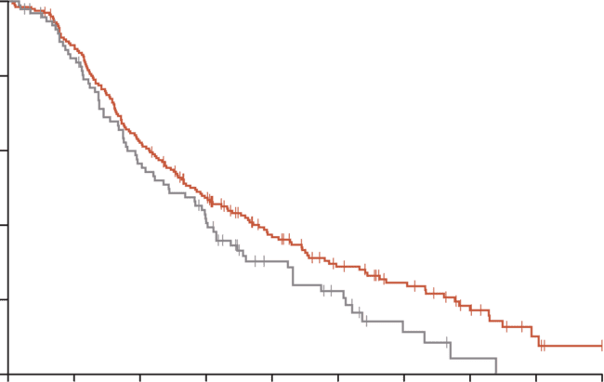
2nd line anti-VEGFR-2: RAMUCIRUMAB (REACH-2)
RAMUCIRUMAB SHOWED improved overall survival compared with placebo in patients with hCC and elevated AFP (≥400 ng/mL) who had previously received sorafenib^{1,a}
TEAEs in ≥10% patients (either group)
Overall survival
Adverse event, n (%) | Ramucirumab group (any cause; N=197) |  |  |  | Placebo group (any cause; N=95)
 | Grades 1-2 | Grade 3 | Grade 4 | Grade 5 | Grades 1-2 | Grade 3 | Grade 4 | Grade 5
Fatigue | 47 (24) | 7 (4) | NA | NA | 13 (14) | 3(3) | NA | NA
Peripheral oedema | 47 (24) | 3 (2) | 0 | 0 | 13 (14) | 0 | 0 | 0
Decreased appetite | 43 (22) | 3 (2) | 0 | 0 | 18 (19) | 1 (1) | 0 | 0
Abdominal pain | 36 (18) | 3 (2) | NA | NA | 10 (11) | 2 (2) | NA | NA
Nausea | 37 (19) | 0 | NA | NA | 11 (12) | 0 | NA | NA
Diarrhoea | 32 (16) | 0 | 0 | 0 | 13 (14) | 1 (1) | 0 | 0
Headache | 28 (14) | 0 | NA | NA | 4 (4) | 1 (1) | NA | NA
Constipation | 26 (13) | 1 (1) | 0 | 0 | 18 (19) | 1 (1) | 0 | 0
Insomnia | 21 (11) | 0 | NA | NA | 5 (5) | 1 (1) | NA | NA
Pyrexia | 20 (10) | 0 | 0 | 0 | 3 (3) | 0 | 0 | 0
Vomiting | 20 (10) | 0 | 0 | 0 | 7 (7) | 0 | 0 | 0
NA indicated TEAEs for which the Common Terminology Criteria for Adverse Events do not define the grade and no events were reported
100
80
HR: 0.710 (95% Cl 0.531-0.949); p=0.0199
60
Overall survival (%)
40
20
Ramucirumab
Placebo
0
No. at risk
(number
censored)
Ramucirumab
Placebo
0
3
6
9
12
15
18
21
24
27
*NA indicated TEAEs for which the Common Terminology Criteria for Adverse Events do not define the grade and no events were reported.
Time since randomisation (months)
197 (0)
95 (0)
172 (2)
76 (5)
121 (2)
50 (6)
87 (8)
36 (7)
56 (22)
19 (15)
37 (30)
12 (17)
26 (36)
4 (20)
14 (41)
1 (21)
4 (47)
0 (21)
0 (50)
0 (21)
ª Ramucirumab is only recommended for patients with an AFP ≥400 ng/mL and failed to demonstrate a benefit in those with AFP <400 ng/mL
AE, adverse event; AFP, α-fetoprotein; CI, confidence interval; HCC, hepatocellular carcinoma; HR, hazard ratio; NA, not applicable; TEAE, treatment-emergent adverse event
Zhu AX, et al. Lancet Oncol. 2019;20:282-296

Slide 23
Available data after progression on 1st line io sorafenib, lenvatinib, regorafenib, cabozantinib and ramucirumab
IO, immuno-oncology (therapy)

Slide 24
AVAILABLE DATA ON TKIs AFTER PROGRESSION ON IO sorafenib vs lenvatinib after IO in retrospective study
49 pts from Korea, Hong Kong and Singapore who received TKI after progression on 1st line atezolizumab + bevacizumabª
100
Sorafenib (N=29)
Lenvatinib (N=19)
100
90
90
80
mPFS 2.5 vs 6.1 months
p=0.004
80
mOS 11.2 vs 16.6 months
p=0.347
70
70
60
60
Progression-free survival (%)
Overall survival (%)
50
50
40
40
30
30
20
20
10
10
0
0
0
2
4
6
8
10
0
5
10
15
20
25
30
Time (months)
Time (months)
ª One patient received cabozantinib – data not shown
Limitation:
Small sample size
Lenvatinib showed better PFS than sorafenib
No statistical difference in OS between lenvatinib and sorafenib
IO, immuno-oncology (therapy); mOS, median OS; mPFS, median PFS; OS, overall survival; PFS, progression-free survival; TKI, tyrosine kinase inhibitor
Yoo C, et al. Liver Cancer. 2021;10:107-114

Slide 25
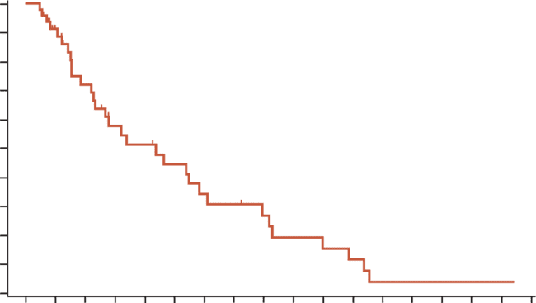
AVAILABLE DATA AFTER PROGRESSION ON IO regorafenib, cabozantinib and ramucirumab after IO
CELESTIAL study – cabozantinib¹
REFINE study – regorafenib²
Outcomes with cabozantinib | Prior IO (N=14) | Two prior regimens (N=130)
Median OS (95% CI), months | 7.9 (5.1-NE) | 8.5 (7.4-9.7)
Median PFS (95% CI), months | 3.7 (1.9-5.6) | 3.7 (3.3-4.1)
Median duration of exposure (range), months | 3.7 (1.9-18.7) | 3.7 (0.5-23.9)
Grade 3/4 AEs, n (%) | 9 (64) | 85 (66)
Treatment-related discontinuations, n (%) | 1 (7) | 19 (15)
OS subgroup analyses [N=1008] | Patients, % | Median OS (95% CI), months
Overall population | 100 | 12.9 (11.4-14.6)
CP grade at baseline A B Missing/NE | 62 12 26 | 15.2 (13.3-16.2) 6.3 (4.9-8.1) 12.2 (9.4-15.3)
ALBI grade at baseline 1 2 Missing | 32 49 15 | 19.8 (16.7-24.6) 9.9 (8.5-11.1) 12.4 (9.3-15.3)
Prior immunotherapy | 9 | 10.2 (7.4-15.2)
Sorafenib intolerant | 9 | 11.1 (8.6-19.5)
Prior treatment lines 1 (sorafenib only) ≥2 | 82 14 | 13.8 (12.2-15.3) 8.7 (7.4-12.1)
REACH-2 expansion cohort – ramucirumab³
1.0
 | Ramucirumab N=47 | No. of events
Median (95% CI), months 6-month survival, % 12-month survival, % 18-month survival, % | 8.7 (4.6, 12.2) 57.6 (40.1, 71.7) 34.1 (18.6, 50.4) 19.2 (7.4, 35.1) | 31
0.9
0.8
0.7
0.6
Overall survival (%)
0.5
0.4
0.3
Efficacy and safety comparable to those reported in the Phase 3 trials
0.2
0.1
Ramucirumab
0.0
0
2
4
6
8
10
12
14
16
18
20
22
24
26
28
30
32
34
No. at risk
Ramucirumab
Time (months)
47
35
26
18
16
13
10
9
7
5
4
3
1
1
1
1
1
0
AE, adverse event; CI, confidence interval; CP, Child-Pugh; IO, immuno-oncology (therapy); NE, non-evaluable; OS, overall survival; PFS, progression-free survival;
1, Abou-Alfa GK, et al. Presented at EASL LCS 2020, abstr PB02-04; 2. Finn RS, et al. Presented at EASL LCS 2022, abstr OS-55; 3. Finn RS, et al. Oncologist. 2022;27:e938-e948

Slide 26
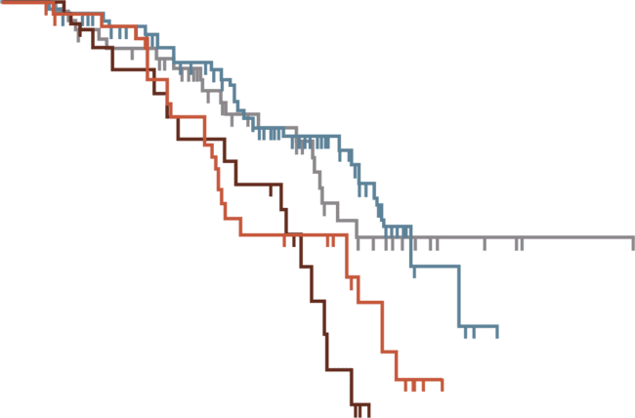
AVAILABLE DATA AFTER PROGRESSION ON IO
Comparison of 2nd line therapies after Atezolizumab + bevacizumab
Retrospective analysis of 464 patients previously treated with atezolizumab + bevacizumab from 46 centres in five countries (Italy, Germany, Portugal, Japan, and Korea
Choice of therapy left to the discretion of the provider
Median survival was 14.2 months for sorafenib (95% CI: 8.8–15.7), 17.0 months for lenvatinib (95% CI: 14.8–18.9), and 12.4 months for cabozantinib (95% CI: 7.2–13.4)
100
90
80
70
60
50
Other
Survival probability (%)
40
30
Lenvatinib
20
Sorafenib
Cabozantinib
10
0
0
10
20
30
Time
No. at risk
Other
Cabozantinib
Lenvatinib
Sorafenib
56
23
84
43
31
14
48
17
4
0
1
0
0
0
0
0
CI, confidence interval; IO, immuno-oncology (therapy);
Persano M, et al. Eur J Cancer. 2023;189:112933

Slide 27

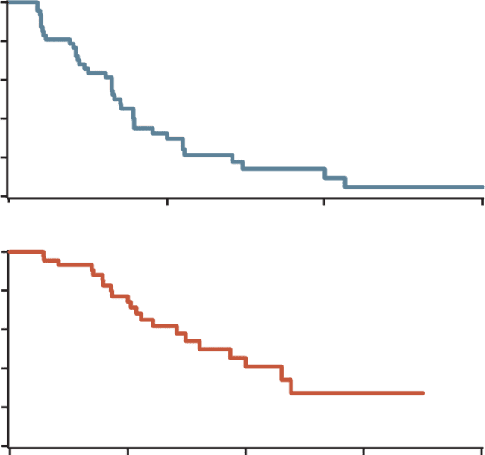

2nd line tki: AVAILABLE DATA AFTER PROGRESSION ON IO cabozantinib after 1st line io: phase 2
1.0
Median progression-free survival: 4.1 months (95% CI, 3.3 5.3)
6-month PFS rate: 32.5%
0.8
0.6
Key eligibility criteria
Prior immune checkpoint inhibitor
Child-Pugh class A
Maximum two prior lines of treatment
Progression-free
survival
0.4
0.2
0
0
6
12
18
1.0
Time (months)
0.8
Median overall survival: 9.9 months (95% CI, 7.3-14.4)
1-year survival rate: 45.3%
N=47 Cabozantinib; 60 mg once daily
0.6
Percentage alive
0.4
0.2
Oct 2020 to May 2022
Median follow-up = 11.2 months
Primary endpoint: progression-free survival
0
0
6
12
18
24
Time (months)
2nd line use: OS = 14.3 mo; PFS = 4.3 mo
3rd line use: OS = 6.6 mo; PFS = 4.0 mo
Median dose = 40 mg/day
Median dose intensity = 69.4%
2nd line cabozantinib demonstrated efficacy in patients who progressed on IO
No new safety signals were observed in the study
CI, confidence interval; IO, immuno-oncology (therapy); mo, months; OS, overall survival; PFS, progression-free survival; TKI, tyrosine kinase inhibitor
Chan SL, et al. J Hepatol. 2024;81:258-264

Slide 28
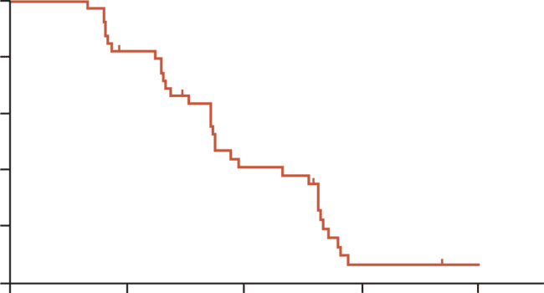
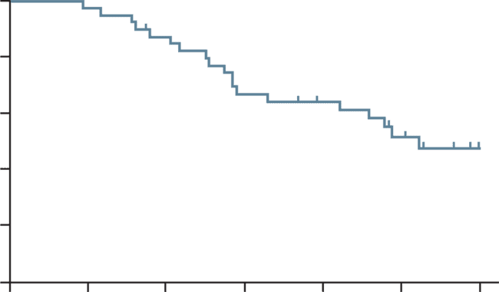
2nd line tki: AVAILABLE DATA AFTER PROGRESSION ON IO regorafenib after 1st line atezolizumab + bevacizumab: Phase 2 regonext
Progression-free survival
Overall survival
100
100
Median PFS:
3.5 months (95% CI, 3,0-3.9)
80
80
60
60
Progression-free
survival (%)
Overall survival (%)
40
40
20
20
Median OS:
10.5 months (95% CI, 7.1-13.8)
0
0
0
2
4
6
8
0
2
4
6
8
10
12
Time (months)
Time (months)
No. at risk
40
31
14
2
1
No. at risk
40
39
34
26
32
14
8
Regorafenib was effective as 2nd line therapy in unresectable patients with HCC who progressed on 1st line atezolizumab + bevacizumab
Efficacy and safety of regorafenib were consistent with those observed in the RESORCE trial
C1, cycle 1; CI, confidence interval; D1, day 1; HCC, hepatocellular carcinoma; IO, immuno-oncology (therapy); OS, overall survival; PFS, progression-free survival; TKI, tyrosine kinase inhibitor
Cheon et al. Liver Cancer 2025;

Slide 29
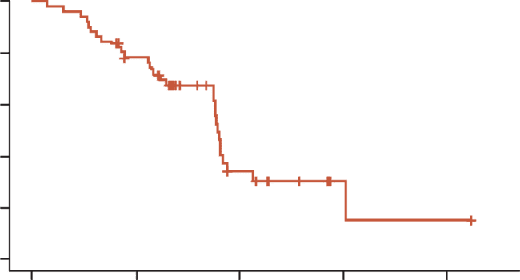
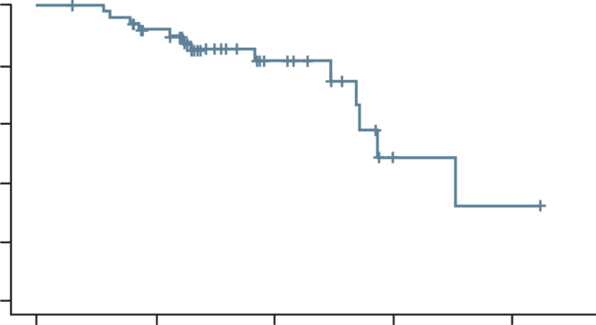
2nd line tki: AVAILABLE DATA AFTER PROGRESSION ON IO lenvatinib after 1st line atezolizumab + bevacizumab: Phase 2 (KCSG HB23 04)
Progression-free survival
Overall survival
100
100
Median PFS:
5.4 months (95% CI, 5.3-5.6)
Events for PFS: 29 (58%)
80
80
60
60
Progression-free
survival (%)
Overall survival (%)
40
40
20
20
Median OS: 8.6 months (95% CI, 8.1-NA)
Events for OS: 13 (26%)
0
0
0
3
6
9
12
0
3
6
9
12
Time (months)
Time (months)
No. at risk
50
37
9
2
1
No. at risk
50
43
18
4
2
2nd line lenvatinib in patients who progressed on 1st line atezolizumab + bevacizumab shows a median PFS of 5.4 months and met its primary endpoint in PFS (4.5 months)
There were no new safety signals of lenvatinib
OS data are not matured and require follow-up
CI, confidence interval; IO, immuno-oncology; PFS, progression-free survival; TKI, tyrosine kinase inhibitor
Yoo C, et al. Ann Oncol. 2024;35 (Supplement 4):S1450. Presented at ESMO Asia, 2024 (LBA1)

Slide 30
ONGOING PHASE 3 STUDY AFTER PROGRESSION ON IO: IMbrave251
2nd line atezolizumab + TKI vs TKI alone after progression on 1st line atezolizumab + bevacizumab
Site selects the choice of TKI:
lenvatinib or sorafenib
Unresectable HCC
Progressed following prior atezolizumab + bevacizumab treatment*
(N=554)
Atezolizumab +
lenvatinib or sorafenib
Treatment until loss of clinical benefit or unacceptable toxicity
R
Survival follow-up
Lenvatinib or sorafenib
Efficacy objectives
Primary: OS
Secondary: PFS,* ORR,* DoR,* TTP,*
TTD in PROs
Safety objective
Percentage of patients with AEs
Exploratory
Number of patients with anti-drug antibodies to atezolizumab
Serum concentration of atezolizumab
*INV-assessed per RECIST v1.1
AE, adverse event; AFP, α-fetoprotein; ALBI, albumin-bilirubin; DoR, duration of response; HBV/HCV, hepatitis B/C virus; HCC, hepatocellular carcinoma; inv, investigator; IO, immuno-oncology (therapy); OS, overall survival; PFS, progression-free survival; ORR, objective response rate; PRO, patient-reported outcome; RECIST, Response Evaluation Criteria in Solid Tumours; TKI, tyrosine kinase inhibitor; TTD, time to deterioration; TTP, time to progression
ClinicalTrials.gov.Identifier: NCT04770896. Available from: https://clinicaltrials.gov/ct2/show/NCT04770896 (accessed Jan 2025)

Slide 31
PROGRESSION ON 1st LINE IO
There is limited prospective data on TKIs after progression on io
IO-based therapies have only recently become the standard of care in the 1st line for HCC
Prospective clinical trials focusing on post-progression TKI treatments after
progression on IO are still limited
  Enrolment in a clinical trial is warmly encouraged
In the absence of evidence-based interventions, patients’ clinical features,
tolerability of the prior therapy, and regulatory approvals in each country drive the decision-making process
If a clinical study is not accessible, there exists initial reassuring evidence
regarding the use of TKIs after IO in routine clinical practice
HCC, hepatocellular carcinoma; IO, immuno-oncology (therapy); TKI, tyrosine kinase inhibitor
Bruix J, et al. J Hepatol. 2021;75:960-974

Slide 32
Available data after progression on 1st line io io after io
IO, immuno-oncology (therapy)

Slide 33
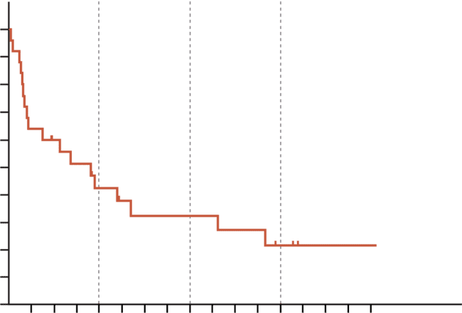
2nd line io: AVAILABLE DATA AFTER PROGRESSION ON IO
Ipilimumab + nivolumab / pembrolizumab after prior IO in retrospective study
12-mo OS: 42.4%
24-mo OS
32.3%
36-mo OS: 21.6%
Best objective response
Activity | N (%)
CR | 3 (12)
PR | 1 (4)
SD | 6 (24)
PD | 12 (48)
Non-evaluable | 3 (12)
ORR | 4 (16)
100
90
80
70
60
Median OS (95% CI):
10.9 months (3.99-17.8)
Overall survival (%)
50
40
30
20
10
0
3
6
9
12
15
18
21
24
27
30
33
36
39
42
45
48
Time (months)
Ipilimumab combined with nivolumab or pembrolizumab has demonstrated durable anti-tumour
activity and promising survival benefits in patients with advanced HCC previously treated with IO
  Acceptable toxicity
CI, confidence interval; CR, complete response; HCC, hepatocellular carcinoma; IO, immuno-oncology (therapy); ORR, objective response rate; OS, overall survival; PD progressive disease; PR, partial response; SD, stable disease
Wong JSL, et al. J Immunother Cancer. 2021;9:e001945

Slide 34
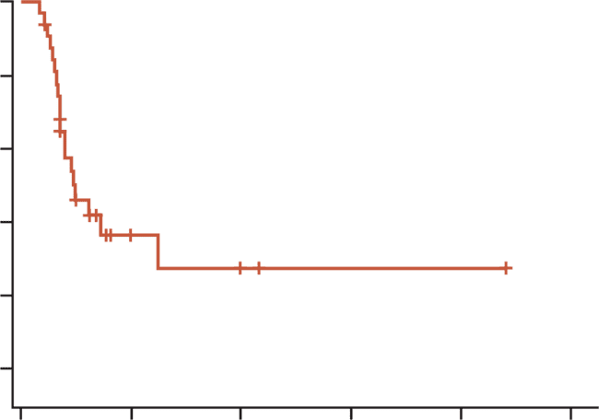
2nd line io: AVAILABLE DATA AFTER PROGRESSION ON IO ipilimumab + nivolumab after prior anti-PD-(L)1 therapy in retrospective study
Multicentre retrospective analysis of 32 patients with prior anti-PD-(L)1 therapy, including 16 with prior atezolizumab + bevacizumab, 10 other ICI + VEGF combinations, and 6 ICI monotherapy
ORR was 22% (1 CR, 6 PR), of whom none had objective response to prior anti-PD(L)1 therapy
Median PFS was 2.9 months and median OS was 9.2 months
There were no new safety signals
Target lesion tumour size
100
Progression-free survival
100
BOR
80
Median PFS (95% CI): 2.9 months (2.1-NR)
CR
PR
SD
PD
50
60
Progression-free
survival (%)
Change from baseline (%)
40
0
20
-50
0
-100
0
6
12
18
24
30
Time (months)
BOR, best overall response; CR, complete response, ICI, immune checkpoint inhibitor; IO, immuno-oncology (therapy); NR, not reached; ORR, objective response rate;
OS, overall survival; PD, progressive disease; PD-1, programmed cell death protein; PD-L1, programmed death ligand 1; PFS, progression-free survival; PR, partial response;
SD, stable disease; VEGF, vascular endothelial growth factor
Alden S, et al. Cancer Res Commun. 2023;3:1312-1317

Slide 35
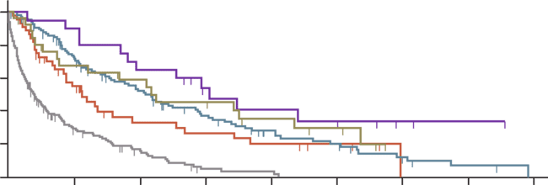
2nd line io: AVAILABLE DATA AFTER PROGRESSION ON IO therapeutic sequencing following IO in retrospective study
Post-progression survival
IO-TKI sequencing is a consolidated option in advanced HCC
IO-IO is adopted clinically despite lack of recommendation
  Future efforts should define which patients benefit from this approach
No ACT
ICI beyond PD
TKI
ICI beyond PD + TKI
Other
100
Log-rank
p<0.0001
80
60
Survival
probability (%)
40
20
0
0
10
20
30
40
Time (months)
No. at risk
No ACT
ICI beyond PD
TKI
ICI beyond PD + TKI
Other
165
44
108
20
27
16
10
47
13
13
2
6
19
6
6
0
0
5
2
0
0
0
0
0
0
Kaplan-Meier curves of post-progression survival (PPS) in hepatocellular carcinoma patients treated with immune checkpoint inhibitor (ICI) according to treatment strategy. Patients who did not receive post-progression anticancer therapy (no ACT): 1.9 months (95% CI: 1.3-2.7, 132 events), patients who received ICIs beyond PD only (ICI beyond PD): 5.6 months (95% CI: 3.5-9.4,
31 events), patients who received post-PD TKIs only (TKI): 10.4 months (95% CI: 7.7-14.4, 79 events), patients who received ICIs beyond PD followed by TKIs (ICI beyond PD + TKI): 15.3 months (95% CI: 8.5-22.0, 12 events), patients who received other post-PD anticancer therapies (other): 10.8 months (95% CI: 3.7-21.7, 17 events).
ACT, anti-cancer therapy; CI, confidence interval; HCC, hepatocellular carcinoma; ICI, immune checkpoint inhibitor; IO, immuno-oncology (therapy); PD, disease progression; TKI, tyrosine kinase inhibitor
Talbot T, et al. Liver Int. 2023;43:695-707

Slide 36


2nd line io: AVAILABLE DATA AFTER PROGRESSION ON IO
EFFICACY AND SAFETY OF IO RECHALLENGE IN RETROSPECTIVE STUDY
International, retrospective
multicentre study:
14 centres
994 patients screened
58 patients with advanced
HCC receiving two lines
of ICI-treatment
(ICI-1 and ICI-2)
Efficacy:
 | ICI-1 | ICI-2
ORR: DCR: Median TTP: | 22% 59% 5.4 | 26% 55% 5.2 months
Safety:
Grade 3-4 adverse events:
ICI-1: 16%, ICI-2: 17%
No treatment-related deaths
IO rechallenge resulted in a treatment benefit in a meaningful proportion of
patients with HCC
IO rechallenge was safe in the study and high-grade treatment-related adverse
events were uncommon
DCR, disease control rate; HCC, hepatocellular carcinoma; ICI, immune checkpoint inhibitor; IO, immuno-oncology (therapy); ORR, objective response rate; TTP, time to progression
Scheiner B, et al. JHEP Rep. 2022;5:100620

Slide 37
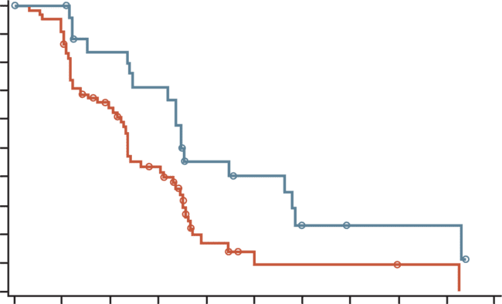
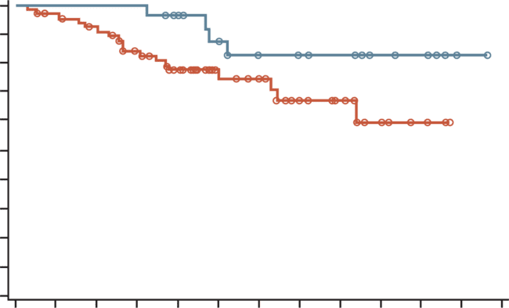
2nd line io: AVAILABLE DATA AFTER PROGRESSION ON IO
Regorafenib + pembrolizumab after IO – Phase 2
Open-label, Phase 2 study in 38 centres in eight countries
Regorafenib + pembrolizumab had modest activity after 1st line IO-based combinations
The safety profile of the combination was consistent with that observed for each drug individually
PFS by patient subgroupª
OS by patient subgroupª
1.0
0.9
0.8
0.7
0.6
0.5
0.4
0.3
0.2
0.1
0.0
1.0
0.9
0.8
0.7
0.6
0.5
0.4
0.3
0.2
0.1
0.0
Median PFS, months
Cohort 1: 2.8 (95% CI 2.4, 3.9)
Cohort 2: 4.2 (95% CI 2.9, 6.8)
Probability of PFS
Probability of OS
Median OS, months
Cohort 1: NE (95% CI 9.9, NE)
Cohort 2: NE (95% CI NE, NE)
censored
censored
0
36
72
108
144
180
216
252
288
324
360
0
36
72
108
144
180
216
252
288
324
360
396
432
Patients at risk
Cohort 1
Cohort 2
Days
Patients at risk
Cohort 1
Cohort 2
Days
68
27
60
26
39
20
24
17
6
9
3
7
2
4
2
2
1
2
1
2
0
0
68
27
64
27
59
27
50
27
40
24
26
20
23
17
15
14
11
13
6
7
3
5
0
1
0
0
Kaplan-Meier analyses. PFS was assessed via RECIST version 1.1 by independent central review. At-risk patient counts were calculated at the start of each timepoint.
ª All patients received regorafenib + pembrolizumab. Cohorts were defined by prior 1st line treatment: Cohort 1 = atezolizumab + bevacizumab;
Cohort 2 = any other ICI regimen (alone or combination)
1L, first-line; CI, confidence interval; ICI, immune checkpoint inhibitor; IO, immuno-oncology (therapy), NE, not estimable; OS, overall survival; PFS progression-free survival; RECIST, Response Evaluation Criteria in Solid Tumours
El-Khoueiry AB, et al. J Clin Oncol. 2024;42 (no. 16 suppl):4007 (presented at ASCO Annual Meeting I)

Slide 38
PROGRESSION ON 1st LINE IO prospective data ARE LACKING FOR io after progression on io
IO-based therapies have only recently become the standard of care in the 1ST line for HCC
Data on the use of IO after progression on prior IO therapy are even more limited than for TKIs after IO
If a clinical trial is not available, switching to an alternative IO regimen may be considered in clinical practice in select patients, based on individual clinical factors, prior response and toxicity on IO, and local availability
HCC, hepatocellular carcinoma; IO, immuno-oncology (therapy); TKI, tyrosine kinase inhibitor

Slide 39
When to switch after progression on 1ST line io
IO, immuno-oncology (therapy)

Slide 40
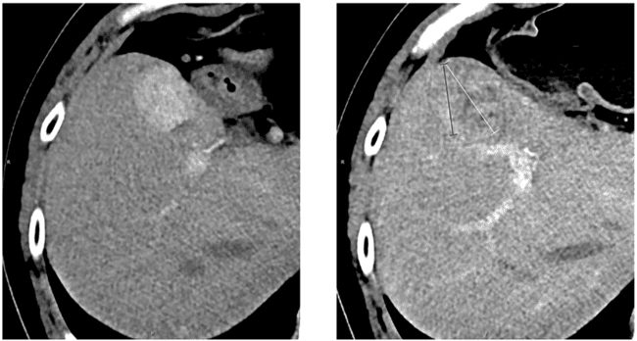
Measuring radiologic progression in hcc mrecist criteria have a powerful ability to discriminate between responders and non-responders
Before start treatment
After immunotherapy
Measurement of the longest tumour diameter in a target hepatic lesion: mRECIST vs RECIST
The response was assessed as progressive disease according to RECIST 1.1 and stable disease based on mRECIST
White line: the overall longest diameter of the tumour according to RECIST 1.1
Red line: the longest diameter of the viable portion of the tumour as per mRECIST and
recognized by contrast enhancement
HCC, hepatocellular carcinoma; (m)RECIST, (modified) Response Evaluation Criteria in Solid Tumours
Zhou M, et al. Front Oncol. 2021;11:764189

Slide 41
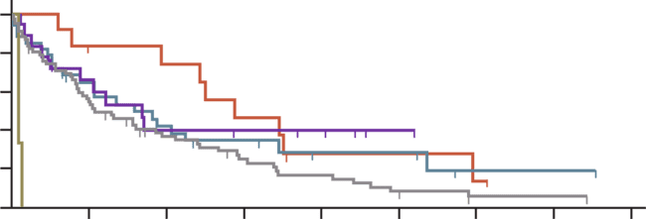
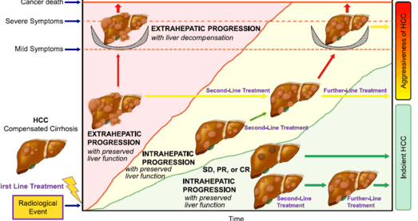
Patterns of progression following 1ST line io type of progression may influence results
Post-progression survival¹
Outcome of patients with HCC across the years according to radiologic response²
IHG only
NIH only
EHG only
NEH only
nVI only
Death related to HCC
100
Log-rank
p<0.0001
Cancer death
80
Severe symptoms
Survival
probability (%)
60
40
Mild symptoms
20
0
0
10
20
30
40
Time (months)
No. at risk
IHG only
NHI only
EHG only
NEH only
nVI only
HCC
Compensated cirrhosis
67
12
34
19
3
19
8
11
6
0
8
2
4
4
0
1
1
1
0
0
0
0
0
0
0
First-line treatment
Kaplan-Meier survival estimates for post-progression survival (PPS) according to the radiological pattern of progression. Intrahepatic growth only: 5.3 months (95% CI: 4.2-9.7, 54 events), new intrahepatic lesion only: 14.4 months (95% CI: 3.8-29.8, 9 events), extrahepatic growth only:
7.9 months (95% CI: 3.3-17.3, 21 events), new extrahepatic lesion only: 8.4 months (95% CI:
2.5-8.5, 10 events), new vascular invasion only: 0.4 months (95% CI: 0.4-0.6, 3 events).
Time
CI, confidence interval; CR, complete response; EHG, extrahepatic growth; HCC, hepatocellular carcinoma; IHG, intrahepatic growth; IO, immuno-oncology (therapy); NEH, new extrahepatic lesions(s); NIH, new intrahepatic lesion(s); nVI, new vascular invasion; PR, partial response; SD, stable disease
1. Talbot T, et al. Liver Int. 2023;43:695-707; 2. Iavarone M, et al. Hepatology. 2024;79:1452-1462

Slide 42







When to switch after progression on 1st line IO parameters influencing decision at progression for advanced Hcc
Parameters at progression under ICIs
Further management
New vascular
invasion
BSC
Individualised
and
multidisciplinary
decision
Toxicity from ICI
ICI continuation
beyond progression
Liver function
(ALBI, Child-Pugh, portal hypertension, …)
ECOG PS
Switch to TKI
Parameters influencing decision at progression on immunotherapy for advanced HCC.
ALBI, albumin-bilirubin score; BSC, best supportive care; ECOG PS, Eastern Cooperative Oncology Group performance status; HCC, hepatocellular carcinoma; ICI, immune checkpoint inhibitor; IO, immuno-oncology (therapy); TKI, tyrosine kinase inhibitor
Cabibbo G and Edeline J. Liver Int. 2023;43:528-530

Slide 43
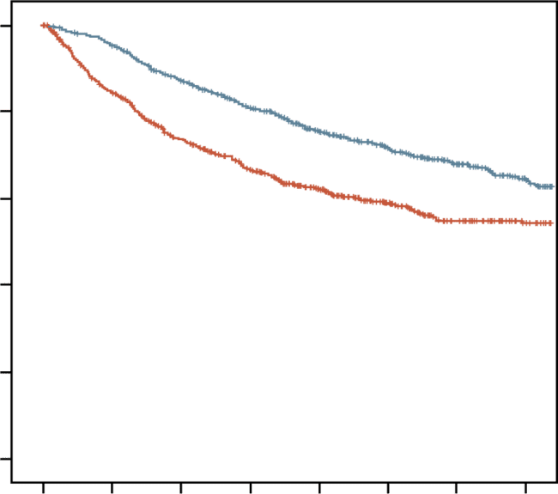
Multidisciplinary approach for hcc key for optimising each patient’s treatment
OS entire cohort¹
Association between multidisciplinary
care and overall survival²
1.0
p<0.001
0.8
Study | Log (HR) | Standard error | Hazard Ratio | HR | 95% CI | Weight (%)
Yopp 2014 | −0.92 | 0.1034 |  | 0.40 | (0.33; 0.49) | 17.0
Chirikov 2015 | −0.15 | 0.0487 |  | 0.86 | (0.78; 0.95) | 18.4
Agarwal 2017 | −0.33 | 0.1379 |  | 0.72 | (0.55; 0.95) | 15.8
Serper 2017 | −0.19 | 0.0398 |  | 0.83 | (0.77; 0.90) | 18.6
Sinn 2019 | −0.76 | 0.0655 |  | 0.47 | (0.41; 0.53) | 18.1
Duininck 2019 | −0.48 | 0.2286 |  | 0.62 | (0.40; 0.97) | 12.2
Random effects model (HK) |  |  |  | 0.63 | (0.45; 0.88) | 100.0
Heterogeneity: I² = 95%, p<0.01
MDT (+)
0.6
Overall survival
MDT (−)
0.4
0.2
0.0
0.5
1
2
0
1
2
3
4
5
6
7
Follow-up duration (years)
No. at risk
MDT (+)
MDT (−)
738
5881
698
4334
625
3642
543
3108
439
2508
332
1893
248
1398
177
1005
5-year survival rate was 71.2% vs. 49.4%, P <0.001
MDT management benefit particularly significant in patients with ALBI 2 and 3, BCLC B and C, AFP > 200 ng/mL
Multidisciplinary care was significantly associated with improved survival
AFP, α-fetoprotein; ALBI, albumin-bilirubin score; BCLC, Barcelona Clinic Liver Cancer; CI, confidence interval; HCC, hepatocellular carcinoma; HK, Hartung-Knapp (adjustment); HR, hazard ratio; MDT, multidisciplinary team; OS, overall survival
1. Sinn DH, et al. PLoS One. 2019;14:e0210730; 2. Seif El Dahan K, et al. Hepatol Commun. 2023;26:e0143

Slide 44
When to switch after progression on 1st line IO parameters influencing decision at progression for advanced Hcc
Assessing progression type and liver function is crucial for detailed prognosis
evaluation in advanced HCC
  Highlights the importance of a multidisciplinary approach for personalised
  treatment in advanced HCC
  Multidisciplinary care is associated with improved overall survival for patients
  with HCC
More accurate patient stratification should be enabled by incorporating progression
type and liver function decline assessment
Progression type and liver function decline assessment should be integrated into
study designs to guide treatment decisions for patients who progress on IO
HCC, hepatocellular carcinoma; IO, immuno-oncology (therapy)

Slide 45
conclusions

Slide 46
Conclusions – what we know
Advanced hcc: strategies for patients ineligible for IO or those with progression on IO
For patients with HCC ineligible for IO, TKIs (sorafenib, lenvatinib) are the recommended 1st line treatment options
After progression on 1st line IO, available strategies include:
  Enrolment in clinical trials
  Switching to a TKI or anti-VEGFR-2
  Considering IO after IO approaches
  Providing best supportive care for patients unsuitable for further systemic therapies
Post-IO progression strategies involve two main approaches:
  T-1 Approach: Focusing on sorafenib or lenvatinib as 2nd line options
  Line-agnostic Approach: Expanding to all 2nd line options (sorafenib, lenvatinib, regorafenib, cabozantinib, ramucirumab)
Transition to 2nd line therapy and decision-making should be guided by:
  Radiologic progression and the pattern of progression
  Patient’s clinical characteristics, tolerability of prior therapy, and regulatory approvals in each country
Receiving a 2nd line treatment is key for better outcomes
Limited prospective data emphasise the need for patient enrolment in clinical trials to optimise
sequencing strategies
HCC, hepatocellular carcinoma; IO, immuno-oncology (therapy); TKI, tyrosine kinase inhibitor

Slide 47
Conclusions – what we need
Advanced hcc: strategies for patients ineligible for IO or those with progression on IO
Identify and validate biomarkers of response and resistance (e.g., anti-drug antibodies?) to guide the selection of optimal treatment sequences for different patient groups
Increase the collection and analysis of tumour samples and liquid biopsies to better understand disease biology and treatment response
Evaluate the cost-effectiveness and risk-benefit ratio of each treatment and sequencing strategy
to support evidence-based decision-making
Conduct randomised clinical trials to define the most effective treatment sequences for
patients with advanced HCC
HCC, hepatocellular carcinoma; IO, immuno-oncology (therapy)

