Slide 2
The expanding role of immunotherapy in hcc: combining locoregional and systemic treatments in intermediate HCC micro learning
Aiwu Ruth He, MD, PhD
Professor of Medicine and Oncology
Columbia University, USA
Beau Toskich, MD, FSIR
Professor of Interventional Radiology
Mayo Clinic Florida, USA
APRIL 2025

Slide 3


Developed by HCC COnnect
This programme is developed by HCC CONNECT,
an international group of experts in the field of
hepatocellular carcinoma and brought to you alongside
GI CONNECT, an international group of experts in the
field of gastrointestinal oncology.
Acknowledgement and disclosures
AstraZeneca has provided a sponsorship grant towards this independent programme. The programme is therefore independent, the content is not influenced by the supporter and is under the sole responsibility of the experts.
Please note:
This educational programme is intended for healthcare professionals only
The views expressed within this programme are the personal opinions of the experts. They do not necessarily represent
the views of the experts’ academic institutions, organisations, or the rest of the HCC CONNECT and GI CONNECT groups.
Expert disclosures:
Prof. Aiwu Ruth He has received financial support/sponsorship for research support, consultation, or speaker fees from the following companies: AstraZeneca, BMS, Boston Scientific, Eisai, Genentech, and Merck
Prof. Beau Toskich has received financial support/sponsorship for research support, consultation, or speaker fees from the following companies: AstraZeneca, Boston Scientific, Delcath, Eisai, Galvanize, Genentech, HistoSonics, Johnson & Johnson, Replimune, Sirtex Medical, Terumo, Turnstone Biologics, VIVOS

Slide 4


This programme has been developed by a Group of experts
Prof. Aiwu Ruth He
Professor of Medicine and Oncology
Columbia University, USA
Prof. Beau Toskich, FSIR
Professor of Interventional Radiology
Mayo Clinic Florida, USA

Slide 5
Clinical takeaways
The expanding role of immunotherapy in hepatocellular carcinoma (HCC) – combining locoregional and systemic treatments in intermediate HCC
Immuno-oncology therapy (IO) and IO combinations are transforming the landscape for patients with advanced and intermediate HCC who are not candidates for local therapy, with 1st line options (IMbrave150, HIMALAYA, CheckMate 9DW) offering improved long-term outcomes, including 20% survival at 5-years in HIMALAYA
Intermediate-stage HCC may benefit from multimodal strategies, combining IO with locoregional therapies (LRTs) to address both visible and invisible disease, enhancing immune response, and optimising tumour control
IO + LRT combinations, such as TACE plus IO, show promise for patients with intermediate HCC, with positive trials like EMERALD-1 and LEAP-012 demonstrating improved PFS and manageable safety profiles, with ongoing evaluation of OS outcomes
A multidisciplinary approach is crucial to determine which patients with intermediate HCC may benefit from multimodal combinations, requiring coordination among oncologists, hepatologists, interventional radiologists, radiation oncologists, and transplant surgeons
IO, immuno-oncology therapy; OS, overall survival; PFS, progression-free survival; TACE, transarterial chemoembolisation

Slide 6
Building the foundation background on hcc, staging, and balancing challenges
HCC, hepatocellular carcinoma;

Slide 7
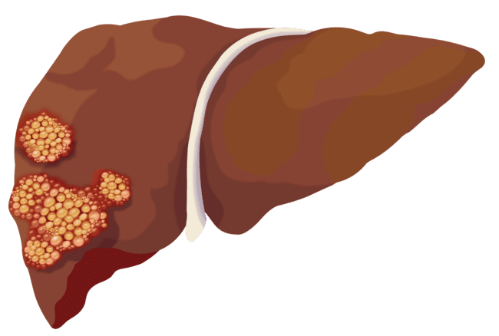
Background
Hepatocellular carcinoma (HCC)¹
Liver cancer is the sixth most prevalent cancer globally and ranks as the third leading cause of cancer-related deaths, with HCC representing 75%-86% of primary liver cancer cases
In the United States, HCC incidence and mortality rates rose between 1970 and 2010; however, incidence began declining in 2011, and mortality rates stabilised in 2013, with one study reporting an annual decrease of ~3% in subsequent years
Cirrhosis, regardless of the underlying liver disease, is the strongest risk factor for HCC, affecting more than 80% of patients diagnosed with the disease
Patients with cirrhosis have an estimated 2% yearly risk of developing HCC
  Chronic viral hepatitis (HBV and HCV) remains a major risk factor for HCC in many regions; however, its impact is decreasing in areas due to HBV vaccination programmes and curative antiviral treatments for HCV
  HCC related to alcohol and metabolic dysfunction-associated steatotic liver disease (MASLD) (previously known as NAFLD²) is now the leading cause of HCC in patients without cirrhosis
HBV/HCV, hepatitis B/C virus; NAFLD, non-alcoholic fatty liver disease
1. Singal AG, et al. Hepatology. 2023;78:1922-1965; 2. New Year, New Name: NAFLD becomes MASLD. Available at: https://www.aafp.org/pubs/afp/afp-community-blog/entry/new-year-new-name-nafld-becomes-masld.html (accessed January 2025)

Slide 8

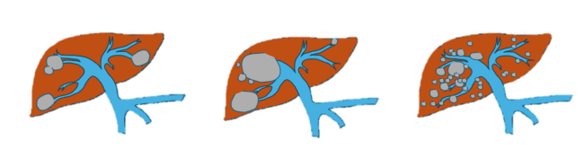

Hcc staging intermediate hcc is complex and heterogeneous
Patients with intermediate HCC exceed the Milan Criteria (UNOS T2) for early HCC:^{1,2}
  One tumour <5 cm or up to three tumours <3 cm
Intermediate HCC sub-stratification:
Up-to-7 criteria^{3,4}
BCLC-B⁸ intermediate HCC – phenotype driven
Through
# of tumours + largest tumour size (in cm) ≤7
Liver transplantation may be considered if within the extended UCSF criteria^{5,6}
In single tumours ≤8 cm, TARE can be an alternative option for patients who are unfavourable for resection⁷
Well defined nodules
Selectable
Within extended transplant criteria
Preserved portal flow
LT may be considered
Well defined nodules
Selectable
Out of extended transplant criteria
Preserved portal flow
TACE recommended
Non-selectable
Diffuse
Infiltrative
Out of extended transplant criteria
Systemic Therapy recommended
Other sub-stratification criteria for intermediate HCC exist, such as Bolondi⁹ and Kinki¹⁰
BCLC-B, Barcelona Clinic Liver Cancer Stage B; HCC, hepatocellular carcinoma; LT, liver transplant; TACE, transarterial chemoembolisation; TARE, transarterial radioembolization; UCSF, University of California, San Francisco; UNOS T2, United Network for Organ Sharing Tumour 2
Graphics kindly provided by Prof. Toskich
1. Famularo S, et al. HPB (Oxford). 2020;22:1349-1358; 2. Gundlach J-P et al. Z Gastroenterol. 2024;62:43-49; 3. Mazzaferro, et al. Lancet Oncology. 2009; 4. Chen H-Y, et al. J Formos Med Assoc. 2022;121:778-786; 5. Yao FY, et al. Am J Transplant. 2007;7:2587-2596; 6. Horwitz JK and Agopian VG. Curr Hepatol Rep. 2024;23:185-192. 7. Vogel A, et al. Ann Oncol. 2025 (article in press; https://doi.org/10.1016/j.annonc.2025.02.006); 8. Reig M, et al. J Hepatol. 2022;76:681-693; 9. Bolondi L, et al. Semin Liver Dis. 2012;32:348-359; 10. Kudo M, et al. Dig Dis. 2015;33:751-758

Slide 9
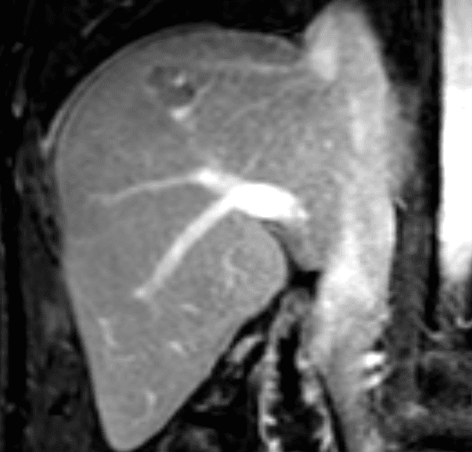
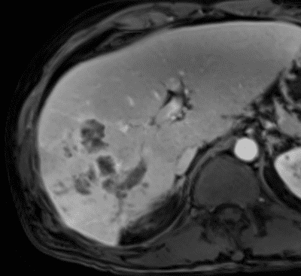
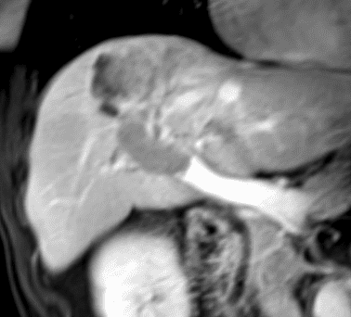
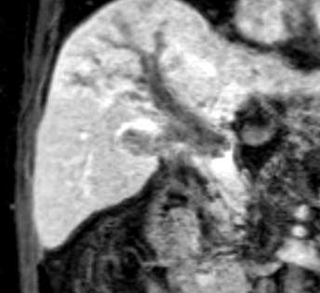
Hcc staging heterogeneity and subclassifications also apply to advanced hcc
Patients with advanced HCC (BCLC-C) have vascular invasion and/or extrahepatic disease¹
Patients with advanced HCC are candidates for systemic therapy but can be candidates for local therapy
depending on the level of vascular invasion, disease biology, and liver involvement^{1,2}
Vascular invasion (LCSGJ)^{2,a}
Extrahepatic disease
Vp1
Vp2
Vp3
Vp4
ª MRI scans and graphics kindly provided by Prof. Toskich
BCLC-C, Barcelona Clinic Liver Cancer Stage C; HCC, hepatocellular carcinoma; LCSGJ, Liver Cancer Study Group of Japan; MRI, magnetic resonance imaging; Vp, vascular portal (classification)
1. Reig M, et al. J Hepatol. 2022;76:681-693; 2. Chan SL, et al. World J Gastroenterol. 2016;22:7289-7300

Slide 10
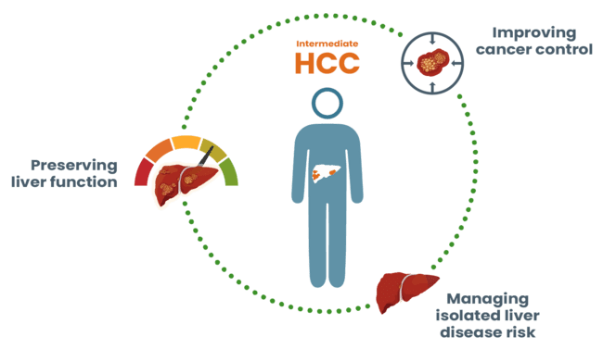
competing hazards in the treatment of HCC primary challenges that must be balanced
Balancing the hazards
  Treatment decisions in HCC require careful evaluation to optimise outcomes^{1,2}
    Preserve liver function: ensuring the patient’s liver can tolerate the chosen therapy¹
    Control cancer progression: selecting the optimal treatment strategy to effectively target the cancer^{1,2}
    Understand and manage isolated liver disease risk: identifying the patient’s hepatic substrate hazard, regardless of their cancer therapy, and ensuring comprehensive care²
HCC, hepatocellular carcinoma
1. Devcic Z, et al. Semin Intervent Radiol. 2019;36:287-297; 2. Lurje I, et al. Int J Mol Sci. 2019;20:1465

Slide 11
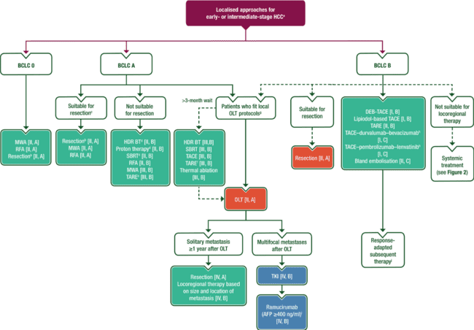
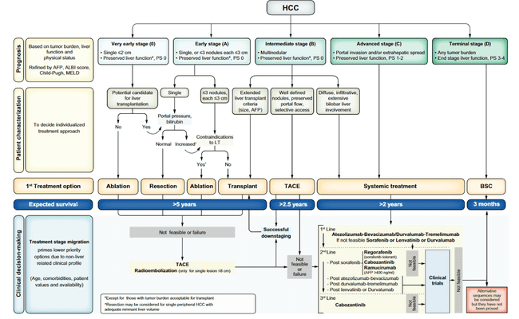
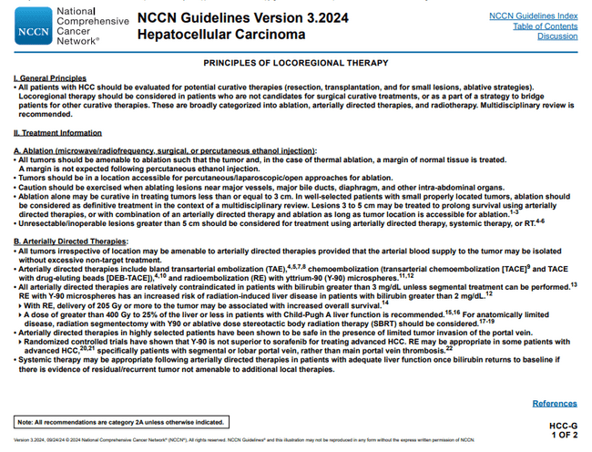
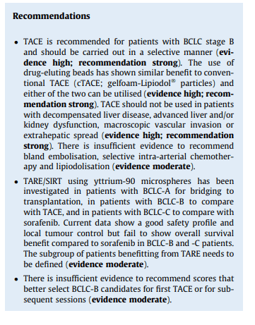
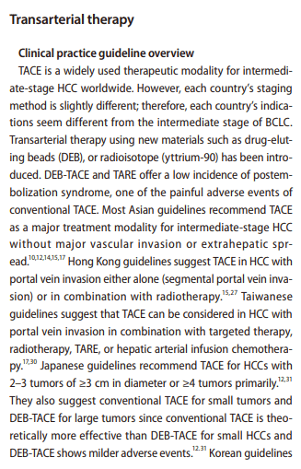
Hcc guidelines overview for further reading
BCLC guidelines¹
  More information HERE
NCCN guidelines²
  More information HERE
AASLD Practice Guidance³
  More information HERE
ESMO Clinical Practice Guidelines⁴
  More information HERE
EASL Clinical Practice Guidelines^{5,a}
  More information HERE
Overview of Asian Clinical Practice Guidelines⁶
  More information HERE
ª Guidelines need updating
AASLD, ;American Association for the Study of Liver Diseases; BCLC, Barcelona Clinic Liver Cancer (algorithm); EASL, European Association for the Study of the Liver; ESMO, European Society for Medical Oncology; HCC, hepatocellular carcinoma; NCCN, National Comprehensive Cancer Network
1. Reig M, et al. J Hepatol. 2022;76:681-693; 2. NCCN Clinical Practice Guidelines in Oncology. Hepatocellular Carcinoma (Version 4.2024). Available here (accessed January 2025); 3. Singal AG, et al. Hepatology. 2023;78:1922-1965; 4. Vogel A, et al. Ann Oncol. 2025 (article in press; https://doi.org/10.1016/j.annonc.2025.02.006); 5. EASL Guidelines. Management of hepatocellular carcinoma. Available here (accessed January 2025); 6. Cho Y, et al. Clin Mol Hepatol. 2023;29:252-262

Slide 12
Standalone therapies for hcc
LRT and IO-based systemic therapies
HCC; hepatocellular carcinoma; IO, immuno-oncology therapy; LRT, locoregional therapy

Slide 13
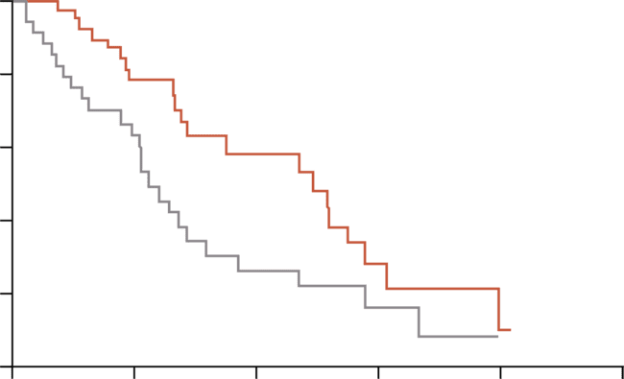
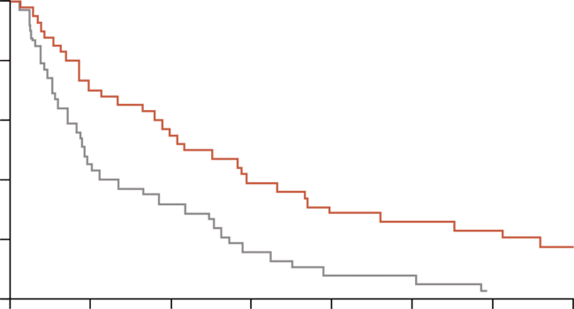
Locoregional therapies standalone evidence benchmark studies supporting TRANSARTERIAL CHEMOEMBOLIsATION (TACE) as standard of care
Significant improvements in survival for patients with unresectable HCC
PROBABILITY OF SURVIVAL¹
PROBABILITY OF SURVIVAL²
100
1.0
80
0.8
60
Chemoembolisation (n=40)
0.6
Survival (%)
Probability of survival
Chemoembolisation (n=40)
40
0.4
Control (n=35)
Log-rank p<0.009
Log-rank p=0.002
20
0.2
Control (n=40)
0
0
0
12
24
36
48
60
0
6
12
18
24
30
36
42
Time since randomisation (months)
Time since randomisation (months)
Patients at risk
Chemoembolisation
Control
Patients at risk
Chemoembolisation
Control
40
35
29
19
14
7
4
3
2
0
40
39
29
17
22
12
16
7
12
4
10
3
10
1
HCC, hepatocellular carcinoma;
1. Llovet JM, et al. Lancet. 2002;359:1734-1739; 2. Lo CM. Hepatology. 2002;35:1164-1171

Slide 14
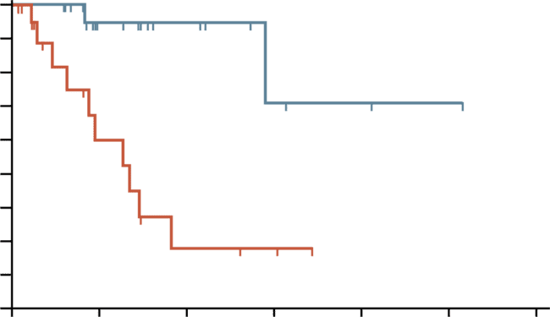
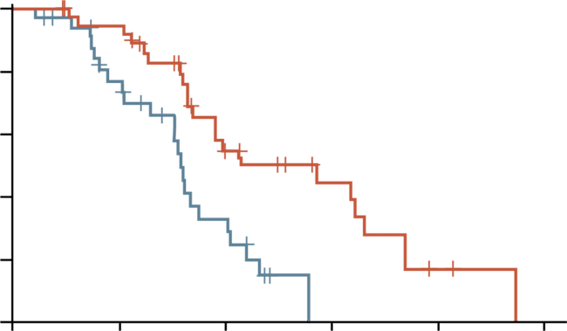
Locoregional therapies: standalone evidence
Y90 TRANSARTERIAL radioembolisation (TARE) COMPARED TO TACE
TTP IN INTENTION-TO-TREAT GROUP¹
TTP IN INTENTION-TO-TREAT GROUP²
100
1.0
 | TARE | DEB-TACE
Events/total | 22 of 38 | 23 of 34
Median (95% CI), mo | 17.1 (8.9-25.4) | 9.5 (8.8-10.2)
HR (95% CI) | 0.36 (0.18-0.70) | Reference
90
80
Y90 (n = 24)
0.8
70
Log-rank p=0.002
Percent without
progression
0.6
60
Probability of
stable disease
50
p=0.0012
0.4
40
cTACE (n = 21)
30
0.2
TARE
20
DEB-TACE
10
0.0
0
5
10
15
20
25
30
0
6
12
18
24
30
No. at risk
cTACE
Y90
Time since randomisation (months)
No. at risk
TARE
DEB-TACE
Time (months)
21
24
8
12
3
7
2
3
0
2
0
1
0
0
38
34
36
30
33
32
26
16
15
8
11
1
8
0
5
0
2
0
1
0
0
0
Unilobar 67%, bilobar 33% (BCLC not reported)
Y90 prolongs TTP when compared with cTACE for early intermediate stage HCC
BCLC A 18%, unilobar 50%, bilobar 50%
Median TTP was 17.1 mo for TARE vs 9.5 mo for DEB-TACE
(HR, 0.36; 95% CI: 0.18, 0.70; p=0.002)
Median overall survival was 30.2 mo after TARE and 15.6 mo after DEB-TACE (HR, 0.48; 95% CI: 0.28, 0.82; p=0.006)
CI, confidence interval; cTACE, conventional TACE; DEB-TACE; drug-eluting bead TACE; HCC, hepatocellular carcinoma; HR, hazard ratio; mo, months; OS, overall survival; TACE, transarterial chemoembolisation; TARE, transarterial radioembolisation; TTP, time to overall tumour progression; Y90, yttrium 90
1. Salem R, et al. Gastroenterology. 2016;151:1155-1163.e2; 2. Dhondt E, et al. Radiology. 2022;303:699-710

Slide 15
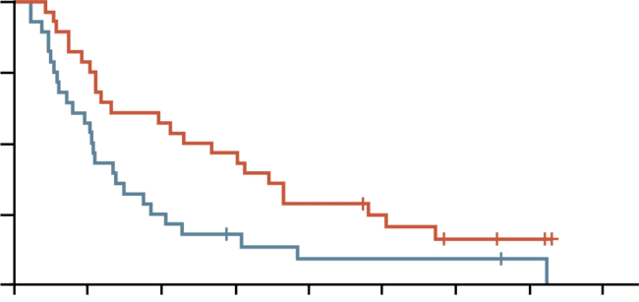
Locoregional therapies: standalone evidence
TARE FOR ADVANCED HCC – Dosisphere-01 Phase 2
SIRT with personalised
dosimetry
28 treated patients
Large HCC
Mainly BCLC-C
R
mITT population
N=56*
SIRT with standard
dosimetry
28 treated patients
MEDIAN OVERALL SURVIVAL
OVERALL SURVIVAL RATES
1.00
OS rate (%) | 2 years | 3 years | 5 years
Personalised vs. standard dosimetry | 50.0 vs. 17.8 | 35.7 vs. 13.3 | 16.4 vs. 8.9
Tumour dose ≥205 Gy vs. <205 Gy | 48.5 vs. 13.3 | 35.7 vs. 13.3 | 18.3 vs. 6.7
Resected vs. not resected | 81.8 vs. 22.2 | 63.6 vs. 15.0 | 53.0 vs. 2.5
HR = 0.51, p=0.02
ORR at 3 months was 79% vs 43%
0.75
OS probability
Personalised
dosimetry
24.8 mo
0.50
0.25
Standard
dosimetry
10.7 mo
0
0
10
20
30
40
50
60
70
80
Follow-up (months)
Patients with advanced HCC treated with personalized TARE dosimetry have a median OS of 24.8 months and half of them are alive at 5 years if downstaged to resection
BCLC-C, Barcelona Clinic Liver Cancer Stage C; HCC, hepatocellular carcinoma; HR, hazard ratio; mITT, modified intent-to-treat population; mo, months; OS, overall survival; ORR, objective response rate; *The study was designed for 254 patients, and stopped preliminary due to a predetermined efficacy criterion
Garin E, et al. J Nucl Med. 2024;65:264-269

Slide 16

Locoregional therapies in intermediate hcc
Summary: achieved results for TACE and tare (Y90)
TACE (Transarterial Chemoembolisation):
  Historically, TACE has been the standard of care for unresectable HCC^{1,2}
  It offers a favourable response rate and is generally well-tolerated³ but has limitations, including a shorter time to progression⁴ and a lack of the ablative capability seen with TARE⁵
  While it has the most supporting evidence, TACE usage is declining,⁶ especially in the USA, where TARE and systemic therapies are increasingly favoured⁷⁻⁹
TARE (Transarterial Radioembolisation):
  TARE is frequently used for patients with more localised disease (BCLC stage A)^{10,11} and as an ablative treatment for larger tumours or those with macrovascular invasion^{12,13}
  In the USA, TARE is now the most common bridging therapy for liver transplant candidates⁹
  Its use in combination with IO regimens shows promise and is being investigated with multiple ongoing trials^{14,15}
  TARE may have a unique mechanism of action by modulating the immune microenvironment,¹⁶ distinct from TACE
  TARE can induce liver remnant hypertrophy and enable resection¹⁷
BCLC-A, Barcelona Clinic Liver Cancer Stage A; HCC, hepatocellular carcinoma; TACE, transarterial chemoembolisation; TARE, transarterial radioembolisation; USA, United States of America; Y90, yttrium 90
1. Gao H, et al. BMJ Support Palliat Care. 2023;14(e2):e003870; 2. ASCO Daily News. EMERALD-1 Trial Shows PFS Benefit With Addition of Durvalumab/Bevacizumab to TACE in Unresectable, Embolization-Eligible HCC. Available here (accessed January 2025); 3. Kotsifa E, et al. J Pers Med. 2022;12:436; 4. Brown AM, et al. Cancer Med. 2023;12:2590-2599; 5. Young S and Golzarian J. AJR Am J Roentgenol. 2020;215:223-234; 6. Pelizzaro F, et al. Fron Oncol. 2022;12:822507; 7. Ahn JC, et al. J Nucl Med. 2021;62:1692-1701; 8. Coffman-D’Annibale K, et al. Carcinogenesis. 2023;44:537-548; 9. Expert input; 10. Badar W, et al. Oncologist. 2024;29:117-122; 11. Guiu B, et al. Cardiovasc Intervent Radio. 2022;45:1599-1607; 12. Kim J, et al. J Nucl Med. 2022;63:1215-1222; 13. Garin E, et al. J Nucl Med. 2024;65:264-269; 14. Clinicaltrials.gov: NCT03040099 15. ClinicalTrials.gov: NCT05063565;16. Chew V, et al. Gut. 2019;68:335-346; 17. Entezari, P., RadioGraphics. 2022;42:2166-2183;

Slide 17
LRT vs systemic treatment studies
Reasons why we see more phase 3 studies for systemic treatments
Randomising patients to a procedural arm versus a non-procedural arm raises ethical concerns when Phase 2 results show efficacy and safety of the procedure
Local treatments require resources and expertise that may not be available in all centres
Perceived lack of standardisation in LRT
Funding for LRT studies can be limited
Post-progression options confound OS analyses for earlier-stage disease treatments
Not all patients who are candidates for local therapy are referred for treatment
Systemic therapy trials are often designed for later-stage disease and enrol quickly
LRT studies can take a long time to enrol in which there may be a change in SoC at the time of completion
Similarly, there are limited Phase 3 data for surgical studies
Getting data for locoregional therapies is not the same as getting data for systemic treatments
Expert input
BCLC, Barcelona Clinic Liver Cancer (algorithm); OS, overall survival; LRT, locoregional therapy; SoC, standard of care

Slide 18
atezolizumab + bevacizumab (IMbrave150) study design
Stratification
Region (Asia, excluding Japan/rest of world)
ECOG PS (0/1)
Macrovascular invasion (MVI) and/or extrahepatic spread (EHS) (presence/absence)
Baseline ɑ-fetoprotein
(AFP; <400/≥400 ng/mL)
Atezolizumab
1200 mg
+ bevacizumab
15 mg/kg IV Q3W
Key eligibility criteria
Locally advanced or metastatic and/or unresectable HCC
No prior systemic therapy
Until loss of clinical benefit or unacceptable toxicity
Survival
follow-up
R
2:1
N=501
Sorafenib
400 mg BID
(open-label)
Primary endpoints
OS
IRF-assessed PFS per RECIST 1.1
Secondary efficacy endpoints
IRF-assessed ORR and DoR per RECIST 1.1
IRF-assessed ORR and DoR per HCC mRECIST
BID, twice daily; DoR, duration of response; ECOG, Eastern Cooperative Oncology Group performance status; HCC, hepatocellular carcinoma; IO, immuno-oncology; IRF, independent review facility; IV, intravenous; (m)RECIST, (modified) Response Evaluation Criteria in Solid Tumours; Q3W, every 3 weeks; R, randomisation; ORR, objective response rate; OS, overall survival
Finn RS, et al. N Engl J Med. 2020;382:1894-1905;

Slide 19
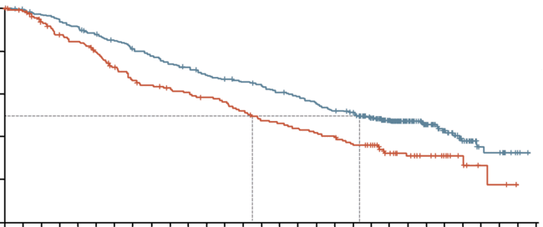
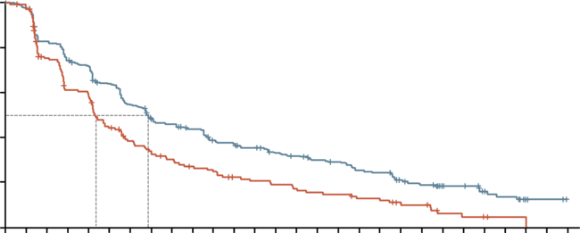
atezolizumab + bevacizumab (IMbrave150) results: OS and PFS benefit versus sorafenib (updated)
With additional 12 months of follow-up, atezolizumab + bevacizumab continued to demonstrate a consistent clinically meaningful treatment benefit vs sorafenib
OVERALL SURVIVAL
PROGRESSION FREE SURVIVAL
 | Atezo + bev (n=336) | Sorafenib (n=165)
Median OS (95% CI), mo | 19.2 (17.0-23.7) | 13.4 (11.4-16.9)
Stratifiedª HR (95% CI) | 0.66 (0.52-0.85)
p value | <0.001*
 | Atezo + bev (n=336) | Sorafenib (n=165)
Median PFS (95% CI), mo | 6.9 (5.7-8.6) | 4.3 (4.0-5.6)
Stratifiedª HR (95% CI) | 0.65 (0.53-0.81)
p value | <0.001*
1.0
1.0
0.8
0.8
0.6
0.6
OS estimate
PFS estimate
0.4
0.4
0.2
0.2
0
13.4
19.2
0
4.3
6.9
0
1
2
3
4
5
6
7
8
9
10
11
12
13
14
15
16
17
18
19
20
21
22
23
24
25
26
27
28
29
0
1
2
3
4
5
6
7
8
9
10
11
12
13
14
15
16
17
18
19
20
21
22
23
24
25
26
27
No. at risk (censored)
Atezo + bev
Sorafenib
Time (months)
No. at risk (censored)
Atezo + bev
Sorafenib
Time (months)
336 (0) | 320 (6) | 302 (6) | 276 (10) | 252 (11) | 233 (12) | 214 (14) | 202 (16) | 186 (17) | 164 (17) | 134 (37) | 80 (87) | 42 (120) | 12 (145) | 2 (154) | 0 (156)
165 (0) | 144 (11) | 128 (13) | 106 (17) | 92 (19) | 85 (21) | 78 (22) | 66 (22) | 61 (22) | 55 (22) | 44 (28) | 24 (43) | 12 (55) | 3 (63) | 0 (65) | 0 (65)
336 (0) | 271 (8) | 234 (10) | 174 (14) | 141 (19) | 113 (24) | 102 (27) | 88 (31) | 77 (35) | 64 (35) | 41 (45) | 25 (60) | 12 (68) | 3 (76)
165 (0) | 110 (18) | 84 (19) | 52 (23) | 39 (25) | 31 (26) | 24 (28) | 19 (28) | 17 (28) | 13 (29) | 9 (31) | 3 (33) | 1 (35) | 0 (35)
ª Stratification factors included are geographic region (Asia excluding Japan vs RoW), AFP level (<400 ng/mL vs ≥400 ng/mL) at baseline, and MVI and/or EHS (yes vs no) per IxRS;
* p value for descriptive purposes only
atezo, atezolizumab; AFP, alpha fetoprotein; bev, bevacizumab; CI, confidence interval; EHS, extrahepatic spread; HR, hazard ratio; IO, immuno-oncology; IxRS, interactive voice/web response system; mo, months; MVI, macrovascular invasion; PFS, progression free survival; OS, overall survival; RoW, rest of world;
Cheng A-L, et al. J Hepatol. 2022;76:862-873

Slide 20
atezolizumab + bevacizumab (IMbrave150) summary
Atezolizumab + bevacizumab continued to demonstrate a consistent clinically meaningful treatment benefit vs sorafenib at 12 months additional follow-up
The safety and tolerability of atezolizumab + bevacizumab remains consistent with the known safety profiles of each individual drug and the underlying disease
The combination is the standard of care for previously untreated, unresectable HCC
HCC, hepatocellular carcinoma; IO, immuno-oncology
Finn RS, et al. N Engl J Med. 2020;382:1894-1905; Cheng A-L, et al. J Hepatol. 2022;76:862-873

Slide 21
durvalumab + tremelimumab (HIMALAYA) study design
Study population
Adults with confirmed uHCC
Child–Pugh A
BCLC B (not eligible for locoregional therapy) or C
No prior systemic therapy for HCC
ECOG PS 0 or 1
No main portal vein thrombosis
EGD was not required
Stratification factors
Aetiology of liver disease: HBV vs HCV vs non-viral
MVI: yes vs no
ECOG PS: 0 vs 1
STRIDE (n=393):
tremelimumab 300 mg × 1 dose
+ durvalumab 1500 mg Q4W
Key objectives
Primary:
OS superiority: STRIDE vs sorafenib
Secondary:
OS non-inferiority: durvalumab vs sorafenib
36-month OS rate
PFS, ORR, and DCR (investigator-assessed per RECIST v1.1)
Safety
R
Durvalumab (n=389):
durvalumab monotherapy
1500 mg Q4W
(N=1171)
Sorafenib (n=389):
sorafenib 400 mg BID
T75+D (n=153): arm closed to enrolmentª
tremelimumab 75 mg Q4W × 4 doses
+ durvalumab 1500 mg Q4W
Multiple testing procedure
OS superiority for
STRIDE vs sorafenib
OS non-inferiority for durvalumab vs sorafenib
Non-inferiority margin 1.08
OS superiority for
durvalumab vs sorafenib
36-month OS rate for STRIDE vs sorafenib
Treatment continued until unacceptable toxicity, or any discontinuation criteria were met. Participants with progressive disease who, in the investigator’s opinion, continued to benefit from
treatment and met the criteria in the setting of progressive disease could continue treatment
ª The T75+D arm (75 mg of tremelimumab Q4W for four doses plus 1500 mg of durvalumab Q4W) was closed following a preplanned analysis of a Phase 2 study. Participants randomised to this arm (n=153) could continue treatment following arm closure. Results from this arm are not reported in this presentation
BCLC-B/C, Barcelona Clinic Liver Cancer Stage B/C; BID, twice daily; DCR, disease control rate; ECOG PS, Eastern Cooperative Oncology Group performance status; EGD, esophagogastroduodenoscopy; HBV/HCV, hepatitis B/C virus; HCC, hepatocellular carcinoma; IO, immuno-oncology; MVI, macrovascular invasion; ORR, objective response rate; OS, overall survival; PFS, progression-free survival; Q4W, every 4 weeks; R, randomised; RECIST, Response Evaluation Criteria in Solid Tumours; STRIDE, single tremelimumab regular interval durvalumab; uHCC, unresectable HCC
Abou-Alfa GK, et al. NEJM Evid. 2022;1:EVIDoa2100070; Rimassa L, et al. ESMO 2024. Abstract #947MO

Slide 22
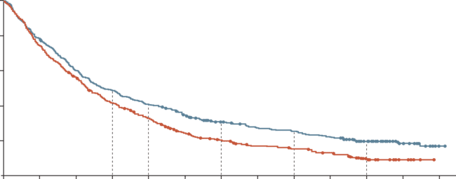
durvalumab + tremelimumab (HIMALAYA)
RESULTS: STRIDE Demonstrated a sustained OS benefit at 5 years
1.0
 | STRIDE (n=393) | Sorafenib (n=389)
OS events, n (%) | 309 (78.6) | 332 (85.3)
Median OS (95% CI), mo | 16.43 (14.16-19.58( | 13.77 (12.25-16.13)
HR (95% CI) p value (2-sided) | 0.76 (0.65-0.89) 0.0008
Median follow-up duration (95% CI), mo | 62.49 (59.47-64.79) | 59.86 (58.32-61.54)
0.8
0.6
18-mo OS:
48.7%
41.5%
24-mo OS:
40.5%
32.6%
Probability of OS
36-mo OS:
30.7%
19.9%
0.4
OS rate
ratio: 1.17
48-mo OS:
25.2%
15.1%
60-mo OS:
19.6%
9.4%
OS rate
ratio: 1.24
0.2
OS data maturity
across the STRIDE and
sorafenib arms: 82.0%
OS rate
ratio: 1.54
OS rate
ratio: 1.67
OS rate
ratio: 2.09
0.0
0
6
12
18
24
30
36
42
48
54
60
66
72
No. at risk
STRIDE
Sorafenib
Time from randomisation (months)
393
389
308
283
235
211
190
155
158
121
131
84
104
66
89
51
83
45
72
37
46
18
20
6
2
0
There were no additional serious safety events
OS benefit with STRIDE was enhanced in participants experiencing disease control
(OS rates of 28.7% for STRIDE vs 12.7 for sorafenib at 5 years)
OS HRs and 95% CIs were calculated using a Cox proportional hazards model adjusting for treatment aetiology, ECOG PS, and MVI. Updated analysis data cutoff: March 1, 2024
CI, confidence interval; ECOG PS, Eastern Cooperative Oncology Group performance status; HR, hazard ratio; IO, immuno-oncology; mo, months; MVI, macrovascular invasion; OS, overall survival; STRIDE, single tremelimumab regular interval durvalumab
Rimassa L, et al. ESMO 2024. Abstract #947MO. Oral presentation

Slide 23
durvalumab + tremelimumab (HIMALAYA) summary
STRIDE demonstrated an unprecedented 5-year survival rate
  There were no additional serious treatment-related adverse events (TRAEs) in the extended follow-up
The results set a new benchmark in uHCC, with one in five patients alive with
STRIDE at 5 years
IO, immuno-oncology; STRIDE, single tremelimumab regular interval durvalumab
Rimassa L, et al. ESMO 2024. Abstract #947MO

Slide 24
nivolumab + ipilimumab (CheckMate 9DW) study design
Key eligibility criteria
uHCCª
≥1 measurable lesion (RECIST v1.1)
Systemic therapy naive
Child–Pugh score 5 or 6
ECOG PS 0 or 1
No main portal vein invasion (Vp4)
NIVO 1 mg/kg IV + IPI 3 mg/kg IV Q3W (up to 4 cycles) then NIVO 480 mg Q4W^{c}
Primary endpoint
OS
Secondary endpoints
ORR and DoR by BICR per RECIST v1.1
Key exploratory endpoints
PFS by investigator per RECIST v1.1
PFS2 by investigator
Safety
n=335
N=668
R
1:1
Investigator’s choice of LEN 8 mg^{d} or
12 mg^{e} PO QD or SOR 400 mg PO BID
n=333
Stratification factors
Aetiology (HBV vs HCV vs uninfected)^{b}
MVI/EHS (present vs absent)
AFP (<400 vs ≥400 ng/mL)
Treatment until disease progression, unacceptable toxicity, withdrawal of consent (all arms), or a maximum treatment duration of 2 years (NIVO + IPI arm only)
Among 325 patients treated with LEN or SOR:
275 (85%) received LEN and 50 (15%) received SOR
At data cutoff (January 31, 2024), the median follow-up^{f} was 35.2 months (range, 26.8-48.9)
ª Disease not eligible for, or progressive disease after, curative surgical and/or locoregional therapies; ^{b} Based on central lab serology results for stratification purpose;
^{c} Minimum of 1 dose of nivolumab + ipilimumab is required before proceeding to nivolumab monotherapy; ^{d} If body weight <60 kg; ^{e} If body weight ≥60 kg; ^{f} Time between randomisation date and cutoff date
AFP, alpha-fetoprotein; BICR, blinded independent central review; BID, twice daily; DoR, duration of response; ECOG PS, Eastern Cooperative Oncology Group performance status; EHS, extrahepatic spread; HBV/HCV, hepatitis B/C virus; IO, immuno-oncology; IPI, ipilimumab; IV, intravenous; LEN, lenvatinib; MVI, macrovascular invasion; NIVO, nivolumab; ORR, objective response rate; OS, overall survival; PFS, progression-free survival; PFS2, second PFS; PO, oral; Q3W, every 3 weeks; Q4W, every 4 weeks; QD, once daily; R, randomised; RECIST, Response Evaluation Criteria in Solid Tumours; SOR, sorafenib; uHCC, unresectable hepatocellular carcinoma; Vp, vascular portal (classification)
ClinicalTrials.gov: NCT04039607; Decaens T, et al. ESMO 2024. Abstract #965MO. Oral presentation

Slide 25
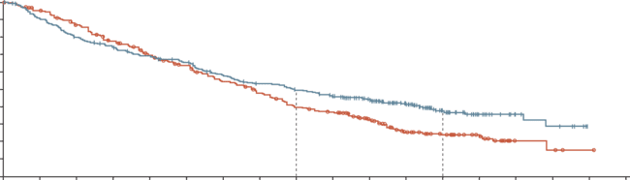
nivolumab + ipilimumab (CheckMate 9DW)
RESULTS: Primary endpoint was met
There was a statistically significant and clinically meaningful OS benefit with nivolumab + ipilimumab versus lenvatinib or sorafenib
OS
TRAEs
 | NIVO + IPI (n=335) | LEN or SOR (n=333)
Events | 194 | 228
Median OS (95% CI), mo | 23.7 (18.8-29.4) | 20.6 (17.5-22.5)
HR (95% CI) p valueª | 0.79 (0.65-0.96) 0.018
All treated patients, n (%) | Nivolumab + ipilimumab (n=332) |  |  | Lenvatinib or sorafenib (n=325)
 | Any grade | Grade 3 or 4 | Any grade leading to D/C | Any grade | Grade 3 or 4 | Any grade leading to D/C
Any TRAEs^{b} | 278 (84) | 137 (41) | 59 (18) | 297 (91) | 138 (42) | 34 (10)
Treatment-related hepatic events
Hepatobiliary disorders | 44 (13) | 35 (11) | 15 (5) | 15 (5) | 10 (3) | 4 (1)
Hepatobiliary investigations^{c} AST increased ALT increased Bilirubin increased | 65 (20) 63 (19) 14 (4) | 20 (6) 16 (5) 1 (<1) | 4 (1) 3 (<1) 1 (<1) | 27 (8) 19 (6) 23 (7) | 2 (<1) 3 (<1) 5 (2) | 1 (<1) 0 1 (<1)
Treatment-related deaths^{d} | 12 (4)^{e} |  |  | 3 (<1)^{f}
100
90
80
70
24-mo rate
60
49%
36-mo rate
OS (%)
50
40
38%
NIVO + IPI
30
39%
20
24%
10
LEN/SOR
0
0
3
6
9
12
15
18
21
24
27
30
33
36
39
42
45
48
51
Time (months)
No. at risk
NIVO + IPI
LEN/SOR
335
333
300
310
264
280
239
245
220
216
206
194
179
164
162
144
150
116
137
106
104
76
71
44
42
34
24
20
11
4
8
3
0
1
0
0
Median OS is estimated using Kaplan–Meier methodology. HR and 95% CI from stratified Cox proportional hazards model. HR is nivolumab + ipilimumab over lenvatinib or sorafenib. Symbols represent censored observations
ª Two-sided p value from stratified log-rank test. Boundary for statistical significance: p≤0.0257; ^{b} Includes events reported between first dose and 30 days after the last dose of study therapy; ^{c} Reported in ≥5% of patients; ^{d} Treatment-related deaths were reported irrespective of timeframe; ^{e} TRAEs leading to death included immune-mediated hepatitis (n=4), hepatic failure (n=3), and hepatic insufficiency, decompensated cirrhosis, diarrhoea-colitis, autoimmune haemolytic anaemia, and dysautonomia (n=1 each). In the nivolumab + ipilimumab arm, 2 patients with hepatic-related causes of death died at least 90 days after the last dose of study treatment. Furthermore, disease progression per BICR was confirmed in 1 patient (with hepatic failure as cause of death) and was suspected by imaging test in 3 additional patients (2 with immune-mediated hepatitis as cause of death and one with hepatic cirrhosis as cause of death); ^{f} TRAEs leading to death included hepatorenal syndrome, ischaemic stroke, and acute kidney injury (n = 1 each)
ALT, alanine aminotransferase; AST, aspartate aminotransferase; BICR, blinded independent central review; CI, confidence interval; D/C, discontinuation; HR, hazard ratio; IO, immuno‑oncology; IPI, ipilimumab; LEN, lenvatinib; NIVO, nivolumab; mo, months; OS, overall survival; SOR, sorafenib; TRAE, treatment-related adverse event
Decaens T, et al. ESMO 2024. Abstract #965MO. Oral presentation

Slide 26
nivolumab + ipilimumab (CheckMate 9DW) summary
Nivolumab + ipilimumab demonstrated statistically significant OS benefit versus lenvatinib or sorafenib, with higher ORR and durable responses, in patients with previously untreated uHCC¹
Safety was manageable and consistent with the established safety profile of the regimen
  Most treatment-related hepatic events were grade 1 / 2 laboratory abnormalities
  The majority of the immune-mediated adverse events were grade 1 / 2 and did not result in treatment discontinuation
Results further support nivolumab + ipilimumab as a 1st line treatment option for patients with uHCC²
IO, immuno-oncology; OS, overall survival; ORR, objective response rate; OS, overall survival; uHCC, unresectable HCC
1. Decaens T, et al. ESMO 2024. Abstract #965MO. Oral presentation 2. Nivolumab Plus Ipilimumab Receives EC Approval for First-Line Unresectable HCC. Available here (accessed March 2025)

Slide 27
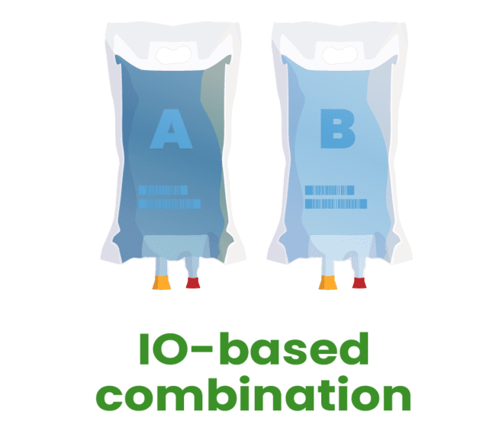
IO-based therapies for unresectable HCC summary: achieved results for IO-based standalone therapies
Atezolizumab + bevacizumab is an IO-based combination approved for 1st line treatment for patients with unresectable HCC¹
  ORR 30%, mOS 19.2 months²
Durvalumab + tremelimumab (STRIDE) is a dual IO combination approved for 1st line treatment for patients with unresectable HCC³
  20% survival rate at 5 years.⁴
  Among the 5-year survival, some patients had stable disease while treated with the STRIDE regimen
Nivolumab + ipilimumab is a dual IO combination and received EC approval for 1st line treatment for patients with unresectable HCC⁶
  ORR 36%,⁵ mOS 23.7 months⁵, median duration of response >30 months⁵
IO and IO-based therapies are generally well-tolerated and immune-related adverse events can be managed with steroids³⁻⁵
IO and IO-based combinations have revolutionised the systemic treatment of unresectable HCC
HCC, hepatocellular carcinoma; IO, immuno-oncology; mOS; median overall survival; ORR, objective response rate; STRIDE; Single Tremelimumab Regular Interval Durvalumab
1. Jain A, et al. World J Hepatol. 2021;13:1132-1142; 2. Cheng A-L, et al. J Hepatol. 2022;76:862-873; 3. Fujii Y, et al. Oncology. 2024. doi: 10.1159/000542517 (Online ahead of print); 4. Rimassa L, et al. ESMO 2024. Abstract #947MO. Oral presentation; 5. Decaens T, et al. ESMO 2024. Abstract #965MO. Oral presentation; 6. Nivolumab Plus Ipilimumab Receives EC Approval for First-Line Unresectable HCC. Available here (accessed March 2025)

Slide 28
The expanding role of IO-based combinations in intermediate hcc
Exploring IO in combination with LRT
HCC, hepatocellular carcinoma; IO, immuno-oncology; LRT, locoregional therapy;

Slide 29
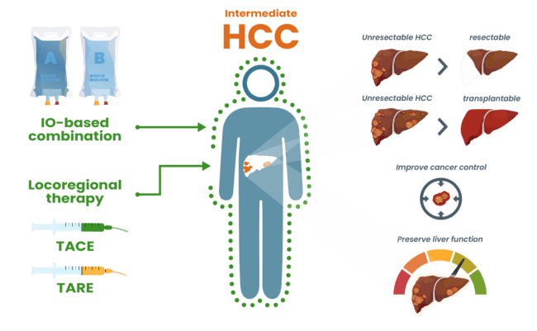
Exploring IO-based treatments combined with LRT
HCC, hepatocellular carcinoma; IO, immuno-oncology; LRT, locoregional therapy; TACE, transarterial chemoembolisation; TARE, transarterial radioembolisation;

Slide 30






Exploring IO-based treatments combined with LRT
Strengths of one therapy mitigate weaknesses of the other
Overview of the contemporary and potential use of Y90 and IO across the BCLC spectrum
Contemporary clinical use
Y90-RE | A – Early Solitary, 3 up to 3 cm | B – Intermediate |  |  | C – Advanced
ICI +/– anti-VEGF
 |  | Extended transplant | Well-defined tumours | Infiltrative, bilobar | Vascular invasion | Extrahepatic metastasis
BCLC Stage |  | Extended transplant | Well-defined tumours | Infiltrative, bilobar | Vascular invasion | Extrahepatic metastasis
Y90-RE limitations potentially addressed with ICI | Out of field progression |  |  | Narrow therapeutic index
 | Watershed regions
 |  |  | Complete tumour coverage
 |  |  | Microsatellite disease
ICI limitations potentially addressed with Y-90-RE |  |  | Low response rates (<30%)
 |  |  | Tolerability and candidacy of full ICI regimens
 |  |  | Immunologically cold tumours and microenvironments
Potential combination treatment strategies | High-risk biology: Y90-RE primary, ICI adjuvant | Y90-RE primary, ICI adjuvant | Y90-RE primary, ICI adjuvant | ICI primary, Y90-RE adjuvant | If Vp1-Vp2: Y90-RE primary, ICI adjuvant | ICI primary, Y90-RE adjuvant
Advantages of combination | Less malignant subclone selection, unaddressed microscopic disease, cancer vaccine? |  |  | Increase ORR, immune modulation, downstage to resection, FLR hypertrophy
Disadvantages of combination | Need for ICI washout in peri-transplant setting, additional adverse event profile |  |  | Hepatic decompensation risk, limiting efficacy of ICIs
The combination of locoregional therapies and IO-based treatments
could improve local and systemic control of the disease
BCLC, Barcelona Clinic Liver Cancer (algorithm); FLR, future liver remnant; ICI, immune checkpoint inhibitor; IO, immuno-oncology; LRT, locoregional therapy; ORR, overall response rate; RE, radioembolisation; VEGF, vascular endothelial growth factor; Vp, vascular portal (classification); Y90, yttrium 90
Malone CD, et al. J Vasc Interv Radiol. 2024;S1051-0443(24)00718-8

Slide 31
Exploring IO-based treatments combined with LRT in hCC
Synergistic effects vs additive effects
Synergy refers to a therapy combination that is more efficacious than the sum of its individual parts
  LRT can enhance the release of tumour antigens and modify the tumour immune microenvironment. This may synergise with IO to strengthen the anti-tumour immune response, which in turn improves local therapy outcomes
Additive refers to a therapy combination that is efficacious up to the sum of its individual parts:
  If a combination of locoregional and systemic treatment is used, it must generally demonstrate outcomes that surpass the results achieved in the individual trials of each approach
A deep dive into tumour characteristics is needed for proper patient selection and treatment design
  Identifying which patient presentation and tumour phenotypes benefit from the treatment intensification of combination IO and LRT is a critical next step for more universal adoption
  There may be some patients who are interested in the potential benefit of combination prior to maturation of these data due to clinically observed durable effects in select cases
HCC, hepatocellular carcinoma; IO, immuno-oncology; LRT, locoregional therapy;
Malone CD, et al. J Vasc Interv Radiol. 2024;S1051-0443(24)00718-8; Expert input;

Slide 32
Exploring IO-based treatments combined with LRT
What would be the main treatment modality in intermediate hcc?
Locoregional therapies as primary therapy:
  Locoregional therapy targets and optimises the definitive treatment of visible disease
  IO-based treatment addresses presumed invisible disease and enhances systemic antitumour immune response
Considerations
  Therapeutic goals:
    Downstaging / bridge to curative treatment may favour locoregional therapy as the main treatment modality
    Systemic control may favour IO-based therapy as the main treatment modality
  Disease load:
    Earlier stages (intermediate) / limited amount of disease may favour locoregional therapy first
    More extensive disease may favour IO-based therapy first
  Liver reserve:
    Locoregional therapy is appropriate for good liver reserve
    IO-based therapy can be considered when local therapy may cause liver dysfunction
Efficacy of the combination of therapies is likely optimised when given in “relatively close proximity”
There is insufficient evidence to declare one sequencing strategy universally better than others
HCC, hepatocellular carcinoma; IO, immuno-oncology; LRT, locoregional therapy
Williamson CW, et al. Cancer. 2021;127:1553-67 and expert input

Slide 33
IO-based treatments combined with LRT emerald-1: study design
Study populationª
Adults with confirmed HCC
Not amenable to curative therapy, e.g. surgical resection, ablation, transplantation
No extrahepatic disease
Child-Pugh A to B7
ECOG PS 0 or 1
Measurable disease per mRECIST
Excludes Vp3 and Vp4
No prior systemic therapy or TACE^{b}
Arm A:
Durvalumab^{c}
(1500 mg Q4W)
+ TACE^{d}
Durvalumab
(1120 mg Q3W) + placebo for bevacizumab (Q3W)
Endpoints
Primary:
PFS^{e} for Arm B vs Arm C using BICR per RECIST 1.1
Key secondary:
PFS for Arm A vs Arm C
OS
QoL
Other secondary:
ORR and TTP using BICR per RECIST 1.1
Safety
PFS, ORR and TTP using investigator and BICR per mRECIST
R
1:1:1
Arm B:
Durvalumab^{b}
(1500 mg Q4W)
+ TACE^{d}
Durvalumab
(1120 mg Q3W) + bevacizumab
(15 mg/kg Q3W)
N=616
Arm C:
Placebo for
durvalumab (Q4W) + TACE^{d}
Placebo for durvalumab
(Q3W) + placebo for bevacizumab (Q3W)
Stratification factors
TACE MODALITY (DEB-TACE vs cTACE)
Geographical region (Japan vs Asia
[excluding Japan] vs other)
Portal vein invasion (Vp1 or
Vp2+/-Vp1 vs none)
(open-label)
ª Upper endoscopy to evaluate varices and risk of bleeding was required within 6 months of randomisation; ^{b} Prior use of TACE or TAE is acceptable if it was used as part of therapy with curative intent, but not if it was used as the sole modality in curative therapy; ^{c} Durvalumab/placebo started ≥7 days after TACE; ^{d} DEB-TACE or cTACE, Participants will receive up to 4 TACE procedures within the 16 weeks following Day 1 of their first TACE procedure; ^{e} Only new lesions consistent with progression that were not eligible for TACE occurring prior to the first on study imaging at
12 weeks were considered progression events; standard mRECIST progression criteria was used after the 12-week imaging
BICR, blinded independent central review, cTACE, conventional TACE; DEB-TACE, drug-eluting TACE; ECOG PS, Eastern Cooperative Oncology Group performance status; HCC, hepatocellular carcinoma; IO, immuno-oncology; LRT, locoregional therapy; (m)RECIST, (modified) Response Evaluation Criteria in Solid Tumours; ORR, objective response rate; OS, overall survival; PFS, progression-free survival; Q3W/Q4W, every 3/4 weeks; QoL, quality of life; R, randomisation; TACE, transarterial chemoembolisation; TAE, transarterial embolisation; TTP, time to progression; Vp, vascular portal (classification)
Lencioni R, et al. J Clin Oncol. 2024;42(3 suppl)LBA432. DOI:10.1200/JCO.2024.42.3_suppl.LBA432; Sangro B, et al. Lancet. 2025;405:216-232

Slide 34
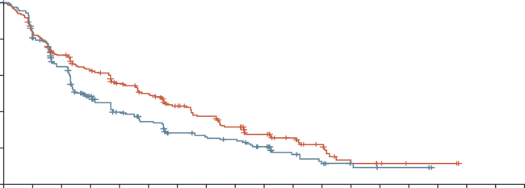
IO-based treatments combined with LRT emerald-1: results – primary endpoint was met
Median PFS was improved with durvalumab + bevacizumab + TACE versus placebos + TACE
No new safety signals were identified
Patients continue to be followed for OS
 | Median PFS (95% CI), months | HR (95% CI) | Stratified log-rank p value
Durvalumab plus bevacizumab plus TACE group (n=204) | 15.0 (11.1-18.9) | 0.77 (0.61-0.98) | 0.032*
Placebos + TACE group (n=205) | 8.2 (6.9-11.1)
100
80
12-mo PFS
55.5%
39.8%
60
18-mo PFS
43.1%
28.3%
Progression-free survival (%)
40
Durvalumab plus bevacizumab + TACE group
20
Placebo + TACE group
0
Number at risk
(number censored)
Durvalumab plus
bevacizumab + TACE group
Placebos + TACE group
0
3
6
9
12
15
18
21
24
27
30
33
36
39
42
45
48
51
54
Time (months)
204
(0)
205
(0)
162
(11)
159
(7)
134
(14)
121
(15)
114
(19)
81
(25)
94
(26)
62
(30)
82
(29)
51
(33)
64
(36)
39
(36)
53
(39)
35
(37)
43
(41)
32
(38)
32
(47)
24
(41)
23
(54)
15
(46)
15
(59)
10
(48)
6
(62)
2
(52)
4
(64)
2
(54)
2
(66)
0
(54)
2
(66)
0
(56)
0
(68)
0
(56)
0
(68)
0
(56)
0
(68)
0
(56)
* Threshold of significance: 0.044
CI, confidence interval; HR, hazard ratio; LRT, locoregional; IO, immuno-oncology; OS, overall survival; PFS, progression-free survival; TACE, transarterial chemoembolisation
Sangro B, et al. Lancet. 2025;405:216-232

Slide 35
IO-based treatments combined with LRT emerald-1: summary
EMERALD-1 met its primary endpoint:
  Median PFS was 15.0 months with D+B+TACE and 8.2 months with placebo + TACE
  PFS HR was 0.77, p=0.032
PFS benefit with D+B+TACE was generally consistent across key clinical subgroups.
The safety profile was manageable and consistent with the known safety profile of TACE, durvalumab and bevacizumab in unresectable HCC
Durvalumab + bevacizumab + TACE has the potential
to set a new standard of care
B, bevacizumab; D, durvalumab; HCC, hepatocellular carcinoma; HR, hazard ratio; IO, immuno-oncology; LRT, locoregional therapy; PFS, progression-free survival; TACE, transarterial chemoembolisation
Sangro B, et al. Lancet. 2025;405:216-232

Slide 36
IO-based treatments combined with LRT
LEAP-012 – Background and study design^{1,2}
Key eligibility criteria
Confirmed HCC not amenable to curative treatment
≥1 measurable HCC lesion per RECIST v1.1
All lesions treatable with TACE in 1 or 2 sessions
No portal vein thrombosis or extrahepatic disease
Child–Pugh liver class A
ECOG PS 0 or 1
Lenvatinib 12 mg (BW ≥60 kg) or
8 mg (BW <60 kg) PO QD
+
pembrolizumab 400 mg IV Q6W (up to 2 years)
+
TACE^{b}
Endpoints
Primary
PFS^{c} and OS
  IA1 is the final analysis for PFS
  Initial alpha of 0.025 (1-sided) allocated to PFS; passed to OS if PFS is statistically significant
Secondary
Secondary: ORR,^{c,d} DoR,^{c,d} TTP,^{c,d} PFS,^{d} and safety
R
1:1
Placebo PO QD +
placebo IV Q6W (up to 2 years)
+
TACE^{b}
Stratification factors
Study site
AFP (≤400 ng/mL vs >400 ng/mL)
ECOG PS (0 vs 1)
Albumin-bilirubin grade (1 vs 2 or 3)
Tumour burden score^{1,a} (≤6 vs >6 but ≤12 vs >12)
ª Largest tumour in cm + number of tumours; ^{b} 2-4 weeks after the start of systemic therapy with a maximum of 2 treatments per tumour (4 total) and no more than 1 treatment per month; ^{c} Per RECIST v1.1 by BICR; ^{d} Per mRECIST by BICR
AFP, alpha fetoprotein; BICR, blinded independent central review; BW, body weight; DoR, duration of response; ECOG PS, Eastern Cooperative Oncology Group performance status; HCC, hepatocellular carcinoma; IA1, interim analysis 1; IO, immuno-oncology; IV, intravenous; LRT, locoregional therapy; (m)RECIST, (modified) RECIST; ORR, objective response rate; OS, overall survival; PFS, progression-free survival; PO, oral; Q6W, every 6 weeks; QD, once daily; R, randomised; TACE, transarterial chemoembolisation; TTP, time to progression
1. ClinicalTrials.gov: NCT04246177; 2. Wang Q, et al. J Hepatol. 2019;70:893-903; 3. Llovet J, et al. ESMO 2024. Abstract #LBA3. Oral presentation

Slide 37
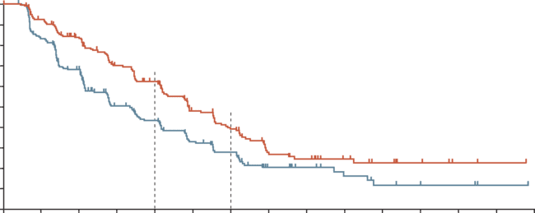
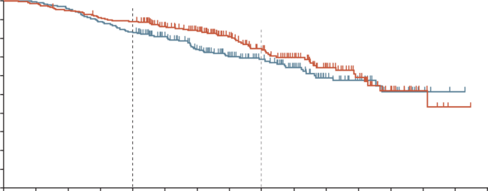
IO-based treatments combined with LRT
LEAP-012 – RESULTS: Primary endpoint in PFS was met
There was a clinically meaningful and statistically significant improvement in PFS for patients with intermediate-stage HCC who received lenvatinib + pembrolizumab + TACE versus dual placebo + TACE
PFS PER RECIST V1.1 BY BICR
OS
 | Lenvatinib + pembrolizumab + TACE | Dual placebo + TACE
Events, n (%) | 69 (29.1) | 82 (33.7)
HR (95% CI) p value^{b} | 0.80 (0.57-1.11) 0.0867
100
 | Lenvatinib + pembrolizumab + TACE | Dual placebo + TACE
Events, n (%) | 132 (55.7) | 154 (63.4)
Median (95% CI), months | 14.6 (12.6-16.7) | 10.0 (8.1-12.2)
HR (95% CI) p valueª | 0.66 (0.51-0.84) 0.0002
100
89.0%
74.6%
90
90
68.6%
80
62.2%
80
83.1%
70
43.4%
70
60
39.1%
60
PFS (%)
27.9%
OS (%)
50
50
40
40
30
30
20
20
10
10
0
0
3
6
9
12
15
18
21
24
27
30
33
36
39
42
0
0
3
6
9
12
15
18
21
24
27
30
33
36
39
42
45
No. at risk
Time (months)
No. at risk
Time (months)
237
243
207
190
176
144
136
89
112
72
72
48
57
37
26
18
22
12
15
8
10
5
7
3
2
3
1
1
0
0
237
243
234
242
224
233
214
216
209
202
180
173
161
145
124
112
95
86
74
65
49
42
31
27
17
15
7
4
1
1
0
0
Although immature, a favourable OS trend was observed
The safety profile of lenvatinib + pembrolizumab, in combination with TACE, was manageable
and consistent with known safety profiles
Data cutoff date for IA1: January 30, 2024; ª One-sided p value from re-randomisation test; threshold p=0.025; ^{b} One-sided p from re-randomisation test; threshold p=0.0012
BICR, blinded independent central review; CI, confidence interval; HCC, hepatocellular carcinoma; HR, hazard ratio; IA1, interim analysis 1; IO, immuno-oncology; LRT, locoregional therapy; OS, overall survival; PFS, progression-free survival; RECIST, Response Evaluation Criteria in Solid Tumours; TACE, transarterial chemoembolisation
Llovet J, et al. ESMO 2024. Abstract #LBA3. Oral presentation; Kudo M, et al. Lancet. 2025;405:203-215

Slide 38
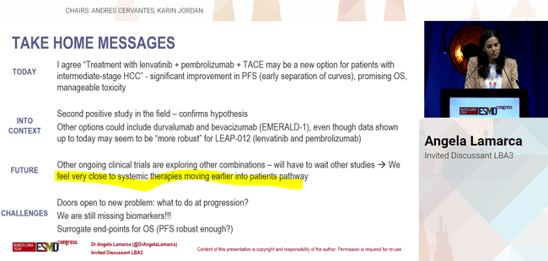
IO-based treatments combined with LRT
LEAP-012 – summary
LEAP-012 met its primary endpoint
  Lenvatinib + pembrolizumab + TACE showed a statistically significant and clinically meaningful improvement in PFS versus double placebo + TACE in patients with intermediate-stage HCC
  There was an early trend toward improvement in OS versus placebo + TACE in patients with intermediate-stage HCC
    OS will be retested in future analyses
The adverse event profile was consistent with known safety profiles of lenvatinib, pembrolizumab, and TACE
  No new safety signals were identified
Lenvatinib + pembrolizumab + TACE may be accepted as a new standard of care in intermediate HCC
HCC, hepatocellular carcinoma; IO, immuno-oncology; LRT, locoregional therapy; OS, overall survival; PFS, progression free survival; TACE, transarterial chemoembolisation
Llovet J, et al. ESMO 2024. Abstract #LBA3. Oral presentation; Kudo M, et al. Lancet. 2025;405:203-215

Slide 39
MDt and multimodal treatment in hcc
HCC, hepatocellular carcinoma; MDT, multidisciplinary team

Slide 40
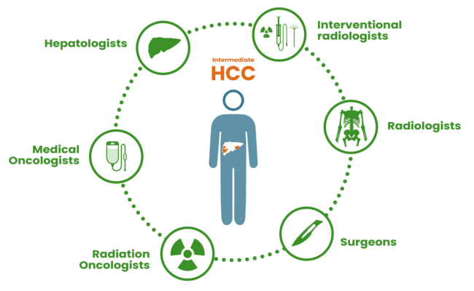
Multidisciplinary team approach for hcc considerations and best practices
HCC care is complex, and requires liver care and HCC treatment, which makes nuanced specialist assessment crucial¹
  Programmatic, multidisciplinary clinical practice, through the course of treatment, is best¹
MDT care is tailored to individual patient needs and provides optimal outcomes¹
  Guidelines provide a foundation, but cannot capture all patient nuances²
  Each specialty optimises its role, achieving more than a single specialist^{1,3}
  Patient needs must always remain the top priority⁴
HCC, hepatocellular carcinoma; MDT, multidisciplinary team
1. Oh JH and Sinn DH. J Liver Cancer. 2024;24:47-56; 2. Matsumoto MM, et al. Cardiovasc Intervent Radio. 2021;44:1070-1080; 3. Naugler WE, et al. Clin Gastroenterol Hepatol. 2015;13:827-835; 4. Suddle A, et al. Gut. 2024;73:1235-1268

Slide 41
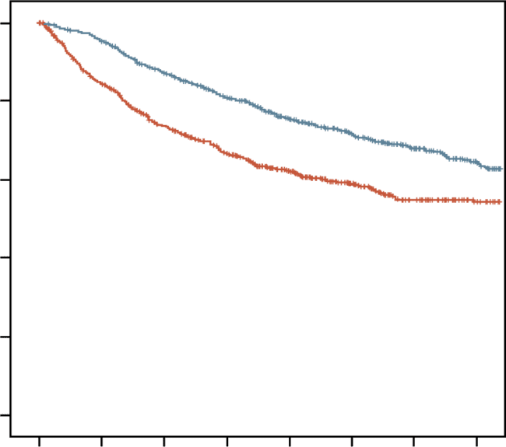
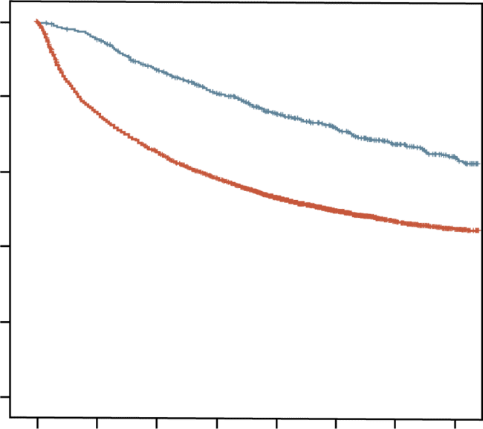
Multidisciplinary team approach for hcc key to offer optimal treatment options to each patient
OS entire cohort¹
OS Exactly Matched cohort¹
Association between multidisciplinary
care and overall survival²
1.0
P<0.001
1.0
P<0.001
Study | Log(HR) | Standard error | Hazard Ratio | HR | 95%-CI | Weight
Yopp 2014 | −0.92 | 0.1034 |  | 0.40 | (0.33; 0.49) | 17.0%
Chirikov 2015 | −0.15 | 0.0487 |  | 0.86 | (0.78; 0.95) | 18.4%
Agarwal 2017 | −0.33 | 0.1379 |  | 0.72 | (0.55; 0.95) | 15.8%
Serper 2017 | −0.19 | 0.0398 |  | 0.83 | (0.77; 0.90) | 18.6%
Sinn 2019 | −0.76 | 0.0655 |  | 0.47 | (0.41; 0.53) | 18.1%
Duininck 2019 | −0.48 | 0.2286 |  | 0.62 | (0.40; 0.97) | 12.2%
Random effects model (HK) |  |  |  | 0.63 | (0.45; 0.88) | 100.0%
Heterogeneity: I² = 95%, P<0.01
0.8
0.8
MDT (+)
MDT (+)
0.6
0.6
Overall survival
MDT (−)
Overall survival
0.4
0.4
MDT (−)
0.2
0.2
0.5
1
2
0.0
0.0
0
1
2
3
4
5
6
7
0
1
2
3
4
5
6
7
Follow-up duration (years)
Follow-up duration (years)
No. at risk
MDT (+)
MDT (−)
738
5881
698
4334
625
3642
543
3108
439
2508
332
1893
248
1398
177
1005
No. at risk
MDT (+)
MDT (−)
698
698
661
574
592
478
515
409
414
320
314
226
239
154
171
112
5 year OS rate 71.4% MDT vs 58.7% non-MDT (P<0.001)
MDT management benefit particularly significant in patients with ALBI 2 and 3 – BCLC B and C – AFP > 200 ng/mL
Multidisciplinary care was significantly associated with improved survival
HCC, hepatocellular carcinoma; IO, immunotherapy; MDT, multidisciplinary team
Sinn DH, et al. PLOS ONE 2019; 2. Dahan et al. Hepatology Communications, 2023

Slide 42
Multidisciplinary team approach for hcc considerations and best practices
Optimizing therapy while preserving liver function is critical for long-term survival of patients¹
  The MDT discussion plays a crucial role in the best treatment approach to optimize treatment opportunities at each stage of disease while managing liver function¹⁻³
The oncologic intent should be clearly defined for
each patient^{2,4}
  The MDT composition may vary based on the oncologic intent⁴
    Curative intent: Eradicate all known disease⁴
    Palliative intent: Improve survival, focus on QoL, disease control, symptom relief, etc.^{2,5} If these patients demonstrate durable response, they may be considered for curative intent⁴
A full window of opportunity and exploration of treatment options within the MDT ensures the best possible outcomes⁴
  The MDT allows for the agile reassessment of patients for modifying the care plan based on treatment response⁴
MDT, multidisciplinary team; QoL, quality of life
1. Naugler WE, et al. Clin Gastroenterol Hepatol. 2015;13:827-835; 2. Suddle A, et al. Gut. 2024;73:1235-1268; 3. Oh JH and Sinn DH. J Liver Cancer. 2024;24:47-56; 4. Miguet M, et al. J Visc Surg. 2019;156:217-227; 5. Woodrell CD, et al. Clin Ther. 2018;40:512-525

Slide 43
conclusions

Slide 44
Conclusions
The expanding role of immunotherapy in hepatocellular carcinoma (HCC) – combining locoregional and systemic treatments in intermediate HCC
IO and IO combinations for advanced and intermediate HCC
  IO and IO combinations are integrated into the 1st line treatment for unresectable HCC
Scientific rationale for IO in intermediate-stage HCC
  Intermediate-stage HCC is heterogeneous. LRT is the current SoC, but there are some patients who will be poor candidates.
  Multimodal approaches combining IO with LRT could potentially target both visible and invisible disease, particularly in more challenging disease presentations
Efficacy and safety of IO + LRT combinations
  Combining IO with TACE shows promising outcomes in terms of safety and efficacy vs TACE alone
    EMERALD-1 and LEAP-012 both meet their primary endpoints of PFS
    Patients continue to be followed for OS data
  Safety profiles were manageable and consistent with the known safety profiles of each treatment
Multidisciplinary team coordination for optimal treatment
  Collaboration among oncologists, hepatologists, interventional radiologists, transplant surgeons, and radiation oncologists is essential for effective treatment planning, sequencing and comprehensive patient care
IO, immuno-oncology; LRT, locoregional therapy; OS, overall survival; PFS, progression free survival; SoC, standard of care; TACE, transarterial chemoembolisation

