Slide 1
Rezatapopt for locally advanced or metastatic solid tumors with a
TP53 Y220C mutation: Initial analysis of the pivotal PYNNACLE Phase 2 trial
Alison M. Schram,¹ Jean-Sébastien Frenel,² Melissa Johnson,³ Antoine Italiano,⁴ Andrew L. Coveler,⁵ John Kaczmar,⁶ Shivaani Kummar,⁷ Giuseppe Curigliano,^{8,9} Alastair Greystoke,¹⁰ Seock-Ah Im,¹¹ Gilberto de Lima Lopes,¹² Aparna R. Parikh,¹³ Anna Fagotti,¹⁴ Peter Grimison,¹⁵
María José de Miguel Luken,¹⁶ Desamparados Roda Perez,¹⁷ David Shao Peng Tan,^{18,19} Tira J. Tan,²⁰ Marcel Wiesweg,²¹ Kim LeDuke,²²
Anita Schmid,²² Deepika Jalota,²² Marc Fellous,²² Ecaterina E. Dumbrava²³
¹Memorial Sloan Kettering Cancer Center, New York City, NY, USA; ²Institut de Cancerologie de l’Ouest, Saint Herblain, France; ³Sarah Cannon and HCA Research Institute, Nashville, TN, USA; ⁴EDOG – Institut Bergonié – PPDS, Bordeaux, France; ⁵University of Washington, Fred Hutch Cancer Center, Seattle, WA, USA; ⁶Medical University of South Carolina, Charleston, SC, USA; ⁷Oregon Health & Science University (OHSU) Knight Cancer Institute, Portland, OR, USA; ⁸Istituto Europeo Di Oncologia, IRCCS, Milan, Italy; ⁹Department of Oncology and Hemato-Oncology, University of Milan, Milan, Italy; ¹⁰Royal Victoria Infirmary, Newcastle Upon Tyne, UK; ¹¹Seoul National University Hospital, Cancer Research Institute, Seoul National University, Seoul, Republic of Korea; ¹²Sylvester Comprehensive Cancer Center, Miami, FL, USA; ¹³Massachusetts General Hospital Cancer Center, Boston, MA, USA; ¹⁴Fondazione Policlinico Universitario Agostino Gemelli IRCCS, Rome, Italy; ¹⁵Chris O'Brien Lifehouse Hospital, Camperdown NSW, Australia; ¹⁶START MADRID, Hospital Universitario HM Sanchinarro, Madrid, Spain; ¹⁷Hospital Clinico Universitario, Valencia, Spain; ¹⁸National University of Singapore (NUS) Centre for Cancer Research (N2CR), Yong Loo Lin School of Medicine, National University of Singapore, Singapore; ¹⁹Department of Haematology-Oncology, National University Cancer Institute, National University Hospital, Singapore; ²⁰Division of Medical Oncology, National Cancer Centre, Singapore; ²¹Department of Medical Oncology, West German Cancer Center, University Hospital Essen, Essen, Germany;
²²PMV Pharmaceuticals, Inc., Princeton, NJ, USA; ²³The University of Texas MD Anderson Cancer Center, Houston, TX, USA.
MA-586-0116 October 2025

Slide 2

Disclosure information
Alison M. Schram
I have the following relevant financial relationships to disclose:
Advisory board: Blueprint Medicines, Mersana, Endeavor Biomedicines, Revolution Medicine,
Day One Biopharmaceuticals, Transcode Therapeutics, Relay Therapeutics
Advisory role: Merus, Pfizer, PMV Pharmaceuticals, Inc., Schrodinger, Repare Therapeutics, Relay Therapeutics
Research funding to institution: ArQule, AstraZeneca, BeiGene, Springworks, Black Diamond,
Boehringer Ingelheim, Elevation Oncology, Kura Oncology, Eli Lilly, Merus, Northern Biologics, Pfizer,
PMV Pharmaceuticals, Inc., Relay Therapeutics, Repare Therapeutics, Revolution Medicine, Surface Oncology
AMS JF, MJ, AI, ALC, JK, SK, GC, AG, S-AI, GdLL, ARP, AF, PG, MJdML, DRP, DSPT, TJT, MW, and EED
are principal investigators for the PYNNACLE trial.
KL, AS, DJ, and MF are employees of PMV Pharmaceuticals, Inc. and own stock or options in
PMV Pharmaceuticals, Inc.
To download the poster and view full author disclosures please scan the QR code.

Slide 3
p53 – a key player in the body’s defense against cancer
TP53 is a tumor suppressor gene that encodes the p53 protein^{1,2}
p53 binds to DNA and plays a key role in cell cycle arrest, DNA repair, and apoptosis^{1–3}
TP53 mutations result in inactivation of p53, which is a key step in oncogenesis^{1–3}
The TP53 Y220C mutation occurs in ~1% of solid tumors and in ~3% of ovarian cancers^{4–6}
TP53 Y220C destabilizes p53, causing loss of tumor suppressor function^{4–6}
DNA damage
Hypoxia
Viral infection
Ubiquitination
Ub
Ub
Ub
Ub
p53
p53
p53 target genes
MDM2
Apoptosis
Cell-cycle arrest
Senescence
Degradation
1. Chillemi G, et al. Cold Spring Harb Perspect Med. 2017;7:a028308; 2. Kastenhuber ER, et al. Cell. 2017;170:1062–1078; 3. Levine AJ. Nat Rev Cancer. 2020;20:471–480;
4. Baugh EH, et al. Cell Death Differ. 2018;25:154–160; 5. Vu BT, et al. ACS Med Chem Lett. 2024;16:34–39; 6. Puzio-Kuter AM, et al. Cancer Discov. 2025;15:1159–1179.

Slide 4
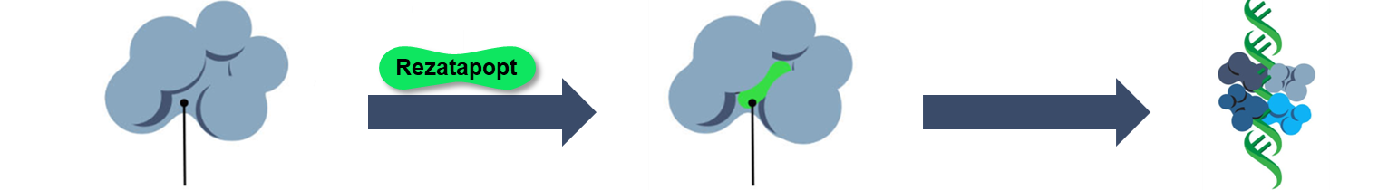
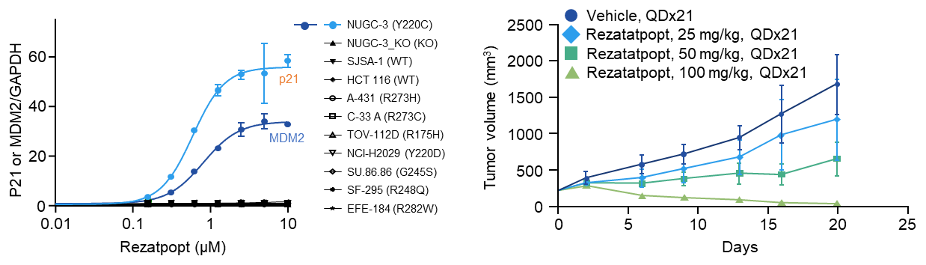
Rezatapopt is a selective p53 Y220C reactivator
Rezatapopt is an investigational, oral,
first-in-class
p53 reactivator
specific to the
TP53 Y220C mutation^{1–3}
Selectively binds to
a pocket created in the mutated p53 Y220C protein, stabilizing it in the wildtype conformation, thereby restoring p53 function^{1–3}
Pocket created near the site of the mutation³
Rezatapopt binds to the pocket and stabilizes the p53 protein³
p53 function restored³
p53 transcriptional activity restored⁴
Tumor regression in vivo⁴
Vehicle, QD x 21
Rezatapopt, 25 mg/kg QD x 21
Rezatapopt, 50 mg/kg QD x 21
Rezatapopt, 100 mg/kg QD x 21
P21 or MDM2/GAPDH
Tumor volume (mm³)
Rezatapopt (μM)
Days
KO, knockout; QD, once daily; WT, wildtype. 1. Vu BT, et al. ACS Med Chem Lett. 2024;16:34–39; 2. Puzio-Kuter AM, et al. Cancer Discov. 2025;15:1159–1179; 3. https://www.pynnaclestudy.com/;
4. Dumble M, et al. Cancer Res. 2021;81(13_Suppl):Abstract LB006.

Slide 5

PYNNACLE study design
Pivotal Phase 2, global, multi-cohort clinical trial assessing rezatapopt in locally advanced or metastatic solid tumors with a TP53 Y220C mutation and KRAS wildtype^{1,2}
Patient population
Basket
N=~200
Patient cohorts defined by tumor type
Rezatapopt
2000 mg QD
with food
Cohort 1: Ovarian cancer
Endpoints
Primary: ORR per BICR
Ovarian cancer cohort
Across all cohorts
Key secondary:
ORR per investigator, TTR, DoR, DCR,
PFS per BICR and investigator, OS, safety
Adults aged ≥18 yearsª
Adolescents aged 12–17 years^{b}
Locally advanced or metastatic solid tumors, excluding primary CNS tumors
Documented TP53 Y220C and KRAS wildtype only (no KRAS SNV mutations)
Prior standard therapy or ineligible for appropriate
SoC therapy
Cohort 2: Lung cancer
Cohort 3: Breast cancer
Cohort 4: Endometrial cancer
Cohort 5: All other solid tumors
ª For all global sites except Singapore (must be ≥21 years of age) and South Korea (must be ≥19 years of age). ^{b} If weighing ≥40 kg (in Australia, South Korea [12–18 years of age], and the USA only).
BICR, blinded independent central review; CNS, central nervous system; DCR, disease control rate; DoR, duration of response; ORR, overall response rate; OS, overall survival; PFS, progression-free survival; QD, once daily; SNV, single nucleotide variant; SoC, standard of care; TTR, time to response.
1. PYNNACLE Study. Available at: https://www.pynnaclestudy.com/. Accessed October 2025; 2. ClinicalTrials.gov. Available at: https://clinicaltrials.gov/study/NCT04585750. Accessed October 2025.

Slide 6
Patient demographics and disease characteristics
Patients were heavily pretreated across broad spectrum of tumor types
 | Overall, N=112
Median age, years (min–max) | 65 (37–91)
Sex, female / male, n (%) | 82 (73) / 30 (27)
Race, n (%) White Asian American Indian or Alaska Native Black or African American Other Not reported | n=108 81 (75) 14 (13) 1 (1) 1 (1) 1 (1) 10 (9)
ECOG status, n (%) 0 / 1 | n=108 47 (44) / 61 (56)
Prior systemic therapies, n (%) 1 2 ≥3 Median (min–max) | n=107 9 (8) 29 (27) 69 (64) 3 (1–10)
ª
High-grade serous | 49 (96%)
Clear cell | 1 (2%)
Sex cord stromal | 1 (2%)
Data cutoff: Sept 4, 2025. ª Includes gastric cancer (n=2), sarcoma (n=2), small intestine cancer (n=1), HCC (n=1), pancreatic cancer (n=1), thymic carcinoma (n=1), and esophagus carcinoma (n=1).
ECOG, Eastern Cooperative Oncology Group; HCC, hepatocellular carcinoma.

Slide 7
Tumor shrinkage observed across all cohorts
Reductions in tumor target lesions were observed across the different tumor types (n=92)ª
  100
  Ovarian
  Breast
  Other
  Lung
  Endometrial
  Gallbladder
  Ampullary carcinoma
  Head and neck
  50
  Best change in the
  sum of target lesions (%)
  SD
  PD
  SD
  SD
  SD
  SD
  PD
  SD
  SD
  SD
  SD
  SD
  SD
  SD
  SD
  PD
  SD
  SD
  SD
  SD
  SD
  SD
  SD
  SD
  SD
  SD
  SD
  SD
  PR
  PR
  PR
  SD
  SD
  SD
  PR
  PR
  SD
  SD
  SD
  SD
  SD
  PR
  SD
  PR
  PR
  PR
  PR
  PR
  NE
  PR
  PR
  PR
  PR
  PR
  PR
  PR
  PR
  PR
  PR
  PR
  PR
  PR
  PR
  CR
  PR
  PR
  PR
  PR
  0
  PD
  PD
  PD
  PD
  PD
  PD
  PD
  SD
  SD
  NE
  SD
  PD
  PD
  SD
  SD
  PD
  PD
  SD
  PD
  SD
  SD
  SD
  NE
  SD
*
*
*
  -50
*
  -100
Data cutoff: Sept 4, 2025. ª Including patients (n=92) with a post-baseline tumor assessment. Best overall responses are noted in the figure (* = uPR). At the time of data extraction, an additional uPR was recorded without tumor measurements reported as of yet.
CR, complete response; NE, non-evaluable; PD, progressive disease; PR, partial response; SD, stable disease; uPR, unconfirmed partial response.

Slide 8
ORR per RECIST v1.1
Based on investigator assessment
Confirmed responses were seen across tumor types
 | Overall n=103ª | Ovarian n=48
ORR,^{b} % (95% CI) | 34.0 (24.9–44.0) | 45.8 (31.4–60.8)
CR | 1 | 1
PR | 29 | 18
uPR | 5^{c} | 3
SD | 39 | 12
PD | 16 | 4
NE | 13 | 10
 | ORR,^{b} n (%)
Lung n=19 | 4 (21.1)
Breast n=12 | 2 (16.7)
Endometrial n=5 | 3 (60.0)
Other^{d} n=19 | 4 (21.1)
Data cutoff: Sept 4, 2025. ª Efficacy-evaluable population includes all enrolled patients with a first post-baseline tumor assessment and patients who discontinued early. ^{b} ORR is calculated using CR, PR, and uPR.
^{c} Four uPRs were confirmed and one uPR remains on treatment after the Sept 4, 2025 data cutoff. ^{d} Includes colorectal (n=6), ampullary carcinoma (n=2), gastric cancer (n=2), sarcoma (n=2),
gallbladder cancer (n=1), head and neck cancer (n=1), small intestine cancer (n=1), ​HCC (n=1), pancreatic cancer (n=1), thymic carcinoma (n=1), and ​esophagus carcinoma (n=1)​.
CI, confidence interval; CR, complete response; HCC, hepatocellular carcinoma; NE, non-evaluable; ORR, overall response rate; PD, progressive disease; PR, partial response;
RECIST, Response Evaluation Criteria in Solid Tumors; SD, stable disease; uPR, unconfirmed partial response.

Slide 9
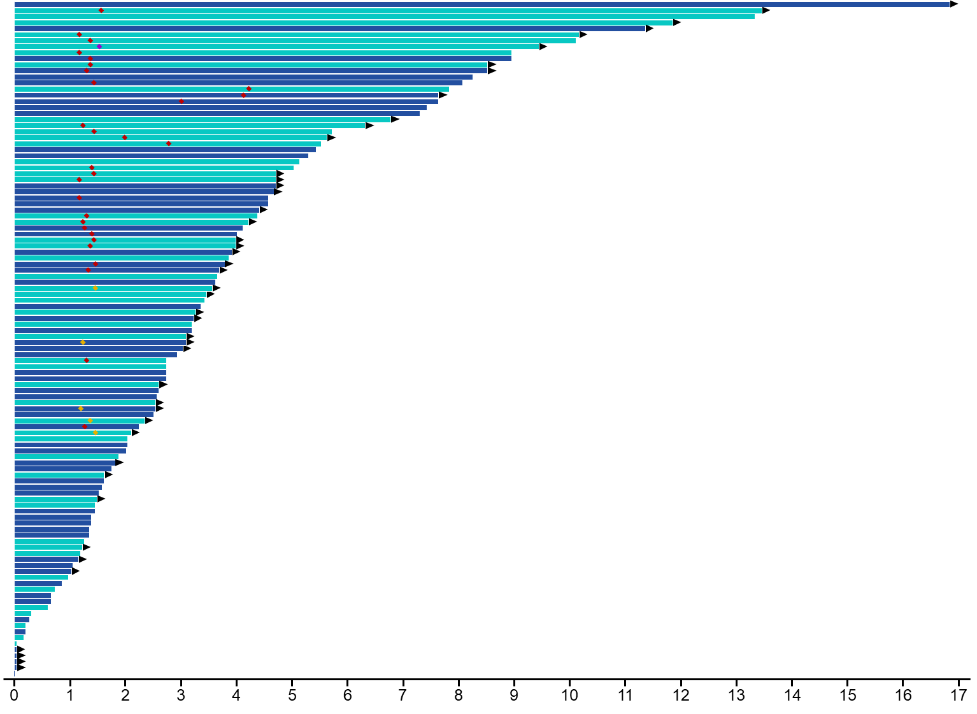
Rapid and durable responses were observed
40% of patients remain on treatment
All cohorts
Median TTR: 1.3 months
Median DoR: 7.6 months
  Ovarian cancer
  All other solid tumors
Ovarian cancer cohort
Median TTR: 1.3 months
Median DoR: 8.0 months
  Treatment ongoing
  CR
  PR
  uPR
Months
Data cutoff: Sept 4, 2025. CR, complete response; DoR, duration of response; PR, partial response; TTR, time to response; uPR, unconfirmed partial response.

Slide 10
Treatment Related Adverse Events
All patients (N=112)
TRAEs in ≥5% of patients
Patients, n (%) | All patients N=112 | Max CTCAE toxicity gradeª
 |  | 1 | 2 | 3 | 4
Nausea | 38 (34) | 24 (21) | 13 (12) | 1 (1) | 0
Fatigue | 26 (23) | 11 (10) | 13 (12) | 2 (2) | 0
Blood creatinine increased | 22 (20) | 5 (4) | 16 (14) | 1 (1) | 0
ALT increased | 20 (18) | 8 (7) | 5 (4) | 6 (5) | 1 (1)
AST increased | 16 (14) | 6 (5) | 3 (3) | 7 (6) | 0
Anemia | 16 (14) | 5 (4) | 6 (5) | 5 (4) | 0
Decreased appetite | 14 (13) | 11 (10) | 3 (3) | 0 | 0
Vomiting | 13 (12) | 7 (6) | 6 (5) | 0 | 0
Diarrhea | 10 (9) | 8 (7) | 1 (1) | 1 (1) | 0
Platelet count decreased | 8 (7) | 3 (3) | 1 (1) | 2 (2) | 2 (2)
Pruritus | 8 (7) | 6 (5) | 2 (2) | 0 | 0
Constipation | 7 (6) | 6 (5) | 1 (1) | 0 | 0
Dry mouth | 7 (6) | 7 (6) | 0 | 0 | 0
Rash maculo-papular | 7 (6) | 1 (1) | 2 (2) | 4 (4) | 0
Asthenia | 6 (5) | 2 (2) | 4 (4) | 0 | 0
TRAEs were mostly Grade 1/2
Most frequent TRAEs: Nausea, fatigue, blood creatinine increased, ALT increased
Laboratory abnormalities were manageable / monitorable with most cases being transient and reversible
Four patients (4%) discontinued treatment due to TRAEs
Administration of rezatapopt with food decreased incidence of gastrointestinal TRAEs compared with Phase 1^{1,2}
Data cutoff: Sept 4, 2025. ª No Grade 5 TRAEs were observed. ALT, alanine aminotransferase; AST, aspartate aminotransferase; CTCAE, Common Terminology Criteria for Adverse Events; TRAE, treatment-related adverse event. 1. Kuo H-CD, et al. Clinical Pharmacology (ACCP) 2024; Poster presentation 044; 2. Schram AM, et al. Annual Meeting on Women’s Cancer (SGO). 2024; Oral presentation (abstract LBA 26).

Slide 11
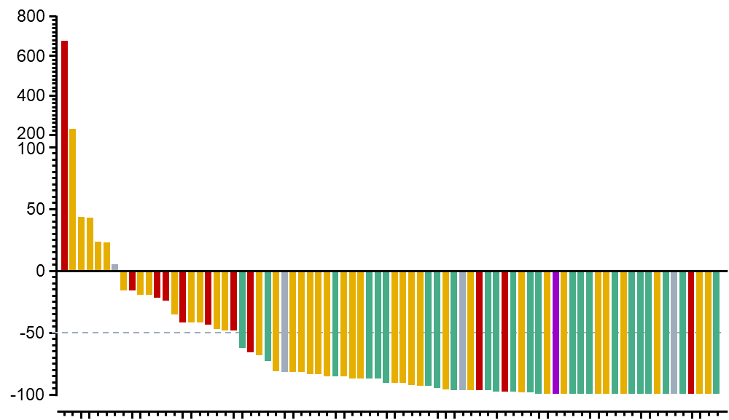
On-target activity supported by decreases in ctDNA TP53 Y220C VAF
BOR (investigator assessed)
  CR
78 patients had ctDNA TP53 Y220C VAF data available at baseline and on treatment
(3–6 weeks)
All patients experiencing a response had a reduction in TP53 Y220C VAF
71 patients (91%) had a reduction in TP53 Y220C VAF
  73% had a reduction of ≥50%
  PR
  SD
  PD
TP53 Y220C VAF
change from baseline in ctDNA (%)
  NE
3–6 weeks post-treatment
Data cutoff: Sept 4, 2025. BOR, best overall response; CR, complete response; ctDNA, circulating tumor DNA; NE, non-evaluable; PD, progressive disease; PR, partial response; SD, stable disease;
VAF, variant allele frequency.

Slide 12
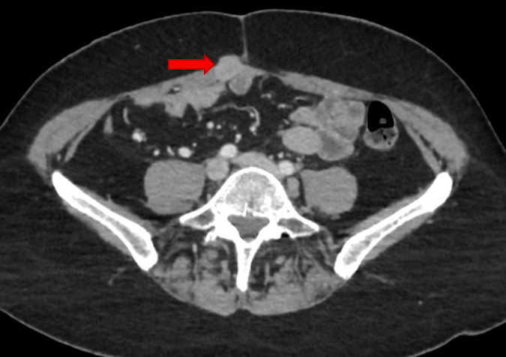
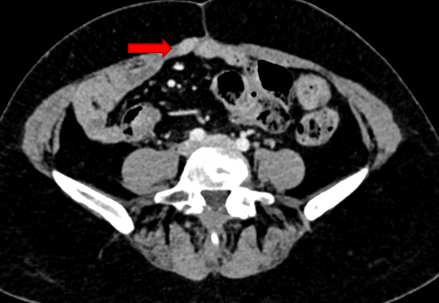
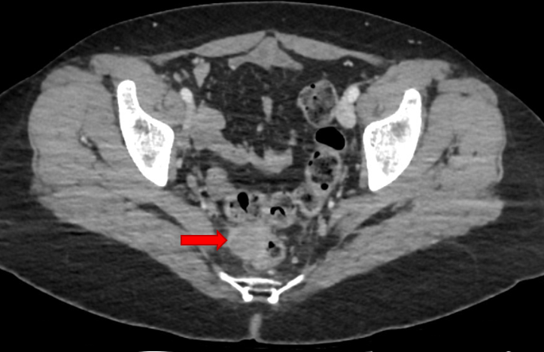
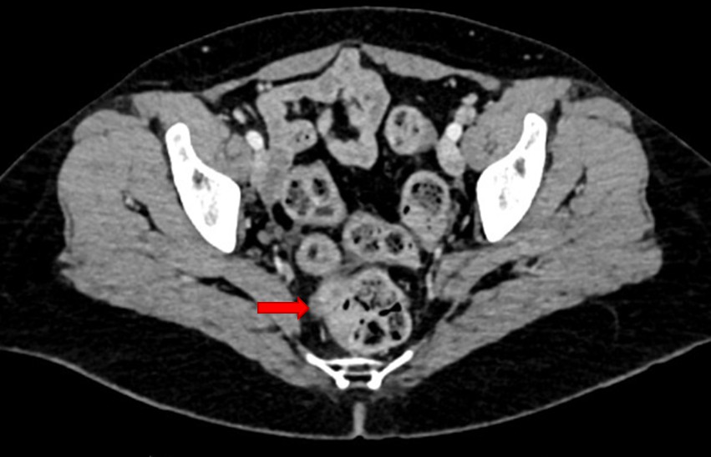
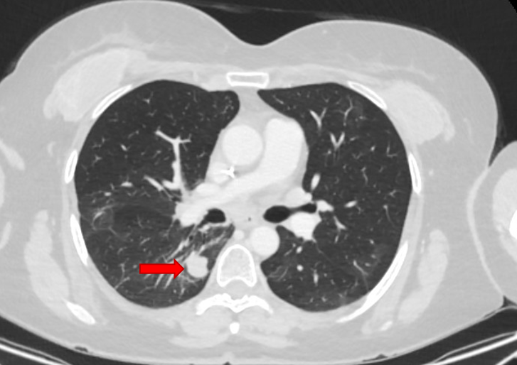
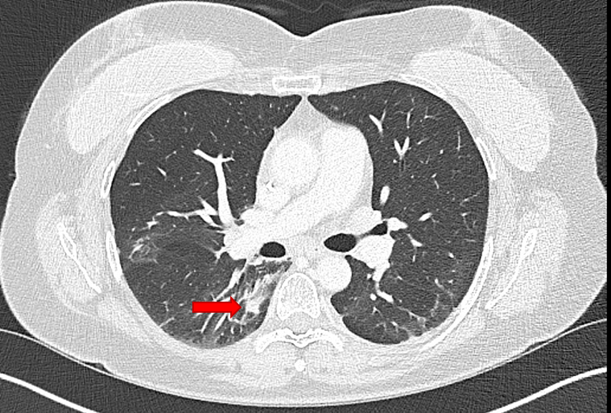
Platinum-resistant HGSOC with rapid and sustained response
  Baseline
  Week 24
52-year-old female with HGSOC
BRCA1 mutation, HRD+, high tumor burden, metastases in lung, chest, pelvis, and lymph nodes
Progressed after multiple lines of prior treatment
Platinum-based chemotherapy, olaparib, bevacizumab, pembrolizumab, T-cell vaccine, bispecific antibody
Rezatapopt: 2000 mg QD
PR at 6 weeks: −44% in target lesions; −60% at week 24
TTR: 1.4 months;
DoR: 8.8+ months (ongoing)
Well-tolerated
transient treatment-related grade 1 pruritus and grade 2 nausea
Treatment ongoing for 10+ months
CA-125 levels over time
CA-125 (U/mL)
Baseline
Cycle
Courtesy of Dr Italiano and Dr Debien
AE, adverse event; DoR, duration of response; HGSOC, high-grade serous ovarian cancer;
HRD, homologous recombination deficiency; PR, partial response; QD, once daily; TRAE, treatment-related adverse event; TTR, time to response.

Slide 13
Conclusions
In this initial analysis of the pivotal PYNNACLE Phase 2 clinical trial, rezatapopt showed single-agent efficacy and manageable safety
Clinical efficacy was achieved in heavily pretreated patients across multiple tumor types
Rezatapopt offers a promising targeted treatment for solid tumors with a TP53 Y220C mutation
To download the poster and view full author disclosures please scan the QR code

Slide 14
Acknowledgments
We would like to thank:
  All the patients, their families, and caregivers who have participated, and continue to participate, in this clinical trial
  Investigators and research staff
  PPD, part of Thermo Fisher Scientific
  Resolution Biosciences
  Foundation Medicine
This clinical trial is sponsored by PMV Pharmaceuticals, Inc.
Medical writing was provided by Danielle Lindley and Carolyn Maskin of Nucleus Global, funded by PMV Pharmaceuticals, Inc.

Slide 15
PYNNACLE Phase 2 clinical trial
Sites and Principal Investigators
Australia
Michael Millward: Linear Clinical Research Ltd
Peter Grimison: Chris O'Brien Lifehouse Hospital
Amy Body: Monash Health, Monash Medical Centre
Germany
Marcel Wiesweg: West German Cancer Center, University Hospital Essen
Georg Martin Haag: Nationale Centrum für Tumorerkrankungen (NCT) Heidelberg
Spain
María José de Miguel Luken: START MADRID, Hospital Universitario HM Sanchinarro
Victor Moreno García: START MADRID, Hospital Universitario Fundacion Jimenez Diaz
Irene Braña: Instituto de Investigacion Oncologica Vall d’Hebron (VHIO)
Elena Garralda: NEXT Oncology-Hospital Quironsalud Barcelona
Desamparados Roda Perez: Hospital Clinico Universitario de Valencia
Santiago Ponce Aix: Hospital Universitario 12 de Octubre
France
Jean-Sébastien Frenel: Institut de Cancerologie de l’Ouest
Lauriane Eberst: ICANS – Institut de cancérologie Strasbourg Europe
Antoine Italiano: EDOG – Institut Bergonie – PPDS
Isabelle Ray-Coquard: Centre Léon Bérard Centre Régional de Lutte Contre Le Cancer Rhône Alpes
Italy
Massimo Di Nicola: Istituto Nazionale Dei Tumori
Anna Fagotti: Fondazione Policlinico Universitario Agostino Gemelli IRCCS
Giuseppe Curigliano: Istituto Europeo Di Oncologia, IRCCS
Lorenza Landi: Istituto Nazionale Tumori Regina Elena
Armando Santoro: Istituto Clinico Humanitas
Anna Passarelli: Istituto Nazionale Tumori IRCCS Fondazione G. Pascale
Republic of Korea
Dae Ho Lee: Asan Medical Center – PPDS
Seock-Ah Im: Seoul National University Hospital
Singapore
David Shao Peng Tan: National University of Singapore (NUS), National University Hospital
Tira J. Tan: National Cancer Centre
UK
Elisa Fontana: Sarah Cannon Research Institute UK – PPDS
Alastair Greystoke: Royal Victoria Infirmary
USA
Alison M. Schram: Memorial Sloan Kettering Cancer Center
Aparna R. Parikh: Massachusetts General Hospital Cancer Center
Anthony Tolcher: Next Oncology, San Antonio
Ecaterina E. Dumbrava: The University of Texas MD Anderson Cancer Center
Geoffrey Shapiro: Dana-Farber Cancer Institute
Andrew L. Coveler: University of Washington, Fred Hutch Cancer Center
Melissa Johnson: Sarah Cannon and HCA Research Institute
Shivaani Kummar: Oregon Health & Science University (OHSU) Knight Cancer Institute
Anthony El-Khoueiry: USC, Norris Cancer Center
Patricia LoRusso: Yale Cancer Center
Nataliya Uboha: University of Wisconsin Cancer Center
John Kaczmar: Medical University of South Carolina
Debra Richardson: University of Oklahoma Peggy and Charles Stephenson Cancer Center
Thomas Karasic: Abramson Cancer Center of The University of Pennsylvania
Gilberto de Lima Lopes: Sylvester Comprehensive Cancer Center
Alexander Spira: Virginia Cancer Specialists (Fairfax) – USOR
Jamal Misleh: Med Onc Hematology Consultants

