Slide 1
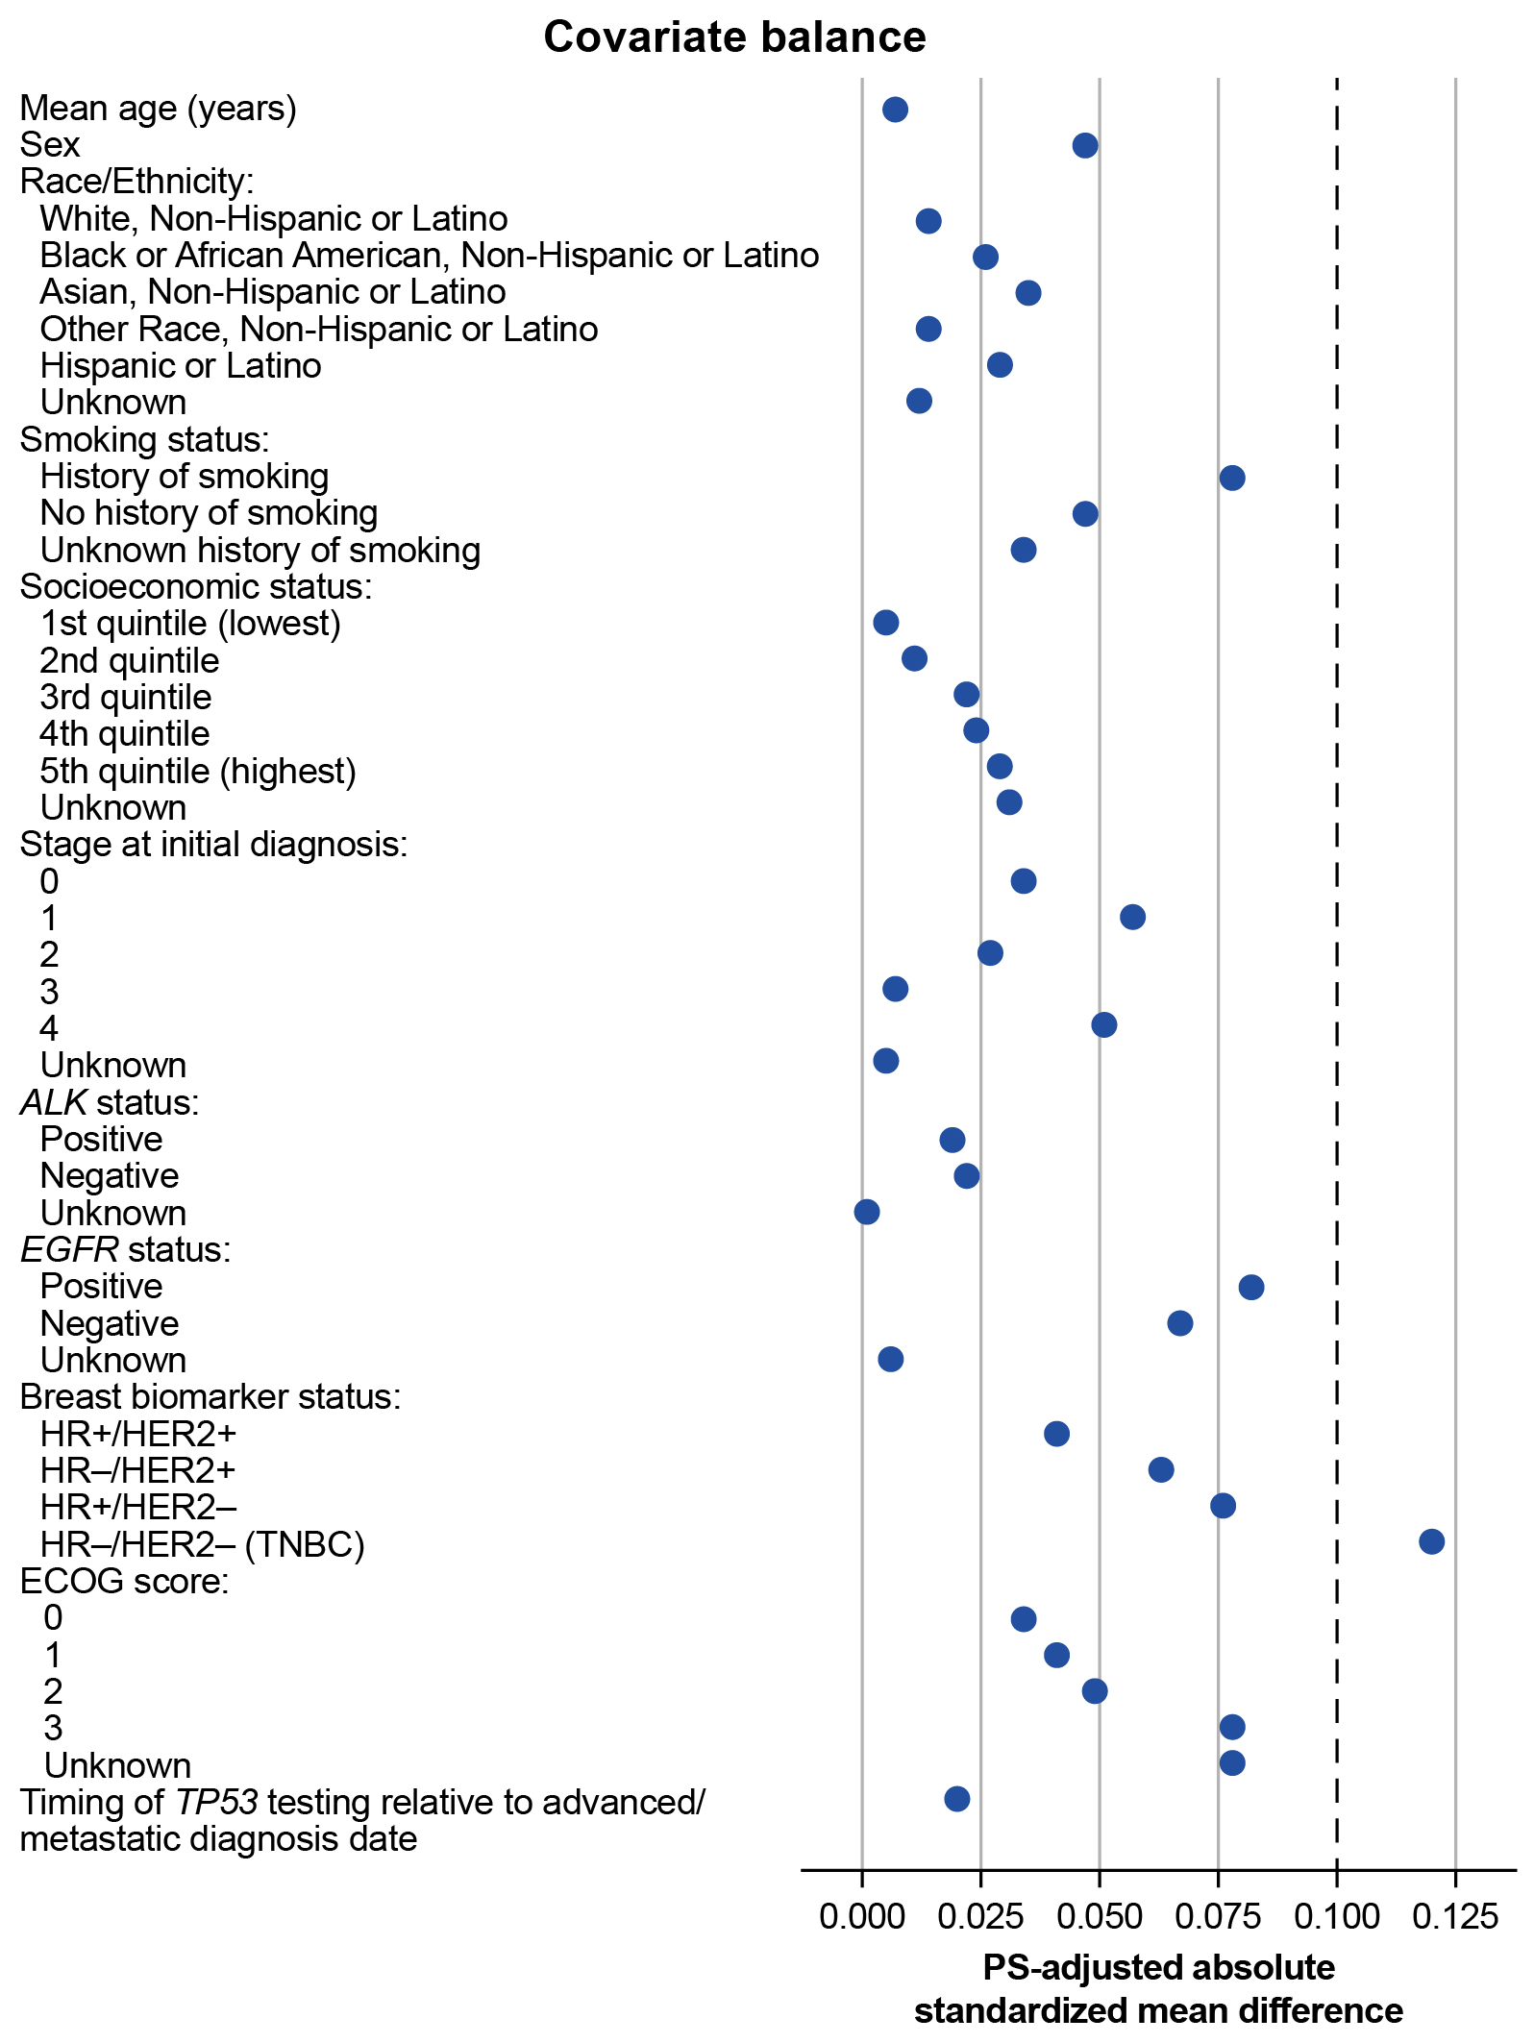

Natural history and prognostic value of the TP53 Y220C mutation in advanced solid tumors: A real-world study
Set up at 50%
Marc Fellous¹, Catherine Green¹, Patricia Prince², John Shen², Cheryl Cho-Phan³, Spencer Langerman³, Gerald Li⁴, Ryon Graf⁴, Ecaterina E Dumbrava⁵, Alison M Schram⁶
¹PMV Pharmaceuticals, Inc., Princeton, NJ, USA; ²Aetion, New York City, NY, USA; ³Flatiron Health, New York City, NY, USA; ⁴Foundation Medicine, Inc., Boston, MA, USA; ⁵The University of Texas MD Anderson Cancer Center, Houston, TX, USA; ⁶Memorial Sloan Kettering Cancer Center, New York City, NY, USA
BACKGROUND
METHODS
TP53 mutations, the most common genomic alterations in cancer, are associated with poor prognosis across many tumor types^{1,2}
The TP53 Y220C mutation occurs in ~1% of solid tumors and more frequently in ovarian, pancreatic, gastric, lung, and breast tumors^{2,3}
This mutation creates a pocket on the surface of the p53 protein, destabilizing the protein structure and causing loss of tumor suppressor function^{2,3}
The role of TP53 mutations in increasing cancer risk and influencing prognosis and clinical outcomes across various solid tumor types is well established;^{4,5} the impact of the TP53 Y220C mutation on survival in patients with solid tumors has not been previously assessed
This real-world study evaluates the natural history of locally advanced or metastatic solid tumors harboring a TP53 Y220C mutation and the prognostic significance of TP53 Y220C
Patients with locally advanced or metastatic solid tumors with a TP53 Y220C mutation were selected (January 1, 2011–September 30, 2023) from the US-based deidentified Flatiron Health-Foundation Medicine Clinicogenomic Database (FH-FMI CGDB)^{6,7}
  Clinical data from the Flatiron Health Research Database⁸ are linked to genomic data, derived from FMI’s comprehensive genomic profiling tests (FoundationOne®CDx, FoundationOne®), in the FH-FMI CGDB by deterministic matching, providing a deidentified dataset^{9–11}
The study design for the primary, secondary, and exploratory objectives are represented in Figure 1
Inclusion criteria for all objectives
  Table 1. Covariates considered for propensity score matching
Locally advanced or metastatic disease diagnosis (used as the index date)
Age ≥18 years
Tumor tissue tested for TP53 Y220C and KRAS SNV mutations with available results
  Figure 1. Study design
Covariate | Applicable tumor types
Tumor typeª | All
Histologyª | Bladder cancer, breast cancer, endometrial cancer, gastric cancer, NSCLC, ovarian cancer, prostate cancer, renal cell carcinoma
Age | All
Index date (calendar date) | All
Sex | All
De novo locally advanced/ metastatic status | All
Smoking status | Bladder cancer, gastric cancer, head and neck cancer, NSCLC, pancreatic cancer, renal cell carcinoma, SCLC
ECOG performance status | All
Race/ethnicity | All
Socioeconomic status at index | All
TP53 test timing (before or after index) | All
HR/HER2 status | Breast cancer
ALK rearrangement status | NSCLC
EGFR mutation status | NSCLC
Jan 1, 2011
Data range start date
Index date: Advanced/ metastatic diagnosis
March 31, 2024
Data range end date
Exclusion criteria
Primary objective:
Participation in a clinical trial (assessed any time prior to the index date); also served to exclude any patients who may have received rezatapopt through the PYNNACLE Phase 1/2 trial
Presence of more than one primary cancer (assessed at any time prior to the index date)
Death record prior to the index month (assessed at any time prior to the index month)ª
Other primary cancer assessment period
Treatment patterns assessment period
OBJECTIVES
Clinical trial participation assessment period
Outcome assessment period (rwOS, rwPFS, rwORR)
Primary and
secondary
objectives
Primary
  Describe demographic, clinical, and tumor (including genomic) characteristics, as well as the treatment journey, of patients with locally advanced or metastatic TP53
  Y220C-mutated solid tumors
Secondary
  Assess rwOS in patients with locally advanced or metastatic TP53 Y220C-mutated
  solid tumors
Exploratory
  Compare rwOS of patients with TP53 Y220C-mutated solid tumors vs patients with solid tumors that do not have a TP53 Y220C mutation (i.e., with other TP53 mutations or TP53 wild-type) in patients with solid tumors with no KRAS single nucleotide variant (SNV)
Exploratory objective:
Patients with tumors harboring any KRAS SNV mutations
Death record prior to the index month (assessed at any time prior to the index month)ª
ª Mortality data were derived from EMR and linked external sources. Patients with a recorded death date preceding their index month were excluded as part of data quality control.
Baseline characteristics assessment period
Exploratory
objectives
Propensity score matching
Tumor tissue tested for TP53 Y220C and KRAS SNV assessment period
In the exploratory objective, only patients with tumors that do not have KRAS SNV (any SNV) mutations were included
Propensity score matching was carried out between patients with TP53 Y220C-mutated solid tumors and patients with tumors that do not have a
TP53 Y220C mutation (non-TP53 Y220C)
  – Each patient with a Y220C-mutated tumor was matched to up to four patients with non-TP53 Y220C-mutated tumors if possible
  – Non-TP53 Y220C group: Included patients with tumors harboring other TP53 mutations or wild-type TP53, depending on tumor type
  – Similar trends were seen across breast, endometrial, NSCLC, and prostate cancer subgroups
Covariates considered in the propensity score matching are shown in Table 1
Covariate assessment period
Start of
study period
Time
Index period: January 1, 2011–September 30, 2023
ª Exact matching performed.
RESULTS
Primary and secondary objectives
As of the data cutoff (March 31, 2024), this study included 615 patients with TP53 Y220C-mutated solid tumors who received at least first-line (n=366), second-line (n=202), or third-line (n=99) therapy
Mean age was 64 years and 62.1% of the patient population were female (Table 2)
Most (95.8%) were tested for the TP53 Y220C mutation on or after advanced/metastatic diagnosis (median: 129 days after)
KRAS SNV mutations were mainly observed in pancreatic (59.0%; 79/134) and colorectal cancers (20.1%; 27/134) representing 79.1% of all patients with tumors harboring KRAS SNV mutations in this study
  Lowest frequency of KRAS SNV mutations were in patients with ovarian (1%), breast (0%), and prostate cancers (0%)
In the Y220C cohort, median rwOS was 25.3 months overall
  For patients with tumors with vs without KRAS SNV mutations: 16.0 vs 30.3 months
    Of note, these populations were not matched and there were differences in tumor type distribution and other confounding factors, which may impact rwOS and explain the
    difference observed
Patients with pancreatic cancer had the shortest rwOS (12.7 months) and patients with ovarian cancer had the longest rWOS (56.0 months)
For patients receiving first-, second-, or third-line therapy, rwORR and rwPFS decreased as prior lines of systemic therapy increased
Exploratory objective
In total, 525 patients had TP53 Y220C-mutated tumors and 1,733 matched patients with non-TP53 Y220C-mutated tumors were identified (Figure 2)
Of the 1,733 patients with non-TP53 Y220C-mutated tumors, 462 (26.7%) had other TP53 alterations
  Including 388 (22.4%) with ovarian cancer and 74 (4.3%) with other tumors (SCLC and carcinosarcoma/malignant mixed Müllerian tumor)
  All remaining 1,271 (73.3%) patients had wild-type TP53 tumors
After propensity score matching, baseline characteristics were generally well balanced (absolute standardized difference in a baseline covariate between patients with and without TP53 Y220C-mutated tumors below 0.10) across patients with TP53 Y220C-mutated tumors and non-TP53 Y220C-mutated tumors and across tumor types (Figure 3)
  There was some residual imbalance (absolute standardized difference in a baseline covariate between patients with and without TP53 Y220C-mutated tumors that reached above 0.10)
    This suggested some remaining imbalance after matching, though not large enough to warrant other matching methods
Most patients (>95%) were tested for the TP53 Y220C mutation on or after advanced/metastatic diagnosis
(median TP53 Y220C: 164.5 days; non-TP53 Y220C: 150.0 days)
Median rwOS was shorter in patients with TP53 Y220C-mutated tumors vs non-TP53 Y220C-mutated tumors (28.5 vs 35.8 months; hazard ratio 1.14; 95% confidence interval: 1.01–1.29]) (Figure 4)
  Similar trends were seen across breast, endometrial, NSCLC, and prostate cancer subgroups
The estimated effect of the TP53 Y220C mutation in the sensitivity analysis was consistent with the primary analysis, though not statistically significant, likely reflecting the association between testing time and survival (i.e., dependent left truncation) among patients with non-TP53 Y220C-mutated tumors
  Dependent left truncation was evaluated using conditional Kendall’s tau test of quasi-independence (tranSurv package for R)¹²
The majority of patients with non-TP53 Y220C ovarian cancer (94.2%) had a different, non-TP53 Y220C mutation likely inactivating p53; therefore, there was no difference in rwOS observed between the patients with TP53 Y220C-mutated and
non-TP53 Y220C-mutated ovarian cancer
  This was an expected observation, given that >96% of patients with HGSOC harbor TP53 mutations¹³
  Figure 4. Exploratory objective: rwOS across the tumor cohorts with and without the TP53 Y220C mutation
TP53 Y220C
Non-TP53 Y220C
  Table 2. Primary and secondary objectives: Baseline characteristics
  Figure 2. Exploratory objective:
  Patient population
  Figure 3. Exploratory objective: Baseline characteristics after propensity score matching
 |  | KRAS SNV mutation
 | Overall, N=615 | Yes, n=134 | No, n=481
Mean age, years (SD) | 64.43 (11.9) | 64.25 (10.4) | 64.48 (12.3)
Gender, n (%) Female/male | 382 (62.1)/ 233 (37.9) | 80 (59.7)/ 54 (40.3) | 302 (62.8)/ 179 (37.2)
Tumor typeª, n (%)
Breast | 74 (12.0) | 0 (0.0) | 74 (15.4)
Colorectal | 61 (9.9) | 27 (20.1) | 34 (7.1)
Gastric | 37 (6.0) | 3 (2.2) | 34 (7.1)
NSCLC | 125 (20.3) | 17 (12.7) | 108 (22.5)
Ovarian | 100 (16.3) | 1 (0.7) | 99 (20.6)
Pancreatic | 79 (12.8) | 79 (59.0) | 0 (0.0)
Other solid tumors | 36 (5.9) | 4 (3.0) | 32 (6.7)
Stage at initial diagnosis, n (%)
Stage 1 | 39 (6.3) | 11 (8.2) | 28 (5.8)
Stage 2 | 61 (9.9) | 17 (12.7) | 44 (9.1)
Stage 3 | 152 (24.7) | 19 (14.2) | 133 (27.7)
Stage 4 | 297 (48.3) | 75 (56.0) | 222 (46.2)
Unknown | 66 (10.7) | 12 (9.0) | 54 (11.2)
Breast-specific receptor status, n (%)^{b}
HR+/HER2+ | 6 (1.0) | 0 (0.0) | 6 (1.2)
HR–/HER2+ | 5 (0.8) | 0 (0.0) | 5 (1.0)
HR+/HER2– | 30 (4.9) | 0 (0.0) | 30 (6.2)
TNBC | 24 (3.9) | 0 (0.0) | 24 (5.0)
NSCLC-specific biomarkers, n (%)
ALK negative/positive | 94 (15.3)/1 (0.2) | 14 (10.4)/0 (0.0) | 80 (16.6)/1 (0.2)
EGFR negative/positive | 85 (13.8)/14 (2.3) | 14 (10.4)/0 (0.0) | 71 (14.8)/14 (2.9)
ECOG performance status, n (%)
0 | 78 (12.7) | 24 (17.9) | 54 (11.2)
1 | 59 (9.6) | 18 (13.4) | 41 (8.5)
≥2 | 14 (2.3) | 4 (3.0) | 10 (2.1)
Unknown | 464 (75.4) | 88 (65.7) | 376 (78.2)
Patients with locally advanced or metastatic disease during the index period
N=2,927
a
a
a
a
Excluded
n
525
1,733
76
219
36
84
120
380
105
412
19
70
Age ≥18 years on the index date
N=2,924
3 (<1%)
ª Difference between TP53 Y220C and non-TP53 Y220C groups are statistically significant with p-values ≤0.05.
CONCLUSIONS
Tumor tissue tested for TP53 Y220C and KRAS SNV mutations
N=2,924
0
(0%)
In this real-world study, patients with TP53 Y220C-mutated solid tumors had poor prognoses and reduced rwOS vs patients with solid tumors without this mutation
Such findings highlight a substantial unmet clinical need and contribute to the body of evidence
on real-world clinical characteristics, and outcomes associated with TP53 mutations
Reactivating p53 offers an attractive therapeutic approach in patients with solid tumors harboring TP53 mutations, addressing a high unmet medical need where targeted treatments are lacking
Known TP53 mutation statusª
at any time during the study period
N=2,924
0
(0%)
No KRAS SNV mutation at any time during
the study period
N=2,259
665 (23%)
Limitations
The sample size was small for certain tumor types, limiting interpretability
Mutation status (TP53 Y220C and KRAS) was determined from genomic testing at any point during the study period
  While best practices recommend avoiding inclusion criteria based on future events to prevent selection and immortal time bias, this approach was necessary given that ~50% of patients in the study were de novo metastatic at diagnosis and therefore would not have undergone genomic testing prior to their initial diagnosis
  To address this, timing of testing was described, and a delayed entry sensitivity analysis for rwOS was conducted, consistent with similar studies¹⁴
Real-world outcomes (rwPFS, rwORR) differ from those collected in clinical trials, limiting direct comparability
  Real-world outcome assessments including healthcare visits and timing of imaging studies have more variability
  Tumor response data in clinical practice are not recorded by physicians using RECIST criteria; therefore,
  “RECIST-like” criteria were applied where possible
  While RECIST-like criteria were used, any patient with a recorded response were not required to have subsequent confirmation of response, which has the potential to overestimate tumor response
No death recorded prior to the index month
N=2,258
1 (<1%)
References: 1. Baugh EH, et al. Cell Death Differ. 2018;25:154–160; 2. Zhou S, et al. Front Oncol. 2023;13:1229696; 3. Puzio-Kuter A, et al. Cancer Discov. 2025;15:1159–1179; 4. Gu J, et al. Mol Clin Oncol. 2016;5:705–713; 5. Poeta ML, et al. N Engl J Med. 2007;357:2552–2561; 6. Estevez M, et al. Cancers. 2022;14:3063; 7. Zhang Q, et al. Value Health. 2024;27:S274; 8. Flatiron Health. Database Characterization Guide. https://flatiron.com/database-characterization (Accessed October 2025); 9. Singal G, et al. JAMA. 2019;321:1391–1399; 10. Milbury CA, et al. PLoS One. 2022;17:e0264138; 11. Frampton GM, et al. Nat Biotechnol. 2013;31:1023–1031; 12. Martin EC, Betensky RA. J Am Stat Assoc. 2005;100:484–492; 13. Backenroth D, et al. Cancer Epidemiol Biomarkers Prev. 2022;31:1195–1201; 14. Cole AJ, et al. Sci Rep. 2016;6:26191.
Acknowledgments: This study is sponsored by PMV Pharmaceuticals, Inc. Medical writing support was provided by Nucleus Global and funded by PMV Pharmaceuticals, Inc.
Disclosures (related to PMV Pharmaceuticals, Inc. only – for full disclosures please see the QR code): MF, CG: Employees (with stock options). PP, JS, CC-P, SL, GL, RG: None. EED: Received research funding/grant, attended advisory boards, and provided a speaker role.
AMS: Provided an advisory role and received research funding.
Abbreviations: ALK, anaplastic lymphoma kinase; ECOG, Eastern Cooperative Oncology Group; EGFR, estimated glomerular filtration rate; EMR, electronic medical records; HER2, human epidermal growth factor receptor 2; HGSOC, high-grade serous ovarian cancer;
HR, hormone receptor; KRAS, Kirsten rat sarcoma viral oncogene homolog; NSCLC, non-small cell lung cancer; PS, propensity-score; RECIST, Response Evaluation Criteria in Solid Tumors; rwORR, real-world overall response rate; rwOS, real-world overall survival;
rwPFS, real-world progression-free survival; SCLC, small cell lung cancer; SD, standard deviation; SNV, single nucleotide variant;
TNBC, triple negative breast cancer.
  Scan QR code to download the poster and view full author disclosures
TP53 Y220C
n=525
Non-TP53 Y220C
n=1,733
ª Tumor types reported in ≥5% of patients in the overall population. Other cancer types include bladder, endometrial, head and neck, melanoma, prostate, renal cell carcinoma, and SCLC. ^{b}Percentage of breast cancer types in the overall breast cancer population: 8.1% HR+/HER2+; 6.8% HR–/HER2+; 40.5% HR+/HER2–; 32.4% TNBC.
ª TP53 Y220C mutation, another non-TP53 Y220C mutation,
or TP53 wild-type.
Presented at the AACR-NCI-EORTC International Conference on Molecular Targets and Cancer Therapeutics; October 22–26, 2025; Boston, MA, USA
Presented by: Marc Fellous

Slide 2
Full author disclosures
Marc Fellous, Catherine Green
Employee: PMV Pharmaceuticals, Inc. with stock options
Patricia Prince, John Shen
Employee: Aetion, a Datavant Company, with stock options
Cheryl Cho-Phan, Spencer Langerman
Employee: Flatiron Health, an independent member of the Roche group
Stock ownership: Roche
Gerald Li, Ryon Graf
Employee: Foundation Medicine, Inc. a wholly owned subsidiary of Roche
Stock ownership: Roche
Ecaterina E Dumbrava
Research or grant funding: Bayer HealthCare Pharmaceuticals Inc., Immunocore Ltd., Amgen, Aileron Therapeutics, Compugen Ltd., Gilead, BOLT Therapeutics, Aprea Therapeutics, Bellicum Pharmaceuticals, PMV Pharmaceuticals, Inc., Triumvira Immunologics, Seagen, Mereo BioPharma, Sanofi, Rain Oncology, Astex Therapeutics, Sotio, Poseida, Mersana Therapeutics, Genentech, Boehringer Ingelheim, Dragonfly Therapeutics, A2A Pharmaceuticals, Volastra, AstraZeneca, Fate Therapeutics, Pfizer, Jacobio, and ModeX Therapeutics
Advisory board: BOLT Therapeutics, Mersana Therapeutics, Orum Therapeutics, Summit Therapeutics, Fate Therapeutics, PMV Pharmaceuticals, Inc.
Speaker: PMV Pharmaceuticals, Inc. and BOLT Therapeutics
Travel, accommodation, expenses: ASCO, LFSA Association, Rain Oncology, Banner MD Anderson Cancer Center, Triumvira Immunologics, KSMO, and Boehringer Ingelheim
Alison M Schram
Advisory board: Blueprint Medicines, Mersana, Endeavor Biomedicines, Revolution Medicine, Day One Biopharmaceuticals, Transcode Therapeutics, and Relay Therapeutics
Advisory role: for Merus, Pfizer, PMV Pharmaceuticals, Inc., Schrodinger, Repare Therapeutics, and Relay Therapeutics
Research funding to institution: ArQule, AstraZeneca, BeiGene, Springworks, Black Diamond, Boehringer Ingelheim, Elevation Oncology, Kura Oncology, Eli Lilly, Merus, Northern Biologics, Pfizer, PMV Pharmaceuticals, Inc., Relay Therapeutics, Repare Therapeutics, Revolution Medicine, and Surface Oncology

