Slide 2
GI CONNECT appropriate use of immunotherapy in the peri-operative setting for Gastric & GEJ cancer Assoc. Prof. Samuel J Klempner Massachusetts General Hospital, United States NOVEMBER 2025

Slide 3

Developed by GI COnnect
This programme is developed by GI CONNECT, an international group of experts in the field of gastrointestinal oncology.
Acknowledgement and disclosures
This GI CONNECT programme is supported through an independent educational grant from AstraZeneca US. The programme is therefore independent, the content is not influenced by the supporter and is under the sole responsibility of the experts.
Please note:
This educational programme is intended for healthcare professionals only
The views expressed within this programme are the personal opinions of the experts. They do not necessarily represent the views of the experts’ academic institutions, organisations, or other group or individual
Expert disclosures:
Dr Sam Klempner has received financial support/sponsorship for research support, consultation, or speaker fees from the following companies:
Astellas, AstraZeneca, BMS, Coherus, Daiichi-Sankyo, Eli Lilly, Merck, Novartis, Nuvalent Therapuetics and Sanofi

Slide 4
Educational objectives
Explore the latest clinical insights on the addition of immunotherapy to peri-operative FLOT, and the implications for clinical practice
Recognise toxicities and be able to manage them appropriately

Slide 5
Clinical takeaways
FLOT remains the standard peri-operative regimen for resectable gastric, GEJ, and esophageal cancers
MATTERHORN supports adding durvalumab to FLOT, with clear improvements in event-free and overall survival, consistent across most subgroups and without added meaningful toxicity
Peri-operative feasibility remains high: over 90% of MATTERHORN participants proceeded to surgery, underscoring that FLOT plus durvalumab is practical in real-world settings
Optimal delivery requires MDT coordination to assess resectability, surgical fitness, and support dose adjustments that preserve neoadjuvant intensity
In practice, most patients can complete neoadjuvant therapy and surgery, and adding durvalumab is reasonable for the majority of FLOT-eligible patients
FLOT, fluorouracil plus leucovorin, oxaliplatin and docetaxel; GEJ, gastroesophageal junction; MDT, multidisciplinary team

Slide 6

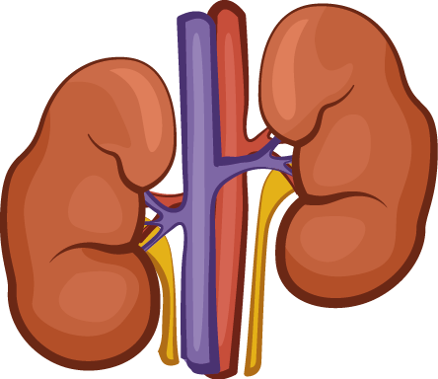
Management of Operable Gastric/GEJ Adenocarcinomas^{1,2}
Neoadjuvant CRT (e.g., CROSS study³)
Concurrent CRT
+/- Adjuvant PD-1 inhibitor⁴
Surveillance
GEJ
Peri-operative chemotherapy (e.g., AIO-FLOT4 study⁵)
Chemotherapy
Chemotherapy
Surveillance
GC
Adjuvant chemotherapy (e.g., CLASSIC study⁶)
Chemotherapy
Surveillance
Made on biorender.com
CRT, chemoradiotherapy; GC, gastric cancer; GEJ, gastroesophageal junction
1. NCCN Guidelines for eosphageal/EGJ cancers, Version 4.2025: https://www.nccn.org/professionals/physician_gls/pdf/esophageal.pdf; 2. Obermannová R, et al. ESMO Open. 2025;10:104134; 3. Van Hagen P, et al. N Engl J Med 2012; 366:2074-2084; 4. Kelly RJ, et al. New Engl J Med. 2021;384:1191-203; 5. Al-Batran SE, et al. Lancet. 2019;393:1948-57; 6. Bang Y-J, et al. Lancet 2012, 379, 315–321

Slide 7
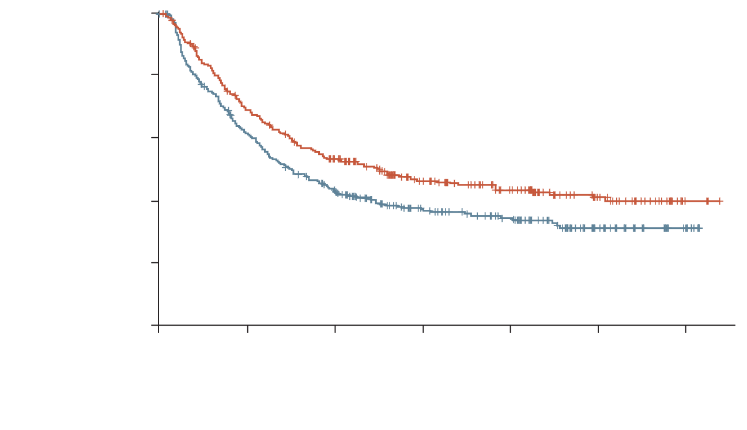
Peri-operative Therapy Is A Global Option
FLOT4 trial¹
100
 | FLOT | ECF/ECX30
mDFS, months | 30 | 18
HR (95% CI) | 0.75 (0.62-0.81)
Log-rank p value | 0.0036
100
 | FLOT | ECF/ECX30
mOS, months | 50 | 35
HR (95% CI) | 0.77 (0.63-0.94)
Log-rank p value | 0.012
80
80
60
60
Disease-free survival (%)
FLOT
Overall survival (%)
FLOT
40
40
20
ECF/ECX
20
ECF/ECX
0
0
0
12
24
36
48
60
72
0
12
24
36
48
60
72
No. at risk
(no. censored)
ECF/ECX
FLOT
Time (months)
No. at risk
(no. censored)
ECF/ECX
FLOT
Time (months)
360 (0)
356 (0)
215 (7)
241 (6)
145 (16)
175 (17)
90 (50)
102 (70)
56 (78)
66 (101)
24 (106)
35 (129)
6 (124)
3 (160)
360 (0)
356 (0)
287 (2)
297 (4)
202 (12)
231 (13)
126 (55)
140 (71)
83 (88)
87 (111)
33 (126)
39 (152)
9 (148)
5 (185)
Guideline | Neoadjuvant/Peri-operative population | Preferred Regimens | Key Trials
NCCN² | High risk cT2N0,cT1b-T2, N+, cT3-cT4a, any N | FLOT; FLOT + durvalumab | AIO-FLOT4,¹ ESOPEC^{5,} MATTERHORN⁶
ESMO³ | cT2-T4 or cN1-3 M0 | FLOT
Pan-Asian ESMO⁴ | Stage >1B resectable/ cT4N+, Bulky lymph nodes | Doublet [fluoropyrimidine/oxaliplatin/cisplatin] or triplet [FLOT, DOS] | AIO-FLOT4,¹ PRODIGY,⁷ RESOLVE,⁸ JCOG0501⁹
5-FU, fluorouracil; CI, confidence interval; (c)TN, (clinical) Tumour, Nodal (staging); (m)DFS, (median) disease-free survival; DOS, docetaxel, oxaliplatin and S-1; ECF/ECX, epirubicin+cisplatin+5-FU/capecitabine; ESMO, European Society for Medical Oncology; FLOT, fluorouracil plus leucovorin, oxaliplatin and docetaxel; HR, hazard ratio; mOS, (median) overall survival; NCCN, National Comprehensive Cancer Network
1. Al-Batran SE, et al. Lancet. 2019;393:1948-57; 2. NCCN Guidelines for eosphageal/EGJ cancers, Version 4.2025: https://www.nccn.org/professionals/physician_gls/pdf/esophageal.pdf; 3. Obermannová R, et al. ESMO Open. 2025;10:104134; 4. Shitara K, et al. ESMO Open. 2024;9:102226; 5. Hoeppner J, et al. N Engl J Med. 2025;392:323-335; 6. Janjigian YY, et al. N Engl J Med. 2025;393:217-30; 7. Kang YK, et al. J Clin Oncol. 2021;39:2903-2913; 8. Zhang X, et al. Lancet Oncol. 2021;22:1081-1092; 9. Iwasaki Y, et al. Gastric Cancer. 2021;24:492-502

Slide 8
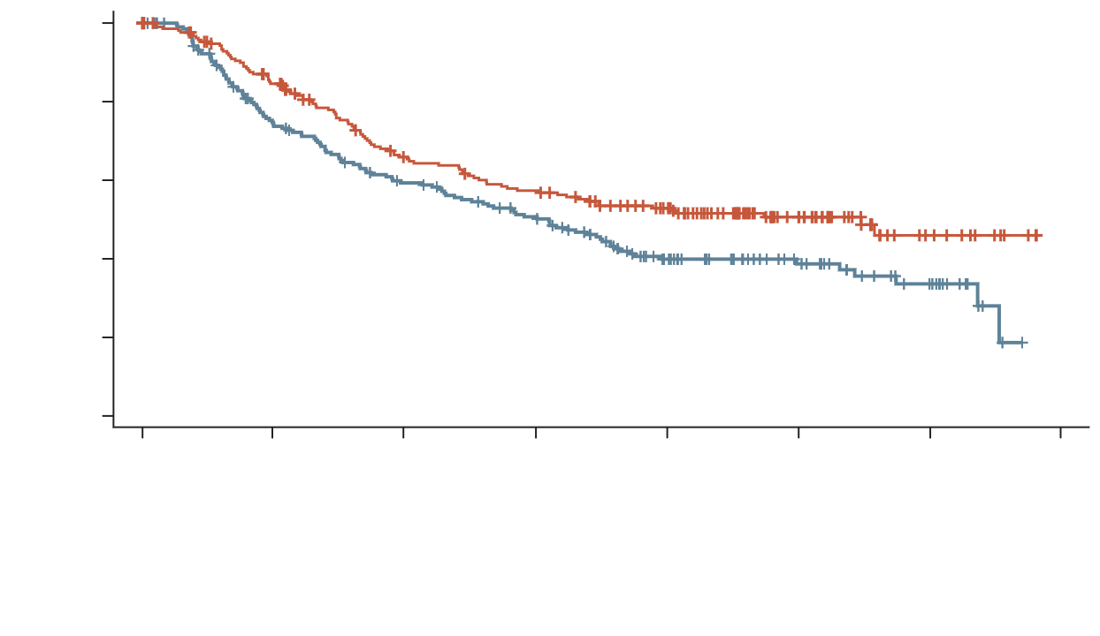
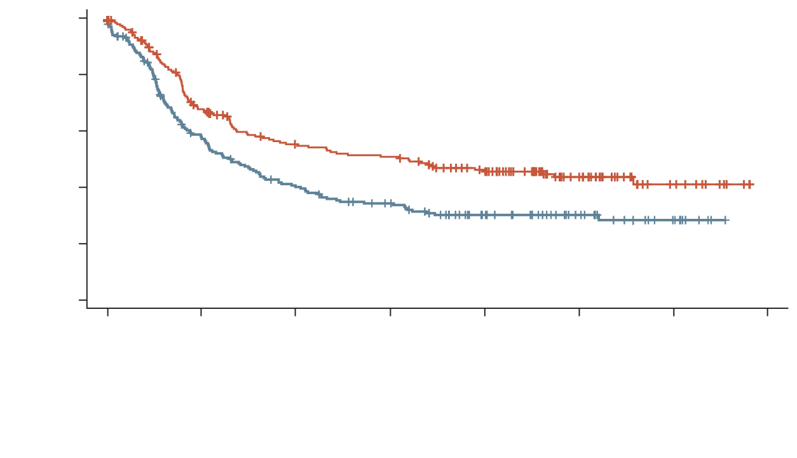
ESOPEC: EFFICACY (ITT POPULATION)
Peri-operative chemotherapy (FLOT) plus surgery improves overall survival compared to neoadjuvant chemoradiation (CROSS) plus surgery for patients with cT1cN+ and cT2-4a,cN-/+ resectable esophageal adenocarcinoma¹
OVERALL SURVIVAL (ITT)²
PROGRESSION-FREE SURVIVAL (ITT)²
100
100
Median follow-up: 55 months
Median follow-up: 55 months
80
80
60
60
Overall survival (%)
FLOT
Progression-free survival (%)
FLOT
40
40
20
20
CROSS
HR 0.70 (0.53-0.92)ª p=0.012
CROSS
HR 0.66 (0.51-0.85)ª p=0.001
0
0
0
12
24
36
48
60
73
84
0
12
24
36
48
60
73
84
Months from randomisation
Months from randomisation
FLOT
CROSS
221
217
172
146
124
113
107
92
84
54
44
32
11
15
0
0
FLOT
CROSS
221
217
135
113
101
78
93
62
73
39
39
22
11
9
0
0
ª Two-sided 95% confidence interval; Cox regression adjusted for N stage and age, stratified for trial site
CROSS, preoperative radiotherapy plus carboplatin and paclitaxel (as used in CROSS study); (c)N, (clinical) Node stage; cT, clinical Tumour stage; FLOT, fluorouracil plus leucovorin, oxaliplatin and docetaxel; HR, hazard ratio; ITT, intention-to-treat
1. Hoeppner J, et al. J Clin Oncol 2024;42(No. 17_Suppl). Abstract LBA1; 2. Hoeppner J, et al. N Engl J Med 2025;392:323-35

Slide 9
the Peri-operative chemotherapy-ICI Landscape
MATTERHORN¹
Study population:
G/GEJ adenocarcinoma
Stage II–IVA
ECOG 0-1
No prior therapy
Stratification factors:
Geographic region
Clinical N status
PD-L1 status
FLOT + durvalumab
SURGERY
FLOT + durvalumab
Durvalumab
R 1:1
Primary = EFS
Secondary = pCR, OS
(N=948)
FLOT + placebo
FLOT + placebo
Placebo
KEYNOTE-585^{2,3}
Study population:
≥T3 and/or N+
ECOG PS 0-1
No prior therapy
Stratification factors:
Asia vs non-Asia
Stage II vs III vs IVA
CT vs FLOT
CTª+pem
FLOT+pem
SURGERY
CTª+pem
FLOT+pem
Pembrolizumab
R 1:1
n=804 – CT (main)
n=203 – FLOT
Primary = pCR,^{b} EFS,^{b} OS^{b}; safety^{c}
Secondary = DFS,^{b} OS,^{d} EFS,^{d} safety^{d}
(N=1007)
CTª+placebo
FLOT+placebo
CTª+placebo
FLOT+placebo
Placebo
ª CT: intravenous cisplatin plus oral capecitabine or fluorouracil; ^{b} Main cohort; ^{c} FLOT cohort; ^{d} FLOT+main cohorts (combined)
DFS, disease-free survival; ECOG PS, Eastern Cooperative Oncology Group performance status; EFS, event-free survival; FLOT, 5-fluorouracil, leucovorin, oxaliplatin and docetaxel; N, Nodal (staging); OS, overall survival; pCR, pathological complete response; pem, pembrolizumab; R, randomisation; T, Tumour (staging)
1. Janjigian YY, et al. J Clin Oncol. 2025;43(suppl 17). Presented at ASCO Congress 2025 (Abstract LBA5); 2. Al-Batran S-E, et al. J Clin Oncol 2024;42(No. 3_suppl). Presented at ASCO GI Cancer Symposium 2024 (Abstract 247, oral presentation); 3. Shitara K, et al. J Clin Oncol. 2025;43:3152-3159

Slide 10
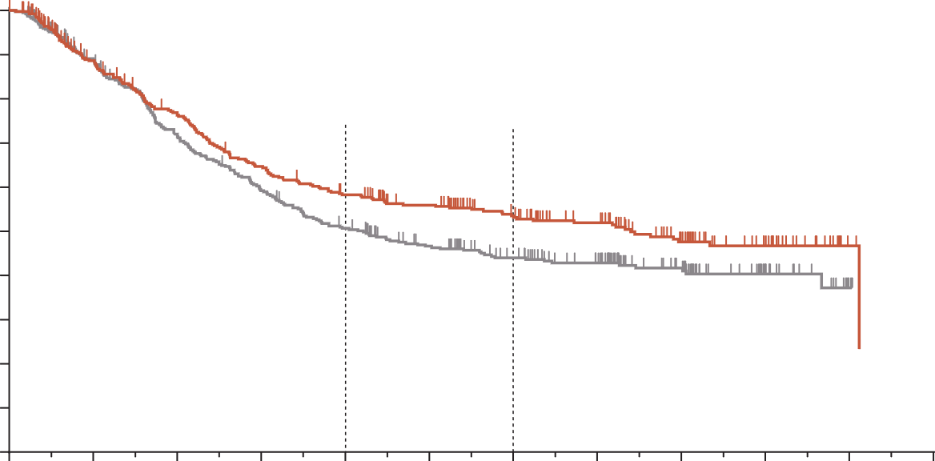
KEYNOTE-585: PERI-opERATIVE chemo/FLOT ± Pembro
Event-free survival did not meet statistical significance per the
pre-specified statistical analysis plan
100
main cohort
90
 | Pembro | Placebo
Event, % | 46 | 53
Median EFS (95% CI), mo | 44.4 (33.0-NR) | 25.3 (20.6-33.9)
80
24-mo rate
36-mo rate
70
58%
60
54%
EFS (%)
50
HR 0.81 (95% CI: 0.67-0.99) p=0.0198ª
51%
40
44%
30
20
10
0
0
6
12
18
24
30
36
42
48
54
60
66
No. at risk
Pembrolizumab
Placebo
Months
402
402
326
332
276
265
233
217
207
183
182
154
147
126
118
105
77
63
36
25
3
3
0
0
ª Threshold for significance was one-sided p=0.0178 Data cut-off date: 9 Feb 2023.
EFS defined as time from randomisation to first occurrence of radiographic disease progression per RECIST v1.1, local or distant recurrence assessed by CT scan or biopsy if indicated, clinical progression, or death due to any cause per investigator assessment
Chemo, chemotherapy; CI, confidence interval; CT, computed tomography; EFS, event-free survival; FLOT, fluorouracil plus leucovorin, oxaliplatin and docetaxel; HR, hazard ratio; mo, months; NR, not reached; pembro, pembrolizumab; RECIST, Response Evaluation Criteria in Solid Tumours
Shitara K, et al. Ann Oncol. 2023;34(suppl_2):S1316. Abstract LBA74

Slide 11
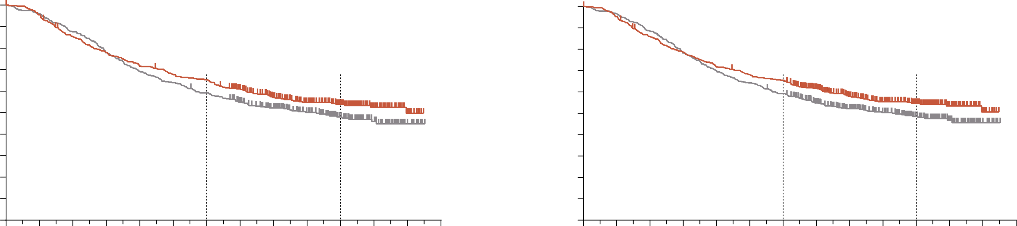
Keynote-585: Final Overall survival
Overall survival did not meet statistical significance per the
pre-specified statistical analysis plan
Main cohort
Main plus FLOT cohorts
 | Pembrolizumab (n=402) | Placebo (n=402)
Events, n (%) | 181 (45%) | 206 (51%)
Median OS (95% CI), mo | 71.8 (52.5-NR) | 55.7 (41.7-NR)
 | Pembrolizumab (n=502) | Placebo (n=505)
Events, n (%) | 218 (43%) | 253 (50%)
Median OS (95% CI) mo | NR (59.2-NR) | 55.7 (42.8-NR)
100
100
90
90
80
80
70
65%
70
66%
60
54%
Pembrolizumab
60
55%
Pembrolizumab
Overall survival (%)
Overall survival (%)
50
59%
50
59%
40
48%
Placebo
40
49%
Placebo
30
30
20
20
10
HR 0.86 (95% CI: 0.71-1.06)
10
HR 0.86 (95% CI: 0.71-1.03)
0
0
0
6
12
18
24
30
36
42
48
54
60
66
72
78
0
6
12
18
24
30
36
42
48
54
60
66
72
78
Time (months)
Time (months)
No. at risk
Pembrolizumab
Placebo
No. at risk
Pembrolizumab
Placebo
402
402
383
386
339
352
310
313
285
278
269
257
259
237
226
209
189
176
145
140
111
90
56
47
15
14
0
0
502
505
477
488
427
447
391
395
357
353
338
324
325
298
258
240
207
195
162
159
127
109
60
50
15
14
0
0
CI, confidence interval; FLOT, fluorouracil plus leucovorin, oxaliplatin and docetaxel; HR, hazard ratio; mo, months; NR, not reached; OS, overall survival
Shitara K, et al. J Clin Oncol. 2025;43:3152-3159

Slide 12
MATTERHORN: study design^{1,2}
MATTERHORN is a global, Phase 3, randomised, double-blind, placebo-controlled study
Study population:
G/GEJ adenocarcinoma
Stage II–IVA per American Joint Committee on Cancer 8th edition
No evidence of metastasis
No prior therapy
ECOG PS 0 or 1
Global enrolment from Asia, Europe, North America and South America
Stratification factors:
Geographical region: Asia versus non-Asia
Clinical lymph node status: positive versus negative
PD-L1 expression: TAP <1% versus TAP ≥1%*
Neoadjuvant
Adjuvant up to 1 year
Durvalumab + FLOT
SURGERY
Durvalumab + FLOT
Durvalumab
Primary endpoint:
EFS
Secondary endpoints:
OS
pCR (central review by modified Ryan criteria)
R 1:1
Placebo + FLOT
Placebo
+ FLOT
Placebo
(N=948)
2 cycles
2 cycles
10 cycles
2 doses of durvalumab or placebo plus 4 doses of FLOT
2 doses of durvalumab or placebo plus 4 doses of FLOT
10 doses of durvalumab or placebo
* Measured by immunohistochemistry using VENTANA PD-L1 (SP263) Companion Diagnostic Assay (Roche Diagnostics; investigational use only) and recorded at randomisation on the Interactive Response Technology System, Randomisation and Trial Supply Management, Electronic Case Report Form or from external vendor data from samples collected on or before randomisation
FLOT: 5-fluorouracil 2600 mg/m², leucovorin 200 mg/m², oxaliplatin 85 mg/m², docetaxel 50 mg/m², on Days 1 and 15 Q4W, 4 doses (2 cycles) pre- and post-operative; durvalumab: 1500 mg on Day 1 Q4W, 2 doses (2 cycles) of durvalumab or placebo pre- and post-operative, followed by 10 doses of post-operative durvalumab or placebo monotherapy. Participants underwent surgery 4-8 weeks after last dose of neoadjuvant therapy. Adjuvant therapy began 4-12 weeks post-surgery. Durvalumab or placebo monotherapy may be continued if post-operative FLOT is discontinued due to toxicity
ECOG PS, Eastern Cooperative Oncology Group performance status; EFS, event-free survival; FLOT, 5-fluorouracil, leucovorin, oxaliplatin and docetaxel; G / GEJ, gastric / gastroesophageal junction; OS, overall survival; pCR, pathological complete response; PD-L1, programmed cell death ligand-1; Q4W, every 4 weeks; R, randomisation; TAP, tumour area positivity
1. Janjigian YY, et al. N Engl J Med. 2025;393:217-30. 2. Janjigian YY, et al. J Clin Oncol. 2025;43(suppl 17). Abstract LBA5. Presented at: ASCO Congress 2025

Slide 13
Durvalumab Does Not Impact FLOT Delivery
Pre-operative
Post-operative (1-year duration)
Durva + FLOT
SURGERY
Durva + FLOT
Durvalumab
R 1:1
Placebo + FLOT
Placebo
+ FLOT
Placebo
NO impact on pre-operative delivery
NO impact on post-operative delivery
Feature | Durva + FLOT | Placebo + FLOT
Received All FLOT | 95% | 92%
Received All durva/placebo | 97% | 95%
Went to surgery | 91% | 90%
Feature | Durva + FLOT | Placebo + FLOT
Started FLOT | 74% | 73%
Received All FLOT | 48% | 52%
Received All durva/placebo | 52% | 52%
durva, durvalumab; FLOT, 5-fluorouracil, leucovorin, oxaliplatin and docetaxel; R, randomisation
Janjigian YY, et al. J Clin Oncol. 2025;43(suppl 17). Presented at ASCO Congress 2025 (Abstract LBA5); Janjigian Y, et al. N Engl J Med 2025;393:217-230

Slide 14
MATTERHORN: Primary endpoint of EFS^{1,2}
A statistically significant improvement in EFS was observed with durvalumab + FLOT versus placebo + FLOT
 | Durvalumab + FLOT (N=474)ª | Placebo + FLOT (N=474) ª
Median EFS (95% CI), months | NR (40.7-NR) | 32.8 (27.9-NR)
HR (95% CI) | 0.71 (0.58-0.86)
Stratified log-rank p-value^{b} | <0.001
1.0
0.9
0.8
0.7
0.6
0.5
0.4
0.3
0.2
0.1
0.0
18-mo EFS
73%
24-mo EFS
67%
64%
Durvalumab + FLOT
Probability of EFS
59%
Placebo + FLOT
Median (range) duration of follow-up,‡ months
Durvalumab + FLOT: 31.6 (0.0-48.1)
Placebo + FLOT: 31.4 (0.0-48.1)
0
3
6
9
12
15
18
21
24
27
30
33
36
39
42
45
48
51
No. of participants at risk
Durvalumab + FLOT
Placebo + FLOT
Time since randomisation (months)
Total no. of events
167
218
474
474
436
429
404
392
381
360
351
329
334
302
320
278
307
264
288
249
234
202
187
160
107
89
88
65
33
26
20
21
2
2
1
1
0
0
ª Full analysis set (all randomised participants, regardless of treatment received); ^{b} The threshold of significance for this analysis was 0.0239; ‡ In censored participants
Events were defined as the earliest of RECIST v1.1 events, non-RECIST v1.1 events or deaths due to any cause. Analysis was based on BICR assessments and / or locally by pathology testing if clinically required. The HR and its CI were estimated from a Cox proportional hazards model, adjusted for geographical region, clinical lymph node status and PD-L1 expression. The CI for the HR was calculated using a profile likelihood approach. The 2-sided p-value was calculated using a stratified log-rank test adjusted for geographical region, clinical lymph node status and PD-L1 expression
BICR, blinded independent central review; CI, confidence interval; EFS, event-free survival; FLOT, 5-fluorouracil, leucovorin, oxaliplatin and docetaxel; HR, hazard ratio; mo, month; NR, not reached; PD-L1, programmed cell death ligand-1; RECIST v1.1, Response Evaluation Criteria in Solid Tumours, version 1.1
1. Janjigian YY, et al. N Engl J Med. 2025;393:217-30; 2. Janjigian YY, et al. J Clin Oncol. 2025;43(suppl 17). Abstract LBA5. Presented at: ASCO Congress (2025)

Slide 15
MATTERHORN: Final OS
A statistically significant and clinically meaningful improvement in OS was observed with durvalumab + FLOT versus placebo + FLOT in the intention-to-treat population
 | Durvalumab + FLOT (n=474)ª | Placebo + FLOT (n=474)ª
Median OS (95% CI), months | NR (NR-NR) | NR (NR-NR)
HR (95% CI) | 0.78 (0.63-0.96)
Stratified log-rank p-value | 0.021 (significance threshold p<0.0499)
1.0
0.9
0.8
0.7
0.6
0.5
0.4
0.3
0.2
0.1
0.0
18-mo OS
∆: 4.0
24-mo OS
∆: 5.1
81.1%
36-mo OS
∆: 6.7
75.5%
77.1%
68.6%
70.4%
Durvalumab + FLOT
61.9%
Placebo + FLOT
Probability of OS
Median (range) duration of follow-up,^{b} months
Durvalumab + FLOT: 43.0 (3.4-57.0)
Placebo + FLOT: 42.9 (0.0-56.5)
0
3
6
9
12
15
18
21
24
27
30
33
36
39
42
45
48
51
54
57
60
No. of participants at risk
Durvalumab + FLOT
Placebo + FLOT
Time since randomisation (months)
Total no. of events
160
192
474
474
464
457
438
439
422
414
403
395
389
374
377
355
367
338
351
324
338
310
334
298
323
293
316
278
255
221
182
167
112
99
71
61
29
23
6
7
1
0
0
0
ª Intention-to-treat analysis set (all randomised participants, regardless of treatment received). ^{b} In censored participants
Data cut-off: 01 September 2025. OS maturity: 37.1%. Events were defined as time from randomisation until the date of death due to any cause. The HR and its CI were estimated from a Cox proportional hazards model, adjusted for geographic region, clinical lymph node status, and PD-L1 expression status. The CI for the HR was calculated using a profile likelihood approach. An HR <1 favours durvalumab + FLOT. The two-sided p-value was calculated using a stratified log-rank test adjusting for geographic region, clinical lymph node status, and PD-L1 expression status.
CI, confidence interval; FLOT, 5-fluorouracil, leucovorin, oxaliplatin, and docetaxel; HR, hazard ratio; mo, month; NR, not reached; OS, overall survival
Tabernero J, et al. Ann Oncol. 2025;36(suppl_2):S1-S60. 10.1016/annonc/annonc1965. Presented at ESMO 2025 (Abstract LBA81)

Slide 16
Matterhorn: OS in key subgroups
A consistent benefit in OS was observed with durvalumab + FLOT versus placebo + FLOT in most key subgroups
OS HR (95% CI)
Subgroup
Category
N
All participants
948
0.78 (0.63, 0.96)
Sex
Male
682
0.74 (0.58, 0.95)
Female
266
0.91 (0.62, 1.35)
Age at randomisation
<65 years
556
0.78 (0.59, 1.04)
≥65 years
392
0.81 (0.58, 1.11)
Geographic region
Asia
180
0.74 (0.43, 1.27)
Non-Asia
768
0.80 (0.64, 1.00)
PD-L1 expression statusª
TAP ≥1%
853
0.79 (0.63, 0.99)
TAP <1%
95
0.79 (0.41, 1.50)
Clinical lymph node status
Positive
667
0.73 (0.57, 0.94)
Negative
277
1.01 (0.67, 1.51)
Primary tumour location
Gastric
640
0.85 (0.66, 1.10)
GEJ
308
0.69 (0.47, 0.99)
ECOG PS
0
703
0.76 (0.59, 0.97)
1
245
0.87 (0.58, 1.32)
Histology type
Intestinal
483
0.76 (0.56, 1.05)
Diffuse
249
0.98 (0.68, 1.40)
Indeterminate
216
0.61 (0.38, 0.96)
0.0
0.5
1.0
1.5
2.0
Durvalumab + FLOT better
Hazard Ratio
Placebo + FLOT better
ª Measured by immunohistochemistry using VENTANA PD-L1 (SP263) Companion Diagnostic Assay (Roche Diagnostics; investigational use only) and recorded at randomisation on the Interactive Response Technology System, Randomisation and Trial Supply Management, Electronic Case Report Form or from external vendor data from samples collected on or before randomisation. Participants provided a tumour tissue sample at screening to determine PD-L1 status using the TAP scoring method
Data cut-off: 01 September 2025. The analysis was performed using a Cox proportional hazards model with treatment as the only covariate. An HR <1 favours durvalumab + FLOT. The CI was calculated using a profile likelihood approach. The grey band represents the 95% CI for the intention-to-treat HR
CI, confidence interval; ECOG, Eastern Cooperative Oncology Group performance status; FLOT, 5-fluorouracil, leucovorin, oxaliplatin and docetaxel; GEJ, gastroesophageal junction; HR, hazard ratio; OS, overall survival; TAP, Tumour Area Positivity
Tabernero J, et al. Ann Oncol. 2025;36(suppl_2):S1-S60. 10.1016/annonc/annonc1965. Presented at ESMO 2025 (Abstract LBA81)

Slide 17

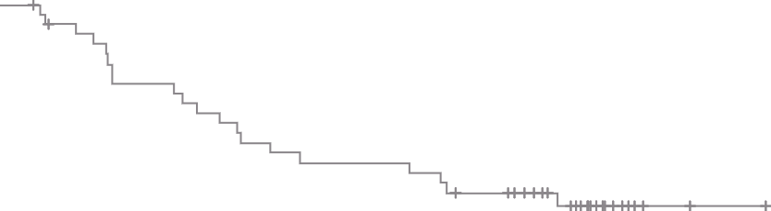


MATTERHORN: OS by PD-L1 status
OS was improved with durvalumab + FLOT versus placebo + FLOT regardless of PD-L1 status
PD-L1 TAP ≥1%ª
PD-L1 TAP <1%ª
 | Durvalumab + FLOT (n=426) | Placebo + FLOT (n=427)
Median OS (95% CI), mo | NR (NR–NR) | NR (NR–NR)
HR (95% CI) | 0.79 (0.63–0.99)
 | Durvalumab + FLOT (n=48) | Placebo + FLOT (n=47)
Median OS (95% CI), mo | NR (43.66–NR) | NR (21.72–NR)
HR (95% CI) | 0.79 (0.41–1.50)
1.0
1.0
0.9
0.9
0.8
Durvalumab + FLOT
0.8
Durvalumab + FLOT
0.7
0.7
0.6
0.6
Probability of OS
0.5
Probability of OS
Placebo + FLOT
0.5
Placebo + FLOT
0.4
0.4
0.3
0.3
0.2
0.2
0.1
0.1
0.0
0.0
0
3
6
9
12
15
18
21
24
27
30
33
36
39
42
45
48
51
54
57
60
0
3
6
9
12
15
18
21
24
27
30
33
36
39
42
45
48
51
54
57
60
No. of participants at risk
Time since randomisation (months)
Total no.
of events
No. of participants at risk
Time since randomisation (months)
Total no.
of events
Durvalumab + FLOT
426
418
394
383
365
353
341
332
317
304
301
292
286
229
165
101
64
25
6
1
0
143
Durvalumab + FLOT
48
46
44
39
38
36
36
35
34
34
33
31
30
26
17
11
7
4
0
0
0
17
Placebo + FLOT
427
412
397
377
358
340
324
308
295
281
270
267
253
200
152
91
59
22
6
0
0
172
Placebo + FLOT
47
45
42
37
37
34
31
30
29
29
28
26
25
21
15
8
2
1
1
0
0
20
ª Measured by immunohistochemistry using VENTANA PD-L1 (SP263) Companion Diagnostic Assay (Roche Diagnostics; investigational use only) and recorded at randomisation on the Interactive Response Technology System, Randomisation and Trial Supply Management, Electronic Case Report Form or from external vendor data from samples collected on or before randomisation. Participants provided a tumour tissue sample at screening to determine PD-L1 status using the TAP scoring method
Data cut-off: 01 September 2025. The HR and its CI were estimated from a Cox proportional hazards model. The CI for the HR was calculated using a profile likelihood approach
CI, confidence interval; FLOT, 5-fluorouracil, leucovorin, oxaliplatin and docetaxel; HR, hazard ratio; NR, not reached; OS, overall survival; PD-L1, programmed death ligand – 1; TAP, Tumour Area Positivity
Tabernero J, et al. Ann Oncol. 2025;36(suppl_2):S1-S60. 10.1016/annonc/annonc1965. Presented at ESMO 2025 (Abstract LBA81)

Slide 18
AE rates similar between Durvalumab and FLOT arms
MATTERHORN STUDY
Most common AEs of any gradeª
Most common maximum Grade 3 or 4 AEs^{b}
70
60
50
40
30
20
10
0
10
20
30
40
50
60
70
70
60
50
40
30
20
10
0
10
20
30
40
50
60
70
Event rate (%)
Event rate (%)
Durvalumab + FLOT (n=475)^{c}
Placebo + FLOT (n=469)^{c}
ª AEs occurring in ≥20% of participants in any treatment group; ^{b} AEs occurring in ≥2% of participants in any treatment group; ^{c} Safety analysis set (participants who received at least one dose of study treatment); one participant in the placebo + FLOT group received a single dose of durvalumab and is, therefore, included in the durvalumab + FLOT group for the safety analysis
AE, adverse event; FLOT, 5-fluorouracil, leucovorin, oxaliplatin and docetaxel
Janjigian YY, et al. J Clin Oncol. 2025;43(suppl 17). Presented at ASCO Congress 2025 (Abstract LBA5)

Slide 19
Matterhorn: conclusions
Durvalumab + FLOT demonstrated a statistically significant and clinically meaningful improvement in OS versus FLOT alone in the intention-to-treat population
OS improved with durvalumab + FLOT versus placebo + FLOT, regardless of PD-L1 status
MATTERHORN represents the first successful perioperative IO trial in gastric/GEJ cancer to meet both its primary endpoint (EFS) and its key secondary endpoint (OS), establishing durvalumab as a new global standard of care for these patients
The FDA have approved durvalumab + FLOT (regardless of PD-L1 status) as neoadjuvant and adjuvant treatment, followed by single agent durvalumab, for adults with resectable gastric/GEJ adenocarcinoma based on the MATTERHORN trial
EFS, event-free survival; FDA, Food and Drug Administration; FLOT, 5-fluorouracil, leucovorin, oxaliplatin and docetaxel; GEJ, gastroesophageal junction; OS, overall survival; PD-L1, programmed death ligand – 1

Slide 20
Implementing FLOT in clinical practice
Early surgical involvement for discussions of candidacy and surgical planning
Dose reductions can be quite effective, limited concern with reductions in oxaliplatin and docetaxel
Neoadjuvant component quite important, and we do not yet have data to clearly de-escalate adjuvant component unless needed to manage toxicities
FLOT, 5-fluorouracil, leucovorin, oxaliplatin and docetaxel

