Slide 2
Expert video with integrated animation ADC in HR+/HER2- mBC: Optimising treatment strategies and ae management april 2025
ADC, antibody drug conjugates; AE, adverse event; HR+, hormone receptor positive; mBC, metastatic breast cancer

Slide 3

Developed by BREAST CANCER COnnect
This programme is developed by BREAST CANCER CONNECT, an international group of experts in the field of breast cancer.
Acknowledgement and disclosures
This BREAST CANCER CONNECT programme is supported through an independent educational grant from AstraZeneca. The programme is therefore independent, the content is not influenced by the supporter and is under the sole responsibility of the experts.
Please note:
This educational programme is intended for healthcare professionals only
The views expressed within this programme are the personal opinions of the experts. They do not necessarily represent the views of the experts’ institutions, or the rest of the BREAST CANCER CONNECT group.
Expert disclosures:
Dr Barbara Pistilli has received financial support/sponsorship for research support, consultation, or speaker fees from the following companies: AstraZeneca, Seagen, Gilead, Novartis, Lilly, MSD, Pierre Fabre, Daiichi Sankyo, Olema and Pfizer

Slide 4
EDUCATIONAL Objectives
Recognise the efficacy and safety profiles of TROP2-directed ADCs for patients with advanced or metastatic HR+/HER2- BC, and their place in the treatment landscape​
Implement optimisation of treatment selection, and make the appropriate sequencing decisions​
Be able to monitor and manage adverse events associated with ADC therapy
ADC, antibody-drug conjugate; BC, breast cancer; HR+, hormone receptor positive

Slide 5
CLINICAL TAKEAWAYS
Endocrine-resistant HR+/HER2− mBC remains a significant unmet need, and ADCs offer a more effective and tolerable later-line alternative to conventional chemotherapy
Dato-DXd demonstrated a statistically significant and clinically meaningful improvement in PFS versus chemotherapy, with continued benefits across secondary efficacy, safety and PRO endpoints, despite OS not reaching statistical significance—potentially influenced by post-progression ADC use
Sacituzumab govitecan remains a valuable treatment option for heavily pretreated patients with HR+/HER2− breast cancer, demonstrating clinically meaningful improvements in PFS, OS, and PRO, with a manageable safety profile when supported by appropriate care.
To support treatment adherence and maintain QoL with ADCs, effective management of AEs is crucial—whether through prophylaxis, supportive medications, interventions, and/or dose modifications.
In the absence of predictive biomarkers, selection of ADCs for HR+/HER2− (IHC0) mBC should be guided by prior treatments, clinical characteristics, toxicity profiles, and patient preferences.
ADC, antibody-drug conjugate; AE, adverse event; Dato-DXd, datopotamab deruxtecan; GI, gastrointestinal; HR+, hormone receptor positive; IHC; immunohistochemistry; mBC, metastatic breast cancer; PFS, progression free survival; PRO, patient-reported outcome; OS, overall survival

Slide 6
TREATMENT LANDSCAPE IN ER+/HER2- mBC in patients with
ER+, estrogen receptor positive; mBC, metastatic breast cancer

Slide 7


treatments SELECTION for patients with ER+/HER2- mBC is influenced by eT-sensitivity¹
Patients with ER+/HER2- mBC¹
ET-sensitive/-naive
If imminent organ failure
AI + CDK4/6i
Chemotherapy or
If HER2-low or -ultralow: T-DXd
PD
Candidate for ET $±$ TT
Not candidate for ET $±$ TTª
Everolimus + exemestane
or Everolimus + fulvestrant
or Switch ET ± CDK4/6i or Fulvestrant monotherapy
If PIK3CAm+: Alpelisib + fulvestrant
If PIK3CAm/AKT/PTEN-alteration:
Capivasertib + fulvestrant
If ESR1m+: Elacestrant
If germline BRCA/PALB2m+: PARP inhibitor
SG or
Dato-DXd
If HER2-low:
T-DXd
PD
If not used before:
T-DXd or SG or
Dato-DXd or ChT
Adapted from Gennari et al.¹
PD
Adapted from: Gennari A, et al. Ann Oncol. 2021¹
ªIf the patient has not received ChT in mBC setting, they can be treated either with ChT or, if the tumour is HER2-low/-ultralow, with T-DXd.
ChT, chemotherapy; Dato-DXd, datopotamab deruxtecan; ER+, estrogen receptor positive; ESR1m+, ESR1 mutant positive; ET, endocrine therapy; mBC, metastatic breast cancer; PD, disease progression; PFS, progression-free survival; SG, Sacituzumab govitican; T-DXd, trastuzumab deruxtecan; TT, targeted therapy
Adapted from: 1. Gennari A, et al. Ann Oncol. 2021;32(12): 1475-1495. ESMO Metastatic Breast Cancer Living Guidelines. V1.2 April 2025 (Accessed April 2025);

Slide 8
ADC introduced for pretreated patients with HR+ mBC and resistance to additional ET ± targeted therapies¹
Antibody drug conjugates
AI + CDK4/6 inhibitors
AI sensitive
1L Chemo
2L CT
3L CT
2L ET
4L CT
3L ET
Fulvestrant + CDK4/6i
AI resistant
Endocrine resistance
This diagram is for illustrative purposes; treatment may vary based on individual patient needs
Primary endocrine resistance²
Secondary endocrine resistance²
PD ≤6 months of 1st line ET-based therapy, while on ET (regardless of CDK4/6i use)
PD after ≥6 months of 1st line ET or PD after any duration of 2L+ ET-based therapy
1L, first line; 2L, second line; 3L, third line; 4L, fourth line; ADC, antibody-drug conjugate; AI, aromatase inhibitor; CT, chemotherapy; ET, endocrine therapy; HR+, hormone receptor positive; mBC, metastatic breast cancer; PD, disease progression
1. Schmid P. Presented at ESMO Virtual Plenary: Datopotamab deruxtecan (Dato-DXd) vs chemotherapy (CT) in previously-treated inoperable or metastatic hormone receptor-positive, HER2-negative (HR+/HER2–) breast cancer (BC): Final overall survival (OS) from the phase III TROPION-Breast01 trial; February 12, 2025; Virtual meeting. Available here (accessed April 25, 2025); 2. Cardoso F, et al. Breast. 2024:76:103756

Slide 9
ADC IN HR+ mBC
ADC, antibody drug conjugates; HR+, hormone receptor positive; mBC, metastatic breast cancer

Slide 10
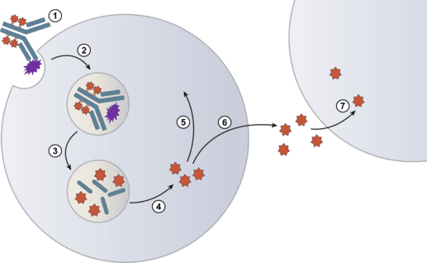
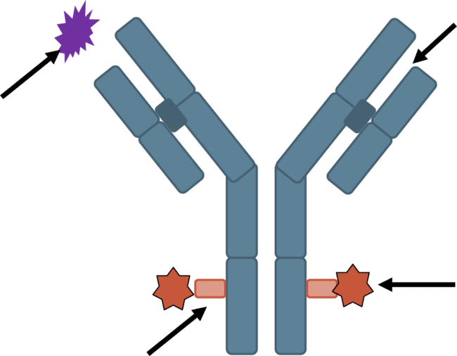
ADC structure and mechanism of action
Structure¹
Mechanism of action²
(1) binding to antigen (2) internalisation of the ADC–antigen complex (3) lysosomal degradation of the antibody portion (4) release of payload within the cytoplasm (5) interaction with target (DNA, Microtubules, Topoisomerase 1)
mAb targets tumour-specific antigens
DNA
Microtubules
Topoisomerase 1
Tumour antigen internalised upon ADC binding
Potent cytotoxic payload
Stable linker releases payload only in target cell
A fraction of the payload may be released in the extracellular environment (6) where it can be taken up by neighbour cells (7) a process known as the bystander effect
ADC, antibody-drug conjugate; mAb, monoclonal antibody
1. Modi S, et al. SABCS 2017. Abstract PD3-07; 2. von Amsberg G. Presented at ESMO Advanced Course on ADC Development, Therapeutic Applications and Research: Thoracic and Genitourinary Cancers 2024; November 25, 2024; Zurich, Switzerland. Available here (accessed April 25, 2025)

Slide 11
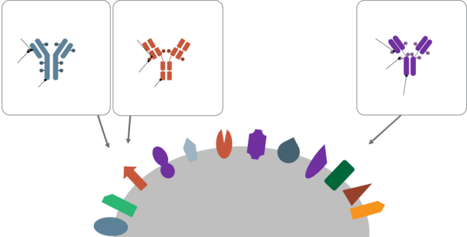
Targets for ADCs in HR+ Breast cancer¹⁻⁵
Sacituzumab govitecan
Datopotamab deruxtecan
Trastuzumab deruxtecan
DAR ≈ 8
DAR ≈ 4
DAR ≈ 8
Tetrapeptide- based cleavable linker for DXd
Maleimide tetrapeptide cleavable linker
Hydrolysable linker
SN-38 payload
Payload mechanism of action: topoisomerase I inhibitor
Payload with long systematic half-life
Bystander antitumour effect
Payload mechanism of action: topoisomerase I inhibitor
Payload with short systematic half-life
Bystander antitumour effect
Exatecan derivative payload DXd (10-fold potency compared to the SN-38 in vitro)
Payload mechanism of action: topoisomerase I inhibitor
Payload with short systematic half-life
Bystander antitumour effect
DXd payload
Humanised anti- TROP2 IgG1 mAb
Humanised anti- TROP2 IgG1 mAb
Humanised anti-HER2 IgG1 mAb
LIV1
CEACAM
MUC1
ROR1/2
PTK7
FRa
TROP2
HER2
HER3
B7H4
Target antigens:
Oncogenic driver (historic)
Antigens expressed on cancer cells
Antigens on tumour vasculature
Antigens in tumour stroma
CD166
Nectin4
ADC, antibody-drug conjugate
1. Bardia A, et al. N Engl J Med. 2021;384:1529-1541; 2. Krop IE, et al. SABCS 2021. Abstract GS1-05; 3. Krop IE, et al. J Clin Oncol. 2022;40(number 16 suppl):1002. Presented at ASCO 2022. Abstract 1002; 4. Modi S, et al. J Clin Oncol. 2023;41(suppl 16):1020; 5. Tsai M, et al. Ann Oncol. 2021;32(suppl_5): S457-S515. Presented at ESMO 2021 (ePoster 335TiP)

Slide 12
Summary of adcs available in hr+ mBC
Comparisons of efficacy and safety should not be drawn or inferred in the absence of head-to-head studies
 | DESTINY-Breast04¹ | DESTINY-Breast06² | TROPION-Breast01^{3,4,5} | TROPiCS-02^{6,7}
Target/population | HER2 low At least 1 line CT max 2 | HER2-low/-ultralow 1st line | TROP2 At least 1 line CT max 2 | TROP2 At least 2 lines CT max 4
Design | T-DXd vs ICC | T-DXd vs ICC | Dato-DXd vs ICC | SG vs ICC
Median PFS, months HR 95% CI | 10.1 vs 5.4 0.51 0.40-0.64 | 13.2 vs 8.1 0.62 0.52-0.75 | 6.9 vs 4.9 0.63 0.52-0.76 | 5.5 vs 4.0 0.66 (0.53-0.83)
Median OS, months HR 95% CI | 23.9 vs 17.5 0.64 0.48-0.86 | Not mature | 18.6 vs 18.3 1.01 0.83-1.22 | 14.4 vs 11.2 0.79 0.65-0.96
ORR, % | 52.6 vs 16.3 | 57.3 vs 31.2 | 36.4 vs 22.9 | 21 vs 14
« crossover ADC », % | NR | 20 | 24 | NR
ADC, antibody-drug conjugate; CT, chemotherapy; Dato-DXd, datopotamab deruxtecan; HR, hazard ratio; HR+, hormone receptor positive; ICC, investigator's choice of chemotherapy; mBC, metastatic breast cancer; NR, not reported; PFS; progression free survival; OS, overall survival; ORR, objective response rate; SG, sacituzumab govitecan; T-DXd, trastuzumab deruxtecan
1. Modi S, et al. N Engl J Med. 2022;387:9-20; 2. Bardiya A, et al. N Engl J Med. 2024;391:2110-2122; 3. Bardia A, et al. Future Oncol. 2024;20(8):423-36; 4. Bardia A, et al. J Clin Oncol. 2025. 20;43:285-296; 5. Pistilli B, et al. Presented at ESMO Virtual Plenary: Datopotamab deruxtecan (Dato-DXd) vs chemotherapy (CT) in previously-treated inoperable or metastatic hormone receptor-positive, HER2-negative (HR+/HER2–) breast cancer (BC): Final overall survival (OS) from the phase III TROPION-Breast01 trial; February 12, 2025; Virtual meeting. VP1-2025. Available here (accessed April 25, 2025); 6. Rugo HS, et al. Lancet. 2023;402(10411):1423-1433; 7. Rugo HS, et al. J Clin Oncol. 2022;40:3365-3376

Slide 13
PATIENT CASE

Slide 14
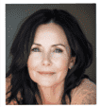
Patient case
What are the next available therapy options for patients like Marie T.?
Patient
Marie T. Age: 60 y.o.
Diagnosis
[2015]
Treatment (eBC)
[2015-2022]
Progression
[2022]
Treatment (mBC)
[2022-2025]
HR+/HER2- (IHC 0) IDC,
Stage IIA (T2N1M0)
Breast conserving surgery
Paclitaxel chemotherapy
Letrozole (7 years)
Sites: bone (pelvis & vertebrae)
Biopsy: Confirms HR+/HER2- (IHC 0) status and no detected mutations
1L: Ribociclib + fulvestrant
(18 months stable → then PD)
2L: Everolimus + exemestane
(8 months, stable --> then PD)
3L: Weekly paclitaxel
(6 months, partial response → then PD)
1L, first-line; 2L, second line; 3L, third line; eBC, early breast cancer; HR+, hormone receptor positive; IDC, in situ ductal carcinoma; IHC, immunohistochemistry; M, metastatic stage; mBC, metastatic breast cancer; N, nodal stage; PD, disease progression; T, tumour stage

Slide 15
ADC IN HR+/HER2- (IHC0) METASTATIC BREAST CANCER
ADC, antibody drug conjugates; HR+, hormone receptor positive; IHC, immunohistochemistry

Slide 16
adc available in hr+/HER2- (IHC0)ª mBC¹
Comparisons of efficacy and safety should not be drawn or inferred in the absence of head-to-head studies
 | DESTINY-Breast04¹ | DESTINY-Breast06² | TROPION-Breast01^{3,4,5} | TROPiCS-02^{6,7}
Target/population | HER2 low At least 1 line CT max 2 | HER2-low/-ultralow 1st line | TROP2 At least 1 line CT max 2 | TROP2 At least 2 lines CT max 4
Design | T-DXd vs ICC | T-DXd vs ICC | Dato-DXd vs ICC | SG vs ICC
Median PFS, months HR 95% CI | 10.1 vs 5.4 0.51 0.40-0.64 | 13.2 vs 8.1 0.62 0.52-0.75 | 6.9 vs 4.9 0.63 0.52-0.76 | 5.5 vs 4.0 0.66 (0.53-0.83)
Median OS, months HR 95% CI | 23.9 vs 17.5 0.64 0.48-0.86 | Not mature | 18.6 vs 18.3 1.01 0.83-1.22 | 14.4 vs 11.2 0.79 0.65-0.96
ORR, % | 52.6 vs 16.3 | 57.3 vs 31.2 | 36.4 vs 22.9 | 21 vs 14
« crossover ADC », % | NR | 20 | 24 | NR
ªNo membrane staining.
ADC, antibody-drug conjugate; CT, chemotherapy; Dato-DXd, datopotamab deruxtecan; HR, hazard ratio; HR+, hormone receptor positive; ICC, investigator's choice of chemotherapy; mBC, metastatic breast cancer; NR, not reported; PFS; progression free survival; OS, overall survival; ORR, objective response rate; SG, sacituzumab govitecan; T-DXd, trastuzumab deruxtecan
1. Modi S, et al. N Engl J Med. 2022;387:9-20; 2. Bardiya A, et al. N Engl J Med. 2024;391:2110-2122; 3. Bardia A, et al. Future Oncol. 2024;20(8):423-36; 4. Bardia A, et al. J Clin Oncol. 2025. 20;43:285-296; 5. Pistilli B, et al. Presented at ESMO Virtual Plenary: Datopotamab deruxtecan (Dato-DXd) vs chemotherapy (CT) in previously-treated inoperable or metastatic hormone receptor-positive, HER2-negative (HR+/HER2–) breast cancer (BC): Final overall survival (OS) from the phase III TROPION-Breast01 trial; February 12, 2025; Virtual meeting. VP1-2025. Available here (accessed April 25, 2025); 6. Rugo HS, et al. Lancet. 2023;402(10411):1423-1433; 7. Rugo HS, et al. J Clin Oncol. 2022;40:3365-3376

Slide 17
TROPION-Breast01 Study Design
Randomised, phase 3, open-label, global study (NCT05104866)
Key inclusion criteria:
Patients with HR+/HER2- breast cancerª (HER2- defined as IHC 0/1+/2+; FISH negative)
Previously treated with 1-2 lines of chemotherapy (inoperable/metastatic setting)
Experienced progression on ET and for whom ET was unsuitable
ECOG PS 0 or 1
Dato-DXd
6 mg/kg IV D1 Q3W
n=365
Dual primary endpoints:
PFS by BICR per RECIST v1.1, and OS
Secondary endpoints:
PFS (investigator assessed) PFS2, TFST, TSST, ORR, DCR at 12 weeks, DoR, PROs, and safety
R 1:1
Investigator’s choice of chemotherapy
as per protocol directions^{b}
(eribulin mesylate D1,8 Q3W; vinorelbine D1,8 Q3W; gemcitabine D1, 8 Q3W; capecitabine D1-14 Q3W)
(n=367)
Randomisation stratified by:
Lines of chemotherapy in inoperable/metastatic setting (1 vs 2)
Geographic location (USA/Canada/Europe vs other geographic regions)
Previous CDK4/6 inhibitor (yes vs no)
Treatment continued until PD, unacceptable tolerability, or other discontinuation criteria
Statistical considerations: Study deemed positive if either of the dual primary endpoints (PFS by BICR or OS) were statistically significant
Detailed description of the statistical methods published previously¹
ª Per American Society of Clinical Oncology/College of American Pathologists (ASCO/CAP) guidelines
^{b} ICC was administered as follows: eribulin mesylate, 1.4 mg/m² IV on Days 1 and 8, Q3W; capecitabine, 1000 or 1250 mg/m² orally twice daily on Days 1 to 14, Q3W (dose per standard institutional practice); vinorelbine, 25 mg/m² IV on Days 1 and 8, Q3W; or gemcitabine, 1000 mg/m² IV on Days 1 and 8, Q3W
BICR, blinded independent central review; D, day; Dato-DXd, datopotamab deruxtecan; DCR, disease control rate; DoR, duration of response; ECOG PS, Eastern Cooperative Oncology Group performance status; ET, endocrine therapy; FISH, fluorescent in-situ hybridisation; HR+, hormone receptor positive; IHC, immunohistochemistry; IV, intravenous; ORR, objective response rate; OS, overall survival; PD, disease progression; PFS, progression-free survival; PFS2, time to second progression or death; PRO, patient-reported outcome; Q3W, every 3 weeks; RECIST, Response Evaluation Criteria in Solid Tumours; TFST, time to first subsequent therapy; TSST, time to second subsequent therapy
1. Bardia A, et al. Future Oncol. 2024;20:423-436; 2. Pistilli B, et al Presented at: ESMO Virtual Plenary: Datopotamab deruxtecan (Dato-DXd) vs chemotherapy (CT) in previously-treated inoperable or metastatic hormone receptor-positive, HER2-negative (HR+/HER2–) breast cancer (BC): Final overall survival (OS) from the phase III TROPION-Breast01 trial; February 12, 2025; Virtual meeting. VP1-2025. Available here (accessed April 25, 2025)

Slide 18
Demographics and Baseline Characteristics¹
 |  |  |  | Dato-DXd (N=365) | ICC (N=367)
Median age (range), years |  |  |  | 56 (29–86) | 54 (28–86)
Female, n (%) |  |  |  | 360 (99) | 363 (99)
Race, n (%) | Black or African American / Asian / White / Otherª | Black or African American / Asian / White / Other* | Black or African American | 4 (1) / 146 (40) / 180 (49) / 35 (10) | 7 (2) / 152 (41) / 170 (46) / 38 (10)
Ethnicity, n (%) |  | Hispanic or Latino / Not Hispanic or Latino^{b} | Hispanic or Latino | 40 (11) / 322 (88) | 43 (12) / 318 (87)
Prior lines of chemotherapy, n (%)^{c} |  |  | 1 / 2 | 229 (63) / 135 (37) | 225 (61) / 141 (38)
Prior CDK4/6 inhibitor, n (%) |  |  | Yes / No | 304 (83) / 61 (17) | 300 (82) / 67 (18)
Prior taxanes and anthracyclines, n (%) |  |  | Taxane / Anthracycline | 295 (81) / 228 (62) | 296 (81) / 239 (65)
HER2 status at baseline by local testing, n (%)^{d} |  |  | HER2 IHC 0 | 113 (31) | 101 (28)
 |  |  | HER2 IHC 1+, 2+ & FISH– | 153 (42) | 150 (41)
ª Including not reported. ^{b} Ethnicity missing: 3 patients in Dato-DXd group; 6 patients in ICC group. ^{c} In the inoperable/metastatic setting; one patient in the Dato-DXd group had 3 prior lines of chemotherapy; one patient in the ICC group had 4 prior lines. ^{d} Latest known HER2 status (determined at diagnosis or at metastasis). All patients were required to have HER2-negative disease per American Society of Clinical Oncology/College of American Pathologists (ASCO/CAP) guidelines, and qualitative results (i.e. negative HER2) could be reported. Quantitative HER2 value was missing in 99 patients (27%) in the Dato-DXd group and 116 patients (32%) in the ICC group
Dato-DXd, datopotamab deruxtecan; FISH, fluorescent in-situ hybridisation; ICC, investigator’s choice of chemotherapy; IHC, immunohistochemistry
1. Bardia A, et al. Future Oncol. 2024;20:423-436; 2. Pistilli B, et al Presented at: ESMO Virtual Plenary: Datopotamab deruxtecan (Dato-DXd) vs chemotherapy (CT) in previously-treated inoperable or metastatic hormone receptor-positive, HER2-negative (HR+/HER2–) breast cancer (BC): Final overall survival (OS) from the phase III TROPION-Breast01 trial; February 12, 2025; Virtual meeting. VP1-2025. Available here (accessed April 25, 2025)

Slide 19
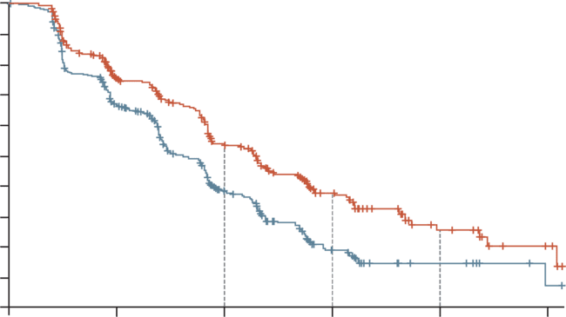
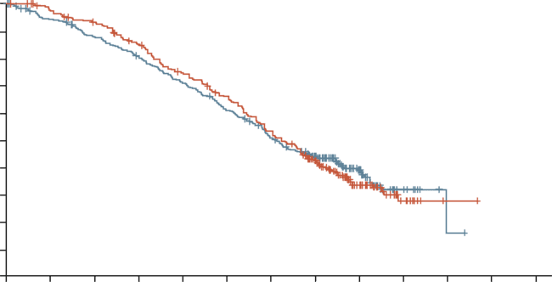
Dato-DXd showed significant improvement in PFS by BICR but OS results were not statistically significant
PFS by BICR^{1,2}
OS^{3,a}
1.0
 | Dato-DXd | ICC
Median PFS, months (95% CI) | 6.9 (5.7-7.4) | 4.9 (4.2-5.5)
HR (95% CI) | 0.63 (0.52-0.76)
p value | <0.0001
1.0
 | Dato-DXd | ICC
OS events, n (%) | 223 (61) | 213 (58)
Median OS, months (95% CI) | 18.6 (17.3-20.1) | 18.3 (17.3-20.5)
HR (95% CI) | 1.01 (0.83-1.22)
0.9
0.9
0.8
0.8
0.7
0.7
0.6
0.6
53.3%
0.5
0.5
Probability of OS
Probability of PFS
37.5%
0.4
0.4
0.3
0.3
38.5%
25.5%
0.2
0.2
0.1
Dato-DXd (N=365)
ICC (N=367)
0.1
Dato-DXd (N=365)
ICC (N=367)
18.7%
14.6%
0.0
0.0
0
3
6
9
12
15
18
21
24
27
30
33
36
0
3
6
9
12
15
No. of patients at risk
Time from randomisation (months)
Time from randomisation (months)
Dato-DXd
ICC
365 | 349 | 331 | 299 | 259 | 227 | 180 | 118 | 49 | 12 | 1
367 | 335 | 309 | 283 | 249 | 213 | 175 | 123 | 51 | 9 | 1
No. of patients at risk
Dato-DXd
ICC
365 | 249 | 158 | 66 | 15 | 4
367 | 205 | 93 | 26 | 8 | 1
Maturity: 59.6%; Median follow-up: 22.8 months
Protocol prespecified OS sensitivity analysis based on the stratification factors according to the eCRF^{b}: HR 0.99 (95% CI: 0.82-1.20)
ª Data cutoff: 24 July 2024. Pre-specified p-value boundary for OS analysis: ⍺=0.0427, ^{b}Mis-stratification between interactive response technology and eCRF <5%.
BICR, blinded independent central review; CI, confidence interval; Dato-DXd, datopotamab deruxtecan; eCRF, electronic case report form; HR; hazard ratio; ICC, investigator's choice of chemotherapy; OS, overall survival; PFS, progression free survival.
1. Bardia A, et al. Future Oncol. 2024;20:423-436; 2. Bardia A, et al. J Clin Oncol. 2024;43;285-296; 3. Pistilli B, et al Presented at ESMO Virtual Plenary: Datopotamab deruxtecan (Dato-DXd) vs chemotherapy (CT) in previously-treated inoperable or metastatic hormone receptor-positive, HER2-negative (HR+/HER2–) breast cancer (BC): Final overall survival (OS) from the phase III TROPION-Breast01 trial; February 12, 2025; Virtual meeting. VP1-2025. Available here (accessed April 25, 2025).

Slide 20
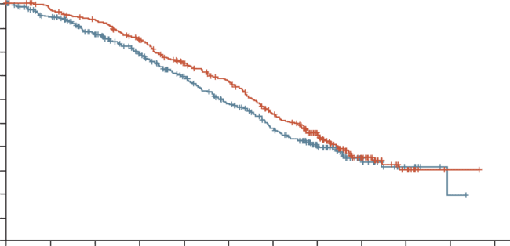
Subsequent ADC treatment may have affected survival resultS: OS Adjusted for Subsequent ADC¹
Post-hoc Sensitivity Analysis Using IPCW Method²⁻⁴
1.0
0.9
 | Dato-DXd | ICC
OS events, n (%) | 195 (53) | 177 (48)
Median OS, months | 19.1 | 17.5
HR (95% CI) | 0.86 (0.70-1.06)
0.8
0.7
0.6
Data cutoff: 24 July 2024
Probability of OS
0.5
0.4
0.3
0.2
0.1
Dato-DXd (N=365)
ICC (N=367)
0.0
0
3
6
9
12
15
18
21
24
27
30
33
Time from randomisation (months)
No. of patients at risk
Dato-DXd
ICC
365 | 348 | 327 | 290 | 245 | 212 | 163 | 105 | 43 | 12 | 2
367 | 329 | 285 | 243 | 196 | 158 | 120 | 79 | 29 | 8 | 2
ADC, antibody-drug conjugate; CI, confidence interval; Dato-DXd, datopotamab deruxtecan; HR, hazard ratio; ICC, investigator’s choice of chemotherapy; IPCW, Inverse Probability Censoring Weighting; OS, overall survival
1. Pistilli B, et al Presented at: ESMO Virtual Plenary: Datopotamab deruxtecan (Dato-DXd) vs chemotherapy (CT) in previously-treated inoperable or metastatic hormone receptor-positive, HER2-negative (HR+/HER2–) breast cancer (BC): Final overall survival (OS) from the phase III TROPION-Breast01 trial; February 12, 2025; Virtual meeting. VP1-2025. Available here (accessed April 25, 2025); 2. Robins JM. In: 1993 Proceedings of the Biopharmaceutical Section, Alexandria, Virginia: American Statistical Association. pp. 24–33; 3. Robins JM, Finkelstein DM. Biometrics 2000;56:779-788; 4. Sherry AD, et al. BMJ Oncol. 2024;3:e000322

Slide 21
Secondary Endpoints: Efficacy continue to favour dato-dxd¹
Final analysis
Median (95% CI), months | Dato-DXd (N=365) | ICC (N=367) | HR (95% CI)
PFS (investigator assessed) | 6.9 (5.9-7.2) | 4.5 (4.2-5.5) | 0.64 (0.55-0.76)
PFS2 | 11.7 (10.8-13.1) | 10.4 (9.6-11.5) | 0.76 (0.63-0.93)
TFST | 8.0 (7.2-8.8) | 5.2 (4.6-5.8) | 0.58 (0.50-0.68)
TSST | 13.7 (12.4-15.0) | 12.3 (10.8-13.7) | 0.83 (0.70-0.98)
 |  | Dato-DXd (N=365) | ICC (N=367)
Response (investigator assessed) | Confirmed overall response, n (%) | 134 (36.7) | 81 (22.1)
 | CR | 3 (0.8) | 0
 | PR | 131 (35.9) | 81 (22.1)
 | DCR at 12 weeks, % | 80.8 | 66.8
 | Median DoR (95% CI), months | 7.2 (5.7-8.6) | 6.0 (4.7-7.7)
Data cutoff: 24 July 2024
CI, confidence interval; CR, complete response; Dato-DXd, datopotamab deruxtecan; DCR, disease control rate; DoR, duration of response; HR, hazard ratio; ICC, investigator’s choice of chemotherapy; PFS, progression-free survival; PFS2, time to second progression or death; PR, partial response; TFST, time to first subsequent therapy; TSST, time to second subsequent therapy
1. Pistilli B, et al Presented at: ESMO Virtual Plenary: Datopotamab deruxtecan (Dato-DXd) vs chemotherapy (CT) in previously-treated inoperable or metastatic hormone receptor-positive, HER2-negative (HR+/HER2–) breast cancer (BC): Final overall survival (OS) from the phase III TROPION-Breast01 trial; February 12, 2025; Virtual meeting. VP1-2025. Available here (accessed April 25, 2025)

Slide 22
Secondary Endpoints: pro results continue to favour dato-dxd¹
Final analysisª
PRO | Median TTD^{b}, months (first instance^{c}) |  | HR (95% CI) | Median TTD, months (confirmed^{d}) |  | HR (95% CI)
 | Dato-DXd | ICC |  | Dato-DXd | ICC
GHS/QoL | 3.4 | 2.1 | 0.83 (0.67-1.04) | 9.7 | 4.8 | 0.76 (0.59-0.99)
Pain | 3.5 | 2.8 | 0.84 (0.67-1.06) | 10.0 | 5.5 | 0.72 (0.55-0.95)
Physical functioning | 5.6 | 3.5 | 0.79 (0.62-1.01) | 14.0 | 6.3 | 0.79 (0.60-1.03)
Data cutoff: 24 July 2024
ª Data on patient-reported outcomes from the first interim analysis were presented previously at the 2024 ASCO Annual Meeting¹; ^{b} TTD in GHS/QoL, pain, and physical functioning are secondary endpoints and were measured using the European Organisation for Research and Treatment of Cancer 30-item core quality of life questionnaire (EORTC QLQ-C30). Deterioration was defined as a change from baseline that reached a clinically meaningful deterioration threshold of 16.6 (for GHS/QoL and pain) or 13.3 (for physical functioning); ^{c} Time to first deterioration (primary analysis) was defined as the time from date of randomisation to date of first deterioration; ^{d} Time to confirmed deterioration (sensitivity analysis) required deterioration to be confirmed at a subsequent timepoint
Dato-DXd, datopotamab deruxtecan; CI, confidence interval; GHS/QoL, global health status/quality of life; HR, hazard ratio; ICC, investigator’s choice of chemotherapy; PRO, patient-reported outcome; TTD, time to deterioration
1. Pernas S, et al. J Clin Oncol. 2024;42(number 16_suppl):1006. Presented at ASCO 2024; 2. Pistilli B, et al Presented at: ESMO Virtual Plenary: Datopotamab deruxtecan (Dato-DXd) vs chemotherapy (CT) in previously-treated inoperable or metastatic hormone receptor-positive, HER2-negative (HR+/HER2–) breast cancer (BC): Final overall survival (OS) from the phase III TROPION-Breast01 trial; February 12, 2025; Virtual meeting. VP1-2025. Available here (accessed April 25, 2025)

Slide 23
overall safety profile of Dato-DXd remained favourable compared with ICC
Compared with the primary PFS data cutoff, with an additional ~12 months follow-up:
Overall safety profile was consistent
No late-onset toxicities were observed
Rate of grade ≥3 TRAEs in the Dato-DXd group was less than half that in the ICC group
Fewer TRAEs leading to dose reductions or interruptions with Dato-DXd compared with ICC; rates of TRAEs leading to discontinuation were similar between arms
TRAEs, n (%) | Dato-DXd (N=360) | ICC (N=351)
All grades | 341 (95) | 303 (86)
Grade ≥3 | 80 (22) | 160 (46)
Associated with dose reduction | 87 (24) | 106 (30)
Associated with dose interruption | 57 (16) | 85 (24)
Associated with discontinuation | 12 (3) | 9 (3)
Associated with death | 0 | 1 (0.3)ª
Serious TRAEs | 22 (6) | 32 (9)
Data cutoff: 24 July 2024 The safety analysis population included all patients who received at least 1 dose of study drug
ª Investigator-reported cause of death: febrile neutropenia
Dato-DXd, datopotamab deruxtecan; ICC, investigator’s choice of chemotherapy; PFS, progression-free survival; TRAE, treatment-related adverse event
1. Pistilli B, et al Presented at ESMO Virtual Plenary: Datopotamab deruxtecan (Dato-DXd) vs chemotherapy (CT) in previously-treated inoperable or metastatic hormone receptor-positive, HER2-negative (HR+/HER2–) breast cancer (BC): Final overall survival (OS) from the phase III TROPION-Breast01 trial; February 12, 2025; Virtual meeting. VP1-2025. Available here (accessed April 25, 2025)

Slide 24
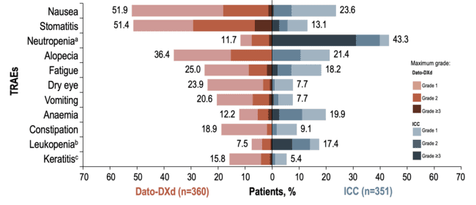
TRAEs Occurring in ≥15% of Patients
Data cutoff: 24 July 2024. Data are ordered according to frequency in either the Dato-DXd or ICC arms
ª Grouped term comprising neutropenia and neutrophil count decreased; ^{b} Grouped term comprising white blood cell count decreased and leukopenia; ^{c} Grouped term comprising keratitis, punctate keratitis, ulcerative keratitis
AE, adverse event; Dato-DXd, datopotamab deruxtecan; ICC, investigator’s choice of chemotherapy; TRAE, treatment related AE
1. Pistilli B, et al Presented at: ESMO Virtual Plenary: Datopotamab deruxtecan (Dato-DXd) vs chemotherapy (CT) in previously-treated inoperable or metastatic hormone receptor-positive, HER2-negative (HR+/HER2–) breast cancer (BC): Final overall survival (OS) from the phase III TROPION-Breast01 trial; February 12, 2025; Virtual meeting. VP1-2025. Available here (accessed April 25, 2025)

Slide 25
TROPiCS-02: A Phase 3 Study of SG in HR+/HER2- Locally Recurrent Inoperable or Metastatic Breast Cancer¹
Metastatic or locally recurrent inoperable HR+/HER2- breast cancer that progressed afterª
At least 1 endocrine therapy, taxane, and CDK4/6 inhibitor in any setting
At least 2, but no more than 4, lines of chemotherapy for metastatic disease
Measurable disease by RECIST 1.1
N=543
Treatment was continued until progression or unacceptable toxicity
Primary endpoint:
PFS by BICR
Secondary endpoints:
OS
ORR, DoR, CBR by LIR and BICR
PRO
Safety
Sacituzumab govitecan 10 mg/kg IV
days 1 and 8, every 21 days
n=272
R 1:1
Treatment of physician’s choice^{b}
(capecitabine, vinorelbine, gemcitabine, or eribulin) n=271
Stratification:
Visceral metastases (yes/no)
Endocrine therapy in metastatic setting ≥6 months (yes/no)
Prior lines of chemotherapies (2 vs 3/4)
ª Disease histology based on the American Society of Clinical Oncology/College of American Pathologists (ASCO/CAP) criteria; ^{b} Single-agent standard-of-care treatment of physician’s choice was specified prior to randomisation by the investigator
BICR, blinded independent central review; CBR, clinical benefit rate; DoR, duration of response; HR+, hormone receptor positive; IV, intravenous; LIR, local investigator review; ORR, objective response rate; OS, overall survival; PFS, progression-free survival, PRO, patient-reported outcomes; R, randomised; RECIST, Response Evaluation Criteria in Solid Tumours; SG, sacituzumab govitecan
1. Rugo H et al. J Clin Oncol. 2022;40:3365-3376; 2. Rugo H, et al. Ann Oncol. 2022;33(supplement 7):S1386. Presented at ESMO 2022. Abstract LBA76. Available here (accessed April 25, 2025)

Slide 26
Demographics and Baseline Characteristics¹
 | SG (N=272) | TPC (N=271)
Female, n (%) | 270 (99) | 268 (99)
Median age, y (range) <65 y, n (%) ≥65 y, n (%) | 57 (29-86) 199 (73) 73 (27) | 55 (27-78) 204 (75) 67 (25)
Race or ethnic group, n (%) White Black Asian Otherª / Not reported^{b} | 184 (68) 8 (3) 11 (4) 69 (25) | 178 (66) 13 (5) 5 (2) 75 (28)
ECOG PS, n (%) 0 1 | 116 (43) 156 (57) | 126 (46) 145 (54)
Visceral metastases at baseline, n (%) | 259 (95) | 258 (95)
Liver metastases, n (%)^{c} | 229 (84) | 237 (87)
De novo metastatic breast cancer, n (%) | 78 (29) | 60 (22)
 | SG (N=272) | TPC (N=271)
Median time from initial metastatic diagnosis to randomisation, mo (range) | 48.5 (1.2-243.8) | 46.6 (3.0-248.8)
Prior chemotherapy in (neo)adjuvant setting, n (%) | 173 (64) | 184 (68)
Prior endocrine therapy use in the metastatic setting ≥6 mo, n (%) | 235 (86) | 234 (86)
Prior CDK4/6 inhibitor use, n (%) ≤12 months >12 months Unknown | 161 (59) 106 (39) 5 (2) | 166 (61) 102 (38) 3 (1)
Median prior chemotherapy regimens in the metastatic setting, n (range)^{d} | 3 (0-8) | 3 (1-5)
ª Includes American Indian or Alaska Native, Native Hawaiian or other Pacific Islander; ^{b} Not reported indicates local regulators did not allow collection of race or ethnicity information; ^{c} Presence of baseline target/non-target liver metastases per RECIST 1.1 by local investigator review; ^{d} The reported number of prior therapies were miscounted at screening for some patients; 9 patients received prior chemotherapy regimens in the metastatic setting outside the per protocol range for inclusion criteria and were included in the intent-to-treat population
ECOG PS, Eastern Cooperative Oncology Group performance status; mo, months; RECIST, Response Evaluation Criteria in Solid Tumours; SG, sacituzumab govitecan; TPC, treatment of physician’s choice; y, years
1. Rugo HS, et al. J Clin Oncol. 2022;40:3365-3376; 2. Rugo H, et al. Ann Oncol. 2022;33(supplement 7):S1386. Presented at ESMO 2022. Abstract LBA76. Available here (accessed April 25, 2025)

Slide 27
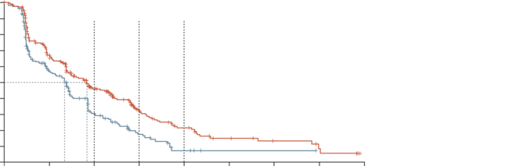
PFS in ITT: SG showed significant benefit in PFS vs TPC with a 34% reduction in risk of PD/death¹
100
90
6 months
9 months
12 months
BICR analysis | SG (N=272) | TPC (N=271)
Median PFS (95% CI), mo | 5.5 (4.2-7.0) | 4.0 (3.1-4.4)
Stratified HR (95% CI) | 0.66 (0.53-0.83)
Stratified Log Rank p value | 0.0003
6-month PFS rate (95% CI), % | 46.1 (39.4-52.6) | 30.3 (23.6-37.3)
9-month PFS rate (95% CI), % | 32.5 (25.9-39.2) | 17.3 (11.5-24.2)
12-month PFS rate (95% CI), % | 21.3 (15.2-28.1) | 7.1 (2.8-13.9)
80
70
60
Progression-free survival probability (%)
50
40
30
20
SG
TPC
10
0
0
3
6
9
12
15
18
21
24
Time (months)
No. of patients at risk (events)
SG
TPC
272 (0) | 148 (83) | 82 (124) | 44 (146) | 22 (160) | 12 (166) | 6 (167) | 3 (169) | 0 (170)
271 (0) | 105 (91) | 41 (136) | 17 (151) | 4 (159) | 1 (159) | 1 (159) | 0 (159)
Median follow-up was 10.2 months
BICR, blinded independent central review; CI, confidence interval; HR, hazard ratio; ITT, intent-to-treat; mo, months; PD, disease progression; PFS, progression-free survival; SG, sacituzumab govitecan; TPC, treatment of physician’s choice
1. Rugo HS, et al. J Clin Oncol. 2022;40:3365-3376; 2. Rugo H, et al. Ann Oncol. 2022;33(supplement 7):S1386. Presented at ESMO 2022. Abstract LBA76. Available here (accessed April 25, 2025)

Slide 28
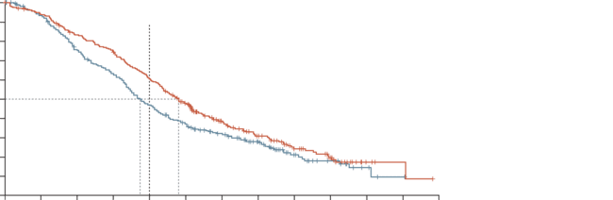
Overall survival: SG showed a statistically significant benefit in OS vs TPC with 21% reduction in the risk of death¹
2nd Interim Analysis
100
 | SG (N=272) | TPC (N=271)
Number of events | 191 | 199
Median OS (95% CI), mo | 14.4 (13.0-15.7) | 11.2 (10.1-12.7)
Stratified HR (95% CI) | 0.79 (0.65-0.96)
Stratified Log Rank p value | 0.020
12 month OS rate (95% CI), % | 61 (55-66) | 47 (41-53)
90
12 months
80
70
60
Overall survival probability (%)
50
40
30
20
SG
TPC
10
0
0
3
6
9
12
15
18
21
24
27
30
33
36
Time (months)
No. of patients still at risk (events)
SG
TPC
272 (0) | 252 (16) | 221 (44) | 197 (67) | 160 (104) | 120 (137) | 80 (158) | 53 (173) | 31 (183) | 20 (188) | 4 (190) | 2 (190) | 0 (191)
271 (0) | 246 (16) | 196 (64) | 164 (95) | 122 (137) | 92 (163) | 70 (174) | 49 (183) | 23 (193) | 13 (196) | 5 (198) | 1 (199) | 0 (199)
Median follow-up was 12.5 months
CI, confidence interval; HR, hazard ratio; OS, overall survival; SG, sacituzumab govitecan; TPC, treatment of physician’s choice
1. Rugo HS, et al. Lancet. 2023;;402(10411):1423-1433; 2. Rugo H, et al. Ann Oncol. 2022;33(supplement 7):S1386. Presented at ESMO 2022. Abstract LBA76. Available here (accessed April 25, 2025)

Slide 29
Responses: SG significantly improveD ORR compared with TPC, with prolonged DOR¹
BICR analysis | SG (N=272) | TPC (N=271)
ORR, n (%) | 57 (21) | 38 (14)
Odds ratio (95% CI) | 1.63 (1.03-2.56), p=0.035
Best overall response, n (%) CR PR SD SD ≥6 mo PD NE | 2 (1) 55 (20) 142 (52) 35 (13) 58 (21) 15 (6) | 0 38 (14) 106 (39) 22 (8) 76 (28) 51 (19)
CBR, n (%)ª | 92 (34) | 60 (22)
Odds ratio (95% CI) | 1.80 (1.23-2.63), p=0.003
Median DoR (95% CI), mo | 8.1 (6.7-9.1) | 5.6 (3.8-7.9)
ª CBR is defined as the percentage of patients with a confirmed best overall response of CR, PR, and SD ≥6 months
BICR, blinded independent central review; CBR, clinical benefit rate; CI, confidence interval; CR, complete response; DoR, duration of response; mo, months; NE, not evaluable; ORR, objective response rate; PD, disease progression; PR, partial response; SD, stable disease; SG, sacituzumab govitecan; TPC, treatment of physician’s choice
1. Rugo HS, et al. Lancet. 2023;;402(10411):1423-1433; 2. Rugo H, et al. Ann Oncol. 2022;33(supplement 7):S1386. Presented at ESMO 2022. Abstract LBA76. Available here (accessed April 25, 2025)

Slide 30
PRO Results: SG treatment provided a significant benefit in HRQoL & fatigue vs tpc¹
EORTC QLQ-C30 time to deterioration endpoints
TTD | Patients SG/TPC, n/n | SG median TTD (95% CI), mo | TPC median TTD (95% CI), mo | Stratified HR (95% CI) | Stratified Log Rank p value
Global Health Status/QoL | 234/207 | 4.3 (3.1-5.7) | 3.0 (2.2-3.9) | 0.75 (0.61-0.92) | 0.006
Fatigue | 234/205 | 2.2 (1.6-2.8) | 1.4 (1.1-1.9) | 0.73 (0.60-0.89) | 0.002
Pain | 229/202 | 3.8 (2.8-5.0) | 3.5 (2.8-5.0) | 0.92 (0.75-1.13) | 0.415
Assessed in all patients in the intent-to-treat population who had an evaluable assessment of HRQoL at baseline and at least one evaluable assessment at post‑baseline visits
CI, confidence interval; EORTC QLQ-C30, European Organization for Research and Treatment of Cancer Quality of Life Questionnaire; HR, hazard ratio; HRQoL, health-related quality of life; mo, months; PRO, patient-reported outcomes; QoL, quality of life; SG, sacituzumab govitecan; TPC, treatment of physician’s choice; TTD, time to deterioration
1.Rugo H, et al. Ann Oncol. 2022;33(supplement 7):S1386. Presented at ESMO 2022. Abstract LBA76. Available here (accessed April 25, 2025)

Slide 31
Summary of common TRAE of any grade (≥10%) and by worst grade ≥3 (≥5%) in any treatment arm¹
Treatment-related adverse events, n (%)ª |  | Sacituzumab govitecan (N=268) |  | Chemotherapy (N=249)
 |  | All grade | Grade ≥3 | All grade | Grade ≥3
Hematologic | Neutropenia^{b} | 188 (70) | 136 (51) | 134 (54) | 95 (38)
 | Anaemia^{c} | 91 (34) | 17 (6) | 62 (25) | 8 (3)
 | Leukopenia^{d} | 37 (14) | 23 (9) | 23 (9) | 13 (5)
 | Lymphopenia^{e} | 31 (12) | 10 (4) | 25 (10) | 8 (3)
 | Thrombocytopenia^{f} | 17 (6) | 1 (<1) | 41 (17) | 9 (4)
 | Febrile neutropenia | 14 (5) | 14 (5) | 11 (4) | 11 (4)
Gastrointestinal | Diarrhoea | 152 (57) | 25 (9) | 42 (17) | 3 (1)
 | Nausea | 148 (55) | 3 (1) | 77 (31) | 7 (3)
 | Vomiting | 51 (19) | 1 (<1) | 30 (12) | 4 (2)
 | Constipation | 50 (19) | 0 | 36 (15) | 0
 | Abdominal pain | 34 (13) | 2 (1) | 17 (7) | 0
Investigations | AST increased | 11 (4) | 0 | 28 (11) | 3 (1)
 | ALT increased | 12 (5) | 0 | 24 (10) | 6 (2)
Other | Alopecia | 123 (46) | 0 | 41 (17) | 0
 | Fatigue | 101 (38) | 15 (6) | 73 (29) | 7 (3)
 | Asthenia | 53 (20) | 5 (2) | 37 (15) | 2 (1)
 | Decreased appetite | 42 (16) | 1 (<1) | 34 (14) | 1 (<1)
 | Neuropathy^{g} | 24 (9) | 3 (1) | 39 (16) | 6 (2)
ª Patients may report more than one event per preferred term. Adverse events were coded using MedDRA v25.0, and adverse event severity was graded per NCI CTCAE v5.0. ^{b} Combined preferred terms of ‘neutropenia’ and ‘neutrophil count decreased.’ ^{c} Combined preferred terms of ‘anaemia,’ ‘haemoglobin decreased,’ and ‘red blood cell count decreased.’ ^{d} Combined preferred terms of ‘leukopenia’ and ‘white blood cell count decreased.’ ^{e} Combined preferred terms of ‘lymphopenia’ and ‘lymphocyte count decreased.’ ^{f} Combined preferred terms of ‘thrombocytopenia’ and ‘platelet count decreased.’ ^{g} Combined preferred terms of ‘gait disturbance,’ ‘hypoesthesia,’ ‘muscular weakness,’ ‘neuropathy peripheral,’ ‘paraesthesia’, and ‘peripheral sensory neuropathy.’
ALT, alanine aminotransferase; AST, aspartate aminotransferase; MedDRA, Medical Dictionary for Regulatory Activities; NCI CTCAE, National Cancer Institute Common Terminology Criteria for Adverse Events; TRAE, treatment-related adverse event
1.Rugo HS, et al. Lancet. 2023;;402(10411):1423-1433 (supplement)

Slide 32
Safety Results analysis was consistent with that of previous studies of SG¹⁻⁴
n (%) | SG (N=268) | TPC (N=249)
Grade ≥3 TEAE | 198 (74) | 150 (60)
TEAEs leading to treatment discontinuation | 17 (6) | 11 (4)
TEAEs leading to dose delay | 178 (66) | 109 (44)
TEAEs leading to dose reductions | 90 (34) | 82 (33)
TE SAEs | 74 (28) | 48 (19)
TEAEs leading to deathª | 6 (2) | 0
Treatment-related | 1 (<1) | 0
ª Of 6 TEAEs leading to death, only 1 was considered by the investigator as treatment-related (septic shock due to neutropenic colitis). The other 5 were: COVID-19 pneumonia, pulmonary embolism, pneumonia, nervous system disorder, and arrhythmia. Upon detailed review of the TEAEs leading to death, there were no patterns identified
TEAEs defined as any AEs that begin or worsen on or after the start of study drug through 30 days after the last dose of study drug
AE, adverse event; G-CSF, granulocyte colony-stimulating factor; GI, gastrointestinal; SAE, serious adverse event; SG, sacituzumab govitecan; TE, treatment-emergent; TEAE, treatment-emergent adverse event; TPC, treatment of physician’s choice
1. Bardia A, et al. N Engl J Med. 2021;384:1529-1541. 2. Kalinsky K, et al. Ann Oncol. 2020;31:1709-1718. 3. Rugo HS, et al. J Clin Oncol. 2022;40:3365-3376; 4. Rugo H, et al. Ann Oncol. 2022;33(supplement 7):S1386. Presented at ESMO 2022. Abstract LBA76. Available here (accessed April 25, 2025)

Slide 33
Adverse Events management

Slide 34
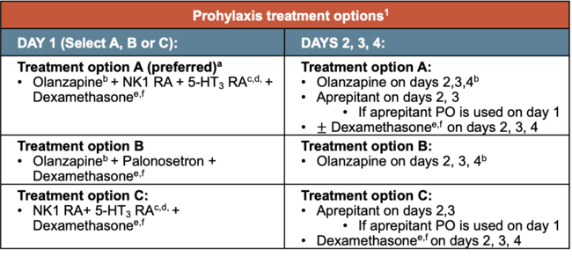
SG/Dato-DXd: Nausea/vomiting management
SG and Dato-DXd are parenteral anticancer agent with high emetic risk (>90% frequency of emesis)^{1,a}
 | Nausea and vomiting grade scales²
 | Nausea | Vomiting
G1 | Loss of appetite without alteration in eating habits | Intervention not indicated
G2 | Oral intake decreased without significant weight loss, dehydration, or malnutrition | Outpatient IV hydration; medical intervention indicated
G3 | Inadequate oral caloric or fluid intake; tube feeding, TPN or hospitalization indicated | Tube feeding, TPN, or hospitalization indicated
G4 | - | Life-threatening consequences
G5 | - | Death
Prohylaxis treatment options¹
DAY 1 (Select A, B or C): | DAYS 2, 3, 4:
Treatment option A (preferred)ª Olanzapine^{b} + NK1 RA + 5-HT₃ RA^{c,d,} + Dexamethasone^{e,f} | Treatment option A: Olanzapine on days 2,3,4^{b} Aprepitant on days 2, 3 If aprepitant PO is used on day 1 $±$ Dexamethasone^{e,f} on days 2, 3, 4
Treatment option B Olanzapine^{b} + Palonosetron + Dexamethasone^{e,f} | Treatment option B: Olanzapine on days 2, 3, 4^{b}
Treatment option C: NK1 RA+ 5-HT₃ RA^{c,d,} + Dexamethasone^{e,f} | Treatment option C: Aprepitant on days 2,3 If aprepitant PO is used on day 1 Dexamethasone^{e,f} on days 2, 3, 4
• Doses of SG should be withheld for G3 nausea or G3-4 vomiting at the time of scheduled treatment administration and resume with additional supportive measures when resolution to ≤ G1 is achieved²
ª If not used previously, consider escalating to a 4-drug regimen (option A) if emesis occurred during a previous cycle of anticancer therapy with a 3-drug regimen (olanzapine-containing regimen B or E or NK1 RA-containing regimen C). Olanzapine-containing regimens may be useful for patients with severe nausea; ^{b}Data suggest that a 2.5-mg dose of olanzapine is efficacious. Consider this dose especially for patients who are older or who are over sedated; ^{c} If netupitant/palonosetron or fosnetupitant/palonosetron fixed combination product is used, no further 5-HT₃ RA is required; ^{d}When used in combination with an NK1 RA, there is no preferred 5-HT₃ RA; ^{e} Emerging data and clinical practice suggest dexamethasone doses may be individualized. Higher doses may be considered, especially when an NK1 RA is not given concomitantly. Lower doses, given for shorter durations, or even elimination of dexamethasone on day 1 or subsequent days (for delayed nausea and emesis prevention) may be acceptable based on patient characteristics. If dexamethasone is eliminated on day 1 or subsequent days, consider the use of an antiemetic combination containing a 5-HT3 RA, NK1 RA, and olanzapine on day 1, and olanzapine for delayed CINV. See Discussion. Radhakrishnan V, et al. JCO Glob Oncol 2024;10:e2300301; ^{f} Use of corticosteroid premedication should be avoided with cellular therapies. Clinicians may wish to consider a dexamethasone-sparing approach with ICI therapy as well.
Dato-DXd, datopotamab deruxtecan; Dexa, Dexamethasone; IV, intravenous; PO, per os; SG, Sacituzumab govitegan; RA, receptor antagonist; TPN, total parenteral nutrition
1. NCCN Clinical Practice Guidelines in Oncology (NCCN Guidelines®) for Antiemesis V.1.2025 (Accessed April 2025); 2. Sacituzumab govitecan. Potential Management Strategies for Select Side Effects. 2023 available at: https://www.trodelvyhcp.com/-/media/project/trodelvy/trodelvyhcp/hcp/nurse-station/pdf/trodelvy_one-pan-breast-side-effects-quick-sheet-now-approved-removal_digital_us-trop-0998.pdf (accessed April 2025).
^{b}Data suggest that a 2.5-mg dose of olanzapine is efficacious. Consider this dose especially for patients who are older or who are oversedated. ^{g}If netupitant/palonosetron or fosnetupitant/palonosetron fixed combination product is used, no further 5-HT₃ RA is required. ^{h}When used in combination with an NK1 RA, there is no preferred 5-HT₃ RA. ^{i}Emerging data and clinical practice suggest dexamethasone doses may be individualized. Higher doses may be considered, especially when an NK1 RA is not given concomitantly. Lower doses, given for shorter durations, or even elimination of dexamethasone on day 1 or subsequent days (for delayed nausea and emesis prevention) may be acceptable based on patient characteristics. If dexamethasone is eliminated on day 1 or subsequent days, consider the use of an antiemetic combination containing a 5-HT3 RA, NK1 RA, and olanzapine on day 1, and olanzapine for delayed CINV. See Discussion. Radhakrishnan V, et al. JCO Glob Oncol 2024;10:e2300301. J Use of corticosteroid premedications should be avoided with cellular therapies. Clinicians may wish to consider a dexamethasone-sparing approach with ICI therapy as well.
1. NCCN Clinical Practice Guidelines in Oncology (NCCN Guidelines®) for Antiemesis V.1.2025 (Accessed April 2025) (NCCN permission pending: reference to be updated to full form after permission is granted)

Slide 35



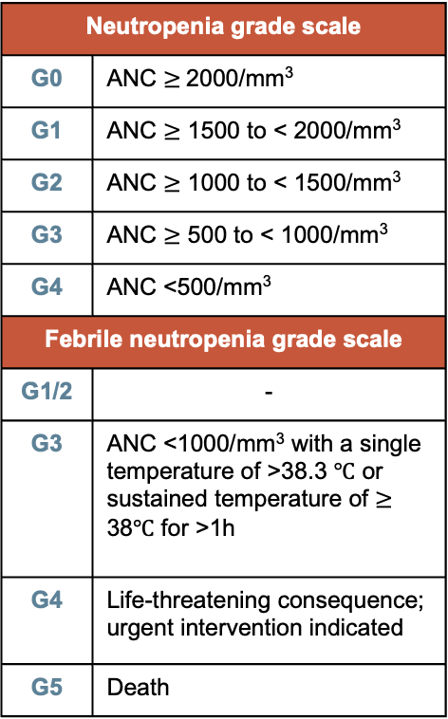
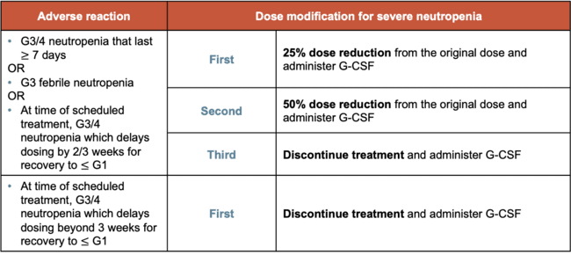
SG: Neutropenia toxicity management¹
Dose modification Withold SG if ANC is below 1500/mm³ on day 1 of any cycle, the neutrophil count is below 1000/mm³ on day 8 of any cycle, or the patient develops neutropenic fever
Prophylaxis If patients experience neutropenia: G-CSF prophylaxis
Note Do not re-escalate SG dose after a dose reduction for adverse reactions has been made
Neutropenia grade scale
G0 | ANC $≥$2000/mm³
G1 | ANC $≥$ 1500 to < 2000/mm³
G2 | ANC $≥$ 1000 to < 1500/mm³
G3 | ANC $≥$ 500 to < 1000/mm³
G4 | ANC <500/mm³
Febrile neutropenia grade scale
G1/2 | -
G3 | ANC <1000/mm³ with a single temperature of >38.3 ℃ or sustained temperature of $≥$ 38℃ for >1h
G4 | Life-threatening consequence; urgent intervention indicated
G5 | Death
Adverse reaction | Dose modification for severe neutropenia
G3/4 neutropenia that last $≥$ 7 days OR G3 febrile neutropenia OR At time of scheduled treatment, G3/4 neutropenia which delays dosing by 2/3 weeks for recovery to $≤$ G1 | First | 25% dose reduction from the original dose and administer G-CSF
 | Second | 50% dose reduction from the original dose and administer G-CSF
 | Third | Discontinue treatment and administer G-CSF
At time of scheduled treatment, G3/4 neutropenia which delays dosing beyond 3 weeks for recovery to $≤$ G1 | First | Discontinue treatment and administer G-CSF
ANC, absolute neutrophil count; G, grade; G-CSF, granulocyte-colony stimulating factor; SG, Sacituzumab govitecan
1. Sacituzumab govitecan. Potential Management Strategies for Select Side Effects. 2023 available at: https://www.trodelvyhcp.com/-/media/project/trodelvy/trodelvyhcp/hcp/nurse-station/pdf/trodelvy_one-pan-breast-side-effects-quick-sheet-now-approved-removal_digital_us-trop-0998.pdf (accessed April 2025).

Slide 36


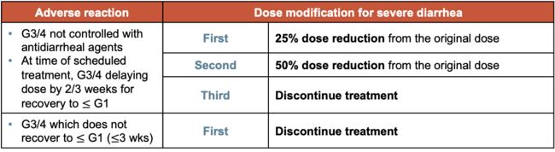
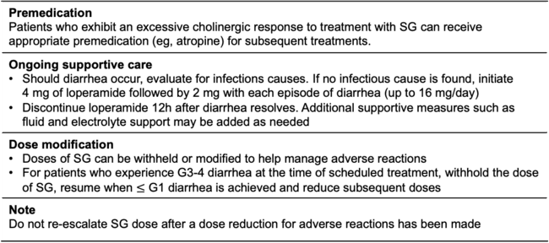
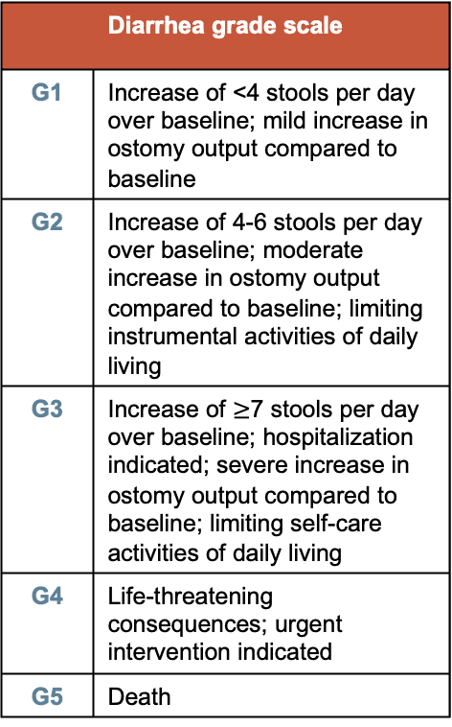
SG: Diarrhoea management¹
Premedication Patients who exhibit an excessive cholinergic response to treatment with SG can receive appropriate premedication (eg, atropine) for subsequent treatments.
Ongoing supportive care Should diarrhoea occur, evaluate for infections causes. If no infectious cause is found, initiate 4 mg of loperamide followed by 2 mg with each episode of diarrhoea (up to 16 mg/day) Discontinue loperamide 12h after diarrhoea resolves. Additional supportive measures such as fluid and electrolyte support may be added as needed
Dose modification Doses of SG can be withheld or modified to help manage adverse reactions For patients who experience G3-4 diarrhoea at the time of scheduled treatment, withhold the dose of SG, resume when $≤$ G1 diarrhea is achieved and reduce subsequent doses
Note Do not re-escalate SG dose after a dose reduction for adverse reactions has been made
Diarrhoea grade scale
G1 | Increase of <4 stools per day over baseline; mild increase in ostomy output compared to baseline
G2 | Increase of 4-6 stools per day over baseline; moderate increase in ostomy output compared to baseline; limiting instrumental activities of daily living
G3 | Increase of $≥$7 stools per day over baseline; hospitalization indicated; severe increase in ostomy output compared to baseline; limiting self-care activities of daily living
G4 | Life-threatening consequences; urgent intervention indicated
G5 | Death
Adverse reaction | Dose modification for severe diarrhoea
G3/4 not controlled with antidiarrhoeal agents At time of scheduled treatment, G3/4 delaying dose by 2/3 weeks for recovery to G1 | First | 25% dose reduction from the original dose
 | Second | 50% dose reduction from the original dose
 | Third | Discontinue treatment
G3/4 which does not recover to G1 ($≤$3 wks) | First | Discontinue treatment
G, grade; h, hours; SG, Sacituzumab govitecan; wks, weeks
1. Sacituzumab govitecan. Potential Management Strategies for Select Side Effects. 2023 available at: https://www.trodelvyhcp.com/-/media/project/trodelvy/trodelvyhcp/hcp/nurse-station/pdf/trodelvy_one-pan-breast-side-effects-quick-sheet-now-approved-removal_digital_us-trop-0998.pdf (accessed April 2025).

Slide 37
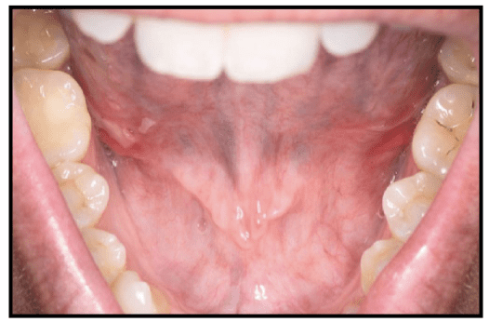
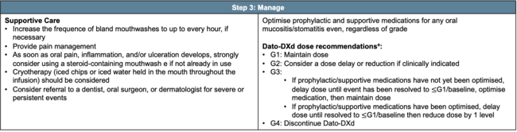
Dato-Dxd: Mucositis management¹
Step 1: Prophylaxis
Initiate daily OCP prior to administration of first Dato-DX dose: Gently brushing teeth after meals and at bedtime using a soft toothbrush and a bland fluoride-containing toothpaste Daily flossing, unless it causes pain or bleeding Daily use of steroid-containing mouthwashª (4x per day, swish for 1-2 minutes then spit out) In the absence of steroid-containing mouthwash, daily use of inert, bland mouthwash^{b} Education on the importance of oral hygiene, hydration, and lubrication of the oral mucosa and adherence to OCP
Step 2: Confirm
Example of stomatitis after one week of Dato-DXd dose delay and treatment
Step 3: Manage
Supportive Care Increase the frequence of bland mouthwashes to up to every hour, if necessary Provide pain management As soon as oral pain, inflammation, and/or ulceration develops, strongly consider using a steroid-containing mouthwash e if not already in use Cryotherapy (iced chips or iced water held in the mouth throughout the infusion) should be considered Consider referral to a dentist, oral surgeon, or dermatologist for severe or persistent events | Optimise prophylactic and supportive medications for any oral mucositis/stomatitis even, regardless of grade Dato-DXd dose recommendations^{e}: G1: Maintain dose G2: Consider a dose delay or reduction if clinically indicated G3: If prophylactic/supportive medications have not yet been optimised, delay dose until event has been resolved to $≤$G1/baseline, optimise medication, then maintain dose If prophylactic/supportive medications have been optimised, delay dose until resolved to $≤$G1/baseline then reduce dose by 1 level G4: Discontinue Dato-DXd
ªDexamethasone 0.1 mg/mL oral solution (10 mL, four times per day, swish for 1–2 min then spit out), or local alternative. Similar mouthwash regimens using an alternative steroid can be used as advocated by institutional/local guidelines. Oral nystatin suspension or other topical antifungal agents can be used ≥ 15 min after the steroid-containing mouthwash as advocated by institutional/local guidelines; ^{b} Non-alcoholic and/or bicarbonate-containing mouthwash (four to six times per day); ^{c} Dato-DXd dose was delayed at the end of Cycle 2 and the patient was treated with clobetasol gel and magic mouthwash (mixture of sucralfate, suspension of aluminum hydroxide, and diphenhydramine); ^{d} Doxepin 0.5 %, viscous lidocaine 2 %; ^{e}Do not re-escalate Dato-DXd dose after a dose reduction for adverse reactions has been made.
Dato-DXd, datopotamab deruxtecan; G, grade OCP, oral care plan.
1. Heist RS, et al. Cancer Treat Rev. 2024:125:102720.

Slide 38
CLINICAL TAKEAWAYS

Slide 39
CLINICAL TAKEAWAYS
Endocrine-resistant HR+/HER2− mBC remains a significant unmet need, and ADCs offer a more effective and tolerable later-line alternative to conventional chemotherapy
Dato-DXd demonstrated a statistically significant and clinically meaningful improvement in PFS versus chemotherapy, with continued benefits across secondary efficacy, safety and PRO endpoints, despite OS not reaching statistical significance—potentially influenced by post-progression ADC use
Sacituzumab govitecan remains a valuable treatment option for heavily pretreated patients with HR+/HER2− breast cancer, demonstrating clinically meaningful improvements in PFS, OS, and PRO, with a manageable safety profile when supported by appropriate care.
To support treatment adherence and maintain QoL with ADCs, effective management of AEs is crucial—whether through prophylaxis, supportive medications, interventions, and/or dose modifications.
In the absence of predictive biomarkers, selection of ADCs for HR+/HER2− (IHC0) mBC should be guided by prior treatments, clinical characteristics, toxicity profiles, and patient preferences.
ADC, antibody-drug conjugate; AE, adverse event; Dato-DXd, datopotamab deruxtecan; GI, gastrointestinal; HR+, hormone receptor positive; IHC; immunohistochemistry; mBC, metastatic breast cancer; PFS, progression free survival; PRO, patient-reported outcome; OS, overall survival

