Slide 2

DEVELOPED BY OBSTETRICS & GYNECOLOGY CONNECT
This programme is developed by OBSTETRICS & GYNECOLOGY
CONNECT, an international group of experts in the field of
obstetrics and gynecology.
Acknowledgement and disclosures
This OBSTETRICS & GYNECOLOGY CONNECT programme has been sponsored by Eisai Europe Limited ("Eisai"). Eisai has had no input on the educational content of, or speakers involved in this programme.
Please note:
This educational programme is intended for healthcare professionals only
The views expressed within this programme are the personal opinions of the expert. They do not necessarily represent the views of the expert’s academic institutions, organisations, or other group or individual
Expert Disclosures:
Prof. Domenica Lorusso has received financial support/sponsorship for research support, consultation, or speaker fees from the following companies:
Grants or contracts from AstraZeneca, Clovis, Genmab, GSK, Immunogen, Incyte, MSD, Novartis, PharmaMar, Seagen, and Roche
Consulting fees from AstraZeneca, Clovis Oncology, Genmab, GSK, Immunogen, MSD, PharmaMar, Seagen, and Novartis
Payment or honoraria from AstraZeneca, Clovis, Corcept, Genmab, GSK, Immunogen, MSD, Oncoinvest, PharmaMar, Seagen, and Sutro
Support for attending meetings and/or travel from GSK, AstraZeneca, Clovis, and MSD
Participation on a Data Safety Monitoring or Advisory Board for AstraZeneca, Clovis, Corcept, Genmab, GSK, Immunogen, MSD, Oncoinvest, PharmaMar, Seagen, and Sutro

Slide 3
CLINICAL TOPIC NEWSLETTER
Optimising treatment selection in advanced endometrial cancer: review of the ESGO guidelines Prof. Domenica Lorusso Full Professor of Obstetrics and Gynecology at Humanitas University, Rozzano Director of The Gynecological Oncology Program at Humanitas San Pio X, Milan, Italy DECEMBER 2025

Slide 4
Educational Objectives
Explain the positioning of lenvatinib plus pembrolizumab in the treatment algorithm for advanced or recurrent endometrial cancer, with reference to the main guidelines, including molecular stratification and sequencing after platinum-based chemotherapy
Demonstrate the ability to select appropriate patients for lenvatinib plus pembrolizumab treatment and apply evidence-based strategies to monitor and manage associated toxicities to optimise patient outcomes

Slide 5
CLINICAL TAKEAWAYS
For advanced/recurrent non-dMMR (pMMR) endometrial cancer, ESGO guidelines recommend ICI + chemotherapy followed by maintenance ICI ± PARPi. When chemotherapy is contraindicated, LEN/PEMBRO is recommended, provided the patient has received prior [neo]adjuvant chemotherapy.
Chemotherapy contraindications may arise from clinical factors (e.g. severe comorbidities, hematologic dysfunction, ECOG PS >2), prior chemotherapy exposure, or patient-centered reasons (e.g. efficacy–safety considerations, informed refusal). However, as guidelines offer no clear definition, decisions remain at the clinician’s discretion.
During LEN/PEMBRO, close monitoring and grade-based management of key toxicities (thyroid dysfunction, hypertension, diarrhoea, proteinuria and immune-related AEs) support ongoing treatment in most patients: use supportive care and dose modification for mild–moderate events, corticosteroids for immune-mediated AEs, and permanent discontinuation for severe or persistent toxicity.

Slide 6
ENDOMETRIAL CANCER MOLECULAR SUBTYPES & Current treatment guidelines

Slide 7
PORTEC3-Trial
Molecular classification is prognostic and predictive of benefit from adjuvant platinum-based therapy¹
POLEmut¹
p53abn¹
MMRd¹
NSMP¹
100
100
CTRT
RT
100
100
75
5-year RFS: 100% (CTRT) vs 96.6% (RT)
HR, 0.02; 95% CI, <0.01 to >10⁵; p_{cox}=0.637
75
75
75
50
50
50
5-year RFS: 68.0% (CTRT) vs 75.5% (RT)
HR, 1.29; 95% CI, 0.68 to 2.45; p_{cox}=0.429
50
5-year RFS: 79.7% (CTRT) vs 67.7% (RT)
HR, 0.68; 95% CI, 0.36 to 1.30; p_{cox}=0.246
RFS (%)
RFS (%)
RFS (%)
RFS (%)
20
CTRT
RT
20
5-year RFS: 58.6% (CTRT) vs 36.2% (RT)
HR, 0.52; 95% CI, 0.30 to 0.91; p_{cox}=0.021
20
CTRT
RT
20
CTRT
RT
0
0
0
0
0
1
2
3
4
5
0
1
2
3
4
5
0
1
2
3
4
5
0
1
2
3
4
5
Time since random assignment (years)
Time since random assignment (years)
Time since random assignment (years)
Time since random assignment (years)
No adj tx needed?
PARP as maintenance?
Adj IO rather than Ctx?
Hormone tx?
POLEmut: does not relapse regardless of tx¹
p53abn: worst prognosis but greatest benefit from adj Ctx¹
MSI and NSMP: intermediate prognosis, but little benefit from Adj Ctx¹
adj, adjuvant; CI, confidence interval; CTRT, chemotherapy + radiotherapy; Ctx, chemotherapy; HR, hazard ratio; IO, immunotherapy; MMRd, mismatch repair deficient; MSI, microsatellite instability; NSMP, no specific molecular profile; p53abn, p53 abnormal; POLEmut, POLE mutation; RFS, recurrence-free survival; RT, radiotherapy; tx, treatment
1. León-Castillo A, et al. J Clin Oncol. 2020;38(29):3388-97

Slide 8
ESGO-ESTRO-ESP guidelines
UNRESECTABLE STAGE III-IV OR RECURRENT ENDOMETRIAL CARCINOMA WITH NO PRIOR CHEMOTHERAPY EXCEPT IN THE ADJUVANT SETTING
MMRd tumours
Non-MMRd tumours
Symptomatic advanced disease OR
rapidly growing recurrent disease
Low-grade ER+
Low volume/asymptomatic advanced disease OR slowly growing recurrent disease
Chemotherapyª + ICI in combination, followed by ICI as maintenance therapy^{b}
[I, A]
Chemotherapyª
[I, A]
Endocrine therapy
Chemotherapy contraindicated
Addition of ICI to chemotherapy, followed by ICI as maintenance therapy^{c}
[I, B]
Addition of ICI to chemotherapy, followed by ICI +PARPi as maintenance therapy^{d}
[I, B]
MPA or MA
[III, A]
Aromatase inhibitors
Tamoxifen
[IV, C]
ICI (± PARPi) contraindicated
Recurrent EC with prior chemotherapy (adj/neoadj setting): pembrolizumab + lenvatinib
[III, C]
Patients with HER2 3+ tumour: addition of trastuzumab to chemotherapy
[II, B]
Surgery or definitive EBRT ± brachytherapy in patients responding to systemic treatments
[IV, B]
ª The standard chemotherapy regimen is carboplatin + paclitaxel
^{b} Immune checkpoint inhibitor (ICI): dostarlimab or durvalumab or pembrolizumab (drugs in alphabetical order)
^{c} ICI: dostarlimab or pembrolizumab
^{d} ICI + poly(ADP-ribose) polymerase inhibitor (PARPi): durvalumab + olaparib
adj/neoadj, adjuvant/neoadjuvant; EBRT, external beam radiotherapy; EC, endometrial carcinoma; ER+ estrogen receptor positive; ICI, immune checkpoint inhibitor; MA, megestrol acetate; MMRd, mismatch repair deficiency, MPA, medroxyprogesterone acetate; PARPi, PARP inhibitor
Concin N, et al. Lancet Oncol. 2025;26(8):e423-e435

Slide 9



Defining “chemotherapy contraindicated”
ESGO 2025 guidelines refers to “chemotherapy contraindicated,” but the term is not explicitly defined. Below are several scenarios that may fall under this category:
Clinical
Prior ChT Exposure
Severe comorbidities (e.g. cardiac, renal, hepatic insufficiency)
Hematologic dysfunction
Frailty, poor performance status (e.g. ECOG PS ≥2)
High risk of life-threatening toxicity
Prior chemotherapy (neoadjuvant/adjuvant)
Cumulative toxicities
Patient-Centric
QoL considerations outweighing potential benefit
Informed refusal of ChT after shared-decision making
ChT, chemotherapy; ECOG PS, Eastern Cooperative Oncology Group performance status; ESGO, European Society of Gynaecological Oncology; QoL, quality of life
Based on the expert opinion and clinical experience of Prof. Domenica Lorusso

Slide 10
PEMBROLIZUMAB + Lenvatinib

Slide 11
KEYNOTE-775
Continued PFS benefit of Len/pembro vs Chemotherapy
PFS RESULTS
pMMR population
PFS RESULTS
All-comers population
100
100
90
5-year rate
6.3%
2.1%
90
5-year rate
9.8%
3.2%
80
80
70
70
60
60
Progression-free survival (%)
Progression-free survival (%)
50
50
40
40
30
30
20
20
10
10
0
0
0
6
12
18
24
30
36
42
48
54
60
66
72
0
6
12
18
24
30
36
42
48
54
60
66
72
Number at risk LEN/PEMBRO
TPC
Time (months)
Number at risk LEN/PEMBRO
TPC
Time (months)
346
351
166
82
80
23
55
12
37
6
26
4
20
3
17
2
15
2
13
2
9
1
5
0
0
0
411
416
203
94
110
27
80
15
59
8
48
6
36
5
41
4
27
3
25
3
17
2
9
1
0
0
 | LEN/PEMBRO | TPC
Events, n (%) | 289 (83.5) | 249 (70.9)
Median PFS (95% CI),^{b} mo | 6.7 (5.6-7.4) | 3.8 (3.6-5.0)
HR (95% CI)^{c} | 0.60 (0.51-0.72)
 | LEN/PEMBRO | TPC
Events, n (%) | 322 (80.8) | 298 (71.6)
Median PFS (95% CI),^{b} mo | 7.3 (5.7-7.6) | 3.8 (3.6-4.2)
HR (95% CI)^{c} | 0.56 (0.48-0.66)
Data cutoff: February 26, 2025. The tick marks indicate censored data; ª Per RECIST version 1.1 by BICR; ^{b} Based on Kaplan-Meier method for censored data; ^{c} Based on Cox regression model with the Efron method of tie handling and treatment as a covariate; analyses were stratified for the pMMR population and all-comers
CI, confidence interval; HR, hazard ratio; LEN, lenvatinib; mo, months; PEMBRO, pembrolizumab; PFS, progression-free survival; pMMR, proficient mismatch repair
Makker V, et al. IGCS 2025. Abstract #481

Slide 12
KEYNOTE-775
Continued OS benefit of Len/pembro vs Chemotherapy
OS RESULTS
pMMR population
OS RESULTS
All-comers population
100
100
90
5-year rate
16.7%
7.3%
90
5-year rate
19.9%
7.7%
80
80
70
70
60
60
Overall survival (%)
Overall survival (%)
50
50
40
40
30
30
20
20
10
10
0
0
0
6
12
18
24
30
36
42
48
54
60
66
72
0
6
12
18
24
30
36
42
48
54
60
66
72
Number at risk LEN/PEMBRO
TPC
Time (months)
Number at risk LEN/PEMBRO
TPC
Time (months)
346
351
285
268
213
173
171
113
129
80
105
67
89
49
79
32
66
24
47
18
36
15
21
5
4
1
411
416
337
306
257
198
211
131
165
94
138
80
120
59
106
40
85
28
67
20
51
17
29
7
4
1
 | LEN/PEMBRO | TPC
Events, n (%) | 285 (82.4) | 310 (88.3)
Median PFS (95% CI),ª mo | 18.0 (14.9-20.5) | 12.2 (11.0-14.1)
HR (95% CI)^{b} | 0.70 (0.60-0.83)
 | LEN/PEMBRO | TPC
Events, n (%) | 325 (79.1) | 363 (87.3)
Median PFS (95% CI),ª mo | 18.7 (15.6-21.3) | 11.9 (10.6-13.3)
HR (95% CI)^{b} | 0.66 (0.57-0.77)
Data cutoff: February 26, 2025. The tick marks indicate censored data; ª Per RECIST version 1.1 by BICR; ^{b} Based on Kaplan-Meier method for censored data; ^{c} Based on Cox regression model with the Efron method of tie handling and treatment as a covariate; analyses were stratified for the pMMR population and all-comers
CI, confidence interval; HR, hazard ratio; LEN, lenvatinib; mo, months; OS, overall survival; PEMBRO, pembrolizumab; pMMR, proficient mismatch repair
Makker V, et al. IGCS 2025. Abstract #481

Slide 13
ENGOT-en9/LEAP-001 TRIAL DESIGN: PEMBROLIZUMAB + LENVATINIB IN 1L TREATMENT OF ENDOMETRIAL CANCER¹⁻³
Key eligibility criteria
Stage III, Stage IV or recurrent endometrial carcinomaª
Radiographically apparent disease – either measurable or non-measurable
No prior chemotherapy except in the neo/adjuvant setting^{b}
ECOG PS 0-1
Tumour tissue sample for MMR testing
Lenvatinib 20 mg orally QD until PD +
Pembrolizumab 200 mg IV Q3W until PD or ×35 cycles
R (1:1) N=842^{2,3}
Paclitaxel 175 mg/m² IV Q3W +
Carboplatin AUC 6mg/mL/min
IV Q3W ×7 cycles^{c}
Stratification factors
MMR status (pMMR vs dMMR)
If pMMR
ECOG PS (0 vs 1)
Measurable disease (yes vs no)
Prior chemotherapy and/or chemoradiation (yes vs no)
Endpoints
Dual primary: PFS per RECIST v1.1 by BICR and OS
Secondary: ORR per RECIST v1.1 by BICR, safety, and HRQoL
Exploratory: Included DoR per RECIST v1.1 by BICR
ª Carcinosarcoma (malignant mixed Müllerian tumour), endometrial leiomyosarcoma or other high-grade sarcomas, or endometrial stromal sarcomas excluded; ^{b} 1 prior line of neoadjuvant and/or adjuvant chemotherapy in the setting of curative-intent resection was permitted if recurrence occurred ≥6 months after last dose; prior radiotherapy with or without chemotherapy, or prior hormonal therapy were also permitted; ^{c} Patients with ongoing clinical benefit could continue chemotherapy beyond 7 cycles if approved by sponsor
1L, first-line; AUC, area under the curve; BICR, blinded independent central review; DoR, duration of response; ECOG PS, Eastern Cooperative Oncology Group performance status; HRQoL, health-related quality of life; IV, intravenous; ORR, objective response rate; OS, overall survival; (p/d)MMR, (proficient/deficient) mismatch repair; PD, progressive disease; PFS, progression-free survival; Q3W, every 3 weeks; QD, once daily; R, randomised; RECIST, Response Evaluation Criteria In Solid Tumours
1. Marth C, et al. Int J Gynecol Cancer. 2022;32:93-100; 2. Marth C, et al. J Clin Oncol. 2025;43:1083-1100 (including protocol); 3. Akilli H, et al. Presented at the ESMO Congress 2025; October 17–21, 2025; Berlin, Germany. Poster 1114P

Slide 14
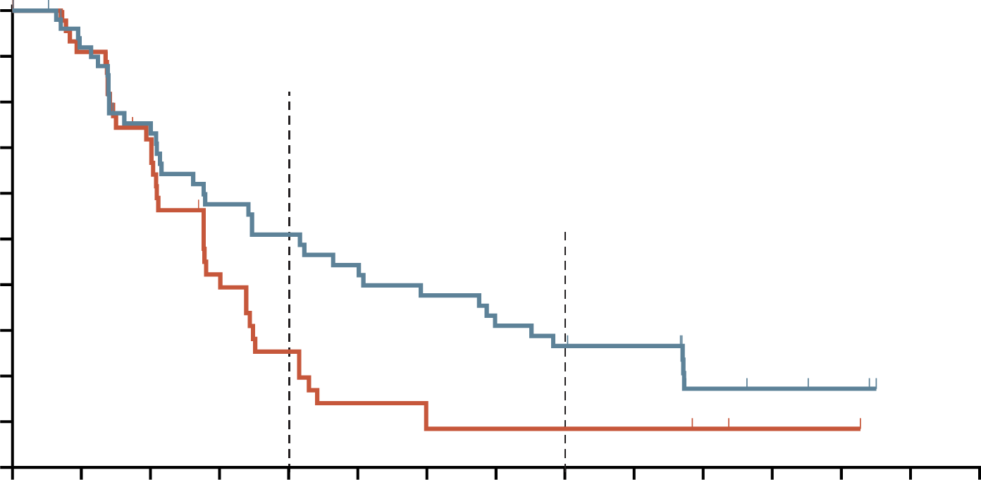
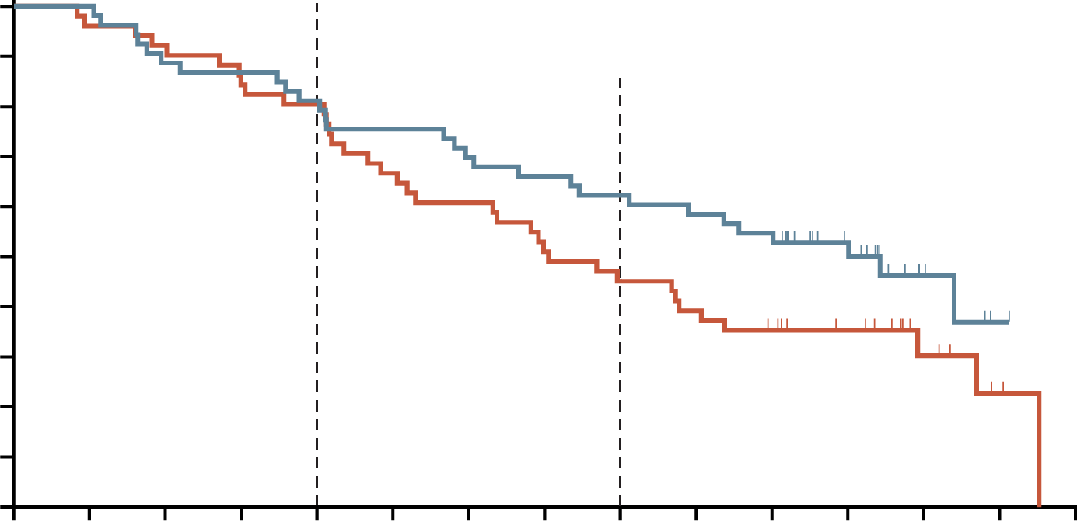
ENGOT-en9/LEAP-001 TRIAL: Significant Increase in PFS & OS WITH LEN/PEMBRO IN PRIOR (NEO)ADJUVANT ChT pMMR SUBGROUP
LEN/PEMBRO was approved based on the KEYNOTE-775 trial for aEC (non-MSI-H/dMMR) after prior systemic therapy in any setting.¹ The ENGOT-en9/LEAP-001 trial further confirms its effectiveness as a 1st line option in this population²
PFS RESULTS²
(pMMR)
OS RESULTS²
(pMMR)
100
100
81.1%
80.4%
90
90
80
51.0%
25.4%
80
62.3%
45.1%
70
70
60
60
Progression-free survival (%)
50
26.6%
8.5%
50
Overall survival (%)
40
40
30
30
20
20
10
10
0
0
0
3
6
9
12
15
18
21
24
27
30
33
36
39
42
0
3
6
9
12
15
18
21
24
27
30
33
36
39
42
Number at risk LEN/PEMBRO
ChT
Time (months)
Number at risk LEN/PEMBRO
ChT
Time (months)
53
51
45
40
34
28
26
15
23
9
20
5
17
3
14
3
12
3
11
3
4
2
3
1
2
1
0
0
0
0
53
51
53
49
47
47
46
43
43
41
40
34
37
31
35
26
33
23
31
20
28
17
18
13
6
6
1
2
0
0
 | LEN/PEMBRO | ChT
Events, n/N | 37/53 | 35/51
Median PFS (95% CI), mo | 12.5 (6.5-20.3) | 8.3 (6.1-10.2)
HR (95% CI) | 0.60 (0.37-0.97)
 | LEN/PEMBRO | ChT
Events, n/N | 28/53 | 36/51
Median OS (95% CI), mo | 34.2 (22.0-NR) | 21.1 (15.1-28.1)
HR (95% CI) | 0.67 (0.41-1.11)
aEC, advanced endometrial cancer; ChT, chemotherapy; CI, confidence interval; HR, hazard ratio; LEN, lenvatinib; mo, months; MSI-H, microsatellite instability-high; NR, not reached; OS, overall survival; p/dMMR, proficient/deficient mismatch repair; PEMBRO, pembrolizumab; PFS, progression-free survival.
1. U.S. Food and Drug Administration. FDA grants regular approval to pembrolizumab and lenvatinib for advanced endometrial carcinoma. Available here (accessed November 2024); 2. Marth C, et al. J Clin Oncol. 2025;43(9):1083-1100

Slide 15
TRAE with Incidence ≥20%: As Treatedª
LEN/PEMBRO (N=420)
ChT (N=411)
Hypertension
Hypothyroidism
Diarrhoea
Proteinuria
Fatigue
Nausea
Decreased appetite
Increased ALT
Increased AST
Arthralgia
Anaemia
Alopecia
Decreased neutrophil count
Neutropenia
Decreased WBC count
Grade 1-2
Peripheral neuropathy
Peripheral sensory neuropathy
Grade 3-5
ª Safety profile was consistent in the pMMR and dMMR populations
Data cutoff date: October 2, 2023
ALT, alanine aminotransferase; AST, aspartate aminotransferase; ChT, chemotherapy; LEN, Lenvatinib; p/dMMR, proficient/deficient mismatch repair; PEMBRO, pembrolizumab; TRAE, treatment related adverse events; WBC, white blood cell count
Marth C, et al. J Clin Oncol. 2025;43(9):1083-1100

Slide 16
Management of select AEs during treatment phase*
Hypothyroidism
Hypertension
Diarrhoea
Proteinuria
Stomatitis, appetite and weight decrease, PPES, fatigue, nausea, vomiting, musculoskeletal disorders
Arterial thromboembolic events, GI perforation
Monitor thyroid function at least monthly during treatment
Monitor BP after 1 week, then every 2 weeks for the first 2 months, and then at least monthly thereafter during treatment
Patients should be alert to first onset of soft bowel movements; clinicians should prescribe antidiarrheals to be utilised as necessary
Monitor periodically during treatment
Clinical team should track all symptoms, labs and relevant vitals
Monitor
Treat hypothyroidism per standard medical practice (guidance from the lenvatinib label)
Withhold lenvatinib for grade 3 hypertension that persists despite optimal antihypertensive therapy
Resume lenvatinib at reduced dose when hypertension is controlled (≤ grade 2)
If symptoms of diarrhoea persist despite medical management, and diarrhoea is lenvatinib-related, follow detailed management algorithmª
If proteinuria ≥2 g/24h (grade ≥2), withhold lenvatinib treatment
Resume lenvatinib treatment at a lower dose when proteinuria <2 g/24h
Based on severity, follow strategy outlined in detailed management algorithmª
Use supportive measures/medication per standard medical practice
Per the pembrolizumab label:
Initiate hormone replacement therapy
Withhold treatment for grade 3-4 endocrinopathies (until patients are clinically stable)
Treat
If colitis is suspected, prompt work-up and management; consider referral to GI specialist (for grade ≥2 diarrhoea)
For grade 2 or 3 immune-mediated colitis, withhold pembrolizumab and administer corticosteroids
If clinical stability is not reached, permanently discontinue pembrolizumab, based on severity
Permanently discontinue lenvatinib for grade 4 hypertension
Discontinue lenvatinib treatment for grade 4 diarrhoea
Discontinue lenvatinib treatment for nephrotic syndrome
Based on severity, follow strategy outlined in detailed management algorithmª
Discontinue lenvatinib treatment for any-grade
Discontinue
For recurrent grade 3 or grade 4 immune-mediated colitis, permanently discontinue pembrolizumab
* Treated with LEN/PEMBRO; ª See Supplementary Figure 7 of Colombo et al. (2024)
AE, adverse event; BP, blood pressure; GI, gastrointestinal; PPES, palmar-plantar erythrodysesthesia syndrome
Colombo N, et al. Oncologist. 2024;29(1):25-35

Slide 17
IMMUNE CHECKPOINT INHIBITOR + Chemotherapy

Slide 18
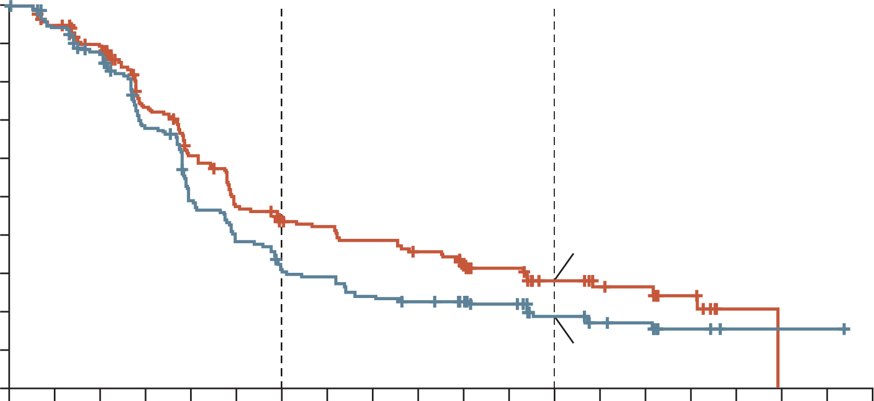
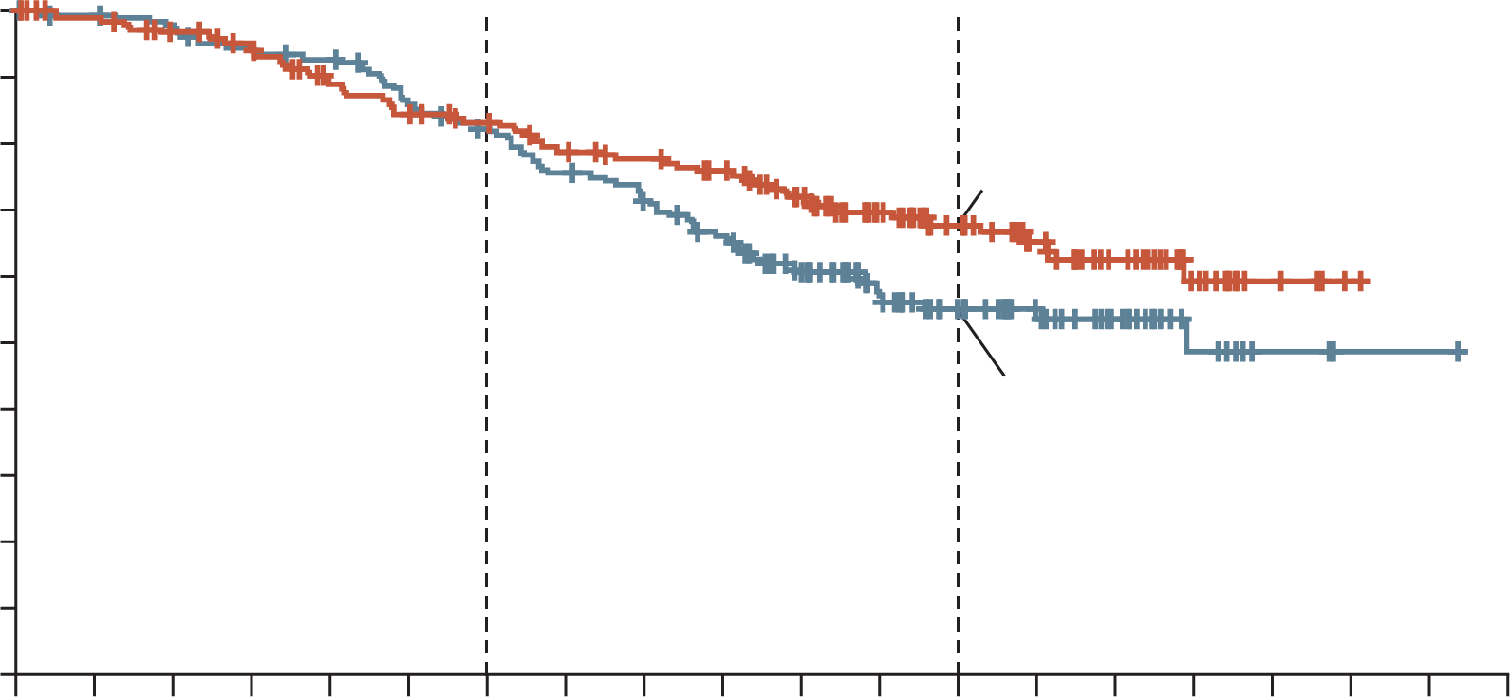
RUBY TRIAL: DOSTARLIMAB + ChT SHOWED IMPROVED PFS IN pMMR POPULATION VS ChT ALONE
Dostarlimab + ChT benefit in pMMR–MSS population: Although less pronounced than in the dMMR–MSI-H group, efficacy was consistent for progression-free and overall survival
PFS RESULTS
(pMMR)
OS RESULTS
(pMMR)
HR 0.76
HR 0.73
100
(95% CI, 0.59 to 0.98)
100
(95% CI, 0.52 to 1.02)
90
90
Dostarlimab group
80
80
67.7 (95% CI, 59.8-74.4)
70
70
60
60
Placebo group
Progression-free survival (%)
Dostarlimab group
Overall survival (%)
50
50
40
28.4 (95% CI, 21.2-36.0)
40
55.1 (95% CI, 46.8-62.5)
30
30
20
Placebo group
20
10
18.8 (95% CI, 12.8-25.7)
10
0
0
0
2
4
6
8
10
12
14
16
18
20
22
24
26
28
30
32
34
36
38
0
2
4
6
8
10
12
14
16
18
20
22
24
26
28
30
32
34
36
38
Months since randomisation
Months since randomisation
Safety analysis in the overall population showed a 10% higher incidence of grade ≥3 AEs with dostarlimab, while chemotherapy discontinuation rates and QoL remained similar between the two groups
AE, adverse event; ChT, chemotherapy; CI, confidence interval; HR, hazard ratio; MSI-H, microsatellite instability-high; MSS, microsatellite stable; OS, overall survival; p/dMMR, proficient/deficient mismatch repair; PFS, progression-free survival; QoL, quality of life
Mirza MR, et al. N Engl J Med. 2023;388(23):2145-58

Slide 19
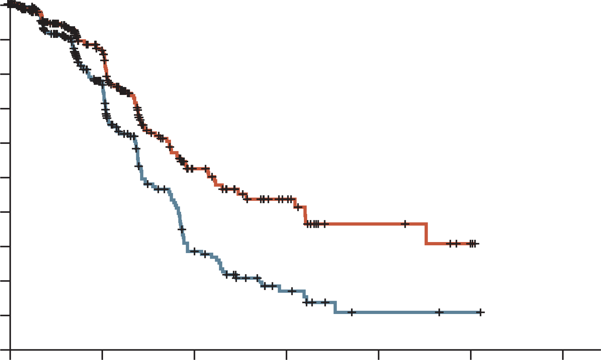
NRG-GY018 TRIAL: SUBGROUP ANALYSIS OF PFS IN pMMR POPULATION FAVORS PEMBROLIZUMAB + ChT vs ChT ALONE
PEMBRO + ChT was associated with longer PFS compared to placebo in patients with pMMR endometrial cancers, although greater benefits were observed in dMMR population
PFS RESULTS:
(pMMR)
GRADE ≥3 ADVERSE EVENTS
1.0
0.9
HR 0.54
(95% CI, 0.41 to 0.71)
0.8
0.7
0.6
Probability of progression-free survival
Paclitaxel–carboplatin+
pembrolizumab
0.5
Percentage of patients
0.4
0.3
0.2
Paclitaxel–carboplatin+
placebo
0.1
0.0
0
6
12
18
24
30
36
Months
pMMR cohort
Frequency of grade ≥3 AEs increased with the addition of pembrolizumab to combination chemotherapy
AE, adverse event; ChT, chemotherapy; CI, confidence interval; HR, hazard ratio; PEMBRO, pembrolizumab; PFS, progression-free survival; p/dMMR, proficient/deficient mismatch repair
Eskander RN, et al. N Engl J Med. 2023;388:2159-70

Slide 20
AtTEnd TRIAL: The addition of atezolizumab to chT did not demonstrate a statistically significant survival benefit
ATEZO + ChT was associated with a a substantial survival improvement in pts with dMMR carcinomas, while no clear PFS benefit was observed in the pMMR or ITT population^{1,2}
OS RESULTS: ITT²
OS RESULTS: pMMR²
100
90
80
70
60
50
40
30
20
10
0
100
90
80
70
60
50
40
30
20
10
0
HR 0.87
(95%CI 0.69-1.10)
p=0.0824
HR 1.02
(95%CI 0.78-1.34)
p=0.6644
Overall survival
Overall survival
Atezolizumab
Placebo
0
6
12
18
24
30
36
42
48
54
60
0
6
12
18
24
30
36
42
48
54
60
Number at risk Atezolizumab
Placebo
Time (months)
Number at risk Atezolizumab
Placebo
Time (months)
360
189
320
171
275
132
234
109
205
101
186
86
162
68
124
49
87
27
58
19
23
8
269
140
236
130
201
100
164
82
141
75
126
62
108
48
80
32
56
21
32
14
12
5
Treatment-related serious AEs occurred in 13% of patients in the atezolizumab group and 3% patients in the placebo group. Treatment-related deaths occurred in two patients (pneumonia in one patient in each group)¹
AE, adverse event; ATEZO, atezolizumab; ChT, chemotherapy; CI, confidence interval; EC, endometrial cancer; HR, hazard ratio; ITT, intention to treat (population); PFS, progression free survival; p/dMMR, proficient/deficient mismatch repair
1. Colombo N, et al. Lancet Oncol. 2024;25:1135-1146; 2. Barretina Ginesta MP, et al. Ann Oncol. 2025;36(suppl_2):S1-S60

Slide 21
IMMUNE CHECKPOINT INHIBITOR + Chemotherapy + PARP inhibitors

Slide 22
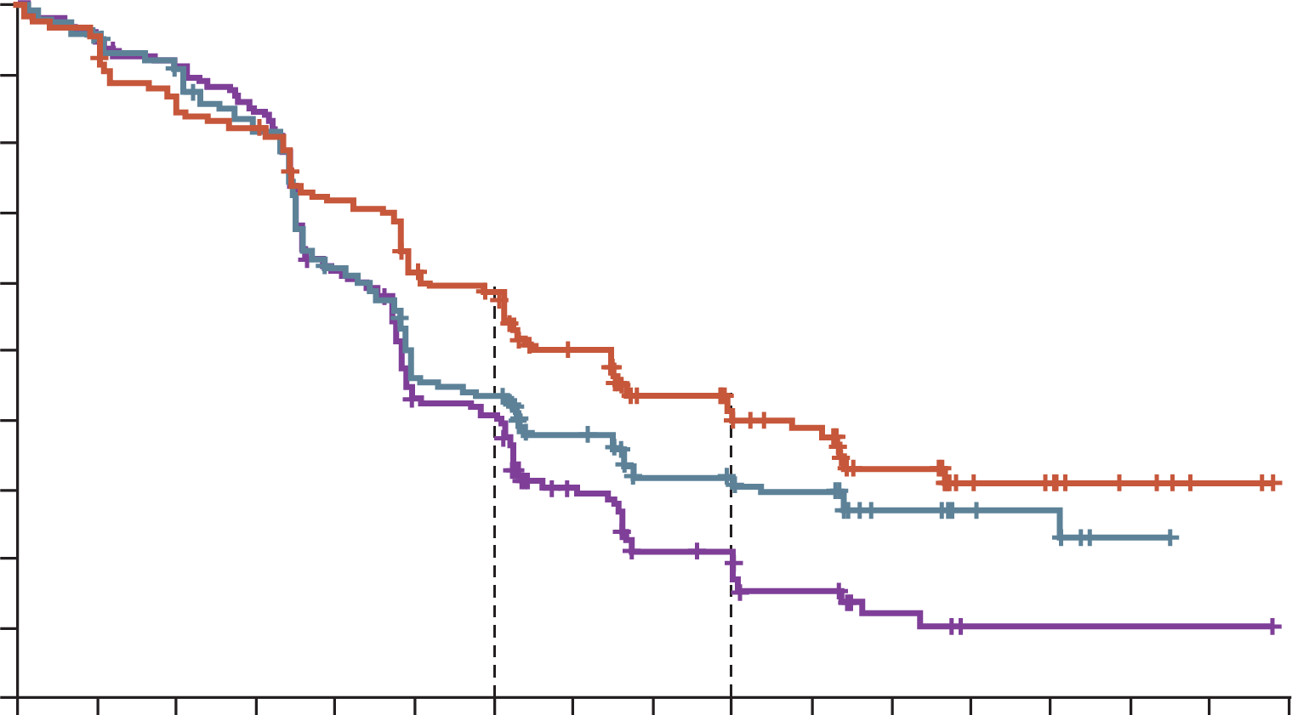
DUO-E TRIAL: DurvA/ChT IMPROVED PFS VS CONTROL IN pMMR SUBGROUP and ADDED BENEFIT with DURVA/OLAP MAINTENANCE
PFS benefit was observed for durvalumab ± olaparib arm versus control in pMMR subgroup, although the greatest benefit was seen in the dMMR subgroup
PFS RESULTS:
pMMR
100
Summary of AEs in the overall population
90
12 months
59.4%
44.4%
40.8%
HR 0.57 (CP+D+O arm)
80
 | Overallª |  |  | Maintenance Phase
 | D + O (n=238) | D (n=235) | Control (n=236) | D + O (n=192) | D (n=183) | Control (n=169)
Grade ≥3 AE, % | 67.2 | 54.9 | 56.4 | 41.1 | 16.4 | 16.6
AE leading to death, % | 2.1 | 1.7 | 3.4 | 1.6 | 0 | 1.2
Immune-mediated AEs, % | 23.5 | 28.1 | 6.8 | 14.1 | 14.8 | 3.6
AEs leading to discontinuation, % | 24.4 | 20.9 | 18.6 | 14.1 | 6.0 | 4.1
18 months
42.0%
31.3%
20.0%
(95% CI, 0.44 to 0.73)
70
60
Progression-free survival (%)
50
40
CP+D+O arm
30
20
CP+D arm
10
control arm
0
0
2
4
6
8
10
12
14
16
18
20
22
24
26
28
30
32
Months
In the overall population, although there was a higher rate of grade ≥3 AEs in the durvalumab + olaparib arm, the safety profiles of each arm were generally consistent with the known profiles of individual components of the regimen
ª ChT Phase + Maintenance Phase
AE, adverse event; ChT, chemotherapy; CI, confidence interval; CP, carboplatin/paclitaxel; D/DURVA, durvalumab; HR, hazard ratio; O/OLAP, olaparib; p/dMMR, proficient/deficient mismatch repair; PFS, progression-free survival
Westin SN, et al. J Clin Oncol. 2024;42:283-99 (including data supplement)

Slide 23
CLINICAL TAKEAWAYS

Slide 24
CLINICAL TAKEAWAYS
For advanced/recurrent non-dMMR (pMMR) endometrial cancer, ESGO guidelines recommend ICI + chemotherapy followed by maintenance ICI ± PARPi. When chemotherapy is contraindicated, LEN/PEMBRO is recommended, provided the patient has received prior [neo]adjuvant chemotherapy.
Chemotherapy contraindications may arise from clinical factors (e.g. severe comorbidities, hematologic dysfunction, ECOG PS >2), prior chemotherapy exposure, or patient-centered reasons (e.g. efficacy–safety considerations, informed refusal). However, as guidelines offer no clear definition, decisions remain at the clinician’s discretion.
During LEN/PEMBRO, close monitoring and grade-based management of key toxicities (thyroid dysfunction, hypertension, diarrhoea, proteinuria and immune-related AEs) support ongoing treatment in most patients: use supportive care and dose modification for mild–moderate events, corticosteroids for immune-mediated AEs, and permanent discontinuation for severe or persistent toxicity.

