Slide 2


Developed by PRECISION ONCOLOGY COnnect
This programme is developed by PRECISION ONCOLOGY CONNECT, an international group of experts in the field of detection and treatment of targetable genetic/genomic alterations in various cancers, and brought to you alongside OBSTETRICS & GYNECOLOGY CONNECT, an international group of experts in the field of obstetrics and gynecology.
Acknowledgement and disclosures
This PRECISION ONCOLOGY CONNECT programme is supported through an independent educational grant from Daiichi Sankyo.​ The programme is therefore independent; the content is not influenced by the supporter and is under the sole responsibility of the experts.
Please note:
This educational programme is intended for healthcare professionals only.
The views expressed within this programme are the personal opinions of the expert. They do not necessarily represent the views of the expert’s academic institutions, organisations, or the rest of the PRECISION ONCOLOGY CONNECT group​.
Expert disclosures:
Prof. Fernando A. Soares served as consultant, participated in advisory boards or received honoraria from AstraZeneca, Daiichi Sankyo, Roche Diagnostics, Roche Pharma, Novartis, MSD, Pfizer, Agilent Dako, Astellas Pharma, Amgen, BMS, AbbVie.

Slide 3
PRECISION ONCOLOGY CONNECT Animated Video
Understanding her2 testing in gynecological cancerS: best practices and treatment implications Prof. Fernando A. Soares University of São Paulo, Brazil February 2026

Slide 4
Educational objectives
Provide Expert Opinion on HER2 immunohistochemistry in ovarian, cervical and endometrial cancers, focusing on best practices, which guidelines exist and scoring criteria to follow:
Understand best practices in HER2 immunohistochemistry
Be able to implement optimal immunohistochemistry testing and scoring of staining for HER2 expression
Recognise the appropriate placement of therapies targeting HER2 alterations (including ADCs) across the patient journey
HER2, human epidermal growth factor receptor 2

Slide 5
Clinical takeaways
HER2 IHC testing is recommended in p53-aberrant endometrial cancer (EC), advanced or recurrent cervical cancer, and recurrent ovarian cancer, as HER2 status guides treatment selection. HER2 assessment and reporting should follow the CAP gynecologic reporting template.
In EC, patients with HER2+ uterine serous carcinoma are eligible for 1st-line carboplatin–paclitaxel + trastuzumab. In this setting, HER2 positivity is defined as IHC 3+ (strong complete or basolateral/lateral membranous staining in >30% of tumour cells [TC]) or IHC 2+ (strong staining in ≤30% of TC, or weak-to-moderate staining in ≥10% of TC) with ISH+.
In the recurrent or metastatic setting across endometrial, cervical, and ovarian cancers, patients with HER2-positive disease are eligible for ≥2nd-line treatment with T-DXd in certain circumstances. Here, HER2 positivity is defined as IHC 3+ (strong complete or basolateral/lateral staining in ≥10% of TC) or IHC 2+ (weak-to-moderate complete or basolateral/lateral staining in ≥10% of TC).
Standardisation across pre-analytic, analytic, and post-analytic phases is essential for reliable HER2 interpretation. In the absence of gynecological-specific guidance, established ASCO/CAP breast cancer standards can be applied.
CAP, College of American Pathologists; HER2, human epidermal growth factor receptor 2; IHC, immunohistochemistry; ISH, in situ hybridisation; NCCN, National Comprehensive Cancer Network; T-DXd, trastuzumab deruxtecan.

Slide 6
Her2 Expression AND TREATMENT IMPLICATIONS

Slide 7
HER2 IHC testing can inform clinical decisions for certain patients with gynecologic cancers
HER2-Positivity Prevalence Varies Across Gynecologic Tumour Types
NCCN Guidelines: Who to Test?
 | Tumour type | The role of HER2 IHC testing according to NCCN Guidelines
 | Endometrial¹⁰ | Recommended for all patients with p53 aberrant carcinomas, regardless of histology
 | Cervical¹¹ | Recommended for all patients with advanced metastatic, or recurrent cervical carcinomas
 | Ovarian¹² | Recommended for all patients with recurrent ovarian cancer
4%-49% Endometrial tumours^{1-4,a}
4%-7% Ovarian tumours^{2,8,9}
✓
✓
5%-44% Cervical tumours^{2,5-7,b}
✓
HER2-Positivity Treatment Implications in Metastatic Settings
1 | Line of therapy | Endometrial Cancer | Cervical Cancer | Ovarian Cancer
HER2-Targeted Treatment Options | 1L¹³ | Carboplatin-paclitaxel + trastuzumab^{c} for patients with HER2+ (IHC 3+ or 2+/ISH+) uterine serous carcinoma or carcinosarcoma¹³ | N/A | N/A
 | 2L+¹⁴ | T-DXd in patient with IHC 3+/2+¹⁴ | T-DXd in patient with IHC 3+/2+¹⁴ | T-DXd in patient with IHC 3+/2+¹⁴
ª Varies according to histological subtype; ^{b} Expression rate of 44.1% with IHC alone vs 5.0% according to traditional method (combined ISH/FISH)⁶; ^{c} Patients who have not received prior trastuzumab
1/2L, first/second line; FISH, fluorescent in-situ hybridisation; IHC, immunohistochemistry; N/A, not applicable; NCCN, National Comprehensive Cancer Network; T-DXd, trastuzumab deruxtecan
1. Vermij L, et al. Cancers. 2021;13(1):44; 2. Uzunparmak B, et al. Ann Oncol. 2023;34:1035-46; 3. Buza N, et al. Mod Pathol. 2013;26:1605-12; 4. Halle MK, et al. Br J Cancer. 2018;118:378-87; 5. Itkin B, et al. PLoS One. 2021;16(9):e0257976; 6. Xu Q, et al. Oncol Lett. 2025;29(5):217; 7. Shi H, et al. Pathol Clin Res. 2021;7:86-95; 8. Chung YW, et al. J Gynecol Oncol. 2019;30:e75; 9. Tuefferd M, et al. PLoS One. 2007;2:e1138; 10. NCCN Guidelines: Uterine Neoplasms. Version 2.2026; Available here (accessed Jan 20, 2026); 11. NCCN Guidelines: Cervical Cancer. Version 2. 2026. Available here (accessed Jan 20, 2026); 14. NCCN Guidelines: Ovarian Cancer Including Fallopian Tube Cancer and Primary Peritoneal Cancer. Version 3.2025. Available here (accessed Jan 20, 2026); 13. Fader AN, et al. Clin Cancer Res. 2020;26(15):3928-35 (including full protocol); 14. Meric-Bernstam F, et al. J Clin Oncol. 2024;42(1):47-58

Slide 8
HER2 IHC Scoring
IHC, immunohistochemistry

Slide 9


Differences to consider in HER2 IHC scoring criteria
1. Staining patterns¹⁻³
2. Percentage of cells stained⁴⁻⁶
3. Intensity of staining⁴⁻⁵
10%
Weak
Control
Circumferential
30%
Strong
Lateral
Basolateral
50%
9
CAP, College of American Pathologists; IHC, immunohistochemistry
1. Abrahao-Machado LF and Scapulatempo-Neto C. World J Gastroenterol. 2016;22(19):4619-25; 2. Wolff AC, et al. Arch Pathol Lab Med. 2023;147(9):993-1000; 3. Bartley AN, et al. J Clin Oncol. 2017;35(4):446-64; 4. Hagemann IS, et al. Arch Pathol Lab Med. 2023;147(10):1148-57. 5. CAP. Template for Reporting Results of Biomarker Testing of Specimens From Patients With Carcinoma of Gynecologic Origin. Version 1.3.0.0. Available here (accessed Jan 20, 2024); 6. Valtorta E, et al. Mod Pathol. 2015;28:1481-91.

Slide 10
GYNECOLOGIC CANCERS CAP REPORTING TEMPLATE:
HER2 Status for Trastuzumab Use
Based on the enrolment criteria for trastuzumab in the randomised phase 2 clinical trial NCT01367002 for endometrial carcinoma
IHC Score | HER2 test interpretation | HER2 status
0 | No staining in tumour cells | Negative
1+ | Faint and incomplete membrane staining, or weak complete staining in <10% of tumour cells | Negative
2+ | Strong complete or basolateral/lateral staining in ≤30%, or weak–moderate staining in ≥10% of tumour cells | ISH amplification?
3+ | Strong complete or basolateral/lateral membrane staining in >30% of tumour cells | Positive
No
Yes
Reporting ISH (FISH) results
Result | Criteria (dual-probe assay)
Negative | FISH HER2/CEP17 ratio less than 2.0, and Average HER2 copy number less than 6 per nucleus
Positive | FISH HER2/CEP17 ratio greater or equal to 2.0, or FISH HER2/CEP17 ratio less than 2.0 with average HER2, copy number equal to or greater than 6 per nucleus
CAP, College of American Pathologists; CEP17, chromosome enumeration probe 17; IHC, immunohistochemistry
1. CAP. Template for Reporting Results of Biomarker Testing of Specimens From Patients With Carcinoma of Gynecologic Origin. Version 1.3.0.0. Available here (accessed Jan 20, 2024)

Slide 11
GYNECOLOGIC CANCERS CAP REPORTING TEMPLATE:
HER2 Status for T-DXd Use
Based on the enrolment criteria for T-DXd in the DESTINY-PanTumor02 phase 2 clinical trial (NCT04482309) for endometrial, cervical or ovarian carcinoma
IHC Score | HER2 test interpretation | HER2 status
0 | Biopsy: No tumour cell staining Surgical specimen: No staining or membrane staining in <10% of tumour cells | Negative
1+ | Biopsy: ≥5 tumour cells with faint/barely perceptible membrane staining (any %) Surgical specimen: Faint, incomplete membrane staining in ≥10% of tumour cells | Negative
2+ | Biopsy: ≥5 tumour cells with weak–moderate complete or basolateral/lateral staining (any %) Surgical specimen: Weak–moderate complete or basolateral/lateral staining in ≥10% of tumour cells | Equivocal
3+ | Biopsy: ≥5 tumour cells with strong complete or basolateral/lateral staining (any %) Surgical specimen: Strong complete or basolateral/lateral staining in ≥10% of tumour cells | Positive
IHC, immunohistochemistry; T-DXd, trastuzumab deruxtecan
1. CAP. Template for Reporting Results of Biomarker Testing of Specimens From Patients With Carcinoma of Gynecologic Origin. Version 1.3.0.0. Available here (accessed Jan 20, 2024)

Slide 12
HER2 Testing: PROCESS AND considerations

Slide 13
Evolution of HER2 scoring guidelines
2018
Fader Trial ESC Criteria
Modified version of ASCO-CAP breast criteria developed to enrol patients with endometrial serous cancer for the Fader trial^{5,6}
2015 HERACLES Trial CRC Criteria
Developed to enrol patients for the HERACLES trial³
2007 ASCO-CAP Breast Criteria
First guidelines for HER2 testing by a joint ASCO-CAP committee^{1,2}
2016 ASCO-ASCP-CAP Gastric Criteria
HER2 testing guidelines by the ASCO-CAP joint committee⁴
2023 ASCO-CAP Breast Criteria
Following updates in 2013 and 2018, the latest breast ASCO-CAP
guideline update was in 2023⁷
There are only ASCO-CAP guidelines for two tumour types,⁸ but many other types require HER2 testing⁹
ASCO, American Society of Clinical Oncology; ASCP, American Society for Clinical Pathology; CAP, College of American Pathologists; CRC, colorectal cancer; ESC, endometrial serous carcinoma
1. Wolff AC, et al. J Clin Oncol. 2007;25(1):118-45; 2. Wolff AC, et al. J Clin Oncol. 2023;41:3867-72; 3. Valtorta E, et al. Mod Pathol. 2015;28:1481-91; 4. Bartley AN, et al. J Clin Oncol. 2017;35(4):446-64; 5. Fader AN, et al. J Clin Oncol. 2018;36(20):2044-51; 6. Buza N, et al. Mod Pathol. 2021;34:1194-202; 7. Wolff AC, et al. Arch Pathol Lab Med. 2023;147(9):993-1000; 8. Lee EK, et al. Gynecol Oncol. 2025;195:152-64; 9. Ismail A, et al. Oncologist. 2025;30:oyaf258

Slide 14
Best practice in HER2 testing and interpretation
HER2 testing must be standardised across pre-analytic, analytic, and post-analytic phases to ensure reliable interpretation*
Pre-analytic
Cold ischemia as short as possible (<1 h)
Prompt tissue fixation in 10 % neutral buffered formalin in a 10:1 vol ratio
Fixation time h from 6 to 72 h
Slicing specimens at 5–10 mm interval to ensure adequate tissue fixation
Use of formalin-fixed paraffin-embedded cell blocks for cytology samples
Use of freshly cut paraffin sections for analysis (preferrable within 1-2 days or less than 4 weeks)
Fixing bone specimen for at least 1 h in 10% neutral buffered formalin before decalcification using EDTA
Communicate with the surgeons or radiologists
Tissue processing
Analytic
Staining and quality assessment of control/
test tissue sample
Post-analytic
Interpretation scoring and reporting
*In the absence of gynecological-specific guidance, established ASCO/CAP breast cancer standards can be applied
EDTA, ethylenediaminetetraacetic acid.
1.Marabi M & Tse G.M, et al. Hum Pathol. 2025 Aug:162:105818.

Slide 15
Best practice in HER2 testing and interpretation.
HER2 testing must be standardised across pre-analytic, analytic, and post-analytic phases to ensure reliable interpretation*
Pre-analytic
Standardised operating procedures must be in place and updated as necessary
Assay procedure standardization
Choice of antibody clone and being aware of its performance (VENTANA PATHWAY B45 vs DAKO HercepTest (mab) vs DAKO HercepTest (pAb)
Considerations on antigen retrieval method, enzymatic activity, reaction time, temperature and substrate concentration
Strict adherence to kit assay protocols
Use of appropriate batch and/or on-slide controls for every run
Use of validated controls with wide range of HER2 expressions (score 0, 1+, 2+ and 3+)
Check and audit controls regularly
Test runs by trained personnel
Consider reference laboratory service depending on circumstance
Tissue processing
Analytic
Staining and quality assessment of control/
test tissue sample
Post-analytic
Interpretation scoring and reporting
*In the absence of gynecological-specific guidance, established ASCO/CAP breast cancer standards can be applied
HER2, human epidermal growth factor receptor 2.
1.Marabi M & Tse G.M, et al. Hum Pathol. 2025 Aug:162:105818.

Slide 16
Best practice in HER2 testing and interpretation.
HER2 testing must be standardised across pre-analytic, analytic, and post-analytic phases to ensure reliable interpretation*
Pre-analytic
Only interpret membrane staining and in invasive tumour
Avoid crushed or marked edge artefacts
Use the magnification and “I–C-E” method when reading the slides
Get a second pathologist's review on cases near cut-off points, preferably from the same lab
Re-test using the same sample or a different sample as necessary
Correlate histological tumour types with the expected IHC results
Consider use of digital or computerized methods or clinically validated artificial intelligence algorithm assistance
Participating in focused educations and training programs on HER2 scoring interpretation
Communicate with the treating clinicians
Give the IHC interpretation (negative vs positive), specifying the staining pattern and % estimation
Tissue processing
Analytic
Staining and quality assessment of control/
test tissue sample
Post-analytic
Interpretation scoring and reporting
*In the absence of gynecological-specific guidance, established ASCO/CAP breast cancer standards can be applied
HER2, human epidermal growth factor receptor 2; IHC, immunohistochemistry.
1.Marabi M & Tse G.M, et al. Hum Pathol. 2025 Aug:162:105818

Slide 17
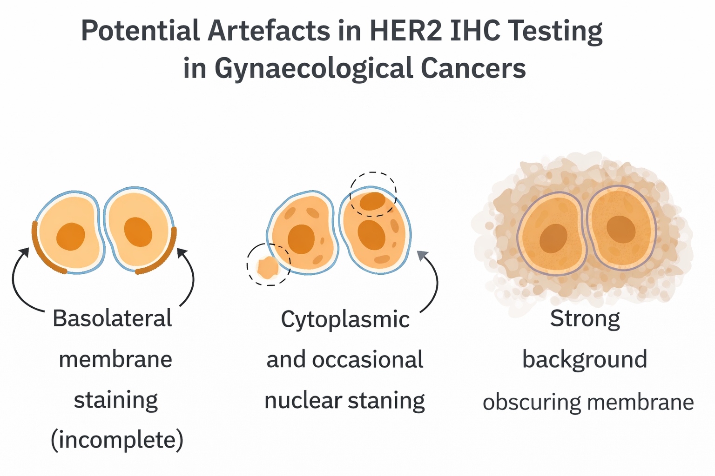
HER2 TESTING: Considerations for accurate assessment
1. Repeat testing on newly obtained tumour tissue is recommended in metastatic disease​¹
2. Areas with the following features should not be selected for HER2 IHC assessment²:
Feature | Low-power clue | High-power clue
Haemorrhage | Red, amorphous areas | Sheets of RBCs
Necrosis | Pale, acellular zones | Ghost cells, debris
Autolysis | Diffuse poor morphology | Smudged nuclei
Fibrosis | Hypocellular stroma | Dense collagen
3. Potential artefacts that may affect HER2 IHC interpretation include²:
Basolateral membrane staining (incomplete)
Cytoplasmic and occasional nuclear staining
Strong background obscuring membrane
IHC, immunohistochemistry; RBC, red blood cell
1. Wolff A.C, et al. J Clin Oncol. 2023;41(22):3867-3872; 2. Recommendations informed by the clinical and diagnostic pathology experience of Dr Fernando Soares

Slide 18
Making the report accessible for clinicians
Suggestions that may reduce the communication barrier
Communication barriers between the pathologist’s report and the clinician’s interpretation may negatively impact patient care and should be addressed early. Below are several proposed strategies:
1
Use active communication to clarify different aspects of the report​
Opportunities to do this may include tumour boards, clinical rounds, via phone communication, or in one-on-one slide reviews​¹
This can help avoid confusion, for example if clinicians are not aware when ordering that ISH and NGS cannot be used to detect protein expression²
2
Use the comments section in the report, where the pathologic diagnosis alone does not convey all relevant information​¹
3
Standardise grammatical structure​¹
4
Explain any diagnostic limitations​¹
ISH, in situ hybridisation; NGS, next-generation sequencing
1. Mirham L, et al. Am J Clin Pathol. 2021;156:521-8; 2. Recommendations informed by the clinical and diagnostic pathology experience of Dr Fernando Soares

Slide 19
T-DXd in HER2+ Solid Tumours: DESTINY-Pantumor02 trial
T-DXd, trastuzumab deruxtecan

Slide 20



Destiny-PanTumor02: a phase 2 study of t-dxd for her2‑expressing solid tumours^{1,2}
An open-label, multicentrE study (nct04482309)
Key eligibility criteria
Advanced solid tumours not eligible for curative therapy
2L+ patient population
HER2 expression (IHC 3+ or 2+)
Local test or central test by HercepTest if local test not feasible (ASCO/CAP gastric cancer scoring)ª
Prior HER2-targeting therapy allowed
ECOG/WHO PS 0-1
Baseline characteristics
267 patients received treatment; 202 (75.7%) based on local HER2 testing
111 (41.6%) patients were IHC 3+ based on HER2 test (local or central) at enrolment, primary efficacy analysis (all patients)
75 (28.1%) patients were IHC 3+ on central testing, sensitivity analysis on efficacy endpoints (subgroup analyses)
Median age was 62 years (23-85) and 109 (40.8%) patients had received ≥3 lines of therapy
Primary endpoint
Confirmed ORR (investigator)
Secondary endpoints
DoR, DCR, PFS, OS
Safety
Exploratory analysis
Subgroup analyses by HER2 status
Primary analysis data cut-off: 8 June 2023 Median follow up: 12.75 mo
Endometrial cancer
Cervical cancer
T-DXd 5.4 mg/kg Q3W
Ovarian cancer
Bladder cancer
40 per cohort^{b}
Other tumours^{c}
Biliary tract cancer
Pancreatic cancer
ª Patients were eligible for either test. All patients were centrally confirmed; ^{b} Planned recruitment, cohorts with no objective responses in the first 15 patients were to be closed; ^{c} Patients with tumours that express HER2, excluding tumours in the tumour-specific cohorts, and breast cancer, non-small cell lung cancer, gastric cancer, and colorectal cancer
2L, second-line; ASCO, American Society of Clinical Oncology; CAP, College of American Pathologists; DCR, disease control rate; DoR, duration of response; ECOG, Eastern Cooperative Oncology Group; IHC, immunohistochemistry; mo, months; ORR, objective response rate; OS, overall survival; PFS, progression-free survival; PS, performance status; Q3W, every 3 weeks; T-DXd, trastuzumab deruxtecan; WHO, World Health Organization
1.Meric-Bernstam F, et al. Ann Oncol. 2023;34(Suppl):S1273-S1274. Oral presentation (LBA34) presented at ESMO 2023: 2.Meric-Bernstam F, et al. J Clin Oncol. 2024;42(1):47-58

Slide 21
Patient disposition
 | Cervical | Endometrial | Ovarian | BTC | Pancreatic | Bladder | Otherª | All patients
Patients treated, n | 40 | 40 | 40 | 41 | 25 | 41 | 40 | 267
Ongoing treatment at DCO, n (%) | 10 (25.0) | 14 (35.0) | 6 (15.0) | 3 (7.3) | 1 (4.0) | 5 (12.2) | 5 (12.5) | 44 (16.5)
Discontinued treatment, n (%) | 30 (75.0) | 26 (65.0) | 34 (85.0) | 38 (92.7) | 24 (96.0) | 36 (87.8) | 35 (87.5) | 223 (83.5)
Disease progression | 21 (52.5) | 18 (45.0) | 29 (72.5) | 22 (53.7) | 17 (68.0) | 26 (63.4) | 23 (57.5) | 156 (58.4)
Adverse event | 4 (10.0) | 2 (5.0) | 3 (7.5) | 8 (19.5) | 3 (12.0) | 4 (9.8) | 6 (15.0) | 30 (11.2)
Other^{b} | 5 (12.5) | 6 (15.0) | 2 (5.0) | 8 (19.5) | 4 (16.0) | 6 (14.6) | 6 (15.0) | 37 (13.9)
Median follow up at DCO (range), months | 7.2 (0.9-23.0) | 14.6 (0.8-24.2) | 12.7 (0.7-23.7) | 6.0 (0.7-20.0) | 4.9 (1.1-19.8) | 12.0 (0.4-21.2) | 12.0 (0.7-23.9) | 9.7 (0.4-24.2)
Median duration of treatment at DCO (range), months | 5.5 (0.7-19.8) | 9.0 (0.7-24.4) | 5.9 (0.7-23.0) | 3.5 (0.7-20.1) | 2.1 (0.7-11.0) | 6.2 (0.4-18.0) | 6.9 (0.7-19.9) | 5.5 (0.4-24.4)
ª Includes salivary gland cancer (n=19), malignant neoplasm of unknown primary site (n=5), extramammary Paget’s disease (n=3), melanoma (n=2), oropharyngeal neoplasm (n=2), adenoid cystic carcinoma, adenocarcinoid tumour of the appendix, head and neck, intestinal adenocarcinoma, lip and/or cavity, oesophageal adenocarcinoma, oesophageal squamous cell carcinoma, testis and vulva (all n=1); ^{b} Includes patients who were lost to follow-up (n=1) and patients who discontinued for unknown reasons (n=3), patient decision (n=10), investigator decision (n=5), and other reasons (n=22; n=16 of which died while on treatment)
BTC, biliary tract cancer; DCO, data cut-off (Nov 16, 2022)
1.Meric-Bernstam F, et al. J Clin Oncol. 2023;41(Suppl):LBA3000. Oral presentation (LBA3000) presented at ASCO Annual Meeting 2023

Slide 22
Baseline characteristics
Characteristic |  | All patients (N=267)
Median age (range), years |  | 62 (23-85)
Female, n (%) |  | 178 (66.7)
Race, n (%) White Asian Other Not reported |  | 163 (61.0) 87 (32.6) 6 (2.25) 5 (1.9)
Median prior lines of therapy (range) 0, n (%) 1, n (%) 2, n (%) ≥3, n (%) |  | 2 (0-13) 3 (1.1) 71 (26.6) 84 (31.5) 107 (40.1)
Prior HER2 therapy, n (%) Monoclonal antibody Tyrosine kinase inhibitor |  | 33 (12.4) 1 (0.4)
Characteristic |  | All patients (N=267)
ECOG PS, n (%) 0 1 2 |  | 126 (47.2) 140 (52.4) 1 (0.4)
HER2 testing for eligibility, n (%)ª Local Central |  | 202 (75.7) 61 (22.8)
HER2-expression for eligibility, n (%)ª IHC 3+ IHC 2+ IHC 1+^{b} |  | 111 (41.6) 151 (56.6) 5 (1.9)
Centrally confirmed HER2 status for efficacy evaluation, n (%)
IHC 3+ IHC 2+ IHC 1+ IHC 0 Unknown^{c} |  | 75 (28.1) 125 (46.8) 25 (9.4) 30 (11.2) 12 (4.5)
ª HER2 expression for eligibility was based on local assessment, based on any HER2 test, where available; ^{b} In the cervical cohort, five patients with IHC 1+ status were included per protocol; ^{c} Includes patients whose samples were not evaluable and may have included patients who did not provide a sample for central testing
ECOG PS, Eastern Cooperative Oncology Group performance status; IHC, immunohistochemistry
1 Meric-Bernstam F, et al. J Clin Oncol. 2024;42(1):47-58

Slide 23
Objective response and duration of response^{1,2}
Endometrial
Cervical
Ovarian
Bladder
Otherª
BTC
Pancreatic
Confirmed ORR by investigator (%)
n=
40
13
17
40
8
20
40
11
19
41
16
20
40
9
16
41
16
14
25
2
19
Median DoR, months (95% CI)^{b} | NR (9.9, NR) | 14.2 (4.1, NR) | 11.3 (4.1, 22.1) | 8.7 (4.3, 11.8) | 22.1 (4.1, NR) | 8.6 (2.1, NR) | 5.7 (NR, NR)
 | All patients (N=267 | IHC 3+ (n=75) | IHC 2+ (n=125)
ORR, % (95% CI) | 37.1 (31.3, 43.2) | 61.3 (49.4, 72.4) | 27.2 (19.6, 35.9)
Median DoR, months (95% CI)^{b} | 11.3 (9.6, 17.8) | 22.1 (9.6, NR) | 9.8 (4.3, 12.6)
Analysis of ORR by investigator was performed in patients who received ≥1 dose of T-DXd; all patients (n=267; including 67 patients with IHC 1+ [n=25], IHC 0 [n=30], or unknown IHC status [n=12] by central testing) and patients with centrally confirmed HER2 IHC 3+ (n=75) or IHC 2+ (n=125) status. Analysis of DoR was performed in patients with objective response who received ≥1 dose of T-DXd; all patients (n=99; including 19 patients with IHC 1+ [n=6], IHC 0 [n=9], or unknown IHC status [n=4] by central testing) and patients with centrally confirmed HER2 IHC 3+ (n=46) or IHC 2+ (n=34) status. ª Responses in extramammary Paget’s disease, head and neck cancer, oropharyngeal neoplasm, and salivary gland cancer; ^{b} Includes patients with a confirmed objective response only
BTC, biliary tract cancer; CI, confidence interval; DoR, duration of response; IHC, immunohistochemistry; NR, not reached; ORR, objective response rate; T‑DXd, trastuzumab deruxtecan
1.Meric-Bernstam F, et al. Ann Oncol. 2023;34(Suppl):S1273-S1274. Oral presentation (LBA34) presented at ESMO 2023; 2.Meric-Bernstam F, et al. J Clin Oncol. 2024;42(1):47-58

Slide 24
Efficacy endpoint: PFS by HER2 status per cohort^{1,2}
ALL COHORTS
ENDOMETRIAL CANCER
Median PFS in months (95% CI)
All cohorts: IHC 3+ 11.9 (8.2, 13.0)
All cohorts : IHC 2+ 5.4 (4.2, 6.0)
All cohorts : Total 6.9 (5.6, 8.0)
Median PFS in months (95% CI)
Endometrial cancer: IHC 3+ NR (7.3, NR)
Endometrial cancer: IHC 2+ 8.5 (4.6, 15.1)
Endometrial cancer: Total 11.1 (7.1, NR)
1.0
1.0
0.8
0.8
0.6
0.6
Probability of PFS
Probability of PFS
0.4
0.4
0.2
0.2
0.0
0.0
0
3
6
9
12
15
18
21
24
27
30
33
0
3
6
9
12
15
18
21
24
27
30
33
Number at risk
IHC 3+
IHC 2+
Total
Time from first dose (months)
Number at risk
IHC 3+
IHC 2+
Total
Time from first dose (months)
75
125
267
63
78
185
51
50
132
39
31
89
34
20
68
23
18
51
19
13
39
12
9
25
1
3
6
0
1
2
0
1
0
13
17
40
12
14
31
11
11
27
10
7
21
10
5
17
9
5
16
8
4
14
5
2
8
0
1
2
0
1
1
0
CERVICAL CANCER
OVARIAN CANCER
Median PFS in months (95% CI)
Cervical cancer: IHC 3+ NR (3.9, NR)
Cervical cancer : IHC 2+ 4.8 (2.7, 5.7)
Cervical cancer : Total 7.0 (4.2, 11.1)
Median PFS in months (95% CI)
Ovarian cancer: IHC 3+ 12.5 (3.1, NR)
Ovarian cancer: IHC 2+ 4.1 (2.3, 12.6)
Ovarian cancer: Total 5.9 (4.0, 8.3)
1.0
1.0
0.8
0.8
0.6
0.6
Probability of PFS
Probability of PFS
0.4
0.4
0.2
0.2
0.0
0.0
0
3
6
9
12
15
18
21
24
27
0
3
6
9
12
15
18
21
24
27
30
Number at risk
IHC 3+
IHC 2+
Total
Time from first dose (months)
Number at risk
IHC 3+
IHC 2+
Total
Time from first dose (months)
8
20
40
8
12
28
7
5
20
6
3
14
5
0
9
3
6
3
3
1
1
1
1
0
0
11
19
40
10
11
28
6
6
17
5
5
12
5
5
11
4
4
9
4
2
7
3
2
6
0
1
1
1
1
0
0
Circle indicates a censored observation
CI, confidence interval; IHC, immunohistochemistry; NR, not reached; PFS, progression-free survival 1.
1.Meric-Bernstam F, et al. Ann Oncol. 2023;34(Suppl):S1273-S1274. Oral presentation (LBA34) presented at ESMO 2023; 2.Meric-Bernstam F, et al. J Clin Oncol. 2024;42(1):47-58

Slide 25
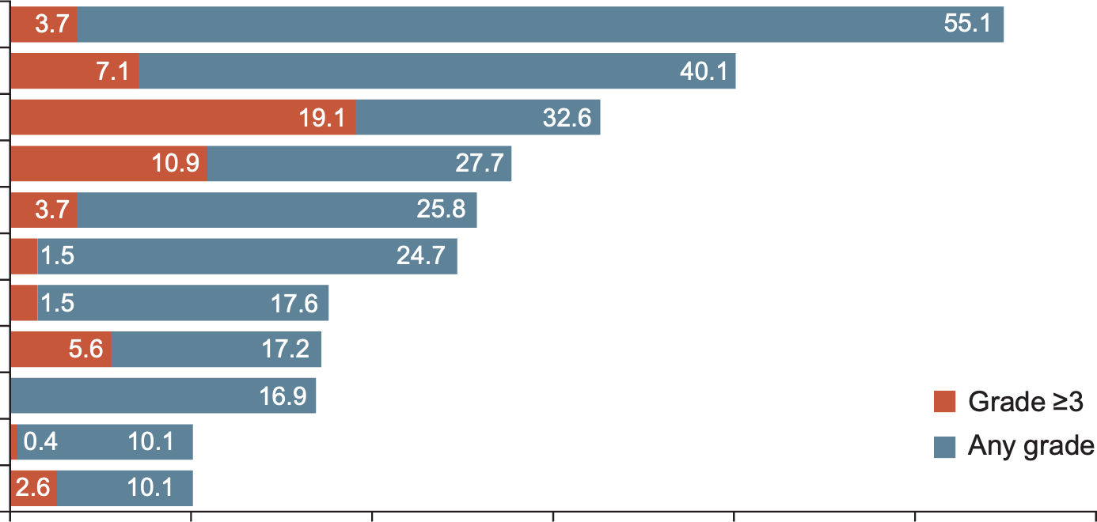
Safety summary^{1,2}
MOST COMMON DRUG-RELATED TEAEs (>10%)
N (%) | All patients (N=267)
Any drug-related TEAEs | 226 (84.6)
Drug-related TEAEs Grade ≥3 | 109 (40.8)
Serious drug-related TEAEs | 36 (13.5)
Drug-related TEAEs associated with dose discontinuations | 23 (8.6)
Drug-related TEAEs associated with dose interruptions | 54 (20.2)
Drug-related TEAEs associated with dose reductions | 54 (20.2)
Drug-related TEAEs associated with deaths | 4 (1.5)ª
Nausea
Fatigue^{b}
Neutropenia^{c}
Anaemia
Diarrhoea
Vomiting
Decreased appetite
Thrombocytopenia^{d}
Alopecia
Increased transaminases^{e}
Leukopenia^{f}
0
10
20
30
40
50
60
Patients experiencing drug-related TEAEs (%)
ILD/pneumonitis adjudicated as T-DXd related, n (%) | Grade 1 | Grade 2 | Grade 3 | Grade 4 | Grade 5 | Any grade
All patients (N=267) | 7 (2.6) | 17 (6.4) | 1 (0.4) | 0 | 3 (1.1) | 28 (10.5)
Analyses were performed in patients who received ≥1 dose of T-DXd (N=267); median total treatment duration 5.6 months (range 0.4-31.1)
ª Included pneumonia (n=1), organising pneumonia (n=1), pneumonitis (n=1), and neutropenic sepsis (n=1); ^{b} Category includes the preferred terms fatigue, asthenia, and malaise; ^{c} Category includes the preferred terms neutrophil count decreased and neutropenia; ^{d} Category includes the preferred terms platelet count decreased and thrombocytopenia; ^{e} Category includes the preferred terms aspartate aminotransferase increased, alanine aminotransferase increased, gamma-glutamyltransferase increased, hypertransaminasemia; ^{f} Category includes the preferred terms white blood cell count decreased and leukopenia
ILD, interstitial lung disease; T-DXd, trastuzumab deruxtecan; TEAE, treatment-emergent adverse event
1.Meric-Bernstam F, et al. Ann Oncol. 2023;34(Suppl):S1273-S1274. Oral presentation (LBA34) presented at ESMO 2023; 2.Meric-Bernstam F, et al. J Clin Oncol. 2024;42(1):47-58

Slide 26
DESTINY-PanTumor02: Conclusions^{1,2}
DP-02 trial supports the potential role of T-DXd as a tumour-agnostic therapy for patients with HER2-expressing solid tumours
T-DXd demonstrated clinically meaningful activity across a broad range of HER2-expressing solid tumours:
ORR: 37.1% in all patients and 61.3% in patients with IHC 3+
Durable responses: median DoR 11.3 months in all patients and 22.1 months in patients with IHC 3+
Durable responses led to clinically meaningful progression-free and overall survival outcomes:
PFS: 6.9 months in all patients and 11.9 months in patients with IHC 3+
OS: 13.4 months in all patients and 21.1 months in patients with IHC 3+
The safety of T-DXd was consistent with the known profile
The FDA granted accelerated approval to T-DXd for adult patients with unresectable or metastatic HER2+ solid tumours who have received prior systemic treatment and have no satisfactory alternative treatment options³
DoR, duration of response; FDA, Food and Drug Administration; IHC, immunohistochemistry; ORR, objective response rate; OS, overall survival; PFS, progression-free survival; T-DXd, trastuzumab deruxtecan
1. Meric-Bernstam F, et al. Ann Oncol. 2023;34(Suppl):S1273-S1274. Oral presentation (LBA34) presented at ESMO 2023; 2. Meric-Bernstam F, et al. J Clin Oncol. 2024;42(1):47-58; 3. FDA grants accelerated approval to fam-trastuzumabderuxtecan-nxki for unresectable or metastatic HER2-positive solid tumors. Available here (accessed Jan 20, 2026)

Slide 27
carboplatin-paclitaxeL + Trastuzumab in HER2+ endometrial cancer: NCT01367002 Trial

Slide 28
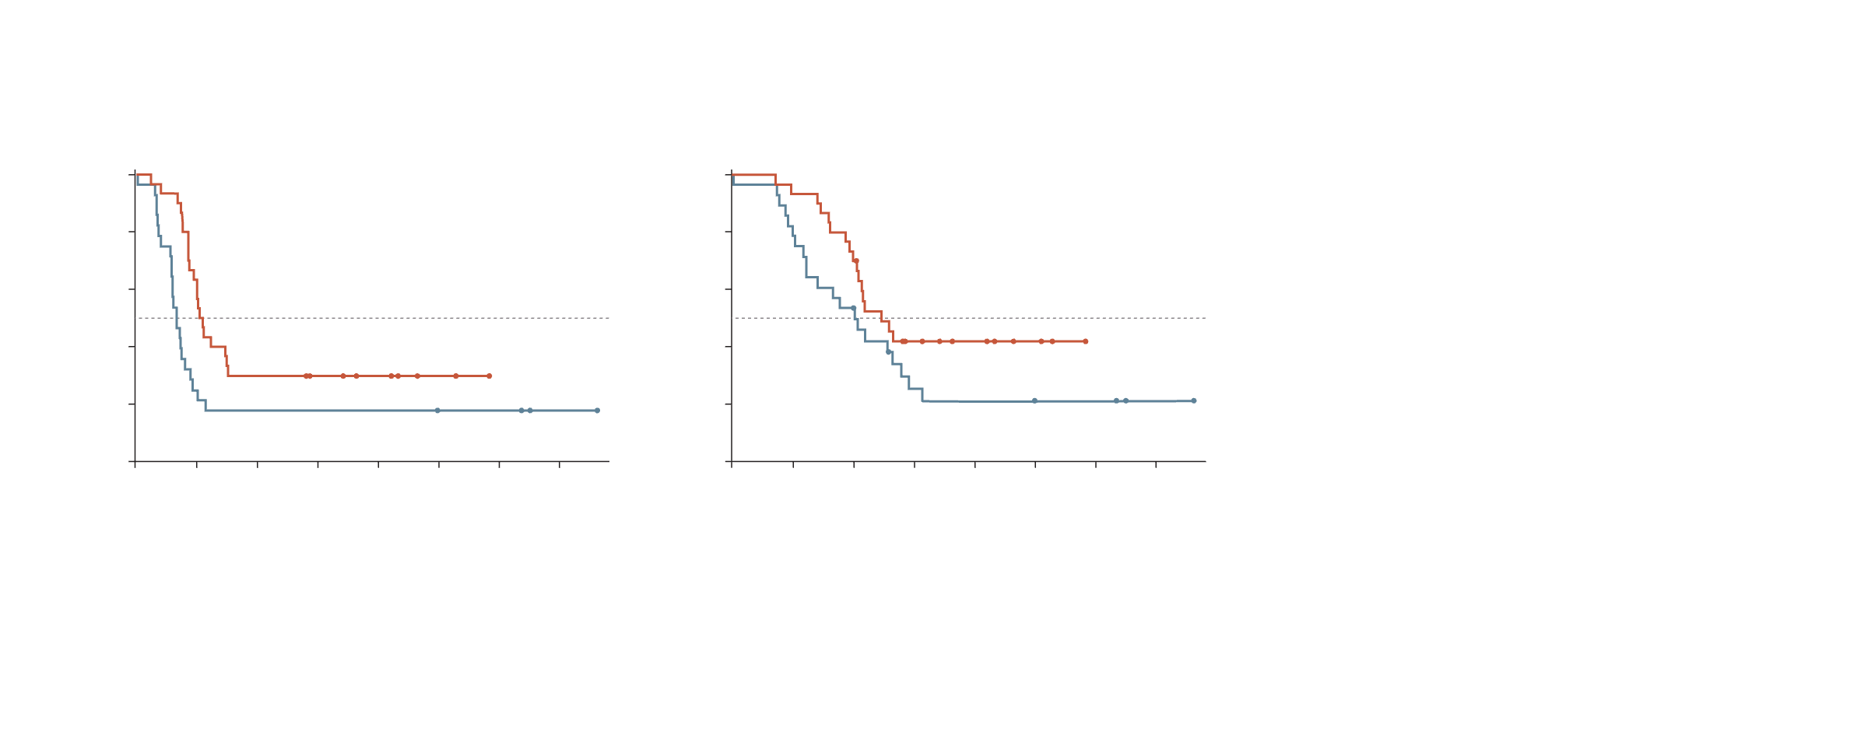
Addition of trastuzumab to CP improves mPFS and OS in advanced/Recurrent HER2+ uterine serous carcinoma
PFS vs trastuzumab, all eligible subjects
with number of subjects at risk
Overall survival vs trastuzumab, all evaluable subjects
with number of subjects at risk
1.0
1.0
Trastuzumab
No
Yes
Censored
Trastuzumab
No
Yes
Censored
0.8
0.8
0.6
Hazard Ratio = 0.462
90% CI: 0.279-0.765; 1-sided P=0.0050
0.6
Hazard Ratio = 0.581
90% CI: 0.339-0.994; 1-sided P=0.046
Proportion progression-free
Proportion alive
0.4
0.4
0.2
0.2
0.0
0.0
0
12
24
36
48
60
72
84
0
12
24
36
48
60
72
84
Months since on-treatment date
Months since on-treatment date
Number at risk
No
Yes
Number at risk
No
Yes
28
30
6
19
5
9
5
7
5
5
5
2
4
0
1
28
30
23
28
15
21
6
10
5
7
5
4
4
0
1
mPFS was 8.0 months in patients who received CP and 12.9 months in patients who received CP+T
OS was 24.4 months in patients who received (CP) and 29.6 months in patients who received CP+T
CI, confidence interval; CP, carboplatin-paclitaxel; mPFS, median progression-free survival; OS, overall survival; PFS, progression-free survival; T, trastuzumab
1. Fader AN, et al. Clin Cancer Res. 2020;26(15):3928-35

Slide 29
Conclusions

Slide 30
Conclusions
HER2 is now a clinically actionable biomarker in gynecological cancers, with treatment implications that vary by tumour type and line of therapy.
Accurate and standardised HER2 testing is essential to ensure appropriate access to both first-line and later-line HER2-targeted treatments.
Clear, structured pathology reporting aligned with CAP standards is critical to support correct interpretation and multidisciplinary treatment decisions.
Close collaboration between pathologists and oncologists is increasingly important as HER2-directed strategies expand across gynecological malignancies
CAP, College of American Pathologists; HER2, human epidermal growth factor receptor 2.

