Slide 2
Virtual Experts Knowledge Share lung connect TROP2-directed ADCs in Lung Cancer: Optimising the Treatment Experience
Monday 11th May 2026
ADC, antibody-drug conjugate

Slide 3

Developed by LUNG COnnect
This programme is developed by LUNG CONNECT, an international group of experts in the field of thoracic oncology and brought to you alongside PRECISION ONCOLOGY CONNECT, an international group of experts in the field of Precision Oncology
Acknowledgement and disclosures
This LUNG CONNECT programme is supported through an independent educational grant from AstraZeneca. The programme is therefore independent, The content is not influenced by the supporter and is under the sole responsibility of the experts.
Please note:
This educational programme is intended for healthcare professionals only
The views expressed within this programme are the personal opinions of the experts. They do not necessarily represent the views of the experts’ academic institutions, organisations, or other group or individual.
Expert disclosures:
Prof. Nicolas Girard has received financial support/sponsorship for research support, consultation, or speaker fees from the following companies: Abbvie, Accord, Amgen, AstraZeneca, BeOne, Bristol Myers Squibb, Daiichi-Sankyo, Ipsen, J&J, Lilly, Merck Sharp & Dohme, Natera, Pfizer, Pharmamar, Pierre Fabre, Regeneron, Summit
Dr Louise Lim has received financial support/sponsorship for research support, consultation, or speaker fees from the following companies: AstraZeneca, Astellas, BMS, Gilead, MSD, Merck-Serono, Pfizer, Roche
Dr Jacob Sands has received financial support/sponsorship for research support, consultation, or speaker fees from the following companies: Abbvie, Amgen, AstraZeneca, Boehringer Ingelheim, Catalyst, Daiichi Sankyo, Fosun, Genentech, Gilead, Jazz Pharmaceuticals, Lilly, Merck, Novartis, Pfizer, Pharma Mar, Sanofi
Mrs Stephanie McDonald has received financial support/sponsorship for research support, consultation, or speaker fees from the following companies: Amgen, AstraZeneca, Bayer, Pfizer

Slide 4




Introducing the scientific committee
Prof. Nicolas Girard
Thoracic Oncologist
Institute Curie, France
Dr Louise Lim
Medical Oncologist
Barts Health NHS Trust, UK
Dr Jacob Sands
Medical Oncologist Dana-Farber Cancer Institute, US
Mrs Stephanie McDonald
Thoracic Oncology Nurse Practitioner Dana-Farber Cancer Institute, US
Mrs Stephanie McDonald
Dana Farber Cancer Institute US

Slide 5



educational OBJECTIVES
Assess the clinical relevance of TROP2-targeted antibody–drug conjugates (ADCs) in NSCLC and their role in evolving treatment strategies
Recognise the potential adverse events associated with TROP2-directed ADCs in metastatic NSCLC, including Dato-DXd
Be able to implement strategies to prevent, minimise and manage adverse events associated with TROP2-directed ADCs to achieve optimal outcomes for NSCLC patients
ADC, antibody-drug conjugates; Dato-DXd, datopotamab deruxtecan; NSCLC, non-small cell lung cancer

Slide 6
Agenda
the evolving TROP2-directed ADC landscape in metastatic NSCLC and strategies to optimise the treatment experience
Topic | Facilitator
The relevance of TROP2 in metastatic NSCLC | Louise Lim
Clinical overview of TROP2-directed ADCs in NSCLC Without actionable genomic alterations With actionable genomic alterations | Nicolas Girard Louise Lim
Optimising the treatment experience: proactive AE monitoring & management | Jacob Sands and Stephanie McDonald
Best practice management: panel discussion and audience questions | All panellists (Facilitator: Nicolas Girard)
Summary and key takeaways | Louise Lim
ADC, antibody-drug conjugate; AE, adverse event; (m)NSCLC, (metastatic) non-small cell lung cancer

Slide 7
The relevance of TROP2 in metastatic NSCLC
Dr Louise Lim Barts Health NHS Trust, UK
NSCLC, non-small cell lung cancer

Slide 8

TROP2: an adc target overexpressed in multiple solid tissues
Oral SCC
62.57%
SGC
44%
Thyroid cancer
82.5%
Breast cancer
62.4% of BC 78.1% of TNBC
NSCLC
64% of AC 75% of SCC
Gastric cancer
66.3%
Pancreatic cancer
55%
Gallbladder cancer
56%
Colon cancer
68.4%
Ovarian cancer
47%
Cervical cancer
88.7%
Prostate cancer
71%
AC, adenocarcinoma; BC, breast cancer; NSCLC, non-small cell lung cancer; SCC, squamous cell carcinoma; SGC, salivary gland carcinoma; TNBC, triple negative breast cancer
Liu X, et al. Pharmacol Ther. 2022:239:108296

Slide 9

WHAT ARE ANTIBODY-DRUG CONJUGATES (ADCs)?
Drug-conjugate structures are based on three components¹⁻⁴
MOA^{2,5}
1
Binding to cell-surface antigen
6
Antibody characteristics IgGs with high affinity for antigens^{1,2} Chimeric/humanised to lower immunogenicity^{1,2} Long serum half-life^{1,2} High molecular weight⁴
1
Cell death
Antibody
mAb targets tumour-specific antigens
5
DNA or microtubule disruption
3
Payload
Potent cytotoxic activity
2
Endocytosis of ADC-antigen complex
3
4
Linker characteristics Prevents premature payload release in non-target tissues^{1,2} Stable in circulation^{2,3} Payload release at target site² Cleavable (pH or protease sensitive) or non-cleavable^{1,2} Stochastic or site-specific conjunction^{3,4}
Lysosomal degradation
Release of active payload
2
Linker
Stable linker releases payload only in target cell and/or in the tumour microenvironment
Payload characteristics Potent cytotoxics¹ DNA (e.g., TOP1) or tubulin inhibitors or immunomodulators⁴ Optimal DAR: 2-8 units per antibody¹
Bystander effect: killing of antigen-negative cancer cells; depends on:^{1,3,6,7a} Use of pH- or protease-cleavable linker Hydrophobicity / membrane permeability of the free drug Extent of ADC internalization after antigen binding Payload release before internalization and from apoptotic cells
ª Not all ADCs exhibit a bystander effect
ADC, antibody-drug conjugate; DAR, drug-to-antibody ratio; Ig, immunoglobin; mAb, monoclonal antibody; MOA, mechanism of action; TOP1, topoisomerase 1
1. Somme LB, et al. BioDrugs. 2024;38:487-97; 2. Shastry M, et al. Am Soc Clin Oncol Educ Book. 2023;43:e390094; 3. Tarantino P, et al. Nat Rev Clin Oncol. 2023;20:558-76; 4. Fu Z, et al. Signal Transduct Target Ther. 2022;7:93; 5. Tsuchikama K, An Z Protein Cell. 2016;9:33-46; 6. Zhou L, et al. Exp Hematol Oncol. 2024;13:26; 7. Staudacher AH, et al. Br J Cancer. 2017;117:1736-42
Adapted from Tsuchikama K et al (2016) and Gilead Sciences Inc. Satellite Symposium, ELCC 2026

Slide 10
TROP2-directed ADCs for NSClc current phase 3 global development
ADCs in development for TROP2 differ in their characteristics
Sacituzumab govitecan (SG)¹⁻⁵
Datopotamab deruxtecan (Dato-DXd)^{1,6,7}
Sacituzumab tirumotecan (Sac-TMT)⁸⁻¹⁰
DAR ≈ 7.6:1
DAR ≈ 4:1
DAR ≈ 7.4:1
Hydrolysable linker (CL2A) for SN-38
Tetrapeptide-based cleavable linker for DXd
TL033 novel cleavable linker
SN-38 payload
DXd payload
KL610023 (T030) payload
Humanised anti-Trop-2-directed IgG1 mAb
Humanised anti-Trop-2-directed IgG1 mAb
Humanised anti-Trop-2-directed IgG1 mAb
Payload MOA: TOP1 inhibitor Bystander antitumour effect
Payload MOA: TOP1 inhibitor Bystander antitumour effect
Payload MOA: TOP1 inhibitor Bystander antitumour effect
ADC, antibody-drug conjugate; DAR, drug-to-antibody ratio; Dato-DXd, datopotamab deruxtecan; Ig, immunoglobin; mAb, monoclonal antibody; MOA, mechanism of action; NSCLC, non-small cell lung cancer; Sac-TMT, Sacituzumab tirumotecan; SG, Sacituzumab govitecan; TOP1, topoisomerase 1; TROP2, trophoblast cell surface antigen 2
1. Parisi C, et al. Cancer Treat Rev. 2023;102572; 2. Shastry M, et al. Am Soc Clin Oncol Educ Book. 2023;43:e390094; 3. Paz-Ares LG, et al. J Clin Oncol. 2024;42:2860-2872; 4. TRODELVY® summary of product characteristics 2023.
Available from: Trodelvy, INN-sacituzumab govitecan (accessed 05 May 2026); 5. TRODELVY® Prescribing Information. 03/2025. Available from trodelvy_pi.pdf (Accessed 05 May 2026). 6. DATROWAY® Prescribing Information. Jun 2025. Available from getPIContent (Accessed 05 May 2026); 7.Sands J, et al. J Clin Oncol. 2025;43:1254-1265; 8. Cheng Y, et al. Front Oncol. 2022;12:951589; 9. FDA Grants Breakthrough Therapy Designation to Sacituzumab Tirumotecan (sac-TMT) for the Treatment of Certain Patients With Previously Treated Advanced or Metastatic Nonsquamous Non-Small Cell Lung Cancer With EGFR Mutations (accessed 05 May 2026); 10. Fang W, et al. N Engl J Med. 2025;394:13-26
Figure partially from Parisi C, et al. Cancer Treat Rev. 2023;118:102572 and Gilead Sciences Inc. Satellite Symposium, ELCC 2026

Slide 11
Take-home messages
1) TROP2 is common in NSCLC
64% of adenocarcinoma and 75% of squamous cell carcinomas show some expression¹
2) Three late-stage ADCs differ mainly by payload and linker
SG (SN-38), Dato-DXd (DXd), Sac-TMT (belotecan-derived) — all aim to improve outcomes beyond docetaxel in later lines;²⁻⁴ combinations and biomarker strategies are the next frontier
Thanks — questions?
ADC, antibody-drug conjugate; Dato-DXd, datopotamab deruxtecan; EGFRm, EGFR mutation; NSCLC, non-small cell lung cancer; Sac-TMT, sacituzumab tirumotecan; SG, sacituzumab govitecan
1. Hsu R. Transl Cancer Res. 2025;14(2):679-84; 2. Paz-Ares LG, et al. J Clin Oncol 42:2860-2872; 3. Ahn M-J, et al. J Clin Oncol. 2025;43:260-72; 4. Fang W, et al. N Engl J Med. 2026;394:13-26

Slide 12
Clinical overview of TROP2-directed ADCs in NSCLC Without actionable genomic alterations
Prof. Nicolas Girard Institute Curie, France
ADC, antibody-drug conjugate; NSCLC, non-small cell lung cancer

Slide 13
Esmo clinical practice guidelines (v1.2 Jan 2025)
Stage IV NSqNSCC, molecular tests negative (EGFR/ALK/ROS1/BRAF/RET/MET/EGFR ex20ins/KRAS G12C/NTRK/HER2) without contraindication for immunotherapy
Oligometastatic
ECOG PS & PD-L1 expression level
Systemic therapy & LRT [II, B)
PS 0-2 & PD-L1 ≥50%
PS 0-1 & any expression of PD-L1
PS 2 & PD-L1 <50%
PS 3-4 regardless of PD-L1
ICI [anti-PD-(L)1 monotherapy] [I, A; MCBS 4-5/A]
(for PS 2: [II, B])
ICI [anti-PD-(L)1 ± anti-CTLA-4]– platinum-doublet ChT followed by ICI ± pemetrexed or bevacizumab [I, A; MCBS 3-4/A] Dual ICI alone (only for PD-L1 ≥1%) [I, A; MCBS 4/A]
Platinum-doublet ChT [I, A / II, A] Atezolizumab [I, B] Single-agent ChT [I, B / II, B]
Disease progression
Disease progression
Disease progression
PS 0-2
PS 3-4
PS 0-2
PS 3-4
PS 0-2
PS 3-4
Platinum-doublet ChT [I, A / II, A; MCBS 4] ± maintenance with pemetrexed [I, A; MCBS 4 / I, B] or gemcitabine [I, C] Platinum-doublet ChT–bevacizumab followed by bevacizumab maintenance [I, A; MCBS 2] ± pemetrexed [I, A] ICI rechallenge [III, B]
Pemetrexed [I, B] Docetaxel [I, B] Nintedanib–docetaxel [II, B] Ramucirumab–docetaxel [I, B; MCBS 1] ICI rechallenge [III, B]
ICI [anti-PD-(L)1 monotherapy] [I, A; MCBS4-5A], if not received in first-line Other options are the same as for the second-line treatment for PS 0-2 after ChT–ICI
Consider adding TTFields [MCBS 4] to ICI monotherapy [II, B] or docetaxel [II, C]
BSC alone [III, A]
BSC, best supportive care; ChT, chemotherapy; ESMO, European Society for Medical Oncology; ICI, immune checkpoint inhibitor; LRT, local radical therapy; MCBS, ESMO Magnitude of Clinical Benefit Scale; NsqNSCC nonsquamous non-small cell carcinoma; PS, performance status (Eastern Cooperative Oncology Group)
1. Hendriks L, et al. Ann Oncol. 2023;34:358-76; 2. Hendriks L, et al. Ann Oncol. 2025;36(19):1223-7 [ESMO Non-Oncogene-Addicted Metastatic Non-Small-Cell Lung Cancer Living Guideline, v1.2 – January 2025. Available here (accessed April 14, 2026)]

Slide 14
Evoke-01: Sacituzumab govitecan in pre-treated ADVANCED/METASTATIC nsclc
Global, randomised, open-label, phase 3 study
Key eligibility criteria:
Measurable stage IV NSCLC
ECOG PS score 0-1
Radiographic progression after platinum-based and anti-PD-(L)1–containing regimenª
In addition, patients with known AGAs must have received ≥1 approved TKI^{b}
EGFR/ALK test required. Testing of other AGAs recommended^{c}
Previously treated stable brain metastases were included
No prior treatment with Topo-1 inhibitors, TROP-2–targeted therapies, or docetaxel
Sacituzumab govitecan
10 mg/kg on Days 1 and 8 of 21-day cycles^{d}
Endpoints:
Primary:
OS
Secondary:
PFS, ORR, DoR, and DCR by INV per RECIST v1.1
Safety and tolerability
QoL using NSCLC-SAQ
N=603
R 1:1
Docetaxel 75 mg/m² on Day 1 of 21-day cycles^{d}
Stratified by:
Histology (squamous vs nonsquamous
Response to last anti-PD-(L)1–containing regimen (responsive [best response CR/PR] vs nonresponsive [PD/SD])
Received prior targeted therapy for AGA (yes vs no)
At data cutoff (29 November 2023), the study median follow-up was 12.7 months (range, 6.0-24.0)
ª (Neo)adjuvant therapy counted if progression within 6 months of platinum treatment and while on maintenance with checkpoint inhibitor agent; ^{b} If local approval exists for targeted therapy to that genomic alteration; ^{c} Based on local SoC and availability of testing/approved targeted agent; ^{d} Until PD or unacceptable toxicity
AGA, actionable genomic alteration; CR, complete response; DCR, disease control rate; DoR, duration of response; ECOG PS, Eastern Cooperative Oncology Group performance status; INV, investigator; (a/m)NSCLC, (advanced/metastatic) non-small cell lung cancer; NSCLC-SAQ, NSCLC-Symptom Assessment Questionnaire; ORR, objective response rate; OS overall survival; PD, progressive disease; PFS, progression-free survival; PR, partial response; QoL, quality of life; R randomisation; RECIST v1.1, Response Evaluation Criteria in Solid Tumours version 1.1; SD, stable disease; SoC, standard of care; TKI, tyrosine kinase inhibitor; Topo-1, topoisomerase-1
Paz-Ares L, et al. J Clin Oncol. 2024;42:2860-72 (ASCO 2024, oral presentation)

Slide 15
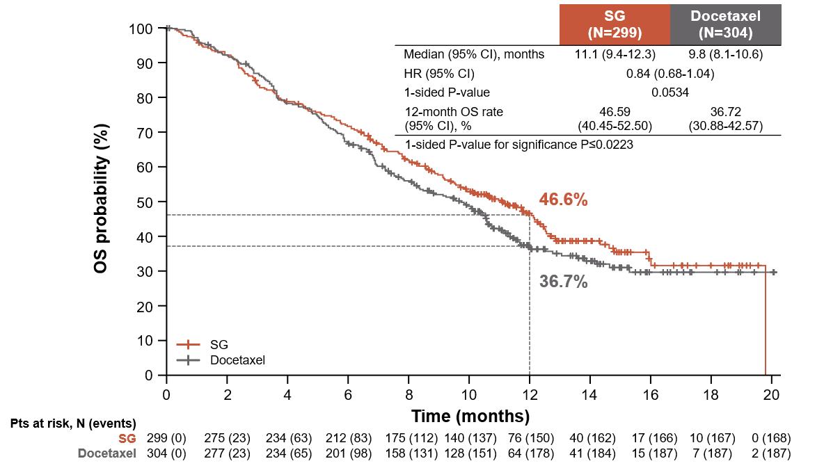
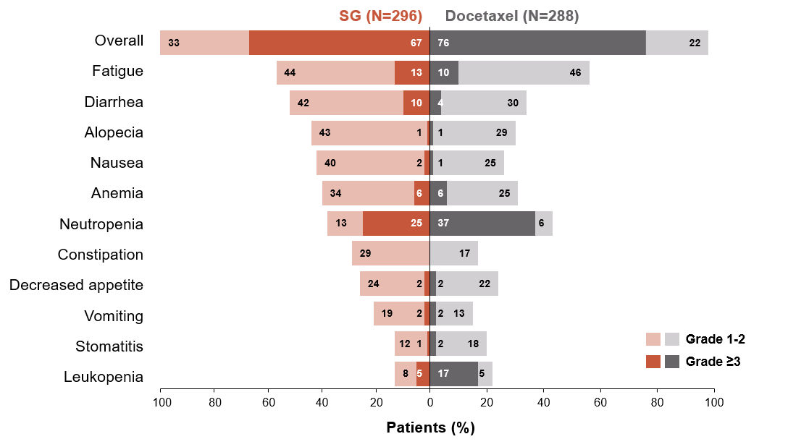
Evoke-01: Sacituzumab govitecan in pre-treated ADVANCED/METASTATIC nsclc
Overall survival (Itt)
TEaes In ≥20% of patients
CI, confidence interval; HR, hazard ratio; ITT, intent-to-treat; NSCLC, non-small cell lung cancer; OS, overall survival; Pts, patients; SG, sacituzumab govitecan; TEAE, treatment-emergent adverse event
Paz-Ares L, et al. J Clin Oncol. 2024;42:2860-72 (ASCO 2024, oral presentation)

Slide 16
Tropion-lung01: Dato-DXd in pre-treated ADVANCED/METASTATIC nsclc
Randomised, phase 3, open-label, global study (nct04656652)
Key eligibility criteria:
NSCLC (stage IIIB, IIIC, or IV)
ECOG PS of 0 or 1
No prior docetaxel
Without actionable genomic alterations
1 or 2 prior lines, including platinum CT and anti–PD-(L)1 mAb therapy
With actionable genomic alterations
Positive for EGFR, ALK, NTRK, BRAF, ROS1, MET exon 14 skipping, or RET
1 or 2 prior approved targeted therapies + platinum-based CT, and ≤1 anti–PD-(L)1 mAb
Dato-DXd
6 mg/kg Q3W (N=299)
Dual primary endpoints:
PFS by BICR
OS
Secondary endpoints:
ORR by BICR
DoR by BICR
Safety
R 1:1
Docetaxel 75 mg/m² Q3W (N=305)
BICR, blinded independent central review; CT, chemotherapy; Dato-DXd, datopotamab deruxtecan; DoR, duration of response; ECOG PS, Eastern Cooperative Oncology Group performance status; mAb, monoclonal antibody; (a/m)NSCLC, (advanced/metastatic) non-small cell lung cancer; ORR, objective response rate; OS, overall survival; PFS, progression-free survival; Q3W, every 3 weeks; R, randomisation
Ahn M-J, et al. J Clin Oncol. 2025;43:260-272 (including protocol); Ahn M-J, et al. Annals of Oncol. 2023:34 (S2): S1305_LBA12 (oral presentation, presented by Lisberg A. ESMO 2023)

Slide 17
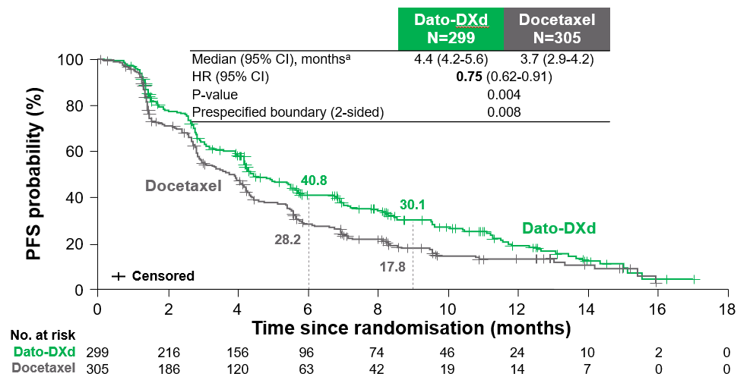
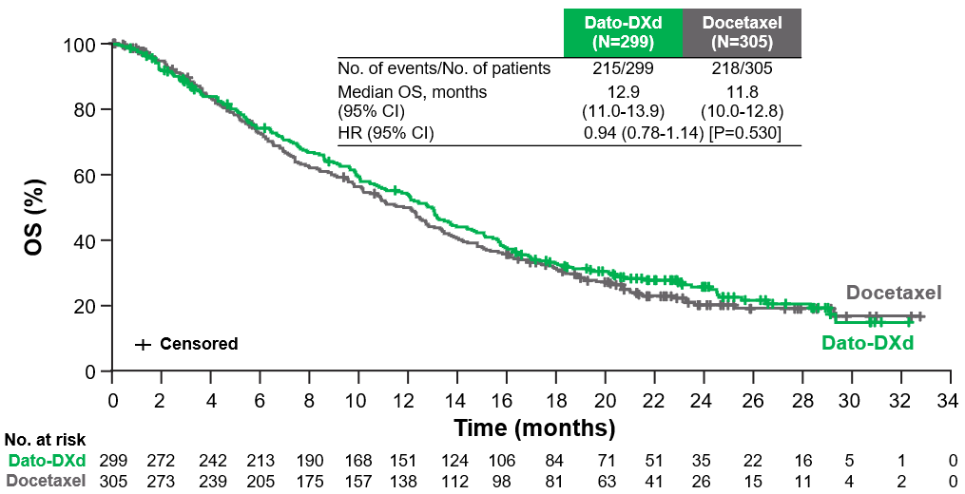
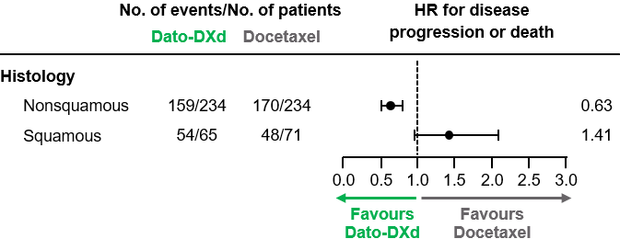
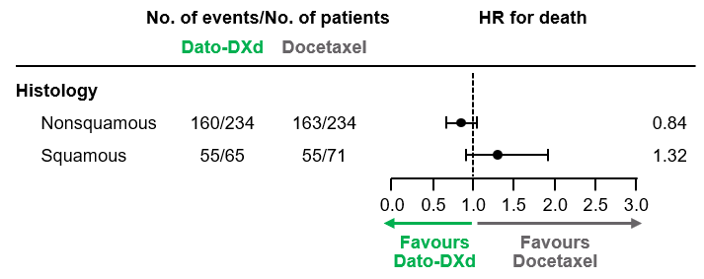
Tropion-lung01: efficacy of Dato-DXd in pre-treated ADVANCED/METASTATIC nsclc
Progression-free survival
overall survival
ª Median PFS follow-up was 10.9 (95% CI, 9.8-12.5) and 9.6 (95% CI, 8.2-11.9) months for Dato-DXd and docetaxel respectively; ^{b} Included 4 CRs and 75 PRs for Dato-DXd and 39 PRs for docetaxel. CI, confidence interval; CR, complete response; Dato-DXd, datopotamab deruxtecan; HR, hazard ratio; mDoR, median duration of response; mo, months; NSCLC, non-small cell lung cancer; ORR, objective response rate; OS, overall survival; PFS, progression-free survival; PR, partial response
Ahn M-J, et al. J Clin Oncol. 2025;43:260-72

Slide 18
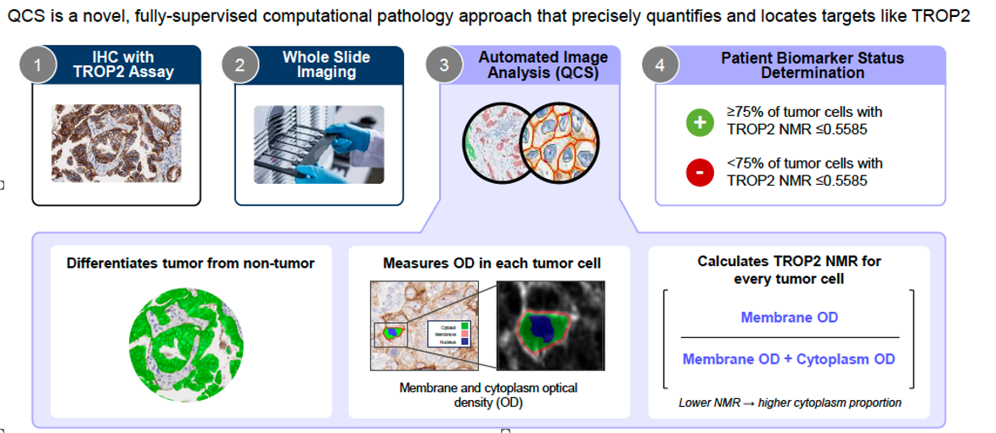
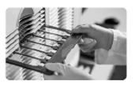

Assessing trop2 as a biomarker (nmr qcs)?
Trop2 normalised membrane ratio (nmr) measured by quantitative continuous scoring (qcs)
QCS is a novel, fully-supervised computational pathology approach that precisely quantifies and locates targets like TROP2
1
IHC with TROP2 Assay
2
Whole Slide Imaging
3
Automated Image Analysis (QCS)
4
Patient Biomarker Status Determination
Whole slide imaging
Whole slide imaging
Whole slide imaging
+
≥75% of tumour cells with TROP2 NMR ≤0.56
−
<75% of tumour cells with TROP2 NMR ≤0.56ª
Differentiates tumour from non-tumour
Measures OD in each tumour cell
Calculates TROP2 NMR for every tumour cell
Membrane OD
Membrane OD + Cytoplasm OD
Membrane and cytoplasm optical density (OD)
Lower NMR → high cytoplasm proportion
ª Or >25% of cells with an NMR >0.56
IHC, immunohistochemistry; NMR, normalised membrane ratio; OD, optical density; QCS, quantitative continuous scoring
Garassino, M.C. et al. Journal of Thoracic Oncology, 2024; Volume 19, Issue 10, S2 - S3 (oral presentation, WCLC 2024, PL02.11.)

Slide 19
trop2 nmr qcs: tropion-lung01
Nsq/non-aga bep: Efficacy by Trop2 qcs-nmr status
TROP2 QCS-NMR positivity is predictive for longer PFS with Dato-DXd in the NSQ/non-AGA biomarker-evaluable population
NSQ/non-AGA BEP, N=221
 | TROP2 QCS-NMR+ |  | TROP2 QCS-NMR–
 | Dato-DXd (n=68) | Docetaxel (n=72) | Dato-DXd (n=40) | Docetaxel (n=41)
ORR, % | 36.8 | 15.3 | 22.5 | 12.2
Median PFS, months | 7.2 | 4.1 | 4.0 | 4.4
HR (95% CI) | 0.52 (0.35-0.78) |  | 1.22 (0.74-2.00)
Treatment by biomarker status interaction: P=0.0098
100
75
PFS probability (%)
50
Dato-DXd, QCS-NMR+
Dato-DXd, QCS-NMR-
Docetaxel, QCS-NMR+
Docetaxel, QCS-NMR-
25
0
0
4
8
12
16
Time from randomisation (months)
Data cutoff: March 29, 2023. PFS HR (95% CI) by TROP2 QCS-NMR status (+ vs -) within treatment: Dato DXd: 0.40 [0.25-0.64]; Docetaxel: 0.94 [0.60-1.49]
AGA, actionable genomic alteration; BEP, biomarker evaluable population; CI, confidence interval; Dato-DXd, datopotamab deruxtecan; HR, hazard ratio; NMR, normalised membrane ratio; NSQ, nonsquamous; ORR, objective response rate; PFS, progression-free survival; QCS, quantitative continuous scoring
Garassino, M.C. et al. Journal of Thoracic Oncology, 2024; Volume 19, Issue 10, S2 - S3 (oral presentation, WCLC 2024, PL02.11.)

Slide 20
Tropion-lung01: SAFETY of Dato-DXd in pre-treated ADVANCED/METASTATIC nsclc
traes occurring in ≥15% of patients
Adverse events of special interest
System organ class Preferred term, n (%) | Dato-DXd N=297 |  | Docetaxel N=290
 | Any grade | Grade ≥3 | Any grade | Grade ≥3
Gastrointestinal disordersª Stomatitis Nausea Diarrhea | 141 (47.5) 101 (34.0) 30 (10.1) | 20 (6.7) 7 (2.4) 1 (0.3) | 45 (15.5) 48 (16.6) 55 (19.0) | 3 (1.0) 3 (1.0) 4 (1.4)
Hematologic disordersª Anemia^{b} Neutropenia^{c} Leukopenia^{d} | 44 (14.8) 14 (4.7) 9 (3.0) | 12 (4.0) 2 (0.7) 0 | 60 (20.7) 76 (26.2) 45 (15.5) | 12 (4.1) 68 (23.4) 38 (13.1)
Skin and subcutaneousª Alopecia | 95 (32.0) | 0 | 101 (34.8) | 1 (0.3)
Metabolism and nutritionª Decreased appetite | 68 (22.9) | 1 (0.3) | 46 (15.9) | 1 (0.3)
General disordersª Asthenia | 56 (18.9) | 8 (2.7) | 56 (19.3) | 5 (1.7)
Adjudicated drug-related ILD or pneumonitis | 26 (8.8)^{e} | 11 (3.7) | 12 (4.1) | 4 (1.4)
AESI, n (%) | Dato-DXd N=297 | Docetaxel N=290
Stomatitis/oral mucositis All grades Grade ≥3 | 164 (55.2) 20 (6.7) | 60 (20.7) 4 (1.4)
Ocular events All grades Grade ≥3 | 64 (21.5) 7 (2.4) | 27 (9.3) 0
Adjudicated drug-related ILD All grades Grade ≥3 Grade 5 | 26 (8.8) 11 (3.7) 7 (2.4) | 12 (4.1) 4 (1.4) 1 (0.3)
AESIs listed in this table are treatment emergent regardless of causality. Some patients may have had more than one event.
Dato-DXd related events:
Stomatitis/oral mucositis resulted in a low rate of treatment discontinuation (0.7%)
Most frequent ocular surface events: lacrimation increased (23 [7.7%]) and dry eye (21 [7.1%]), all mild or moderate. Any-grade and grade ≥3 keratitis occurred in 12 (4.0%) and 4 (1.3%) patients, respectively
Seven adjudicated drug-related grade 5 ILD events: primary cause of death in 4 out of 7 was attributed to disease progression by investigator
Data cut-off: March 1, 2024. ª No grade 5 events occurred with Dato-DXd or docetaxel; ^{b} Grouped PTs of anemia, hemoglobin decreased, and RBC count decreased; ^{c} Grouped PTs of neutropenia and neutrophil count decreased; ^{d} Grouped PTs of leukopenia and WBC count decreased. ^{e}2 (0.7%) G1 events, 13 (4.4%) G2 events, 3 (1.0% G3, 1 (0.3% G4, 7 (2.4%) G5 events; AESI, adverse event of special interest; Dato-DXd, datopotamab deruxtecan; G, grade; ILD, interstitial lung disease; NSCLC, non-small cell lung cancer; PT, preferred term; TRAE, treatment-related adverse event; WBC, white blood cell
Ahn MJ, et al. J Clin Oncol. 2025;43(3):260-72 (including Supplementary appendix)

Slide 21
tropion-lung17: Dato-DXd in pre-treated ADVANCED/METASTATIC nsclc
Ongoing phase 3 trial in TROP2 NMR positive nsq NSCLC without AGA
Patients:
Aged ≥18 years
Pathologically documented non-squamous NSCLC (stage IIIB, IIIC, or IV, per AJCC Staging Manual, 9th Edition) without AGA
Negative for EGFR, ALK, and ROS1 mutations
No known AGAs including KRAS G12C, NTRK, BRAF, MET exon14 skipping, RET, or HER2 mutations
TROP2 NMR positive
Prior receipt of platinum-based chemotherapy and anti-PD-(L)1 monoclonal antibodies
≥1 measurable lesion per RECIST v1.1
ECOG PS 0 or 1
Stable or asymptomatic brain metastases permitted
Dato-DXd
6 mg/kgª IV Q3W
Dual primary endpoints:
PFS by BICR
OS
N=400
R 1:1
Docetaxel 75 mg/m² IV Q3W
Stratified by:
Duration of prior anti-PD-(L)1 therapy (<6 months vs ≥6 months)
Geographical region
(US, Europe, Canada vs other geographic regions)
Treatment will continue until investigator assessed radiological progression per RECIST v1.1, unacceptable toxicity, withdrawal of consent, or any other discontinuation criterion is met
ª Up to a maximum of 540 mg for patients ≥90 kg
AJCC, American Joint Committee on Cancer; AGA, actionable genomic alterations; BICR, blinded independent central review; Dato-DXd, datopotamab deruxtecan; ECOG PS, Eastern Cooperative Oncology Group performance status; IV, intravenously; NMR, normalised membrane ratio; NSCLC, non-small cell lung cancer; NSQ, non-squamous; OS, overall survival; PD-(L)1, programmed cell death-(ligand) 1; PFS, progression-free survival; PS, performance status; Q3W, every three weeks; R, randomisation; RECIST, Response Evaluation Criteria in Solid Tumours; TROP2, trophoblast cell surface antigen 2; US, United States
Sands J, et al. ESMO Open. 2026;11 (suppl_3):106452.(ELCC 2026, poster #145TiP)

Slide 22
Esmo clinical practice guidelines (v1.2 Jan 2025)
Stage IV NSqNSCC, molecular tests negative (EGFR/ALK/ROS1/BRAF/RET/MET/EGFR ex20ins/KRAS G12C/NTRK/HER2) without contraindication for immunotherapy
Oligometastatic
ECOG PS & PD-L1 expression level
Systemic therapy & LRT [II, B)
PS 0-2 & PD-L1 ≥50%
PS 0-1 & any expression of PD-L1
PS 2 & PD-L1 <50%
PS 3-4 regardless of PD-L1
ICI [anti-PD-(L)1 monotherapy] [I, A; MCBS 4-5/A]
(for PS 2: [II, B])
ICI [anti-PD-(L)1 ± anti-CTLA-4]– platinum-doublet ChT followed by ICI ± pemetrexed or bevacizumab [I, A; MCBS 3-4/A] Dual ICI alone (only for PD-L1 ≥1%) [I, A; MCBS 4/A]
Platinum-doublet ChT [I, A / II, A] Atezolizumab [I, B] Single-agent ChT [I, B / II, B]
Disease progression
Disease progression
Disease progression
PS 0-2
PS 3-4
PS 0-2
PS 3-4
PS 0-2
PS 3-4
Platinum-doublet ChT [I, A / II, A; MCBS 4] ± maintenance with pemetrexed [I, A; MCBS 4 / I, B] or gemcitabine [I, C] Platinum-doublet ChT–bevacizumab followed by bevacizumab maintenance [I, A; MCBS 2] ± pemetrexed [I, A] ICI rechallenge [III, B]
Pemetrexed [I, B] Docetaxel [I, B] Nintedanib–docetaxel [II, B] Ramucirumab–docetaxel [I, B; MCBS 1] ICI rechallenge [III, B]
ICI [anti-PD-(L)1 monotherapy] [I, A; MCBS4-5A], if not received in first-line Other options are the same as for the second-line treatment for PS 0-2 after ChT–ICI
Consider adding TTFields [MCBS 4] to ICI monotherapy [II, B] or docetaxel [II, C]
BSC alone [III, A]
BSC, best supportive care; ChT, chemotherapy; ESMO, European Society for Medical Oncology; ICI, immune checkpoint inhibitor; LRT, local radical therapy; MCBS, ESMO Magnitude of Clinical Benefit Scale; NsqNSCC nonsquamous non-small cell carcinoma; PS, performance status (Eastern Cooperative Oncology Group)
1. Hendriks L, et al. Ann Oncol. 2023;34:358-76; 2. Hendriks L, et al. Ann Oncol. 2025;36(19):1223-7 [ESMO Non-Oncogene-Addicted Metastatic Non-Small-Cell Lung Cancer Living Guideline, v1.2 – January 2025. Available here (accessed April 14, 2026)]

Slide 23
Evoke-02: Sacituzumab govitecan (sg) COMBINATIONS as 1l treatment for ADVANCED/METASTATIC nsclc
PHASE 2 STUDY
Key inclusion criteria
NSCLC Stage IV
ECOG PS 0-1
No prior systemic treatment for mNSCLC
Measurable disease per RECIST v1.1
No know AGAs
Cohort A PD-L1 TPS ≥50% NSQ or SQ n=30
21-day cycles
SG 10 mg/kg IV on Day 1 and Day 8ª + pembrolizumab 200 mg IV on Day 1 (up to 35 cycles)
Primary endpoints:
ORR by IRC
DLTs in safety run-in
Secondary endpoints:
PFS, DOR and DCR by IRC
OS
Safety and tolerability
Cohort B PD-L1 TPS <50% NSQ or SQ n=62
Cohort C NSQ n=54
21-day cycles
SG RP2D IV on Day 1 and Day 8ª + pembrolizumab 200 mg IV on Day 1 (up to 35 cycles) + carboplatin AUC 5 or cisplatin 75 mg/m² IV on Day 1 (up to 4 cycles)
Safety run-in Any PD-L1 TPS n=5
Cohort D SQ n=41
ª Until PD or unacceptable toxicity
1L, first-line; AGA, actionable genomic alteration; AUC, area under the curve; DCR, disease control rate; DLT, dose-limiting toxicity; DOR, duration of response; ECOG PS, Eastern Cooperative Oncology Group performance status; IRC, independent review committee; IV, intravenous; (m)NSCLC, (metastatic) non-small cell lung cancer; NSQ, non-squamous cell; ORR, objective response rate; OS, overall survival; PD, progressive disease; PD-L1, programmed cell death ligand 1; PFS, progression-free survival; RECIST, Response Evaluation Criteria in Solid Tumours; RP2D, recommended phase 2 dose; SG, sacituzumab govitecan; SQ, squamous cell; TPS, tumour proportion score
Reck M, et al. J Thorac Oncol. 2026;21:103509; EVOKE-02.pdf (accessed May 02, 2026); NCT05186974

Slide 24
Evoke-02: sg COMBINATIONS as 1l treatment for ADVANCED/METASTATIC nsclc (EFFICACY)
Efficacy by investigator assessment^{1a}
PFS by irc¹
Response rates | Cohort A (PD-L1 TPS ≥50%) SG + pembrolizumab (N=30) | Cohort B (PD-L1 TPS <50%) SG + pembrolizumab (N=62)
ORR (95% CI), %ª | 66.7 (47.2-82.7) | 29.0 (18.2-41.9)
CR, n (%) | 1 (3.3) | 0
PR, n (%) | 19 (63.3) | 18 (29.0)
SD, n (%) | 6 (20.0) | 23 (37.1)
PD, n (%) | 3 (10.0) | 9 (14.5)
NE, n (%)^{b} | 1 (3.3) | 12 (19.4)
Median PFS (95% CI),ª months | 13.1 (6.7-NR) | 7.0 (4.2-12.9)
Median DoR (95% CI),ª months | NR (9.4-NR) | 11.9 (6.9-NR)
100
90
80
70
60
50
40
30
20
10
0
Cohort A
Median (95% CI) PFS, months 13.1 (6.7-NR)
PFS (%)
0 | 1 | 2 | 3 | 4 | 5 | 6 | 7 | 8 | 9 | 10 | 11 | 12 | 13 | 14 | 15 | 16 | 17 | 18 | 19 | 20 | 21 | 22 | 23 | 24
No. at risk (events)
Cohort A
Time (months)
30 (0) | 29 (0) | 26 (3) | 25 (4) | 23 (5) | 22 (5) | 19 (8) | 17 (10) | 17 (10) | 16 (11) | 16 (11) | 14 (12) | 13 (13) | 13 (13) | 11 (14) | 11 (14) | 7 (14) | 7 (14) | 4 (14) | 4 (14) | 2 (14) | 2 (14) | 0 (14)
100
90
80
70
60
50
40
30
20
10
0
Cohort B
PFS (%)
Median (95% CI) PFS, months 7.0 (4.2-12.9)
Data cutoff date: 3 June 2024
Study median (range) follow up: 16.6 (8.5-23.8)
0 | 1 | 2 | 3 | 4 | 5 | 6 | 7 | 8 | 9 | 10 | 11 | 12 | 13 | 14 | 15 | 16 | 17 | 18 | 19 | 20 | 21 | 22 | 23 | 24
No. at risk (events)
Cohort B
Time (months)
62 (0) | 50 (0) | 40 (9) | 36 (11) | 33 (13) | 25 (18) | 22 (21) | 20 (23) | 19 (24) | 16 (25) | 8 (28) | 8 (28) | 8 (29) | 7 (29) | 5 (31) | 4 (31) | 3 (31) | 3 (31) | 3 (31) | 3 (31) | 2 (31) | 2 (31) | 1 (31) | 1 (31) | 0 (31)
ª Per IRC; ^{b} Includes not assessed
1L, first-line; CI, confidence interval; CR, complete response; DOR, duration of response; IRC, independent review committee; NE, not evaluable; NR, not reached; NSCLC, non-small cell lung cancer; ORR, objective response rate; PD, progressive disease; PD-L1, programmed cell death ligand 1; PFS, progression-free survival; PR, partial response; SG, sacituzumab govitecan; SD, stable disease; TPS, tumour proportion score
Reck M, et al. J Thorac Oncol. 2026;21:103509

Slide 25
Evoke-02: sg COMBINATIONS as 1l treatment for ADVANCED/METASTATIC nsclc (SAFETY)
Safety summary¹
Any-grade TEAEs reported in ≥10% of patients¹
TEAEs, n (%) | Total SG + pembrolizumab (N=92)
Any-grade TEAEs | 92 (100)
Grade ≥3 TEAES | 70 (76.1)
TEAEs related to any study drug | 84 (91.3)
Grade ≥3 TEAEs related to any study drug | 42 (45.7)
Serious TEAEs | 58 (63.0)
Related to any study drug | 19 (20.7)
TEAEs leading to treatment discontinuation of any study drug | 25 (27.2)
TEAEs leading to discontinuation of SG | 22 (23.9)
TEAEs leading to discontinuation of pembrolizumab | 21 (22.8)
TEAEs leading to dose reduction of SG | 16 (17.4)
TEAEs leading to dose interruption of any study drug | 65 (70.7)
TEAEs leading to dose interruption of SG | 64 (69.6)
TEAEs leading to dose interruption of pembrolizumab | 51 (55.4)
TEAEs leading to death | 8 (8.7)
TEAEs related to any study drug leading to deathª | 3 (3.3)
Patients (%)
ª Two patients had neutropenic sepsis, one patient had sepsis
1L, first-line; ALT, alanine aminotransferase; AST, aspartate aminotransferase; NSCLC, non-small cell lung cancer; SG, sacituzumab govitecan; TEAEs, treatment-emergent adverse events
1. Reck M, et al. J Thorac Oncol. 2026;21:103509

Slide 26
Evoke-03: sg COMBINATIONS as 1l treatment for ADVANCED/METASTATIC nsclc (ongoing)
Phase 3, study evaluating SG + pembrolizumab vs pembrolizumab monotherapy for 1L treatment of patients with mNSCLC with PD-L1 TPS ≥50%
Key inclusion criteria:
Stage IV mNSCLC
No prior systemic treatment for mNSCLC
PD-L1 TPS ≥50%
No pneumonitis/ILD
EGFR/ALK/ROS1-directed primary therapy not indicated
No active CNS metastases and/or carcinomatous meningitis
21-day cycles
SG 10 mg/kg Q1W IV on Day 1 and Day 8 of a 21-day cycle + pembrolizumab 200 mg Q3W IV on Day 1 for up to 35 cycles
Primary endpoints:
PFS
OS
Secondary endpoints:
ORR
DOR
Safety
PROs using EORTC QLC-C30
N=614
R 1:1
21-day cycles
Pembrolizumab 200 mg Q3W IV on Day 1 for up to 35 cycles
1L, first-line; CNS, central nervous system; DOR, duration of response; EORTC QLQ-C30, The European Organisation for Research and Treatment of Cancer Quality of Life Questionnaire-Core 30; ILD, interstitial lung disease; IV, intravenous; (m)NSCLC, (metastatic) non-small cell lung cancer; ORR, objective response rate; OS, overall survival; PD-L1, programmed death ligand 1; PFS, progression-free survival; PROs, patient reported outcomes; R, randomisation; SG, sacituzumab govitecan; TPS, tumour proportion score; Q’X’W, every ‘x’ weeks
EVOKE-03.pdf; Moskovitz M, et al. Cancer Res 2023; 83 (8_Supplement): CT067 (AACR 2023 poster); NCT05609968

Slide 27
Exploring Dato-DXd combinations as 1L treatment in ADVANCED/METASTATIC nsclc
TROPION-Lung02^{1,2}
Phase 1b study of Dato-DXd + pembrolizumab ± Pt-ChT for a/mNSCLC without AGAsª
TROPION-Lung04^{3,4}
Phase 1b, open-label, multicentre, dose-escalation / dose-confirmation and dose-expansion study evaluating Dato-DXd + durvalumab ± ChT in a/mNSCLC
^{,4}
Key eligibility:
a/mNSCLC
Dose escalation:^{b}
≤2 lines of prior therapy^{c}
Dose expansion
≤1 line of Pt-ChT (Cohorts 1 and 2)^{c}
Treatment naïve (Cohort 2)^{c,d}
Treatment naïve (Cohorts 3-6)^{c}
1L patients only
Key eligibility:
Previously treated or treatment-naïve a/mNSCLCe
No AGAs
ECOG PS 0-1
Part 1: Sequential dose escalation^{f}
Part 2: Dose expansion
Dato-DXd Q3W IV
+
Pembro Q3W IV
±
Pt-ChT Q3W IV
Cohort 1 (n=2)
4 mg/kg
+
200 mg
Cohort 1
Dato-DXd 4 mg/kg + durvalumab 1120 mg Q3W
Doublet
Cohort 2 (n=40)
Doublet
6 mg/kg
+
200 mg
Dato-DXd 6 mg/kg + durvalumab 1120 mg Q3W (1L; n=1)
Dato-DXd 6 mg/kg + durvalumab 1120 mg Q3W (1L; n=14)
Cohort 2
Cohort 3 (n=14)
4 mg/kg
+
200 mg
+
carboplatin AUC 5
Primary endpoints:
Safety and tolerability
Key secondary endpoints:
ORR, DCR, DOR, PFS (investigator assessment
Dato-DXd 4 mg/kg + durvalumab 1120 mg + 4 cycles of carboplatin AUC 5 Q3W
Cohort 4 (n=26)
6 mg/kg
+
200 mg
+
carboplatin AUC 5
Cohort 3^{g}
Primary endpoints:
DLTs and TEAEs
Secondary endpoints:
ORR, DOR, PFS, OS
Triplet
Cohort 5 (n=8)
cisplatin 75 mg/m²
Triplet
4 mg/kg
+
200 mg
+
Dato-DXd 6 mg/kg + durvalumab 1120 mg + 4 cycles of carboplatin AUC 5 Q3W (1L; n=6)
Dato-DXd 6 mg/kg + durvalumab 1120 mg + 4 cycles of carboplatin AUC 5 Q3W (1L; n=31)
Cohort 6 (n=6)
cisplatin 75 mg/m²
Cohort 4
6 mg/kg
+
200 mg
+
ª Patients with known AGAs were not eligible for this study; ^{b} The first 3-6 patients in each cohort were enrolled to confirm acceptable safety/DLT rate, the remaining are considered part of dose expansion; ^{c} Prior therapy requirements are for the a/m setting; ^{d} enrolment after 30 Jun 2022; ^{e} Patients in Cohort 1 and one patient in Cohort 2 had received ≥1 platinum-based chemotherapy regimen and anti-PD-1/PD-L1 therapy as per an earlier version of the clinical study protocol. Subsequent patients were treatment-naïve or had ≤1 prior line of systemic chemotherapy without concomitant immune checkpoint inhibitors. ^{f} Dose escalation was guided by a mTPI-2 design and conducted sequentially from Cohort 1 to 2 (Dato-DXd 4 mg/kg to 6 mg/kg) and Cohort 2 to 4 (doublet to triplet combination); ^{g} Cohort 3 was skipped as there were sufficient data available from the Dato-DXd development program to conclude that 4 mg/kg Dato-DXd in combination with immunotherapy and carboplatin had an acceptable safety profile. 1L, first-line; a/m, advanced/metastatic; AGA, actionable genomic alterations; AUC, area under the curve; ChT, chemotherapy; Dato-DXd, datopotamab deruxtecan; DCR, disease control rate; DLT, dose-limiting toxicity; DOR, duration of response; ECOG PS, Eastern Cooperative Oncology Group performance status; IV, intravenous; NSCLC, non-small cell lung cancer; ORR, objective response rate; OS, overall survival; pembro, pembrolizumab; PFS, progression-free survival; Pt, platinum; Q3W, every 3 weeks; TEAE, treatment-emergent adverse event
1. Levy B, et al. J Thorac Oncol. 2026;21:103688; 2. NCT04526691; 3. Cuppens K, et al. Annals of Oncology, 2025; 10 (suppl_2): 1-7. 10.1016/esmoop/esmoop104162 (ESMO TAT 2025; oral presentation); 4. NCT04612751

Slide 28
Tropion-lung02: Dato-DXd 1L combinations in ADVANCED/METASTATIC nsclc (efficacy)
EFFICACY BY TREATMENT ARM¹
EFFICACY BY pd-l1 status¹
EFFICACY BY trop-2 nmr¹
100
 | Doublet (N=42) |  | Triplet (N=54)
 | PD-L1 <50% | PD-L1 ≥50% | PD-L1 <50% | PD-L1 ≥50%
N | 30 | 5 | 40 | 10
ORR, % | 53.3 | 100 | 55.0 | 60.0
BOR, %
CR | 3.3 | 0 | 2.5 | 10.0
PR | 50.0 | 100 | 52.5 | 50.0
DOR, months | 12.0 | NE | 14.6 | NE
DCR, % | 96.7 | 100 | 87.5 | 90.0
Median PFS, months | 11.1 | NE | 6.4 | 6.8
Median OS, months | NE | NE | 13.3 | NE
 | Trop-2 NMR+ (N=37) | Trop-2 NMR- (N=39)
Median PFS (95% CI), months | 12.0 (8.2-26.2) | 8.1 (4.2-13.2)
HR (95% CI) | 0.62 (0.35-1.10)
Median PFS (95% CI) Doublet: 11.2 months (8.2-21.3)
80
60
100
PFS (%)
40
80
20
0
Censored
60
0 | 2 | 4 | 6 | 8 | 10 | 12 | 14 | 16 | 18 | 20 | 22 | 24 | 26 | 28 | 30 | 32
PFS (%)
No. at risk:
Doublet
Time since start of treatment (months)
40
42 | 36 | 32 | 28 | 25 | 22 | 12 | 10 | 8 | 6 | 5 | 4 | 4 | 4 | 2 | 0
100
20
80
Median PFS (95% CI) Triplet: 6.8 months (5.5-11.1)
Censored
60
0
PFS (%)
0
10
Time (months)
20
30
40
No. at risk:
Trop-2 NMR+
Trop-2 NMR-
37
39
22
15
8
4
0
1
20
Censored
0
Dato-DXd + pembro ± Pt-ChT showed
durable antitumour activity across PD-L1 subgroups
Exploratory TROP-2 NMR biomarker analysis
showed a trend toward prolonged PFS in patients who were biomarker positive compared with biomarker negative¹
0 | 2 | 4 | 6 | 8 | 10 | 12 | 14 | 16 | 18 | 20 | 22 | 24 | 26 | 28 | 30 | 32
No. at risk:
Triplet
Time since start of treatment (months)
54 | 48 | 38 | 28 | 23 | 20 | 18 | 17 | 14 | 9 | 7 | 6 | 5 | 4 | 2 | 1 | 0
1L, first-line; BOR; best overall response; ChT, chemotherapy; CI, confidence interval; CR, complete response; Dato-DXd, datopotamab deruxtecan; DCR, disease control rate; DOR, duration of response; HR, hazard ratio; NMR, normalised membrane ratio; NSCLC, non-small cell lung cancer; ORR, objective response rate; NE, not evaluable; OS, overall survival; PD-L1, programmed death ligand 1; pembro, pembrolizumab; PFS, progression-free survival; PR, partial response; Pt, platinum
1. Levy B, et al. J Thorac Oncol. 2026;21:103688

Slide 29
Tropion-lung02: Dato-DXd 1L combinations in ADVANCED/METASTATIC nsclc (safety)
Safety summary, 1L patients¹
TEAEs reported in ≥10% of patients¹
Event, n (%) | Doublet (N=42) | Triplet (N=54)
TRAEs | 39 (92.9) | 54 (100)
Grade ≥3 | 17 (40.5) | 30 (55.6)
Associated with death | 0 | 0
TRAEs associated with dose modifications
Dose reduction of any drug | 8 (19.0) | 14 (25.9)
Dose reduction of Dato-DXd | 8 (19.0) | 7 (13.0)
Discontinuation of any drug | 14 (33.3) | 20 (37.0)
Discontinuation of Dato-DXd | 13 (31.0) | 16 (29.6)
Serious TRAEs | 5 (11.9) | 12 (22.2)
Grade ≥3 | 4 (9.5) | 9 (16.7)
AESIs
Oral mucositis/stomatitis | 26 (61.9) | 22 (40.7)
Grade 3 | 2 (4.8) | 1 (1.9)
Adjudicated drug-related ILD/pneumonitis | 11 (26.2) | 14 (25.9)
Grade 3 | 2 (4.8) | 1 (1.9)
Ocular surface events | 9 (21.4) | 18 (33.3)
Grade 3 | 1 (2.4) | 2 (3.7)
Doublet
Grade 1-2
Grade ≥3
Triplet
Grade 1-2
Grade ≥3
60
40
20
Patients (%)
Grade 3 TRAEs were more frequent in the triplet cohort than the doublet cohort. No Grade 4 or 5 events were observed¹
1L, first-line; AESI, adverse event of special interest; Dato-DXd, datopotamab deruxtecan; ILD, interstitial lung disease; NSCLC, non-small cell lung cancer; TEAEs, treatment-emergent adverse events; TRAE, treatment-related adverse event
1. Levy B, et al. J Thorac Oncol. 2026;21:103688

Slide 30
Tropion-lung04: Dato-DXd 1L combinations in ADVANCED/METASTATIC nsclc (efficacy)
Antitumour activity
Durable responses were observed for both the doublet and triplet combinations¹
Response in patients in the 1L setting,ª n (%) | Cohort 2 doublet (N=15) | Cohort 4 triplet (N=37)
Confirmed ORR, % [95% CI] | 53.3 [26.6-78.7] | 56.8 [39.5-72.9]
BOR, n (%) CR PR SD PD | 1 (6.7) 7 (46.7) 5 (33.3) 2 (13.3) | 0 21 (56.8) 12 (32.4) 3 (8.1)
Median PFS, months [95% CI] | 7.3 [2.0-29.5] | 8.7 [5.6-10.1]
Median DOR, months [95% CI] | 15.0 [4.5-28.8] | 8.8 [5.8-NE]
DCR,^{b}% [95% CI] | 86.7 [59.5-98.3] | 89.2 [74.6-97.0]
Data cutoff: 24 Oct 2024
ª Investigator assessed per RECIST v1.1; ^{b} Defined as patients with CR + PR + SD; SD includes unconfirmed CR/PR or SD ≥5 weeks
1L, first-line; BOR; best overall response; CI, confidence interval; CR, complete response; Dato-DXd, datopotamab deruxtecan; DCR, disease control rate; DOR, duration of response; NE, not evaluable; NSCLC, non-small cell lung cancer; ORR, objective response rate; PD, progressive disease; PFS, progression-free survival; PR, partial response; RECIST, Response Evaluation Criteria in Solid Tumours; SD, stable disease
Cuppens K et al. ESMO Open. 2025;10(supplement 2):104164 (ESMO TAT 2025; oral presentation)

Slide 31
Tropion-lung04: Dato-DXd 1L combinations in ADVANCED/METASTATIC nsclc (safety)
Safety summary
TEAEs in ≥15%^{e} of patients
Events, n (%) | Cohort 2 1L doublet (N=15) | Cohort 4 1L triplet (N=37)
TEAEs | 15 (100) | 37 (100)
Treatment related | 15 (100) | 37 (100)
Grade ≥3 TEAEs | 9 (60.0) | 26 (70.3)
Treatment related | 7 (46.7) | 23 (62.2)
SAEs | 7 (46.7) | 19 (51.4)
Treatment related | 6 (40.0) | 10 (27.0)
TEAEs associated with:
Death | 0 | 2 (5.4)ª
Discontinuation of any drug | 4 (26.7) | 9 (24.3)
Discontinuation of Dato-DXd | 4 (26.7) | 8 (21.6)
Adjudicated drug-related ILD, pneumonitis^{b} | 3 (20.0) | 6 (16.2)
Grade ≥3 | 1 (6.7)^{c} | 1 (2.7)^{d}
Cohort 2: 1L Dato-DXd + durvalumab (N=15)
Cohort 4: 1L Dato-DXd + durvalumab + carboplatin (N=37)
Doublet
Grade 1-2
Grade ≥3
Triplet
Grade 1-2
Grade ≥3
100
80
60
40
20
Patients with TEAE (%)
ª Grade 5 pneumonitis (adjudicated as drug-related) and grade 5 dyspnea; ^{b} ILD/pneumonitis is comprised only of events adjudicated as drug-related ILD and based on a list of 55 preferred terms; ^{c} Grade 4, patient received sotorasib after PD/discontinuation of study treatment; ^{d} Grade 5, adjudicated as being study treatment-related’; ^{e}≥15% of grade 1/2 TEAEs in either cohort.
1L, first-line; Dato-DXd, datopotamab deruxtecan; ILD, interstitial lung disease; NSCLC, non-small cell lung cancer; PD, progressive disease; SAE, serious adverse event; TEAE, treatment-emergent adverse event
Cuppens K et al. ESMO Open. 2025;10(supplement 2):104164 (ESMO TAT 2025; oral presentation)

Slide 32
Dato-Dxd 1L COMBINATION TRIALS
Ongoing phase 3 studies in the 1l nsq nsclc setting without aga
AVANZAR Dato-DXd + durvalumab + carboplatin^{1,2} (N=1000)
Key inclusion criteria ECOG PS: 0-1 No AGAs (EGFR/ALK/ROS1 negative) No prior systemic therapy in the a/m setting Stage IIIB, IIICª or IV NSCLC
TROPION-Lung07 Dato-DXd + pembrolizumab ± Pt-ChT^{3,4} (N=975)
Key inclusion criteria PD-L1 expression <50% No AGAs (EGFR/ALK/ROS1 negative) No prior systemic therapy in the a/m setting Stage IIIB, IIICª or IV NSCLC
TROPION-Lung08 Dato-DXd + pembrolizumab vs pembrolizumab⁵⁻⁷ (N=740)
Key inclusion criteria PD-L1 TPS ≥50% No AGAs (EGFR/ALK/ROS1 negative) No prior systemic therapy in the a/m setting Stage IIIB, IIICª or IV NSCLC
TROPION-Lung10 Dato-DXd + rilvegostomig vs rilvegostomig vs pembrolizumab⁸ (N=675)
Key inclusion criteria PD-L1 expression ≥50% No AGAs (EGFR/ALK/ROS1 negative) No prior systemic therapy in the a/m setting Stage IIIB, IIIC or IV NSCLCª
R 1:1
R 1:1:1
R 1:1
R 1:1:1
Dato-DXd + durvalumab + carboplatin Q3W IV for 4 cycles
Dato-DXd +
Durvalumab Q3W IV
Histology-specific ChT + pembrolizumab Q3W IV
Dato-DXd Q3W + pembrolizumab Q3W IV + cisplatin or carboplatin Q3W IV (max 4 cycles)
Dato-DXd Q3W IV + pembrolizumab Q3W IV
Pembrolizumab Q3W IV + pemetrexed Q3W IV + cisplatin or carboplatin Q3W IV (max 4 cycles)
Dato-DXd Q3W IV +
pembrolizumab Q3W IV
Pembrolizumab Q3W IV
Dato-DXd Q3W IV +
rilvegostomig Q3W IV
Rilvegostomig Q3W IV
Pembrolizumab Q3W IV
Primary endpoints:
PFS^{b} and OS (NSQ; Trop-2 NMR+)
PFS^{b} and OS (NSQ)
Secondary endpoints:
PFS,^{b-d} OS,^{c,d} ORR,^{b-e} DOR,^{b-e} PFS,^{c-f} PFS2,^{c-e} safety and tolerability, PK, immunogenicity
Primary endpoints:
PFS^{b} and OS (ITT population)
PFS^{b} and OS (Trop-2 NMR+)
Secondary endpoints:
Key: ORRb
Other: PFS,^{f} ORR,^{f} DOR,^{b-f} TTR,^{b,f} DCR,^{b,f} PFS2, TTD, safety, immunogenicity
Primary endpoints:
PFS^{b} (NSQ)
OS (NSQ)
Secondary endpoints:
Key: OS,^{d,e} PFS,^{d,e} ORR^{b,d,e}
Other: PFS,^{e,f} PFS2,d,e ORR,^{d-f} DOR,^{b,d-f} DCR,^{b,d,f} TTD,^{b,d-f} safety, immunogenicity
Primary endpoints:
PFS^{b} (Trop-2 NMR+)
OS (Trop-2 NMR+)
Secondary endpoints:
PFS,^{b,g} OS,^{g} ORR,^{b,c,g} DOR,^{b,c,g} PROs,^{c,g} PK, immunogenicity, PFS2^{c,f,g}
ª Not a candidate for surgical resection or definitive chemoradiation; ^{b} By BICR; ^{c} Trop-2 biomarker-positive population by QCS-NMR assay; ^{d} ITT population; ^{e} NSQ population; ^{f} By investigator; ^{g} Full analysis set population 1L first line
AGA, actionable genomic alteration, a/m, advanced/metastatic; BICR, blinded independent central review; ChT, chemotherapy; Dato-DXd, datopotamab deruxtecan; DCR, disease control rate; DOR, duration of response; ECOG PS, Eastern Cooperative Oncology Group performance status; ITT, intention-to-treat; IV, intravenous; max, maximum; NMR, nornalised membrane ratio; NSCLC, non-small cell lung cancer; NSQ, non-squamous; ORR, objective response rate; OS, overall survival; PD-L1, programmed cell death ligand 1; PFS, progression-free survival; PFS2, second progression-free-survival; PK, pharmacokinetics; PRO, patient reported outcome; Pt, platinum; Q3W, every 3 weeks; QCS, Quantitative Continuous Scoring; R, randomisation; TPS, tumour proportion score; TTD, time to deterioration; TTR, time to response
1. Aggarwal C, et al. Poster presented at WCLC 2023 (Abstract P2 04-02); 2. NCT05687266. Updated 10 Dec 2025. Available from: https//clinicaltrials.gov/study/NCT05687266 (Accessed 2 Feb 2026); 3. Okamoto I, et al. Poster presented at ESMO 2023 (Abstract 1505TiP); 4. NCT05555732. Updated 19 Feb 2026. Available from https//clinicaltrials.gov/study/NCT05555732 (Accessed 2 Mar 2026); 5. Zhou C, et al. Poster presented at WCLC 2023 (Abstract P2 08-01); 6. Levy BP, et al. Future Oncol. 2023;19:1461-72; 7. NCT05215340. Updated 7 Jan 2026. Available from: https//clinicaltrials.gov/study/NCT05215340 (Accessed 2 Feb 2026); 8. NCT06357533. Updated 27 Oct 2025. Available from: https//clinicaltrials.gov/study/06357533 (Accessed 2 Feb 2026)

Slide 33
Optitrop-lung05: Sac-TMT 1L combinations in ADVANCED/METASTATIC nsclc^{1,2}
At interim analysis:
Sac-TMT plus pembrolizumab significantly improved PFS vs pembrolizumab alone in PD-L1–positive advanced NSCLC
The combination showed a positive OS trend
Key eligibility criteria:
ECOG PS score 0 or 1
mNSCLC (stage IIIB/IIIC or stage IV ineligible for surgery or radical radiotherapy)
PD-L1 TPS ≥ 1
No prior systemic therapy for locally advanced or metastatic disease
Sac-TMT on days 1, 15, and 29
+ pembrolizumab
of day 1 of a 6-week cycle
Primary endpoint:
PFS assessed by BIRC (RECIST 1.1)
Secondary endpoints:
OS
PFS (by INV)
ORR (BICR/INV)
DoR, DCR, TTR
HRQoL
Safety
R 1:1
Pembrolizumab
of day 1 of a 6-week cycle
1L, first-line; BIRC, blinded independent review committee; DCR, disease control rate; DoR, duration of response; ECOG PS, European Cooperative Oncology Group performance status; HRQoL, health-related quality of life; INV, investigator; IV, intravenously; (m)NSCLC, (metastatic) non-small cell lung cancer; ORR, objective response rate; OS, overall survival; PFS, progression-free survival; R, randomisation; RECIST, Response Evaluation Criteria in Solid Tumours; Sac-TMT, sacituzumab tirumotecan; TPS, tumour proportion score; TTR, time to response
1. Kelun-Biotech Biopharmaceutical Co., Ltd. Press release. November 24, 2025. Available here (accessed May 06, 2026); 2. ClinicalTrials.gov. Identifier NCT06448312

Slide 34
Sac-TMT 1L COMBINATION TRIALS
Ongoing phase 3 studies in the 1l nsclc setting without aga
TroFuse-007 (Phase 3):¹ Phase 3, randomised, open-label study evaluating Sac-TMT + pembrolizumab compared with pembrolizumab monotherapy for 1L treatment of patients with NSQ or SQ mNSCLC with PD-L1 TPS ≥50%¹
Key inclusion criteria:
mNSCLC
ECOG PS: 0-1
No prior systemic treatment for mNSCLC
PD-L1 TPS ≥50%
No pneumonitis/ILD
EGFR/ALK/ROS1-directed primary therapy not indicated
Sac-TMT IV on Days 1, 15 and 29 of each 6-week cycle
+
Pembrolizumab 400 mg Q6W IV on Day 1 for 18 cycles
Primary endpoint:
OS
Secondary endpoints:
PFS, OR, DOR
Safety
PROs
N=614
R 1:1
Pembrolizumab 400 mg Q6W IV on Day 1
TroFuse-023 (Phase 3):² Phase 3, randomised, open-label study evaluating pembrolizumab + carboplatin / taxane followed by pembrolizumab ± maintenance Sac-TMT for 1L treatment of patients with SQ mNSCLC²
Key inclusion criteria:
SQ mNSCLC
ECOG PS: 0-1
No prior systemic treatment for mNSCLC
No pneumonitis/ILD
Induction phase
Maintenance phase
Pembrolizumab 200 mg Q3W + carboplatin AUC 6 mg/mL/min Q3W + paclitaxel 200 mg/m² Q3W or nab-paclitaxel 100 mg/m² weekly (4 cycles)
Sac-TMT 4 mg/kg Q2W IV
+
Pembrolizumab 400 mg Q6W IV for 96 weeks
Primary endpoint:
OS
Secondary endpoints:
PFS
Safety
PROs
N=851
R 1:1
Pembrolizumab 400 mg Q6W IV for 96 weeks
1L, first-line; DOR, duration of response; ECOG PS, Eastern Cooperative Oncology Group performance status; ILD, interstitial lung disease; IV, intravenous; (m)NSCLC, (metastatic) non-small cell lung cancer; OR, objective response; OS, overall survival; PD-L1, programmed death ligand 1; PFS, progression-free survival; PROs, patient reported outcomes; SQ, squamous cell; TPS, tumour proportion score; Q’X’W, every ‘x’ weeks
1. Frost N, et al. J Thorac Oncol. 2024;1910 Suppl):S389-S390 (presented at WCLC 2024, Abstract P4.11D.02); 2. Garassino MC, et al. Cancer Res. 2025;85 (8_Supplement_2): CT250 (presented at AACR 2025)

Slide 35
Clinical overview of TROP2-directed ADCs in NSCLC With actionable genomic alterations
Dr Louise Lim Barts Health NHS Trust, UK
NSCLC, non-small cell lung cancer

Slide 36
TROP2 Expression in EGFR-mutant vs wild-type NSCLC
EGFR wild-type NSCLC
TROP2 detected in the majority of tumours (adenocarcinoma and squamous)¹
Supports TROP2 directed ADC trials¹
Interest in development of potential biomarkers¹ (e.g. quantitative IHC/AI scoring)
EGFR-mutant NSCLC
Reports show higher TROP2 IHC expression in EGFRm vs EGFR-wild-type NSCLC²
TROP2 can be enriched in TKI‑resistant states (incl. drug-tolerant persister cells)³
EGFR mutation has been linked to increased internalisation/activity for some TROP2 ADCs in preclinical work⁴
EGFR wild-type = broad TROP2 expression
EGFRm = often higher TROP2 expression and biologically enriched during resistance
ADC, antibody-drug conjugate; AI, artificial intelligence; EGFRm, EGFR mutation; IHC, immunohistochemistry; NSCLC, non-small cell lung cancer; TKI, tyrosine kinase inhibitor
1. Kuo P, et al. PLoS One. 2025;20(4):e0321555; 2. Baldacci S, et al. J Thorac Oncol. 2024;19 (10)_Suppl S80:19S80 (WCLC 2024, Abstract MA07.06); 3. Baldacci S, et al. Cancer Discov. 2025;15(11):2235-50; 4. Zhao S, et al. Nat Med. 2025;31:1976-86

Slide 37
Esmo clinical practice guidelines: EGFR-mutant nsclc
V1.3 Feb 2026
Stage IV mNSCLC with EGFR-activating mutation before systemic progression
Stage IV mNSCLC with EGFR-activating mutation [ESCAT I-A; ESCAT I-B for uncommon sensitising EGFR mutations]
EGFR-activating mutation after systemic progression with third-generation TKI
Stage IV mNSCLC with EGFR- activating mutation progressing after a third-generation TKI
PS 0-2 [I, A] PS 3-4 for all following options [III, A]
Genomic analysis by NGS (tissue or cfDNA followed by tissue, if no target is found with cfDNA) [III, C]
Osimertinib-platinum-based doublet ChT [I, A; MCBS 3] Lazertinib-amivantamab-vmjw [I, A; MCBS 4] EGFR TKI monotherapy [I, A-B; MCBS 3-4] Erlotinib–anti-VEGF(R) Ab [I, B; MCBS 1-2] Gefitinib–carboplatin–pemetrexed [I, B]
Resistance mechanism identified
No resistance mechanism identified
Amivantamab-vmjw–platinum-based doublet ChT [I, A; MCBS 2] Platinum-based doublet ChT [III, A] Atezolizumab–bevacizumab–paclitaxel–carboplatin [III, B; MCBS 3]
Clinical trial [III, B] or refer to no resistance mechanism
Systemic progression
Disease progression
Oligoprogression
Datopotamab deruxtecan [III, B; MCBS 2] T-DXd [III, B] for patients with HER2+ (IHC 3+)
Local treatment (surgery or RT) and continue targeted systemic treatment [IV, C]
Systemic progression
Ab, antibody; cfDNA, cell-free DNA; ChT, chemotherapy; ESCAT, ESMO Scale for Clinical Actionability of molecular Targets; ESMO, European Society for Medical Oncology; MCBS, ESMO Magnitude of Clinical Benefit Scale; (m)NSCLC, (metastatic) non-small cell lung cancer; NGS, next-generation sequencing; PS, performance status (Eastern Cooperative Oncology Group); RT, radiotherapy; T‑DXd, trastuzumab deruxtecan; TKI, tyrosine kinase inhibitor
1. Hendriks L, et al. Ann Oncol. 2023;34:339-357; 2. Hendriks L, et al. ESMO Oncogene-Addicted Metastatic NSCLC Living Guideline, v1.3 – February 2026. Available here (accessed March 16, 2026)

Slide 38
dato-DXd in pre-treated egfr-mutant nsclc
tropion-lung05 and tropion-lung01 POOLED ANALYSIS
Patients with EGFRm NSCLC who received Dato-DXd 6 mg/kg Q3W were included in the pool
TROPION-Lung05 (Phase 2 study)
Presence of ≥1 actionable genomic alteration (EGFR, ALK, ROS1, NTRK, BRAF, MET exon 14 skipping, or RET)
≥1 line of targeted therapy
1-2 prior cytotoxic agent–containing therapies including Pt-CT in the metastatic setting
Radiographic disease progression after most recent therapy
Dato-DXd
6 mg/kg Q3Wª (N=137)
EGFRm Pool: N=117
TROPION-Lung05 (n=78)
TROPION-Lung01 (n=39)
Endpoints:
ORR per BICR
BOR per BICR
DCR per BICR
DoR per BICR
PFS per BICR
OS
Safety
TROPION-Lung01 (Phase 3 study)
In those with actionable genomic alterations (EGFR, ALK, ROS1, NTRK, BRAF, MET exon 14 skipping, or RET)
1-2 prior approved targeted therapies + Pt-CT, and ≥1 anti–PD-(L)1 mAb
No prior docetaxel
Dato-DXd
6 mg/kg Q3W^{b} (N=299)
R 1:1
Docetaxel
75 mg/kg² Q3W^{b} (N=305)
ª Data cutoff: December 14, 2022; ^{b} Data cutoff: March 1, 2024 (OS and safety) or March 29, 2023 (all other efficacy endpoints)
ADC, antibody-drug conjugate; BICR, blinded independent central review; BOR, best overall response; Dato-DXd, datopotamab deruxtecan; DCR, disease control rate; DoR, duration of response; EGFRm, EGFR mutation; mAb, monoclonal antibody; NSCLC, non-small cell lung cancer; ORR, overall response rate; OS, overall survival; PFS, progression-free survival; Pt-CT, platinum-based chemotherapy; Q3W, once every 3 weeks; R, randomised
Ahn M-J, et al. Ann Oncol. 2024;35 (Suppl 4):S1630-S1631 (oral presentation, ESMO Asia 2024)

Slide 39
dato-DXd in pre-treated egfr-mutant nsclc
tropion-lung05 and tropion-lung01 efficacy
PFS and OS in the EGFRm Pool (N=117)
+
+
Response | EGFRm Pool (N=117) | Prior Osimertinib (N=96)
Confirmed ORR, n (%) (95% CI) | 50 (42.7) (33.6-52.2) | 43 (44.8) (34.6-55.3)
BOR, n (%)
CR | 5 (4.3) | 4 (4.2)
PR | 45 (38.5) | 39 (40.6)
SD | 48 (41.0) | 37 (38.5)
Non-CR/non-PD | 3 (2.6) | 2 (2.1)
PD | 12 (10.3) | 10 (10.4)
NE | 4 (3.4) | 4 (4.2)
Median DoR (95% CI), mo | 7.0 (4.2-9.8) | 6.9 (4.2-9.8)
DCR, n (%) (95% CI) | 101 (86.3) (78.7-92.0) | 82 (85.4) (76.7-91.8)
Median PFS (95% CI), mo | 5.8 (5.4-8.2) | 5.7 (5.4-7.9)
Median OS (95% CI), mo | 15.6 (13.1-19.0) | 14.7 (13.0-18.3)
+
+
+
+
Median PFS (95% CI), mo
5.8 (5.4-8.2)
+
+
+
+
+
+
+
+
+
48.5
PFS, %
+
+
+
+
+
+
+
+
+
23.3
+
+
+
+
+
+
+
+
+
+ Censored
+
Time, mo
No. at Risk | 117 | 115 | 101 | 86 | 77 | 61 | 42 | 34 | 31 | 20 | 17 | 17 | 13 | 11 | 10 | 10 | 4 | 2 | 2 | 0
+
+
+
83.4
Median OS (95% CI), mo
15.6 (13.1-19.0)
+
+
64.7
+
+
+
+
OS, %
+
+
+
+
+
+
+
+
+
+
+
+
+
+
+
+
+
+
+
+
+
+
+
+
+
+
+
+
+
+
+
+
+
+
+
+ Censored
Time, mo
No. at Risk | 117 | 117 | 113 | 109 | 103 | 98 | 94 | 89 | 86 | 80 | 77 | 73 | 68 | 63 | 53 | 47 | 35 | 24 | 19 | 12 | 6 | 0
ADC, antibody-drug conjugate; BOR, best overall response; CI, confidence interval; CR, complete response; DCR, disease control rate; DoR, duration of response; EGFRm, EGFR mutated; mo, months; ORR, overall response rate; OS, overall survival; PD, progressive disease; PFS, progression-free survival; PR, partial response; SD, stable disease
Ahn M-J, et al. Ann Oncol. 2024;35 (Suppl 4):S1630-S1631 (oral presentation, ESMO Asia 2024)

Slide 40
dato-DXd in pre-treated egfr-mutant nsclc
TROPION-Lung05 and TROPION-Lung01 safety
TRAEs occurring in ≥10% of EGFRm pool (N=117)
 | EGFRm Pool (N=117)
TRAEs, n (%) | 111 (95)
Grade ≥3 | 27 (23)
Associated with dose reduction | 26 (22)
Associated with dose delay | 27 (23)
Associated with treatment discontinuation | 6 (5)
Associated with death | 0 (0)
Serious TRAEs | 9 (8)
AESIs,ª n (%)
Stomatitis/oral mucositis | 81 (69)
Grade 3^{b} | 11 (9)
Ocular surface events | 38 (32)
Grade 3^{b} | 3 (3)
Adjudicated drug-related ILD | 5 (4)
Grade 3^{b} | 1 (1)
^{c}
Patients (%)
Median Dato-DXd treatment duration: 6.1 months
Overall safety profile consistent with TROPION-Lung 01 and 05
No grade 4 or 5 adjudicated drug-related ILD
Ocular surface eventsª were primarily dry eye (12%), vision blurred and keratitis (each 7%)
No TRAEs associated with death
ª AESIs listed are treatment emergent and include all preferred terms that define the medical concept. Some patients may have had >1 event; ^{b} No grade 4 or 5 events occurred; ^{c} Includes an event incorrectly reported as grade 3 per CTCAE grades
AESI, adverse event of special interest; CTCAE, Common Terminology Criteria for Adverse Events; Dato-DXd, datopotamab deruxtecan; EGFRm, EGFR mutation; ILD, interstitial lung disease; TRAE, treatment-related adverse event
Ahn M-J, et al. Ann Oncol. 2024;35 (Suppl 4):S1630-S1631 (oral presentation, ESMO Asia 2024)

Slide 41
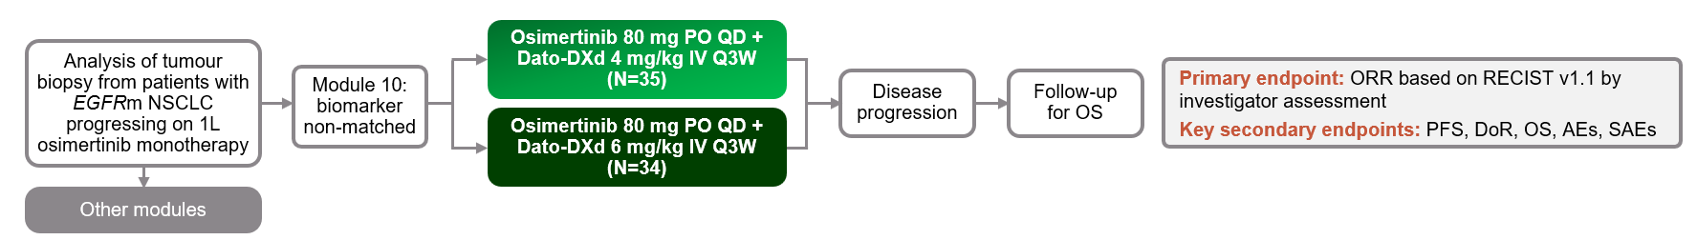
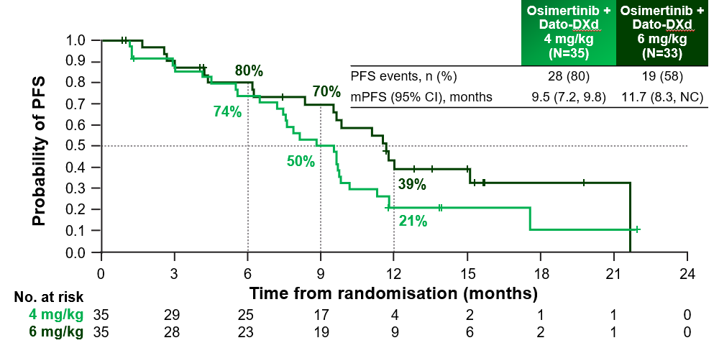
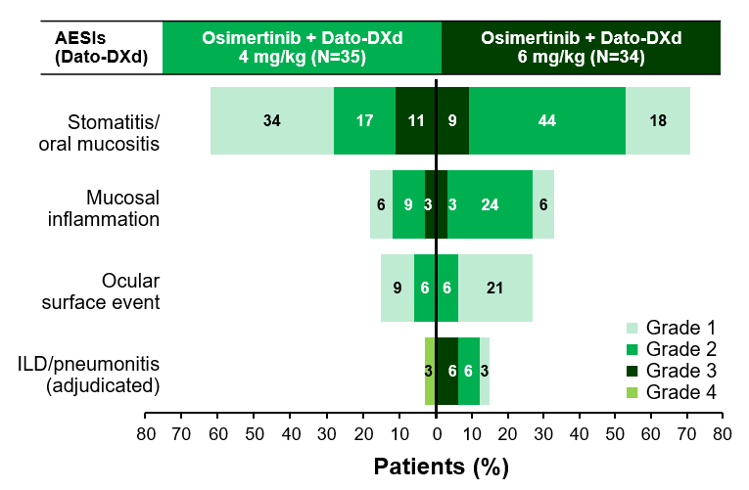
Dato-DXd combinations in POST-OSIMERTINIB EGFR-MUTANT NSCLC
Orchard: module 10 study design and results
Progression-free survival
Safety Summary
1L, first-line; ADC, antibody-drug conjugate; AE, adverse event; AESI, adverse event of special interest; CI, confidence interval; Dato‑DXd, datopotamab deruxtecan; DoR, duration of response; EGFRm, EGFR mutation; ILD, interstitial lung disease; IV, intravenous; NC, not calculable; NSCLC, non-small cell lung cancer; (m)PFS, (median) progression-free survival; ORR, objective response rate; OS, overall survival; PO, orally; Q3W, every 3 weeks; QD, once daily; RECIST v1.1, Response Evaluation Criteria in Solid Tumours version 1.1; SAE, serious AE
Le X, et al. J Thorac Oncol. 2025;20(3):S2-S4. ELCC 2025 (oral presentation, Abstr 1O)

Slide 42
Dato-DXd in POST-OSIMERTINIB EGFR-MUTANT NSCLC
TROPION-Lung15: Phase 3, ongoing trial
Key eligibility criteria:
Aged ≥ 18 years
ECOG or WHO PS score 0 or 1
Histologically or cytologically confirmed NSQ, locally advanced or metastatic
Documented EGFR-TKI sensitive mutations
≤ 2 prior lines of EGFR-TKIs
Radiological progression on prior osimertinib monotherapy
Dato-DXd
(6 mg/kg IV, Q3W)
Dual primary endpoints:
PFS by BICR Dato-DXd vs Pt-CT Dato-DXd + Osi vs Pt-CT
Key secondary endpoints:
OS
CNS-PFS by BICR
Safety
R 1:1:1
Dato-DXd
(6 mg/kg IV, Q3W) + Osi
N=630
Platinum-based chemotherapy
Stratification:
Brain metastases baseline (yes vs no)
Prior Osi: adjuvant vs post-CRT/1L vs 2L
Race: Chinese Asian vs non-Chinese Asian vs non-Asian
NCT06417814
1L/2L, first/second-line; BICR, blinded independent central review; CNS, central nervous system; CRT, chemoradiotherapy; Dato-DXd, datopotamab deruxtecan; ECOG, Eastern Cooperative Oncology Group; IV, intravenous; NSCLC, non-small cell lung cancer; NSQ, non-squamous; OS, overall survival; Osi, osimertinib; PFS, progression-free survival; PS, performance status; Pt-CT, platinum-based chemotherapy; Q3W, every 3 weeks; R, randomisation; Sac-TMT, sacituzumab tirumotecan; TKI, tyrosine kinase inhibitors; WHO, World Health Organization
Nadal E, et al. J Thorac Oncol. 2025;20 (3, supplement 1):S87-S88 (ELCC 2025, Poster 124TiP); Tan DS, et al. Ther Adv Med Oncol. 2025;17: doi: 10.1177/17588359251385410

Slide 43
Sac-TMT in EGFR-MUTANT NSCLC POST-EGFR TKI AND Pt-CT
Optitrop-lung03: study design
Open-label, randomised, multicentre, registrational trial (NCT05631262)
Key eligibility criteria:
ECOG PS score 0 or 1
Nsq-NSCLC (stage IIIB/IIIC ineligible for surgery or radical radiotherapy or stage IV)
EGFR-sensitising mutations, including Ex19del and L858R
Progression after prior combination or sequential treatment with EGFR-TKIs and platinum-based chemotherapy
Stratification factors:
Brain metastases (present vs absent)
Sac-TMT
5 mg/kg IV, Q2W
Treatment until disease progression, intolerable toxicity, or any other reason for discontinuation
Primary endpoint:
ORR assessed by BIRC (RECIST 1.1)
Secondary endpoints:
PFS
OS
ORR assessed by investigator
DoR, DCR, TTR
Safety
R 2:1
Docetaxel 75 mg/m² IV, Q3W
After PD verified by BIRC, patients could be permitted to cross over to receive Sac‑TMT
ADC, antibody-drug conjugate; BIRC, blinded independent review committee; DCR, disease control rate; DoR, duration of response; ECOG PS, European Cooperative Oncology Group performance status; Ex19del, exon 19 deletion; IV, intravenous; (Nsq-)NSCLC, nonsquamous non-small cell lung cancer; ORR, objective response rate; OS, overall survival; PD, progressive disease; Pt-CT, platinum chemotherapy; PFS, progression-free survival; Q2/3W, every 2 or 3 weeks; R, randomisation; RECIST, Response Evaluation Criteria in Solid Tumours; Sac-TMT, sacituzumab tirumotecan; TKI, tyrosine kinase inhibitor; TTR, time to response
Zhang L, et al. J Clin Oncol 2025;43(suppl 16). Abstr 8507 (ASCO 2025, oral presentation)

Slide 44
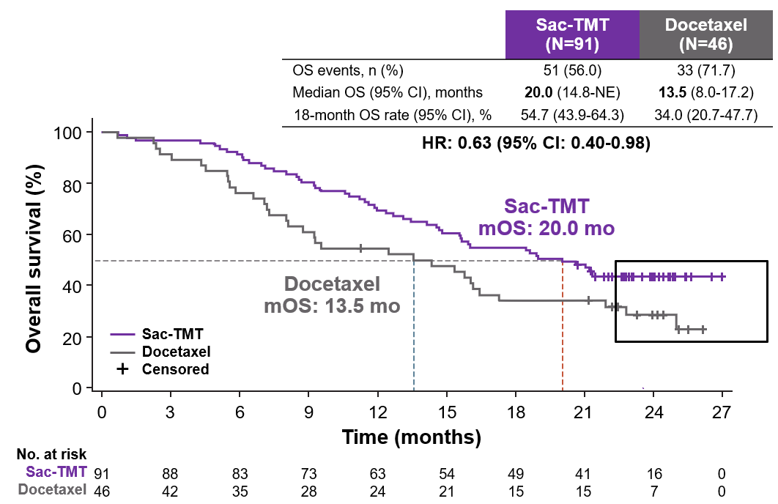
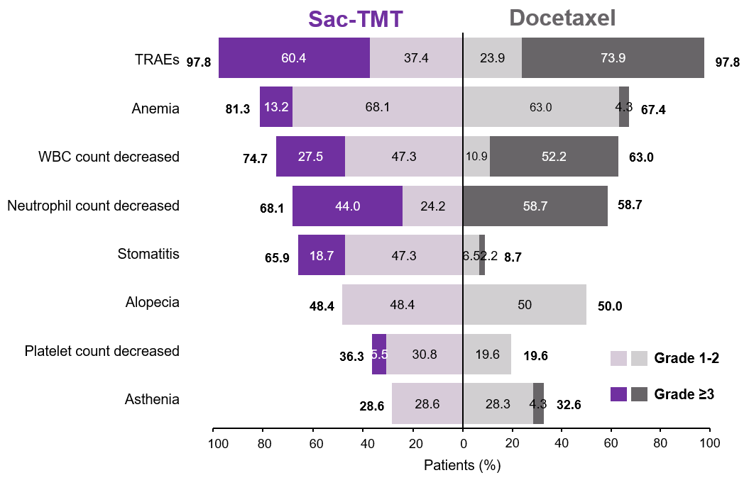
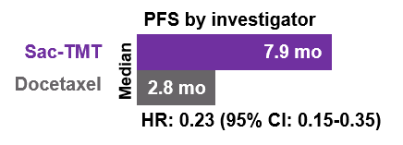
Optitrop-lung03: Sac-TMT in EGFR-MUTANT NSCLC POST-EGFR TKI AND Pt-CT
Efficacy
Any grade TRAEs with incidence ≥30%
The most common TRAEs for both Sac-TMT and docetaxel were hematologic toxicities
Febrile neutropenia: none in the Sac-TMT group and 19.6% of patients in the docetaxel group
ILD/pneumonitis were reported as 2.2% in both groups
No TRAEs led to treatment discontinuation or death in the Sac-TMT group
Data cut-off: 11 December 2025 (23.8 months follow-up)
CI, confidence interval; HR, hazard ratio; ILD, interstitial lung disease; mo, months; NE, not estimable; NSCLC, non-small cell lung cancer; (m)OS, (median) overall survival; PFS, progression-free survival; Pt‑CT, platinum-based chemotherapy; Sac-TMT, sacituzumab tirumotecan; TKI, tyrosine kinase inhibitor; TRAE, treatment-related adverse event; WBC, white blood cell
Yang Y, et al. Abstract LBA4, ELCC 2026 (oral presentation)

Slide 45
Sac-TMT in EGFR-MUTANT NSCLC POST-EGFR TKI
Optitrop-lung04: study design
Open-label, randomised, multicentre, phase 3 trial (NCT05870319)
Key eligibility criteria:
ECOG PS score 0 or 1
Nsq-NSCLC (stage IIIB/IIIC or stage IV)
EGFR-sensitive mutations
Progression after 3rd gen TKI therapy or progression after 1st or 2nd gen TKIs with negative T790M
Stratification factors:
Prior EGFR-TKI therapy (3rd gen TKI in 1st line vs in 2nd line vs no 3rd gen TKI)
Brain metastases (yes vs no)
Sac-TMT
5 mg/kg IV, Q2W
Primary endpoint:
PFS assessed by BIRC (RECIST 1.1)
Secondary endpoints:
OS (key secondary endpoint)
PFS (assessed by investigator)
ORR, DoR, DCR, etc.
Safety
Treatment until disease progression, intolerable toxicity, or any other reason for discontinuation
R 1:1
Pemetrexed 500 mg/m² + carboplatin AUC 5, or Cisplatin 75 mg/m² Q3W for up to 4 cycles
Pemetrexed 500 mg/m² maintenance, Q3W
ADC, antibody-drug conjugate; AUC, area under the curve; BIRC, blinded independent review committee; DCR, disease control rate; DoR, duration of response; ECOG PS, European Cooperative Oncology Group performance status; gen, generation; IV, intravenous; (Nsq-)NSCLC, nonsquamous non-small cell lung cancer; ORR, objective response rate; OS, overall survival; PFS, progression-free survival; RECIST, Response Evaluation Criteria in Solid Tumours; Q2/3W, every 2 or 3 weeks; R, randomisation; Sac‑TMT, sacituzumab tirumotecan; TKI, tyrosine kinase inhibitor
Zhang L, et al. Ann Oncol. 2025;36, S1613-S1614 (LBA5, ESMO 2025, oral presentation); Fang W, et al. N Engl J Med 2026;394:13-26

Slide 46
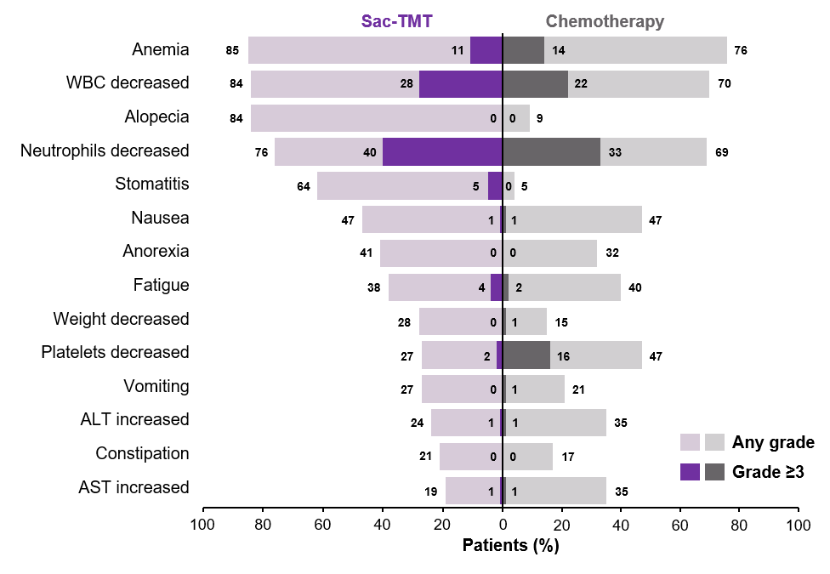
Optitrop-lung04: Sac-TMT in EGFR-MUTANT NSCLC POST-EGFR TKI
Efficacy
Any grade TRAEs with incidence ≥20%
 | Sac-TMT (n=188) | CT (n=188)
Median PFSª (95% CI), months | 8.3 (6.7-9.9) | 4.3 (4.2-5.5)
HR (95% CI) p value | 0.49 (0.39-0.62) <0.0001
12-month PFS rate (95% CI), %, | 32.3 (25.5-39.2) | 7.9 (4.4-12.8)
Median OS (95% CI), months | NR (21.5-NE) | 17.4 (15.7-20.4)
HR (95% CI) p value | 0.60 (0.44-0.82) 0.001^{b}
ORRª (95% CI), % | 60.6 (53.3-67.7) | 43.1 (35.9-50.5)
Median DoRª (95% CI), months | 8.3 (6.2-10.0) | 4.2 (3.0-4.4)
DCRª (95% CI), % | 87.2 (81.6-91.6) | 80.3 (73.9-85.7)
A consistent OS and PFS and benefit of Sac-TMT over chemotherapy was observed across all predefined subgroups
No drug-related ILD/ pneumonitis occurred in either arm
Ocular surface toxicity occurred in 9.6% of patients in the Sac-TMT group (all grade 1 or 2)
Data cutoff: July 11, 2024, for PFS IA and July 6, 2025 for safety analysis/preplanned IA of OS and final PFS analysis
ª By BIRC; ^{b} Two-sided p-value by stratified log-rank test, based on pre-specified OS IA, 2-sided P value was less than the pre-specified efficacy boundary to achieve statistically significant improvement ALT, alanine aminotransferase; AST, aspartate aminotransferase; BICR, blinded independent central review; CI, confidence interval; CT, chemotherapy; DCR, disease control rate; DoR, duration of response; HR, hazard ratio; ; IA, interim analysis; ILD, interstitial lung disease; NE, not estimable; NSCLC, non-small cell lung cancer; ORR, overall response rate; OS, overall survival; PFS, progression-free survival; Sac-TMT, sacituzumab tirumotecan; TRAE, treatment related adverse event; WBC, white blood cell
Zhang L, et al. Ann Oncol. 2025;36, S1613-S1614 (LBA5, ESMO 2025, oral presentation); Fang W, et al. N Engl J Med 2026;394:13-26

Slide 47
Sac-tmt ongoing global phase 3 trials in pre-treated egfr-mutant nsclc
TroFuse-004 (NCT06074588)¹
TroFuse-009 (NCT06305754)²
Study population:
Age ≥18 years
Histologically/cytologically documented advancedª or metastatic nonsquamous NSCLC
Presence of ex19del or exon 21 L858R EGFRm or other genomic alterations^{b}
Documented disease progression following 1 or 2 prior lines of TKIs plus 1 platinum-based chemotherapy ± anti–PD-(L)1
Measurable disease per RECIST version 1.1
Study population:
Age ≥18 years
Histologically/cytologically documented stage III (not eligible for surgical resection or curative chemoradiation) or stage IV non-squamous NSCLC
Presence of exon 19del, L858R, G719X, S7681, or L861Q
Documented disease progression on prior EGFR TKI
Measurable disease per RECIST version 1.1
Arm A
R 1:1
Arm B
R 1:1
Sac-TMT 4 mg/kg
IV Q2W (days 1, 15, and 29 of each 6-wk cycle)
N=556
Docetaxel 75 mg/m² or pemetrexed 500 mg/m² IV Q3W (days 1 and 22 of each 6-wk cycle
Sac-TMT
4 mg/kg IV, Q2W
Pt-CT
N=520
Primary endpoints:
PFS by BICR
OS (in patients with EGFRm)
Secondary endpoints:
PFS, OS, ORR, DOR, PROs ,Safety
Primary endpoints:
PFS by BICR
OS
Secondary endpoints:
ORR • PROs
DoR • Safety
Stratification factors:
EGFRm prior treatment (EGFRm with third-generation TKI vs EGFRm without third-generation TKI vs other genomic alterations)
Brain metastasis (yes vs no)
TROP2 expression (low vs medium vs high)
Stratification factors:
Brain metastases baseline (yes vs no)
EGFR TKI 1L: 3rd gen vs 1st/2nd gen, including 3rd gen in 2L
TROP2 expression: no or low vs medium vs high
ª Stage III disease not eligible for resection or curative radiation;
^{b} Including alterations in ALK, ROS1, BRAF V600E, NTRK, MET exon 14 skipping, or RET and less common EGFR mutations (exon 20 S768I, exon 21 L861Q, and/or exon 18 G719X)
1L/2L, first/second-line; BICR, blinded independent central review; DoR, duration of response; ex19del, exon 19 deletion; gen, generation; IV, intravenous; NSCLC, non-small cell lung cancer; ORR, objective response rate; OS, overall survival; PFS, progression-free survival; PROs, patient reported outcomes; Pt-CT, platinum-chemotherapy; Q2/3W, every 2 or 3 weeks; R, randomisation; RECIST, Response Evaluation Criteria in Solid Tumours; Sac-TMT, sacituzumab tirumotecan; TKI, tyrosine kinase inhibitors;
1. Garon EB, et al. J Thorac Oncol. 2024;19 (10, supplement):S245-S246) (WCLC 2024, Abstract P2.10A.06; 2. Leighl NB, et al. J Thorac Oncol. 2024;19(10, supplement): S246-S247 (WCLC 2024, Abstract P2.10A.07)

Slide 48
Dato-DXd as 1L treatment in EGFR-MUTANT NSCLC
TROPION-Lung 14: Phase 3, ongoing trial
Key eligibility:
EGFR mutation (ex19del or L858R)
Locally advanced/ metastatic nonsquamous NSCLC
No prior therapy for advanced disease
Primary endpoint:
PFS by BICR
Key secondary endpoints: OS, ORR, DoR, Safety, PK and Immunogenicity etc.
Osimertinib 80 mg QD + Dato-DXd 6 mg/kg Q3W
R 1:1
Osimertinib 80 mg QD
N=582
NCT06350097
1L, first-line; BICR, blinded independent central review; Dato-DXd, datopotamab deruxtecan; DoR, duration of response; ex19del, exon 19 deletion; gen, generation; IV, intravenous; NSCLC, non-small cell lung cancer; ORR, objective response rate; OS, overall survival; PFS, progression-free survival; PK, pharmacokinetics; Q3W, every 3 weeks; QD, once daily; R, randomisation
Lu S, et al. J Clin Oncol 2025; 43: TPS8647

Slide 49
Future landscape & strategic implications
Will ADC + IO replace IO monotherapy in PD-L1 ≥50%?
Triplet intensification vs biomarker selection strategies
Potential need for TROP2 expression stratification
Impact on second-line ADC positioning
Competitive pressure from bispecifics and next-generation ADCs
Will OS improvement justify toxicity?
ADC, antibody-drug conjugate; IO, immunotherapy; PD-L1, programmed death ligand 1

Slide 50
Optimising the treatment experience: proactive AE monitoring & management
Dr Jacob Sands Dana-Farber Cancer Institute, US
Mrs Stephanie McDonald Dana-Farber Cancer Institute, US

Slide 51
Safety considerations for adcs
AEs can be on- or off-target and are influenced by:
Tumour-associated antigen and its expression pattern
Payload type and pharmacokinetics
Conjugation chemistry Stable conjugation decreases risk of off-target effects
Linker cleavage Premature payload release can cause off-target effects
DAR Optimised for ideal ADC risk-benefit balance
Safety considerations
Toxicities relate to payload class and linker behaviour:^{2,3}
Myelosuppression (e.g., neutropenia)
GI toxicity (e.g., diarrhea)
Mucositis/stomatitis and ocular surface events⁴
Interstitial lung disease/pneumonitis
ADC, antibody-drug conjugate; GI, gastrointestinal; NSCLC, non-small cell lung cancer
1. Nguyen TD, et al. Cancers (Basel). 2023;15:713; 2. Ballestin P, et al. Pharmaceutics. 2025;17:258; 3. Lisberg A, et al. Oncologist. 2025;30:oyaf225; 4. Meric-Bernstam F, et al. Oncologist. 2025;30:oyaf031

Slide 52
Oral mucositis/stomatitis

Slide 53
Stomatitis events across trop2-adcs in nsclcª
 | Grade | EVOKE-01¹ SG (N=296) n (%) | TROPION-Lung01² Dato-DXd (N=297) n (%) | OptiTROP-Lung03³ Sac-TMT (N=91) n (%)
 | Any grade | 13.2 | 47.5 | 65.9
 | Grade ≥ 3 | 1.0 | 6.7 | 18.7
Stomatitis
Stomatitis/oral mucositis often occurs earlier during the course of ADC therapy but can occur at anytime throughout treatment
It is usually grade 1-2 and can usually be managed with dose reduction/delay
Prevention is key!
ªEvents are treatment emergent for the EVOKE-01 study and treatment-related for TROPION-Lung01 and OptiTROP-Lung03
ADC, antibody drug conjugate; Dato-Dxd, datopotamab deruxtecan; NSCLC, non-small cell lung cancer; Sac‑TMT, sacituzumab tirumotecan; SG, sacituzumab govitecan
1. Paz-Ares L, et al. J Clin Oncol. 2024;42,2860-72; 2. Ahn MJ, et al. J Clin Oncol. 2025;43(3):260-72; 3. Fang WF, et al. ESMO Open. 2026;11(Suppl 3):106960 (presented at ELCC 2026, LBA4)

Slide 54
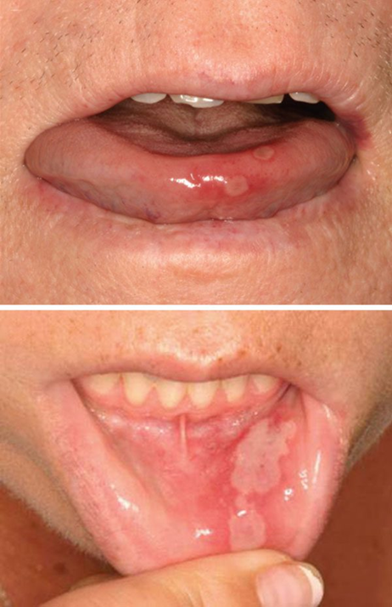
Recognising Mucositis/Stomatitis
Signs and symptoms of Mucositis/Stomatitis
Potential questions for patients to monitor for mucositis/ stomatitis
Symptoms include:
Does your mouth feel dry or swollen?
Is it hard to eat due to pain, bleeding, or burning sensations?
Are there any changes in your eating habits?
Are you having trouble swallowing or talking?
Ulceration
White discoloration in mouth
Mouth and throat pain
Thickening of the saliva
Dry mouth
Bleeding of the oral mucosa
Red, shiny, swollen mouth/ gums
Trouble swallowing, talking, or eating
Mucositis/Stomatitis risk factors
Age (youngest and oldest patients more at risk)
Pre-existing systemic conditions (e.g. autoimmune disease)
Poor oral health
Diet
History of smoking
Prior treatment with chemotherapy or ICI agents
Bell A, Kasi A. Oral Mucositis. [Updated 2023 May 29]. In: StatPearls [Internet]. Treasure Island (FL): StatPearls Publishing; 2026 Jan-. Available from: https://www.ncbi.nlm.nih.gov/books/NBK565848/; Gupta A and West HJ. JAMA Oncol. 2016;2:1379; Cleveland Clinic. Mucositis. Available here (accessed March 27, 2026); Meric-Bernstam F, et al. Oncologist. 2025;30:oyaf031

Slide 55
Stomatitis/Mucositis Prophylaxis
Good oral hygiene
Prophylaxis
Nutritional support
Routine actions to prevent infections and provide oral comfort¹
Avoidance of:¹
Oral cryotherapy¹
Ice chips or ice water held in the mouth throughout the infusion
Smoking
Alcohol
Hot drinks
Gentle brushing of teeth after meals and at bedtime using a soft toothbrush and a bland fluoride-containing toothpaste
===
Acidic, spicy, hot, or raw food
Daily use of a corticosteroid-containing mouthwash,^{2,4}
e.g., dexamethasone oral solution
Oral or topical antifungal may be used after the steroid-containing mouthwash^{2,4}
Topical analgesic for pain management^{2,4}
Daily flossing, unless it causes pain or bleeding¹
Drink ample amounts of fluids^{1,2} (~2L or ≥64 oz/day)
Bland rinse^{1,2}
Saline or sodium bicarbonate mouthwash
Monitoring for Stomatitis/Mucositis
Regular oral exams by oncology care team to detect mucositis early^{1,3}
Oral sensitivity, inflammation and tenderness of the oral mucosa can occur without the appearance of sores¹
Hydration and lubrication¹ of oral surfaces
Oral moisturisers
Lip lubrication (petrolatum, lip balm, or lip cream)
1. Lisberg A, et al. Oncologist. 2025;30:oyaf225; 2. Meric-Bernstam F, et al. Oncologist. 2025;30:oyaf031; 3. Lightfoot MDS, et al. Int J Gynecol Cancer. 2025;35:101997; 4. Villa A, et al. Support Care Cancer 2024; 549: https://doi.org/10.1007/s00520-024-08689-8

Slide 56

PATIENT CASE
Patient Profile
65-year-old male, no smoking history
ECOG PS 0
Biopsy → lung adenocarcinoma
PET CT showed liver and bone mets; MRI of brain showed no mets
Biomarker testing: EGFR exon 19 deletion
Treatment
Initiated 1L FLAURA2 osi and chemo (carboplatin + pemetrexed), progressed after 20 months
Switched treatment to Dato-DXd 6 mg/kg Q3W IV
At C2, patient experienced 4 days of painful (Grade 2) mucositis symptoms
Able to tolerate soft solids, and weight is stable
Educational case study
1L, first-line; C2, cycle 2; Dato-DXd, datopotamab deruxtecan; ECOG PS, Eastern Cooperative Oncology Group performance status; IV, intravenous; mets, metastases; MRI, magnetic resonance imaging; osi, osimertinib; PET CT, positron emission tomography/computed tomography; Q3W, every 3 weeks

Slide 57
Polling question
UPON EXAMINATION, The Patient receiving Dato-DXd HAS SOME EVIDENCE OF MUCOSITIS BUT NO SYMPTOMS, Consistent with grade 1 mucositis. What is the best next step?
A. Hold treatment and start steroid mouth wash
B. Start antibiotics
C. Continue treatment, initiate intensive oral care (including steroid mouthwash, oral hygiene, cryotherapy)
D. Permanently discontinue Dato-DXd

Slide 58
Stomatitis/oral mucositis with Dato-DXd
Patients with treatment-emergent stomatitis/ oral mucositis (N=117)
Median time to onset:^{b} 29 days
Absent or clinically asymptomatic/mild:
Monitor/continue prophylaxis
Median time to asymptomatic resolution:^{c} 50 days
Patients (%)
Stomatitis/oral mucositis often occurs earlier during the course of Dato-DXd therapy but can occur at anytime throughout treatment
Majority of cases are grade 1, asymptomatic and no intervention is required
Grade 2 and above requires intervention/dose management
Prevention is key!
Clinically symptomatic:
Requires intervention
Impact on dosingª (N=117)
Patients (%)
ª For Gr 2 events, dose reductions or delays considered if clinically indicated; ^{b} Of Gr ≥2events; ^{c} Of first Gr ≥2 stomatitis event from clinically symptomatic to asymptomatic (Gr 1 or resolved); ^{d} 32 of 39 events. Gr, grade
1. Ahn M, et al, et al. Ann Oncol. 2024;35(Suppl):S1630–S1631 (presented at ESMO Asia Congress 2024, LBA7); 2. Lisberg A, et al. Oncologist. 2025;30:oyaf225

Slide 59
Stomatitis/Mucositis Management
Supportive Care during Dato-DXd treatment
Increase the frequency of bland mouth rinses up to every hour, if necessary and applicable¹
Provide adequate pain management (e.g. lidocaine-based mouthwash, topical clobetasol gel)¹
As soon as oral pain, inflammation, and/or ulceration develops, strongly consider steroid-containing mouth rinses (e.g. dexamethasone 0.1 mg/mL, 10 mL 4 times daily, swish for 1–2 minutes, then spit out, or local alternative)^{1,2}
May consider oral nystatin suspension or other topical antifungal ≥15 minutes after the steroid-containing mouthwash, according to clinician preference based on institutional/local guidelines²
Consider cryotherapy (ice chips or ice water held in the mouth) throughout the infusion²
For severe and/or persistent events, consider referral to a dentist, oral surgeon, oral medicine expert or dermatologist²
Dato-Dxd, datopotamab deruxtecan
1. Lisberg A, et al. Oncologist. 2025;30:oyaf225; 2. Meric-Bernstam F, et al. Oncologist. 2025;30:oyaf031

Slide 60
Stomatitis/Mucositis Management
Dose Modifications with Dato-DXd
Grade 1
Asymptomatic or mild symptoms
Grade 2
Moderate pain or ulcer that does not interfere with oral intake
Grade 3
Severe pain; interfering with oral intake
Grade 4
Life threatening consequences; urgent intervention indicated
Maintain dose
If prophylactic and supportive medications have not yet been optimised, delay dose until resolved to grade ≤1 or baseline, optimise medications, and then maintain dose
Discontinue patient from study treatment
Optimise prophylactic and supportive medications
Optimise prophylactic and supportive medications
Consider a dose delay or reduction if clinically indicated
If prophylactic and supportive medications have already been optimised, delay dose until resolved to grade ≤1 or baseline, then reduce dose by 1 level
Dato-DXd, datopotamab deruxtecan
Lisberg A, et al. Oncologist. 2025;30:oyaf225; Meric-Bernstam F, et al. Oncologist. 2025;30:oyaf031; NCI CTCAE, National Cancer Institute Common Terminology Criteria for Adverse Events v6.0

Slide 61
Ocular surface events

Slide 62
Ocular surface events across trop2-adcs in nsclcª
 | Grade | EVOKE-01¹ SG (N=296) n (%) | TROPION-Lung01² Dato-DXd (N=297) n (%) | OptiTROP-Lung03³ Sac-TMT (N=91) n (%)
 | Any grade | NR | 21.5 | NR
 | Grade ≥ 3 | NR | 9.3 | NR
Ocular surface events
ADCs are associated with various ocular AEs: keratitis, blurred vision, cataract, conjunctivitis, dry eye, photophobia
Most ADC-associated ocular AEs are reversible with dose delay or dose reduction
Management of ocular AEs requires a multidisciplinary approach to minimise treatment discontinuation and optimise clinical outcomes
ªEvents are treatment emergent for the EVOKE-01 study and treatment-related for TROPION-Lung01 and OptiTROP-Lung03
ADC, antibody drug conjugate; AE, adverse event; Dato-DXd, datopotamab deruxtecan; NR, not reported; NSCLC, non-small cell lung cancer; Sac‑TMT, sacituzumab tirumotecan; SG, sacituzumab govitecan
1. Paz-Ares L, et al. J Clin Oncol. 2024;42,2860-72; 2. Ahn MJ, et al. J Clin Oncol. 2025;43(3):260-72 (supplementary appendix); 3. Fang WF, et al. ESMO Open. 2026;11(Suppl 3):106960 (presented at ELCC 2026, LBA4)

Slide 63
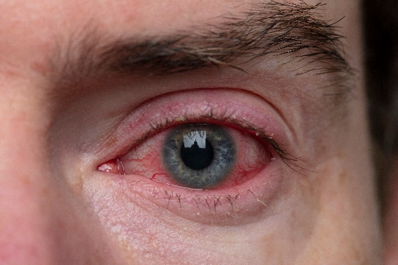
Recognising Ocular Surface Events (OSE)
Signs and symptoms of OSE
Potential questions for patients to help identify OSE
Symptoms include:
Have you noticed your eyes watering more than usual?
Are you experiencing any pain or discomfort in or around your eyes?
Have you had any problems with your vision, such as blurriness, seeing double, or difficulty focusing recently?
Does it feel like there is something in your eye, such as a grain of sand or an eyelash, even though nothing is there?
Do you find your eyes are unusually sensitive to light, or do bright lights make your eyes feel uncomfortable?
Have you noticed any redness in your eyes that is not related to tiredness or allergy?
Are your eyes feeling dry, scratchy, or gritty, especially during the day or when you wake up?
(Additional) Do you have any new eye symptoms, or worsening of existing symptoms, since your last visit?
Increased lacrimation
Red eye
Ocular pain
Visual disturbances (decreased or blurred vision)
Foreign body sensation
Dry eyes
Photophobia
Baseline and ongoing ophthalmic assessment must be performed by a licensed eye care provider (e.g., ophthalmologist or optometrist)
Refer to a licensed eye care provider (e.g., ophthalmologist or optometrist), if any symptoms warrant ophthalmological assessment: for any grade ≥2 OSEs (consider referral for grade 1 OSEs)
Notify prescribing oncologist:
If there are any contraindications to prescribing ADC (e.g., if the patient presents with clinically significant corneal disease)
If eye condition is suspected due to any new or worsening signs and symptoms
For any grade ≥1 OSEs
ADC, antibody-drug conjugate
Dy GK, et al. Oncologist. 2024;29:e1435-e1451; Lindgren ES, et al. Curr Ophthalmol Rep. 2024;12:13-22; Lisberg A, et al. Oncologist. 2025;30:oyaf225

Slide 64
PATIENT CASE
Patient Profile
64-year-old female, no smoking history, hypertension, seasonal allergies
ECOG PS 0
Biopsy → lung adenocarcinoma
PET CT showed lung, bone and adrenal metastasis
Biomarker testing; EGFR exon 19 deletion
Treatment
Initiated 1L carboplatin + pemetrexed, progressed after 8 months
Switched treatment to Dato-DXd 6 mg/kg Q3W IV on clinical trial
At C4, patient experienced gritty sensation both eyes, mild burning and tearing, no loss of vision or eye pain
Educational case study
1L, first-line; C4, cycle 4; Dato-DXd, datopotamab deruxtecan; ECOG PS, Eastern Cooperative Oncology Group performance status; IV, intravenous; PET CT, positron emission tomography/computed tomography; Q3W, every 3 weeks

Slide 65
Polling question
Patient receiving Dato-DXd reports gritty sensation, mild burning, tearing in both eyes without vision loss or eye pain. What is the most appropriate initial management?
A. Continue treatment without intervention and re-assess at the next cycle
B. Optimise supportive care with preservative-free lubricating eye drops and refer to eye care provider
C. Start topical antibiotic eye drops and hold treatment
D. Permanently discontinue Dato-DXd

Slide 66
Ocular Surface Events - Prophylaxis and Monitoring
PROPHYLAXIS
It should be strongly recommended that subjects/participants avoid the use of contact lenses starting on the day of the first Dato-DXd dose and to use artificial tears (preferably preservative-free) 4 times/day as a preventative measure and up to 8 times/day if clinically needed¹
MONITOR
Refer patients to an eye care professional (optometrist or ophthalmologist) for an ophthalmic exam prior to treatment initiation, annually while on treatment, at end of treatment, and as clinically indicated^{1,2} Including visual acuity testing, intraocular pressure, fundoscopy, slit lamp exam with fluorescein staining² Monitor patients for ocular adverse reactions during treatment (i.e. redness, pain, teary eyes, blurred vision). If present, promptly refer patients to an eye care professional² Eye care professional to provide an objective assessment for the prescribing oncologist:³ so that they may decide if the next dose of the ADC can be given as scheduled, delayed, reduced, or discontinued
ADC, antibody drug conjugate; Dato-DXd, datopotamab deruxtecan; OSE, ocular surface events
1. Heist RS, et al. Cancer Treat Rev. 2024;125:102720; 2. Lisberg A, et al. Oncologist. 2025;30:oyaf225; 3. Berkenstock MK, et al. https://www.aao.org/education/clinical-statement/antibody-drug-conjugates-ocular-toxicities-call-st (Accessed 17-April-2026)

Slide 67
Ocular surface adverse events/keratitis Management
With Dato-DXd Treatment
Grade 1
Asymptomatic; clinical or diagnostic observations only; intervention not indicated
Grade 2
Symptomatic; moderate decrease in visual acuity (best corrected visual acuity 20/40 and better or ≤3 lines decreased vision from known baseline)
Grade 3
Symptomatic with marked decrease in visual acuity (best corrected visual acuity worse than 20/40 or >3 lines of decreased vision from known baseline, up to 20/200); corneal ulcer; limiting self-care activities of daily living
Grade 4
Perforation; best corrected visual acuity of 20/200 or worse in the affected eye
Consider obtaining an ophthalmological assessment
Obtain an urgent
ophthalmological assessment
Obtain an ophthalmological assessment
Obtain an ophthalmological assessment
Ensure use of artificial tears daily (or increase frequency to 8 times daily)
Delay dose until resolved to grade ≤1, then maintain dose
Delay dose until resolved to grade ≤1, then reduce dose by 1 level
Discontinue Dato-DXd treatment
Dato-DXd, datopotamab deruxtecan
Lisberg A, et al. Oncologist. 2025;30:oyaf225; NCI CTCAE, National Cancer Institute Common Terminology Criteria for Adverse Events v6.0

Slide 68
Interstitial lung disease

Slide 69
ILD/pneumonitis events across trop2-adcs in nsclcª
 | Grade | EVOKE-01¹ SG (N=296) n (%) | TROPION-Lung01^{2,b} Dato-DXd (N=297) n (%) | OptiTROP-Lung03³ Sac-TMT (N=91) n (%)
 | Any grade | NR | 8.8 | 2.2
 | Grade ≥ 3 | NR | 3.7 | NR
Adjudicated drug-related ILD/
pneumonitis
Diagnosing ILD early and initiating prompt treatment is critical to assure patient safety
Multidisciplinary management of ILD is important!
Pulmonologists are key members of the MDT once ILD is suspected
Nurses and APPs play a critical role in counseling patients on early identification, closely monitoring patient symptoms
ªEvents are treatment emergent for the EVOKE-01 study and treatment-related for TROPION-Lung01 and OptiTROP-Lung03; ^{b}Among the 26 patients (8.8%) in the Dato-DXd group who had adjudicated drug-related ILD or pneumonitis, two (0.7%) had grade 1 events, 13 (4.4%) had grade 2 events, three (1.0%) had grade 3 events, one (0.3%) had a grade 4 event, and seven (2.4%) had grade 5 events
ADC, antibody drug conjugate; APP, advanced practice provider; Dato-DXd, datopotamab deruxtecan; ILD, interstitial lung disease; MDT, multidisciplinary team; NR, not reported; NSCLC, non-small cell lung cancer; Sac‑TMT, sacituzumab tirumotecan; SG, sacituzumab govitecan
1. Paz-Ares L, et al. J Clin Oncol. 2024;42,2860-72; 2. Ahn MJ, et al. J Clin Oncol. 2025;43(3):260-72; 3. Fang WF, et al. ESMO Open. 2026;11(Suppl 3):106960 (presented at ELCC 2026, Abstract LBA4)

Slide 70
Recognising Interstitial Lung Disease (ILD)
Signs and symptoms of ILD
Potential questions for patients to assess for ILD
Symptoms include:
Have you been coughing recently?
Is it a dry cough?
Have you had any shortness of breath, especially during or after physical activity?
Have you experienced any new breathing or respiratory problems?
If you already have respiratory problems, have they gotten worse?
Have you had a fever?
Have you been feeling tired?
Have you lost weight?
Cough (often dry)
Fever
Asthenia (weakness)
Fatigue
Chest pain or tightness
Dyspnea (shortness of breath)
ILD risk factors
Patient has a history of non-infectious ILD/pneumonitis, including radiation pneumonitis, that required steroids, has current ILD/pneumonitis, or has suspected ILD/pneumonitis that cannot be ruled out by imaging at screening
Patient has severe pulmonary function compromise
Previous thoracic radiotherapy or chemotherapy
Lisberg A, et al. Oncologist. 2025;30:oyaf225; Shi J, et al. Ther Adv Respir Dis. 2024:18:1-15; Swain SM, et al. Cancer Treat Rev. 2022;106:102378; Johkoh T, et al. Clin. Lung Cancer. 2014;15(6):448-54; Sato Y, et al. Chest. 2022;162(5):1188-98; Shibaki R, et al. Cancer Med. 2022;11(20):3743-50; Chen X, et al. Support. Care Cancer. 2022;30(8):6515-24

Slide 71
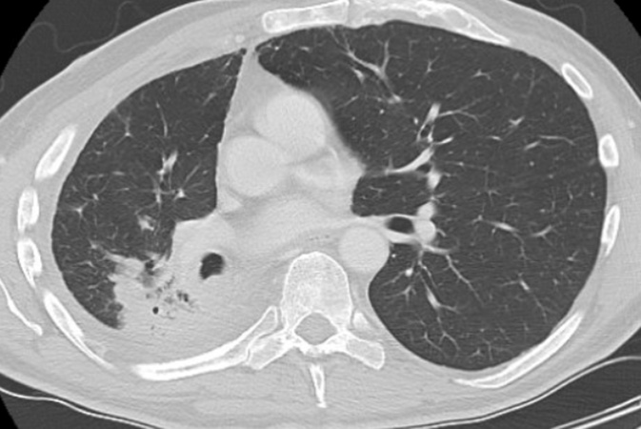
Clinical evaluations: interstitial lung disease (ILD)
Evaluations
Evaluations include:
65-year-old man with metastatic adenocarcinoma initially treated with carboplatin, pemetrexed, and pembrolizumab started 2nd line treatment on Dato-DXd (on clinical trial). Baseline scan:
High-resolution CT
Pulmonologist consultation
Bronchoscopy and BAL if indicated and feasible
Infectious disease consultation if indicated
Clinical Laboratory tests
Pulmonary function tests (FVC and CO and SpO2)
Differential diagnosis
Infection
Progression of underlying disease
Pulmonary Effusion
Pericardial Effusion
COPD flare
Other pulmonary disorder of unknown origin
Image provided by Jacob Sands, MD
BAL, bronchoalveolar lavage; CO, carbon monoxide; COPD, chronic obstructive pulmonary disease; CT, computed tomography; Dato-DXd, datopotamab deruxtecan; FVC, forced vital capacity; Sp02, peripheral capillary oxygen saturation

Slide 72
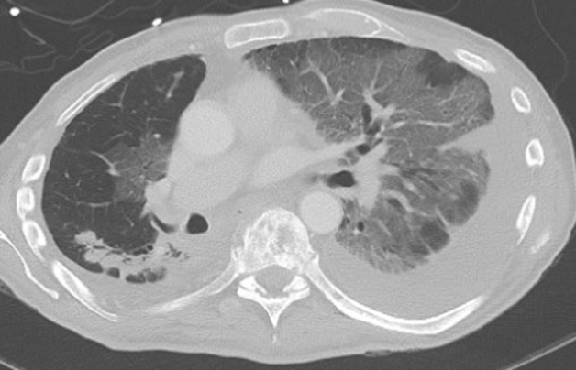
Clinical Evaluations: interstitial lung disease (ILD)
Evaluations
After 2+ months on treatment:
High-resolution CT
Pulmonologist consultation
Bronchoscopy and BAL if indicated and feasible
Infectious disease consultation if indicated
Clinical Laboratory tests
Pulmonary Function Tests (FVC and CO and SpO2
Management ILD
Screen – monitor for patients that have a h/o ILD
Scan – baseline and every 6-12 weeks
Synergy – collaborate with medical team and patients to monitor closely for symptoms of ILD and use multidisciplinary approach once ILD is suspected
Suspend treatment – once ILD is suspected hold treatment
Steroids – adapt dose and taper based on grade
Images provided by Jacob Sands, MD
BAL, bronchoalveolar lavage; CO, carbon monoxide; CT, computed tomography; FVC, forced vital capacity; h/o, history of; Sp02, peripheral capillary oxygen saturation
Swain SM, et al. Cancer Treat Rev. 2022;106:102378; Tarantino P and Tolaney SM. JCO Oncol Pract. 19:526-527

Slide 73
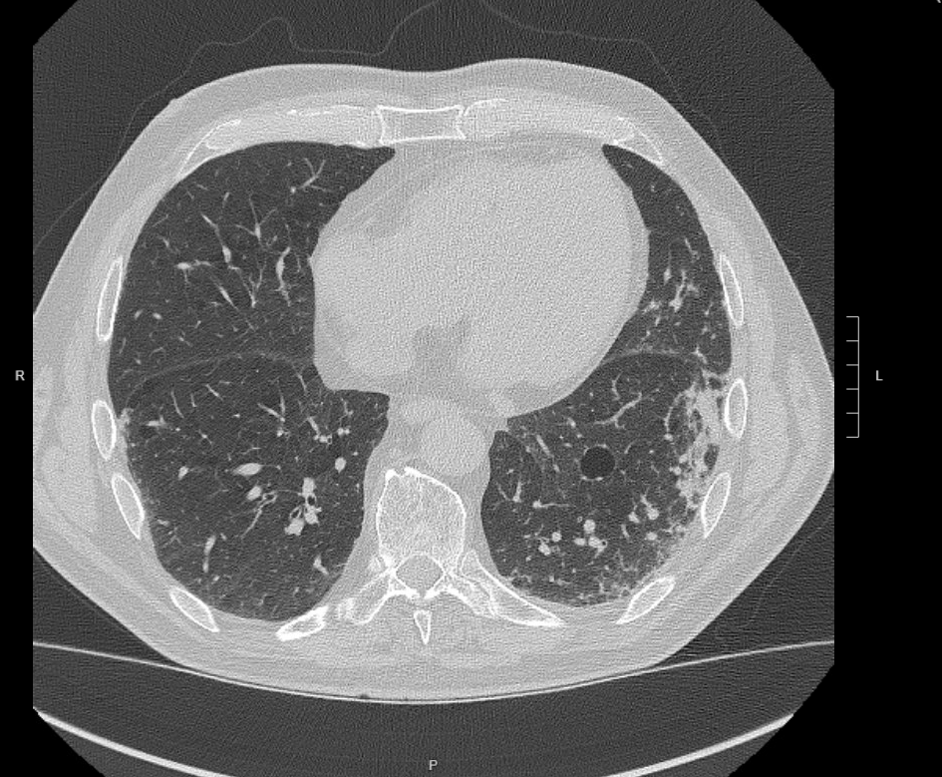
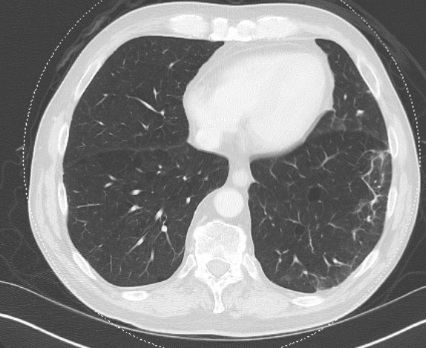
But ILD can be a more complicated scenario...
March 2025 – Grade II pneumonitis
May 2025
Images provided by Jacob Sands, MD
ILD, interstitial lung disease

Slide 74
Interstitial lung disease with adc therapy
ILD
ADC-related ILD is not fully understood:
Bystander effect: a high affinity of the target antibody (HER2, TROP2, and HER3) for tumour cells might lead to increased exposure of normal lung tissue to the payload
ADC may activate immune mediators leading to inflammatory processes and finally development of ILD
Rare but serious condition: it is essential that patient understand signs and symptoms
Requires expedited work up to rule out other causes, steroids mainstay of therapy ILD
Permanently discontinue for grade 2 or higher
ADC, antibody-drug conjugate; ILD, interstitial lung disease
Ahn M, et al, et al. Ann Oncol. 2024;35(Suppl):S1630–S1631 (presented at ESMO Asia Congress 2024, LBA7); Lisberg A, et al. Oncologist. 2025;30:oyaf225; Liu R, et al. Front Oncol. 15:1638054; Rosner SI, et al. Am Soc Clin Oncol Educ Book. 2023;43:e389968; Shi J, et al. Ther Adv Respir Dis. 2024:18:1-15; Swain SM, et al. Cancer Treat Rev. 2022;106:102378

Slide 75
Interstitial lung disease Management
Dose Modifications with Dato-DXd
Grade 1
Asymptomatic; clinical or diagnostic observations only
Grade 2
Symptomatic; medical intervention indicated; limiting instrumental activities of daily living
Grade 3-4
G3: Severe symptoms; limiting self-care activities of daily living; oxygen indicated; G4: Life-threatening respiratory compromise; urgent intervention indicated (eg, tracheotomy or intubation)
Consider a consultation with a pulmonologist
Monitor and closely follow-up in 2-7 days for onset of clinical symptoms and SpO2
Consider follow-up imaging in 1-2 weeks (or as clinically indicated)
Consider starting systemic corticosteroids (e.g. at least 0.5 mg/ kg/day prednisone or equivalent) until improvement, followed by gradual taper over at least 4 weeks
Pause Dato-DXd until resolved to grade 0, then:
If resolved in ≤28 days from day of onset, maintain dose
If resolved in >28 days from day of onset, reduce dose by one level
Permanently discontinue treatment
Consider a consultation with a pulmonologist
Promptly start systemic corticosteroids (e.g. ≥ 1.0 mg/kg/day prednisone or equivalent) for at least 14 days or until complete resolution of clinical symptoms and chest CT findings, followed by gradual taper over ≥4 weeks
Monitor symptoms closely and re-image as clinically indicated.
If clinical or diagnostic observations worsen or do not improve in 5 days:
Consider increasing corticosteroid dose (e.g. 2 mg/kg/day prednisone or equivalent) and switching to IV administration (e.g. methylprednisolone)
Reconsider additional workup for alternative etiologies
Escalate care as clinically indicated
Permanently discontinue treatment
Consider a consultation with a pulmonologist
Hospitalisation required
Promptly initiate intensive corticosteroid treatment empiric high-dose methylprednisolone IV treatment (e.g. 500-1000 mg/day for 3 days), followed by prednisone ≥1.0 mg/kg/day (or equivalent) for ≥14 days or until complete resolution of clinical symptoms and chest CT findings, followed by gradual taper over ≥4 weeks
Re-image as clinically indicated
If still no improvement within 3-5 days:
Reconsider additional workup for alternative etiologies
Consider other immunosuppressants and/or treat per local practice
CT, computed tomography; Dato-DXd, datopotamab deruxtecan; IV, intravenous; SpO2, capillary peripheral oxygen saturation
Lisberg A, et al. Oncologist. 2025;30:oyaf225

Slide 76
Other adverse events - Hematological events - GI events
GI, gastrointestinal

Slide 77
Gi and hematological events across trop2-adcs in nsclcª
 |  | EVOKE-01¹ SG (N=296) n (%) |  | TROPION-Lung01² Dato-DXd (N=297) n (%) |  | OptiTROP-Lung03^{3,4b} Sac-TMT (N=91) n (%)
 |  | Any grade | Grade ≥ 3 | Any grade | Grade ≥ 3 | Any grade | Grade ≥ 3
 | Anemia | 40.2 | 6.4 | 14.8 | 4.0 | 81.3 | 13.2
 | WBC decreased | NR | NR | NR | NR | 74.7 | 27.5
 | Neutropenia | 37.5 | 24.7 | 4.7 | 0.7 | 68.1 | 44.0
 | Leukopenia | 12.8 | 5.1 | 3.0 | 0 | NR | NR
 | Thrombocytopenia | NR | NR | NR | NR | 36.3 | 5.5
 | Diarrhea | 52.7 | 10.5 | 10.1 | 0.3 | 2 | 0
 | Nausea | 41.6 | 1.7 | 34.0 | 2.4 | 19 | 0
 | Vomiting | 20.9 | 2.4 | NR | NR | NR | NR
 | Constipation | 29.1 | 0 | NR | NR | NR | NR
Hematological
events
GI events
ªEvents are treatment emergent for the EVOKE-01 study and treatment-related for TROPION-Lung01 and OptiTROP-Lung03; ^{b}GI events not reported in Fang et al (2026), taken from an earlier publication (Fang et al (2025)
ADC, antibody drug conjugate; Dato-DXd, datopotamab deruxtecan; GI, gastrointestinal; NR, not reported; NSCLC, non-small cell lung cancer; Sac‑TMT, sacituzumab tirumotecan; SG, sacituzumab govitecan; WBC, white blood cell
1. Paz-Ares L, et al. J Clin Oncol. 2024;42,2860-72; 2. Ahn MJ, et al. J Clin Oncol. 2025;43(3):260-72; 3. Fang WF, et al. ESMO Open. 2026;11(Suppl 3):106960 (presented at ELCC 2026, LBA4); 4. Fang W, et al. BMJ 2025;389:e085680

Slide 78
PATIENT CASE
Patient Profile
64-year-old male with metastatic NSCLC (adenocarcinoma)
Molecular testing: EGFR/ALK/ROS1 negative, KRAS G12C negative
PD-L1 <1%
Metastases: lung, liver, bone
Prior Therapy
Platinum-based chemotherapy + pembrolizumab → progression
Docetaxel → progression
Current Treatment
Sacituzumab govitecan 10 mg/kg Days 1 & 8, every 21 days on clinical trial
Baseline Status
ANC 2.1 K/µL | Hgb 11.2 g/dL | Platelets 210 K/µL
Normal bowel habits
Early Treatment Course
After Cycle 1 Day 1:
Onset of loose stools (5–6/day)
Mild abdominal cramping, fatigue
Cycle 1 Day 8 labs:
ANC 1.1 K/µL
Treatment administered
Educational case study
ANC, absolute neutrophil count; NSCLC, non-small cell lung cancer

Slide 79
Toxicity Escalation – Sets Up Dx & Management
PATIENT CASE: NSCLC on Sacituzumab Govitecan
Post–Cycle 1 Day 8 (Day +5)
≥8 watery stools/day, nocturnal symptoms
Poor oral intake, dizziness, weakness
Afebrile
Clinical Challenge
Overlapping GI and hematologic toxicity
Need to distinguish:
Drug-related diarrhea vs infectious vs immune-mediated
Decision points:
Hold therapy
Supportive care
Growth factor consideration
Future dose modification
Clinic Evaluation
Mild hypotension, tachycardia
ANC 0.7 K/µL (Grade 3 neutropenia)
Hemoglobin 9.6 g/dL
Electrolyte abnormalities (hypokalemia)
Stool studies pending
Educational case study
ANC, absolute neutrophil count; Dx, diagnosis; GI, gastrointestinal

Slide 80
Polling question
Which supportive care strategy helps reduce risk of neutropenia with sacituzumab govitecan?
A. Give antibiotics to all patients
B. Use G-CSF in high-risk patients
C. Give steroids before all treatments
D. Hydration only

Slide 81
Recognising Hematologic Toxicities
Symptoms include:
Potential questions for patients to monitor
Often asymptomatic
Fatigue
Any fevers, chills since last visit?
Recent ED visits, antibiotics or hospitalisations?
Mouth sores or sore throat?
New cough, dysuria, or skin changes?
Any change in energy, shortness of breath or dizziness?
Any limitations to your daily activities outside your baseline?
Any new palpitations or chest pain?
Any easy bruising or bleeding?
Any nosebleeds or gum bleeding?
Any blood in urine or stool?
Fever ≥ 38.3°C (101°F)
Dyspnea
Chills, rigors
Pallor
Oral ulcers
Tachycardia
Easy bruising
Gum bleeding
Risk factors
Baseline cytopenias
Older age
ECOG PS >2
Nutritional deficiencies (iron, b12, folate)
Renal or hepatic dysfunction
Extensive bone marrow involvement
Heavily pre-treated patients
Short interval from prior cytotoxic chemotherapy
Prior platinum, topoisomerase inhibitors or ADC exposure
ADC, antibody-drug conjugate; ECOG PS, Eastern Cooperative Oncology Group performance status; ED, emergency department
Fang W, et al. N Engl J Med. 2026;394(1):13-26; Wang S, et al. Expert Opinion on Drug Safety 2025; 25(4), 767-75; Merck Manual Professional Edition (Accessed 07 April 2026); Common Terminology Criteria for Adverse Events (CTCAE) v6.0 (MedDRA 28.0) ; Zhao X, et al. Front. Immunol. 2025; 16:1634688

Slide 82
Hematologic Adverse Events – Sacituzumab Govitecan (NSCLC)
Common Hematological AEs
Neutropenia (most frequent; can be severe)
Anemia
Less commonly thrombocytopenia
Diagnosis & Grading
CBC with differential prior to each dose
CTCAE grading:
ANC <1.0 K/µL → Grade ≥3 neutropenia
Evaluate for:
Fever or infection
Cumulative myelosuppression from prior therapies
Management
Hold sacituzumab govitecan for Grade ≥3 neutropenia
Initiate G-CSF for:
Prolonged or recurrent Grade ≥3 neutropenia
Prior neutropenic complications
Resume treatment after recovery:
ANC ≥1.5 K/µL
Dose Modification
Dose reduction recommended for recurrent Grade 3–4 neutropenia
Strong consideration for secondary G-CSF prophylaxis
Clinical Pearl
Proactive ANC monitoring and early growth-factor support help maintain treatment continuity in heavily pretreated NSCLC patients
Multidisciplinary coordination improves safety (registered nurse, nurse practitioner/physician assistant, physician, pharmacy)
AE, adverse event; ANC, absolute neutrophil count; CBC, complete blood count; CTCAE, Common Terminology Criteria for Adverse Events; G-CSF, granulocyte colony-stimulating factor; NSCLC, non-small cell lung cancer
Fleming PJ Jr, et al. J Adv Pract Oncol. 2021;12:747-52; Gilead Sciences. TRODELVY® (sacituzumab govitecan-hziy) prescribing information. Revised March 2025; National Cancer Institute CTCAE v5.0. 2017; Zhang Y, et al. Front Oncol. 15:1624386; Bardia A, et al. N Engl J Med 2021; 384:1529-41; National Cancer Institute. Common Terminology Criteria for Adverse Events (CTCAE) v5.0

Slide 83
Recognising Gastrointestinal adverse events
Signs and symptoms of nausea and vomiting
Potential questions for patients to monitor for nausea and vomiting
Symptoms include:
Have you begun losing weight, eating or drinking less, or feeling dehydrated?
How frequently do you vomit or feel the need to vomit?
Do you feel discomfort in the chest, upper abdomen, or throat?
Abdominal pain
Bloated or swollen belly
Headache
Fatigue
Lack of appetite
Weight loss
Dizziness or weakness
Not making as much urine as usual
Nausea and vomiting risk factors
Younger age
Female sex
Anxiety
Travel sickness or nausea during pregnancy
Previous treatments
Insufficient sleep before chemotherapy
Duration of chemotherapy-induced nausea and vomiting
1. American Cancer Society. Understanding Nausea and Vomiting. Available here (accessed March 27, 2026); 2. Jordan K, et al. Eur. J. Cancer. 2025;222:115451

Slide 84
Gastrointestinal Toxicity – Diarrhea Management (SN-38 Payload)
Mechanism
SN-38–mediated intestinal mucosal injury
Typically early onset after dosing
Diagnosis
Grade diarrhea using CTCAE:
≥7 stools/day or nocturnal symptoms → Grade 3
Rule out:
Infectious causes (C. diff, GI panel)
Immune-mediated colitis (less likely without ICI)
Management
Hold sacituzumab govitecan for Grade ≥3 diarrhea
Aggressive antidiarrheal therapy:
Loperamide at first loose stool ± escalation
IV fluids and electrolyte repletion
Monitor hydration status and renal function
Rechallenge & Prevention
Resume therapy only when diarrhea ≤ Grade 1
Dose reduction for recurrent severe diarrhea
Patient education:
Early reporting
Hydration and diet counselling
Clinical Pearl
Early intervention prevents dehydration, hospitalisation, and unnecessary treatment discontinuation
CTCAE, Common Terminology Criteria for Adverse Events; GI, gastrointestinal; ICI, immune checkpoint inhibitor; IV, intravenous
Benson AB 3rd, et al. J Clin Oncol. 2004;24:2918-2926; National Cancer Institute CTCAE v5.0. 2017; TRODELVY® (sacituzumab govitecan-hziy) prescribing information. Revised March 2025; Ocean AJ, et al. Cancer. 2017;123:3843-3853; Sahi N, et al. Loperamide. [Updated 2024 Feb 28]. In: StatPearls [Internet]. Treasure Island (FL): StatPearls Publishing; 2026 Jan-. Available from: https://www.ncbi.nlm.nih.gov/books/NBK557885/; Sun R, et al. Toxicol Appl Pharmacol. 2020;389:115032; https://www.nccn.org/professionals/physician_gls/pdf/palliative.pdf (Accessed 07 Apr 2026)

Slide 85
Managing Gastrointestinal adverse events
To help control nausea
To help manage vomiting
Eat small meals throughout the day
Lie on side to prevent inhalation of vomit
Avoid foods that can cause nausea (e.g. foods with strong smells)
Try frozen liquids such as ice chips
Sit upright or lie with head raised for 1 hour after a meal
Eat food at room temperature
Once vomiting stops, start taking in small amounts of clear liquids slowly and increase as tolerated
Drink plenty of water and other fluids in slow sips throughout the day
Seek a dietitian or specialist nutritionist
Call HCP if:
Vomiting persists for 2-3 days
Cannot take medication
Cannot take in more than 4 cups of liquid or ice chips in a day
Hasn’t eaten for more than 2 days
Alternative treatments including relaxation techniques, acupuncture, hypnosis, or music therapy
Keeping a diary of when and why nausea occurs may also be helpful
HCP, healthcare professional
1. National Cancer Institute. Nausea and Vomiting and Cancer Treatment. Updated March 10, 2025. Available here (accessed March 27, 2026); 2. American Cancer Society. Managing Nausea and Vomiting at Home. Available here (accessed March 27,2026); 3. National Cancer Institute. Nutrition in Cancer Care (PDQ®)–HCP Version. Updated October 15, 2024. Available here (accessed March 27, 2026)

Slide 86
Multidisciplinary management is essential!

Slide 87
Multidisciplinary collaboration for MANAGing adc‑RELATED ADVERSE eVENTs
Eyecare provider¹
Perform ophthalmologic assessments when indicated; provide guidance on prophylaxis; support ocular AE diagnosis, care, and resolution
Specialist consultations can help to mitigate AEs
Pulmonologist/ radiologist¹
Cardiologist¹⁰
Healthcare team and patient education¹
Adherence to any recommended prophylaxis guidance²
Vigilance and early intervention¹
Support early diagnosis and management of cardiac AEs
Diagnose and manage ILD/pneumonitis
Dentist/
oral surgeon/
dermatologist²
Hematologist⁹
Provide guidance on hematological AEs
Support the management of severe or persistent stomatitis
Neurologist⁸
Healthcare team coordination^{1,3}
Close communication between oncologist and the wider healthcare team is critical to optimise patient experience with ADCs
Gastroenterologist^{4,5}
Diagnose and treat peripheral neuropathy and provide guidance on other ocular AEs (e.g. optic neuritis) when indicated
Provide guidance in case of new/worsening gastrointestinal AEs
Oncologist
Nurse
Pharmacist
Dietitian/nutritionist^{6,7}
Perform baseline nutritional assessments where indicated; provide recommendations to maintain patient nutritional status during treatment as indicated
ADC, antibody drug conjugate; AE, adverse event; ILD, interstitial lung disease
1. Lisberg A, et al. Oncologist. 2025;30:oyaf225; 2. Meric-Bernstam F, et al. Oncologist. 2025;30:oyaf031; 3. Zhang J, et al. Asia Pac J Oncol Nurs. 2024;11:100595; 4. Kovac MB and Seruga B. Radiol Oncol. 2024;58:170-178; 5. Professional Committee on Clinical Research of Oncology Drugs, Chinese Anti-Cancer Association, et al. Cancer Innov. 2022;1:3-24; 6. National Cancer Institute. Nutrition in Cancer Care (PDQ®). Available here (accessed April 10, 2026); 7. Mahmood I. Antibodies (Basel). 2021;10:40; 8. Velasco R, et al. Cancer (Basel). 2021;13:6125; 9. Rao M, et al. PLoS 2025; 20(10): e0334513; 10. Long P, et al. Front Pharmacol. 2024;15:1378010

Slide 88
Steps to optimising treatment with ADCs
Understanding ADCs
It’s important that the healthcare team, including oncology nurses, understand how ADCs work and can describe this simply to patients¹⁻⁶
Data awareness
ADC efficacy and safety profiles differ^{1,7}; awareness of the most common AEs for the relevant ADCs and how to mitigate them can help optimise the patient experience^{1,6}
Access to prophylactic medications
Many potential AEs, such as nausea / vomiting, dry eye, or stomatitis, may require prophylactic medications.^{1,6,8} Prevention and management of AEs is critical for optimising prognosis¹
Referral/consultation pathways
Managing ADC-related AEs sometimes requires support from other specialties.^{1,8} Timely specialist referral and multidisciplinary management are recommended¹
Patient materials
Educational resources can help patients recognise AEs related to ADC treatment and provide practical guidance on managing them^{2,9}
ADC, antibody-drug conjugate; AE, adverse event
1. Professional Committee on Clinical Research of Oncology Drugs, Chinese Anti-Cancer Association, et al. Cancer Innov. 2022;1:3-24; 2. Wolters Kluwer. Five strategies for providing effective patient education. Available here (accessed April 10, 2026); 3. Trail PA, et al. Pharmacol Ther. 2018;181:126-142; 4. Passaro A, et al. J Clin Oncol. 2023;41:3747-3761; 5. Clark C and Komo I. Clin J Oncol Nurs. 2024;28:188-196; 6. D’Arienzo A, et al. eClinicalMedicine. 2023;62:102113; 7. Woodford R, et al. ESMO Open. 2025;10:105573; 8. Lisberg A, et al. Oncologist. 2025;30:oyaf225; 9. Managing Side Effects of Antibody–Drug Conjugate (ADC) Therapy: A Guide for Patients With Metastatic Breast Cancer (accessed April 20, 2026)

Slide 89
Best practice management panel discussion and audience questions
Prof. Nicolas Girard Institute Curie, France
Dr Louise Lim Barts Health NHS Trust, UK
Dr Jacob Sands Dana-Farber Cancer Institute, US
Mrs Stephanie McDonald Dana-Farber Cancer Institute, US

Slide 90
KEY CLINICAL TAKEAWAYS AND CLOSE
Dr Louise Lim Barts Health NHS Trust, UK
ADC, antibody-drug conjugate; NSCLC, non-small cell lung cancer

Slide 91
KEY CLINICAL TAKEAWAYS
TROP2-ADCs are emerging as a promising therapeutic option across multiple treatment settings in NSCLC
Datopotamab deruxtecan has received FDA approval, while sacituzumab tirumotecan is approved in China, reflecting growing global adoption of this class
TROP2-ADCs demonstrate generally consistent and manageable safety profiles, with commonly observed adverse events including stomatitis, nausea, fatigue, and hematologic toxicities
These agents are associated with specific toxicities that require a multidisciplinary approach, early recognition, and timely intervention
Proactive prophylaxis and structured toxicity management are essential to support treatment continuity and optimise patient outcomes
Ongoing phase 3 trials will further clarify the efficacy, safety, and positioning of TROP2-ADCs within the NSCLC treatment landscape
ADC, antibody drug conjugate; Dato-Dxd, datopotamab deruxtecan; GI, gastrointestinal; NR, not reported; NSCLC, non-small cell lung cancer; Sac‑TMT, sacituzumab tirumotecan; SG, sacituzumab govitecan

