Slide 1
Strategic Treatment Sequencing and Novel Approaches in
2L+ ER+/HER2– mBC
ESMO Breast Cancer 2026
| Industry Satellite Symposium
Wednesday, May 6th, 2026
DISCLAIMER
This Symposium has been sponsored by Menarini Stemline and is intended for healthcare professionals only.
MED--ELA-2600048
MED-DE-ELA-2600032

Slide 2



Faculty
Nadia Harbeck, MD, PhD
LMU University Hospital
Director of the Breast Center and Head of the Oncological Therapy and Clinical Trials Unit and the Center for Hereditary Breast and Ovarian Cancer at the Department of Obstetrics and Gynecology, LMU University Hospital, Munich. She also holds the Chair of Conservative Oncology and is a Steering Committee Member of CCC Munich LMU.​
Tiffany Traina, MD, FASCO
Memorial Sloan Kettering
Vice Chair of the Department of Medicine and medical oncologist in the Breast Medicine Service since 2006. Leads the TNBC Clinical Research Program and serves on the TBCRC TNBC working group. Member of the New York Metropolitan Breast Cancer Group and the editorial board of the European Journal of Clinical & Medical Oncology.
Frederik Marmé,
University Hospital Mannheim
Gynecologic oncologist at the University Hospital Mannheim and the Medical Faculty Mannheim of Heidelberg University, Germany. Head of the Section Conservative Gynecologic Oncology and the Gynecologic Clinical Trials Unit at the University Hospital Mannheim. Co-chair of the AGO Study Group and member of the Scientific Board of the GBC.

Slide 3
Disclosures
Faculty
disclosures
Nadia Harbeck has received financial support/sponsorship for research support, consultation, or speaker fees from the following companies: AstraZeneca, Daiichi-Sankyo, Gilead,
Lilly, MSD, Novartis, Pierre-Fabre, Pfizer, Roche, Sandoz, Stemline-Menarini, Viatris.
Other: Co-Director West German Study Group.
Tiffany Traina has received financial support/sponsorship for research support or consultation or advisory fees from Genentech/Roche, Pfizer, AstraZeneca, Merck, Daiichi Sankyo, Gilead Sciences, Tersera, Menarini Stemline, Exact Sciences, BioNTech SE, Veracyte, Aktis Oncology, Ellipses Pharma, and Astellas Pharma
Frederik Marmé has received financial support/sponsorship for research support, consultation, speaker fees or travel grant from the following companies: AstraZeneca, Daiichi Sankyo, EISAI, GenomicHealth, Gilead Sciences, GSK, Immunicom, INCYTE, MSD, Novartis, Pfizer, Lilly, Roche, Böhringer-Ingelheim, Myriad Genetics, Seagen/Pfizer, Novocure, Menarini Stemline, BIONTECH, Nerviano Medical Sciences, and Novartis.​
No financial interest: AGO Research GmbH, German Breast Group, Vaccibody

Slide 4
Objectives
The 2L+ ER+/HER2− endocrine-sensitive mBC setting is rapidly changing.
The objectives of this symposium are to:
Review strategic treatment sequencing and novel therapeutic approaches, informed by the ESMO Living Guidelines
Discuss biomarker-driven treatment decisions and the evolving role of ESR1 testing

Slide 5
Agenda
Time | Title | Presenter
10 min | Welcome and introduction, Evolving standards in 2L+ ER+/HER2– mBC | Nadia Harbeck
25 min | Treating endocrine therapy-eligible patients after 1L progression | Tiffany Traina
15 min | Biomarker driven treatment decisions: Evolution of ESR1 testing | Frederik Marmé
10 min | Discussion and Q&A | All

Slide 6

Housekeeping
Please keep your cell phone on silent mode and refrain from using other electronic devices during the presentation.
Microphones will be provided for live audience questions at the end of the session.
Notes:
‹#›

Slide 7
Evolving Standards in
2L+ ER+/HER2– mBC
Nadia Harbeck
LMU University Hospital, Munich, Germany
2L, second line; ER, estrogen receptor; HER2, human epidermal growth factor receptor 2; mBC, metastatic breast cancer.

Slide 8
Real-world data show that the vast majority of patients are exposed to
1L CDK4/6i + ET for ≥12 months¹⁻³
≥6 months¹⁻³
≥12 months^{1,2}
≥18 months¹
Rate of disease progression or death
No disease progression or death
~90%
~90-70%
~70-50%

Slide 9
Eligibility for endocrine therapy can be classified by clinical variables¹⁻⁴
Primary endocrine resistance
Secondary endocrine resistance
PD within first 6 months of
1L ET-based therapy for advanced
breast cancer, while on ET
(regardless of CDK4/6i use)¹
PD after ≥6 months of 1L ET¹
or
PD after any duration of 2L+
ET-based therapy¹
Usually non-eligible for ET regimens
Eligible for ET regimens

Slide 10
Treatment for patients eligible for 2L endocrine therapy is defined according to the presence of genomic alterations
Intrinsic alterations
Includes alterations of the PI3K/AKT/mTOR pathway, BRCA1/2 mutations, RB1 loss, TP53 alteration^{1,2}
Acquired mutations
Mechanisms of resistance, such as ESR1 mutations, may occur in up to 50% of patients after prior endocrine therapy in mBC³⁻⁵

Slide 11
ESMO Guidelines recommend assessing clinical eligibility and mutational status testing before initiating an endocrine therapy-based treatment¹
1L
Patients with ER+/HER2– mBC
De novo mBC or recurrence >12 months after the end of adjuvant ET
If progression >6 months
AI + CDK4/6i
If progression ≤6 months of 1L ET ± CDK4/6i, or visceral crisis^{4,5}
ESR1 [liquid^{2,3}], PIK3CA, PTEN, AKT1, BRCA1/2, PALB2, HER2-low/-ultralow
PD
Candidate for ET ± TT
Not candidate for ET ± TT
2L+
If no targetable alteration or
relevant therapeutic not available:
Everolimus + exemestane
or
Everolimus + fulvestrant
or
Switch ET ± CDK4/6i
or
Fulvestrant monotherapy
If PIK3CA-mut+:
Alpelisib + fulvestrant
If PIK3CA-mut/AKT/PTEN alteration:
Capivasertib
+ fulvestrant
If ESR1-mut+: Elacestrant
or
Imlunestrant
If germline BRCA/PALB2-mut+:
PARP inhibitor
No prior ChT for mBC
Prior ChT for mBC
If HER2-low or
-ultralow: T-DXd
ChTª
If HER2-low:
T-DXd
SG or
Dato-DXd
PD
If not used before: T-DXd or SG or Dato-DXd or ChT
ESR1 mutational status testing, if not done before
PD
Adapted from Gennari R et al, 2021

Slide 12
Treating Endocrine Therapy-Eligible Patients After 1L Progression
Tiffany Traina
Memorial Sloan Kettering, New York, US

Slide 13
ESMO Guidelines recommend assessing clinical eligibility and mutational status testing before initiating an endocrine therapy-based treatment¹
1L
Patients with ER+/HER2– mBC
De novo mBC or recurrence >12 months after the end of adjuvant ET
If progression >6 months
AI + CDK4/6i
If progression ≤6 months of 1L ET ± CDK4/6i, or visceral crisis^{4,5}
ESR1 [liquid^{2,3}], PIK3CA, PTEN, AKT1, BRCA1/2, PALB2, HER2-low/-ultralow
PD
Candidate for ET ± TT
Not candidate for ET ± TT
2L+
If no targetable alteration or
relevant therapeutic not available:
Everolimus + exemestane
or
Everolimus + fulvestrant
or
Switch ET ± CDK4/6i
or
Fulvestrant monotherapy
If PIK3CA-mut+:
Alpelisib + fulvestrant
If PIK3CA-mut/AKT/PTEN alteration:
Capivasertib
+ fulvestrant
If ESR1-mut+: Elacestrant
or
Imlunestrant
If germline BRCA/PALB2-mut+:
PARP inhibitor
No prior ChT for mBC
Prior ChT for mBC
If HER2-low or
-ultralow: T-DXd
ChTª
If HER2-low:
T-DXd
SG or
Dato-DXd
PD
If not used before: T-DXd or SG or Dato-DXd or ChT
ESR1 mutational status testing, if not done before
PD
Adapted from Gennari R et al, 2021

Slide 14
Second-line treatment choice is defined by the eligibility to receive endocrine therapy and driven by biomarker status
1L
Patients with ER+/HER2– mBC
De novo mBC or recurrence >12 months after the end of adjuvant ET
If progression >6 months
AI + CDK4/6i
If progression ≤6 months of 1L ET ± CDK4/6i, or visceral crisis^{4,5}
ESR1 [liquid^{2,3}], PIK3CA, PTEN, AKT1, BRCA1/2, PALB2, HER2-low/-ultralow
PD
Candidate for ET ± TT
Not candidate for ET ± TT
2L+
If no targetable alteration or
relevant therapeutic not available:
Everolimus + exemestane
or
Everolimus + fulvestrant
or
Switch ET ± CDK4/6i
or
Fulvestrant monotherapy
If PIK3CA-mut+:
Alpelisib + fulvestrant
If PIK3CA-mut/AKT/PTEN alteration:
Capivasertib
+ fulvestrant
If ESR1-mut+: Elacestrant
or
Imlunestrant
If germline BRCA/PALB2-mut+:
PARP inhibitor
No prior ChT for mBC
Prior ChT for mBC
If HER2-low or
-ultralow: T-DXd
ChTª
If HER2-low:
T-DXd
SG or
Dato-DXd
PD
If not used before: T-DXd or SG or Dato-DXd or ChT
ESR1 mutational status testing, if not done before
PD
Adapted from Gennari R et al, 2021

Slide 15
CDK4/6i rechallenge so far had mixed results in all-comers and negative results in ESR1-mut subgroup
 | MAINTAIN^{1,2} | PACE^{2,3} | PALMIRA^{4,5,6} | postMONARCH^{2,6}
Phase (n) | Ph2 (119) | Ph2 (220) | Ph2 (198) | Ph3 (368)
Experimental arm | Ribociclib + fulv or exemestane | Palbociclib + fulvª | Palbociclib + fulv or letrozole | Abemaciclib + fulv
Control arm | Fulv or exemestane | Fulv | Fulv or letrozole | Fulv (+ PBO)
ESR1-mut (%) | 30% | 50% | N/A | 40%
mPFS all patients mPFS, months HR (95% CI) | 5.3 vs 2.8 HR 0.57 (95% CI 0.39-0.85) | 4.6 vs 4.8 HR 1.11 (90% CI 0.74-1.66) | 4.9 vs 3.6 HR 0.84 (95% CI 0.66-1.07) | 6.0 vs 5.3 HR 0.73 (95% CI 0.57-0.95)
mPFS ESR1-mut mPFS, months HR (95% CI) | 3.0 vs 3.0 HR 1.22 (95% CI 0.59-2.49) | 5.2 vs 3.3 HR 0.68 (90% CI 0.42-1.09) | Not reported | Not reported HR 0.79 (95% CI 0.54-1.15)
Comparisons of efficacy and safety should not be drawn or inferred in the absence of head-to-head studies

Slide 16
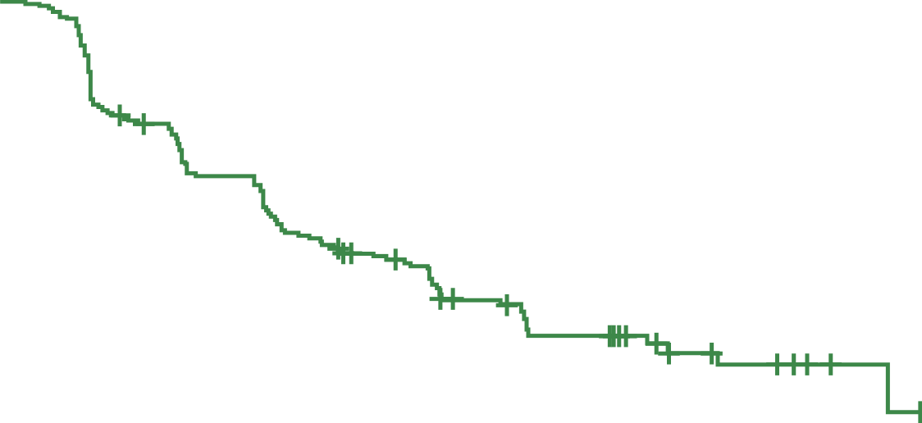
postMONARCH phase 3 trial: CDK4/6i rechallenge shows mPFS benefit mainly after palbociclib, with no benefit after ribociclib and in ESR1-mut tumors¹
postMONARCH: ITT mPFSª
postMONARCH: Subgroup analysis
100
Abemaciclib + fulvestrant
Placebo + fulvestrant
Subgroup | N (%) | events | HR (95% CI) | Interaction p-value
Visceral Metastasis |  |  |  | 0.07
Yes | 221 (60) | 173 | 0.87 (0.64-1.17)
No | 147 (40) | 85 | 0.53 (0.34-0.83)
Liver Metastasis |  |  |  | 0.40
Yes | 139 (38) | 115 | 0.63 (0.44-0.91)
No | 229 (62) | 143 | 0.78 (0.56-1.09)
Prior CDK4/6 inhibitor |  |  |  | 0.19
Palbociclib | 217 (59) | 145 | 0.62 (0.44-0.86)
Ribociclib | 122 (33) | 94 | 1.01 (0.67-1.51)
Abemaciclib | 28 (8) | 19 | 0.66 (0.27-1.84)
ESR1-mut |  |  |  | 0.98
Detected | 145 (45) | 110 | 0.79 (0.54-1.15)
Not detected | 175 (55) | 120 | 0.79 (0.55-1.13)
80
60
PFS (%)
40
20
0
0
3
6
9
12
15
18
21
No. of patients
ABE + FUL
PBO + FUL
Months
182
186
124
114
80
62
61
47
21
17
9
7
2
3
0
0
 | ABE + FUL (N=182) | PBO + FUL (N=186)
mPFS, mo [95% CI] | 6.0 [5.6-8.6] | 5.3 [3.7-5.6]
HR [95% CI] | 0.73 [0.57-0.95]
Nominal p-value | 0.02

Slide 17
What about everolimus (mTORi) plus ET?
 | BOLERO-2¹⁻³ | RWD Rozenblit et al.⁴ | RWD Vasseur et al.⁵ | TRINITI-1⁶ | RWD EVERGREEN⁷
Phase (n) | Ph3 (724) | N/A (246) | N/A (57) | Ph1/2 (95) | N/A (207)
Experimental arm | Everolimus + exemestane | Everolimus + ET | Everolimus + fulvestrant | Everolimus + exemestane + ribociclib | ET + everolimus
Control arm | Placebo + exemestane | N/A | N/A | N/A | ET
Previous CDK4/6i | 0% | 22% | 100% | 100% | 100%
ESR1-mut, % | ~30% | N/A | N/A | 34% | N/A
mPFS all patients mPFS, months HR (95% CI) | 7.8 vs 3.2 0.45 (0.38-0.54) | mTTNT Prior CDK4/6i: 4.3 No prior CDK4/6i: 6.2 | 6.8 | 5.7 | 5.0
mPFS ESR1-mut mPFS, months HR (95% CI) | 5.4 vs 2.8 0.52 (0.36-0.75) | N/A | N/A | 3.5ª N/A (1.9-7.3) | N/A
Comparisons of efficacy and safety should not be drawn or inferred in the absence of head-to-head studies

Slide 18
Second-line treatment choice is defined by the eligibility to receive endocrine therapy and driven by biomarker status
1L
Patients with ER+/HER2– mBC
De novo mBC or recurrence >12 months after the end of adjuvant ET
If progression >6 months
AI + CDK4/6i
If progression ≤6 months of 1L ET ± CDK4/6i, or visceral crisis^{4,5}
ESR1 [liquid^{2,3}], PIK3CA, PTEN, AKT1, BRCA1/2, PALB2, HER2-low/-ultralow
PD
Candidate for ET ± TT
Not candidate for ET ± TT
2L+
If no targetable alteration or
relevant therapeutic not available:
Everolimus + exemestane
or
Everolimus + fulvestrant
or
Switch ET ± CDK4/6i
or
Fulvestrant monotherapy
If PIK3CA-mut+:
Alpelisib + fulvestrant
If PIK3CA-mut/AKT/PTEN alteration:
Capivasertib
+ fulvestrant
If ESR1-mut+: Elacestrant
or
Imlunestrant
If germline BRCA/PALB2-mut+:
PARP inhibitor
No prior ChT for mBC
Prior ChT for mBC
If HER2-low or
-ultralow: T-DXd
ChTª
If HER2-low:
T-DXd
SG or
Dato-DXd
PD
If not used before: T-DXd or SG or Dato-DXd or ChT
ESR1 mutational status testing, if not done before
PD
Adapted from Gennari R et al, 2021
Notes:
Voiceover here that combinations here have been utilized in an ESR1-mut agnostic patient population

Slide 19
Alpelisib + fulvestrant in patients with ER+/HER2– and PIK3CA-mut mBC
SOLAR-1: PIK3CA-mut¹
Patients WITHOUT prior CDK4/6i therapyª
BYLieve^{2,3}
Patients WITH prior CDK4/6i therapy
Cohort A: PFS in total population by ESR1-mut status^{2,3}
100
100
80
Alpelisib + fulvestrant
Placebo + fulvestrant
80
ESR1-mut
ESR1-wt
60
60
PFS (%)
PFS (%)
40
40
20
20
0
0
0
2
4
6
8
10
12
14
16
18
20
22
24
26
28
30
31
0
5
10
15
20
25
30
35
40
No. of patients
ALPE + FUL
PBO + FUL
Months
No. of patients
ESR1-mut
ESR1-wt
Months
169
172
145
120
123
89
97
80
85
67
75
58
62
48
50
37
39
29
30
20
17
14
14
9
5
3
3
2
1
0
1
0
0
0
27
75
15
51
8
28
5
21
4
11
1
4
0
2
0
1
0
1
 | ALPE + FUL (n=169) | PBO + FUL (n=172)
mPFS, mo [95% CI] | 11 [7.5-14.5] | 5.7 [3.7-7.4]
HR [95% CI] | 0.65 [0.50-0.85]
Log-rank p-value | <0.001
 | Total² (n=119) | ESR1-mut³ (n=27) | ESR1-wt³ (n=75)
mPFS, mo [95% CI] | 8.0 [5.6-8.6] | 5.6 [3.8-12.0] | 8.3 [5.5-10.1]
Notes:
mPFS not clinically meaningful

Slide 20
CAPItello-291: Reduced mPFS benefit for capivasertib + fulvestrant in AKT-altered tumors with prior CDK4/6i as well as with prior chemotherapy
ESR1-mut data is not available
100
CAPItello-291: AKT pathway–altered tumors¹
CAPItello-291: Impact of prior CDK4/6i therapy²
80
Capivasertib + fulvestrant
Placebo + fulvestrant
 |  | N | CAPI + FUL | PBO + FUL
Overall |  | 289 | 7.3 | 3.1
Prior CDK4/6i | Yes | 208 | 5.5 | 2.0
 | No | 81 | 11 | 7.4
Prior chemotherapy for mBC | Yes | 53 | 4.0 | 2.0
 | No | 236 | 7.4 | 3.5
Liver metastases at baseline | Yes | 123 | 5.5 | 1.8
 | No | 166 | 9.1 | 3.7
60
PFS (%)
40
20
0
4
6
8
10
12
14
16
18
20
22
24
26
0
2
No. of patients
CAPI + FUL
PBO + FUL
Months
155
134
127
77
99
48
80
37
65
28
54
24
38
17
26
11
21
6
12
2
3
1
2
1
1
0
0
0
 | CAPI + FUL (n=155) | PBO + FUL (n=134)
mPFS, mo¹ [95% CI] | 7.3 [5.5-9.0] | 3.1 [2.0-3.7]
Adjusted HR [95% CI] | 0.50 [0.38-0.65]
Log-rank p-value | <0.001
0.25
0.50
1.00
2.00
Favors
CAPI + FUL
Hazard ratio
(95% CI)
Favors
PBO + FUL

Slide 21
Safety of ET combination regimens for second-line+, ER+/HER2− mBC
Comparisons of efficacy and safety should not be drawn or inferred in the absence of head-to-head studies
 | mTOR inhibitors + ET |  |  | PIK3CA inhibitors + ET |  |  | AKT-pathwayª inhibitors + ET
 | Everolimus¹ |  |  | Alpelisib² |  |  | Capivasertib³
 | All grades | Grade 3/4 |  | All grades |  | Grade 3/4 | All grades | Grade 3/4
Adverse event incidence for combinations, %
Neutropenia | – | – | – |  | – |  | – | –
Leukopenia | – | – | – |  | – |  | – | –
Anemia | 16 | 6 | – |  | – |  | 10 | 2
Stomatitis | 56 | 8 | 25 |  | 3 |  | 15 | 2
Rash | 36 | 1 | 36 |  | 10 |  | 38 | 12
Diarrhea | 30 | 2 | 58 |  | 7 |  | 72 | 9
Hyperglycemia | 13 | 4 | 64 |  | 33 |  | 16 | 2
Fatigue | 33 | 4 | 24 |  | 4 |  | 21 | 1
Nausea | 29 | 0 | 45 |  | 3 |  | 35 | 1
Discontinuation rate, % | 19 |  | 25 |  |  |  | 13
PI3K/AKT/mTOR pathway inhibitors are associated with
Grade 3/4 diarrhea, rash, hyperglycemia and stomatitis

Slide 22
Second-line treatment choice is defined by the eligibility to receive endocrine therapy and driven by biomarker status
1L
Patients with ER+/HER2– mBC
De novo mBC or recurrence >12 months after the end of adjuvant ET
If progression >6 months
AI + CDK4/6i
If progression ≤6 months of 1L ET ± CDK4/6i, or visceral crisis^{4,5}
ESR1 [liquid^{2,3}], PIK3CA, PTEN, AKT1, BRCA1/2, PALB2, HER2-low/-ultralow
PD
Candidate for ET ± TT
Not candidate for ET ± TT
2L+
If no targetable alteration or
relevant therapeutic not available:
Everolimus + exemestane
or
Everolimus + fulvestrant
or
Switch ET ± CDK4/6i
or
Fulvestrant monotherapy
If PIK3CA-mut+:
Alpelisib + fulvestrant
If PIK3CA-mut/AKT/PTEN alteration:
Capivasertib
+ fulvestrant
If ESR1-mut+: Elacestrant
or
Imlunestrant
If germline BRCA/PALB2-mut+:
PARP inhibitor
No prior ChT for mBC
Prior ChT for mBC
If HER2-low or
-ultralow: T-DXd
ChTª
If HER2-low:
T-DXd
SG or
Dato-DXd
PD
If not used before: T-DXd or SG or Dato-DXd or ChT
ESR1 mutational status testing, if not done before
PD
Adapted from Gennari R et al, 2021
Notes:
Voiceover here that combinations here have been utilized in an ESR1-mut agnostic patient population

Slide 23
VERITAC-2: Phase 3 trial of vepdegestrant vs fulvestrant¹
Patient population
Age ≥18 years old
ER+/HER2- a/mBC
Prior therapy:
‒ 1 line of CDK4/6i + ET
‒ ≤1 additional ET
‒ Most recent ET for ≥6 months
‒ No prior fulvestrant
‒ No prior chemotherapy
Phase 3
Vepdegestrant
200 mg orally QD
Primary objectives:
PFS by BICR in ESR1-mut; PFS in all patients
Secondary objectives:
OS, CBR, ORR, safety
R
1:1
N=624
Fulvestrant
500 mg IMª
Stratification factors
ESR1-mut (Y/N)
Visceral disease (Y/N)

Slide 24
ESR1-mut data were positive for mPFS in VERITAC-2, but no statistically significant benefit in mPFS was seen in the ITT population¹
PFS by BICR in patients with ESR1-mut
PFS by BICR for ITT population
100
100
90
Vepdegestrant
Fulvestrant
90
Vepdegestrant
Fulvestrant
80
80
70
70
60
60
PFS (%)
PFS (%)
50
50
40
40
30
30
20
20
10
10
0
0
0
1
2
3
4
5
6
7
8
9
10
11
12
13
14
15
16
17
18
0
1
2
3
4
5
6
7
8
9
10
11
12
13
14
15
16
17
18
No. of patients
Vepdegestrant Fulvestrant
Months
No. of patients
Vepdegestrant Fulvestrant
Months
136
134
134
125
87
62
78
52
55
30
53
29
38
15
37
12
22
8
22
8
15
7
14
2
10
1
8
1
4
1
3
1
3
0
2
0
0
0
313
311
306
292
189
162
168
143
113
101
108
98
74
58
72
54
46
36
46
36
28
23
24
12
15
7
12
7
6
4
4
3
4
2
2
0
0
0
 | VEP (n=136) | FUL (n=134)
mPFS, mo¹ [95% CI] | 5.0 [3.7–7.4] | 2.1 [1.9–3.5]
Absolute difference, mos | +2.9
Stratified HR [95% CI] | 0.57 [0.42–0.77]; 2-sided p<0.001
 | VEP (n=313) | FUL (n=311)
mPFS, mo¹ [95% CI] | 3.7 [3.6–5.3] | 3.6 [2.2–3.8]
Absolute difference, mos | +0.1
Stratified HR [95% CI] | 0.83 [0.68–1.02]; 2-sided p=0.07
OS data were not yet mature¹

Slide 25
Safety and tolerability¹
Overview
TEAEs in >10% of patients in either group
TEAEs, % | Vepdegestrant (n=312) | Fulvestrant (n=307)
Any grade | 87 | 81
Grade ≥3 | 23 | 18
Serious | 10 | 9
Leading to treatment discontinuation | 3 | 1
Leading to dose reduction | 2 | NA
 | Vepdegestrant (n=312)
TEAEs, % | Any grade | Grade 3/4
Fatigueª | 27 | 1
ALT increased^{b} | 14 | 1
AST increased^{b} | 14 | 1
Nausea | 13 | 0
Anemia^{b,c} | 12 | 2
Neutropenia^{d} | 12 | 2e
Back pain | 11 | 1
Arthralgia | 11 | 1
Decreased appetite | 11 | <1
VERITAC-2 QT prolongation
TEAEs: vepdegestrant, 10%; fulvestrant, 1%
A QT interval sub-study (n=88) confirmed a mild increase (11.1 ms) from baseline in mean QTcF, with upper 90% CI (13.7 ms) <20 ms,^{f} indicating no large QT-prolonging effect
On May 01, 2026 U.S. Food and Drug Administration (FDA) has granted approval for VEPPANU (vepdegestrant)²
The FDA also published “Warnings and Precautions” for QTc interval prolongation²

Slide 26
EMBER-3: Phase 3 trial of imlunestrant vs SOC or imlunestrant + abemaciclib¹
Patient population
Age ≥18 years oldª
ER+/HER2− a/mBC
Prior therapy:
    ‒ Prior treatment with an AI, alone or in combination with a CDK4/6 inhibitor^{b}
    ‒ No prior fulvestrant
    ‒ No prior chemotherapy
Phase 3
Imlunestrant 400 mg QD
(n=331)
Primary objectives:
Investigator-assessed PFS in ESR1-mut^{e} patients (A vs B) and all patients (A vs B; C vs A)
Secondary objectives:
OS, PFS by BICR, ORR, safety
A
R
1:1:1
SOC ET^{c} (fulvestrant or exemestane)
(n=330)
B
N=874
    Imlunestrant^{d} 400 mg QD + abemaciclib (n=213)
C
Stratification factors
Prior CDK4/6i therapy (Y/N) | Region^{f}
Visceral metastases (Y/N)

Slide 27
EMBER-3: Baseline demographics in ESR1-mut patient population¹
65% prior CDK4/6 inhibitors, 21% treatment in 1L
Characteristic |  | Imlunestrant n=138 | SOC ET n=118
Median age, years (range) |  | 61 (28-85) | 60 (33-85)
Post-menopausal, % |  | 89 | 89
Region, % | East Asia North America/Western Europe Other | 22 46 33 | 22 46 32
Visceral metastases, % |  | 61 | 57
ESR1-mut, %ª |  | 100 | 100
PI3K pathway mutations, % |  | 52 | 48
Prior chemotherapy, % |  | - | -
Prior fulvestrant, % |  | - | -
Primary endocrine resistance, % |  | - | -
Most recent ET, % | As (neo) adjuvant therapy For aBC | 21 73 | 20 77
Prior CDK4/6i, % | Overall As adjuvant therapy For aBC | 67 2 65 | 72 3 70
Table adapted from Jhaveri KL et al, 2025

Slide 28
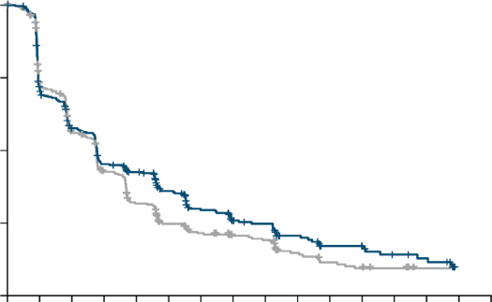
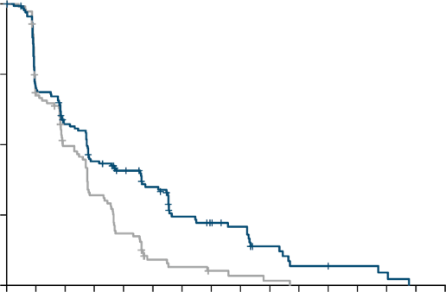
EMBER-3: Imlunestrant monotherapy has no mPFS benefit in ITT patient population; mPFS benefit is shown in patients with ESR1-mut^{1,2}
ITT patient population
69% prior CDK4/6i,
32% treatment in 1L
100
ESR1-mut patient population
65% prior CDK4/6i,
21% treatment in 1L
100
75
Imlunestrant
SOC
75
Imlunestrant
SOC
Percentage of patients
50
50
45
Percentage of patients
44
43
30
25
25
32
25
22
0
0
7
0
2
4
6
8
10
12
14
16
18
20
22
24
26
28
30
0
2
4
6
8
10
12
14
16
18
20
22
24
26
28
30
No. of patients
IMLU
SOC
Months
No. of patients
IMLU
SOC
Months
331
330
225
221
173
165
135
122
118
89
89
63
62
51
47
41
43
38
30
23
20
17
19
14
13
10
10
2
0
0
0
0
138
118
95
74
74
51
56
33
45
19
35
7
22
5
18
3
15
2
8
1
4
0
4
0
3
0
2
0
0
0
0
0
 | IMLU (n=331) | SOC (n=330)
mPFS, mo | 5.6 | 5.5
Absolute difference | +0.1
HR [95% CI] | 0.87 [0.72-1.04], P=0.12
 | IMLU (n=138) | SOC (n=118)
mPFS, mo | 5.5 | 3.8
Absolute difference | +1.7
HR [95% CI] | 0.62 [0.46-0.82], P<0.001²
Notes:
Pivoting now to other oral SERDs in development, starting with imlunestrant
Imlunestrant data did not reach statistical significance in the all-comer population, and for those with ESR1-mut, pts had a 5.5. mPFS despite no previous therapies (chemo, fulvestrant)

Slide 29
EMBER-3: The safety profiles of imlunestrant were consistent with previous findings¹
 | Imlunestrant (n=327) |  | SOC ET (n=324)
Adverse events in ≥10% of patients, % | All grades | Grade ≥3 | All grades | Grade ≥3
Fatigue | 23 | <1 | 13 | 1
Diarrhea | 21 | <1 | 12 | 0
Nausea | 17 | <1 | 13 | 0
Arthralgia | 14 | 1 | 14 | <1
AST increased | 13 | 1 | 13 | 1
Back pain | 11 | 1 | 7 | <1
ALT increased | 10 | <1 | 10 | 1
Anemia | 10 | 2 | 13 | 3

Slide 30
EMERALD: Phase 3 trial of elacestrant vs SOC endocrine therapy¹
Patient population
Age ≥18 years old
ER+/HER2− a/mBC
Prior therapy:
‒ 1–2 lines of ET
‒ CDK4/6i required
‒ Primary resistance allowed
‒ Prior fulvestrant allowed
‒ Prior chemotherapy allowed
Phase 3
Elacestrant
345 mg dailyª
Primary objectives:
PFS in ESR1-mut;
PFS in all patients
Secondary objectives:
OS, PFS, ORR, DOR, CBR, SD, safety and tolerability
R
1:1
N=477
Investigator’s choice (SOC)^{b}
Stratification factors
ESR1-mut status | Prior treatment with fulvestrant
Presence of visceral metastases

Slide 31
EMERALD: Baseline characteristics¹
ESR1-mut patient population included 100% prior CDK4/6i, 70% visceral disease, 37% treatment as 3rd line, 24% prior fulvestrant, 23% prior chemotherapy
 | Elacestrant |  | SOC
 | All (n=239) | ESR1-mut (n=115) | All (n=238) | ESR1-mut (n=113)
Median age, years (range) | 63 (24-89) | 64 (28-89) | 64 (32-83) | 63 (32-83)
Female, n (%) | 233 (97.5) | 115 (100) | 237 (99.6) | 113 (100)
ECOG PS, n (%)
0 | 143 (59.8) | 67 (58.3) | 135 (56.7) | 62 (54.9)
1 | 96 (40.2) | 48 (41.7) | 103 (43.3) | 51 (45.1)
Visceral metastasisª, n (%) | 163 (68.2) | 81 (70.4) | 169 (71.1) | 84 (74.3)
Prior CDK4/6i, n (%) | 239 (100) | 115 (100) | 238 (100) | 113 (100)
Line of therapy in mBC, n (%)
2nd line | 129 (54.0) | 73 (63.5) | 141 (59.2) | 69 (61.1)
3rd line | 110 (46.0) | 42 (36.5) | 97 (40.8) | 44 (38.9)
Prior therapies for advanced or metastatic disease, n (%)
Fulvestrant | 70 (29.3) | 27 (23.5) | 75 (31.5) | 28 (24.8)
Aromatase inhibitor | 193 (80.8) | 101 (87.8) | 194 (81.1) | 96 (85.0)
Tamoxifen | 19 (7.9) | 9 (7.8) | 15 (6.3) | 9 (8.0)
No. of prior lines of chemotherapy in a/mBC, n (%)
0 | 191(79.9) | 89 (77.4) | 180(75.6) | 81 (71.7)
1 | 48 (20.1) | 26 (22.6) | 58 (24.4) | 32 (28.3)
ªIncludes lung, liver, brain, pleural, and peritoneal involvement.
a/mBC, advanced/metastatic breast cancer; CDK4/6i, cyclin-dependent kinase 4/6 inhibitor; ECOG PS, Eastern Cooperative Oncology Group performance status; ESR1, estrogen receptor 1 gene; mut, mutation; SOC, standard of care.
1. Adapted from Bidard FC, et al. J Clin Oncol. 2022;40(28):3246-3256.

Slide 32
EMERALD: Elacestrant shows statistically significant results for both
ITT and ESR1-mut patient populations¹
ITT patient population
100
ESR1-mut patient population
100
Elacestrant
Elacestrant
SOC
SOC
80
80
60
60
45% reduction in risk of progression or death¹
PFS (%)
PFS (%)
40
40
20
20
0
0
0
2
4
6
8
10
12
14
16
18
20
22
No. of
patients
ELA
SOC
0
2
4
6
8
10
12
14
16
18
20
22
24
No. of
patients
ELA
SOC
Months
24
Months
239 | 223 | 106 | 89 | 60 | 57 | 42 | 40 | 34 | 33 | 27 | 24 | 19 | 13 | 11 | 8 | 7 | 6 | 6 | 2 | 2 | 2 | 2 | 1 | 0
238 | 206 | 84 | 68 | 39 | 38 | 25 | 25 | 16 | 15 | 7 | 4 | 3 | 3 | 2 | 2 | 1 | 0
115 | 105 | 54 | 46 | 35 | 33 | 26 | 26 | 21 | 20 | 16 | 14 | 11 | 9 | 7 | 5 | 5 | 4 | 4 | 1 | 1 | 1 | 1 | 1 | 0
113 | 99 | 39 | 34 | 19 | 18 | 12 | 12 | 9 | 9 | 4 | 1 | 1 | 1 | 0
 | Elacestrant (n=239) | SOC (n=238)
mPFS, mo | 2.8 | 1.9
Absolute difference, mo | +0.9
HR [95% CI] | 0.70 [0.55-0.88], P=0.0018
 | Elacestrant (n=115) | SOC (n=113)
mPFS, mo | 3.8 | 1.9
Absolute difference, mo | +1.9
HR [95% CI] | 0.55 [0.39-0.77], P=0.0005

Slide 33
EMERALD: Elacestrant shows improved mPFS in ESR1-mut population with no prior chemotherapy¹
Post-hoc analysis
100
Elacestrant
SOC
80
60
 | Elacestrant (n=89) | SOC (n=81)
mPFS, mo | 5.3 | 1.9
Absolute difference, mo | +3.4
HR [95% CI]ª | 0.54 [0.36-0.80], P=0.00235
PFS (%)
40
20
0
0
2
4
6
8
10
12
14
16
18
20
22
24
Months
No. of patients
ELA
SOC
89
81
48
29
31
15
24
10
20
9
15
4
11
1
7
0
5
4
1
1
0

Slide 34
EMERALD: Elacestrant shows an 8.6 months mPFS in ESR1-mut patient population whose tumors retained endocrine sensitivity¹⁻³ mPFS was 7.3 mo in patients with liver and/or lung mets, and 5.5 mo in those with ESR1 and PIK3CAmut tumors^{1,2}
Post-hoc analysis: ≥12 months duration of prior ET + CDK4/6i^{1,2}
Patients with ≥12 months of prior ET + CDK4/6i | % (n) | Elacestrant mPFS, months | SOC mPFS, months | HR [95% CI]
All ESR1-mut patients | 100 (159) | 8.6 | 1.9 | 0.41 [0.26-0.63]
PIK3CA-mutª | 39 (62) | 5.5 | 1.9 | 0.42 [0.18-0.94]
Bone metastases^{b} | 86 (136) | 9.1 | 1.9 | 0.38 [0.23-0.62]
Liver and/or lung metastases^{c} | 71 (113) | 7.3 | 1.9 | 0.35 [0.21-0.59]
≥3 metastatic sites^{d} | 33 (53) | 10.8 | 1.8 | 0.31 [0.12-0.79]
TP53-mut | 38 (61) | 8.6 | 1.9 | 0.30 [0.13-0.64]
HER2−low expression^{e} | 48 (77) | 9.0 | 1.9 | 0.30 [0.14-0.60]
100
Elacestrant
SOC
80
60
PFS (%)
40
20
0
0
5
10
15
20
20
30
Months
ELA
SOC
78
81
42
26
31
12
24
10
20
9
16
5
11
2
9
1
8
1
7
0
6
5
5
1
1
0
 | Elacestrant (n=78) | SOC (n=81)
mPFS, mo | 8.6 | 1.9
Absolute difference, mo | +6.7
HR [95% CI] | 0.41 [0.26-0.63]
Notes:
VOICEOVER here is that SOC provides no benefit across subgroups, and has the same benefit regardless of clinical/molecular variable.

Slide 35
Elacestrant real-world data
Elacestrant is the first oral SERD approved in patients with ESR1-mut ER+/ HER2− mBC,
based on results from the EMERALD clinical study, showing improved PFS HR 0.55 (95% CI 0.39-0.77)¹
Real-world insights are valuable for affirming the efficacy benefit of elacestrant in current clinical practice
Two different RWE studies were performed:
Clinical and genomic factors associated with elacestrant outcomes in ESR1-mut mBC¹ Guardant Health (Maxwell R. Lloyd, Azka Ali, Caroline M. Weipert, Sheila R. Solomon, Jayati Saha, Marla Lipsyc-Sharf, Erika P. Hamilton, Kevin Kalinsky, Adam Brufsky, Aditya Bardia, Nicole Zhang, Seth A. Wander)
Real-world outcomes of elacestrant in ER+/HER2−, ESR1-mut mBC² Komodo/Foundation Medicine* (Hope S. Rugo, Virginia Kaklamani, Heather McArthur, Seth A. Wander, William Gradishar, Reshma Mahtani, Mark Pegram, Maryam Lustberg, Elyse Swallow, Jessica Maitland, Sebastian Kloss, Tomer Wasserman, and Sara M. Tolaney)

Slide 36
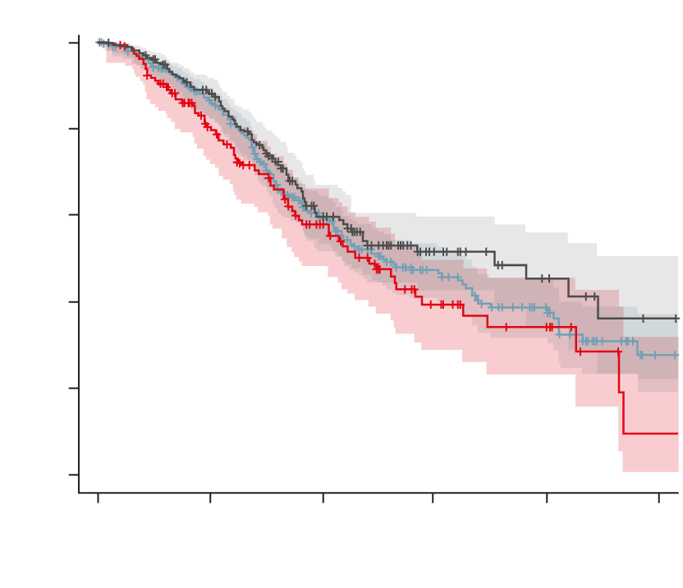
Clinical factors associated with elacestrant outcomes in ESR1-mut mBC¹
Lloyd et al, Guardant Health*
TTNT since elacestrant initiation by line
1.0
Adjusted HR, ≤1 prior lines as reference, (95% Cl):
2 prior lines: 1.34 (0.96-1.87)
≥3 prior lines: 1.12 (0.85-1.48)
0.8
≤1 prior lines
2 prior lines
≥3 prior lines
Prior lines | ≤1 | 2 | ≥3
Subjects | 203 | 151 | 388
Event | 77 | 70 | 165
Censored | 126 | 81 | 233
Median TTNT | 8.833 | 6.033 | 6.333
95% CI | 5.467– | 4.467-7.200 | 5.433-8.200
0.6
Survival probability
0.4
0.2
+ Censored
Logrank P=0.1811
0.0
Patients treated in earlier lines
(i.e., ≤1 prior line of therapy) had a longer TTNT
0.0
2.5
5.0
7.5
10.0
12.5
Time (months)
≤1
2
≥3
203
151
388
142
90
253
53
38
98
16
13
40
7
1
10
Observational retrospective analyses are not intended for direct comparisons with clinical trials.

Slide 37
Real-world outcomes of elacestrant in ER+/HER2−, ESR1-mut mBC¹
Rugo et al, Komodo/Foundation Medicine*
mTTNT: 1 prior line of ET ± CDK4/6i
1.00
0.75
 | 2L (n=56)
Events, n (%) | 22 (39.3)
Median TTNT, mo [95% CI] | 10.8 [5.9-NR]
0.50
Survival probability
0.25
0.00
Observational retrospective analyses are not intended for direct comparisons with clinical trials.
0
2
4
6
8
10
12
14
16
18
20
22
Time (months)
No. at risk
Events
56
0
50
3
35
11
18
17
13
19
7
19
6
20
6
20
3
22
2
22
1
22
0
22

Slide 38
Real-world outcomes observed with elacestrant in patients with ER+/HER2−, ESR1-mutated mBC were similar to outcomes reported in the EMERALD subgroup analysis
 | Real-World Data Komodo/Foundation Medicine^{1,c} (N=306) |  |  | Real-World Data GuardantINFORM² (N=742) |  |  | Phase 3 EMERALD Subgroup Analysis³ (N=78)
 | n | mTTNT | (95% CI) | n | mTTNT | (95% CI) | n | mPFS | (95% CI)
1-2 prior lines of ET ± CDK4/6i | 128 | 8.2 | (6.3, 13.0) | – | – | – | – | – | –
1-2 prior lines of ET ± CDK4/6i ≥12 months | 116 | 8.4 | (6.3, 14.1) | – | – | – | 78 | 8.6 | (4.1, 10.8)
1 prior line of ET ± CDK4/6i | 56 | 10.8 | (5.9, NR) | 203^{d} | 8.8 | (5.5, NR) | – | – | –
2 prior lines of ET ± CDK4/6i | 72 | 7.7 | (4.8, 13.0) | 151 | 6.0 | (4.5, 7.2) | – | – | –
≥3 prior lines of ET ± CDK4/6i | 172 | 7.5 | (7.1, 9.9) | 388 | 6.3 | (5.4, 8.2) | – | – | –
Visceral metastasis | 266 | 7.9 | (7.0, 9.9) | – | – | – | – | – | –
Liver metastases | 138 | 7.2 | (6.3, 9.0) | – | – | – | – | – | –
Liver and/or lung metastases | – | – | – | – | – | – | 56 | 7.3 | (2.2, 10.8)
Coexisting ESR1 and PI3K pathway mutations^{a,b} | 130 | 6.3 | (4.8, 7.9) | 234 | 5.2 | (4.2, 6.0) | 27 | 5.5 | (2.1, 10.8)
All patients with no prior chemotherapy | 153 | 8.4 | (7.1, 13.3) | – | – | – | – | – | –
All patients with no prior fulvestrant | 85 | 12.9 | (7.2, NR) | 347 | 7.7 | (5.7, 10.2) | – | – | –
Due to the retrospective, observational design of these analyses, only associations between treatments and outcomes can be inferred rather than causality.
The intention of this display is a summary overview; a cross-study/-analysis comparison is generally not possible due to the different methodologies used in these analyses.
Notes:
Benefit is in line with the 8.6 months mPFS in patients with longer prior CDK4/6i (>12 mo) from the EMERALD subgroup analysis

Slide 39
After CDK4/6i, elacestrant single agent in patients with ESR1 and PIK3CA
co-mutations delivers similar benefit to combination therapies with PI3K/AKTi
 | EMERALD¹ | Llyod RWE^{2,a} | Rugo RWE^{3,a} | EMBER-3⁴ | BYLieve^{5,6} | CAPItello-291
 | Elacestrant |  |  | Imlunestrant | Alpelisib + fulv | Capivasertib + fulv
 |  |  |  |  |  | Original⁷ FoundationOne© CDx (tissue) | Exploratory⁸ Guadant IntinityTM (blood)
 | mPFS, mo | mTTNT, mo | mTTNT, mo | mPFS, mo | mPFS, mo | mPFS, mo | mPFS, mo
Prior CDK4/6i & only AKT/PIK3CA-mut | N/A | N/A | N/A | N/A | Primary analysis (n=121) 8.0 | Subgroup analysis (n=113) 5.5 | N/A
Subgroup analysis
Prior CDK4/6i & AKT/PIK3CA-mut AND ESR1-mut | Post-hoc analysis ≥12 mo prior CDK4/6i (n= 27) 5.5 | 76% of total population received prior CDK4/6i (n= 234) 5.2 | 90% of total population received prior CDK4/6i (n= 130) 6.3 | 65% of total population received prior CDK4/6i (n= 39) 3.8 | 100% of total population received prior CDK4/6i (n= 27) 5.6 | Not reported | 77% of total population received prior CDK4/6i (n= 149) 5.5
Prior CDK4/6i & AKT/PIK3CA-mut AND ESR1-mut but 2L & no prior CT | - | - | - | - |  |  | (n= 94) 7.0^{b}
Comparisons of efficacy and safety should not be drawn or inferred in the absence of head-to-head studies.
The intention of this display is a summary overview; a cross-study/-analysis comparison is generally not possible due to the different methodologies used in these analyses.
ª This was an exploratory analysis. RWE analysis results are observational in nature. There was no prespecified statistical procedure controlling for type 1 error; ^{b}Restricted to post-1L ET + CDK4/6i ESR1-mutant, AKT pathway–altered ABC population with no prior chemotherapy for advanced disease.

Slide 40
EMERALD: Safety¹
Most common adverse events ≥10% in either arm in the overall population¹
 | Elacestrant (n=237) |  | SOC (n=230)
Adverse events^{1,a} | All grades (%) | Grade ≥3 (%) | All grades (%) | Grade ≥3 (%)
Nausea | 35 | 2.5 | 19 | 0.9
Vomiting^{b} | 19 | 0.8 | 9 | 0
Diarrhea | 13 | 0 | 10 | 1
Constipation | 12 | 0 | 6 | 0
Abdominal pain^{b} | 11 | 1 | 10 | 0.9
Dyspepsia | 10 | 0 | 2.6 | 0
Fatigue^{b} | 26 | 2 | 27 | 1
Decreased appetite | 15 | 0.8 | 10 | 0.4
Headache | 12 | 2 | 12 | 0
Hot flush | 11 | 0 | 8 | 0
Nausea summary¹ | Elacestrant (n=237) | SOC (n=230)
Grade 3 nausea, % | 2.5 | 0.9
Dose-reduction rate due to nausea, % | 1.3 | NA
Discontinuation rate due to nausea, % | 1.3 | 0
Antiemetic use, %* | 8.0 | 10.3 (AI) 3.7 (fulvestrant)
Nausea was generally reported early, with a median time to first onset of 14 days.²
*Patients who received fulvestrant may have been on antiemetics prior to enrollment.¹
No patient experienced Grade 4 nausea or vomiting with elacestrant¹
Treatment-related AEs leading to discontinuation were 3.4% and 0.9% in the elacestrant and SOC arms, respectively¹
No hematologic safety signal was observed, and none of the patients in either treatment arm had sinus bradycardia¹
Notes:
‹#›

Slide 41
Oral SERD combination studies
EMBER-3: Phase 3 trial of imlunestrant vs imlunestrant + abemaciclib¹
Patient population
Age ≥18 years oldª
ER+/HER2− a/mBC
Prior therapy:
    ‒ Prior treatment with an AI, alone or in combination with a CDK4/6 inhibitor^{b}
    ‒ No prior fulvestrant
    ‒ No prior chemotherapy
Phase 3
Imlunestrant 400 mg QD
(n=331)
Primary objectives:
Investigator-assessed PFS in ESR1-mut^{e} patients (A vs B) and all patients (A vs B; C vs A)
Secondary objectives:
OS, PFS by BICR, ORR, safety
A
R
1:1:1
SOC ET^{c} (fulvestrant or exemestane)
(n=330)
B
N=874
    Imlunestrant^{d} 400 mg QD + abemaciclib (n=213)
C
Stratification factors
Prior CDK4/6i therapy (Y/N) | Region^{f}
Visceral metastases (Y/N)

Slide 42
EMBER-3: Imlunestrant plus abemaciclib^{1,2}
ITT patient population
65% prior CDK4/6i, 30% treatment in 1L
100
Imlunestrant + abemaciclib
Imlunestrant
66%
75
43%
Combination currently not approved by the FDA/EMA
50
Progression-free survival (%)
34%
40%
26%
25
28%
 | IMLU + ABE (n=213) | IMLU (n=213)
mPFS, mo | 10.9 | 5.5
HR [95% CI] | 0.59 [0.47-0.74], P<0.0001
18%
13%
0
0
3
6
9
12
15
18
21
24
27
30
33
36
39
No. at risk
IMLU + ABE
IMLU
Time (months)
213
213
159
130
122
78
101
73
78
54
70
46
59
35
54
26
36
18
20
14
14
8
10
4
2
0
0
0

Slide 43
EMBER-3: The safety profiles of imlunestrant + abemaciclib were consistent with previous findings¹
 | Imlunestrant + abemaciclib (n=208) |  | SOC ET (n=324)
Adverse events in ≥20% of patients, % | All grades | Grade ≥3 | All grades | Grade ≥3
Diarrhea | 86 | 8 | 12 | 0
Nausea | 49 | 2 | 13 | 0
Neutropenia | 48 | 20 | 5 | 2
Anemia | 44 | 8 | 13 | 3
Fatigue | 39 | 5 | 13 | 1
Vomiting | 31 | 1 | 5 | <1
Leukopenia | 26 | 4 | 5 | 0
Hypercreatinemia | 22 | 1 | 2 | 0
Abdominal pain | 20 | 2 | 6 | <1
Decreased appetite | 20 | 1 | 4 | <1

Slide 44
Oral SERD combination studies
evERA: Phase 3 trial of giredestrant + everolimus vs SOC ET + everolimus^{1,2}
Key eligibility criteria*
ER+, HER2– aBC (1–3L of therapy)
≤2 prior lines of ET in the aBC setting
PD or relapse during/post-CDK4/6i + ET†
No prior chemotherapy in the aBC setting
Measurable disease per RECIST v1.1 or evaluable bone metastases
N=373*
Giredestrant (30 mg PO QD) +
everolimus (10 mg PO QD)‡
Until PD
or
unacceptable
toxicity
R
1:1
SOC ET§ + everolimus (10 mg PO QD)‡
§Exemestane/fulvestrant/tamoxifen
‡ Dexamethasone mouthwash prophylaxis and treatment was strongly
recommended per SWISH trial protocol²
* Trial was enriched to 55% of patients with ESR1m at baseline
(centrally tested via circulating tumor DNA)
† Patients had to receive ≥6 months of CDK4/6i + ET in the aBC setting to be eligible for enrolment; prior fulvestrant was allowed
Stratification factors
≤2 Prior treatment with fulvestrant (yes vs no)
ESR1m (yes vs no/indeterminate)
Site of disease (visceral [lung and/or liver involvement] vs non-visceral)
Co-primary endpoints (RECIST v1.1):
INV-PFS in patients whose tumors had ESR1m
INV-PFS in the ITT population
Key secondary endpoints:
OS
INV-ORR, DoR
Exploratory endpoints:
Clinical and biomarker
subgroup analyses

Slide 45
evERA: Phase 3 trial baseline characteristics¹
 | Giredestrant + everolimus n=183 | SOC ET + everolimus n=190
Median age, years (range) | 62.0 (27–83) | 60.0 (28–84)
Female sex, n (%) | 182 (99.5) | 187 (98.4)
Race, n (%) White Asian Black Other | 103 (56.3) 66 (36.1) 9 (4.9) 5 (2.7) | 119 (62.6) 57 (30.0) 9 (4.7) 5 (2.6)
Region, n (%) North America Asia–Pacific Western Europe Other | 69 (37.7) 58 (31.7) 36 (19.7) 20 (10.9) | 75 (39.5) 49 (25.8) 43 (22.6) 23 (12.1)
Visceral disease, n (%)* Disease involvement in liver | 126 (68.9) 89 (48.6) | 131 (68.9) 100 (52.6)
Post-menopausal at screening, n (%) | 156 (85.2) | 159 (83.7)
 | Giredestrant + everolimus n=183 | SOC ET + everolimus n=190
ESR1m, n (%)† | 102 (55.7) | 105 (55.3)
PIK3CA/AKT1/PTEN alteration, n (%)† PIK3CAm AKT1 E17K alteration PTEN alteration | 82 (44.8) 64 (35.0) 14 (7.7) 13 (7.1) | 80 (42.1) 51 (26.8) 12 (6.3) 28 (14.7)
Duration of prior CDK4/6i§ <12 mo ≥12 mo 12 to <24 mo ≥24 mo | 44 (24.0) 136 (74.3) 61 (33.3) 75 (41.0) | 50 (26.3) 135 (71.0) 60 (31.6) 75 (39.5)
Prior CDK4/6i, n (%) Palbociclib Ribociclib Abemaciclib | 183 (100) 104 (56.8) 52 (28.4) 53 (29.0) | 190 (100) 119 (62.6) 54 (28.4) 49 (25.8)
Prior fulvestrant, n (%) First line with CDK4/6i | 86 (47.0) 53 (29.0) | 89 (46.8) 42 (22.1)

Slide 46
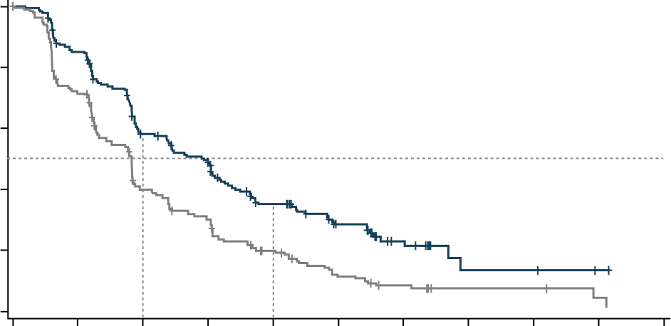
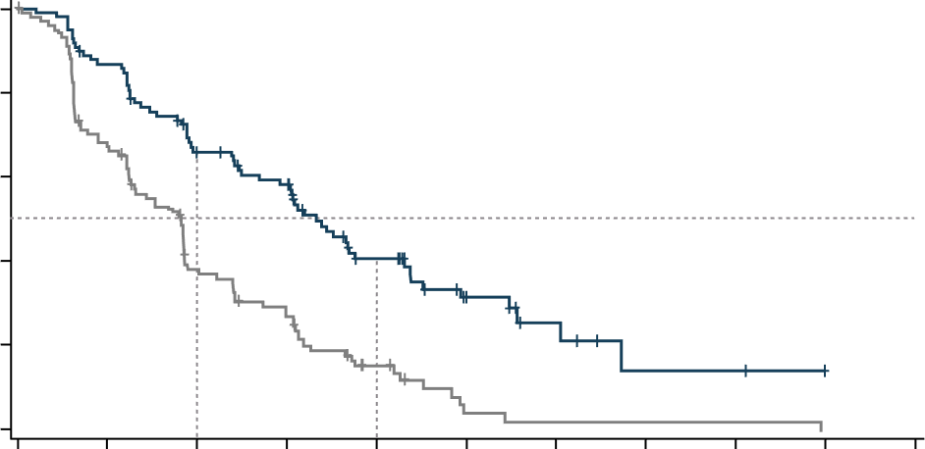
evERA: Phase 3 trial co-primary endpoints, INV-PFS in the ITT and ESR1-mut populations¹
ITT patient population
ESR1-mut patient population
 | Giredestrant + everolimus (n=183) | SOC ET + everolimus (n=190)
Events, n (%) | 126 (68.9) | 163 (85.8)
Median, mo (95% CI) | 8.77 (6.60, 9.59) | 5.49 (4.01, 5.59)
Stratified HR | 0.56
(95% CI) | (0.44, 0.71); P<0.0001
 | Giredestrant + everolimus (n=102) | SOC ET + everolimus (n=105)
Events, n (%) | 63 (61.8) | 89 (84.8)
Median, mo (95% CI) | 9.99 (8.08, 12.94) | 5.45 (3.75, 5.62)
Stratified HR | 0.38
(95% CI) | (0.27, 0.54); P<0.0001
100
100
80
80
66.1%
60
57.4%
60
INV-PFS (%)
INV-PFS (%)
40.5%
40
39.6%
34.1%
40
38.1%
20
20
15.2%
18.1%
0
0
0
3
6
9
12
15
18
21
24
27
30
0
3
6
9
12
15
18
21
24
27
30
No. at risk
Giredestrant + everolimus
SOC ET + everolimus
Time (months)
No. at risk
Giredestrant + everolimus
SOC ET + everolimus
Time (months)
183
190
149
131
95
68
70
50
47
27
29
14
14
7
3
3
3
3
1
1
102
105
85
67
61
35
52
25
28
10
13
2
6
1
2
1
2
1
Combination not yet approved by the FDA/EMA

Slide 47
evERA: Phase 3 trial adverse event overview¹
Common TEAEs (≥10% of patients in either arm)
Safety overview
Giredestrant + everolimus n=182
SOC ET + everolimus n=186
Patients with AE, n (%) | Giredestrant + everolimus (n=182) | SOC ET + everolimus (n=186)
AEs with fatal outcome† | 5 (2.7) | 5 (2.7)
AEs leading to everolimus dose reduction‡ | 56 (30.8) | 49 (26.3)
AEs leading to discontinuation of treatment§
Giredestrant or SOC ET Everolimus Any | 15 (8.2) 31 (17.0) 31 (17.0) | 12 (6.5) 22 (11.8) 22 (11.8)
Stomatitis*
Diarrhea
Anemia
Nausea
Fatigue
Decreased appetite
Pneumonitis
Headache
Rash
Arthralgia
Constipation
AST increased
Edema peripheral
Cough
Vomiting
ALT increased
Hyperglycemia
Insomnia
Hypokalemia
Neutrophil count decreased
Pruritus
Back pain
Dysgeusia
Platelet count decreased
Weight decreased
2.7 / 44.5
45.7 / 3.2
0 / 26.9
21.5 / 1.1
6.0 / 17.6
12.4 / 8.6
Selected AEs
Patients with AE, n (%) | Giredestrant + everolimus (n=182) |  | SOC ET + everolimus (n=186)
 | Grade 1-2 | Grade 3-4 | Grade 1-2 | Grade 3-4
Bradycardia¶ | 7 (3.8) | 0 | 1 (0.5) | 0
Photopsia | 0 | 0 | 0 | 0
Giredestrant +
everolimus
SOC ET +
everolimus
Grade 1-2
Grade 3-4
50
40
30
20
10
0
10
20
30
40
50
Patients (%)

Slide 48
Ongoing oral SERD combination studies
ELEVATE: Phase 2 trial of elacestrant combination regimens¹⁻³
KEY ELIGIBILITY
ELEVATE PHASE 1b (n=90)
ELEVATE PHASE 2
Elacestrant 86-345 mg* combined with either:
Alpelisib 150-250 mg^{a,b,c}
Everolimus 5-10 mg^{d,e,f,g}
Palbociclib 100-125 mg^{h,i,j}
Ribociclib 400-600 mg^{k,l,m,n,o}
Capivasertib 320-400 mg^{p,q,r}
Elacestrant 345 mg + everolimus 7.5 mg
(n=50)
Women (pre-, peri-, or postmenopausal) or men
ER+, HER2- a/mBC
1-2 lines of prior ET +/- CDK4/6i
Prior fulvestrant allowed
Primary endocrine resistance allowed
No prior chemotherapy in the a/mBC setting
≥1 measurable lesion as per RECIST v1.1 or a mainly lytic
bone lesion
Elacestrant 345 mg + abemaciclib 150 mg
(n=60)
RP2D
Elacestrant 345 mg + ribociclib 400 mg
(n=30)
ELECTRA PHASE 1b (n=27)
Elacestrant 258-345 mg* combined
with abemaciclib 100-150 mg^{s,t,u}
Elacestrant 345 mg + capivasertib 320 mg
(n=60)
Phase 2
Objectives
Primary: PFS (RECIST v1.1)
Secondary: ORR, DoR, CBR, PFS, OS, and safety
*Elacestrant 86 mg is equivalent to 100 mg elacestrant hydrochloride; elacestrant 172 mg is equivalent to 200 mg elacestrant hydrochloride; elacestrant 258 mg is equivalent to 300 mg elacestrant hydrochloride; elacestrant 345 mg is equivalent to 400 mg elacestrant hydrochloride. ªElacestrant 258 mg* + alpelisib 250 mg (cohort 1); ^{b}Elacestrant 258 mg* + alpelisib 200 mg (cohort -1); cElacestrant 258 mg* + alpelisib 150 mg (cohort -2); ^{d}Elacestrant 258 mg* + everolimus 5 mg (cohort 1); ^{e}Elacestrant 345 mg* + everolimus 5 mg (cohort 2); ^{f}Elacestrant 345 mg* + everolimus 10 mg (cohort 3); ^{g}Elacestrant 345 mg* + everolimus 7.5 mg (cohort 4); ^{h}Elacestrant 258 mg* + palbociclib 100 mg (cohort 1); ^{i}Elacestrant 345 mg* + palbociclib 100 mg (cohort 2); ^{j}Elacestrant 345 mg* + palbociclib 125 mg (cohort 3); ^{k}Elacestrant 86 mg* + ribociclib 400 mg (cohort 1); ^{l}Elacestrant 172 mg* + ribociclib 400 mg (cohort 2); ^{m}Elacestrant 258 mg* + ribociclib 400 mg (cohort 3); ^{n}Elacestrant 172 mg* + ribociclib 600 mg (cohort 4); ºElacestrant 345 mg* + ribociclib 400 mg (cohort 5); ^{p}Elacestrant 258 mg* + capivasertib 320 mg (cohort 1); ^{q}Elacestrant 345 mg* + capivasertib 320 mg (cohort 2); ^{r}Elacestrant 345 mg* + capivasertib 400 mg (cohort 3); ^{s}Elacestrant 258 mg* + abemaciclib 100 mg (cohort 1); ^{t}Elacestrant 345 mg* + abemaciclib 100 mg (cohort 2); ^{u}Elacestrant 345 mg* + abemaciclib 150 mg (cohort 3); a/mBC, advanced/metastatic breast cancer; CBR, clinical benefit rate; CDK4/6i, cyclin-dependent kinase 4/6 inhibitor; DoR, duration of response; ER, estrogen receptor; ET, endocrine therapy; HER2, human epidermal growth factor receptor 2; n, number; ORR, objective response rate; OS, overall survival; PFS, progression-free survival; RECIST, Response Evaluation Criteria in Solid Tumors; RP2D, recommended phase 2 dose; SERD, selective estrogen receptor degrader; v, version.

Slide 49
ELEVATE: Phase 2 trial of elacestrant + everolimus mPFS results in all patients and key subgroups^{1,2}
100
 | Elacestrant + everolimus
Subgroup | n | mPFS, months (95% CI)
All patients | 50 | 8.3 [4.0-10.2]
Visceral disease | 36 | 7.7 [3.7-9.4]
No prior fulvestrant | 25 | 8.3 [4.2-12.9]
No primary endocrine resistance | 40 | 8.3 [4.0-12.9]
ESR1-mut | 21 | 8.3 [3.5-12.9]
ESR1-wt | 27 | 9.0 [4.2-12.7]
PIK3CA-mut | 25 | 8.3 [3.6-10.2]
PIK3CA-wt | 23 | 9.4 [4.0-NR]
 | ELA + EVE
Events, n (%) | 29 (58)
mPFS, mo (95% CI) | 8.3 (4.0-10.2)
80
60
Survival Probability (%)
40
20
Censored
0
0.0
2.5
5.0
7.5
10.0
12.5
15.0
Months
Follow Up Time, median (95% CI), months: 4.1 (3.6-8.3)
At Risk
50
37
24
20
13
10
0
Elacestrant + everolimus showed a consistent PFS benefit across all subgroups
Key clinical characteristics: Prior CDK4/6i 100%, Visceral metastases 72%, Primary ET resistance 20%, ESR1-mut 42%, PIK3CA-mut 50%, Prior fulvestrant 50%

Slide 50
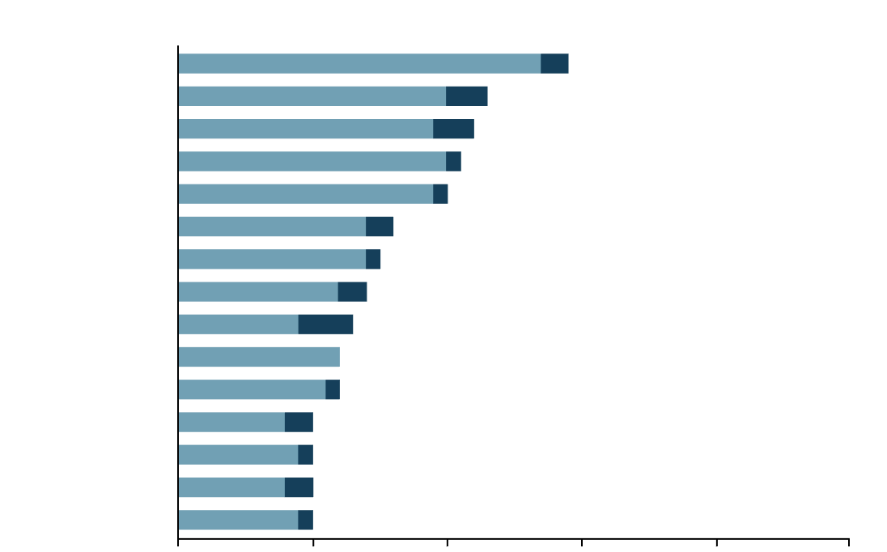
ELEVATE: Phase 2 trial of elacestrant + everolimus adverse events^{1,2}
TEAEs ≥20% reported
Nausea
Diarrhea
Fatigue
Vomiting
Stomatitis
Hypercholesterolemia
Abdominal pain
Rash
Anemia
Dysgeusia
Mucosal inflammation
AST increase
Headache
Hyperglycemia
Thrombocytopenia
n=29
The safety profile is consistent with either everolimus plus standard ET or elacestrant
No bradycardia or photopsia were reported, and no new safety signals were observed
Any TEAE leading to elacestrant + everolimus drug withdrawal: 6%
Any TEAE leading to elacestrant + everolimus drug dose reduction: 2%
n=23
n=22
n=21
n=20
n=16
n=15
n=14
n=13
n=12
n=12
n=10
Grade 1-2
n=10
Grade ≥3
n=10
n=10
0%
20%
40%
60%
80%
100%

Slide 51
ELEVATE: Phase 2 trial of elacestrant + abemaciclib mPFS results in all patients and key subgroups^{1,2}
100
 | ELA + ABE
Events, n (%) | 29 (48)
mPFS, mo (95% CI) | 14.3 (7.3-16.6)
 | Elacestrant + abemaciclib
Subgroup | N | mPFS, months (95% CI)
All patients | 60 | 14.3 [7.3-16.6]
Visceral disease | 55 | 14.3 [7.4-16.6]
No prior fulvestrant | 42 | 14.8 [8.7-NR]
No primary endocrine resistance | 51 | 14.3 [7.3-16.6]
80
60
Survival Probability (%)
40
Follow Up Time, median (95% CI), months: Overall: 8.6 (6.5-12.6) – Arm C: 5.7 (4.6-8.7)
– Arm D: 11.6 (8.5-13.4)
20
Maturity not reached for PFS (95% CI) for genomic subgroups (ESR1 / PIK3CA) or by prior CDK4/6i exposure
Censored
0
0
5
10
15
Months
At Risk
60
45
24
2
Elacestrant + abemaciclib showed a consistent PFS benefit across all subgroups
Key clinical characteristics: Visceral metastases 92%, primary ET resistance 15%, ESR1-mut 33% (10/23), PIK3CA-mut 27%, prior CDK4/6i 50%, Prior fulvestrant 30%

Slide 52
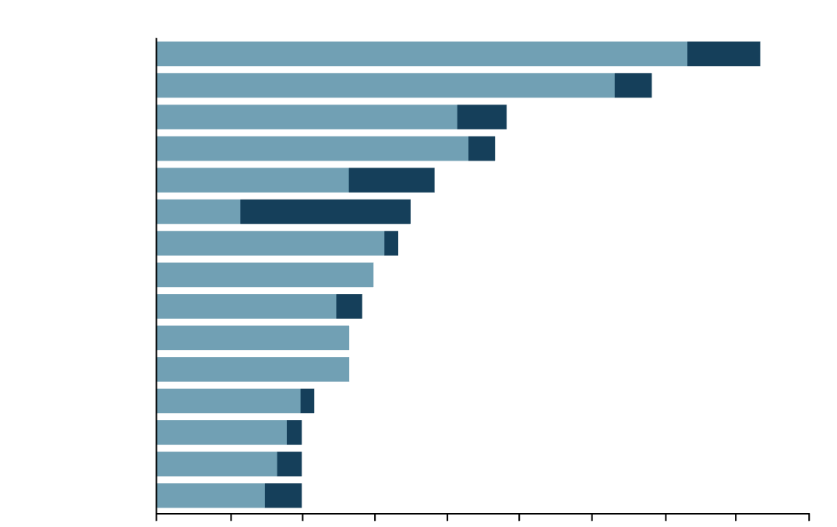
ELEVATE: Phase 2 trial of elacestrant + abemaciclib adverse events^{1,2}
TEAEs ≥20% reported
The safety profile is consistent with either abemaciclib plus standard ET or elacestrant
No bradycardia or photopsia were reported, and no new safety signals were observed
Any TEAE leading to elacestrant + abemaciclib drug withdrawal: 0%
Any TEAE leading to elacestrant + abemaciclib drug reduction: 5%
Diarrhea
Nausea
Fatigue
Vomiting
Anemia
Neutropenia
Abdominal pain
Decreased appetite
Weight decreased
Constipation
Rash
Dizziness
Headache
Thrombocytopenia
Leukopenia
n=50
n=41
n=29
n=28
n=23
n=21
n=20
n=18
n=17
n=16
n=16
n=13
Grade 1–2
n=12
n=12
Grade ≥3
n=12
0%
10%
20%
30%
40%
50%
60%
70%
80%
90%

Slide 53
Ongoing oral SERD combination studies
ADELA: Phase 3 trial of elacestrant + everolimus vs elacestrant + placebo^{1,2}
PHASE 3
ER+/HER2−
ESR1-mut aBC
N=240
    Arm A
Elacestrant
345 mg* QD
Everolimus
7.5 mg† QD
PHASE 3 OBJECTIVES
Patient Population
R
Primary: Evaluate PFS based on BIRC‡
Key Secondary: Evaluate OS determined locally by investigator
Secondary: Evaluate investigator-assessed PFS, BIRC and investigator-assessed ORR, CBR, DoR, TTR, and best percentage of change in tumor burden,§
safety, and HRQoL
    1:1
    Arm B
Elacestrant
345 mg* QD
Placebo
STRATIFICATION FACTORS
Presence of visceral metastases (yes vs no)
Duration of prior CDK4/6i therapy (≥12 mo vs <12 mo) in the advanced setting
    KEY INCLUSION CRITERIA
Women (pre-||, peri-||, or postmenopausal) and men aged ≥18 years
Histologically or cytologically confirmed ER+/HER2− unresectable locally recurrent or metastatic disease
Confirmed ESR1-mutation
PD on prior ET + CDK4/6i for aBC after ≥6 mo
                Patients receiving CDK4/6i-based therapy in the adjuvant setting are eligible if PD is confirmed after ≥12 mo of treatment but no more than 12 mo following CDK4/6i treatment completion
No prior chemotherapy in the advanced setting
    KEY EXCLUSION CRITERIA
Formal contraindication to ET defined as visceral crisis and/or rapidly or symptomatic progressive visceral disease
Received treatment with approved or investigational cancer therapy
≤14 days prior to randomization (except for fulvestrant that must be administered ≥28 days before randomization)
Known active uncontrolled or symptomatic CNS metastases, metastasis-related spinal cord compression, and/or leptomeningeal disease
Concurrent malignancy or malignancy within 3 years before randomization
Previously received 1–2 lines of ET for aBC
          Progression during or within 12 months of adjuvant ET is considered as a line of ET for advanced disease
No prior elacestrant or other investigational SERDs¶, PROTAC, CERAN, or novel SERM, and/or PI3K/AKT/mTOR inhibitors, including everolimus
ECOG PS 0 or 1
Adequate hematologic and organ function

Slide 54
Key takeaways
Second-line treatment choices are defined by the eligibility to receive endocrine therapy and are driven by biomarker status. For patients whose tumors retained endocrine-sensitivity, guidelines recommend exhausting sequential ET-based regimens¹
EMERALD study patient population reflects real-world practice with 100% prior CDK4/6i, 70% visceral mets; prior fulvestrant, ChT, and primary endocrine resistance allowed, leading to elacestrant approval in patients with ESR1-mut tumors²
RWE of elacestrant data shows consistent benefit of ~8-11 months of TTNT in line with the 8.6 months of mPFS in patients with longer prior ET + CDK4/6i exposure (EMERALD study subgroup analysis)^{3,4}
In tumors retaining endocrine-sensitivity and coexisting PIK3CA and ESR1 mutations, elacestrant monotherapy can be a good option before PI3K/AKTi combination regimens as data shows similar efficacy with a manageable safety profile⁴
Oral SERDs show benefit when combined with CDK4/6i or everolimus. The baseline characteristics of these studies are different and should be taken into account when evaluating outcomes⁵⁻⁸

Slide 55
Biomarker driven treatment decisions: Evolution of ESR1 testing
Frederik Marmé
University Hospital Mannheim, Mannheim, Germany

Slide 56
Why to test for biomarkers:
The clinical utility of testing mutations drives therapeutic decisions in mBC
Actionable
information
Mutation testing provides clinically actionable information that directly influences treatment selection and sequencing decisions^{1,2}
Intrinsic mutations
ESR1 acquired mutations
Identification of PI3K/AKT/PTEN alterations enable precision therapy for PI3K or AKT inhibitors, demonstrating reduction in the risk of progression or death³⁻⁷
ESR1 mutations guide clinicians toward more effective treatment approaches, as tumors become resistant to SOC endocrine therapy, even in the context of coexisting intrinsic mutations⁸⁻¹⁰

Slide 57










Why to test for ESR1-mut:
ESR1-muts are a mechanism of acquired endocrine resistance
Estrogen
Wild-type ERα is bound by the estrogen ligand, leading to ligand-dependent activation, coactivator recruitment, and downstream regulation of gene expression and associated cancer growth¹
RTK
ESR1-mut that encodes for the estrogen receptor commonly affect the ligand-binding domain of ERα, resulting in ligand-independent ERα activation and constitutive signaling^{1,2}
PI3K
AKT
ESR1-mut are:¹⁻¹¹
Mutated ERα
(ESR1-mut)
WT ERα
(ESR1wt)
mTOR
Acquired under the selective pressure of ET, particular AIs, and are rarely detected in the primary tumor
Subclonal and heterogeneous within the tumor
One of the main mechanisms of endocrine resistance and key driver of disease progression
Ligand-independent ER activation
Ligand-dependent ER activation
ER-mediated
gene transcription
CCND1
gene
ESR1-mut leads to resistance of AIs or fulvestrant
Cell proliferation, differentiation, survival
References: Adapted from Brufsky A, et al. The Oncologist. 2018;23:528-539; 2. Vasan N, et al. Ann Oncol. 2019;30(suppl_10):x3-x11.

Slide 58
When to test for ESR1-mut:
Longer exposure to ET in mBC increases ESR1-mut prevalence¹⁻¹⁰
Early breast cancer^{1-3,5,7}
Advanced / metastatic breast cancer²⁻⁹
Adjuvant treatment (Tx)
Recurrence after adjuvant Tx
1L mBC Tx
AI + CDK4/6i
Progression after 1L mBC Tx
Tissue biopsy to confirm BC
and test for intrinsic mutations:
PIK3CA/AKT/PTEN
BRCA1/2, PALB2
Liquid biopsy to test for acquired mutations:
ESR1
ESR1-mut
~20-40%
2 L
ESR1-mut
<2%
ESR1-mut
~5-10%
% ESR1-mut
ESR1-mut
~40-50%
3 L
ESR1 mutations occur almost exclusively after ET in the mBC setting⁵
Testing for ESR1-mut should occur at each progression if not detected previously¹⁰⁻¹²

Slide 59
When to test for ESR1-mut:
ESR1 and PIK3CA mutations are different
PIK3CA-mut can be largely detected in the primary tumor or at initial metastasis diagnosis.¹⁻⁵ In contrast, ESR1-mut are most often detected in later stages of metastatic disease.⁶⁻¹⁴
 |  | Early Breast Cancer | 1L Metastatic Breast Cancer | 2L Metastatic Breast Cancer | 3L+ Metastatic Breast Cancer
PIK3CA Mutations³⁻¹⁰ | Mainly intrinsic Late modest clonal enrichment
ESR1 Mutations¹¹⁻¹⁷ | Predominantly acquired
~40–45%
~30–35%
~35–40%
~35–45%
~40–50%
~20–40%
~5–10%
Rare <2%
‹#›
1L, first-line; 2L, second-line; 3L+, third-line plus; ESR1, estrogen receptor 1; PIK3CA, phosphatidylinositol-3-kinase catalytic subunit alpha.
1. Sandbothe M, et al. Virchows Arch. 2025 Oct;487(4):895-899; 2. Zundelevich A, Breast Cancer Res. 2020 Feb 3;22(1):16. Erratum in: Breast Cancer Res. 2020 Mar 12;22(1):28; 3. The Cancer Genome Atlas Network. Nature. 2012;490(7418):61-70; 4. Andre F, et al. N Engl J Med. 2019;380(20):1929-1940; 5. Pereira B, et al. Nat Commun. 2016;7:11479; 6. Zardavas D, et al. Breast Cancer Res. 2014,16:201; 7. O'Leary B, et al. Nat Commun. 2018; 9(1):896;
8. Wander SA, et al. Cancer Discov. 2020;10(8):1174-1193; 9. Mosele F, et al. Ann Oncol. 2020;31(11):1491-1505; 10. Toy W, et al. Nat Genet. 2013;45(12):1439-1445; 11. Robinson DR, et al. Nat Genet. 2013;45(12):1446-1451;
12. Fribbens C, et al. J Clin Oncol. 2016;34(19):2219-2226; 13. Chandarlapaty S, et al. JAMA Oncol. 2016;2(10):1310-1315; 14. Schiavon G, et al. Sci Transl Med. 2015;7(313):313ra182;
15. Bidard FC, et al. Lancet Oncol. 2022;23:1367-1377; 16. Clatot F, et al. Breast Cancer Res. 2020;22(1):56; 17. O'Leary B. Cancer Discov. 2018;8(11):1390-1403.

Slide 60
How to test for ESR1-mut:
Liquid biopsy is preferred approach for detecting ESR1-mut as they are subclonal and heterogeneous¹⁻². Fresh tissue-based test may also be considered but reported detection rates are lower³⁻⁵
2L mBC ESR1-mut incidence rate in tissue and liquid biopsies⁵
2L, second line; ctDNA, circulating tumor DNA; ESR1, estrogen receptor 1; mBC, metastatic breast cancer; mut=mutation.
1. Tarabichi M, et al. Nat Methods. 2021;18(2):144-155; 2. Dustin D, et al. Cancer. 2019;125(21):3714-3728; 3. Burstein HJ, et al. J Clin Oncol. 2023;41(18):3423-3425;
4. Bhave MA, et al. Breast Cancer Res Treat. 2024;207(3):599-609; 5. Correction in: Bhave MA, et al. Breast Cancer Res Treat. 2024;207:611-614.

Slide 61




How to test for ESR1-mut:
Tissue vs liquid biopsy
Tissue biopsy^{1–5}
    Low sensitivity for ESR1-mut
    Invasive
    Long turnaround time
    Given the subclonal and heterogeneous nature of ESR1-mut within the tumor, all mutations may not be detected
    Primary archival tissue should not be used, as ESR1-mut are typically acquired during the metastatic breast cancer treatment
Liquid biopsy^{1–3,6–8}
    High sensitivity for ESR1-mut
    Minimally invasive
    Fast sample acquisition
    Reveals tumor heterogeneity, including presence of subclonal ESR1-mut from all metastatic disease sites
NGS (may be part of a solid tumor panel)
Available ESR1-mut detection methods include^{9,a}:
Digital PCR assays

Slide 62
ESMO, NCCN and ASCO recommendations for ESR1-mut testing
Testing for ESR1-mut should be performed at each progression, preferably in ctDNA, if not detected previously¹⁻⁵
European Society of Medical Oncology (ESMO)¹⁻³
NGS of plasma or tissue biopsy should be carried out after resistance to ET in order to optimize the likelihood of detecting ESR1-mut
ESMO
National Comprehensive Cancer Network® (NCCN®)^{4,5}
Detection of ESR1-mut: NGS or PCR (ctDNA preferred)
Given the acquired nature of ESR1-mut during metastatic breast cancer treatment, primary archived breast cancer tissue should NOT be used as a source of tumor tissue for ESR1-mut testing
NCCN
American Society of Clinical Oncology (ASCO)⁶
Detection of ESR1-mut: Blood-based ctDNA is preferred owing to greater sensitivity
ESR1-muts develop in response to selection pressure during ET and are typically undetectable in the primary tumor
Patients whose tumor or ctDNA tests remain ESR1-wt may warrant re-testing at subsequent progression(s) to determine if an ESR1-mut has arisen
ASCO
Notes:
‹#›

Slide 63
Key takeaways
Testing for ESR1-mut should be considered at each progression during the metastatic treatment course¹⁻⁶
ESR1-mut differ from PIK3CA-mut. PIK3CA-mut can be largely detected in the primary tumor or at initial metastasis diagnosis, before initiating 1L therapy⁷⁻¹¹
ESR1-mut are most often detected in later stages of metastatic disease.¹²⁻¹⁶ About 40-50% of ESR1-mut are found at progression on prior ET in the metastatic setting^{14, 17-20}
Molecular profiling via liquid or fresh-tissue biopsy is essential to assess ESR1-mut before initiating
2L or 3L therapy¹⁻³
NCCN, ASCO and ESMO guidelines support liquid biopsy as a preferred method for ESR1-mut assessment^{1,4-6}
Archival tissue from primary tumor should NOT be used to identify ESR1-mut, as ESR1-mut develop mainly during metastatic treatment¹²
1L, first-line; 2L, second-line; 3L, third-line; ASCO, American Society for Clinical Oncology; ESMO, European Society for Medical Oncology; ESR1, estrogen receptor 1; NCCN, National Comprehensive Cancer Network; PIK3CA, phosphatidylinositol-3-kinase catalytic subunit alpha.

Slide 64
Q&A / Discussion
Faculty

Slide 65
Key takeaways
2L treatment choices are defined by the eligibility to receive ET and are driven by biomarker status. For patients whose tumors retained endocrine-sensitivity, guidelines recommend exhausting sequential ET-based regimens¹
EMERALD study patient population reflects real-world practice with 100% prior CDK4/6i, 70% visceral mets; prior fulvestrant, ChT, and primary endocrine resistance allowed, leading to elacestrant approval in ESR1-mut tumors²
In tumors retaining endocrine-sensitivity and coexisting PIK3CA/ESR1 mutations, elacestrant monotherapy can be a good option before PI3K/AKTi combination regimens as data shows similar efficacy with a manageable AE³
RWE of elacestrant data shows consistent benefit of ~8-11 months of TTNT in line with the 8.6 months of mPFS in patients with longer prior ET + CDK4/6i exposure (EMERALD study subgroup analysis)^{4,5}
About 40-50% of ESR1-mut are found at progression on prior ET in the metastatic setting. ESR1-mut testing should occur at each progression on ET if not detected previously, due to increasing chances of finding it.⁶⁻¹⁵
Blood-based ctDNA is considered the preferred testing methodology for ESR1-mut.¹¹⁻¹⁶ Archival tissue from primary tumor should NOT be used to identify ESR1-mut, as ESR1-mut develop mainly during metastatic treatment¹⁶

